Slide 1
UNIT 3
INTRODUCTION TO DATA STRUCTURES

Slide 2
An Introduction to Data Structures
Since the invention of computers, people have been using the term "Data" to refer to Computer Information, either transmitted or stored.
However, there is data that exists in order types as well.
Data can be numbers or texts written on a piece of paper, in the form of bits and bytes stored inside the memory of electronic devices, or facts stored within a person's mind.
As the world started modernizing, this data became a significant aspect of everyone's day-to-day life, and various implementations allowed them to store it differently.

Slide 3
Data is a collection of facts and figures or a set of values or values of a specific format that refers to a single set of item values.
The data items are then classified into sub-items, which is the group of items that are not known as the simple primary form of the item.
Let us consider an example where an employee name can be broken down into three sub-items:
First, Middle, and Last. However, an ID assigned to an employee will generally be considered a single item.

Slide 4
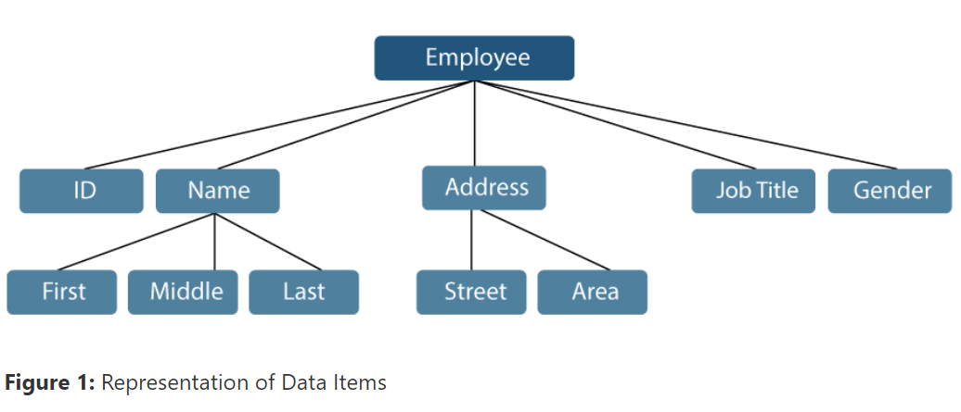
In the example mentioned above, the items such as ID, Age, Gender, First, Middle, Last, Street, Locality, etc., are elementary data items. In contrast, the Name and the Address are group data items.

Slide 5
What is Data Structure?
Data Structure is a branch of Computer Science. The study of data structure allows us to understand the organization of data and the management of the data flow in order to increase the efficiency of any process or program.
Data Structure is a particular way of storing and organizing data in the memory of the computer so that these data can easily be retrieved and efficiently utilized in the future when required.
The data can be managed in various ways, like the logical or mathematical model for a specific organization of data is known as a data structure.

Slide 6
Some examples of Data Structures are Arrays, Linked Lists, Stack, Queue, Trees, etc. Data Structures are widely used in almost every aspect of Computer Science, i.e., Compiler Design, Operating Systems, Graphics, Artificial Intelligence, and many more.
Data Structures are the main part of many Computer Science Algorithms as they allow the programmers to manage the data in an effective way. It plays a crucial role in improving the performance of a program or software, as the main objective of the software is to store and retrieve the user's data as fast as possible.

Slide 7
Basic Terminologies related to Data Structures
The following are some fundamental terminologies used whenever the data structures are involved:
Data: We can define data as an elementary value or a collection of values. For example, the Employee's name and ID are the data related to the Employee.
Data Items: A Single unit of value is known as Data Item.
Group Items: Data Items that have subordinate data items are known as Group Items. For example, an employee's name can have a first, middle, and last name.
Elementary Items: Data Items that are unable to divide into sub-items are known as Elementary Items. For example, the ID of an Employee.
Entity and Attribute: A class of certain objects is represented by an Entity. It consists of different Attributes. Each Attribute symbolizes the specific property of that Entity. For example,

Slide 8
Attributes | ID | Name | Gender | Job Title
Values | 1234 | Stacey M. Hill | Female | Software Developer
Entities with similar attributes form an Entity Set. Each attribute of an entity set has a range of values, the set of all possible values that could be assigned to the specific attribute.

Slide 9
The term "information" is sometimes utilized for data with given attributes of meaningful or processed data.
Field: A single elementary unit of information symbolizing the Attribute of an Entity is known as Field.
Record: A collection of different data items are known as a Record. For example, if we talk about the employee entity, then its name, id, address, and job title can be grouped to form the record for the employee.
File: A collection of different Records of one entity type is known as a File. For example, if there are 100 employees, there will be 25 records in the related file containing data about each employee.

Slide 10
Understanding the Need for Data Structures
As applications are becoming more complex and the amount of data is increasing every day, which may lead to problems with data searching, processing speed, multiple requests handling, and many more.
Data Structures support different methods to organize, manage, and store data efficiently. With the help of Data Structures, we can easily traverse the data items.
Data Structures provide Efficiency, Reusability, and Abstraction.

Slide 11
Why should we learn Data Structures?
Data Structures and Algorithms are two of the key aspects of Computer Science.
Data Structures allow us to organize and store data, whereas Algorithms allow us to process that data meaningfully.
Learning Data Structures and Algorithms will help us become better Programmers.
We will be able to write code that is more effective and reliable.
We will also be able to solve problems more quickly and efficiently.

Slide 12
Understanding some Key Features of Data Structures
Some of the Significant Features of Data Structures are:
Robustness: Generally, all computer programmers aim to produce software that yields correct output for every possible input, along with efficient execution on all hardware platforms. This type of robust software must manage both valid and invalid inputs.
Adaptability: Building software applications like Web Browsers, Word Processors, and Internet Search Engine include huge software systems that require correct and efficient working or execution for many years. Moreover, software evolves due to emerging technologies or ever-changing market conditions.
Reusability: The features like Reusability and Adaptability go hand in hand. It is known that the programmer needs many resources to build any software, making it a costly enterprise. However, if the software is developed in a reusable and adaptable way, then it can be applied in most future applications. Thus, by executing quality data structures, it is possible to build reusable software, which appears to be cost-effective and timesaving.

Slide 13
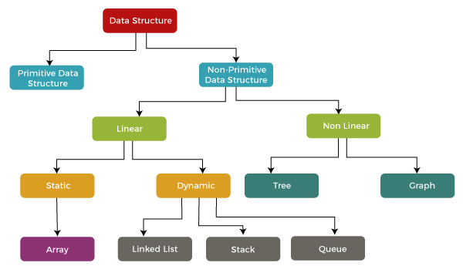
Classification of Data Structures

Slide 14
Primitive data structure
In the case of primitive data structure, it contains fundamental data types such as integer, float, character, pointer, and these fundamental data types can hold a single type of value.
For example, integer variable can hold integer type of value, float variable can hold floating type of value, character variable can hold character type of value whereas the pointer variable can hold pointer type of value.

Slide 15
In the case of non-primitive data structure, it is categorized into two parts such as linear data structure and non-linear data structure.

Slide 16
Linear data structure:
Data structure in which data elements are arranged sequentially or linearly, where each element is attached to its previous and next adjacent elements, is called a linear data structure.
Examples of linear data structures are array, stack, queue, linked list, etc.
  Static data structure: Static data structure has a fixed memory size. It is easier to access the elements in a static data structure.
  An example of this data structure is an array.
  Dynamic data structure: In the dynamic data structure, the size is not fixed. It can be randomly updated during the runtime which may be considered efficient concerning the memory (space) complexity of the code.
  Examples of this data structure are queue, stack, etc.

Slide 17
Non-linear data structure: Data structures where data elements are not placed sequentially or linearly are called non-linear data structures. In a non-linear data structure, we can’t traverse all the elements in a single run only.
Examples of non-linear data structures are trees and graphs.

Slide 18
Arrays:
An array is a linear data structure and it is a collection of items stored at contiguous memory locations.
The idea is to store multiple items of the same type together in one place. It allows the processing of a large amount of data in a relatively short period.
The first element of the array is indexed by a subscript of 0.
There are different operations possible in an array, like Searching, Sorting, Inserting, Traversing, Reversing, and Deleting.

Slide 19
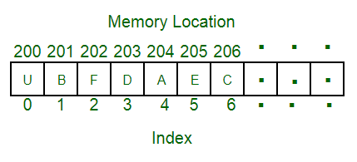

Slide 20
Characteristics of an Array:
An array has various characteristics which are as follows:
Arrays use an index-based data structure which helps to identify each of the elements in an array easily using the index.
If a user wants to store multiple values of the same data type, then the array can be utilized efficiently.
An array can also handle complex data structures by storing data in a two-dimensional array.
An array is also used to implement other data structures like Stacks, Queues, Heaps, Hash tables, etc.
The search process in an array can be done very easily.

Slide 21
Arrays can be classified into different types:
One-Dimensional Array: An Array with only one row of data elements is known as a One-Dimensional Array. It is stored in ascending storage location.
Two-Dimensional Array: An Array consisting of multiple rows and columns of data elements is called a Two-Dimensional Array. It is also known as a Matrix.
Multidimensional Array: We can define Multidimensional Array as an Array of Arrays. Multidimensional Arrays are not bounded to two indices or two dimensions as they can include as many indices are per the need.

Slide 22
Linked list:
A linked list is a linear data structure in which elements are not stored at contiguous memory locations. The elements in a linked list are linked using pointers as shown in the below image:
Types of linked lists:
Singly-linked list
Doubly linked list
Circular linked list
Doubly circular linked list

Slide 23
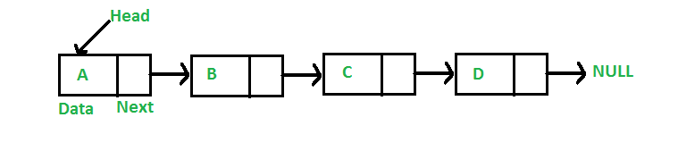
Linked list

Slide 24
Data elements in this data structure are represented by the Nodes, connected using links or pointers.
Each node contains two fields, the information field consists of the actual data, and the pointer field consists of the address of the subsequent nodes in the list.
The pointer of the last node of the linked list consists of a null pointer, as it points to nothing.
Unlike the Arrays, the user can dynamically adjust the size of a Linked List as per the requirements.

Slide 25
Linked Lists can be classified into different types:
Singly Linked List: A Singly Linked List is the most common type of Linked List. Each node has data and a pointer field containing an address to the next node.
Doubly Linked List: A Doubly Linked List consists of an information field and two pointer fields. The information field contains the data. The first pointer field contains an address of the previous node, whereas another pointer field contains a reference to the next node. Thus, we can go in both directions (backward as well as forward).
Circular Linked List: The Circular Linked List is similar to the Singly Linked List. The only key difference is that the last node contains the address of the first node, forming a circular loop in the Circular Linked List.

Slide 26
Some Applications of Linked Lists:
The Linked Lists help us implement stacks, queues, binary trees, and graphs of predefined size.
We can also implement Operating System's function for dynamic memory management.
Linked Lists also allow polynomial implementation for mathematical operations.
We can use Circular Linked List to implement Operating Systems or application functions that Round Robin execution of tasks.
Circular Linked List is also helpful in a Slide Show where a user requires to go back to the first slide after the last slide is presented.
Doubly Linked List is utilized to implement forward and backward buttons in a browser to move forward and backward in the opened pages of a website.

Slide 27
STACKS
A Stack is a Linear Data Structure that follows the LIFO (Last In, First Out) principle that allows operations like insertion and deletion from one end of the Stack, i.e., Top.
Stacks can be implemented with the help of contiguous memory, an Array, and non-contiguous memory, a Linked List.
Real-life examples of Stacks are piles of books, a deck of cards, piles of money, and many more.

Slide 28


Slide 29
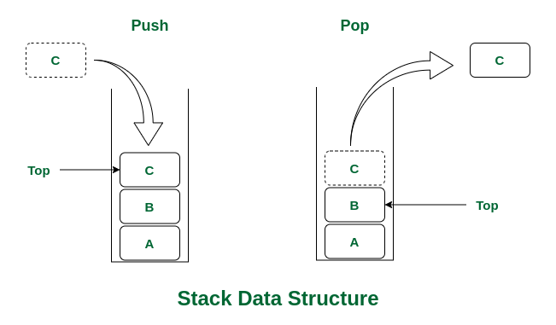

Slide 30
The primary operations in the Stack are as follows:
Push: Operation to insert a new element in the Stack is termed as Push Operation.
Pop: Operation to remove or delete elements from the Stack is termed as Pop Operation.

Slide 31
Applications of stack
The Stack is used as a Temporary Storage Structure for recursive operations.
Stack is also utilized as Auxiliary Storage Structure for function calls, nested operations, and deferred/postponed functions.
We can manage function calls using Stacks.
Stacks are also utilized to evaluate the arithmetic expressions in different programming languages.
Stacks are also helpful in converting infix expressions to postfix expressions.
Stacks allow us to check the expression's syntax in the programming environment.
We can match parenthesis using Stacks.
Stacks can be used to reverse a String.
Stacks are helpful in solving problems based on backtracking.
We can use Stacks in depth-first search in graph and tree traversal.
Stacks are also used in Operating System functions.
Stacks are also used in UNDO and REDO functions in an edit.

Slide 32
Queues
A Queue is a linear data structure similar to a Stack with some limitations on the insertion and deletion of the elements.
The insertion of an element in a Queue is done at one end, and the removal is done at another or opposite end.
Thus, we can conclude that the Queue data structure follows FIFO (First In, First Out) principle to manipulate the data elements. Implementation of Queues can be done using Arrays, Linked Lists, or Stacks.
Some real-life examples of Queues are a line at the ticket counter, an escalator, a car wash, and many more.

Slide 33
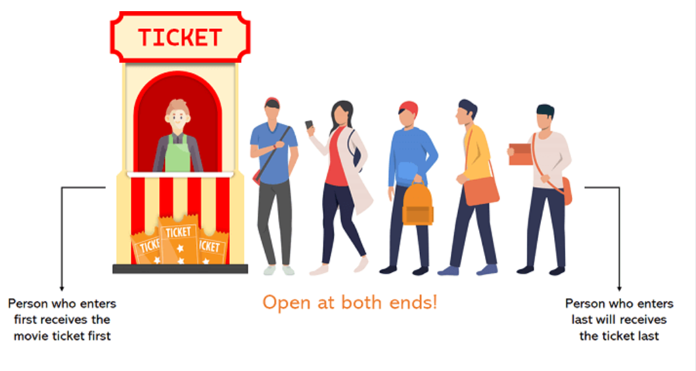

Slide 34
The following are the primary operations of the Queue:
Enqueue: The insertion or Addition of some data elements to the Queue is called Enqueue. The element insertion is always done with the help of the rear pointer.
Dequeue: Deleting or removing data elements from the Queue is termed Dequeue. The deletion of the element is always done with the help of the front pointer.

Slide 35
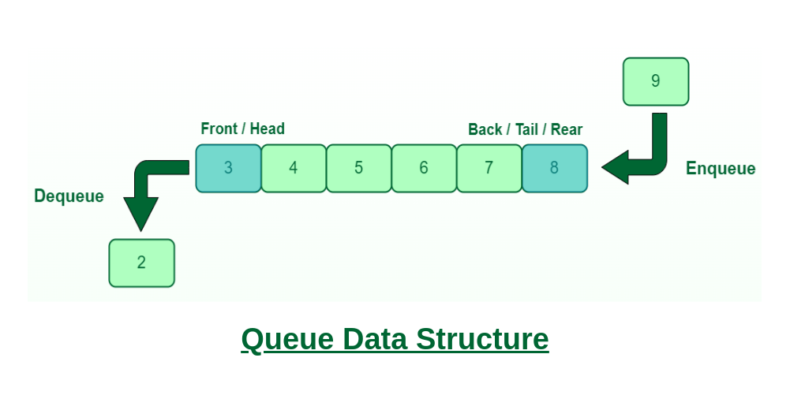

Slide 36
Characteristics of a Queue:
The queue has various different characteristics which are as follows:
The queue is a FIFO (First In First Out) structure.
To remove the last element of the Queue, all the elements inserted before the new element in the queue must be removed.
A queue is an ordered list of elements of similar data types.

Slide 37
Applications of Queue:
Queue is used for handling website traffic.
It helps to maintain the playlist in media players.
Queue is used in operating systems for handling interrupts.
It helps in serving requests on a single shared resource, like a printer, CPU task scheduling, etc.
It is used in the asynchronous transfer of data e.g. pipes, file IO, and sockets.
Queues are used for job scheduling in the operating system.
In social media to upload multiple photos or videos queue is used.
To send an e-mail queue data structure is used.
To handle website traffic at a time queues are used.
In Windows operating system, to switch multiple applications.

Slide 38
Tree:
A tree is a non-linear and hierarchical data structure where the elements are arranged in a tree-like structure.
In a tree, the topmost node is called the root node. Each node contains some data, and data can be of any type.
It consists of a central node, structural nodes, and sub-nodes which are connected via edges.
Different tree data structures allow quicker and easier access to the data as it is a non-linear data structure.
A tree has various terminologies like Node, Root, Edge, Height of a tree, Degree of a tree, etc.

Slide 39
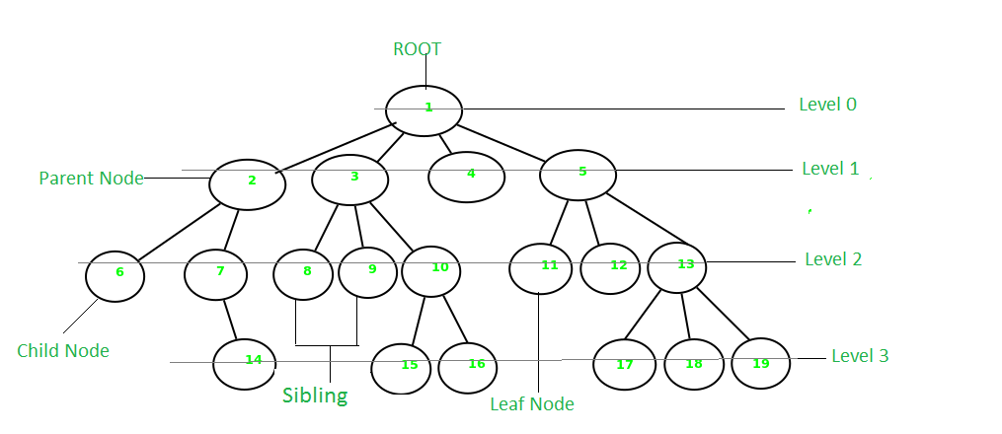

Slide 40
Characteristics of a Tree:
The tree has various different characteristics which are as follows:
A tree is also known as a Recursive data structure.
In a tree, the Height of the root can be defined as the longest path from the root node to the leaf node.
In a tree, one can also calculate the depth from the top to any node. The root node has a depth of 0.

Slide 41
Applications of Tree:
Different applications of Tree are as follows:
Heap is a tree data structure that is implemented using arrays and used to implement priority queues.
B-Tree and B+ Tree are used to implement indexing in databases.
Syntax Tree helps in scanning, parsing, generation of code, and evaluation of arithmetic expressions in Compiler design.

Slide 42
Graph:
A graph is a non-linear data structure that consists of vertices (or nodes) and edges.
It consists of a finite set of vertices and set of edges that connect a pair of nodes.
The graph is used to solve the most challenging and complex programming problems.
It has different terminologies which are Path, Degree, Adjacent vertices, Connected components, etc.

Slide 43
