Slide 1

NATIONAL ENGINEERING COLLEGE,
K.R.NAGAR, KOVILPATTI - 628 503
23CS1ME - Mini-Capstone Project
GENERIC COMPLAINT RESOLUTION AND ESCALATION SYSTEM
PROJECT COORDINATOR:
STUDENT DETAILS:
MS. R. Vazhan Arul Santhiya, AP/CSE
SUBIKSHAN M – 2212110
DATE: 03-01-2026

Slide 2
PROBLEM DEFINITION & MOTIVATION
Problem Definition
In many organizations, complaints are handled using emails, phone calls, WhatsApp messages, or manual registers.
Once a complaint is submitted, there is no proper mechanism to track its progress.
Users are unaware of complaint status.
Administrators cannot monitor delays or staff accountability.
Motivation
Delayed complaint resolution
Lack of transparency
No escalation mechanism
Poor service quality
Hence, a structured and centralized complaint management system is required.

Slide 3
LITERATURE SURVEY & SYSTEM ANALYSIS
Brenda Pomerance (2001) — Automated Complaint Management System (Patent US20010044729A1)
This patent describes a computer-implemented complaint/dispute management system that accepts complaints via a web interface, compares complaint details against stored business rules, and can automatically generate resolution offers or escalate to automated mediation. The system keeps detailed case records and supports automated negotiation and compliance monitoring. Google Patents
Limitation: The patent focuses on automated negotiation between consumer and merchant and arbitration-style dispute resolution; it does not address role-based staff assignment, configurable organizational escalation policies, or analytics-driven bottleneck identification needed for internal organizational complaint workflows.
Feras Al-Hawari & Hala Barham (2019) — A machine learning based help desk system for IT service management (Journal of King Saud University — Computer and Information Sciences)
This paper presents a help-desk system that uses text classification (ML) to automatically assign and classify tickets, improving routing accuracy and reducing resolution time. The authors report that including ticket comments and descriptions in training data raised classifier accuracy significantly, and the system supports admin views for service definition, role management, and KPI reporting. ScienceDirect
Limitation: The study focuses on ML-based ticket classification and ITSM automation; it assumes advanced data availability and does not propose lightweight, configurable escalation rules or a generic, domain-independent complaint lifecycle suitable for small/medium organizations.

Slide 4
LITERATURE SURVEY & SYSTEM ANALYSIS
(The following papers and documents were surveyed to understand recent trends in complaint management, ticketing systems, and escalation workflows.)
• S. Kumar & R. Gupta (2019) – Web-Based Complaint Management System for Service Organizations
• A. Al-Hawari & H. Barham (2019) – A Machine Learning Based Help Desk System for IT Service Management
• P. Singh & N. Verma (2020) – Design and Implementation of Online Grievance Redressal System
• M. Alshamrani & A. Alkhathlan (2021) – Role-Based Ticketing and Issue Tracking Systems for Organizations
• R. Patel & K. Shah (2022) – Analysis of Complaint Handling and Escalation Mechanisms in Enterprise Systems
• J. Lee & S. Kim (2023) – Workflow-Oriented Service Request Management Systems: A Survey
“The above literature was surveyed to identify recent system architectures, workflows, and escalation strategies. Detailed analysis was carried out for selected core references.”

Slide 5
EXISTING SYSTEM & LIMITATIONS
Existing System
Manual complaint registers
Email and phone-based communication
Informal follow-ups
Basic online forms without tracking
Limitations
Complaints get lost or ignored
No resolution timeline enforcement
No escalation for delays
No accountability or analytics
High dependency on manual follow-ups

Slide 6
PROPOSED SOLUTION
Proposed Solution
A Generic Complaint Resolution and Escalation System that:
Digitally registers complaints
Tracks the complete complaint lifecycle
Assigns complaints to responsible staff
Defines resolution timelines
Automatically escalates delayed complaints
Provides monitoring dashboards for administrators
Feasibility
Uses standard web technologies
No hardware dependency
Scalable and reusable across domains

Slide 7
USERS, ACTORS & FUNCTIONAL SCOPE
System Actors
User (Complaint):
Raises complaints
Tracks complaint status
Provides feedback
Staff (Resolver):
Views assigned complaints
Updates status
Resolves issues
Admin (Supervisor):
Assigns complaints
Sets resolution timelines
Handles escalations
Monitors system performance
Functional Scope
Complaint registration
Status tracking
Escalation handling
Role-based access control

Slide 8


Sustainable Development Goals (SDG) Mapping
SDG 16 – Peace, Justice and Strong Institutions
Promotes transparent and accountable complaint handling
Ensures timely resolution and responsibility tracking
Strengthens organizational governance and trust
SDG 9 – Industry, Innovation and Infrastructure
Encourages digital transformation of service processes
Improves efficiency through automated workflows

Slide 9
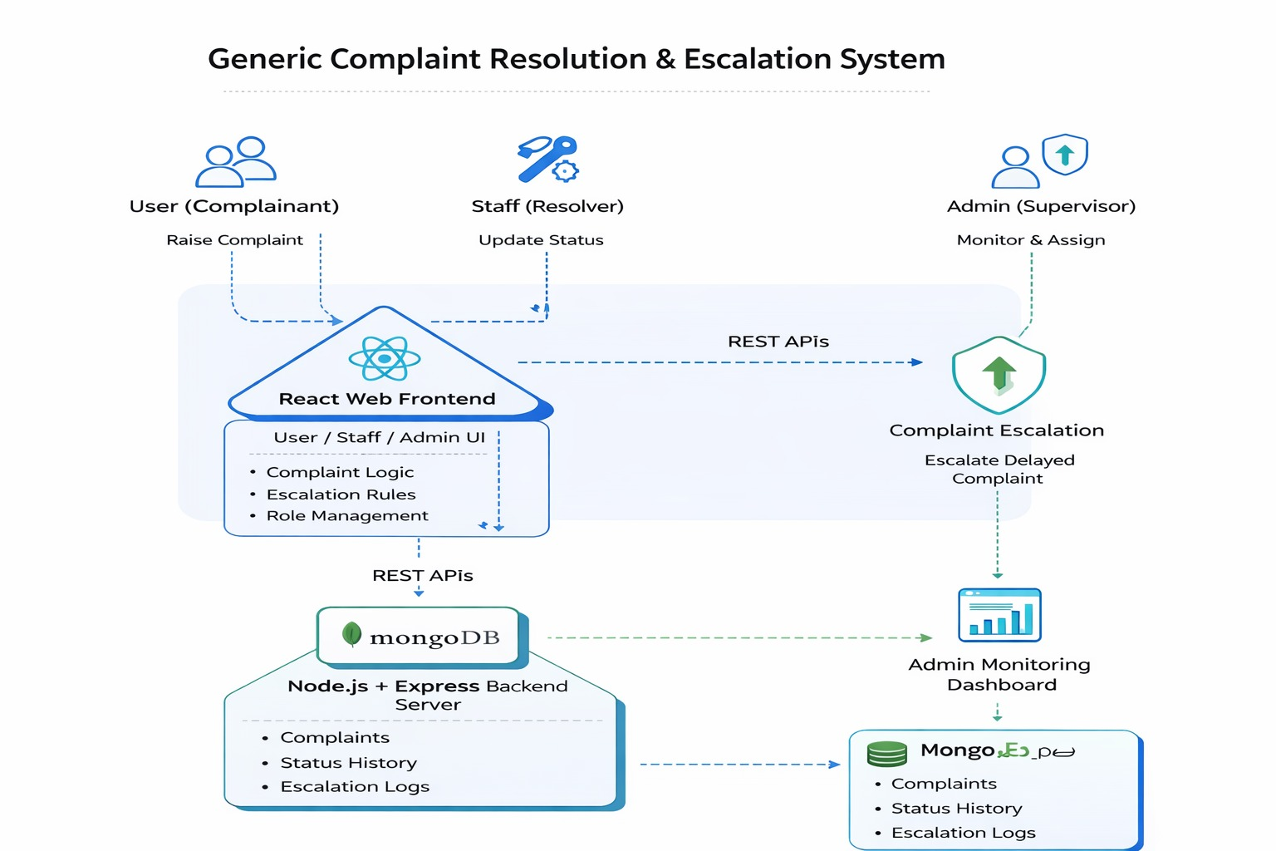
CONCEPTUAL ARCHITECTURE DIAGRAM
Explanation
Frontend handles user interaction
Backend processes complaint logic and escalation rules
MongoDB stores complaint lifecycle data
Escalation ensures accountability and timely resolution

Slide 10
TOOLS & TECHNOLOGIES
Frontend
React.js
HTML, CSS, JavaScript
Backend
Node.js
Express.js
Database
MongoDB
Other Tools
JWT Authentication
REST APIs
Git for version control

Slide 11
PROJECT PLANNING & MILESTONES
Phase | Duration | Activities
Phase 1 | Weeks 1–2 | Problem identification, literature survey, system analysis
Phase 2 | Weeks 3–4 | Requirement analysis & use case identification
Phase 3 | Weeks 5–6 | System architecture design & database schema design
Phase 4 | Weeks 7–8 | Backend development (APIs, complaint logic, escalation rules)
Phase 5 | Weeks 9–10 | Frontend development (UI for User, Staff, Admin)
Phase 6 | Week 11 | Integration, testing, and bug fixing
Phase 7 | Week 12 | Deployment, documentation, and final review preparation

Slide 12
CONCLUSION
This project proposes a generic, reusable, full-stack complaint resolution and escalation system, aligned with real-world organizational needs and the mini capstone course objectives.

