Slide 1
TASK-1
CROSS SITE SCRIPTING - VULNERABILITY
SUBIKSHA . N

Slide 2
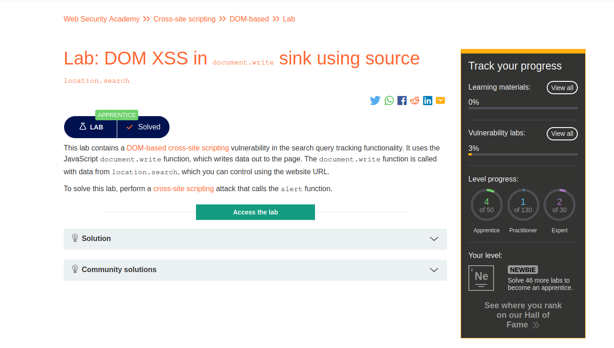

Slide 3
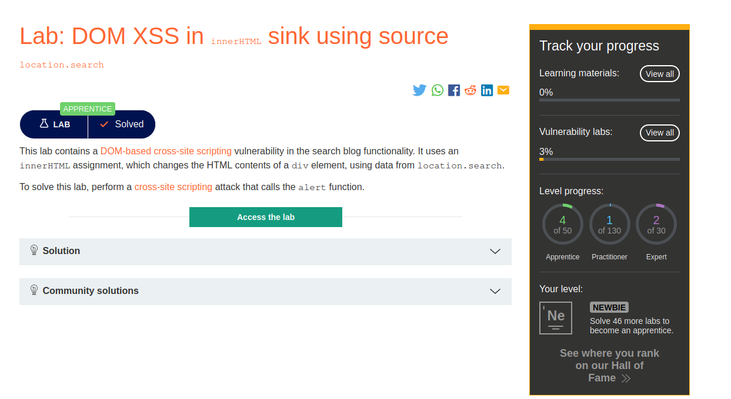

Slide 4
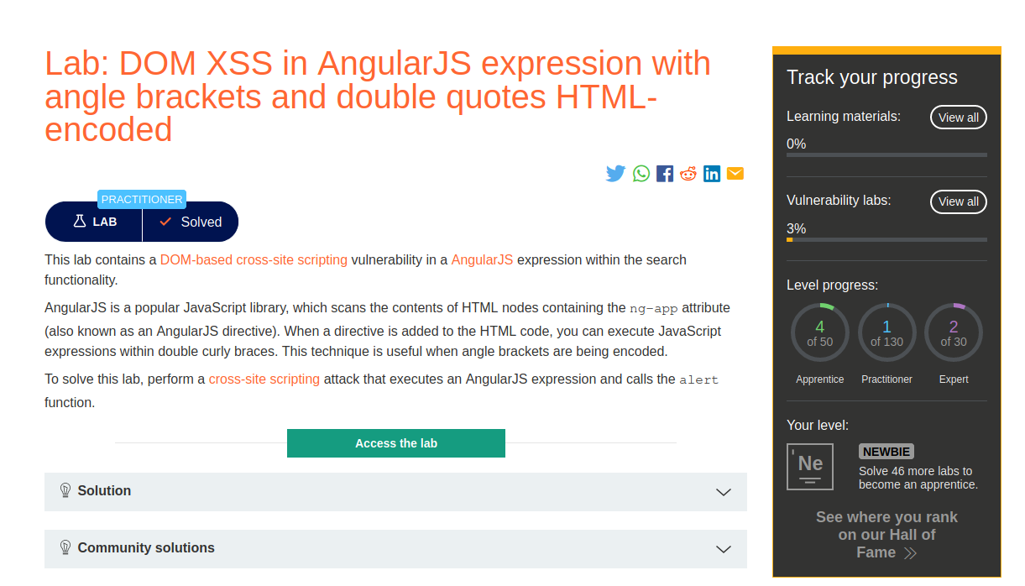

Slide 5
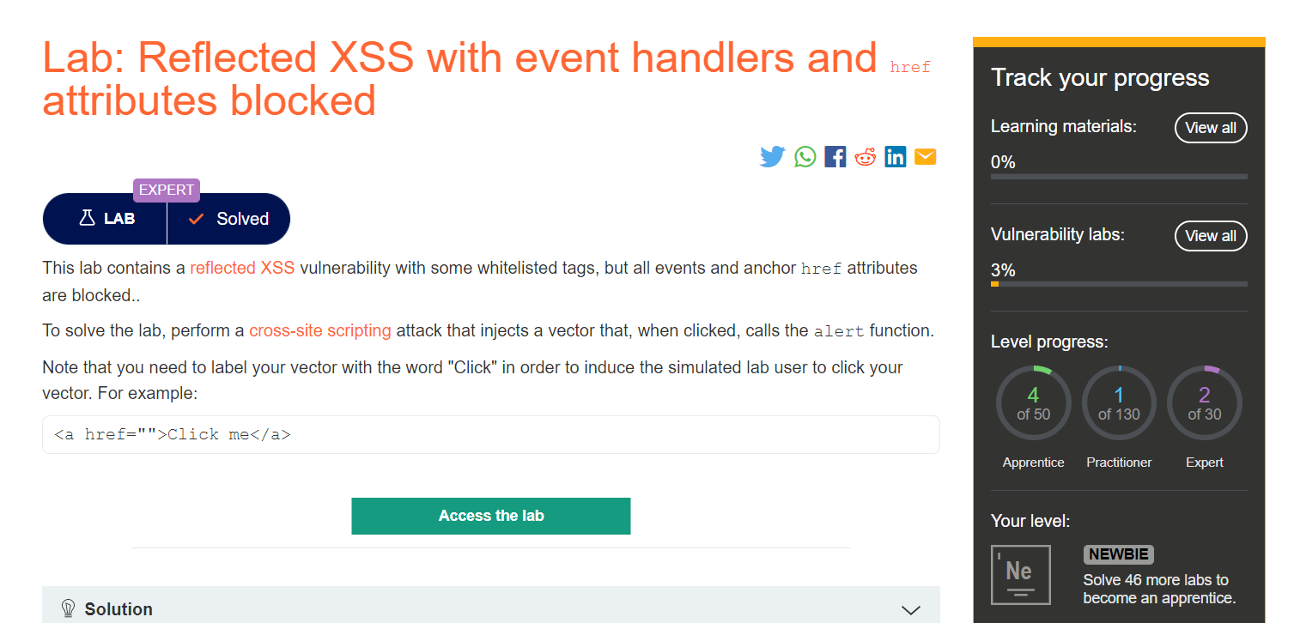

Slide 6
