Slide 1
TASK-2
FINDING VULNERABILITY OF
http://zero.webappsecurity.com/
SUBIKSHA. N

Slide 2
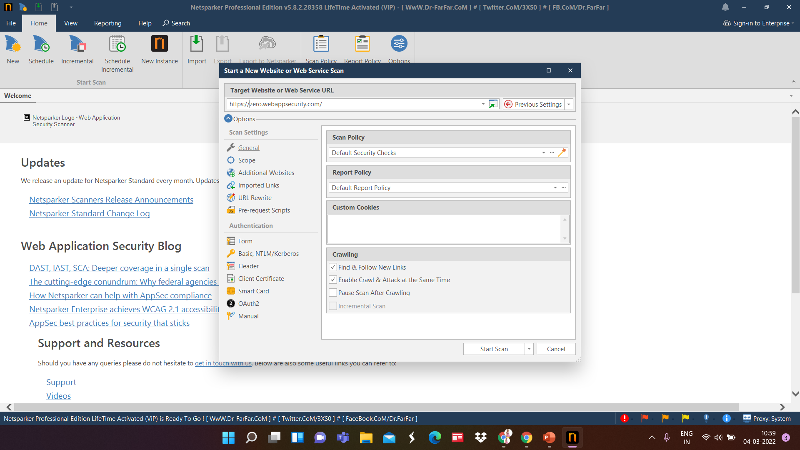

Slide 3
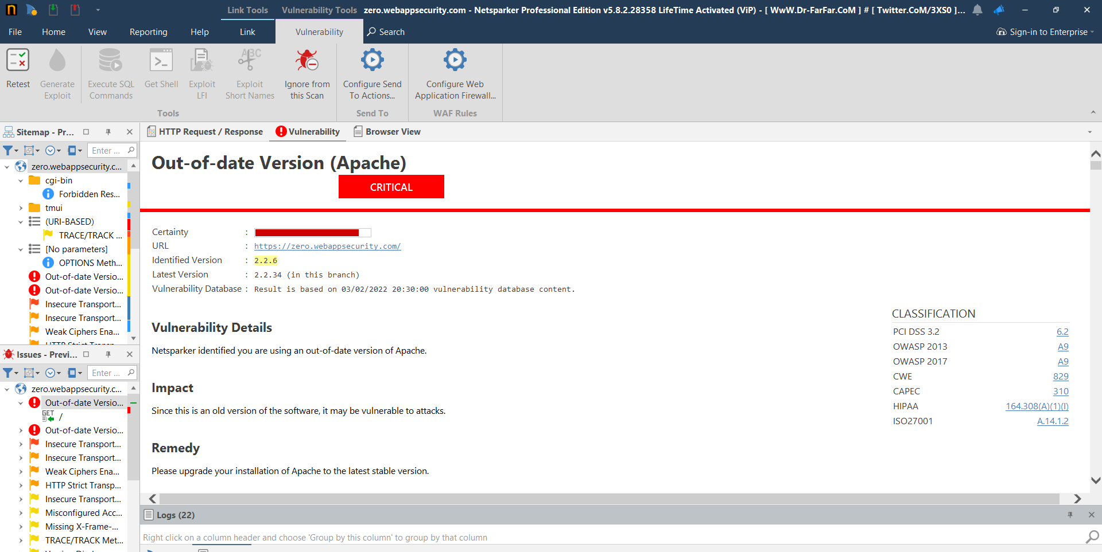

Slide 4
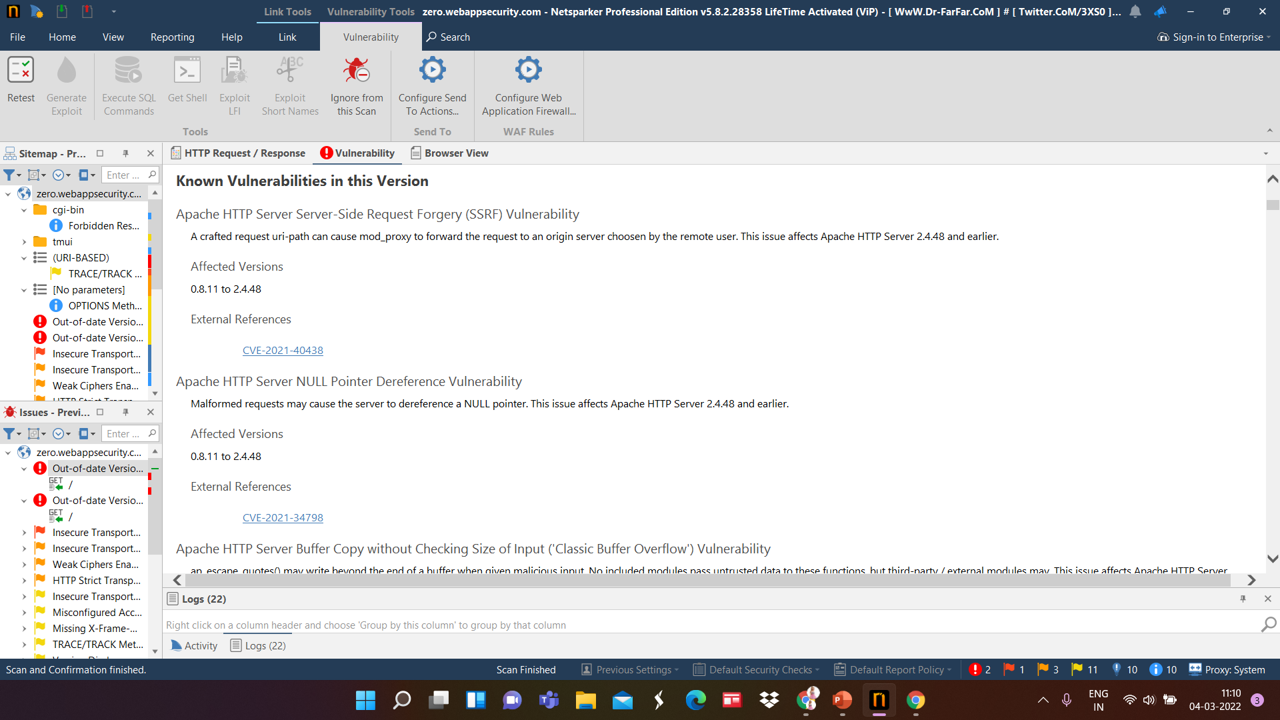

Slide 5
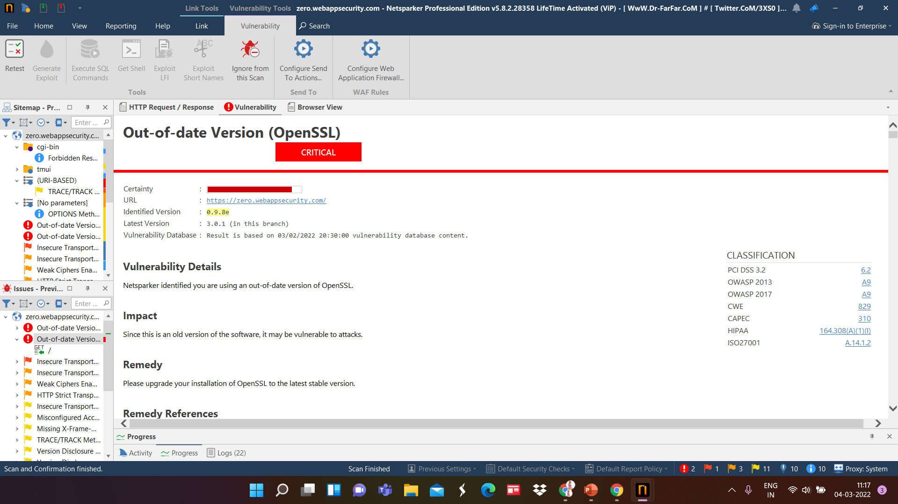

Slide 6
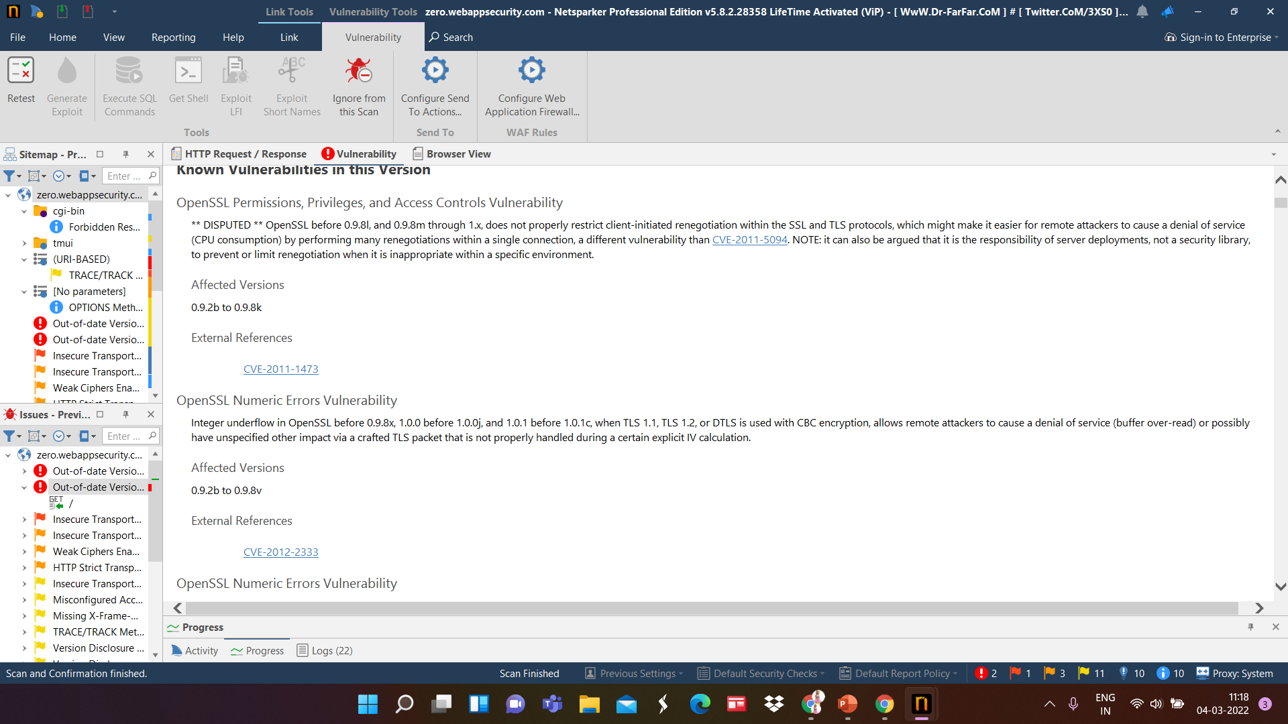

Slide 7
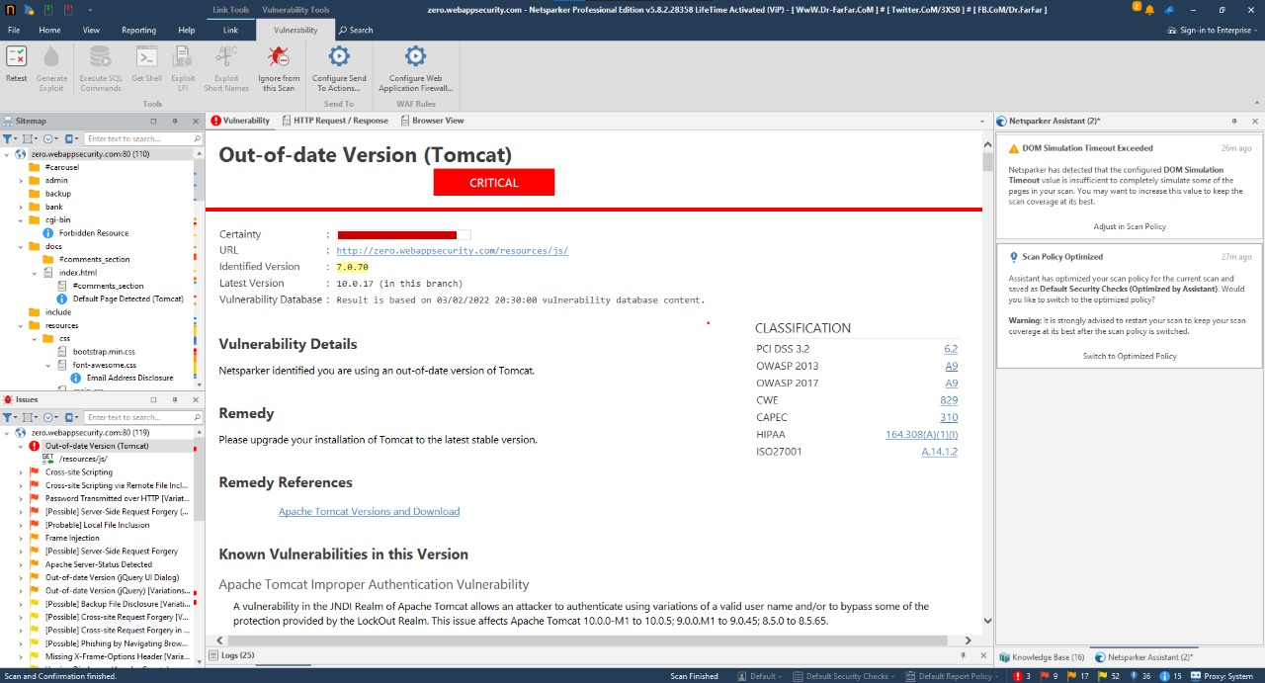

Slide 8
REPORT

Slide 9
Vulnerability of APACHE (Version)
Certainty - HIGH
URL - https://zero.webappsecurity.com/
Identified Version - 2.2.6
Latest Version - 2.2.34 (in this branch)
Vulnerability Database - Result is based on 03/02/2022 20:30:00 vulnerability database content.
Impact - Since this is an old version of the software, it may be vulnerable to attacks.
Remedy - Upgrade the installation of apache to the latest version

Slide 10
SOLUTIONS:
Use generic email addresses such as contact@ or info@ for general communications and remove user/people-specific email addresses from the website; should this be required, use submission forms for this purpose.

