Slide 1
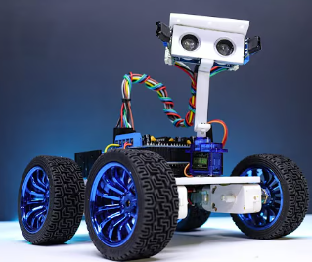
IoT-Based Human Following Robot for Smart Campus Assistance
RoboTrackers| Hackathon 2025

Slide 2
Problem Statement
In a large campus environment, students, staff, and visitors often need assistance in navigating, carrying items, or following designated routes.
Manual guidance or support is time-consuming, inefficient, and not scalable.
Existing solutions rarely provide autonomous following capability combined with real-time monitoring.
There is a need for a smart, autonomous robot that can follow humans safely and provide live data via IoT for monitoring and optimization.

Slide 3
Solution Overview
What it does: An autonomous robot that follows a human while continuously monitoring distance and movement. Data is sent to ThingSpeak for real-time visualization and analysis.
Key Features / Technology:
Arduino Uno: Main controller for sensor processing and motor control.
Ultrasonic Sensors: Detects and maintains safe distance from the human.

Slide 4
ESP8266 Wi-Fi Module: Sends real-time data to the cloud (ThingSpeak).
DC Motors with L298N Driver: Enables smooth and controlled movement.
IoT Integration: Live monitoring of robot’s status and distance data.
Why it’s unique / innovative:
Combines human-following robotics with IoT cloud monitoring.
Allows remote observation and data-driven improvements.
Offers a scalable platform for future AI or smart automation features.

Slide 5
Desirability (User Need)
Target Users:
Warehouse staff and factory workers for automated material transport.
Healthcare workers for patient monitoring and assistance.
Home users seeking smart robotic helpers.
Researchers and hobbyists exploring IoT and robotics integration.
Pain Points Solved:
Reduces manual effort and fatigue in following or carrying tasks.
Provides real-time monitoring and IoT-enabled data for remote supervision.
Improves safety by maintaining consistent distance and avoiding obstacles.
User Validation / Feedback:
Early tests show the robot accurately follows a target human without collisions.
Remote monitoring through ThingSpeak allows users to track performance and reliability.

Slide 6
Feasibility (Can You Build It?)
Tools, Platforms, & Tech Stack:
Arduino Uno – Main controller for sensors and motors.
Ultrasonic Sensors (HC-SR04) – Distance detection for following humans.
ESP8266 Wi-Fi Module – IoT connectivity to ThingSpeak.
L298N Motor Driver & DC Motors – Robot mobility.
ThingSpeak Platform – Real-time data visualization and cloud monitoring.
Arduino IDE / C++ – Programming and development environment.

Slide 7
Development Architecture / Plan:
Build the robot chassis and mount motors.
Connect sensors and ESP8266 module to Arduino Uno.
Write and test Arduino code for human-following behavior.
Integrate IoT functionality to send data to ThingSpeak.
Test end-to-end functionality and optimize performance.
Resource Availability & Limitations:
Components are readily available and low-cost.
Limitations include battery life, sensor range, and potential Wi-Fi connectivity issues.
Can be scaled or enhanced in future with cameras or AI modules.

Slide 8
Viability (Is It Sustainable?)
Revenue / Impact Model:
Could be marketed as assistive robots for warehouses, hospitals, and smart homes.
Generates revenue through robot sales, IoT monitoring subscriptions, or custom automation solutions.
Offers time and labor savings, improving operational efficiency.
Target Market Size / Demand:
Growing demand in logistics, healthcare, and home automation sectors.
Industry trends indicate increasing adoption of autonomous and IoT-enabled robots.
Cost Estimates / Scalability Potential:
Estimated prototype cost: ₹5,000–₹10,000 (Arduino, sensors, motors, Wi-Fi module).
Can scale with additional features like AI-based object recognition, multi-robot coordination, or cloud analytics.
Low-cost components and modular design make it feasible for mass production.

Slide 9
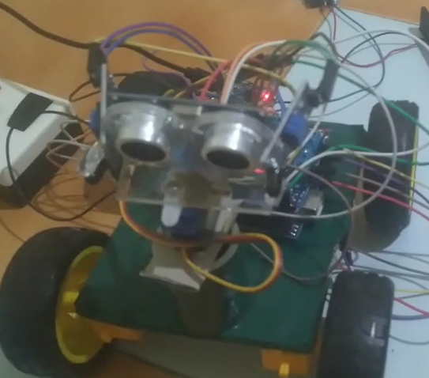
Prototype / Demo

Slide 10
Roadmap
What We Have Built So Far:
Assembled robot chassis with DC motors and motor driver.
Integrated Arduino Uno with ultrasonic sensors for human-following functionality.
Established ESP8266 Wi-Fi module connectivity with ThingSpeak for real-time monitoring.
Tested basic following and live data logging.
Next 30/60/90-Day Plan:
Next 30 Days: Optimize following algorithm, improve sensor accuracy, and fine-tune motor control.
Next 60 Days: Add advanced IoT features, create better dashboards on ThingSpeak, and perform extended field testing.
Next 90 Days: Integrate optional AI modules (like camera-based recognition) and test multi-environment adaptability.

Slide 11
Team & Roles
Name | Role | Skills / Background
Lokesh S | Project Lead & Cloud Specialist | ESP8266/ESP32, ThingSpeak, Data Visualization
Subikshan S | Embedded Systems Developer | Arduino programming, Circuit Design, IoT Integration
Guatham N | Robotics & Mechanical Design | Chassis design, Motor control, Sensor integration
Hari haran V S | Software & AI Integrator | C/Python programming, AI/ML basics, Algorithm optimization
Team Credentials:
Hands-on experience in Arduino-based robotics projects and IoT systems.
Strong problem-solving skills and practical knowledge of sensors and motor control.
Previous internships and projects in embedded systems, automation, and IoT platforms.

Slide 12
Ask
Funding: Support to purchase advanced sensors, camera modules, and high-capacity batteries for prototype enhancement.
Mentorship: Guidance from experts in robotics, IoT, and AI integration to optimize algorithms and system performance.
Feedback: Insights on usability, design improvements, and real-world applications.
Partnerships: Opportunities to collaborate with companies or labs for testing and scaling the robot in practical environments.
Goal: To refine the prototype into a market-ready, efficient human-following robot with IoT monitoring and future AI capabilities.

Slide 13
Thank You
• Contact details:
email:lokeshsuvalo2025@gmail.com
Linked-in:https://www.linkedin.com/in/lokesh-s-812021355
Git hub: https://github.com/subikshans733
Contact:+91 8610533189

