Slide 1

Chapter 1: Introduction to Cognitive Psychology Spring 2020; Tape recording

Slide 2

Cognitive Psychology Is…
The study of how people perceive, learn, remember, and think about information.
Problem Solving
Memory
Categorization
Mental Imagery
Attention
Pattern Recognition
Language
Notes:
There are many sub-fields in cognitive psychology. They are usually in the time order in the online processing in our cognitive system.
In other words, as we perceive stimuli, “Attention” → “Pattern recognition” → Working memory, Categorization, Mental Imagery, Language → Long-term memory → Problem solving, Decision” happen as they go. The time order is not clear-cut; some modules (sub-fields) are overlapped, and many times information flows to LTM (long term Memory), and then get back to the working memory in order to function.
Each cognitive psychologist is usually studying each sub-fields because each field is so diverse and large in its realm. In this course, we are going through just introduction of these sub-fields, focused on main theories, research questions, research methods, and experimental ideas including methods.
The contents of main theories, research ideas, and experimental methods are important in the sense that students can cultivate the abilities to understand main debating points. Eventually, students can have some sense to interpret experimental results and design the experiments.

Slide 3

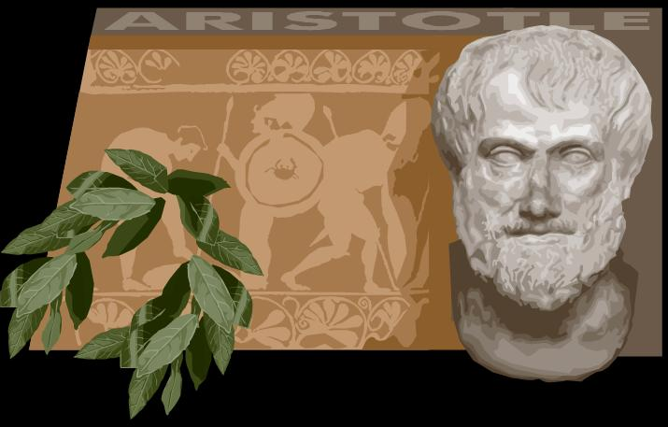
Philosophical Roots
Rationalist
Logic & reasoning
is key
Empiricist
Experience & observation is key
Notes:
This the two main roots in philosophy for the background for experimental psychology;
Most students are expected to have the basic knowledge about history of philosophy

Slide 4
Rationalism
(Descartes)
Empiricism
(Locke)
Synthesis:
Dualism (Descartes) issue: emphasis on thinking processes
Both have a role (Kant)
Notes:
Google search Rationalist and Emprist, Kant
For cognitive psychology, Rationalism contribute to building hypothesis by rational thinking. Psychologist makes the information mechanism based on causal relationships between two or more variables based on logics, coming from observations, previous literatures, and intuition. These processes are all depends on symbolic thinking, which is directly related to Rationalism. The accumulations of the hypotheses eventually leads to a theory in the text book.
Empricism argues that anything than can not be observed or experimented can be a truth. Thus, there should be empirical evidence to be a real science, and thus obtaining data by experiments is the key for cognitive psychology. The recent booming of cognitive neuroscience in which the relationship between brain and cognitive functions are studied is based on Empricism.
Kant combined these two stream, and cognitive psychology adopt both, although the degrees of emphasis are different field by field, and scholar by scholar.

Slide 5
Functionalism
(James)
“Process”
Structuralism
(Titchener)
“Elements”
Synthesis:
Associationism (how events associated)
(Thorndike)
Notes:
Structuralism: methodology that implies elements of human psychology must be understood by way of their relationship to a broader, overarching system or structure. It works to uncover the structures that underlie all the things that humans do, think, perceive, and feel.
Functionalism: It states that mental states (beliefs, desires, being in pain, etc.) are constituted solely by their functional role, which means, their causal relations with other mental states, sensory inputs and behavioral outputs. Actual contents of cognitive processes, their interactions, and their causal relationship are main focus in cognitive psychology.
Next slide shows two examples of cognitive processing models.
The structure of boxes and shape of the models are related with Structuralism.
Actual contents (e.g., memory contents), and relationships (Sensory memory can affect working memory, not vice versa).corresponds to the interest of Functionalism

Slide 6
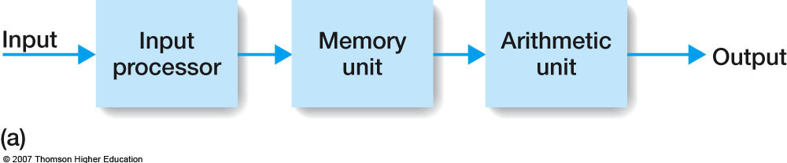
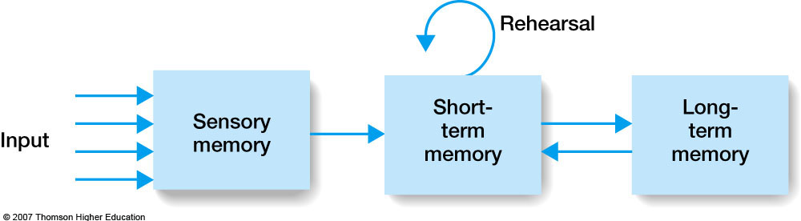
Notes:
Cognitive psychology box and arrow model.
This kind of box and arrow model is common in many topics.
The first model is general flow of information in Arithmetic calculation; Input stimulus (e.g., Calculus, Differential) come in to the cognitive early stage (Input processor) → search memory for the corresponding formulas (Memory) →
Actual calculation, applying the formulas (Arithemtic) → Output
The second model is the important multi-stage memory model: There are three types of memory, sensory memory, short term memory (currently replaced by “working memory”), and the long term memory.
Each memory system has different characteristics, time allocations, and functions, which would be covered in the following chapters.
You can see the structure of boxes and shape of the models for each information processing.
In addition, Actual contents (e.g., memory contents), and relationships (Sensory memory can affect working memory, not vice versa).can be seen.

Slide 7
Important to Cognitive Psychology
1950’s Development of Computers
Structure and Process
A "cognitive revolution” occurred and increased interest in the study of mental processes (cognitions)
Notes:
This is a brief history of cognitive psychology
From the 1920s to the 1950s, the main approach to psychology was behaviorism. Initially, its adherents viewed mental events such as thoughts, ideas, attention, and consciousness as unobservables, hence outside the realm of a science of psychology. One pioneer of cognitive psychology, who worked outside the boundaries (both intellectual and geographical) of behaviorism was Jean Piaget. From 1926 to the 1950s and into the 1980s, he studied the thoughts, language, and intelligence of children and adults.
Biggest direct change of trend departing from behaviorism starts from 1950’s computer development. Our mind is like computer structure and processes. For example, computer has the input buffer such as keyboard something like sensory memory, RAM in computer something like short term memory, hard disk like long term memory.
Behavior to Cognition is “cognitive revolution” in whole psychology area. We begin to put more emphasis to mental processes and intention rather than output, the behavior.

Slide 8
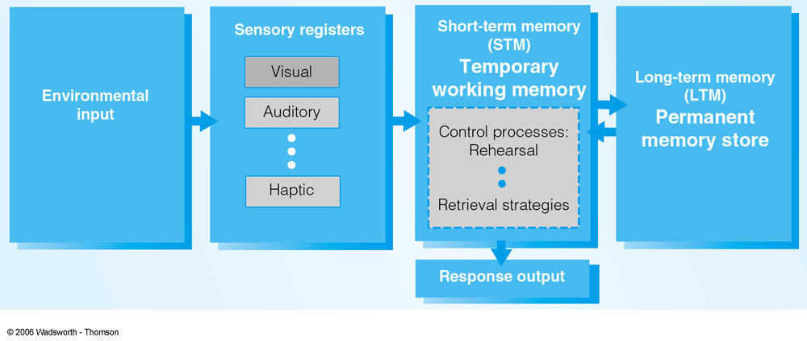
Perception to Cognition order
Problem Soving,
Decision Making,
Creativity
Categorization
(범주화)
Reasoning
(추리)
Notes:
This is a kind of information flow from perception to cognition
Enviromental input → vision, auditory… 5 senses → Working memory → Longterm memory → Categorizaiton (this can also occur in the Working memory; difficult categorization needs LTM [Is it situation to wear mask?]) → reasoning → problem solving.
Each cognitive stage has their own information flow model. Thus, there are global macro models, and micro specific models. For example, attention has 3 types of models even for only selection process in the early stage.

Slide 9
Research Methods
Experiments
Psychobiological studies
Self report
Case studies
Naturalistic Observation
Computer Simulations
Notes:
Methods
This is the topic of introductory psychology, but intends to emphasize that the experiment is the main tool in cognitive psychology. Understanding how to come up with ideas, design experiment, obtaining data, interpreting results, and testing a hypothesis are main focuses in this course.
Psychobiological means some cognitive psychologists interested in the relationship between brain and cognitive functions. This field called “cognitive neuroscience”, and the fMRI, ERP, PET, MEG are used to obtain the data.
Self report and case studies are used for limited cases: In pilot test, we can ask subjects’ perception about experiments. Some rare cognitive disorder and false memory can be studied by case studies.
Observation: it can provide the research idea and directions. Using smart phone while driving increases accidents, and why?
Computer simulaions: write software to function like human ; following slide

Slide 10
In an Experiment…
Random sample of participants
Manipulate the Independent Variable
Create experimental group
Create control group
Randomly assign participants
Measure the Dependent Variable
Same for all groups
Control all other variables
Prevent confounds

Slide 11
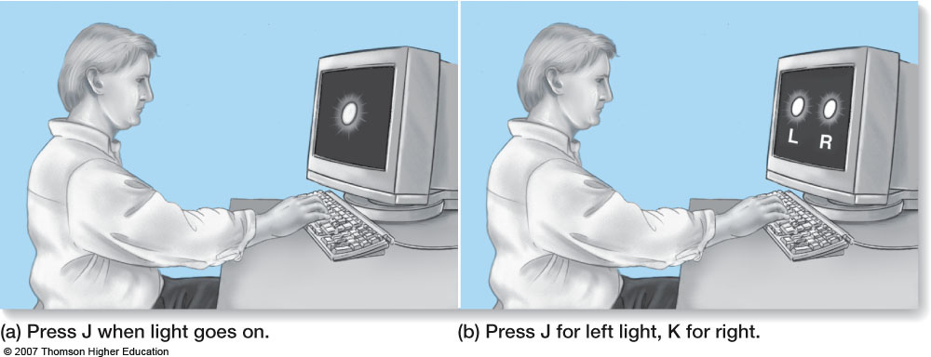
Donders (1868)
Choice RT – Simple RT = Time to make a decision
Choice RT = 1/10th sec longer than Simple RT
1/10th sec to make decision

Slide 12
Reaction Time Experiment
The time elapsed between some stimulus
and the person’s response to the stimulus
X |<-------RT----→| /
Q1)In which condition are reaction times longer?
Constant Timing
Random Timing
Reaction Times
12
12

Slide 13
평균 RT(msec) [1 second = 1000 milliseconds]
Constant Timing
Random Timing
실험 참가자 번호
Constant Timing
Random Timing
한 실험참가자의
시행간 RT변화
(milliseconds)
0
1100
13
0
Trial
1100
Trial
13

Slide 14
Typical Independent Variables
Manipulate stimulus materials
Compare words to non-words
Compare Yes questions to No questions
Control how participants process materials
Change Instruction
Vary speed of presentation of materials

Slide 15
Typical Dependent Variables
Reaction Time (milliseconds)
Mental events take time
Accuracy/Error analysis
How well the participant does on a task

Slide 16
Behaviorism overcame the limitations posed by introspection.
It focused on observable behaviors.
Behaviorism uncovered principles of how behavior changes in response to stimuli, such as rewards and punishments
Problems with behaviorism became very apparent in the 1950s.
Stimulus-response accounts are not enough to explain behavior.
Behavior has a “mental” cause.
Different STMs elicit same behavior. Same STMs elicit different behavior
Introspective methods for studying mental events are not scientific.
However, we need to study mental events in order to understand behavior.

Slide 17
Underlying Themes
Nature vs. Nurture
Rationalism vs. Empiricism
Structures vs. Processes
Domain Generality vs. Domain Specificity
Causal (Laboratory) vs. Ecological validity
Applied vs. Basic Research
Biological vs. Behavioral Methods

Slide 18
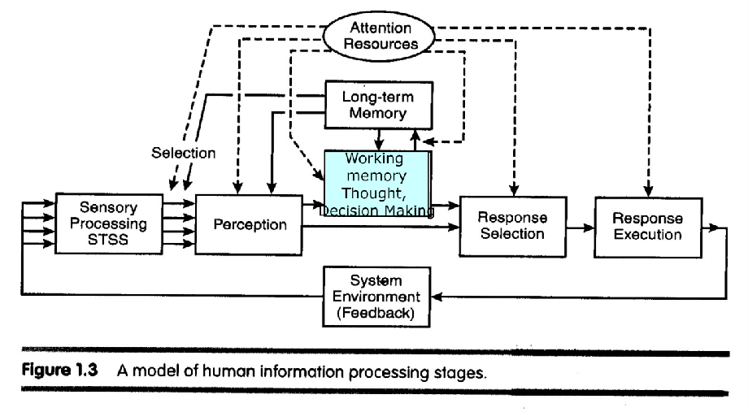
Model: with more details

Slide 19
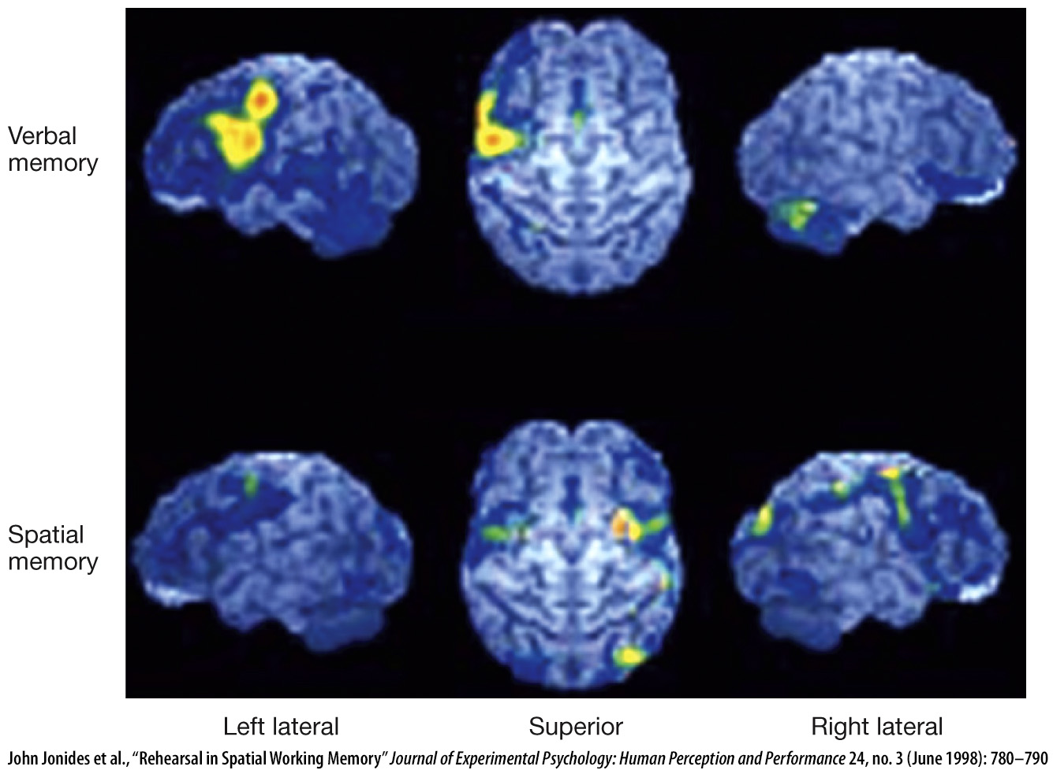
Evidence from “cognitive neuroscience” is also brought into the model.
Areas involved
In subvocal rehearsal

Slide 20
MISC Topics
Cognitive processes interact with each other and with non-cognitive processes
Emotions may affect decisions
Working memory capacity contributes to reading speed
Noncognitive processes (e.g., motivation) can contribute cognition (e.g., learning)

