Slide 1

Chapter 3: Perception

Slide 2
Perception Is…
The process of recognizing, organizing and interpreting information including very basic units (e.g., line, color, size, depth)
How do you recognize these items?

Slide 3
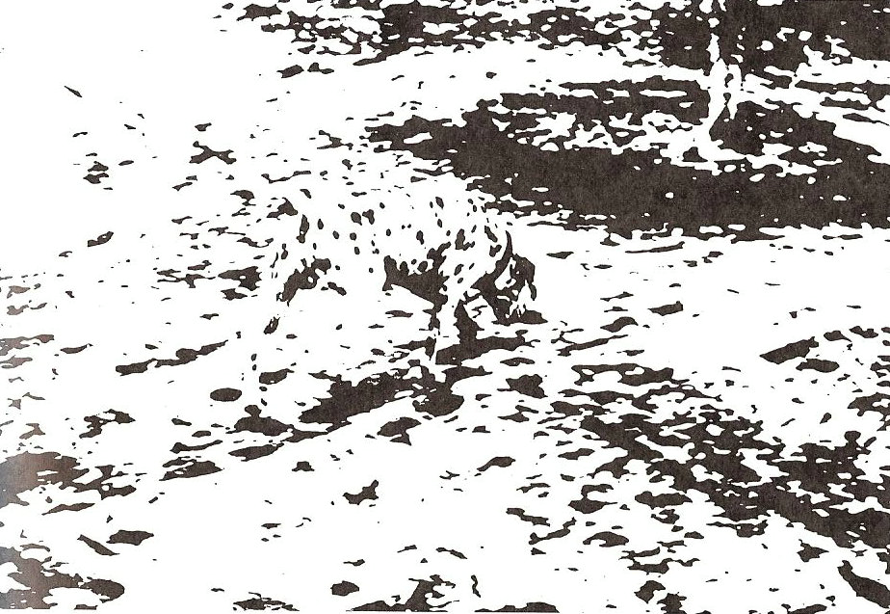
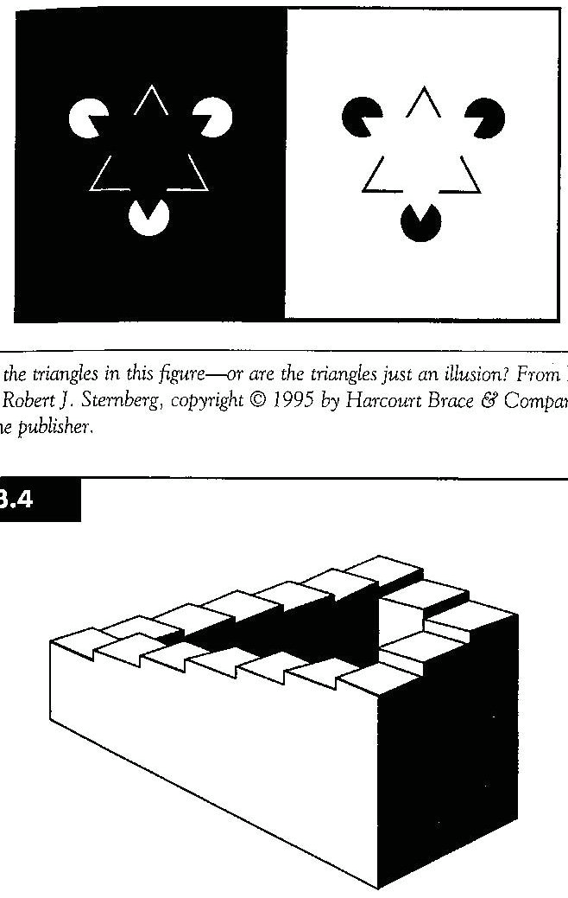
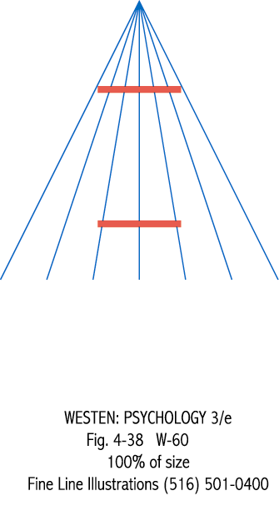
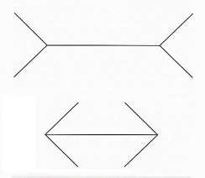
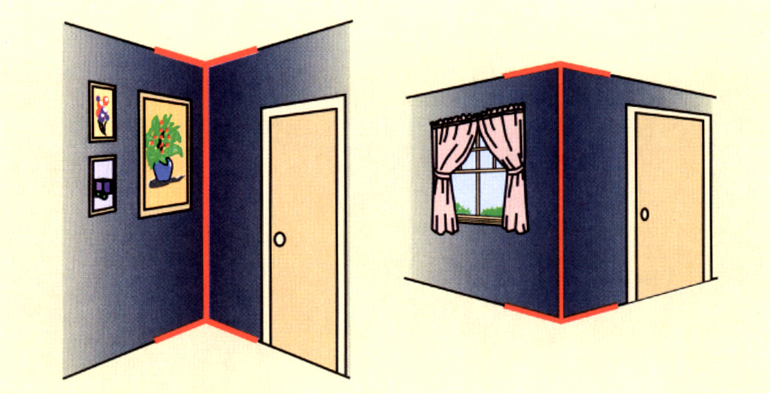
Perceptual Illusions

Slide 4
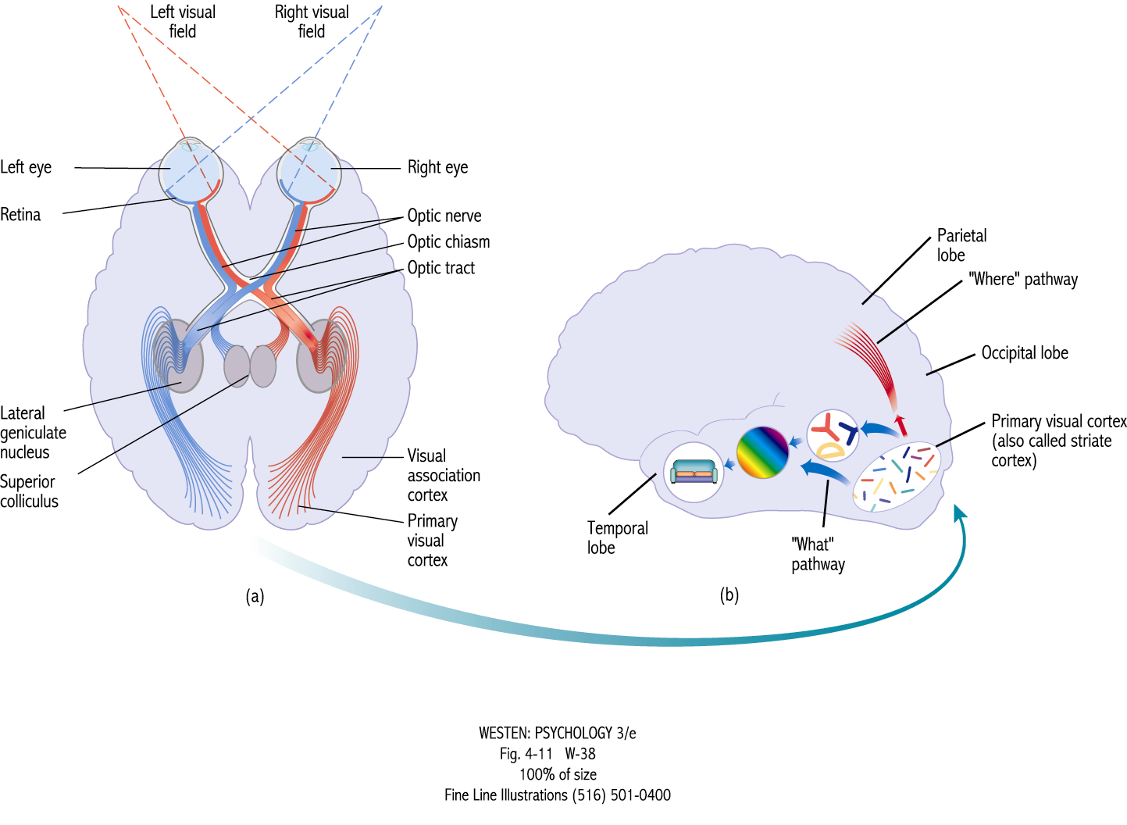

Slide 5
Main topics
Depth perception, Gestalt principles
Applying Gestalt to Korean word Experiments
Pattern recognition
1. template theory
2. prototype theory
3. feature theory
Whole versus part ?

Slide 6
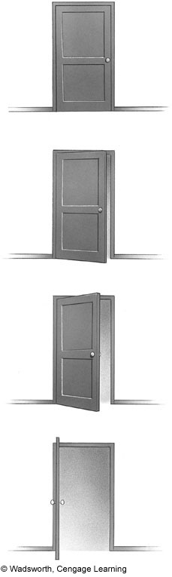
Perceptual Basics
Perceptual Constancy
Object remains the same even though our sensation of the object changes
Example:
Shape constancy
Notes:
Figure 3.9: Here you see a rectangular door and door frame, showing the door as closed, slightly opened, more fully opened, or wide open. Of course, the door does not appear to be a different shape in each panel. Indeed, it would be odd if you perceived a door to be changing shapes as you opened it. Yet, the shape of the image of the door sensed by your retinas does change as you open the door. If you look at the figure, you will see that the drawn shape of the door is different in each panel.

Slide 7
Depth Perception
The ability to see the world in 3 dimensions and detect distance
Vision only has a 2-dimensional view
We must interpret the information given to perceive depth
We take flat images and create a three dimensional view
Optical illusions demonstrate that this interpretation does not always have to be correct

Slide 8
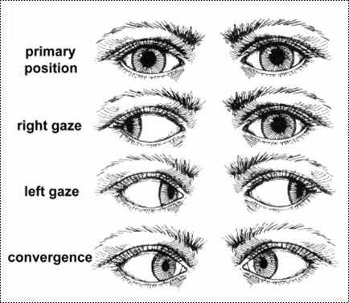
Monocular Depth Cues
Notes:
Teaching Tip: Use a photograph to illustrate cues these cues. Microsoft clips is a good starting point.

Slide 9
Monocular Depth Cues
Linear Perspective
Parallel lines
converge in distance
Aerial Perspective
Images seem blurry, the farther away
Motion Parallax
Objects get smaller at decreasing speed in distance
Notes:
Teaching Tip: Use a photograph to illustrate cues these cues. Microsoft clips is a good starting point.

Slide 10
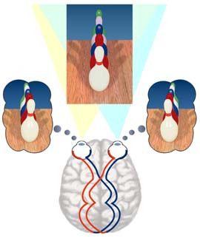
Binocular Depth Cues
Binocular Disparity
Each eye views a slightly different angle of an object; Brain uses this to create a 3-d image

Slide 11
Gestalt’s View of Perception
Basic Tenet
“The whole is more than a sum of its parts.”
Law of Prägnanz
Individuals organize their experience in as simple, concise, symmetrical and complete manner as possible

Slide 12
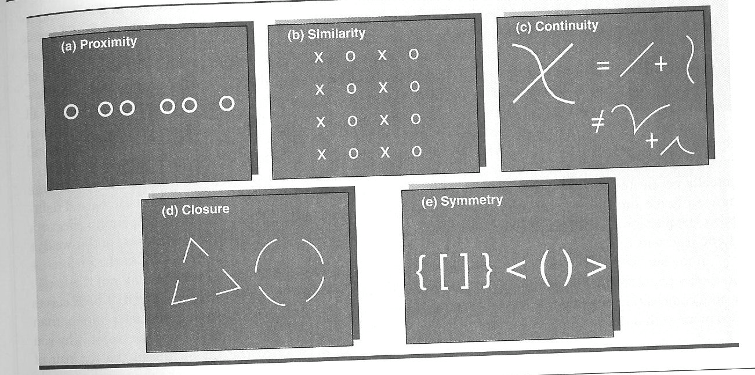
Gestalt’s Principles of Visual Perception

Slide 13
Introducing recent research: Korean orthography
Korean words that can be affected by the Gestalt continuity principle
Two types of words: 스포츠 vs 미리내 ; “미리내” matches with the contiunity.

Slide 14
Introducing recent research: Lee (2016)
How about the vertical writing?
Many street signs & titles are the vertical writing.
→ 스포츠 would be easier to perceive.

Slide 15
Pattern Recognition (Bottom-Up Processing Theories)
0
Template theories
Prototype theories
Feature theories

Slide 16
Template Theory
0
Basics of template theory
Multiple templates are held in memory
To recognize the incoming stimuli, you compare to templates in memory until a match is found
See stimuli
Search memory for a match
Notes:
One click to view the words “See Stimuli” and then the demonstration will illustrate the template theory. All images obtained from Microsoft clips.

Slide 17
Template Theory
0
Weakness of theory
Problem of imperfect matches
Cannot account for the flexibility of pattern recognition system
Search for match in memory
See stimuli
No perfect match in memory
Notes:
One click to view the words “See Stimuli”, then the demonstration of the weakness of the theory will occur. All images taken from Microsoft clips.

Slide 18
Prototype Theories
0
Modification of template matching (flexible templates)
Takes various instances of an object and abstracts out the common characteristics
No match is perfect; a criterion for matching is needed

Slide 19
Prototype Evidence
0
Franks & Bransford (1971)
Presented objects based on prototypes
Prototype not shown
Yet participants are confident they had seen prototype
Suggests existence of prototypes

Slide 20
Prototype Evidence
0
Solso & McCarthy (1981)
Participants were shown a series of faces
Later, a recognition test was given with some old faces, a prototype face, and some new faces that differed in degree from prototype
Results :
Participants were more confident they had seen the prototype than actual items they had seen.
Notes:
Solso, R.L. & McCarthy, J. E. (1981). Prototype formation of faces: a case of psuedo-memory. British Journal of Psychology, 72, 499-503.
Figure 3.21 (c): These faces are similar to those created in the experiment by Robert Solso and John McCarthy (1981).

Slide 21
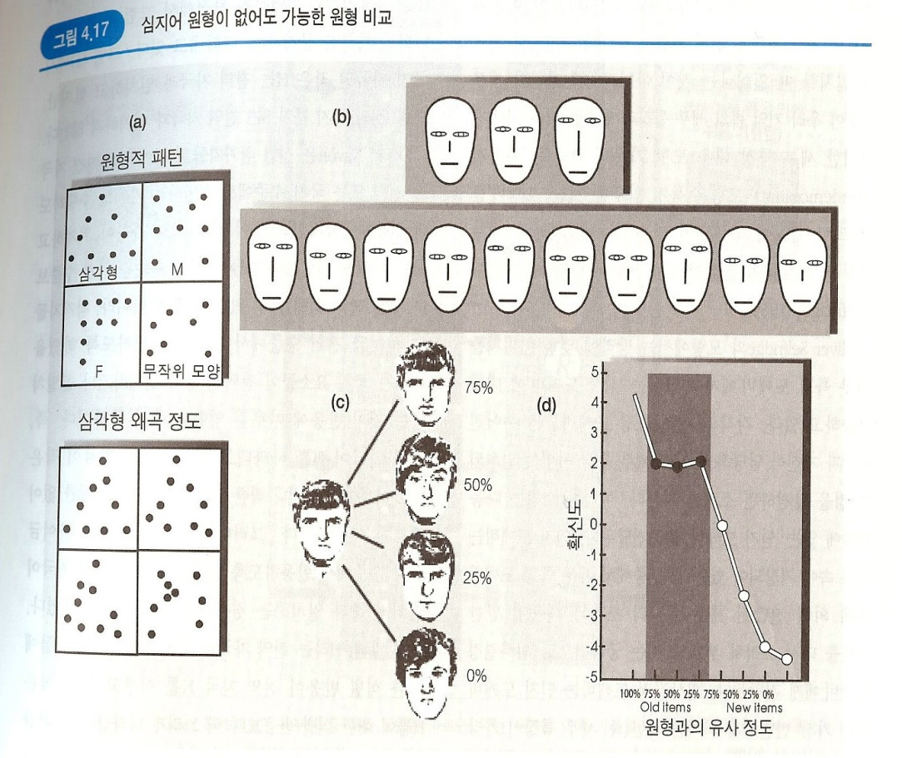
0
Notes:
Solso, R.L. & McCarthy, J. E. (1981). Prototype formation of faces: a case of psuedo-memory. British Journal of Psychology, 72, 499-503.
Figure 3.21 (d): This graph illustrates Solso and McCarthy’s findings, indicating the confidence rating for perceived recognition of each face, including the recognition of a prototypical face never observed by the subjects.

Slide 22
Research on Prototypes
0
Researchers have found that prototypical faces are found to be more attractive to participants
Halberstadt & Rhodes (2000)
Examined the impact of prototypes of dogs, wristwatches, and birds on attractiveness of the stimuli
Results indicate a strong relationship between averageness and attractiveness of the dogs, birds, and wristwatches

Slide 23
Feature Theories
0
Recognize objects on the basis of a small number of characteristics (features)
Detect specific elements and assemble them into more complex forms
Brain cells that respond to specific features, such as lines and angles are referred to as “feature detectors”

Slide 24
Feature Evidence
0
Hubel & Wiesel (1979) using single cell technique
Simple cells detect bars or edges of particular orientation in particular location
Complex cells, Hypercomplex cells
Lee and Won (2018):
엊 -> 정 (no priming); Letter’s locations are fixed;
잌 -> 킹 (no priming): wrong letter combination plays no role; 밍 -> 임 (priming) -> feature plays a role

Slide 25
A
Decision
Objects
A
B
C
Z
)
(
Features
A
Image
Selfridge (1959)

Slide 26
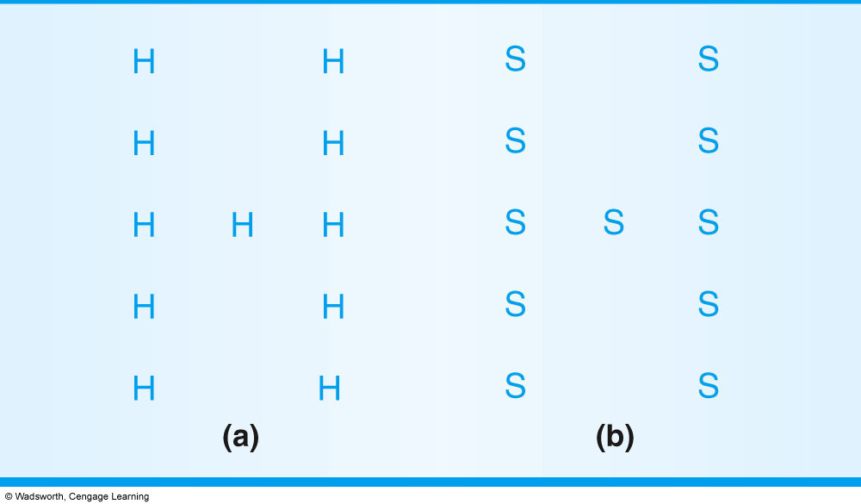
Say what letter is? Global Precedence prevail

Slide 27
Navon (1977)
Participants asked what they saw on the
Global level
Local Level
Results depended on whether letters are more widely spaced. Local –precedence effect stimuli depicted here. Participants were faster at identifying local features of the letters.
Notes:
Global precedence effect found when letters were closer together.
Figure 3.24: Compare panels a and b, in which the local letters are widely spaced.

Slide 28
Two types of Perceptual theories
Direct Perception theories
Perception comes from the stimuli in the environment
Bottom-up processing
Parts are identified, put together, and then recognition occurs
Constructive Perception theories
People actively construct perceptions using information based on expectations
Top-down processing

Slide 29

Top-down Processing Evidence
0
Context effects
Notes:
Fig. 3.18: When you read these words, you probably have no difficulty differentiating the A from the H. Look more closely at each of these two letters. What features differentiate them?

