Slide 1

Chapter 5: Memory:
Models and Research Methods

Slide 2

Memory Is …
The mechanism we use to create, maintain and retrieve information about the past
Notes:
Introductory slide to emphasis the important functions of memory. Discuss what life would be like with no memory.

Slide 3
Processes in Memory
Encoding
  Processes used to store information in memory
Storage
  Processes used to maintain information in memory
Retrieval
  Processes used to get information back out of memory

Slide 4
Main points
Introduction of experimental tasks
Sensory memory
1) Concept
2) logic and procedures of Sperling’s experiment:
Why Partial Report task ?
STM & Long term memory: Level of Processing theory
Working Memory Model: 4 evidences for Phonological Loop
Tulving’s model

Slide 5
Methods Used to Study Memory
Free Recall
  Recall all the words you can from the list you saw previously
Cued Recall
  Recall everything you can that is associated with the Civil War
  Participants are given a cue to facilitate recall
Serial Recall
  Recall the names of all previous presidents in the order they were elected
  Need to recall order as well as item names

Slide 6
Recognition Tasks
Circle all the words you previously studied
Indicate which pictures you saw yesterday
The participant selects from a list of items they have previously seen

Slide 7
Implicit Versus Explicit Memory Tasks
Explicit memory tasks
  Involves conscious recollection
  Participant knows they are trying to retrieve information from their memory
Implicit memory tasks
  Require participants to complete a task
  The completion of the task indirectly indicates memory

Slide 8
Implicit Memory Tasks
Participants are exposed to a word list
Tiger
Lion
Zebra
Panda
Leopard
Elephant
After a delay…
Participants then complete word puzzles, they are not aware they are a type of memory test
Word fragment Completion:
C_E_TA_
E_E_ _A_ N_
_ E _ R A
Word Stem Completion:
Mon _____
Pan_____
Notes:
No connection is made to the previously studied list. Participants are simply asked to make a word out of the word fragment.
Some of the answers will be words the participant has seen before. Some of the fragments will be words they have not seen. Fragment completion rates of the previously seen words are then compared to completion rates of unseen words. The difference between the scores indicates memory.
Answers to Word fragment completion: Cheetah, elephant, zebra; Word stem completion answers: Monkey, Panda.

Slide 9
Models of Memory
Represent ways that memory has been conceptualized
  Atkinson & Shiffrin’s 3 Stage Model of Memory
  Craik & Lockhart’s Level of Processing Model
  Baddeley’s Working Memory Model
  Tulving’s Multiple Memory Systems Model

Slide 10
Traditional Model of Memory
Atkinson & Shiffrin (1968) 3 Stage Model
Short -Term
Store
Long -Term
Store
Sensory Store
Stimuli
Information Processing Model

Slide 11
Sperling (1960) Iconic Memory Research
Whole report procedure
  Flash a matrix of letters for 50 milliseconds
  Identify as many letters as possible
  Participants typically remembered 4 letters
Partial Report Procedure
  Flash a matrix of letters for 50 milliseconds
  Participants are told to report bottom row
  Participants were able to report any row requested

Slide 12
Sperling Sensory Memory Demonstration
A matrix of 12 letters and numbers will be briefly flashed on the next few slides
As soon as you see the information, write down everything you can remember in its proper location
Notes:
The following demonstration was created by Thomas P. Pusateri (2004) for Thomson/Wadsworth.

Slide 13
Whole Report
Here’s where the letters and numbers will appear
-- Keep your eyes on the “X” on the next slide
X X X X
X X X X
X X X X
Notes:
Instructor Note: Once the students have written down all they can remember just click the mouse to see the matrix and determine how many items the students remember.

Slide 14
X
B 5 Q T
2 H S 9
O 4 M Y

Slide 15
B 5 Q T
2 H S 9
O 4 M Y

Slide 16
Partial Report – No Delay
For the next demonstration, report only the top, middle, or bottom row. The row to report will be identified by markers IMMEDIATELY after you see the letters.
X X X X
X X X X
X X X X
Notes:
Instructor Note: Once the students have written down all they can remember just click the mouse to see the matrix and determine how many items the students remember.

Slide 17
X
2 V 9 R
Q M 7 L
K H 5 F

Slide 18
2 V 9 R
Q M 7 L
> K H 5 F <

Slide 19
Sensory Stores
Iconic store or Visual sensory register
  Holds visual information for 250 msec longer
  Information held is pre-categorical
  Capacity – up to 12 items
  usually 10 items due to output interference
  Information fades quickly
Notes:
hpbahric@cc.owu.edu

Slide 20
Short-Term Memory
Rehearsal
Attention
  Attend to information in the sensory store, it moves to STM
Rehearsal
  Repeat the information to keep maintained in STM
Retrieval
  Access memory in LTM and place in STM
Short Term
Memory (STM)
Attention
Storage & Retrieval

Slide 21
Research on Short-Term Memory
Miller (1956)
  Examined memory capacity
  7+/- 2 items or “chunks”
Chunking - organize the input into larger units
  1 9 8 0 1 9 9 8 2 0 0 3 - Exceeds capacity
  1980 1998 2003 - Reorganize by chunking.
Birth-year
College Graduation
H.S graduation
Notes:
Student using a chunking strategy can use LTM of important dates to remember a longer string of numbers.

Slide 22
Long-Term Memory
Capacity
  Thus far limitless
Duration
  Potentially permanent
Long Term
Memory (LTM)

Slide 23
Bahrick’s Research on Very Long Term Memory
High school year books containing all of the names and photos of the students were used to assess memory
392 ex-high school students (17-74) took 4 different memory tests:
  Free recall of the names
  A photo recognition test where they were asked to identify former classmates
  A name recognition test
  A name and photo matching test
For some of the participants, it was as long as 48 years since they graduated from High school
Notes:
Bahrick, H. P., Bahrick, P.O., & Wittlinger, R. P. (1975). Fifty years of memory for names and faces: A cross-sectional approach. Journal of Experimental Psychology, 104(1), 54-75.

Slide 24
Bahrick et. al., (1975) Results
90% accuracy in face and name recognition after 34 years
80% accuracy for name recognition after 48 years
40% accuracy for face recognition after 48 years
60% accuracy for free recall after 15 years
30% accuracy for free recall after 30 years
Notes:
Note how the recognition results differ from the free recall results.

Slide 25
Levels of Processing Model of Memory
Craik & Lockhart (1972)
  Different ways to process information lead to different strengths of memories
  Deep processing leads to better memory
    elaborating according to meaning leads to a strong memory
  Shallow processing emphasizes the physical features of the stimulus
    the memory trace is fragile and quickly decays
  Distinguished between maintenance rehearsal and elaborative rehearsal
Notes:
Craik, F.I.M., & Lockhart, R.S. (1972). Levels of processing. A framework for memory research. Journal of Verbal Learning and Verbal Behaviour, 11, 671-684.

Slide 26
Support for Levels of Processing
Craik & Tulving (1975)
  Participants studied a list in 3 different ways
  Structural: Is the word in capital letters?
  Phonemic: Does the word rhyme with dog?
  Semantic: Does the word fit in this sentence? The ______ is delicious.
  A recognition test was given to see which type of processing led to the best memory

Slide 27
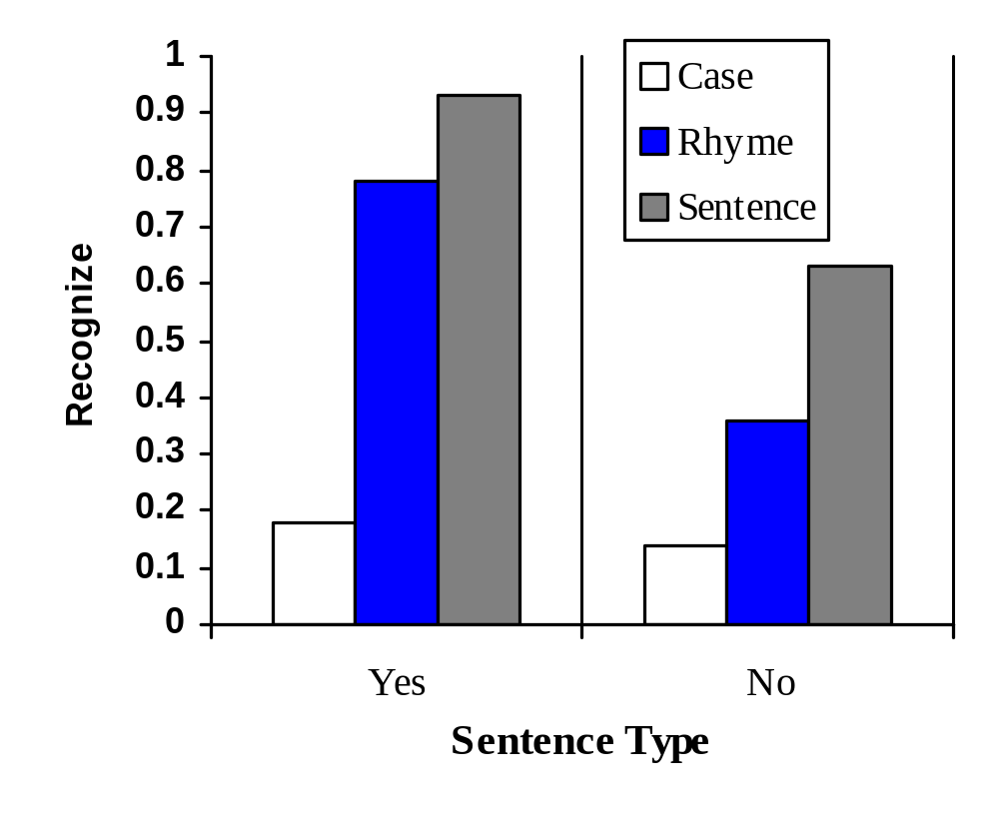
Craik & Tulving (1975) Results

Slide 28
Baddeleys’ Working Memory Model
Central Executive
Visual Scribe
Articulatory Loop
Visuo-spatial
Sketch Pad
Phonological
Store
Episodic Buffer
Notes:
Baddeley (1986)
Baddeley’s model of working memory contains several elements: A central executive, auditory working memory, visuo-spatial working memory, and an episodic Buffer.
Material can also enter conscious workspace from long-term memory.

Slide 29
Working Memory Model
Articulatory Loop
  Used to maintain information for a short time and for acoustic rehearsal
Visuo-spatial Sketch Pad
  Used for maintaining and processing visuo-spatial information
Episodic Buffer
  Used for storage of a multimodal code, holding an integrated episode between systems using different codes

Slide 30
Working Memory Model
Central Executive Function
  Focuses attention on relevant items and inhibiting irrelevant ones
  Plans sequence of tasks to accomplish goals, schedules processes in complex tasks, often switches attention between different parts
  Updates and checks content to determine next step in sequence of parts

Slide 31
Working Memory Model Support
Baddeley (1986)
  Participants studied two different list types
  1 syllable: wit, sum, harm, bay, top
  5 syllables: university, opportunity, aluminum, constitutional, auditorium
Reading rate seemed to determine recall performance
Supports conceptualization of an articulatory loop

Slide 32
Working Memory Model Support
    Phonology similarity effect: (PGTCD < RHXJW)
    Inhibition of articulation : Disapperance of PSE 시각적으로 제시된 항목들에 조음 억제를 하면 음운 유사성 효과가 사라짐
    Effect of irrelevant speech in recall: listening irrelevant speech affects recall performance for visually presented words
    Word length effect: Better recall of short syllabic words than long words

Slide 33
Tulving’s Multiple-Memory Systems Model
Semantic Memory
  General knowledge
  Facts, definitions, historical dates
Episodic Memory
  Event memories (first kiss, 6th birthday)
Procedural Memory
  Memories on how to do something (skiing, biking, tying your shoe)

Slide 34
Multiple-Memory Systems Model Support
Nyberg, Cabeza, & Tulving (1996)
  PET technology to look at episodic and semantic memory
  Asked people to engage in semantic or episodic memory tasks while being monitored by PET
Results
  Left (hemisphere) frontal lobe differentially active in encoding and in semantic memory retrieval
  Right (hemisphere) frontal lobe differentially active in retrieval of episodic memory
Notes:
Nyberg, L., Cabeza, R., & Tulving, E. (1996). PET studies of encoding and retrieval: The HERA model. Psychonomic Bulletin & Review, 3, 135-148.

Slide 35
Deficient Memory
Amnesias
  Retrograde Amnesia
    Loss of memory for events that occurred before the trauma
  Infantile Amnesia
    Inability to recall events of young childhood
  Antereograde Amnesia
    No memory for events that occur after the trauma

Slide 36
Amnesia Studies
Study antereograde amnesiacs using implicit and explicit memory tests
Amnesiacs show normal priming (implicit), but poor recognition memory (explicit)
They did not remember having seen the word list, but completed the word fragments at the same rate as normals

Slide 37
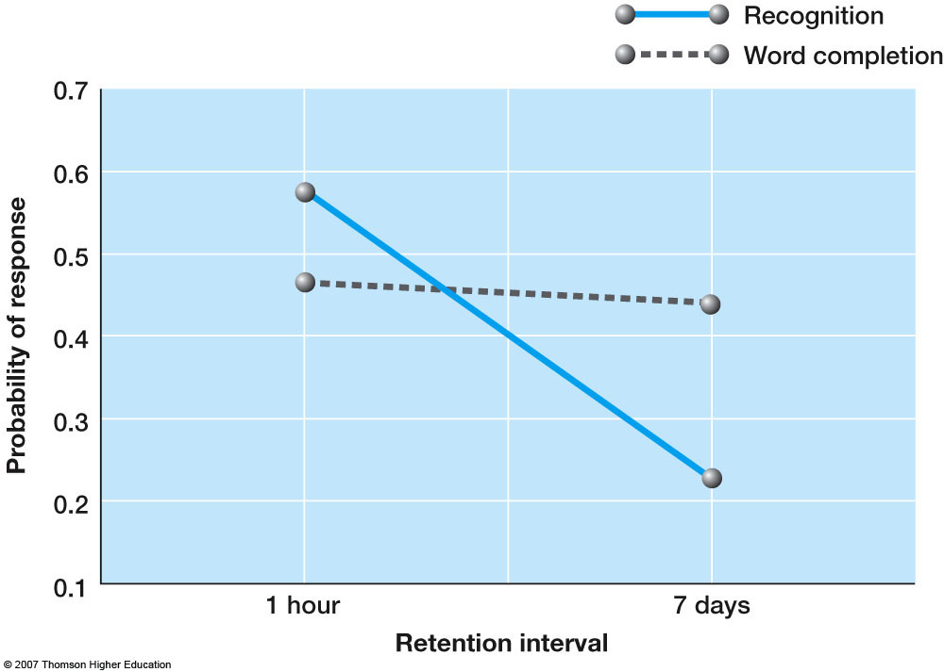
Amnasia
WC is similar

