Slide 1

Chapter 6: Memory Processes

Slide 2
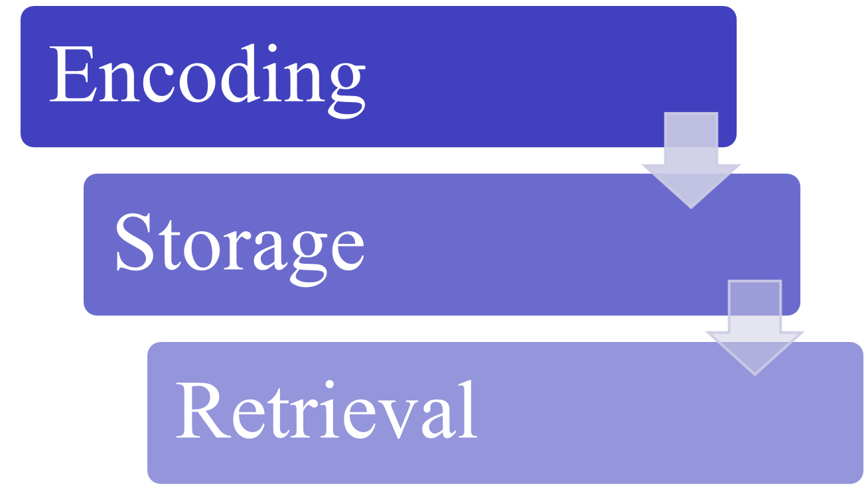
Memory Processes

Slide 3
Main points
Evidence of visual encoding; phonological coding
Retrieval: STM
  Concept
  logic and procedures of Sternberg’s experiment:
  Serial – Exuastive Search
Nelson’s “Still There” experiment
Theories of Forgetting
LTM experiment; Serial Position Curve
  Concept 2) logic and procedures of LTM experiment
Constructive Nature of LTM
Encoding Specificity

Slide 4
Encoding Processes
Creating an acoustic code
  What it sounds like
Creating a visual code
  What it looks like
In terms of processing stimuli online

Slide 5


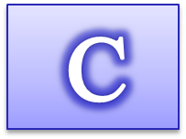






Evidence for Acoustic Encoding in STM
Conrad (1964)
  Visually present a series of letters briefly
  Immediately write the letters viewed once series is complete (Try it - Starts on next click)

Slide 6
Conrad (1964)
You Viewed B C F M N P N S T V
What errors did you make?
  F for S
  B for V
  P for B
Not visual errors (e.g., E for F, O for Q, R for P)
Thus, items acoustically even though stimuli were presented visually

Slide 7
Posner & Keele (1967)
Evidence for visual encoding in STM
  Letter matching task
  Two letters separated by brief interval
  Participant had to indicate if same letter
    A-a Yes
    A-A Yes
    a-a Yes
    A-M No
  Measure reaction time

Slide 8
Posner & Keele (1967) Results
If letters were the same visually (a-a) participants were faster than if the letters were not the same visually (A-a)
Results indicate that visual code was also present for STM

Slide 9
Transfer from STM to LTM
Consolidation
  Integrating new information into stored information
Rehearsal
Elaborative rehearsal is better than maintenance rehearsal
- Distributed practice is better than massed practice
  “Spacing effect”

Slide 10
Retrieval Processes
Getting information back out
Multiple processes can be used to enhance retrieval
Different strategies are used for short term storage and long term storage
Matching the type of processes done during encoding with the type of processes done at retrieval increases success

Slide 11
Retrieval from STM
Is the search serial or parallel?
  Serial indicates one by one search
  Parallel means all items are processed at once
Is the search exhaustive or self-terminating?
  Exhaustive indicates that all items in the set are examined
  Self-terminating means that after target is found the search stops

Slide 12

Studying Searching in STM
0
Saul Sternberg (1967)
Memorize a set of numbers (6,3,8,2,7)
Shown a probe digit
Participant must indicate if the probe was in the set
Time to respond is measured
2
6,5,8,2,7
Yes
Notes:
After first click, the demonstration is automated and will simulate a trial in Sternberg’s experiment.

Slide 13
Sternberg (1967)
0
3 critical factors manipulated
  How many items were in the set the participants had to memorize
  Whether the probe was in the list
  The probe’s location in the set

Slide 14
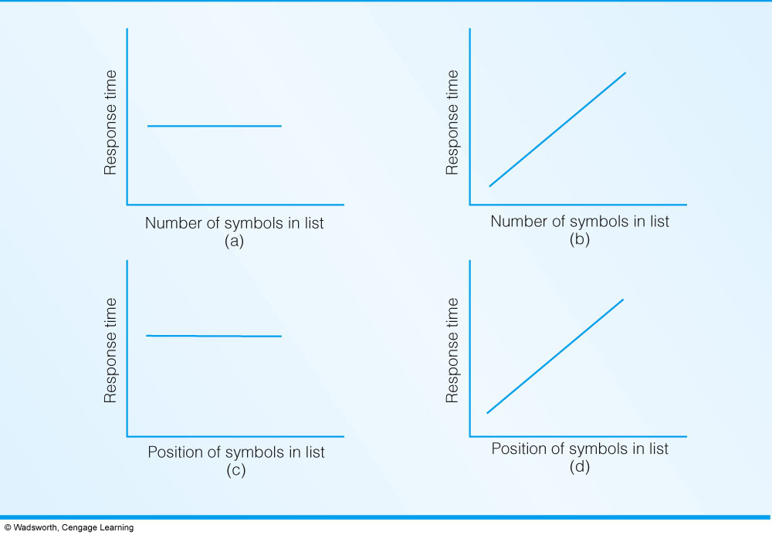
Sternberg (1967)
Possible Result Patterns
  A represents parallel processing
  B illustrates serial processing
  C illustrates exhaustive processing
  D illustrates self-terminating processing
Notes:
Fig 6.1: Panel a illustrates findings suggestive of parallel processing; b illustrates serial processing; c shows exhaustive serial processing; and d
shows self-terminating serial processing.

Slide 15
Sternberg’s Conclusion
B) & C): we need more time as the number of list increases (B; serial search), even though target detected, we continue search (C: exhaustive search)
A serial exhaustive model

Slide 16
Retrieval from LTM
The types of cues you use to retrieve may affect what you can retrieve…
  Free recall vs Categorized recall
  Study random list or an organized list
What is the impact on memory?

Slide 17
Bower, Clark, Lesgold, and Winzenz (1969)
Randomized list
Naples World Italy Americas
Montreal Bristol Washington Ottowa
Orlando England Europe Dallas
Liverpool Winnipeg Rome USA
London Florence Canada
Organized list
World
Europe Americas
England Italy USA Canada
London Rome Washington Ottowa
Liverpool Florence Dallas Montreal
Bristol Naples Orlando Winnipeg

Slide 18
Bower & Associates (1969)
Participants remembered 65% of the organized list, only 19% of the random list
Thus, Organization helps memory retrieval

Slide 19
If You Cannot Retrieve from LTM…
Has the memory disappeared?
Is the memory available but not accessible?

Slide 20
Evidence Supporting “Still There” Theory
Nelson (1971)
Paired associate List
43-house
67-dog
38-dress
77-sissors
Cued recall test
38- ________
77- ________
Two week delay
Subjects recalled 75% of items on list
But focus was on 25% they forgot.

Slide 21
Nelson (1971) Critical Manipulation
If participants forgot “38-dress” and “77-sissors” then participants relearned either same pairs or changed pairs
 | 25% “forgotten” | Relearned | Results
Same | 38-dress 77-sissors | 38-dress 77-sissors
Changed | 38-dress 77-sissors | 38-apple 77-kettle
78%
43%
The better performance of participants in the same condition indicate that there was some memory left for “forgotten” items. Otherwise both groups would remember the same amount.

Slide 22
Theories about Forgetting
Decay theory
  Memory is weakened with disuse -> Vanishes
  Simply passage of time…
Interference theory
  Proactive: old memories interfere with recall of new information
  Retroactive: new memories interfere with recall of old information

Slide 23
Retroactive Interference from LTM
0
Experimental group | Learn List A | Learn List B | Delay | Test for Memory A
Control group | Learn List A | ------------ | Delay | Test for Memory A
The experimental group will remember less material from the tested list A compared to the control group
Information learned afterwards interferes with retrieval of List A.
Notes:
An example is you learn new rules for a card game. Now you cannot remember how you used to play.

Slide 24
Proactive Interference from LTM
Experimental group | Learn List A | Learn List B | Delay | Test for Memory B
Control group | No study | Learn List B | Delay | Test for Memory B
The experimental group remembers less material from the tested list B than the control group
Information previously learned (list A) interferes with retrieval of List B
Notes:
 hard to learn a new ATM pin number because you keep thinking about your old one.

Slide 25
Let’s Test Your LTM!
You will see several words, one at a time
Do whatever you can to try and remember as many of the words as you can
At the end of the list, try to recall as many words as you can
Notes:
The following demonstration was created by Thomas P. Pusateri (2004) for Thomson/Wadsworth. The following are his instructions for this demonstration.
ALL-PURPOSE MEMORY DEMONSTRATION
I first saw this demonstration at a workshop presentation by Douglas Bernstein from the University of Illinois, Urbana-Champaign. He could not locate the original source of this demonstration, which was introduced to him by one of his teaching assistants in introductory psychology. Before presenting the words, tell students that you will show them a list of words, and their task is to memorize the entire list. Have the students recall the list immediately after you present the last word; do not use a distractor task, otherwise you may not produce a recency effect.
Ask about ten volunteers to report their recall for the words, expose each word individually, and ask for a show of hands from those who recalled the words. Ask the class to explain why the volunteers did well in recalling these words prior to exposing the line that describes the memory effect. Here is a brief explanation of each memory effect, with some elaboration you may use in your discussion:
Primacy effect. The words “bed” and “clock” were the first two words in this list. Most students will recall these words due to the greater opportunity for rehearsing these words.
Recency effect. The words “snore” and “pillow” were the last two words in the list. Most students will recall these words because they are still in their immediate attention (short-term memory) during recall. You may wish to ask students how recall for these words could be disrupted. The answer is by introducing a distractor task after presentation of the list.
Repetition/Rehearsal. Words in the middle of a list are often not well-recalled, however, most students will recall the word “night”. This word was repeated three times in the list, so students had additional opportunity to rehearse this word compared to other words in the middle of the list.
Distinctiveness. Most of the words are associated with each other. However, one word in the list, “artichoke” is so different than the others that it is often recalled, even though it appears in the middle of the list. You may discuss this as an example of deeper processing of a word that is distinctive, salient, and unusual.
Semantic Organization. First ask the volunteers if they recalled the word “toss”. (You may want to include the entire class in this question, to produce a larger potential response rate.) Then, ask those who recalled “toss” whether they followed recall of the word “toss” immediately by recall of the word “turn”. There will be several students who recall the words as a pair, even though they are separated in the list and “turn” precedes “toss”. You may discuss this as a form of semantic organization (which is more thoroughly discussed in Chapter 9 of Reed’s text). I also tie it into the definition of elaboration of memory. The words are very highly associated and easily connected together in students’ recall.
“False Memory”. Ask the whole class if anyone recalled the word “sleep”. Ask those students who recalled this word to attempt to recall where in the list the word appeared. Was it in the first half or the last half of the list? Most students who recall the word will report that they “know” it is in the list, but they cannot “remember” exactly where the word appeared. You may then discuss current research by Jacoby, Roediger, and other researchers on the “know/remember” distinction. You may also tie this into a discussion of other, more elaborate examples of possible false memory (e.g., the accuracy of eyewitness testimony, and the current controversy surrounding adult memory of childhood sexual abuse).

Slide 26
BED

Slide 27
CLOCK

Slide 28
DREAM

Slide 29
NIGHT

Slide 30
TURN

Slide 31
MATTRESS

Slide 32
SNOOZE

Slide 33
NOD

Slide 34
TIRED

Slide 35
NIGHT

Slide 36
ARTICHOKE

Slide 37
INSOMNIA

Slide 38
REST

Slide 39
TOSS

Slide 40
NIGHT

Slide 41
ALARM

Slide 42
NAP

Slide 43
SNORE

Slide 44
PILLOW

Slide 45
Write down the words you saw

Slide 46
Here are the words in the order viewed
BED
CLOCK
DREAM
NIGHT
TURN
MATTRESS
SNOOZE
NOD
TIRED
NIGHT
ARTICHOKE
INSOMNIA
REST
TOSS
NIGHT
ALARM
NAP
SNORE
PILLOW
Did you recall? Explanation
Bed? Clock?
Primacy Effect
Snore? Pillow?
Recency Effect
Artichoke?
Distinctiveness
Toss? Toss & Turn?
Clustering
Sleep?
False Memory
Notes:
Once the students examine how many words they have remembered, you can click and discuss each of the memory effects one by one.

Slide 47
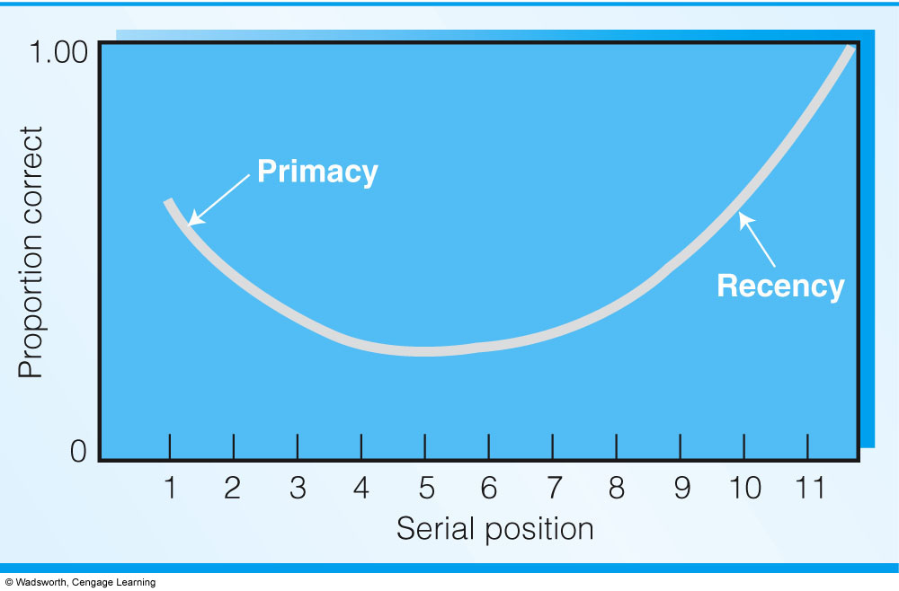
Serial Position Curve
Primacy indicates the role of LTM; Recency indicates the role of STM(WM).
Notes:
Fig. 6.3: When asked to recall a list of words, we show superior recall of words close to the end of a list (the recency effect), pretty good recall of words close to the beginning of the list (primacy effect), and relatively poor recall of words in the middle of the list.

Slide 48
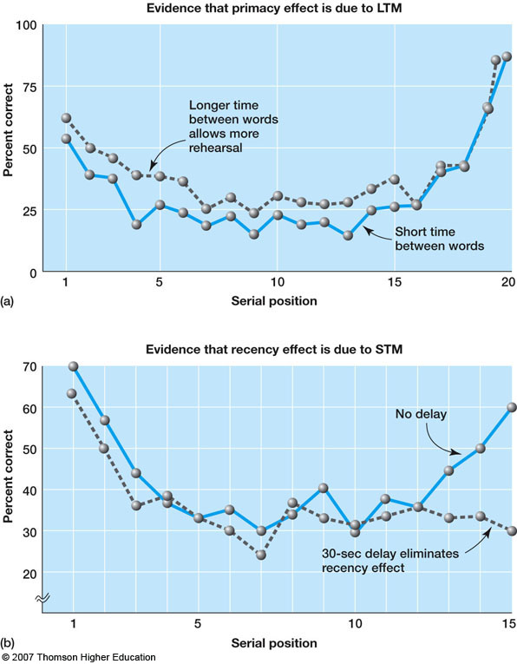
Follow-up studies

Slide 49
Autobiographical Memory
Memory of personal history
Constructive in nature
Bartlett (1932) was the first to demonstrate distortions for prose
  Read stories about Native Americans
  Subjects were good at recalling “gist” information
  Omission of detail was systematic
    Tended to omit information that did not make sense to the participants

Slide 50
Constructive Nature of LTM
Bartlett (1932) was the first to demonstrate distortions for prose
  Read stories about Native Americans
  Subjects were good at recalling “gist” information
  Omission of detail was systematic
    Tended to omit information that did not make sense to the participants
Notes:
May need to define “gist”.

Slide 51
Constructive Nature of LTM
Prior experience influences how we recall information
Having retrieval cues can help us recall more information, but cues can also lead to errors

Slide 52
Owens, Bower and Black (1979)
Nancy arrived at the cocktail party. She looked around the room to see who was there. She went to talk with Tom. She felt she had to talk to him but was a little nervous about just what to say. A group of people started to play charades. Nancy went over and had some refreshments. The hors d’oevres were good but she was interested in talking to the rest of the people at the party. After a while, she decided she’d had enough and left the party.
Some participants also heard that passage, but w/ this theme:
Nancy woke up feeling sick and she wondered if she really were pregnant. How could she tell Tom she had been seeing? And the money was another problem.
Participants were then asked to recall as much about the story as they could

Slide 53
Owens, Bower and Black (1979) Results
 | Theme | No Theme
Studied Propositions | 29.2 | 20.3
Inferred Propositions | 15.2 | 3.7
The “theme” offered some background information and some retrieval cues, which increased recall.
However, the background info also led to more intrusions (memory for information not present), such as “Tom got Nancy pregnant.”

Slide 54
Memory Distortion
Simply recalling may distort your memory
Simple suggestion may distort your memory
Memory is constructive in nature

Slide 55
Eyewitness memory
The single greatest cause of wrongful convictions nationwide, playing a role in more than 75% of convictions overturned through DNA testing.

Slide 56

A study: Problems with Lineups
Assumption that the perpetrator is in lineup
Distractor selection is also important ; multiple comparison -> one by one is better
Police behavior may also influence –reinforcement
A decision consolidate the false memory
* Recognition works best within seconds; if the test takes more than minutes, it can create false memory

Slide 57
Encoding Specificity
Memory is improved when information available at encoding is also available at retrieval
When you memorize, you also store contextual information

Slide 58
Encoding Specificity
Tulving (1983)
  People encode the context with the target material
    Physical match (class, diving, smell)
    Emotional match (happy, depressed)
    Robert Bjork: leading psychologist
    https://www.youtube.com/watch?v=GjHvw6X95hs

Slide 59
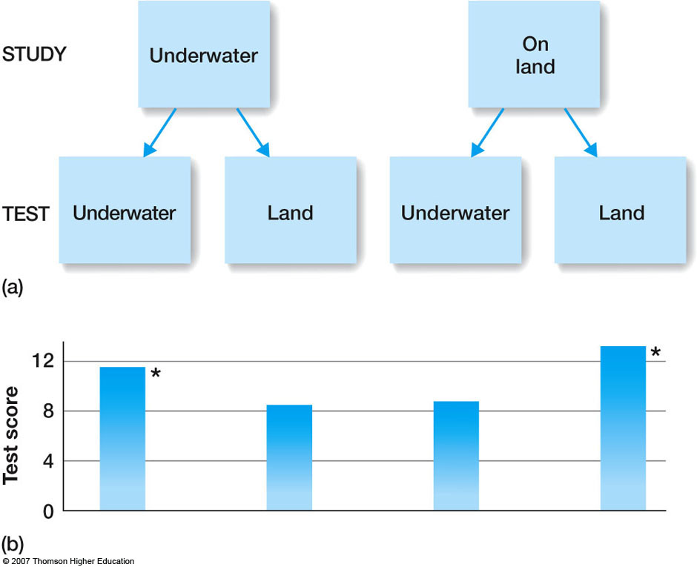

Slide 60
