Slide 1

Chapter 7: Representation and Manipulation of Knowledge in Memory: Images and Propositions

Slide 2
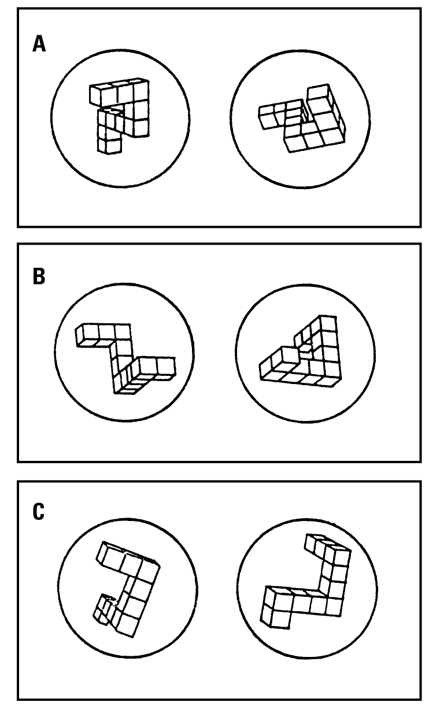
Mental Imagery
Mental Imagery
Shepard & Metzler (1971)
Subjects had to decide whether displays had two similar shapes
Some pairs were similar, but rotated to various degrees

Slide 3
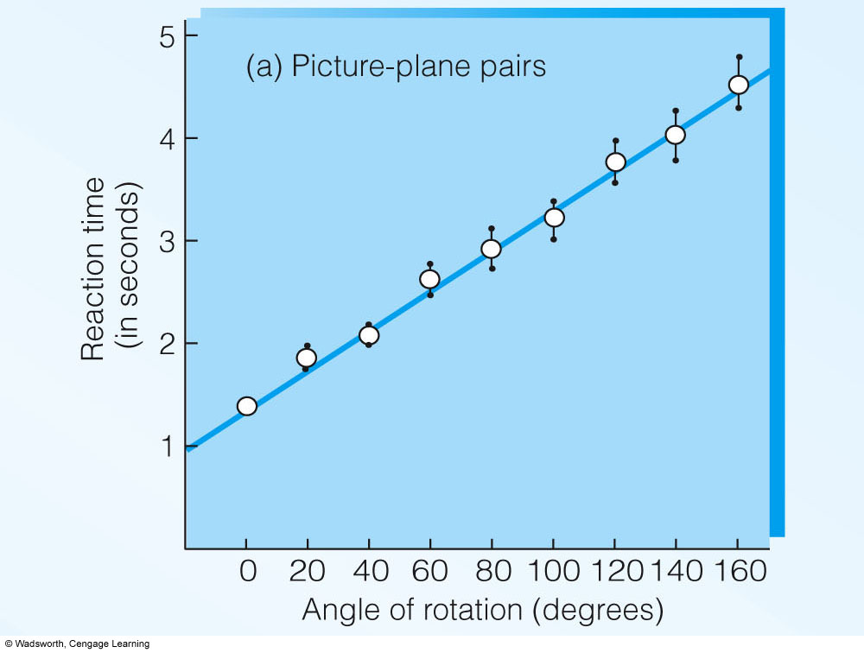
Mental Imagery
Shepard & Metzler (1971)
Kosslyn proposes images are used to help solve certain types of problems
How many chairs are there in your house?

Slide 4
Main Points
Dual – Code theory:
1) Experimental procedures
2) Logic & Results
Propositional Theory
Functional Equivalence Hyphothesis
Various evidences
* Cognitive Map: Heuristics

Slide 5
Dual Code Theory
Paivio (1971)
We use two codes to represent information
Image codes- analogue codes, shares some perceptual features
Symbolic codes- arbitrary symbols to represent items (e.g., words)
Two codes are linked

Slide 6
Evidence for Dual Code Theory
Paivio compared concrete words (potato, horse) with abstract words (justice, love)
Found participants were better able to recall concrete words
Concluded that dual code was created for concrete words (analog & verbal label) but not for abstract words
Notes:
Paivio, A. (1991). Dual coding theory: retrospect and current status. Canadian Journal of Psychology 45, 255-87.

Slide 7
Evidence for Dual Code Theory
Brooks (1968)
One group saw a block diagram of a letter
Memorized it
Were asked to mentally travel the letter and indicate if the corner was on the extreme top or bottom (No, no yes, yes, no, yes, no, yes, no, no [extreme top])
Start

Slide 8
Evidence for Dual Code Theory
Brooks (1968) cont.
Second group saw a sentence
Memorized it
Were asked to classify each word as a noun by indicating "yes" or "no"
Verbal task
A bird in the hand is not in the bush

Slide 9
Evidence for Dual Code Theory
Brooks (1968) cont.
Participants were then asked to respond in one of two ways
Say “Yes” or “No”
Point to the answer “Yes or No”
Why was this important?
Yes
No
No
Yes
Yes
No
Yes
No
Yes
No
No
Yes
Notes:
Note that one answer method is verbal: the other requires visual or spatial processing.

Slide 10
Evidence for Dual Code Theory
Brooks (1968) Results
Task | Verbal | Pointing
Letter Diagrams | 11.3 sec. | 28.2 sec.
Sentences | 13.8 sec. | 9.8 sec.
For image task, RT was slower when pointing.
For the symbolic task, RT was slower for the verbal response.
Different pattern = different processing for different codes
Notes:
Reaction time to classify words in a sentence when they gave a verbal response were slower than when they were allowed to point.
Reaction time to classify the corners of a letter when they had to point to a response was slower than when they were allowed to give a verbal response.
Conclusion: Participants in Brook’s letter task behaved as if they were scanning an analog representation of a physical array, with the pointing task causing interference and leading to a longer reaction time. Participants in the sentence task behaved as if they were using a verbal code, thus, the verbal response task lead to the slower reaction time.
This is evidence that two different codes are being used.

Slide 11
Propositional Theory
Do not store in form of images even for pictorial forms
Instead have a “generic” code that is called “propositional”
images may be stored propositionally
Create a verbal or visual code by transforming the propositional code

Slide 12
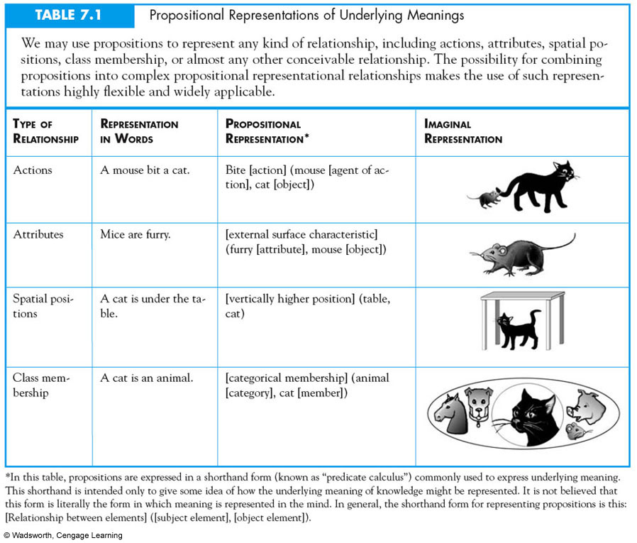
Propositional Representations
Notes:
T

Slide 13
Carmichael, Hogan, & Walters (1932)
Participants were shown simple figures with one of two verbal labels
Hourglass
Or
Table
Sun or ship’s wheel

Slide 14
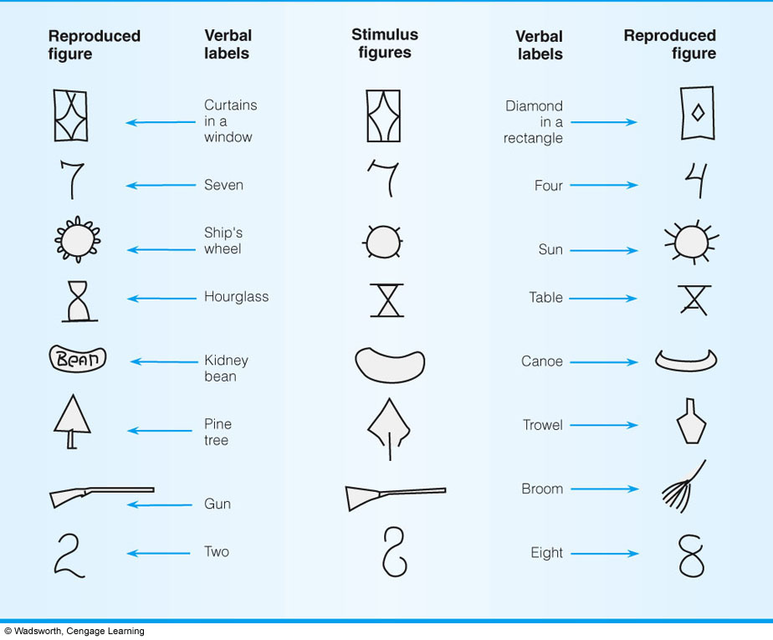
Carmichael, Hogan, & Walters (1932) Results
Notes:
Fig. 7.5: Semantic labels clearly infl uence mental images, as shown here in the differing drawings based on mental images of objects given differing
semantic (verbal) labels.

Slide 15
Carmichael, Hogan, & Walters (1932) Results
Later participants were asked to draw items seen
Participants distorted the images to fit the labels
This pattern supports the idea that images may be stored propositionally not as original analog image

Slide 16
Mental Imagery Studies Demonstrate
Active process
Response times are proportional to degree of rotation
People can rotate images in three-dimensional space as easily as two-dimensional space
Images are “Mental Sculptures”

Slide 17
Functional-Equivalency Hypothesis
First proposed by Shepard and Kosslyn
Mental images are internal representations that operate in a way that is analogous to the functioning of the perception of physical objects

Slide 18
Neuropsychological Evidence & Mental Imagery
Cohen & Kosslyn
Same brain areas are involved in perception and mental rotation
Support for functional-equivalence hypothesis

Slide 19
Kosslyn (1976)
Asked college students and fourth graders simple questions about animals
Does a cat have claws?
Does a cat have a head?
Varied the type of instructions used to answer questions
Imagery instructions
No imagery

Slide 20
Kosslyn (1976) Results
In imagery condition, questions were answered faster if the attribute was larger
In no imagery condition, questions were answered faster based on distinctiveness of characteristic for the animal, no impact of size

Slide 21
Size Judgments (Moyer, 1973)
Which is larger, moose or roach?
Which is larger, wolf or lion?
When objects are similar in size, participants imagine both objects and then compare the size of the objects in their image
Similar results when making comparisons of actual physical objects
The closer in size, the longer the reaction time

Slide 22
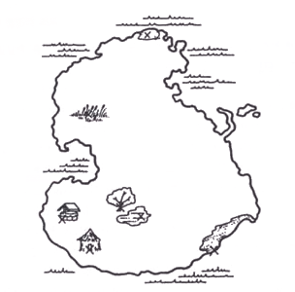
Functional-Equivalence Evidence
Kosslyn (1983)
Memorize map
Later ask to scan image
Manipulate distance between items in scan
Rock to lake
Lake to Hut
Measure reaction time

Slide 23
Kosslyn (1983) Results
Linear relationship between the distance to scan and actual reaction time of participants
Further support for functional-equivalence hypothesis
Mental images are internal representations that operate in a way that is analogous to the functioning of the perception of physical objects

Slide 24
Cognitive Maps: Historically
Tolman – Rats can learn to get out from a maze without reinforcement
von Frisch – Bees can make image map to honey and hive.
Using three types of knowledge
Landmark (special buildings)
Route-road (procedures to get to one place from another)
Survey (global map-like view)

Slide 25
Tversky (1993)
Cognitive maps more like cognitive collages
Constructionist view of creating cognitive maps
Distortions can occur when using heuristics
Notes:
Tversky, B. (1993). Cognitive Maps, Cognitive Collages, and Spatial Mental Models. In Frank, A.U. and Campari, I. (Eds/) Spatial Information Theory: A Theoretical Basis for GIS, Proceedings COSIT ’93. Lecture Notes in Computer Science, 716, pp. 14-24, Springer: Berlin.

Slide 26
Heuristics Affecting Cognitive Maps
Relative position heuristics
Use conceptual knowledge about borderline and context: Reno & San Diego
Alignment heuristic
Students view two maps of the Americas
One a correct map, and a second map which was altered (South America was moved westward with respect to North America)
A majority of students thought the altered map was the correct one
Notes:
Tversky, B. (1993). Cognitive Maps, Cognitive Collages, and Spatial Mental Models. In Frank, A.U. and Campari, I. (Eds/) Spatial Information Theory: A Theoretical Basis for GIS, Proceedings COSIT ’93. Lecture Notes in Computer Science, 716, pp. 14-24, Springer: Berlin.
Alignment heuristic depicted in previous slides is reiterated here. Tversky, B. (1981). Distortions in memory for maps. Cognitive Psychology, 13, 407- 433.

Slide 27
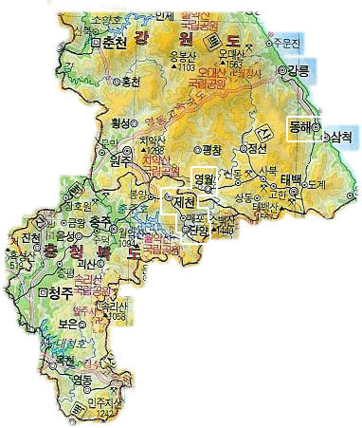
Relative position heuristics

Slide 28
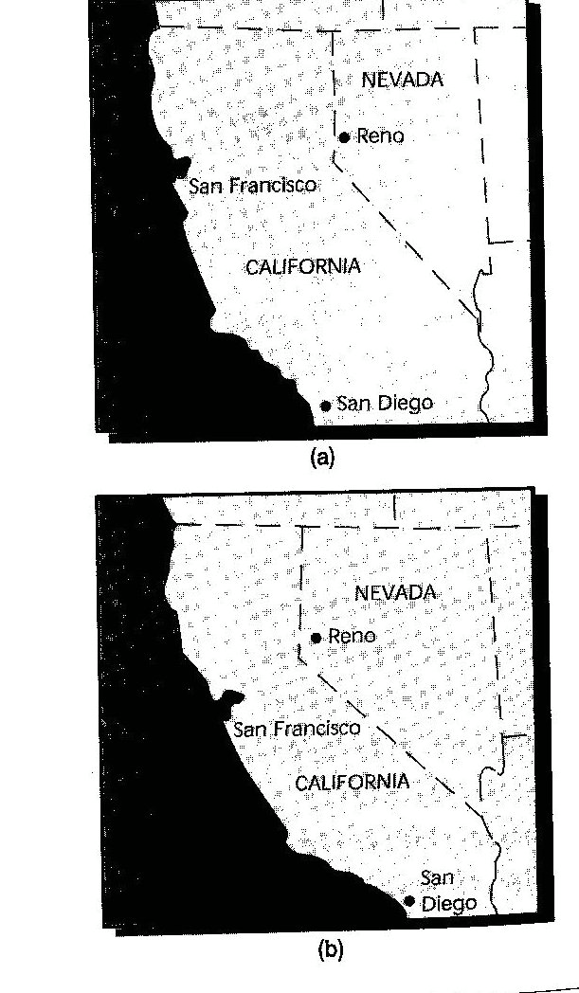

Slide 29
Heuristics Affecting Cognitive Maps
Density Heuristic
More landmarks between two points, the greater the distance we estimate
Right angle bias
Streets are drawn at 90-degree angles (even when they are not)
Symmetry heuristic
Irregular geographic boundaries are made regular (e.g., Americans straighten out the Canadian border)
Notes:
Tversky, B. (1993). Cognitive Maps, Cognitive Collages, and Spatial Mental Models. In Frank, A.U. and Campari, I. (Eds/) Spatial Information Theory: A Theoretical Basis for GIS, Proceedings COSIT ’93. Lecture Notes in Computer Science, 716, pp. 14-24, Springer: Berlin.

