Slide 1

Chapter 8: Representation and Organization of Knowledge in Memory: Concepts, Categories, Networks and Schemas

Slide 2
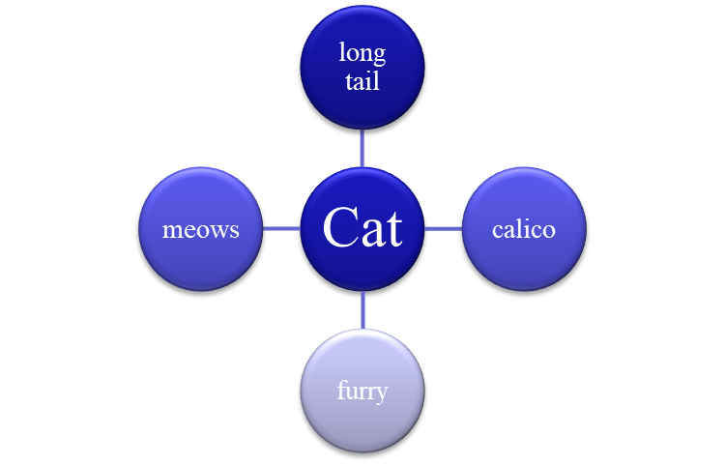
Declarative Knowledge
Stored in Concepts
  A mental representation of an item and associated knowledge and beliefs (cat, tools, furniture)

Slide 3
When Do We Use Concepts?
Create categories
Make inferences
Combine to form complex thoughts: “paper teacher?”
For communication
*Concept - Unit of symbolic knowledge
*Category - Rule used to organize concepts

Slide 4
Different Types of Concepts
Natural Concept
  Occur naturally (e.g. plants, trees, cats)
Artifact Concept
  Created by humans (e.g., hammers, computers)
Ad Hoc Concepts
  Created individually to suit a need (things you need to be happy, things you do to please parents)

Slide 5
Different Theories on Concept Organization
Defining Features (Classical View)
Prototypes
Exemplars
Semantic network models

Slide 6

Defining Features
A defining feature
  Must have this to be considered a member
  What are the defining features of a mime? -> no sound
  Defining features of triagle? -> three closed lines
Notes:
Image taken from Microsoft, no copyright needed

Slide 7
Problem with Defining Features Theory
Difficult to specify necessary features of some concepts
  What is the defining feature of a monster?
  A bachelor?
  A family?
Notes:
Problem with theory is that it is not always easy to come up with defining features.
So for monsters, if they say scary, bring up the cookie monster, or Monsters Inc.; for weddings, not all need priests, not all need churches, etc…
Images taken from Microsoft.

Slide 8
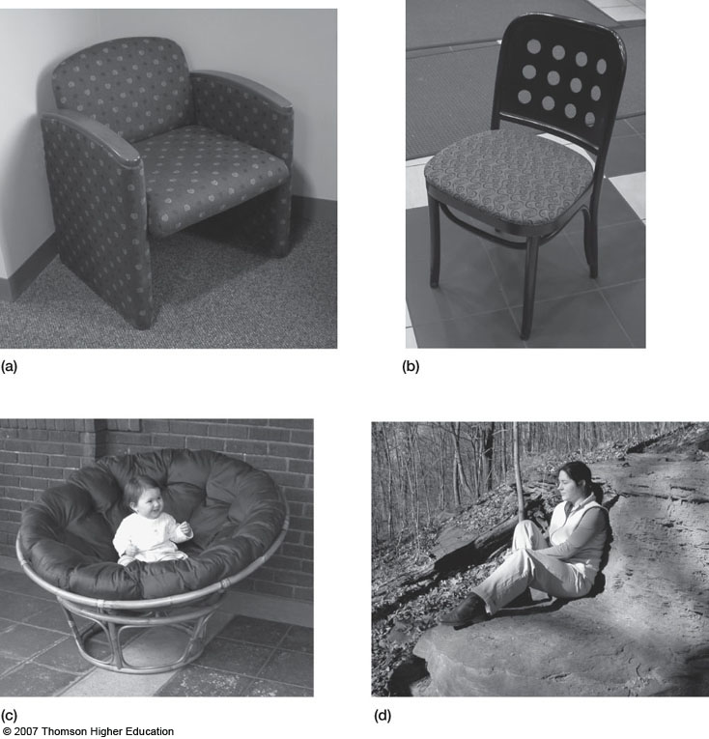

Slide 9


Additional Defining Features Problem
Typicality Effects
  Some things are better examples of a concept than others
  Robin is a more typical bird than a ostrich
Notes:
Clip art from microsoft office

Slide 10
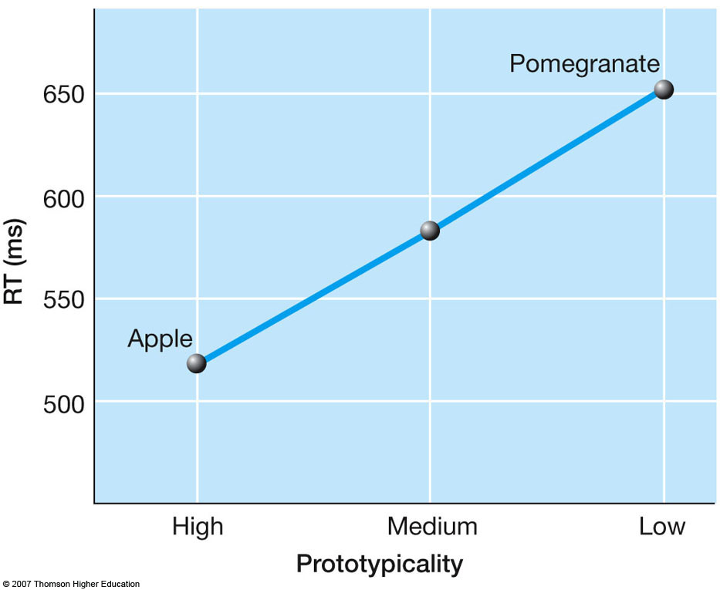

Slide 11
Prototype Theory
Abstracted representation of a category containing salient features that are true of most instances
Characteristic features which describe what members of that concept are like
  Monster prototype has these characteristics: Scary, pale, has sharp teeth, is evil, lives in odd place (coffins, closets, or graveyards)
  Vampires, Zombies, and Bogeymen all fit that prototype well,
  Can a green, grumpy, lives in a garbage can monster also fit? Yes, but less well.

Slide 12
Exemplar View
No single prototype but rather multiple examples convey idea what the concept represents
Vegetable Concept = Peas, Carrots, or Beans
Is a green pepper a vegetable?
The more similar a specific exemplar is to a known category member, the faster it will be categorized

Slide 13
Exemplar View
Similar to Prototype View
  Representation is not a definition
Different: Representation is not abstract
  Descriptions of specific examples
To categorize, compare to stored examples

Slide 14
Semantic Network Model
Nodes represent concepts in memory
Relations represented links among sets of nodes
Robin
Property
Wings

Slide 15
Collins & Quillian’s Model (1969)
Structure is hierarchical
Time to retrieve information based on number of links
Cognitive economy
  Properties stored only at highest possible level
Inheritance
  Lower-level items also share properties of higher level items

Slide 16
Collins & Quillian’s Model (1969)
Has skin
Animal
Breathes
Eats
Has fins
Has fur
Fish
swim
Dog
barks
Has gills
4 legs
Is pink
Has spots
Salmon
Is edible
Dalmatian
Skinny tail
Lays eggs upstream
Black &
white
Notes:
Explain cognitive economy, inheritance with model.

Slide 17
Support for Collins & Quillian Model
Sentence verification task
Indicate if the following sentences are true or false: Measure reaction time
  Salmon are pink.
  Animals breathe.
  A dog has four legs.
  A dalmatian has skin.
The more links traveled according to model, the longer the reaction time of truth verification

Slide 18
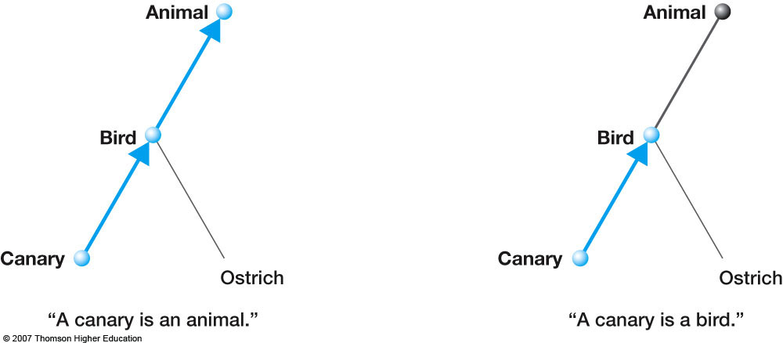
The first one is longer than the second

Slide 19
Collins & Loftus (1975) Semantic Model
Got rid of hierarchy
Got rid of cognitive economy
Allowed links to vary in length to account for typicality effects
Spreading activation
  Activation is the arousal level of a node
  Spreads down links
  Used to extract information from network

Slide 20
swims
fish
4 legs
fur
Goldie
dog
pet
Lucy
mutt
poodle

Slide 21
Basic Level
Superordinate
Largest number of
features
Used most often
Furniture, Animal
Basic Level
Chair, Bird
Bean Bag, Robin
Subordinate

Slide 22
Evidence Basic-Level is Special
People almost exclusively use basic-level names in free-naming tasks
Children learn basic-level concepts sooner than other levels
Basic-level is much more common in adult discourse than names for superordinate categories
Different cultures tend to use the same basic-level categories, at least for living things

Slide 23
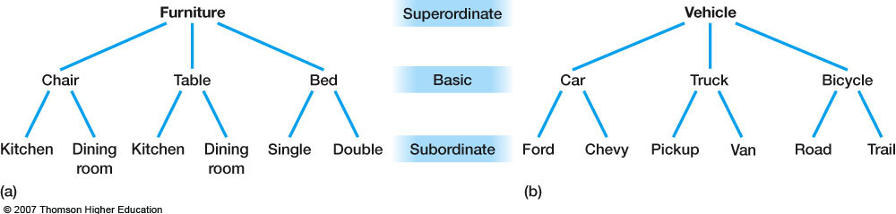
Example of Representation related with basic level
Representation general: (https://www.youtube.com/watch?v=0RSMKyRVuV8)

Slide 24
Schemas
Schemas are models of the external world based on past experience
Schemas for concepts underlying situations, events, or sequences of actions ; Ordering food in a restaurant

Slide 25
Schemas
Organize our knowledge
May include other schemas
Help in encoding, storage, and recall
Allows us to make inferences

Slide 26
Schema Research
Tuckey & Brewer (2003)
  Examined the impact of schemas on eyewitness memory
  One factor manipulated was the ambiguity or schema consistency of film crime watched
  Created a film that activated bank robbery schema
Notes:
Tuckey, M.R. & Brewer, N. (2003). The effect of schemas, stimulus ambiguity, and interview schedule, on eyewitness memory over time. Journal of Experimental Psychology: Applied, 9, 101-118.

Slide 27
Tuckey & Brewer (2003)
Participants saw one of two short films of a bank robbery
Notes:
Just click on the black square for the movie to play.
Film of bank robbery provide by Michelle Tuckey.
Tuckey, M.R. & Brewer, N. (2003). The effect of schemas, stimulus ambiguity, and interview schedule, on eyewitness memory over time. Journal of Experimental Psychology: Applied, 9, 101-118.

Slide 28
Tuckey & Brewer (2003)
Ambiguous schema film
  Enter bank
  “Hurry up”
  Possible guns
  Take money
  Leave bank
  Running escape
Schema inconsistent film
  Partner chubby
  One wore a suit
  Another wore bright clothing
  Was apologetic
  One escaped on bus
  One a female
Notes:
Tuckey, M.R. & Brewer, N. (2003). The effect of schemas, stimulus ambiguity, and interview schedule, on eyewitness memory over time. Journal of Experimental Psychology: Applied, 9, 101-118.

Slide 29
Tuckey & Brewer (2003)
Ambiguity/Schema manipulation
Half of the participants saw a film that contained ambiguous scenes like
  Criminals may have guns
  Verbal demands of the tellers were made (but no explicit demands for money)
Other half of participants viewed a film that did not have ambiguous scenes
  Another wore bright clothing
  Apologetic speech occurred in the film
Notes:
Tuckey, M.R. & Brewer, N. (2003). The effect of schemas, stimulus ambiguity, and interview schedule, on eyewitness memory over time. Journal of Experimental Psychology: Applied, 9, 101-118.

Slide 30
Tuckey & Brewer (2003)
 | Ambiguous Schema | Schema Inconsistent
Correct information | 1.5 | 2.84
Intrusions | 2.3 | 1.11
Results indicated lower recall and more schema
consistent intrusions occurring in the
ambiguous condition & correct recall for schema inconsistent Info. => The role of schema
Notes:
Results taken from Table 6, closed questionnaire items in Tuckey, M.R. & Brewer, N. (2003). The effect of schemas, stimulus ambiguity, and interview schedule,
on eyewitness memory over time. Journal of Experimental Psychology: Applied, 9, 101-118.

Slide 31
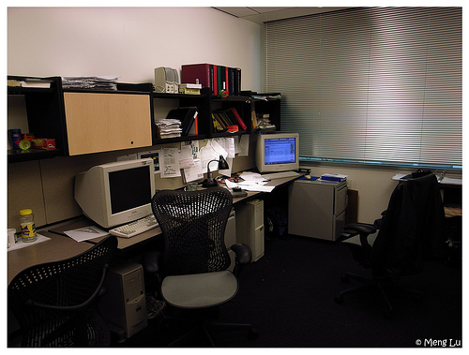
Office picture

Slide 32
Brewer and Treyens (1981)
Memory for student's office
  28 objects mentioned in recall
  19 were inferred such as “printer” (not present)
  9 people recalled books
  8 people recalled skull (which was presented)
Participants recalled expected objects or highly unexpected objects
Notes:
Office Picture; Brewer & Treyens (1981); Fig.1; p. 211.
Brewer, William F.; Treyens, James C.(1981) The role of schemata in memory for places. Cognitive Psychology, 13, 207-230.

Slide 33
Scripts
Type of schema about events
Structure captures general information about routine events
  Eating in a restaurant, attending a movie, a visiting a doctor’s office
Scripts have typical roles
  (Customers, waiter, cook), (ticket vendor, patrons, refreshments), (doctor, nurse, patient)

Slide 34
Scripts
When we hear or read about a scripted event, our knowledge of the entire script is activated
We can fill in or infer the scenes and actions that are not explicitly mentioned

Slide 35
Schank and Abelman (1977)
Visit a restaurant script
  Sit down
  Look at menu
  Order food
  Eat
  Pay
  Leave
73% of subjects produce the above actions
48% agreed on a further 9 actions
(e.g., “gave a tip”)
Notes:
Schank, R. C. & R. P. Abelson. (1977). Scripts, Plans, Goals and Understanding, Chapters 1-3:1-68, Hillsdale, NJ: Erlbaum.

