Slide 1


Alibaba Cloud Academic Empowerment Program Introduction
2020.2

Slide 2



Alibaba Cloud Academic Empowerment Program
Bring the digital intelligence knowledge to academies worldwide
Student Development
Educator
Expansion
Research
Acceleration
Student Server
On-line Clouder
Train-the-Trainer
Educator Server
* Alibaba Innovative
Research (AIR)
Encourage students dry-run innovation in free ECS
Free on-line courses and professional certification
To be accredited Alibaba Cloud Instructor
Experimental environment and Hands-on labs
* Alibaba Research
Fellowship (ARF)
Tianchi Competition
Student
Ambassador
Alibaba Cloud
MVP
Hands-on Lab
Participation AI Challenge in Tianchi platform
Award for student advocates for Alibaba Cloud
Privilege for cloud summit and developer conference
Curriculum based free labs
* Alibaba Talent
Program (ATP)

Slide 3




Student Development
Students at member institutions will receive multiple supports from Alibaba Cloud including free server , free training & certification, AI Competition opportunities and be advocates for Alibaba Cloud
Student Server
On-line Clouder
Tianchi Competition
Student Ambassador
Free ECS for students
at member institutions
1 Core CPU, 1GB RAM
10 Apsara Clouder
1 ACA Certification
Big Data Competition,
Data Lab,
Curriculum Cooperation,
and Data Talents Certification
Award for student advocates for Alibaba Cloud
Special package and certificate
Exclusive training from Alibaba Cloud experts
Invitation to local community events

Slide 4
Student Server
Students at AAEP member institutions can apply for free student ECS, no payment method is needed
Specs
1 Core CPU, 1GB RAM
40GB Ultra Disk
1MB Internet Bandwidth
Length
12 months free usage
can be renewed for another 12 months for free if its user is still a student at the member institution and pass a renewal test
Requirements
Valid identification documents issued by an AAEP members institution
No payment method is needed
Application Process *
Register an Alibaba Cloud account
Apply for Student Certification
Get AAEP Student Certification
Get a Student ECS for free
*Applications will open in April 2020

Slide 5
Student Ambassador
An award for students at AAEP member institutions who actively advocate for Alibaba Cloud
Benefits
Student Ambassador package and certificate
Technical sessions with Alibaba Cloud experts
Invitation to local Alibaba Cloud events
Chance to become Alibaba Cloud MVP after graduation
Responsibilities
Organize events and webinars for Alibaba Cloud at campus
Speak for Alibaba Cloud at campus
Share about latest products and campaigns
Collect requests about Alibaba Cloud from students
Qualifications
Current student at a AAEP member institution
Have an ACA Certification or above
Speak at and/or organize at least 2 campus events or webinars about Alibaba Cloud
Other contribution to Alibaba Cloud community
Application Process*
Submit application form and supporting documents
Candidate Evaluation by educators at member institutions and experts at Alibaba Cloud**
Final result announcement
*Applications will open in April 2020
**Candidates will be reviewed quarterly; for each member institution, up to 1 student ambassador is awarded every half year

Slide 6




Educator Expansion
Educators at member institutions will receive multiple supports from Alibaba Cloud including free training, educator server, MVP opportunities and hands-on lab
"Train the Trainer" program
Educator Server
Alibaba Cloud MVP
Hands-on Lab
Curriculum based hands-on labs
Courseware share and
dedicated session
for knowledge transfer
Free ECS for educators
2 Core CPU, 4GB Memory,
80GB ESSD
Opportunities to join
the community
of global cloud industry leaders

Slide 7
Educator Server
Educators at AAEP member institutions can apply for free Educators ECS
Specs
2 Core CPU, 4GB RAM
80GB ESSD
2MB Internet Bandwidth
Length
12 months free usage
can be renewed for another 12 months for free if the user is teaching Alibaba Cloud courses
Requirements
Current educator at a member institution who is teaching or planning to teach Alibaba Cloud courses
No payment method is needed
Application process*
Submit application to contact person at the member institution
The institution send the list of educators to Alibaba Cloud team
Alibaba Cloud distributes voucher to educators
Get a free Educator ECS with the voucher
*Applications will open in April 2020

Slide 8
Alibaba Cloud MVP
An award for thought leaders devoted to helping others understand and use Alibaba Cloud technologies
Benefits
Alibaba Cloud MVP Kit
Technical Session with Alibaba Cloud Experts
Alibaba Cloud Lab Credits*
Invitation to MVP Global Annual Summit*
Tickets to Alibaba Cloud Computing Conference*
Visit to the Alibaba Headquarters*
Responsibilities
Help students to learn Alibaba Cloud
Write tutorial, and/or blog posts about Alibaba Cloud
Speak about Alibaba Cloud at local events
Help Alibaba Cloud to improve products
Qualifications
Have opened a course related to Alibaba Cloud
Have at least one of the following contributions
Blog posts about Alibaba Cloud
Presentation at tech events
Interaction on tech forums about Alibaba Cloud
5+ accepted suggestions on Alibaba Cloud Connect
Application Process*
Submit application
Candidate review by Alibaba Cloud experts**
Final result announcement
*For MVPs with gold level and above
**Candidates will be reviewed quarterly

Slide 9
TTT：Train The Trainer process-1
Step 1
Application
Step 2
Interview
If qualified, we will choose an Alibaba Cloud product for you
Present the demo session in our regional office, we’ll have a local representative reviewing your talk
Pass ACP Exam (*1)
Sign NDA and send profile (*2), We’ll review your qualification
Please prepare the material for a 30 min demo session (*3)
If passed, move on to phase 2
(*1) compulsory exam: ACT 81001, 81002, 81005 : ACP Cloud Computing Certification, ACT 82001: ACP Big Data Certification, ACT 83001: ACP Security Solutions Certification
(*2) Plz send to cloud-training@list.alibaba-inc.com or project contact person
(*3) we will provide guidelines, but you have to prepare the materials (ex. ppt) by yourself

Slide 10
TTT : Train The Trainer process-2
Step 3
1st Demo Training
Step 4
E-learning course(optional)
Step 5
1st live Training
Review the training materials we sent thoroughly
Once ready, plz send a demo training request (*1) and schedule the time with us (*2)
Record an e-learning (*3) course and submit for review
Conduct a formal classroom training and have the trainees finish the survey (*4)
We may conduct 2~3 rounds demo until your training skill meets our criteria, then you are ready for 1st live delivery
If the survey result is >4.2 (5) score and comments are OK, You will receive an email to announce you get alibaba cloud certified instructor certificate.
(*1) The demo session will take 1~2 hours, we’ll ask you to teach in a conference meeting. Plz be well-prepared
(*2) We’ll ask you to teach 1 or 2 chapters in the 1st round. After you are qualified, we’ll move on to other chapters and then a full demo training in the final round
(*3) Plz refer to https://edu.alibabacloud.com/elearning and follow the guideline we provide。 （optional）
(*4) We’ll send a local representative to monitor the whole training. PLz do not deliver the demo training without notifying us

Slide 11



Research Acceleration
Researchers at member institutions will have opportunities to access to the world-class research resources
Alibaba Innovative Research (AIR)
Alibaba Research Fellowship (ARF)
Alibaba Talent Program (ATP)
Financial support, dataset / database management support and other necessary support for innovative research projects
Opportunities to collaborate with Alibaba scientists
Visiting research scholar opportunities at Alibaba Facilities
Datasets and relevant industrial needs in cloud computing scenarios
Financial support for visiting and relevant cost
Outstanding PhD students opportunities co-supervised by member institutions and Alibaba on research Innovation

Slide 12
Alibaba Innovative Research (AIR)
Collaborate with Alibaba to discover, define and solve valuable research problems in industry scenarios
Research Areas
Security, Internet of Things, Nature Language Processing, Human-Computer Interaction, Future Networks, Storage Technology, System Software and Operation, Database, Big Data & Data Mining, Chip Technology, BlockChain
Supports from Alibaba
Research funding
Datasets
Real-life business scenarios
Other necessary supports for innovative research projects
Qualifications
Full-time faculty member or research staff
Working at a non-profit academic, university or research institution
Application process
Applications open in every June
Select an appropriate research topic and submit proposal before deadline
Announcement of accepted applications

Slide 13
Alibaba Research Fellowship (ARF)
Providing research opportunities to worldwide visiting scholars in Alibaba real scenarios for 3 ~12 months
Supports from Alibaba
Alibaba's eco-economic resources
Abundant commercial application scenarios
Research infrastructure and huge amount of data
Qualifications
2 years working experience with PhD degree
Currently employed at the level of assistant professor or above at a university or research institution
Excellent research capability and solid hands-on capability

Slide 14
How to Apply and Land?
Institution Membership Application
Landing
AAEP Student Server Application
Program T&C
Review
Sign up and
Seal
AAEP Student Ambassador Application
Or
MOU
AAEP Educator Server Application
Alibaba Cloud MVP Application
Please visit AAEP site to find more information:
https://edu.alibabacloud.com/campus/index
TTT
Process
Research Cooperation Project Setup

Slide 15
AAEP Reference Cases

Slide 16
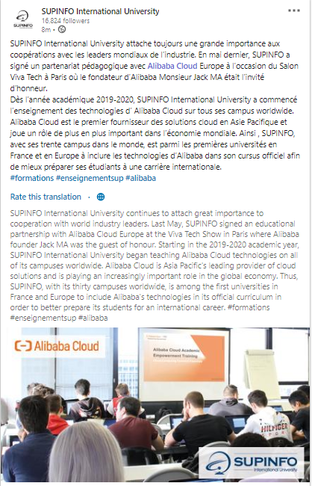
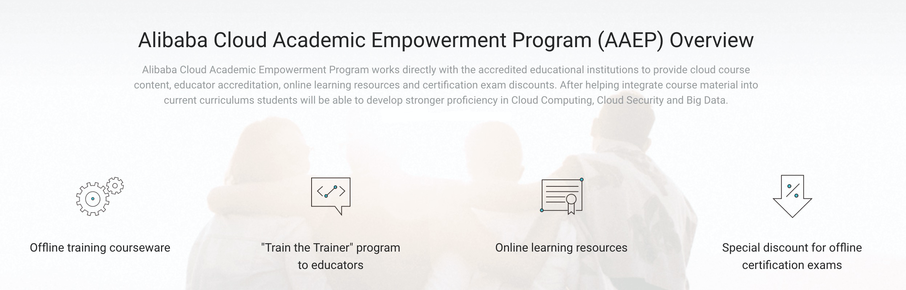
University Cooperation:
Top IT University in Europe -- SUPINFO
What is AAEP?
What did we cooperate with SUPINFO?
Integrated Alibaba Cloud course into SUPINFO’s curriculum (2 academic credits)
Trained 11 trainers
Will deliver Alibaba Cloud training courses for more than 380 students.
Course will be delivered in 19 different campuses, 4 countries and 4 continents

Slide 17



