Slide 1
Analysis of Schools’ neighborhood IN TORONTO and their influence on student’s education
SUBIN AUGUSTINE
November 2019

Slide 2
Choosing a Public School
Key factors:
Rating of the school and the quality of the education it provides
Neighborhood where the school is located?
Parents may give due consideration to:
The kind of venues located in the vicinity of the school?
Could more cafés or a movie theatre be a distraction or having more parks and libraries a positive influence?

Slide 3
The Project Aim
Evaluate and ascertain whether the venues surrounding the school have an effect on the student’s educational development.
For representation of the quality of education in a school, the percentage of students passing the Ontario Secondary School Literacy Test in the first attempt is considered. The Ontario Secondary School Literacy Test (OSSLT) measures whether students are meeting the minimum standard for literacy across all subjects up to the end of Grade 9.
The project considers a sample set of 104 schools in Toronto, limited due to data unavailability.

Slide 4
Data Requirements
Toronto’s location information: List of boroughs, neighbourhoods and postcodes were scraped from Wikipedia.
Schools information and Test results: Information used includes School’s geolocation, postcodes and percentage of students that passed the Grade10 OSSLT on their first attempt for each school. Downloaded from Ontario’s data catalogue
Venues around a particular location: Foursquare API used to extract the list of all venues present within 500mts distance from the school

Slide 5
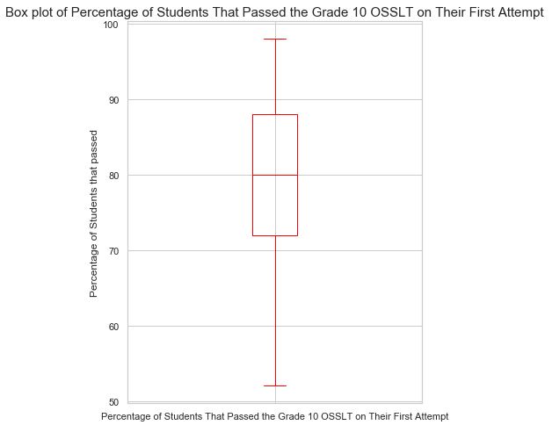
Distribution of Pass Percentages of Schools
Distribution set of 104 schools in Toronto.

Slide 6
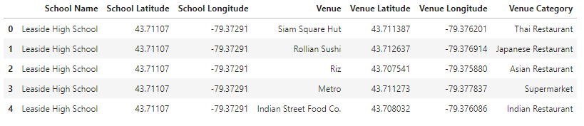
Data from School Database and Foursquare API
All venues within a radius of 500m
Number of venues downloaded limited to 100 per school

Slide 7
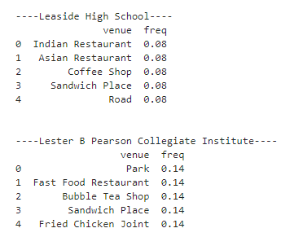
Frequency of Occurrence of Each Venue
Factor used to cluster each school - Similarity in the occurrence of each venue.

Slide 8
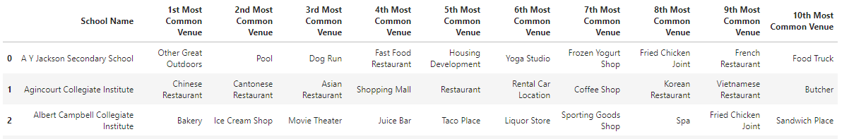
Rearranging per Most Common Venues

Slide 9
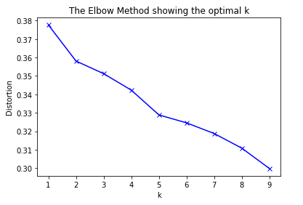
K-means Clustering
Unsupervised machine learning algorithm k-means to cluster each school based on their surrounding venues.
Elbow clustering shows K = 5 as optimal.

Slide 10
Distinguishing Factors in Each Cluster
Cluster 0: Mostly coffee shops, restaurants and food outlets.
Cluster 1: Pool is common factor
Cluster 2: Near bus lines, same locality.
Cluster 3: Pubs were the most common venue
Cluster 4: Coffee shops, furniture/home store and grocery store. Coffee shops surrounding schools in cluster 4 are significantly lower than those in Cluster 0.

Slide 11
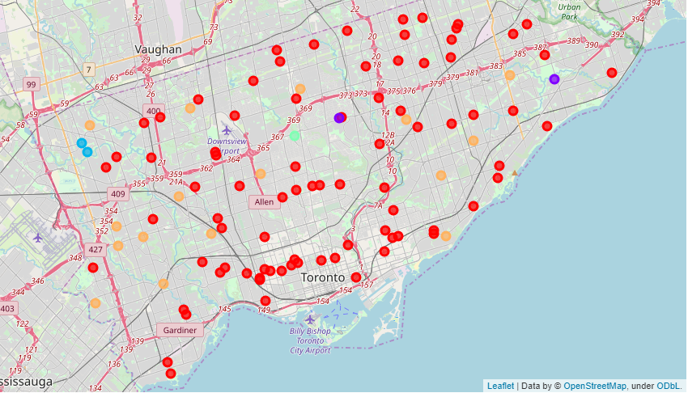
Map of Toronto - Schools Colour Coded as per Cluster

Slide 12
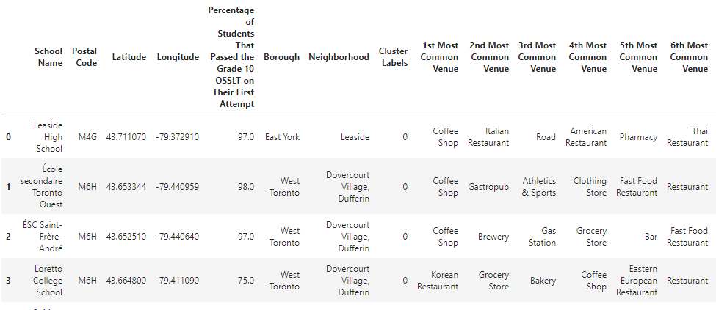
Consolidated Data with Cluster Number
Information derived after clustering, and appending pass percentages

Slide 13
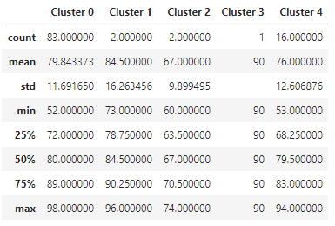
Result
Table summarizes analysis on the pass percentages of schools within each of the 5 clusters.
No significant difference in pass percentages between cluster
However, significant variations in pass percentage of schools located in same cluster, i.e., identical neighborhood.

Slide 14
Conclusion and Future Direction
Neighborhood of a school does not have a significant influence over the students of a school.
Further study should be conducted to understand the root cause of such huge variation in the pass percentages of the school with a more comprehensive set of data.
Data set can be expanded with more information, such as, the income status of the student’s households. Could also be further processed, consolidating venues into fewer categories
Such a study may aid in improving the quality of education such that all students have access to high quality education irrespective of the schools that they attend.

