Slide 1
What are components?
Components are data which will contain scene description of scene publish, it is scene breakup and this data creation based on downstream requirements, some examples like *.ma, *.abc, custom data format, ect.
Each task has its own components, Tool will help to extract the components from the maya. Those tools I term as a Bake Tool such as Model Bake, Lookdev Bake, Puppet Bake, etc. Not recommend manually saving the data from respective software because while creating components there are some custom modifications that happen. Such as dependency links, custom properties are updated with these components.
Advantages are ultimately users not wanting to think more about the technical things such as naming convention, searching his/her file, dependency files. Tools will bring all files and user can concentrate on its on creative works.

Slide 2
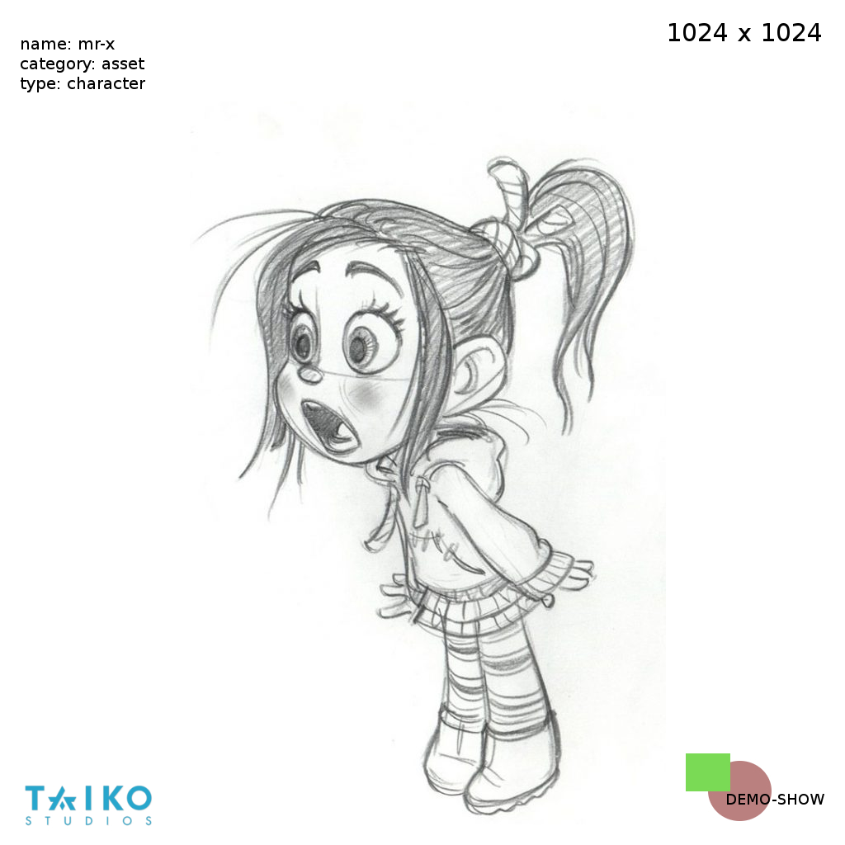
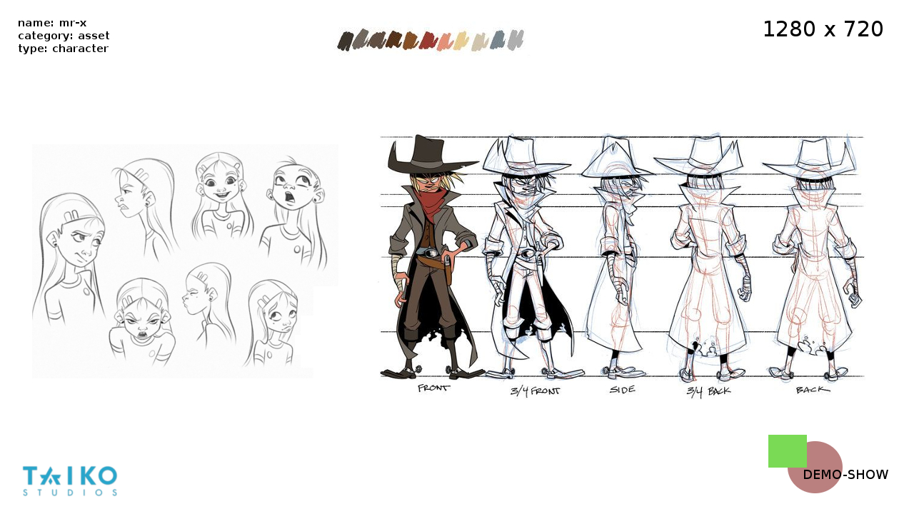
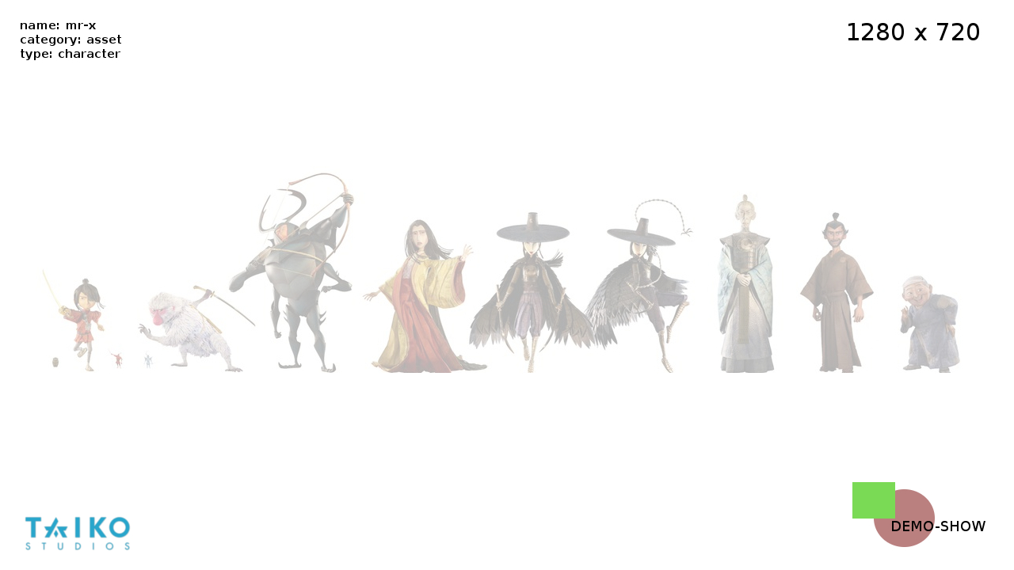
Art components
Look | ['.jpg', '.png']
Turnaround | ['.jpg', '.png']
Lineup | ['.jpg', '.png']

Slide 3
Model components
Look | ['.jpg', '.png']
MOV | ['.mov', '.avi']
Maya-File | ['.ma', '.mb']
Maya-UV | ['.json']

Slide 4
Lookdev components
Look | ['.jpg', '.png']
MOV | ['.mov', '.avi']
Maya-File | ['.ma']
Maya-Shader | ['.ma']
Shader | ['.json']
Source-Images | ['.ma', '.mb']

Slide 5
Groom components
Look | ['.jpg', '.png']
MOV | ['.mov', '.avi']
Maya-File | ['.ma']
Maya-Shader | ['.ma']
Shader | ['.json']
Source-Images | ['.ma', '.mb']

Slide 6
Puppet (Rig) components
Look | ['.jpg', '.png']
MOV | ['.mov', '.avi']
Default-Pose | ['.json']
Maya-File | ['.ma']
Source-Images | ['.ma', '.mb']

Slide 7
Layout components
Look | ['.jpg', '.png']
Preview | ['.mov', '.avi']
Casting-Sheet | ['.json']
Maya-File | ['.ma']
Anim | ['.json']
Cache | ['.cache']

Slide 8
Animation components
Look | ['.jpg', '.png']
Preview | ['.mov', '.avi']
Casting-Sheet | ['.json']
Maya-File | ['.ma']
Cache | ['.abc']

Slide 9
Rendering components
Look | ['.jpg', '.png']
Casting-Sheet | ['.json']
Maya-File | ['.ma']

