Slide 1
Pipeline Proposal
  Introduction
  User Discipline
  Project
  Category
  Step or Task
  Versions
  Version Components
  Configure the Pipeline Package and Project
  Let’s start the works
  Work flow
  Detailed Work flow with specific step
  Folder Structure
  Versioning
  Step Published Components (Data Types)
  Core Pipeline Production Tools
  Pipeline Frameworks and Packages (Repository)

Slide 2
1. Introduction
This pipeline setup is very simple, but totally different from traditional pipeline setup. Because our studio work happens in different manner, ie different peoples are working from different places. So maintain consistency of workfollow is very hard. The pipeline tool will take care of consistency of the project. All kind of data transfer from one department to another via Pipeline Tools.
The most important part of it to establish well-defined guidelines, practices, and disciplines, each of our user should well aware of our pipeline tool.
Here, we can look at the Linear workflow. What I mean by linear? Data travel with a specific hierarchy structure.
Task 1
Decision
Start
Process
Result
End
Task 2
Pipeline core module has been developed in Python-3.7 64Bit, this module only work in Windows 10 64Bit or upper version.

Slide 3
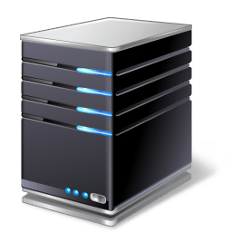
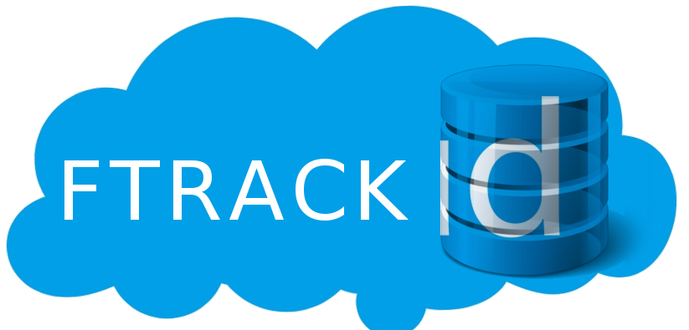



2. Studio Resources
Here, our resources are local storage with different locations and one common ftrack storage. Our Pipeline tools will help to maintain this data structure on all local storage. And this should be an automation process.
Ftrack (Cloud) is the Global storage unit, this is our final valid data storage unit. And this Global storage unit can sync with each location storage with the help of Taiko Browser Tool. For example, Once local workspace submit or publish happened, first it will store local storage and that new data will upload to ftrack storage. If this process happened that can download to any other local storage. The result is identically the same in all local storage.
Workspace is the local user PC. For each location workspace, pipeline tools maintain the same discipline, to avoid complexity.
Storage is the local location storage unit. All project data and pipeline setups are set up on the local location storage. pipeline tools maintain the same discipline, to avoid complexity. This also same as Workspace, but production need to maintain the submit and publish. Please avoid invalid data in the local storage unit and maintain like a final project data.
Look at the below flowchart to get more details,
Submit
Publish

Slide 4
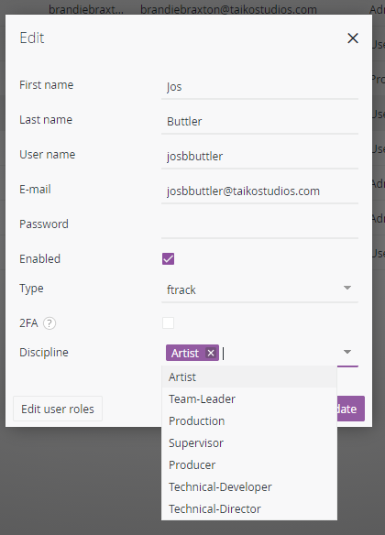
2. User Discipline
We need to create user account for all user, this is very important because we need track user task. Pipeline tool behave based on the user discipline. We have three groups such as guest-user, standard-user and super-user.
and seven user types. The user privileges has to decided based on under the what user group.
Gust-User - start and submit his tasks
Super-User - Approve, decline and publish the tasks
Standard-User – start, submit, approve, decline and publish his and others tasks
Type | Group
1. Artist | guest-user
2. Team-Leader | standard-user
3. Production | super-user
4. Supervisor | super-user
5. Producer | super-user
6. Technical-Developer | guest-user
7. Technical-Director | super-user
In the Ftrack, there is a new attribute called discipline, this is the custom attribute. While create the user, update the value of discipline attribute, this should be mandatory, look at the image

Slide 5
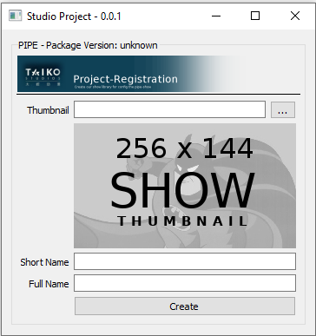
3. Project
While create project in ftrack three attributes are mandatory, such as name, full name, and thumbnail.
For example
name = “MSH”
full name = “my super hero”
thumbnail = “your local directory, format should be *.png or *.jpg and resolution 256x144”
Pipeline tool will help to generate the project. But super-user have only the permission to create the project.

Slide 6
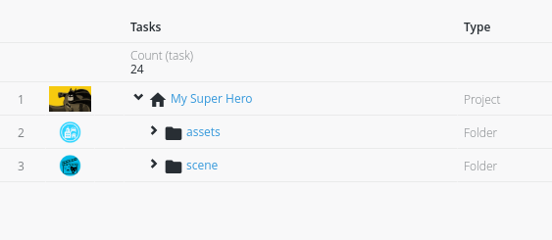
4. Category
Under the project we are divided in to two category, such as Assets and Scene, so the term category means assets and scene. Once you create the project categories are generate automatically.

Slide 7
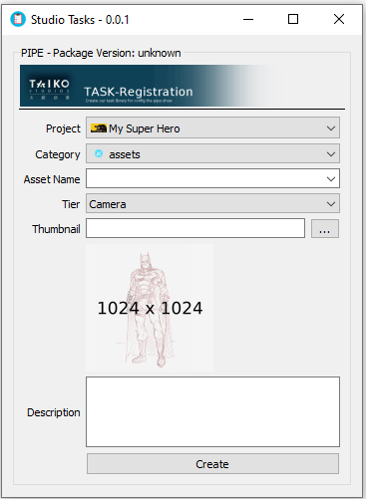
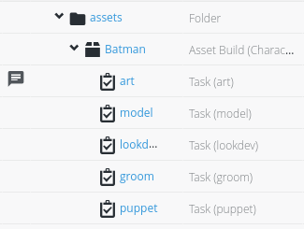
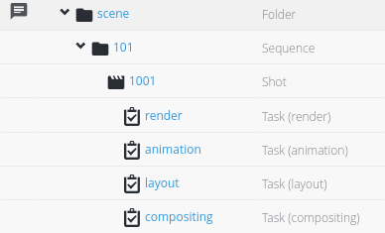
5. Step or Task
Under the category we are divided in to different steps, all steps are the tasks. Our pipeline should support to add more steps. Create tasks using use pipe tool mandatory, because all dependency task will generate automatically. Once you
create task then you can go to ftrack assign the task to respective users, also you can do your on changes
All the task assignment has to done via ftrack. There is no tool for task assignment.
Art | Assets
Model | Assets
Lookdev | Assets
Groom | Assets
Puppet | Assets
Layout | Scene
Animation | Scene
Render | Scene
Compositing | Scene

Slide 8
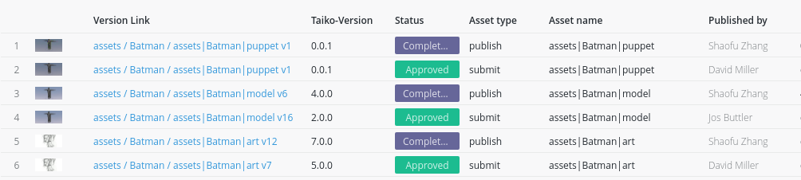
6. Versions
We have two kind of versions such as submit and publish, the term we can call kind. And we are following Semantic Versioning, ie version number MAJOR.MINOR.PATCH, increment. More details https://semver.org/.
Submit and publish are its on versions, for example submitted version 0.2.0 is approved so publish version should be 0.0.1 or increment of publish versions
1. Submit - has to done by task assignee. Once task done he/she can submit the task.
2. Publish - has to done by task assigner (super-user or standard-user).

Slide 9
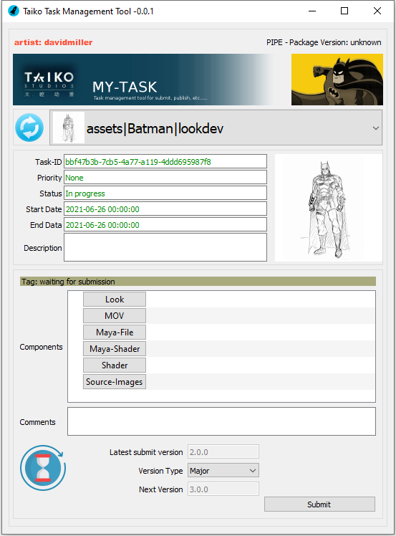
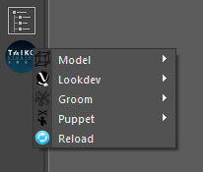
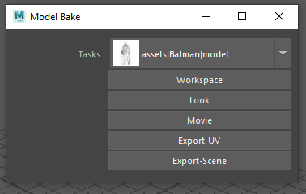
7. Version Components
Versions contains components(each task has its on components). Tool will help to extract the components from the maya. That tools I term as a Bake such as Model Bake, Lookdev Bake, Puppet Bake, etc. Once extract the components, use My Task tool to submit the components with in increment version

Slide 10
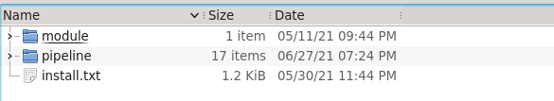
8. Configure the Pipeline Package and Project
> In-house, no need to wary about configuration of the pipeline package and project. Lets start from Start the Project page
> FreeLancer or any one work from his personal computer, just follow the below instruction.
    Download the Pipeline Package from respective link, we will send the package link
    Extract the contents of the package to your local directory, user can choose the directory, I recommend My-Document directory is the best practices.
    Two folder such as module and pipeline.
    Open the TAIKO.bat file inside the package and edit the PROJECT-DIRNAME (line 20) to your local directory. And edit the USER-TYPE= to freelancer
      for example
      set PROJECT-DIRNAME=your project directory
      set PROJECT-DIRNAME=D:/taiko-studio/projects
      set PROJECT-DIRNAME=D:/test/works/projects
      please not does not add your project folder name
      set USER-TYPE=freelancer

Slide 11
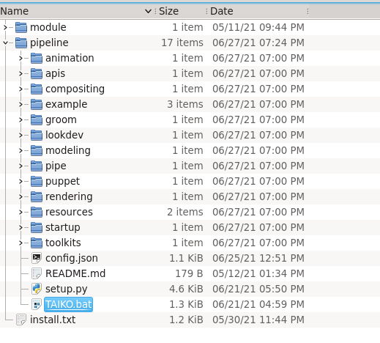
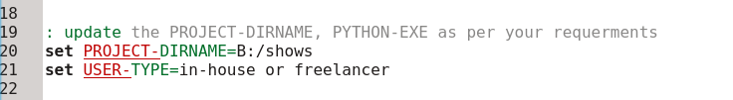
4. Open the Command Promt drag and drop the TAIKO.bat and press enter or directly double click on the TAIKO.bat file

Slide 12
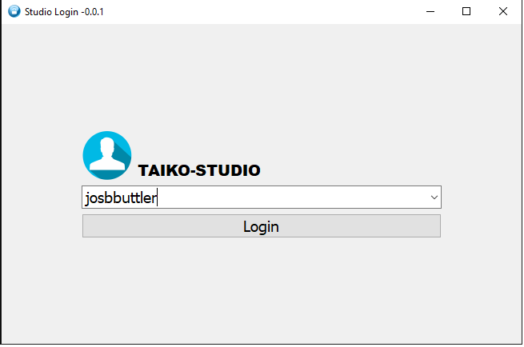
9. Let’s start the works
> Step 1, login with your ftrack user name

Slide 13
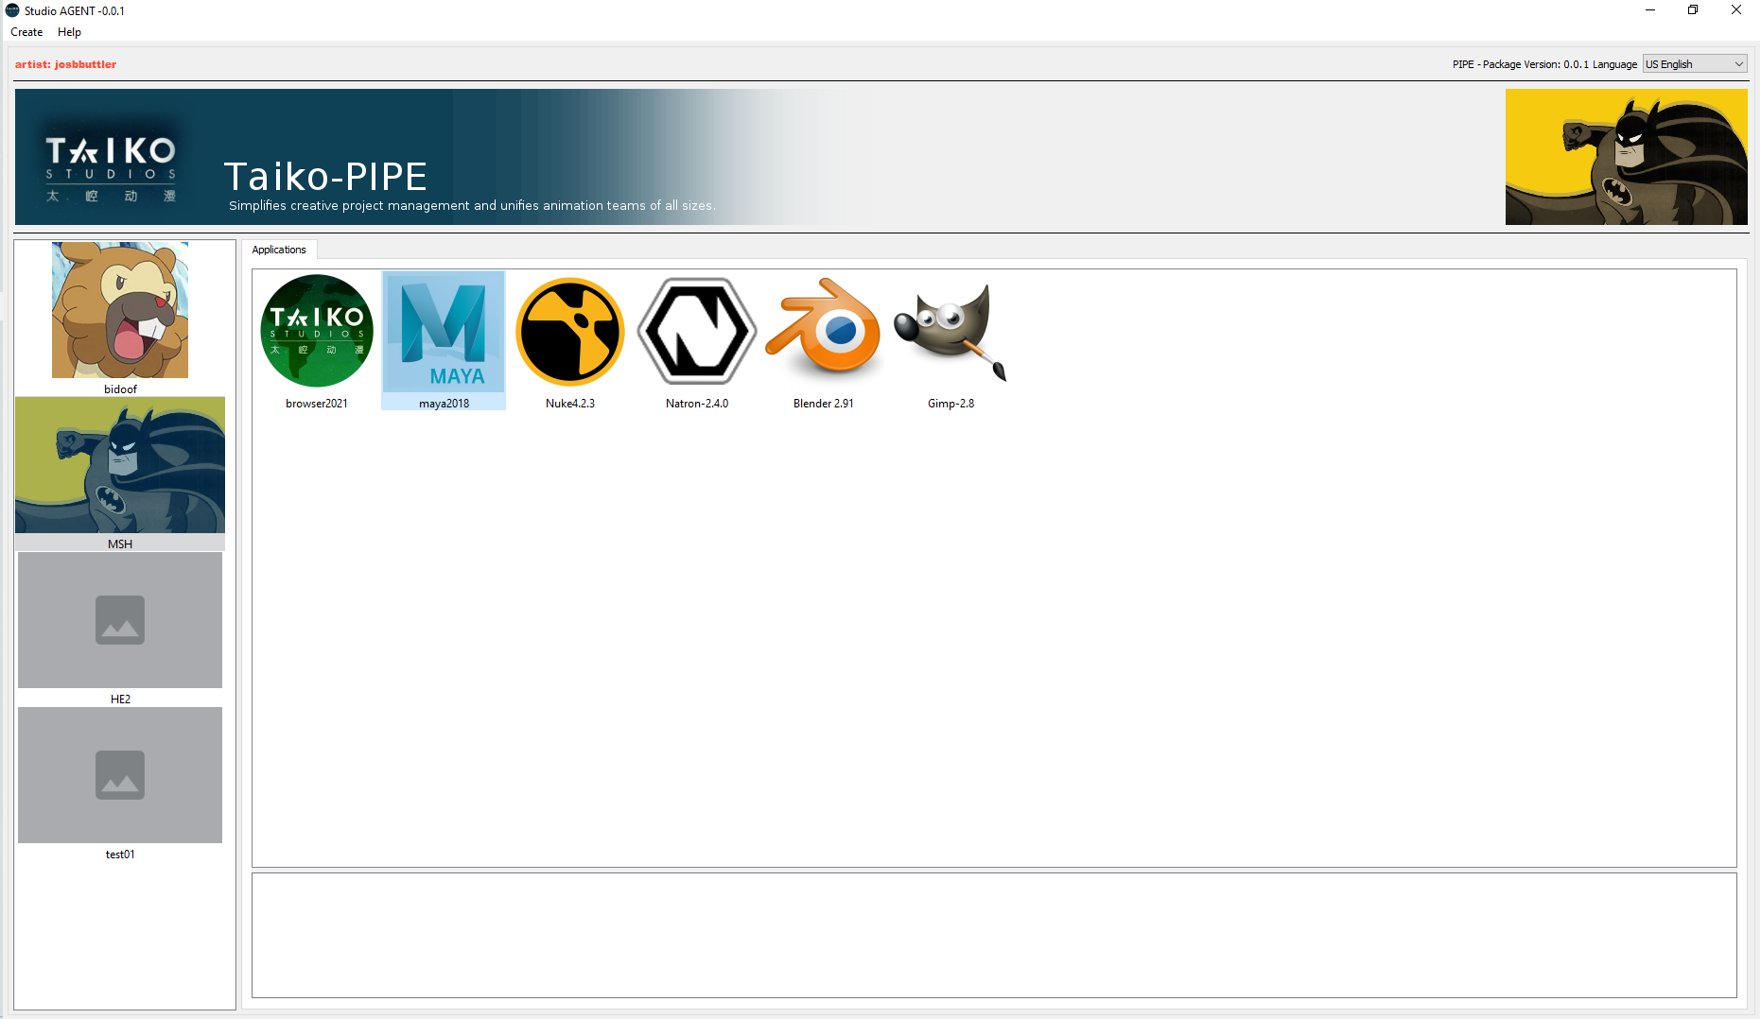
> Step 2, After login you will get the studio agent tool, this is core tool for all user. All user need to use this tool to launch all application like maya, nuke, etc.

Slide 14
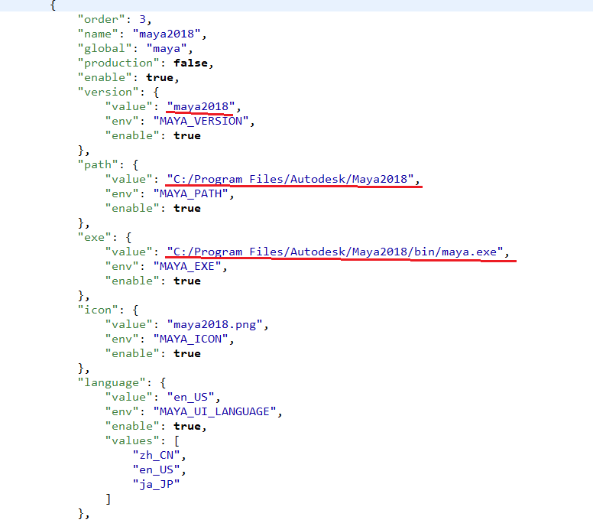
How to configure Studio Agent Tool ?
pipeline\pipe\0.0.1\pipe\resources\inputs\applications.json, update the path of your software, in below maya is the one of the example, if you want to add new software, just duplicate the maya and rename to as per your requirements

Slide 15
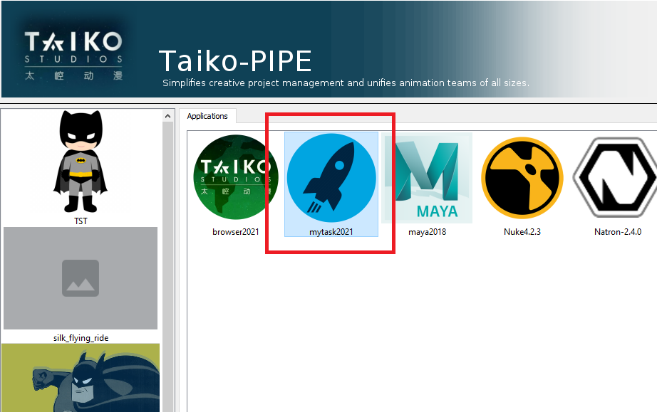
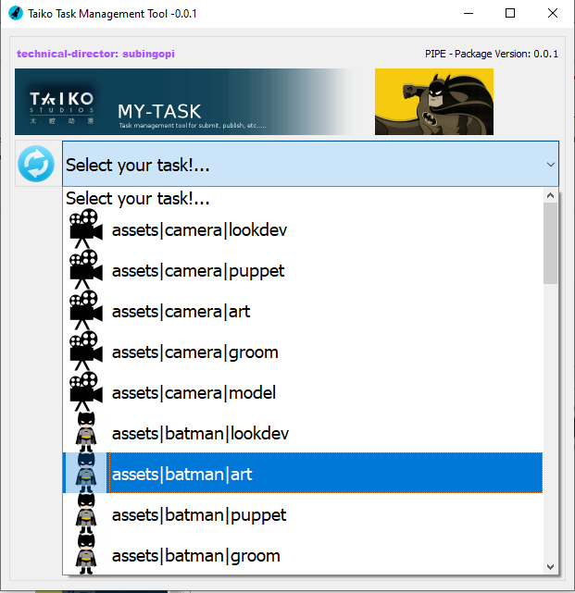
> Step 3, Select your project from right column, double click on the maya icon from second column
> Step 4, Select your project from right column, double click on the mytask2021. My-Task Tool will drive your tasks. And user can see his/her tasks, to load takes time, please wait until open the tool, more details, just look at the Command Prompt console.

Slide 16
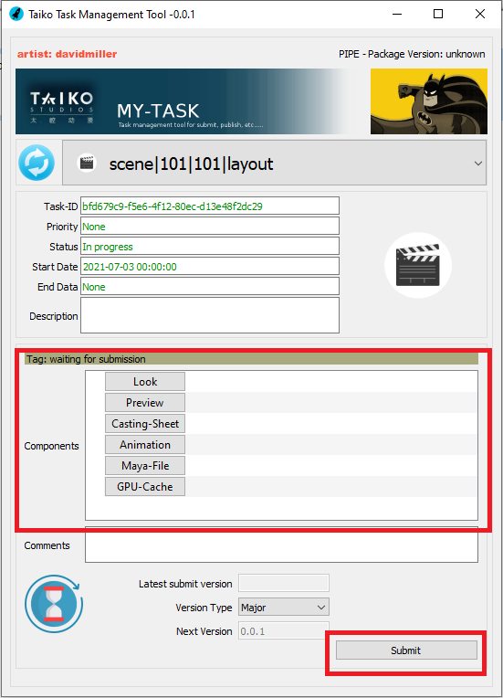
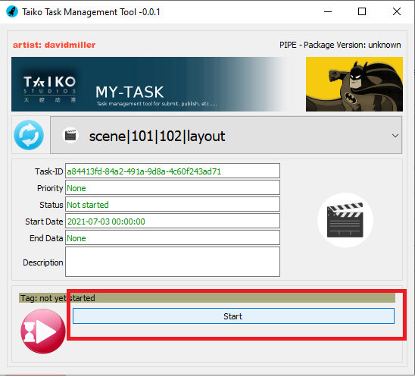
> Step 4, (This is normal user level) Select your task and click on start button, once its done submit his/her task. (Submit components use the bake tools from maya.)

Slide 17
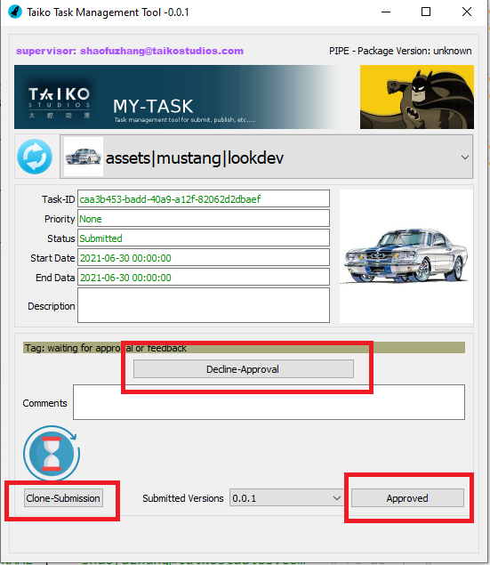
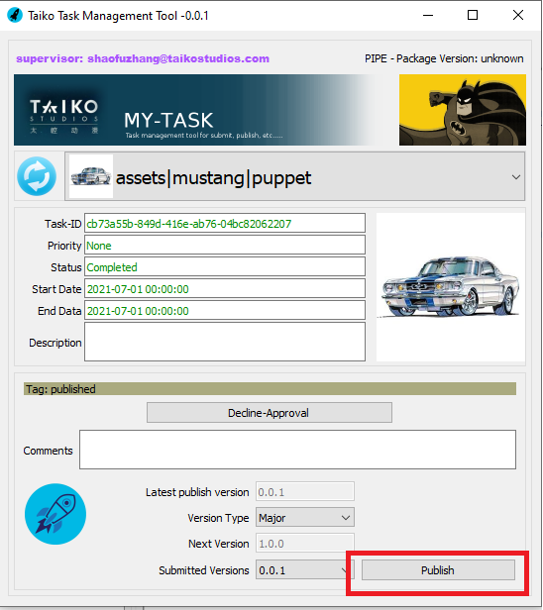
> Step 5, This level only for super users, they can approve or decline the task. Super user can see all tasks.
Click on Clone-Submission button to download the user submission, and super user can review the task
> Step 6, Then click on the publish button

Slide 18
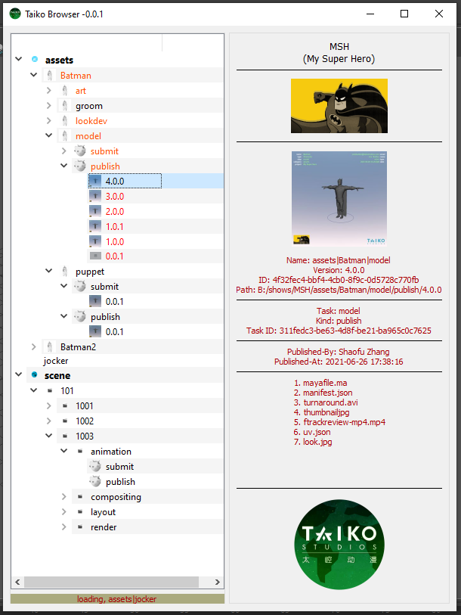
> Step 7, Taiko Browser, this the task browser tool, all user can use this tool to get the status and download the task and its components.
Use this tool to generate the assets and shots. This will make and maintain the well folder structure. Even if you removed any components, user can re-generate all elements in our show.
User can access this tool from maya as well.
To open, import and reference the asset and scene. Use only this tool, then only pipeline can track all scene level submission and publish. In Asset level if you want to download the dependency, use this tool to download the respective dependency step or task, by default once user click on start button from My-Task automatically download the dependency steps or tasks.

Slide 19
10. Work flow
Project Workflow: this is our data transfer flow. Just go with the below workflow.
Concept
Model + UV
LookDev
Puppet
Groom
0.5K
Groom FX
4K
CFX
Layout
Animation
EFX
Cache
Render presets
Render
Composting
Output

Slide 20
11. Detailed Work flow with specific step
Here look at the below flow chart, data is coming from upstream step publish, and once it comes to the current step user need to submit his/her file, If it is not approved its go back to the user with messages, and he/she fix the bug and need to submit again, then is it approved, it goes to publish process. And publish data has to block (no modification). If you want to edit the existing publish, he/she can publish as a next version.
The advantage of submitting, we can avoid multiple publish processes. Submitted data are temporary files, once it's approved we can delete it. Either each correction we need to make each publish. I recommend this publish data should be valid and should pass to downstream steps. For the review proposes, we can use submit process instead of publishing. This one of the best practices to optimize our storage.
Upstream Publish
Data
Step
Submit
Decision
No
Yes
Publish
Data
Downstream Step

Slide 21
12. Folder Structure
Is it never matter what kind of folder structure we are following, because all valid data we handle through the pipeline tools, but pretty and standard folder structures avoid much confusion and easy to find the data. I propose the below folder structure. This is the simple, efficient, and standard folder structure. The editorials I am skipping because I would like to discuss more with supervisor.
├── animation
│ └── sequence_101
│ └── shot_101
│ ├── publish
│ │ ├── 0.0.1
│ │ └── 0.0.2
│ ├── submit
│ │ ├── 0.0.1
│ │ └── 1.0.0
│ └── works
├── composting
│ └── sequence_101
│ └── shot_101
│ ├── publish
│ │ └── 0.0.1
│ ├── submit
│ │ ├── 0.0.1
│ │ └── 1.0.0
│ └── works
├── layout
│ └── sequence_101
│ └── shot_101
│ ├── publish
│ │ └── 0.0.2
│ ├── submit
│ │ └── 1.0.0
│ └── works
└── render
└── sequence_101
└── shot_101
├── publish
│ └── 0.0.1
├── submit
│ ├── 0.0.1
│ ├── 0.0.2
│ └── 1.0.0
└── works
└── show1
├── editorials
├── assets
└── scene
├── layout
├── animation
├── render
└── composting
│ └── boy
│ ├── model
│ │ ├── publish
│ │ │ ├── 0.0.1
│ │ │ └── 0.0.2
│ │ ├── submit
│ │ │ ├── 0.0.1
│ │ │ ├── 0.0.2
│ │ │ └── 1.0.0
│ │ └── works
│ ├── lookdev
│ │ ├── publish
│ │ │ ├── 0.0.1
│ │ ├── submit
│ │ │ └── 0.0.1
│ │ └── works
│ └── puppet
│ ├── publish
│ │ ├── 0.0.1
│ ├── submit
│ │ └── 0.0.1
│ └── works

Slide 22
13. Versioning
For versions, I prefer Semantic Versioning.
  MAJOR - when you make incompatible changes.
  MINOR - when you add functionality in a backward-compatible manner
  PATCH - when you make backward-compatible bug fixes.
More details https://semver.org/
Here variants and versions we can include with semantic versions, Instead of v1, v2, v3, this is very efficient and visually understand what kind of changes happened, is it major or minor or patch.
And any kind of versions and dependency conflict happened our tool will find out. Most probably conflict never happened because publish and build process done by Pipeline tools. And we have a version management tool as well.
Look at the below flowchart to get more ideas.

Slide 23



Model Versions
Lookdev Versions
Default
Green
Red
Default
Green
Red
0.0.1
0.0.1
0.0.2
0.1.0
0.1.0
1.0.0
1.0.0
2.0.0
1.0.1
2.0.1
1.0.2
1.1.0
2.0.0
2.1.0
3.0.0
4.0.0
4.1.0
5.0.0
Puppet Versions
5.0.1
Default
Green
Red
Here Asset Latest version and its dependency
 | Model | Lookdev | Puppet
Boy | 5.0.1 | 2.0.1 | 2.0.1
Default | 3.0.0 | 0.1.0 | 0.0.2
Green | 4.1.0 | 1.0.0 | 1.0.0
Red | 5.0.1 | 2.0.1 | 2.0.1
0.0.1
0.0.2
1.0.0
2.0.0
2.0.1

Slide 24
Layout
Sequence 101 – Shot 101
Sequence 101 – Shot 102
Animation
Sequence 101 – Shot 101
Sequence 101 – Shot 102
Render
Sequence 101 – Shot 101
Sequence 101 – Shot 102
0.0.1
0.0.1
0.0.1
0.0.2
0.0.2
0.2.0
0.1.0
1.0.0
0.3.0
0.0.1
0.0.1
0.0.1
0.1.0
0.0.2
1.0.0
Here Shot Latest version and its dependency
Composting
Sequence 101 – Shot 101
Sequence 101 – Shot 102
 | Layout | Animation | Render | Composting
101/101 | 0.1.0 | 1.0.0 | 0.3.0 | 0.1.0
101/102 | 0.1.0 | 0.0.2 | 1.0.0 | 0.1.0
0.0.1
0.0.2
0.1.0
0.0.1
0.1.0

Slide 25
14. Step Published Data Types
Here, the output data might be change as per our requirement, I add some basic output data for the respective steps.
Steps | Outputs
Model + UV | Model Scene, UV Data, Alembic Cache, Scene Description
LookDev | Lookdev Scene, 4k and 0.5k Source Images, Render Presets, Scene Description
Puppet | Puppet Scene, Scene Description
Groom | Groom Scene, Scene Description
Layout | Layout Scene, Animation Data, Asset Scene Description, Movie, Scene Description
Animation | Animation Scene, Animation Data, Asset Scene Description, Animation Cache, Movie, Scene Description
Render | Render Scene, Asset Scene Description, Render outputs, Movie, Scene Description
Groom FX | Groom Scene, Groom Cache, Movie, Scene Description
FX | EFX Scene, EFX Cache, Movie, Scene Description
Composting | Composting Scene, Output movie, Scene Description

Slide 26
15. Core Pipeline Production Tools
  Studio Agent
    To configure and launch applications and software.
  My-Task
    Task Management tool.
  Taiko Browser
    Get the status and download the task and its components.
  Maya Steps Bake Tools
    Extract the components from the maya for submit the step tasks.
11. Pipeline Resources
  Python 3.7.8 (tags/v3.7.8:4b47a5b6ba, Jun 28 2020, 08:53:46) [MSC v.1916 64 bit (AMD64)] on win32
  Python 2.7.18 (v2.7.18:8d21aa21f2, Apr 20 2020, 13:25:05) [MSC v.1500 64 bit (AMD64)] on win32
  PySide
  FTrack API
  PILLOW
  opencv-python 4.5.2.54

Slide 27
16. Pipeline Frameworks and Packages (Repository)
To address inconsistencies and duplicated development efforts, in our case to develop a production pipeline. Each framework has its classes contained by packages. All frameworks are each repository and frameworks are no dependent on any other repositories. Frameworks are standalone packages. And all repositories are dependent on the framework but and no dependency on other repositories.
which you are going to see the examples
  animation
  apis
  compositing
  groom
  lookdev
  modeling
  pipe
  puppet
  rendering
  resources
  startup
  toolkits

