Slide 1

Performance Evaluation of Distributed Systems
Khojema Vora & Subin Joseph

Slide 2
Agenda
Introduction
Lossless Compression Algorithms
System Specifications
Maximum Compression Ratio
Chunk Size Vs. Compression Ratio & Profiling
Experimental Setup
Stream Compression System Design
Performance Evaluation
Conclusion
Khojema & Subin – Performance Evaluation of Distributed Systems
<number>/25

Slide 3
Introduction
Main Goal: To reduce the network load without loss of packets
Solution: Lossless Compression
  Two kinds of lossless compression
  Block Compression: All the input data is compressed or decompressed by one call to the compression or decompression function.
  Stream Compression: Compression or decompression function is called repeatedly to compress or decompress data from a source buffer to a destination buffer
  Here implementation is based on Stream compression
Challenges:
  Air traffic data should be delivered in real-time.
  Compression method is limited by CPU processing time
Find a reasonable trade-off between compression ratio and CPU processing time.
Khojema & Subin – Performance Evaluation of Distributed Systems
<number>/25

Slide 4
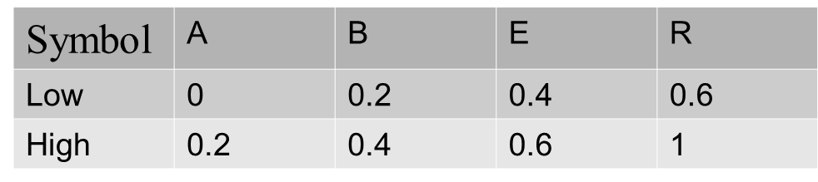
Lossless Compression Algorithms
Arithmetic coding
The Idea: Encodes data (the data string) by creating a code string which represents a fractional value on the number line between 0 and 1.
Create an interval [low, high) for each symbol, based on cumulative probabilities.
Scale the remaining intervals:
  New Low = Current Low + Sumn-1(p)*(H–L)
  New High = Current High + Sumn(p)*(H –L)
Consider the string ARBER
Khojema & Subin – Performance Evaluation of Distributed Systems
<number>/25

Slide 5
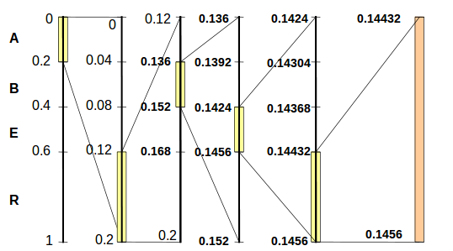
Arithmetic Coding
First take symbol A and subdivide the interval A(0-0.2) in the same as we subdivided the original chunk.
The final interval for the input string ARBER is [0.14432, 0.1456).
Khojema & Subin – Performance Evaluation of Distributed Systems
<number>/25

Slide 6
Arithmetic Coding
For the sample interval, one may choose point 0.14432,which in binary is: 0 0 1 0 0 1 0 0 1 1 1 1 0 0 1 0 0 0 1 0 0 1 1 1 1 1 0 1 0 0 0 0 0 0 1 0 1 0 0 0 1 0 1 0 0 0 0 1 1 1 1 (51Bits)
Decoding is straightforward: Start with the last interval and divide intervals proportionally to symbol probabilities. Proceed until and END-OF-STREAM control sequence is reached
Khojema & Subin – Performance Evaluation of Distributed Systems
<number>/25

Slide 7
LZW Algorithm (Lempel-Ziv-Welch)
The Idea: Rely on reoccurring patterns to save data space and a dictionary based Algorithm
LZW works by encoding strings. Some strings are replaced by a single code word (assume code word is fixed- 12 bits)
For 8 bit characters, first 256 (or less) entries in table are reserved for the characters
Rest of table (257-4096) represent strings
Consider this string : thisisthe
By default uncompressed ASCII is equal to
01110100 01101000 01101001 01110011 01101001 01110011 01110100 01101000 01100101 or 116 104 105 115 105 115 116 104 101
Khojema & Subin – Performance Evaluation of Distributed Systems
<number>/25

Slide 8
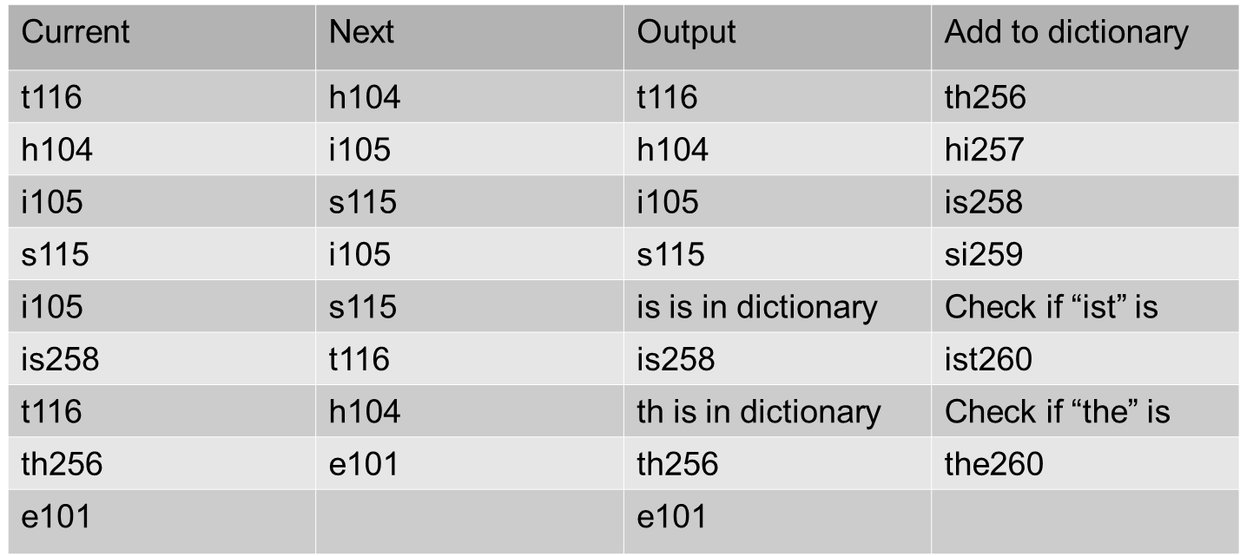
LZW Algorithm (Lempel-Ziv-Welch)
Output will be: 116 104 105 115 258 256 101
The encoded string is 7bytes compared to 9 bytes in uncompressed string
Khojema & Subin – Performance Evaluation of Distributed Systems
<number>/25

Slide 9
System Specifications
We used mainly two systems to implement, test and evaluate each given task (Hardware Specifications)
  Linux System:
  Memory : 3.8 GiB
  Processor: Intel CoreTM i5-4210U CPU @ 1.70GHz
  OS Type : 64-bit
  Mac OSX 10.11.3:
  Memory : 4 GB 1333 MHz DDR3
  Processor: Intel CoreTM i5 2.3 GHz
  OS Type : 64-bit
Software Specifications:
  Python Language(Version 3)
  PyCharm Integrated Development Environment(IDE).
Khojema & Subin – Performance Evaluation of Distributed Systems
<number>/25

Slide 10
Maximum Compression Ratio
Goal: To analyze 5 different compression algorithms and evaluations of their results
We have considered following compression algorithms;
  Burrows-Wheeler
  Zlib (Deflate)
  Gzip (Deflate)
  Huffman Coding
  LZMA
  LZW
We evaluated different parameters such as, Compression ratio, Time recorded for compression, Original file size and Compressed file size
Original file size: ~300 MB
Khojema & Subin – Performance Evaluation of Distributed Systems
<number>/25

Slide 11
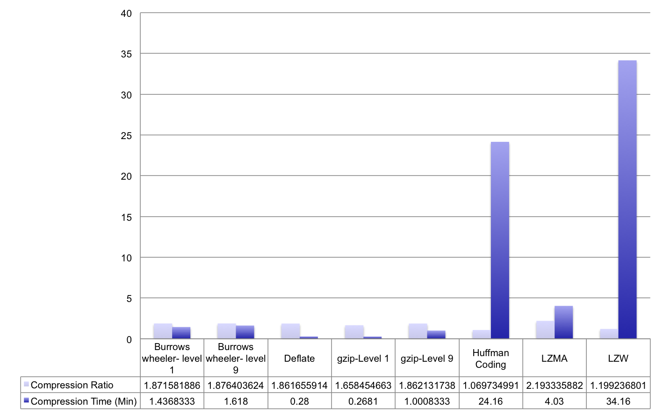
Maximum Compression Ratio
Khojema & Subin – Performance Evaluation of Distributed Systems
<number>/25

Slide 12
Maximum Compression Ratio
Higher compression ratio has given by LZMA at average time of ~4 minutes
Huffman coding has provided lower compression ratio in approximate ~25 minutes
LZW took approximate ~35 minute for compression
Deflate algorithm (Zlib) took ~28 seconds for compression
Khojema & Subin – Performance Evaluation of Distributed Systems
<number>/25

Slide 13
Chunk Size Vs. Compression Ratio and Profiling
Goal: To evaluate compression ratio for different block sizes of given data
We considered Zlib and Burrows-Wheeler compression algorithms
The experiment was conducted on different group sizes of 1,2,4,8,16,64,….,1024 and repeat it with 100 different groups for each size
Used cleaned data set by removing the ESC characters from each packet
Dropped all packets except packet type ‘2’ and ‘3’
Khojema & Subin – Performance Evaluation of Distributed Systems
<number>/25

Slide 14
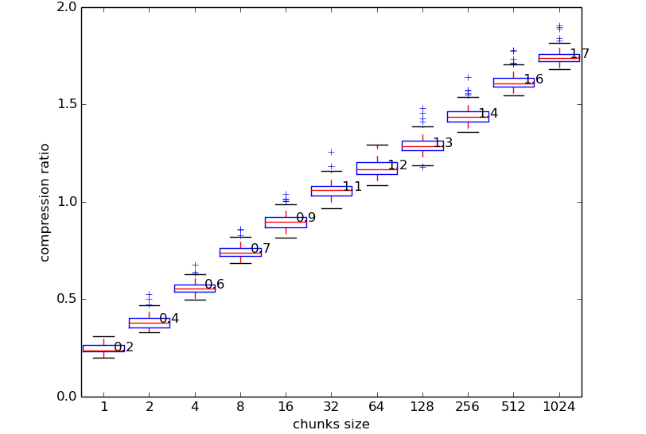
Chunk Size Vs. Compression Ratio of Burrows Wheeler
Khojema & Subin – Performance Evaluation of Distributed Systems
<number>/25

Slide 15
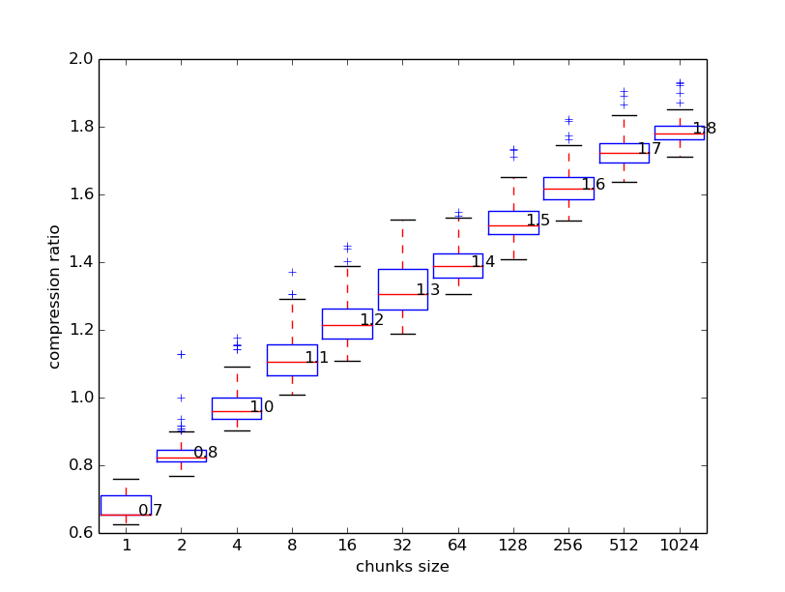
Chunk Size Vs. Compression Ratio of Zlib
Khojema & Subin – Performance Evaluation of Distributed Systems
<number>/25

Slide 16
Chunk Size Vs. Compression Ratio
Burrows Wheeler gives compression ratio
  Chunk size 1 → 0.2
  Chunk size 1024 → 1.7
Zlib gives compression ratio
  Chunk size 1 → 0.7
  Chunk size 1024 → 1.8
Zlib takes 1.2ms to compress chunk size of 1024
Burrows Wheeler takes 6ms to compress chunk size of 1024
Insight: As chunk size grows compression ratio also increases
Khojema & Subin – Performance Evaluation of Distributed Systems
<number>/25

Slide 17
Profiling LZW
Analyzed the execution time characteristics of main functions in a LZW compression algorithm.
  Pack function: Takes an iterator of integer codepoints as input and returns an iterator over bytes, containing the codepoint packed into varying lengths
  Encode_bytes: Converts the given input to byte format
  Read_bytes: Reading bytes
  Write_bytes: Writing bytes
  Bits_to_bytes: Which converts data’s in bit format to byte format
  Int_to_bits: Converts integer format to bits format
Khojema & Subin – Performance Evaluation of Distributed Systems
<number>/25

Slide 18
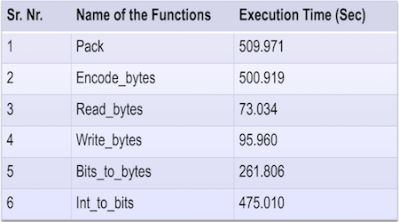
Profiling LZW
Result shows average time over multiple runs (5 Runs)
Khojema & Subin – Performance Evaluation of Distributed Systems
<number>/25

Slide 19
Experimental Setup
The sensor data consists of
  <esc> "2": 6 byte MLAT timestamp, 1 byte signal level, 7 byte Mode-S short frame
  <esc> "3": 6 byte MLAT timestamp, 1 byte signal level, 14 byte Mode-S long frame
Drop the packets that begin with unknown codes <esc> “?”
System Design Requirements
  Real-time Capability: Compression and Decompression should never exceed 1s
  Low complexity of compression: Compression part should have low complexity
  Low Communication Overhead: Performance of the system measures in Total transmit data including system/Control overhead of the compression system.
The compression and decompression system should be able to work via Linux pipelines as follows.
netcat sensordata | compress | tee a.bin | decompress > b.bin
Khojema & Subin – Performance Evaluation of Distributed Systems
<number>/25

Slide 20
Stream Compression System Design
Sensor(Source):
  Ignore ESC character and packets of unknown type( <esc> ‘?’)
  Use buffer to store packets of different sizes
  Idea: Continuously stores sequence of messages in a buffer for some amount of milliseconds and then compress the data
  Send compressed data to Server(Destination)
Server(Destination)
  Receives sequence of compressed data
  Decompress it with same algorithm
Khojema & Subin – Performance Evaluation of Distributed Systems
<number>/25

Slide 21
Stream Compression System Design
Choice of Compression Algorithm
  Use LZMA if compression ratio is critical, and you are willing to sacrifice speed to achieve it.
  Use Zlib, if speed and compression are more or less equally important
  Our choice was Zlib(refer slide 16)
Planned to design a compression system that buffer for 900ms and compress and decompress the data in remaining 100ms
Khojema & Subin – Performance Evaluation of Distributed Systems
<number>/25

Slide 22
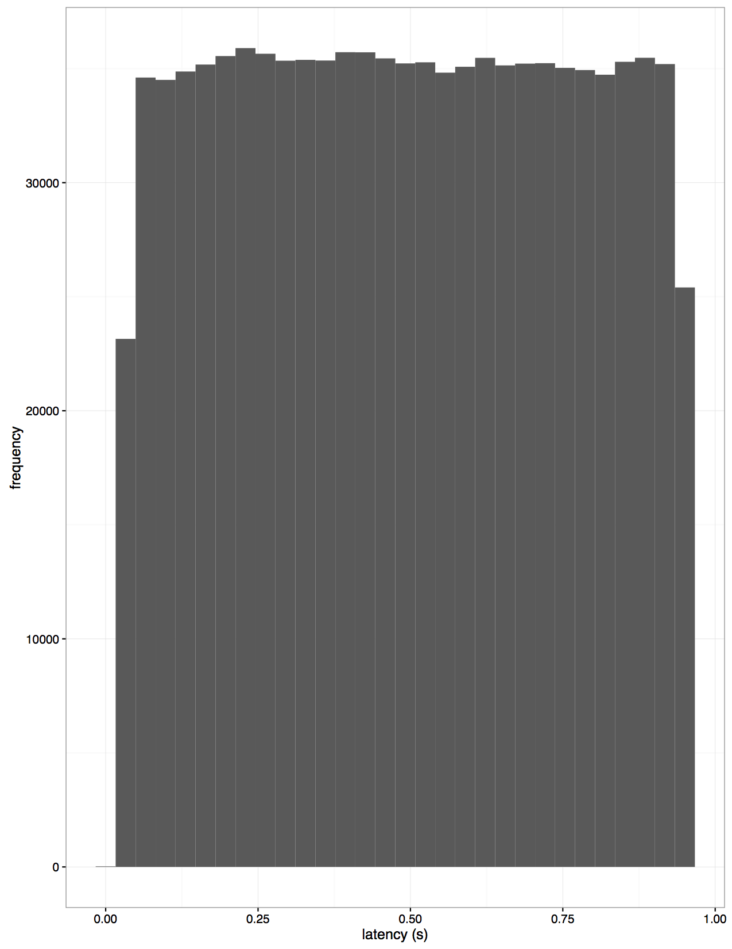
Performance Evaluation
Frequency Vs Latency of Sensor data
  Evaluated 1 million packets of final result
  Frequency distribution was linear over majority of time and latency did not exceed time limit of 1s
Khojema & Subin – Performance Evaluation of Distributed Systems
<number>/25

Slide 23
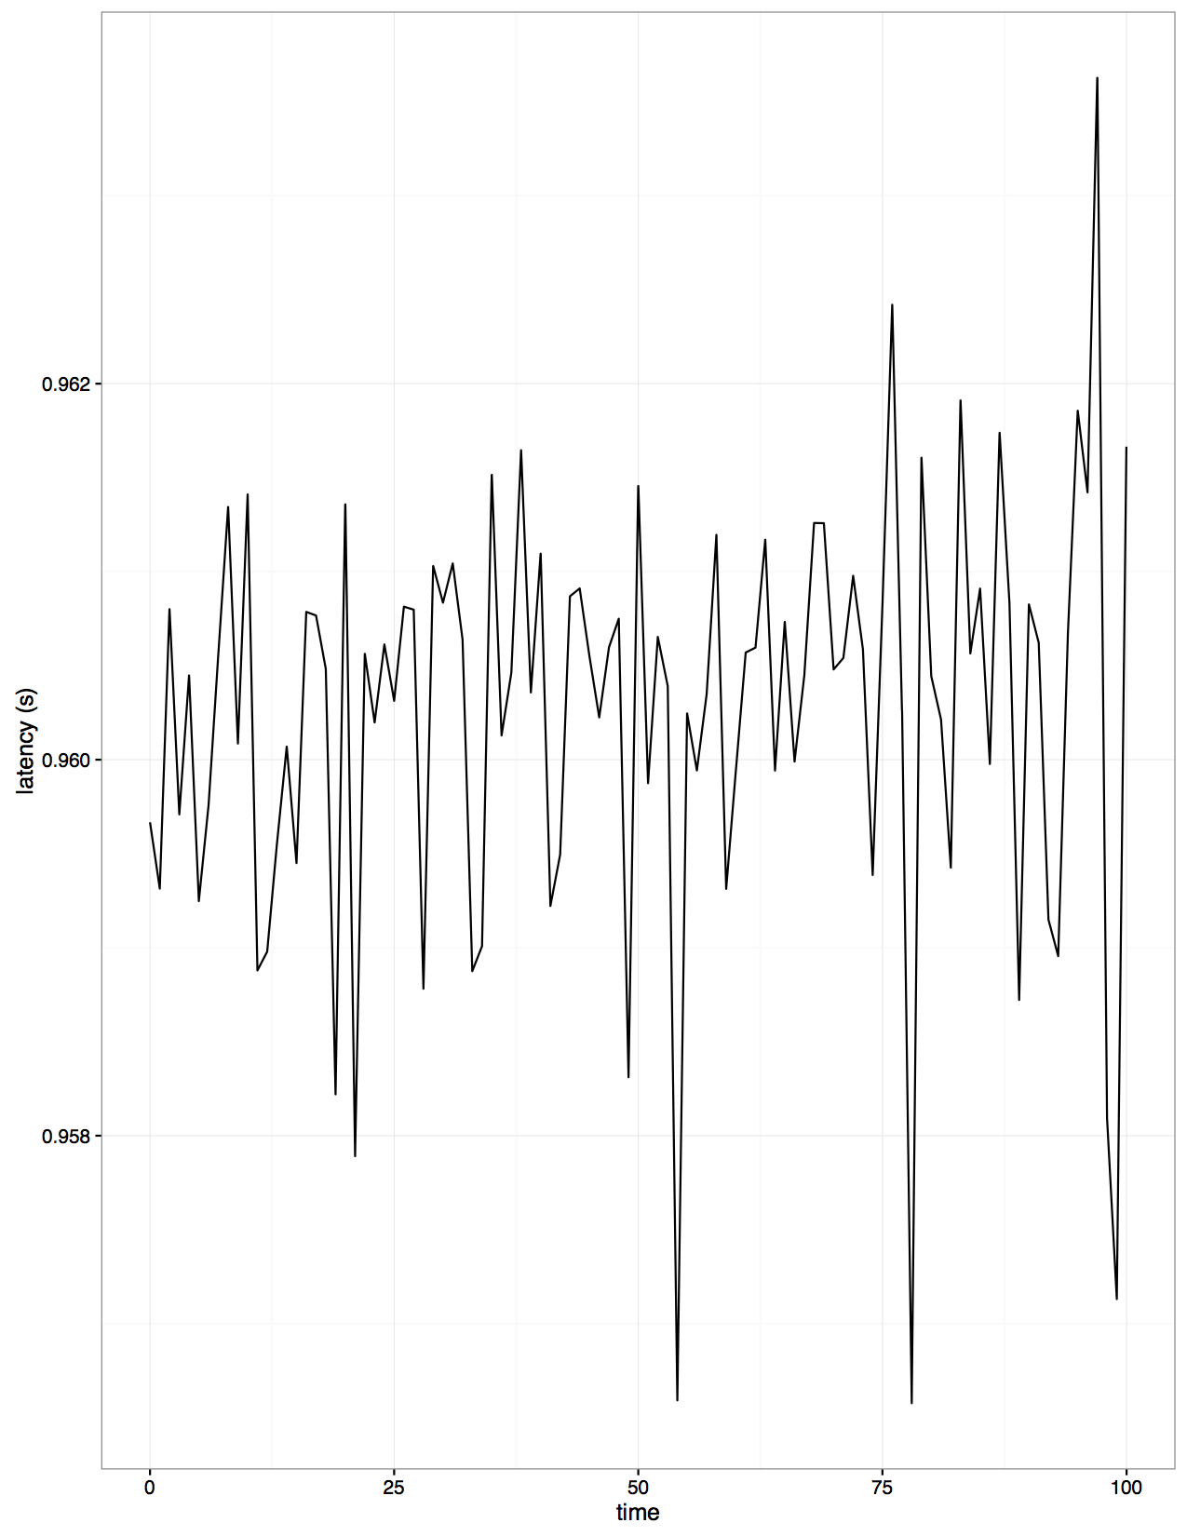
Performance Evaluation
Maximum latency distribution of Sensor data
  Considered the packets which show the maximum latency distribution
  Noticed that the major portion of the latency was during buffering of the sensor data.
  The maximum latency varies from 0.956 seconds to 0.963 seconds.
Khojema & Subin – Performance Evaluation of Distributed Systems
<number>/25

Slide 24
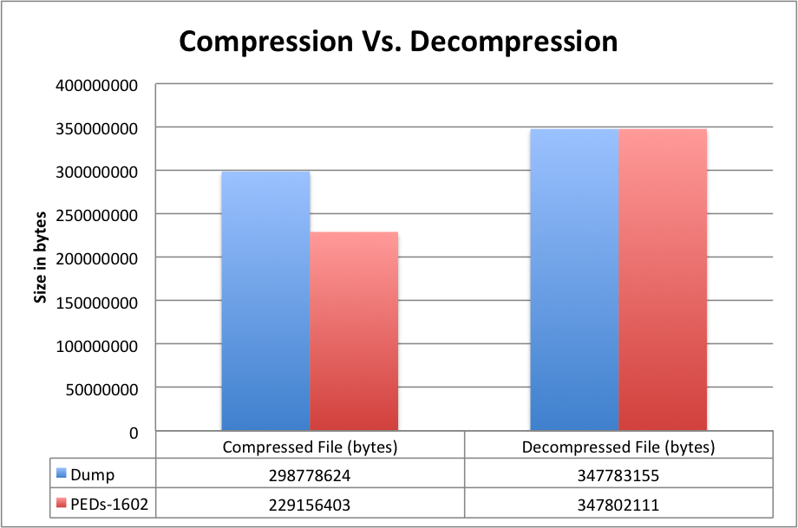
Performance Evaluation
Comparison of compression ratios of group 1602 and ‘Dump’
  Dump is the output of the out-of-the-box Linux stream compression using the Lempel-Ziv algorithm
  Implementation was tested over more than 24 hours
  Recorded compression ratio is 1.52 for 1602 and 1.16 for ‘Dump’
Khojema & Subin – Performance Evaluation of Distributed Systems
<number>/25

Slide 25
Conclusion
Could reduce the network load significantly without any loss of packets by meeting the given system design requirements.
Achieved high compression ratio of ~1.52 in sequence of data stream using deflate algorithm (Zlib).
The maximum latency of around 0.963s recorded during our experiment.
Khojema & Subin – Performance Evaluation of Distributed Systems
<number>/25

