Slide 1
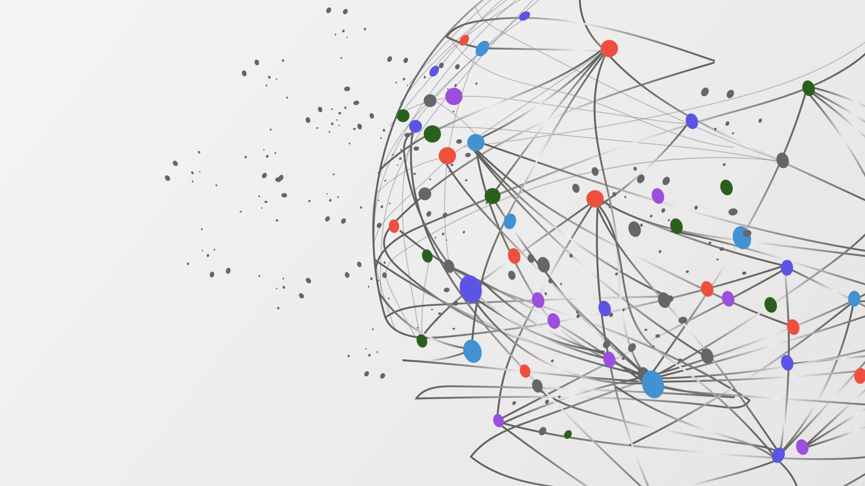
AllianzVerba
Pdf Translator

Slide 2
Introduction and business problem
Currently Compliance team receives PDF documents in different languages.
Only two FT’s have access to the AIMS ++ translator.
Rest of the team uses google translate to convert the pdf.

Slide 3
2. Proposed solution
We can make use of AllianzVerba. The pdf Translator , which is much faster compared to the existing translators.
AllianzVerba · Streamlit

Slide 4
3. How the application works
1. Upload PDF
The user uploads the PDF document that needs to be translated.
2. Translate Document
The application translates the document into the selected target language.
3. Preview and Adjust Quality
The user previews the translated PDF, checks the output, and adjusts the document quality using the available options.
4. Download PDF
Once satisfied with the translated document, the user downloads the final PDF.

Slide 5
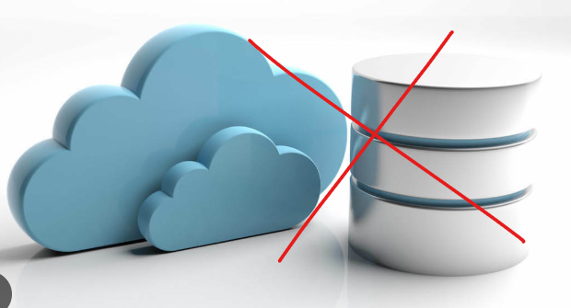
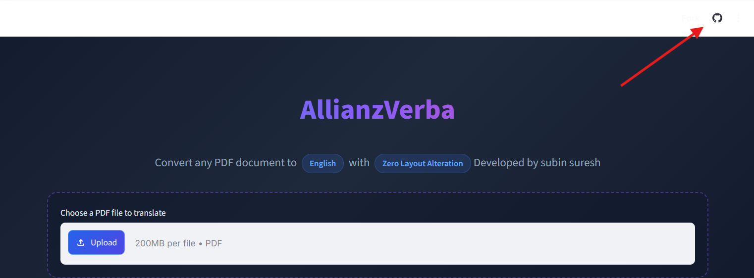
Security and data privacy
No Database : The application does not use a database to store uploaded PDF documents. Companies internal documents are not going outside and its safe .
Code Transparency: The source code is available for review to understand how documents are processed and handled. Code is open to review in Github and its hosted in streamlet.

Slide 6
Demo

