Slide 1
Identification of Bias in Diffusion Models

Slide 2
Structure of Work
Can we identify bias in Diffusion generative models?
Why is there bias in the models?
Data bias, Annotator bias, Model bias
What is the metric to measure bias in models?
Bias mitigation techniques

Slide 3
Sources of Bias: Dataset Bias
Method of data collection
Ex:

Slide 4
Experiment: Dataset & Model Bias Detection
Three datasets
CelebA-HQ: 27000 facial training images of 256x256 dimensions
Fairface: ~87000 facial training images of 224x224 dimensions, balanced dataset
Fairface: 48000 facial training images of 224x224 dimensions, perfectly balanced dataset in races and gender attributes

Slide 5
Sources of Bias: Annotator Bias
Annotator bias (out group homogeneity)
It occurs when the annotator is more accurate labelling concepts she/he is familiar with
Ex: Identifying races of people

Slide 6
Sources of Bias: Model Bias
The statistical model displays bias when the dataset is balanced
Ex: Usage of Empirical Risk Minimization tends to overwhelm the minority group with data from the majority group

Slide 7
Experiment: Dataset & Model Bias Detection
Three models under investigation
DDPM/DDIM
Stable Diffusion
DDGAN

Slide 8
Experiment Design
The diffusion model trained on each of the dataset, and the samples generated by the model is analysed for the presence of bias across attributes such as race, gender, and age
Training time for CelebA-HQ dataset (27000 images of 256x256 dim):
Nvidia A5000 1x24 GB GPU: 30 days for 550 epochs
Nvidia A100 1x80 GB GPU: 12 days for 550 epochs
Training time for Fairface dataset (87000 images of 224x224 dim):
Nvidia A5000 1x24 GB GPU: 60 days for 500 epochs
Nvidia A100 1x80 GB GPU: 26 days for 500 epochs

Slide 9

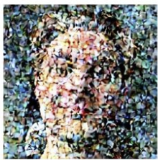
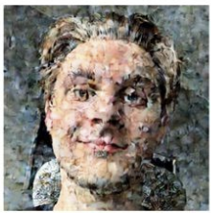

Experiment Design
Attribute Classifier
race
x_{t}
p_{Ɵ}(x_{t-1}|x_{t})
x_{t-1}
z
X₀
gender
age
Diffusion Models
Image source: https://deepsense.ai/diffusion-models-in-practice-part-1-the-tools-of-the-trade/

Slide 10
Experiment Design
Attribute Classifier
race
x_{t}
p_{Ɵ}(x_{t-1}|x_{t})
x_{t-1}
z
X₀
gender
age
Diffusion Models
Image source: https://deepsense.ai/diffusion-models-in-practice-part-1-the-tools-of-the-trade/

Slide 11
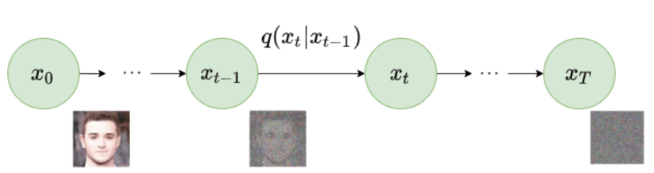
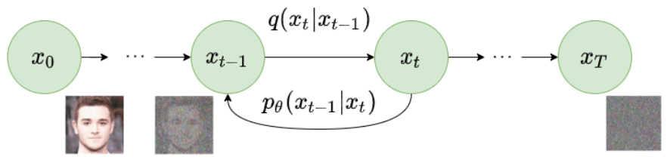
DDPM Architecture
Forward Diffusion Process
Reverse Diffusion Process
Source: Ho et. al, Denoising Diffusion Probabilistic Models, NeurIPS 2020

Slide 12
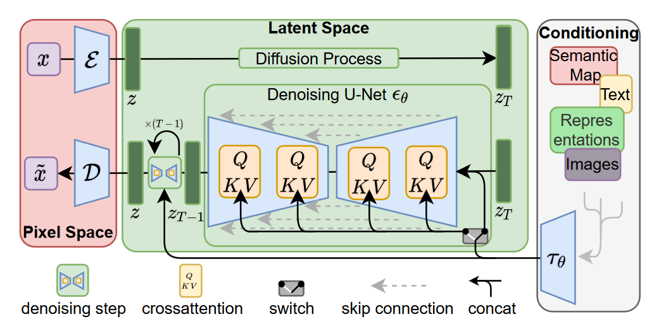
Stable-Diffusion Architecture
Source: Rombach et. al, High-Resolution Image Synthesis with Latent Diffusion Models, CVPR 2022

Slide 13
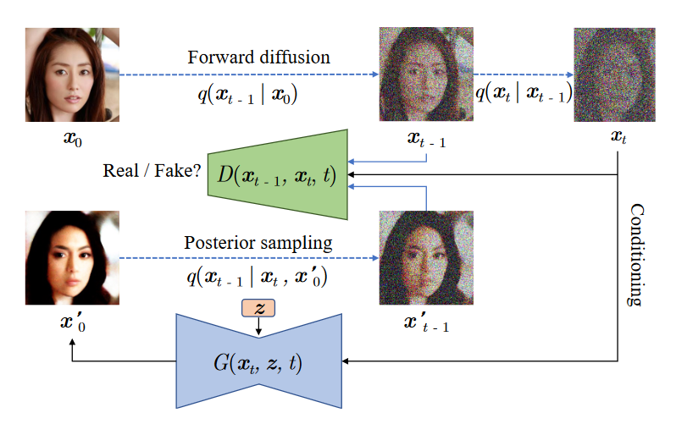
DiffusionGAN Architecture
Source: Xiao et. al, Tackling the Generative Learning Trilemma with Denoising Diffusion GANs, ICLR - 2022

Slide 14
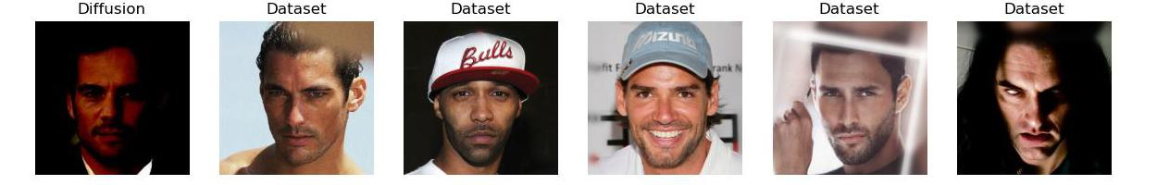
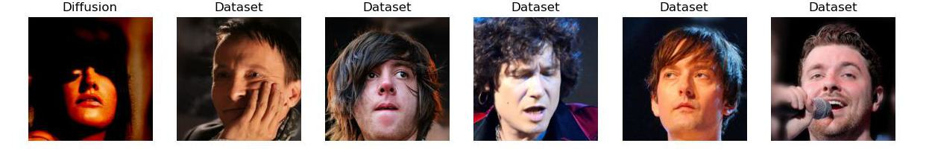
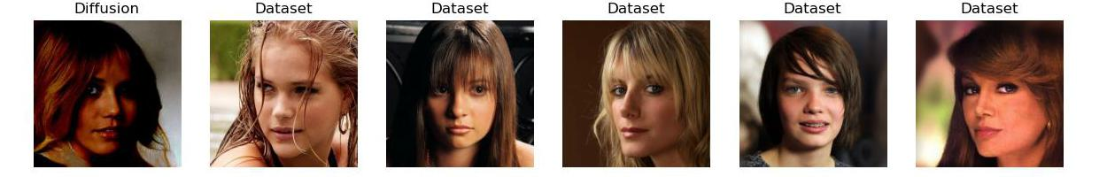
Generated output
Training dataset
Fig: Left column: Generated samples from the DDGAN model,
Right columns: Top-5 nearest neighbour matches from the training set

Slide 15
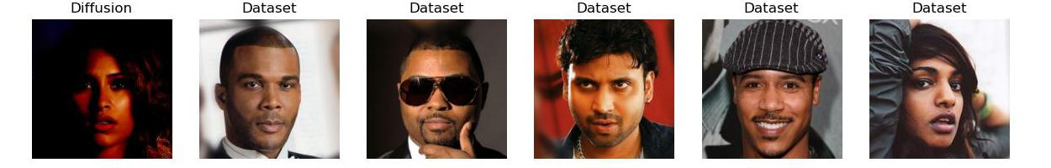
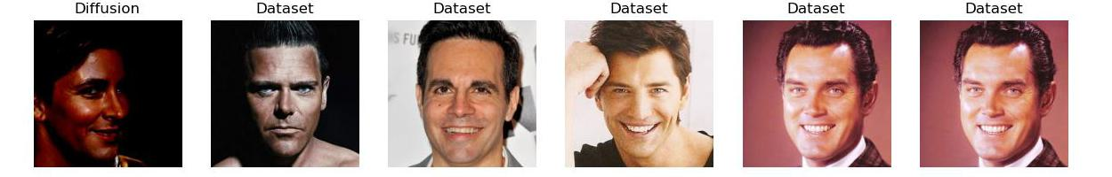
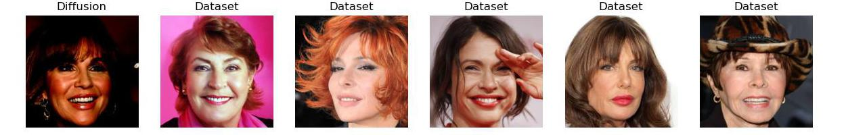
Generated output
Training dataset
Fig: Left column: Generated samples from the DDGAN model,
Right columns: Top-5 nearest neighbour matches from the training set

Slide 16
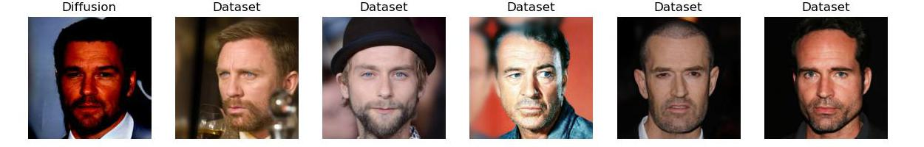
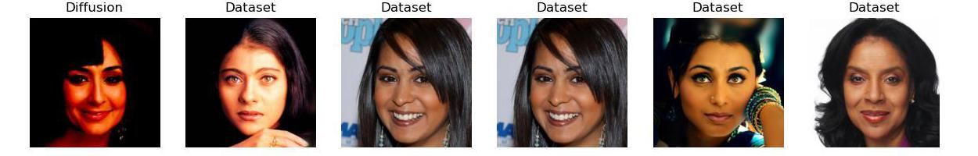
Generated output
Training dataset
Fig: Left column: Generated samples from the DDGAN model,
Right columns: Top-5 nearest neighbour matches from the training set

Slide 17
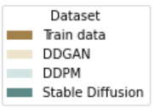
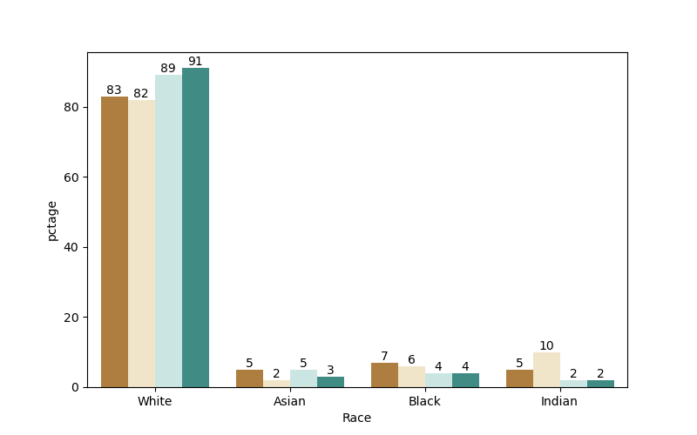
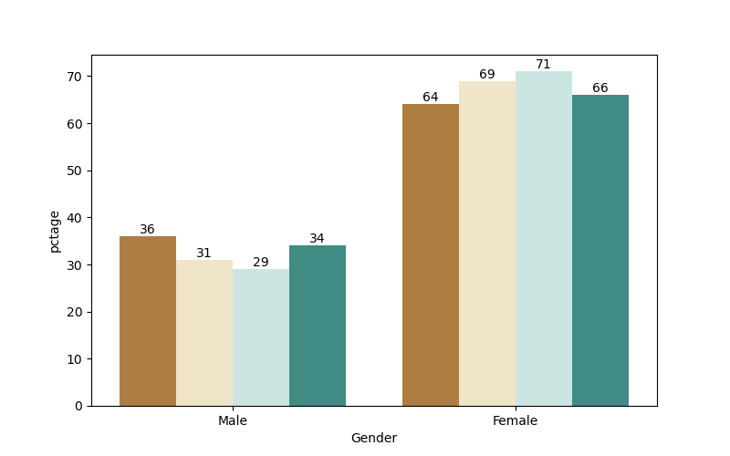
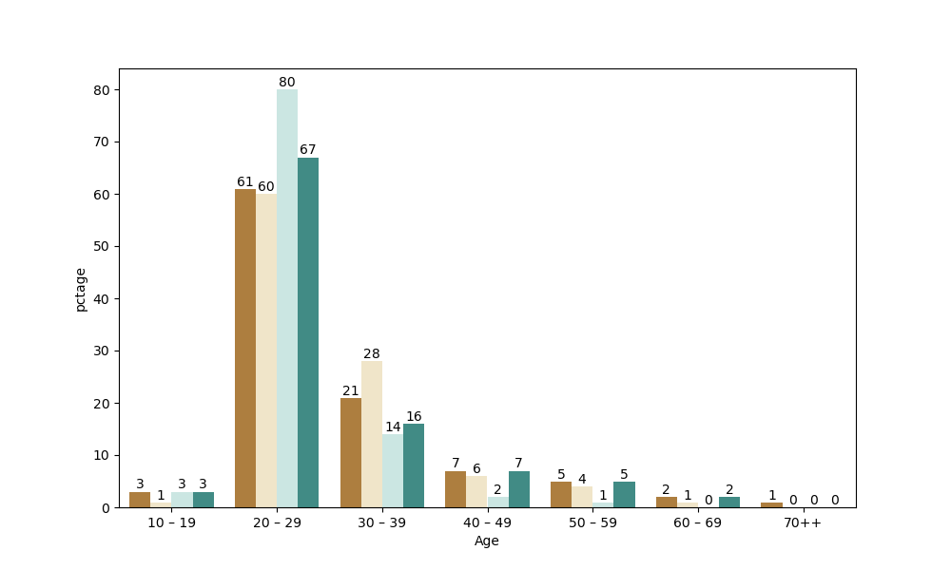
Comparison: CelebA-HQ
CelebA-HQ training dataset have white faces, females, and younger age group biases
Training data has 83% White faces which is maintained in DDGAN and more generated in DDPM and Stable Diffusion
Asian, Indian, and black facial images are less generated by DDPM and Stable Diffusion models
Training data has 2/3rd proportion of female facial images, which is maintained in DDGAN and Stable Diffusion models
DDPM tends to generate more females
Training data has 2/3rd proportion of young faces, which is almost maintained in DDGAN and Stable Diffusion models
DDPM tends to generate more young faces
Diffusion models trained on CelebA-HQ faces are biased to generate young white female facial images

Slide 18
Comparison: Gender imbalance in Race
Train Data
Generated Data - DDGAN
x
Generated Data - DDPM
Generated Data – Stable Diffusion

Slide 19
Comparison: Racial imbalance in Gender
Train Data
Generated Data - DDGAN
In training data, even across gender (male & female), White faces are more predominant
All models almost maintains the same bias across races in gender as of the training data
Generated Data - DDPM
Generated Data – Stable Diffusion

Slide 20
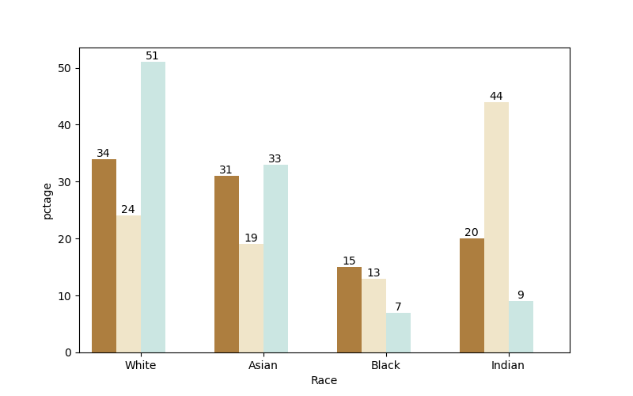
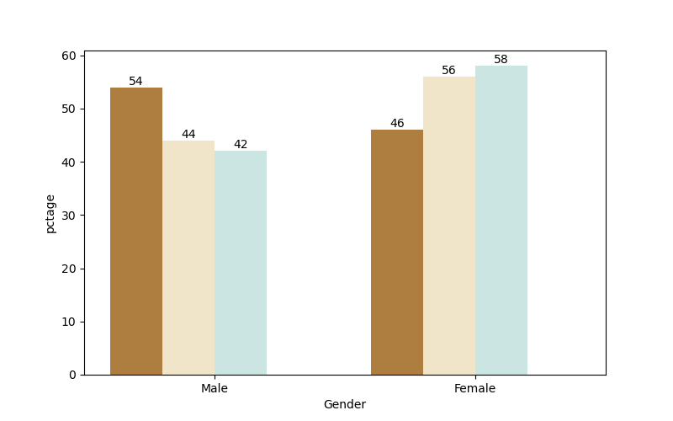
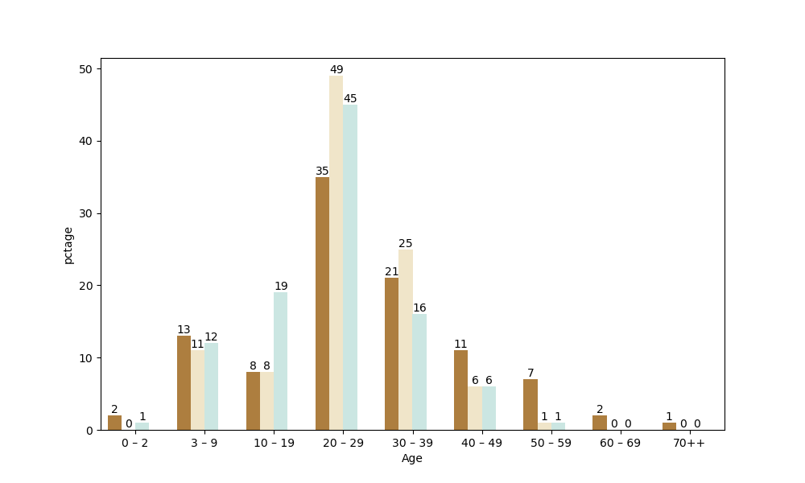
Comparison: FairFace dataset
Fairface training dataset is almost balanced in race and gender, but depict younger age group biases

Slide 21
Comparison: Gender imbalance in Race
Train Data
Generated Data - DDGAN
Generated Data - DDPM
Generated Data – Stable Diffusion

Slide 22
Perspective: Racial imbalance in Gender
Train Data
Generated Data - DDGAN
Generated Data - DDPM
Generated Data – Stable Diffusion

Slide 23
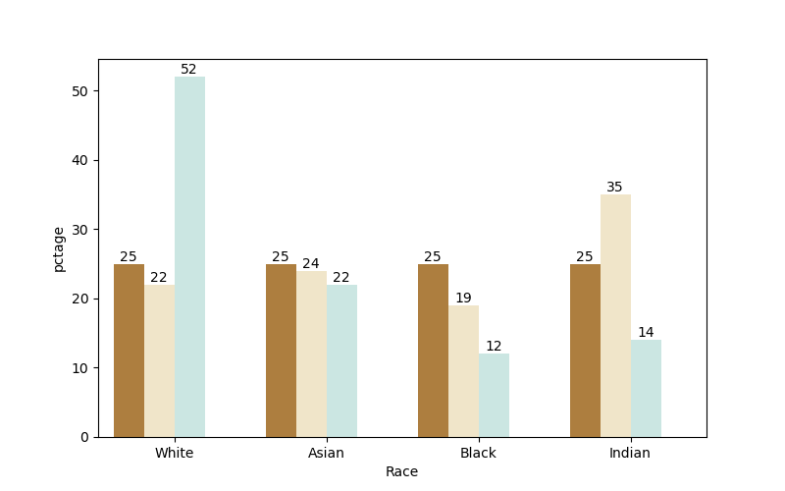
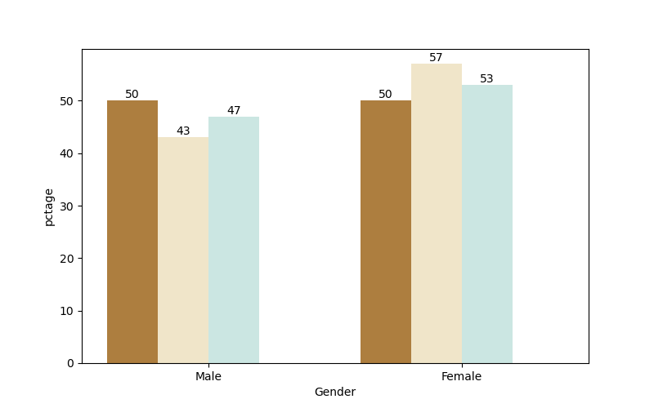
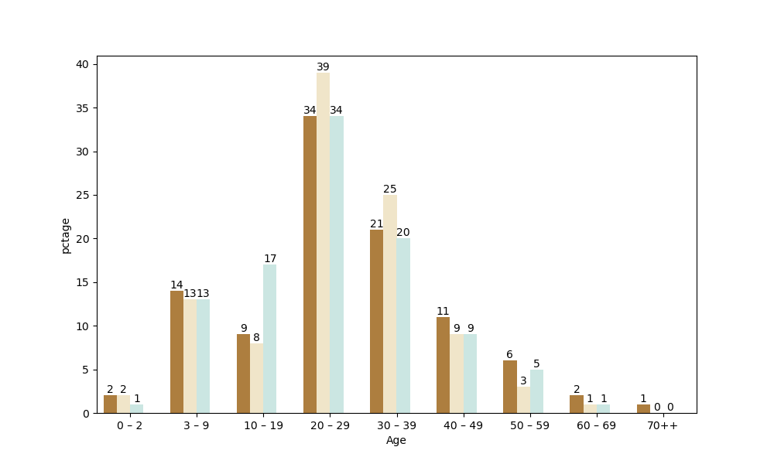
Comparison: FairFace-Sub (R + G balanced) dataset
x

Slide 24
Comparison: Gender imbalance in Race
Train Data
Generated Data - DDGAN
Generated Data - DDPM
Generated Data – Stable Diffusion

Slide 25
Perspective: Racial imbalance in Gender
Train Data
Generated Data - DDGAN
Generated Data - DDPM
Generated Data – Stable Diffusion

Slide 26
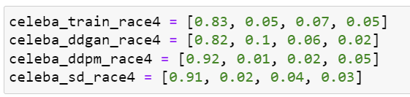
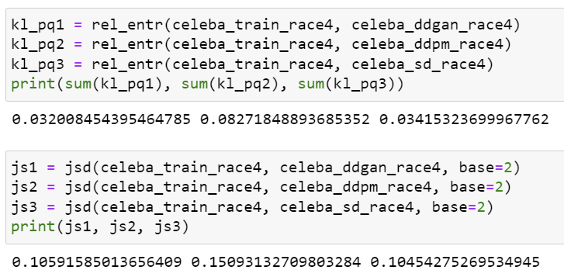

Slide 27
Appendix
DDPM: (256 epoch) Generated output (2086 samples) on CelebA-HQ
DDPM: (75 epoch) – Generated output (597 samples) on Fairface
SD: Generated output (3000 samples) on CelebA-HQ
DiffusionGAN: Generated output (2949 samples) on CelebA-HQ
DiffusionGAN: (110 epoch) – Generated output (6235 samples) on Fairface

Slide 28













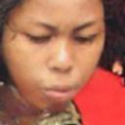











Slide 29


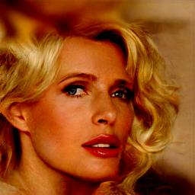

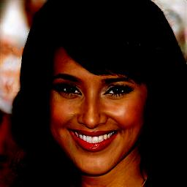
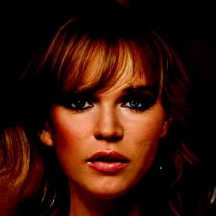




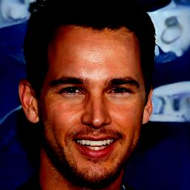
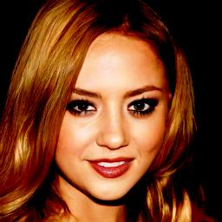
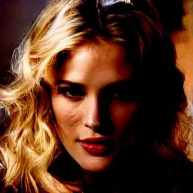


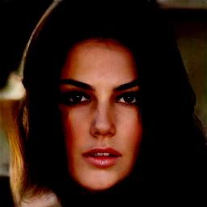
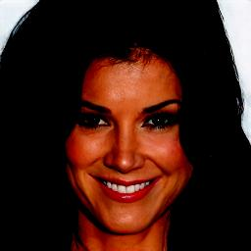
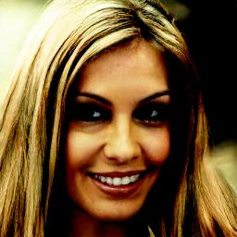
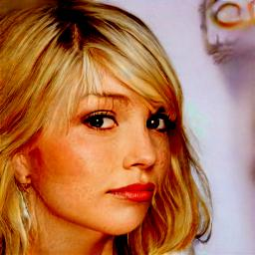
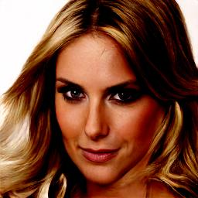



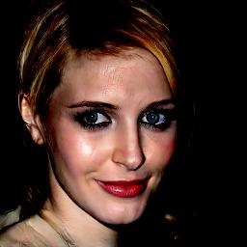

Slide 30

