Slide 1
Identification of Bias in Diffusion Models

Slide 2
Structure of Work
Can we identify bias in Diffusion generative models?
Why is there bias in the models?
Data bias, Annotator bias, Model bias
What is the metric to measure bias in models?
Bias mitigation techniques

Slide 3
Sources of Bias: Dataset Bias
Method of data collection
Ex:

Slide 4
Experiment: Dataset & Model Bias Detection
Three datasets
CelebA-HQ: 27000 facial training images of 256x256 dimensions
Fairface: ~87000 facial training images of 224x224 dimensions, balanced dataset
Fairface: 48000 facial training images of 224x224 dimensions, perfectly balanced dataset in races and gender attributes

Slide 5
CelebA-HQ – Training dataset (27000 samples)
CelebA-HQ training dataset have white faces, females, and younger age group biases

Slide 6
Racial imbalance in Gender
Gender imbalance in Race
Similar proportions of races are maintained across the male and female gender
Almost similar gender distribution is maintained across all the races
Female faces are proportionally higher than the male ones for each race

Slide 7
Fairface – Training dataset (82470 samples)
Fairface training dataset is almost balanced in race and gender, but depict younger age group biases

Slide 8
Racial imbalance in Gender
Gender imbalance in Race
Similar proportions of races are maintained across the male and female gender
Almost similar gender distribution is maintained across all the races
Male faces are slightly higher than the female ones across the races

Slide 9
Fairface (Balanced) – Training dataset (48000 samples)

Slide 10
Racial imbalance in Gender
Gender imbalance in Race

Slide 11
Sources of Bias: Annotator Bias
Annotator bias (out group homogeneity)
It occurs when the annotator is more accurate labelling concepts she/he is familiar with
Ex: Identifying races of people

Slide 12
Sources of Bias: Model Bias
The statistical model displays bias when the dataset is balanced
Ex: Usage of Empirical Risk Minimization tends to overwhelm the minority group with data from the majority group

Slide 13
Experiment: Dataset & Model Bias Detection
Three models under investigation
DDPM/DDIM
Stable Diffusion
DDGAN

Slide 14
Experiment Design
The diffusion model trained on each of the dataset, and the samples generated by the model is analysed for the presence of bias across attributes such as race, gender, and age
Training time for CelebA-HQ dataset (27000 images of 256x256 dim):
Nvidia A5000 1x24 GB GPU: 30 days for 550 epochs
Nvidia A100 1x80 GB GPU: 12 days for 550 epochs
Training time for Fairface dataset (87000 images of 224x224 dim):
Nvidia A5000 1x24 GB GPU: 60 days for 500 epochs
Nvidia A100 1x80 GB GPU: 26 days for 500 epochs

Slide 15
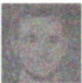

Experiment Design
X₀
Attribute Classifier
race/race4
x_{t}
p_{Ɵ}(x_{t-1}|x_{t})
x_{t-1}
z
gender
age
Diffusion Models

Slide 16
Analysis on DDPM model

Slide 17
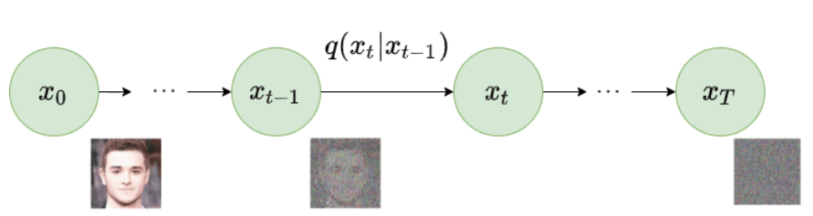
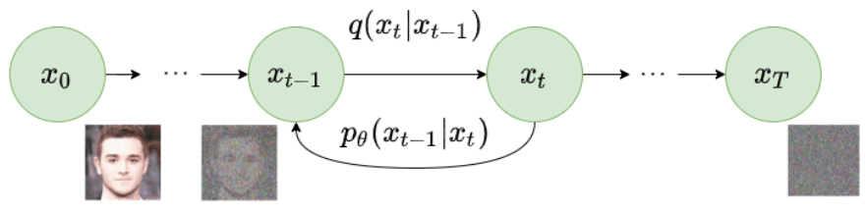
DDPM Architecture
Forward Diffusion Process
Reverse Diffusion Process
Source: Ho et. al, Denoising Diffusion Probabilistic Models, NeurIPS 2020

Slide 18
DDPM: (256 epoch) Generated output (2086 samples) on CelebA-HQ

Slide 19
Racial imbalance in Gender
Gender imbalance in Race

Slide 20
DDPM: (75 epoch) – Generated output (597 samples) on Fairface

Slide 21
Racial imbalance in Gender
Gender imbalance in Race

Slide 22
Analysis on Stable Diffusion model

Slide 23
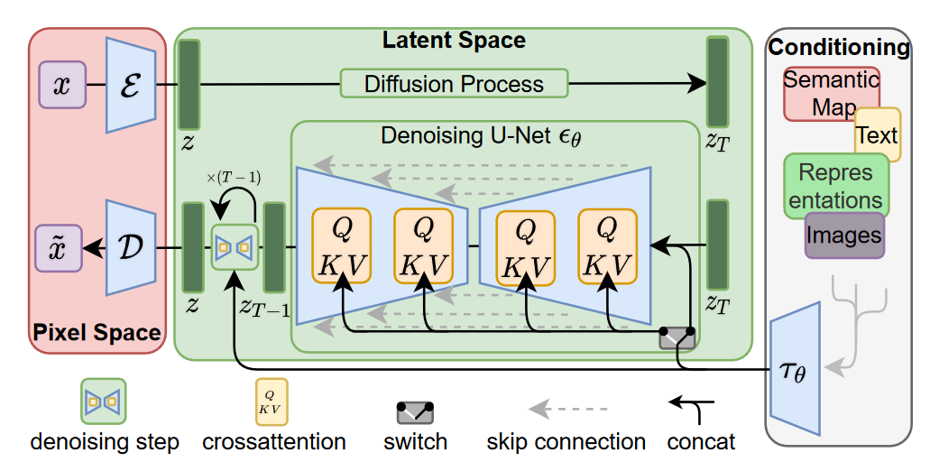
Stable-Diffusion Architecture
Source: Rombach et. al, High-Resolution Image Synthesis with Latent Diffusion Models, CVPR 2022

Slide 24
SD: Generated output (3000 samples) on CelebA-HQ

Slide 25
Racial imbalance in Gender
Gender imbalance in Race

Slide 26
SD: Generated output (xx samples) on Fairface

Slide 27
Racial imbalance in Gender
Gender imbalance in Race

Slide 28
Analysis on DDGAN model

Slide 29
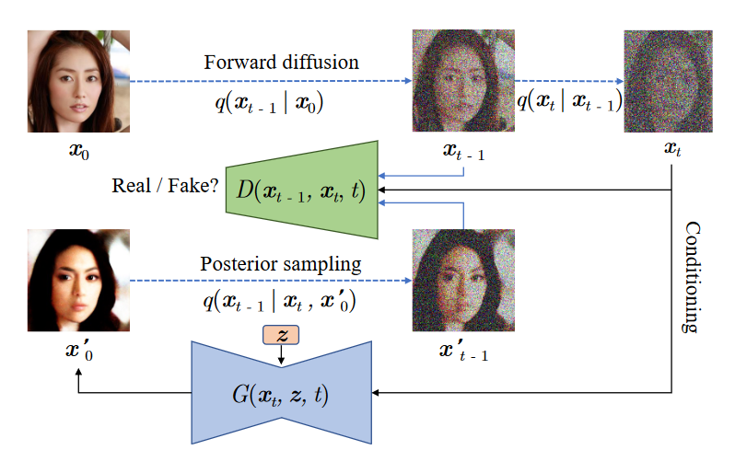
DiffusionGAN Architecture
Source: Xiao et. al, Tackling the Generative Learning Trilemma with Denoising Diffusion GANs, ICLR - 2022

Slide 30
DiffusionGAN: Generated output (2949 samples) on CelebA-HQ

Slide 31
Racial imbalance in Gender
Gender imbalance in Race

Slide 32
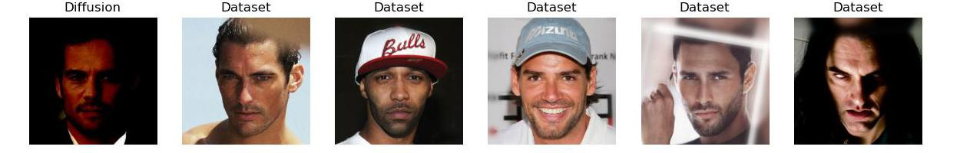
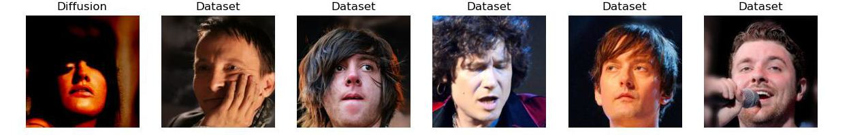
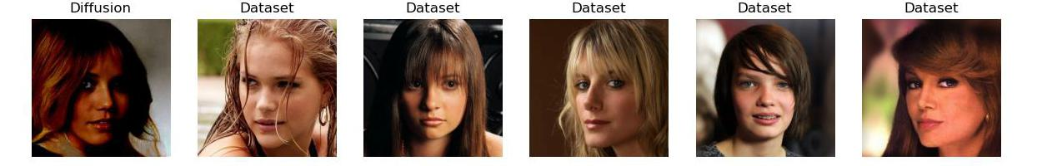
Generated output
Training dataset
Fig: Left column: Generated samples from the DDGAN model,
Right columns: Top-5 nearest neighbour matches from the training set

Slide 33
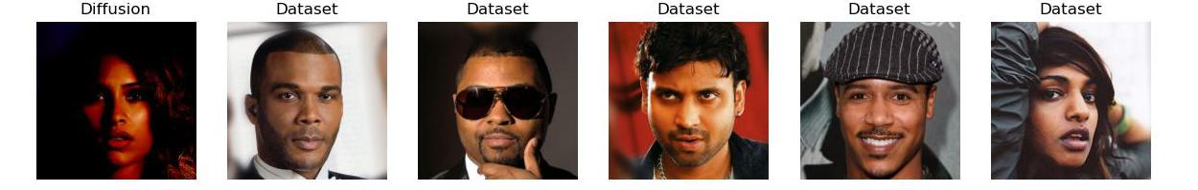
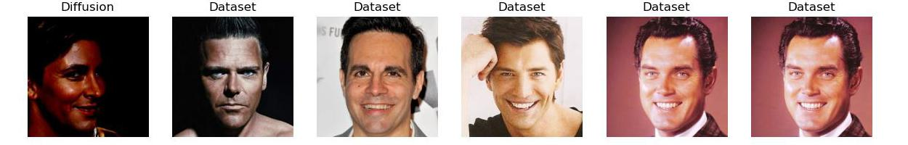
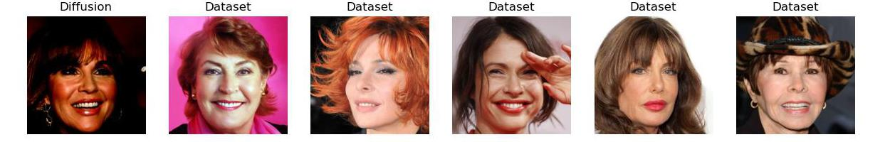
Generated output
Training dataset
Fig: Left column: Generated samples from the DDGAN model,
Right columns: Top-5 nearest neighbour matches from the training set

Slide 34
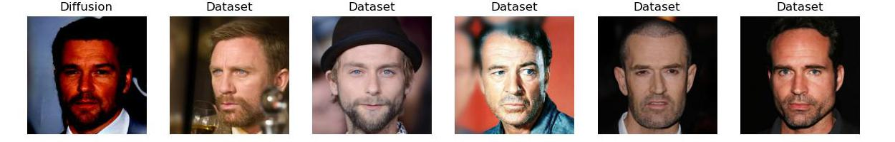
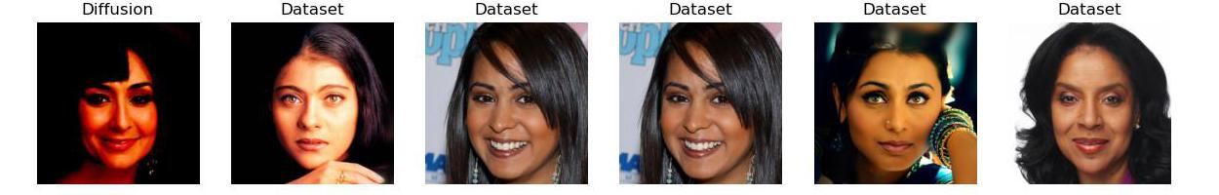
Generated output
Training dataset
Fig: Left column: Generated samples from the DDGAN model,
Right columns: Top-5 nearest neighbour matches from the training set

Slide 35
DiffusionGAN: (110 epoch) – Generated output (6235 samples) on Fairface

Slide 36
Racial imbalance in Gender
Gender imbalance in Race

Slide 37
CelebA-HQ dataset

Slide 38
Comparison: Race
Train Data
Generated Data - DDGAN
Training data has 83% White faces which is maintained in DDGAN and more generated in DDPM and Stable Diffusion
Asian, Indian, and black facial images are less generated by DDPM and Stable Diffusion models
Generated Data - DDPM
Generated Data – Stable Diffusion

Slide 39
Comparison: Gender
Train Data
Generated Data - DDGAN
Training data has 2/3rd proportion of female facial images, which is maintained in DDGAN and Stable Diffusion models
DDPM tends to generate more females
Generated Data - DDPM
Generated Data – Stable Diffusion

Slide 40
Comparison: Age
Train Data
Generated Data - DDGAN
Training data has 2/3rd proportion of young faces, which is almost maintained in DDGAN and Stable Diffusion models
DDPM tends to generate more young faces
Diffusion models trained on CelebA-HQ faces are biased to generate young white female facial images
Generated Data - DDPM
Generated Data – Stable Diffusion

Slide 41
Comparison: Racial imbalance in Gender
Train Data
Generated Data - DDGAN
In training data, even across gender (male & female), White faces are more predominant
All models almost maintains the same bias across races in gender as of the training data
Generated Data - DDPM
Generated Data – Stable Diffusion

Slide 42
Comparison: Gender imbalance in Race
Train Data
Generated Data - DDGAN
x
Generated Data - DDPM
Generated Data – Stable Diffusion

Slide 43
Fairface dataset

Slide 44
Comparison: Race
Train Data
Generated Data - DDGAN
Generated Data - DDPM
Generated Data – Stable Diffusion

Slide 45
Comparison: Gender
Train Data
Generated Data - DDGAN
Generated Data - DDPM
Generated Data – Stable Diffusion

Slide 46
Comparison: Age
Train Data
Generated Data - DDGAN
Generated Data - DDPM
Generated Data – Stable Diffusion

Slide 47
Perspective: Racial imbalance in Gender
Train Data
Generated Data - DDGAN
Generated Data - DDPM
Generated Data – Stable Diffusion

Slide 48
Comparison: Gender imbalance in Race
Train Data
Generated Data - DDGAN
Generated Data - DDPM
Generated Data – Stable Diffusion

Slide 49
Fairface balanced (race + gender) dataset

Slide 50
Comparison: Race
Train Data
Generated Data - DDGAN
Generated Data - DDPM
Generated Data – Stable Diffusion

Slide 51
Comparison: Gender
Train Data
Generated Data - DDGAN
Generated Data - DDPM
Generated Data – Stable Diffusion

Slide 52
Comparison: Age
Train Data
Generated Data - DDGAN
Generated Data - DDPM
Generated Data – Stable Diffusion

Slide 53
Perspective: Racial imbalance in Gender
Train Data
Generated Data - DDGAN
Generated Data - DDPM
Generated Data – Stable Diffusion

Slide 54
Comparison: Gender imbalance in Race
Train Data
Generated Data - DDGAN
Generated Data - DDPM
Generated Data – Stable Diffusion

Slide 55
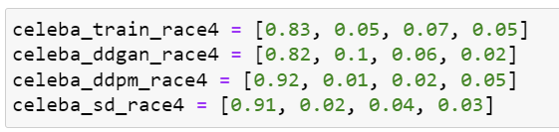
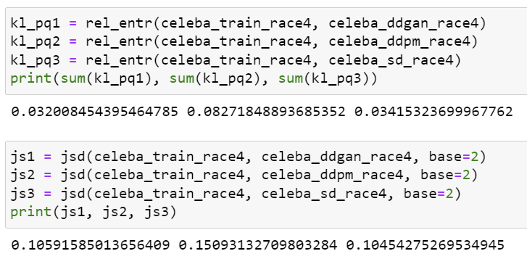

Slide 56
Appendix

