Slide 1
Identification of Bias in Diffusion Models

Slide 2
Structure of Work
Can we identify bias in Diffusion generative models?
Why is there bias in the models?
Data bias, Annotator bias, Model bias
What is the metric to measure bias in models?
Bias mitigation techniques

Slide 3
Sources of Bias: Dataset Bias
Ex:

Slide 4
Sources of Bias: Annotator Bias
Annotator bias (out group homogeneity)
It occurs when the annotator is more accurate labelling concepts she/he is familiar with
Ex: Identifying races of people

Slide 5
Sources of Bias: Model Bias
The statistical model displays bias when the dataset is balanced
Ex: Usage of Empirical Risk Minimization tends to overwhelm the minority group with data from the majority group

Slide 6
Experiment: Dataset & Model Bias Detection
Two datasets
CelebA-HQ: ~27000 facial training images of 256x256 dimensions
Fairface: ~87000 facial training images of 224x224 dimensions, balanced dataset
Three models
DDPM/DDIM
Stable Diffusion
DDGAN

Slide 7
CelebA-HQ – Training dataset (27000 samples)

Slide 8
Racial imbalance in Gender
Gender imbalance in Race

Slide 9
Fairface – Training dataset (86744 samples)

Slide 10
Racial imbalance in Gender
Gender imbalance in Race

Slide 11
Experiment Design
The diffusion model trained on each of the dataset, and the samples generated by the model is analysed for the presence of bias across attributes such as race, gender, and age
Training time for CelebA-HQ dataset (27000 images of 256x256 dim):
Nvidia A5000 1x24 GB GPU: 30 days for 550 epochs
Nvidia A100 2x80 GB GPU: 12 days for 550 epochs
Training time for Fairface dataset (87000 images of 224x224 dim):
Nvidia A100 1x80 GB GPU: 26 days for 500 epochs
Nvidia A100 2x80 GB GPU: 13 days for 500 epochs

Slide 12
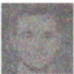

Experiment Design
X₀
Attribute Classifier
race/race4
x_{t}
p_{Ɵ}(x_{t-1}|x_{t})
x_{t-1}
z
gender
age
Diffusion Models

Slide 13
Analysis on DDPM model

Slide 14
DDPM Architecture

Slide 15
DDPM: Generated output (2716 samples) on CelebA-HQ

Slide 16
Racial imbalance in Gender
Gender imbalance in Race

Slide 17
DDPM: (75 epoch) – Generated output (3000 samples) on Fairface

Slide 18
Racial imbalance in Gender
Gender imbalance in Race

Slide 19
Analysis on Stable Diffusion model

Slide 20
Stable-Diffusion Architecture

Slide 21
SD: Generated output (3000 samples) on CelebA-HQ

Slide 22
Racial imbalance in Gender
Gender imbalance in Race

Slide 23
SD: Generated output (xx samples) on Fairface

Slide 24
Racial imbalance in Gender
Gender imbalance in Race

Slide 25
Analysis on DDGAN model

Slide 26
DiffusionGAN Architecture

Slide 27
DiffusionGAN: Generated output (3000 samples) on CelebA-HQ

Slide 28
Racial imbalance in Gender
Gender imbalance in Race

Slide 29
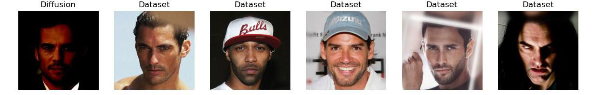
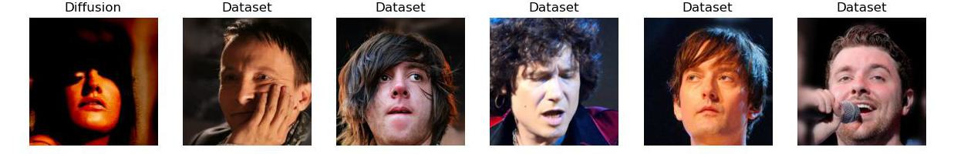
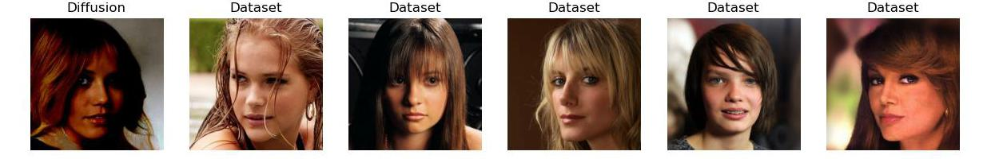
Generated output
Training dataset
Fig: Left column: Generated samples from the DDGAN model,
Right columns: Top-5 nearest neighbour matches from the training set

Slide 30
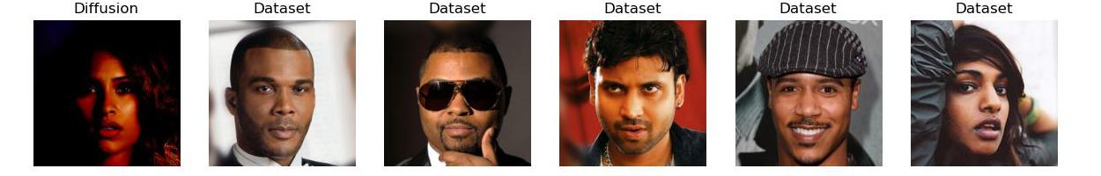
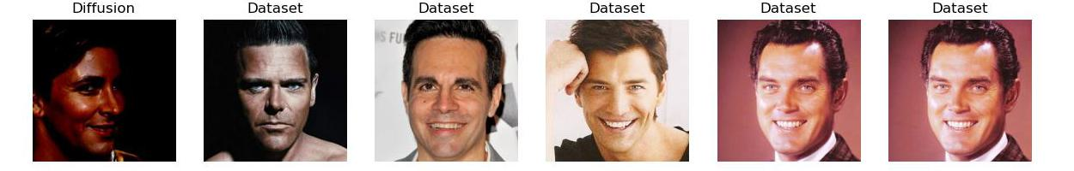
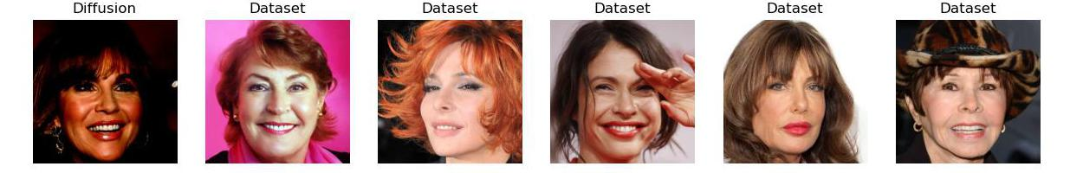
Generated output
Training dataset
Fig: Left column: Generated samples from the DDGAN model,
Right columns: Top-5 nearest neighbour matches from the training set

Slide 31
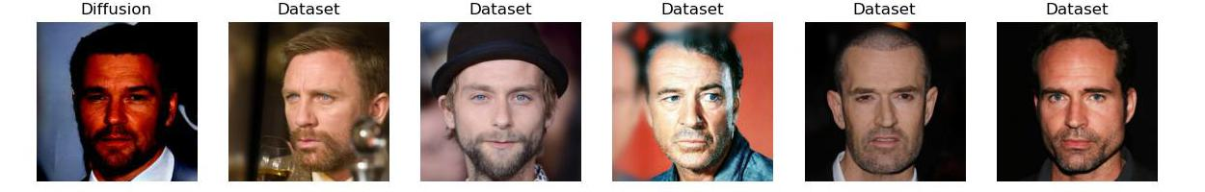
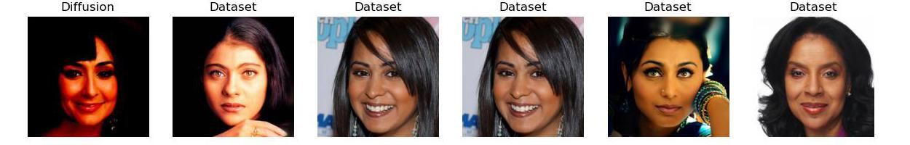
Generated output
Training dataset
Fig: Left column: Generated samples from the DDGAN model,
Right columns: Top-5 nearest neighbour matches from the training set

Slide 32
DiffusionGAN: (110 epoch) – Generated output (3000 samples) on Fairface

Slide 33
Racial imbalance in Gender
Gender imbalance in Race

Slide 34
CelebA-HQ dataset

Slide 35
Comparison: Race
Train Data
Generated Data - DDGAN
Generated Data - DDPM
Generated Data – Stable Diffusion
Train data has 72% White, and 13% Asian
Stable diffusion generates more White images
More bias
DDPM and DDGAN attempt to generate similar distribution

Slide 36
Comparison: Gender
Train Data
Generated Data - DDGAN
Generated Data - DDPM
Generated Data – Stable Diffusion
Train data has 2/3rd female
All models maintains almost the same bias

Slide 37
Comparison: Age
Train Data
Generated Data - DDGAN
Generated Data - DDPM
Generated Data – Stable Diffusion
Train data has 2/3rd young people
All models maintains the same bias
Diffusion models trained on CelebA-HQ faces are biased to generate Young white female faces

Slide 38
Comparison: Racial imbalance in Gender
In training data, even across gender (male & female), White faces are more predominant
All models almost maintains the same bias across races in gender as of the training data
DDGAN & DDPM generates more Asian female faces
Stable Diffusion generates more Female white faces
Train Data
Generated Data - DDGAN
Generated Data - DDPM
Generated Data – Stable Diffusion

Slide 39
Comparison: Gender imbalance in Race
a
Train Data
Generated Data - DDGAN
Generated Data - DDPM
Generated Data – Stable Diffusion

Slide 40
Fairface dataset

Slide 41
Comparison: Race
Train Data
Generated Data - DDGAN
Generated Data - DDPM
Generated Data – Stable Diffusion

Slide 42
Comparison: Gender
Train Data
Generated Data - DDGAN
Generated Data - DDPM
Generated Data – Stable Diffusion

Slide 43
Comparison: Age
Train Data
Generated Data - DDGAN
Generated Data - DDPM
Generated Data – Stable Diffusion

Slide 44
Perspective: Racial imbalance in Gender
Train Data
Generated Data - DDGAN
Generated Data - DDPM
Generated Data – Stable Diffusion

Slide 45
Comparison: Gender imbalance in Race
Train Data
Generated Data - DDGAN
Generated Data - DDPM
Generated Data – Stable Diffusion

Slide 46
Appendix

Slide 47
CelebA-HQ – Training dataset (27000 samples)

Slide 48
Fairface – Training dataset (86744 samples)

Slide 49
DDPM: Generated output (2716 samples) on CelebA-HQ

Slide 50
DDPM: (75 epoch) – Generated output (3000 samples) on Fairface

Slide 51
SD: Generated output (3000 samples) on CelebA-HQ

Slide 52
DiffusionGAN: Generated output (3000 samples) on CelebA-HQ

Slide 53
DiffusionGAN: (110 epoch) – Generated output (3000 samples) on Fairface

Slide 54
CelebA-HQ – Val 3000 samples

Slide 55
Fairface – Val 10954 samples

Slide 56
CelebA-HQ – Train 27000 samples
Row Labels | Count of face_name_align | %age
Asian | 3356 | 12.43
Black | 2475 | 9.17
Indian | 1631 | 6.04
White | 19538 | 72.36
Grand Total | 27000 | 100

