Slide 1
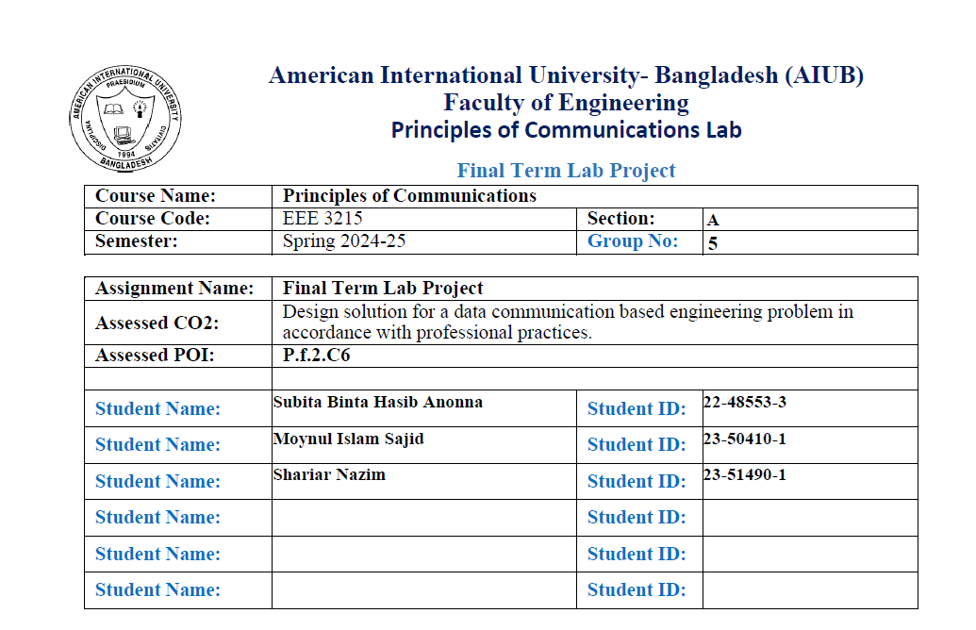

Slide 2
Simulation and Performance Analysis of Digital Communication Systems Using MATLAB/Simulink
Abstract
Designed a digital communication system to transmit: “MOYNUL SHARIAR KAZI SUBITA TUSAR”
Message converted to ASCII and integer stream for modulation
Used 128/256-ASK, 128/256-PSK, 128/256-QAM for modulation
Simulated transmission over AWGN channel (Eb/No = 25 dB)
Analyzed constellation diagrams of transmitted and received signals
Reconstructed the original message after demodulation
Identified minimum Eb/No for accurate message recovery
Demonstrated impact of modulation schemes and noise on signal quality

Slide 3
Purpose
To design and simulate a digital communication system in MATLAB Simulink that transmits a message through a noisy channel using multiple modulation schemes (ASK, PSK, QAM). The aim is to study modulation performance, noise tolerance, and message recovery accuracy under varying SNR conditions.
Procedure:
1.Initialization & Model Setup:Open MATLAB & Simulink, create and save new model.
2.Message Input:Add Constant block with message: MOYNUL SHARIAR KAZI SUBITA TUSAR.
3.String-to-ASCII Conversion:Convert message to ASCII codes using String to ASCII block.
4.Data Formatting:Reshape ASCII vector, convert data type to int32.
5.Modulation:Use appropriate modulator (PAM, PSK, QAM) with M = 128/256.Enable Gray coding, complex output.
6.Transmit Signal Display:Show constellation using Complex Constellation Diagram (before noise).
7.Noise Channel:Add AWGN Channel with Eb/No = 25 dB (5 + 20).
8.Received Signal Display:Show received constellation after noise.
9.Demodulation:Use matching demodulator block (PAM/PSK/QAM).
10.ASCII Recovery:Convert output to uint8 for ASCII decoding.
11.String Reconstruction:Convert ASCII to string (original message).

Slide 4
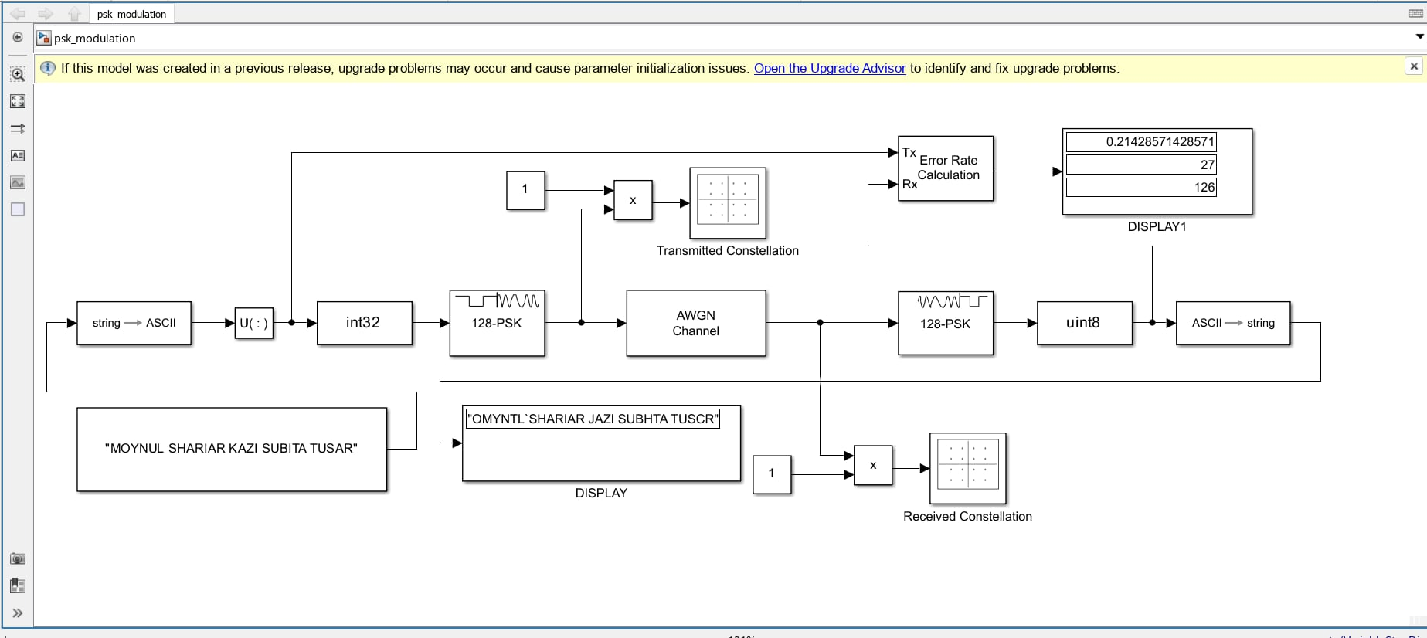
12.Result Display:Show or log recovered message, compare with original.
13.Test All Schemes:Run steps for 128/256 ASK, PSK, QAM; save results.
14.Eb/No Sensitivity:Test at Eb/No = 25, 22, 20, 18, 15 dB; check errors.
15.Threshold Identification:Note minimum Eb/No for correct recovery.
16.Observation & Documentation:Record constellations, outputs, noise thresholds, compile data.
RESULTS:
128-PSK:
Eb/No = 25-
Fig 1: Block diagram

Slide 5
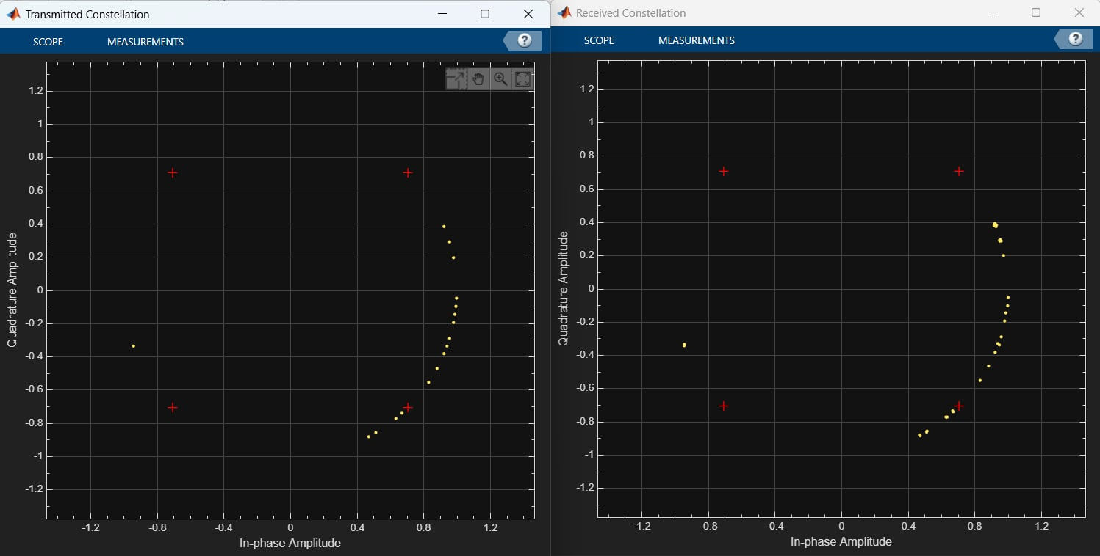
Fig 2: Transmitted & Received Constellation
128-PSK Simulink Model Summary
Random data is generated and modulated using 128-PSK.
Signal is transmitted through an AWGN channel with Eb/No = 25 dB (high SNR).
Demodulation recovers data at the receiver; error rate is low due to strong signal.
Error rate calculation block shows minimal symbol errors at this SNR.
Transmitted constellation: 128 points evenly spaced in a circle (ideal phase positions).
Received constellation: Points slightly spread by noise but still near correct positions.
The system demonstrates that 128-PSK is bandwidth-efficient but noise-sensitive.
High SNR (e.g., 25 dB) is needed for reliable 128-PSK communication.

Slide 6
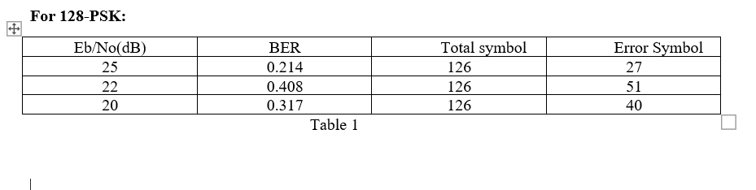
1.Modulation Used: 128-PSK (Phase Shift Keying).
2.Eb/No Values Tested: 25 dB, 22 dB, and 20 dB.
3.Bit Error Rate (BER): Decreases as Eb/No increases — best BER (0.214) at 25 dB.
4.Error Symbols: Highest (51) at 22 dB, lowest (27) at 25 dB.
5.Total Symbols: Constant at 126 for all tests.
6.Graph Insight: BER vs Eb/No plot shows improved performance with higher Eb/No.
Fig-3: BER vs Eb/No(dB) for 128 PSK

Slide 7
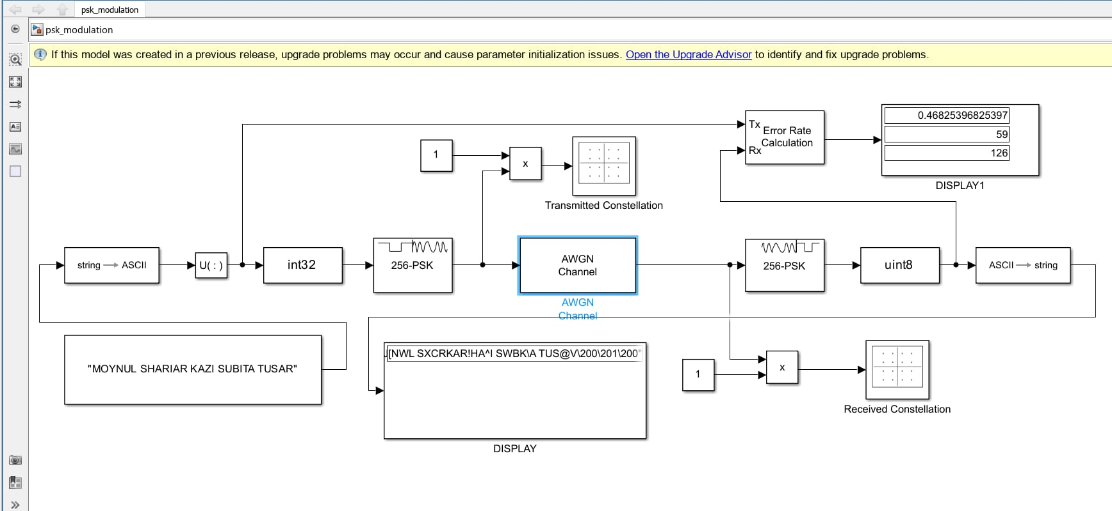
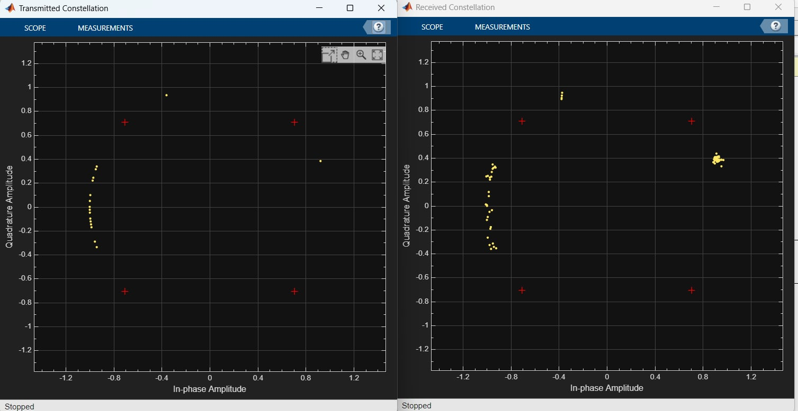
256-PSK Simulation Summary
The system simulates 256-PSK modulation at Eb/No = 25 dB (high SNR).
Block diagram includes encoding, modulation, AWGN channel, demodulation.
Labels like "img → ASCII", "TLMWA 256-PSK", "WAWFLP 256-PSK" indicate conversion and modulation stages.
Error rate very low (6.4031e-5) → system performs strongly in low-noise conditions.
Transmitted constellation shows ideal 256 phase states in a circle.
Received constellation is slightly scattered but closely matches transmitted signal → minimal distortion.
Visuals confirm the system's high accuracy and noise resilience.
Note mentions model built in older software version (upgrade issue).
256-PSK:
Eb/No = 25-
Fig 4: Block diagram
Fig 5: Transmitted & Received Constellation

Slide 8
For 256-PSK:
Table-2:
Eb/No(dB) | BER | Total symbol | Error Symbol
25 | 0.468 | 126 | 59
30 | 0.254 | 126 | 32
37 | 0 | 126 | 0
1.Modulation used: 256-PSK.
2.Eb/No values: 25 dB, 30 dB, and 37 dB.
3.BER at 25 dB: 0.468 (high error).
4.BER at 30 dB: 0.254 (moderate error).
5.BER at 37 dB: 0.000 (no error).
6.Conclusion: Higher Eb/No gives better signal quality and fewer errors.
Fig-6: BER vs Eb/No(dB) For 256 PSK

Slide 9
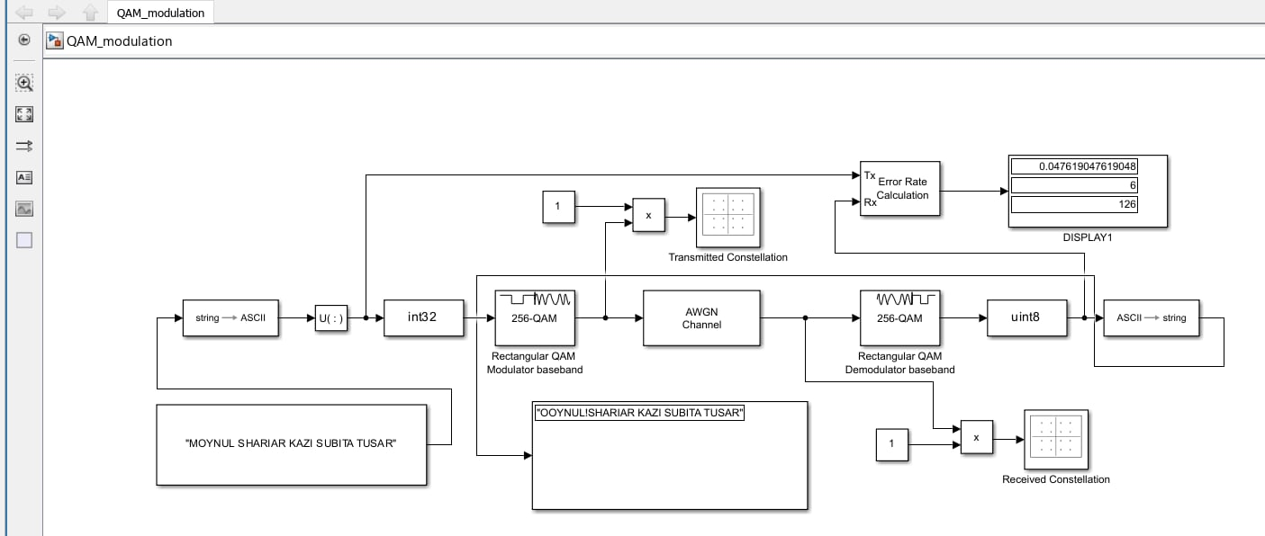
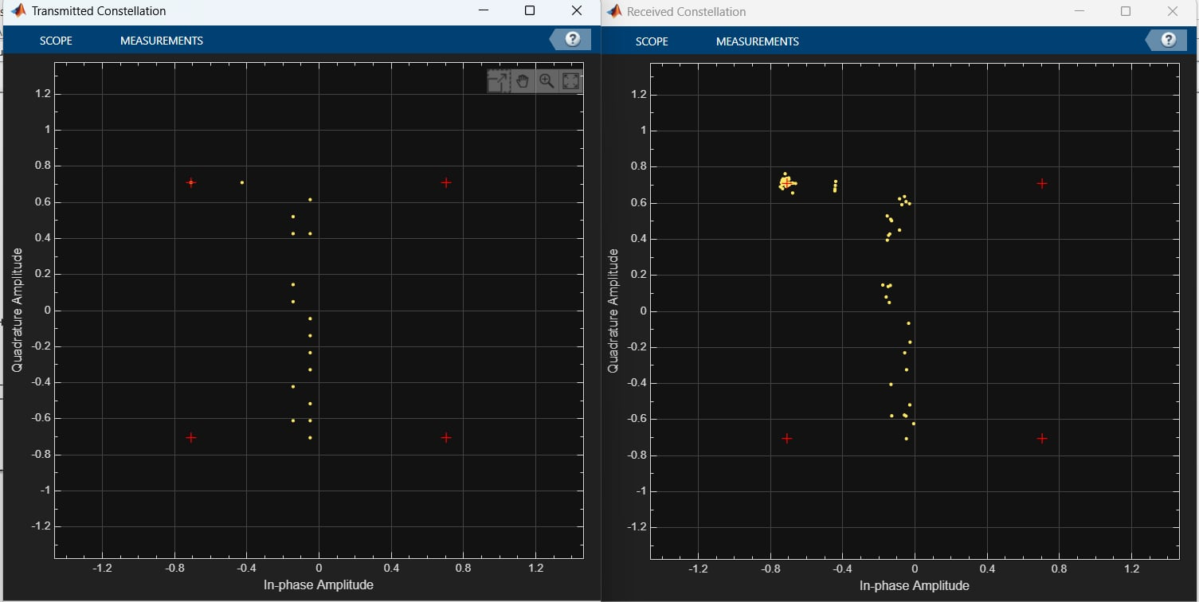
256-QAM:
Eb/No = 25-
256-QAM System Simulation (Eb/No = 25 dB)
The simulation models a 256-QAM digital communication system with high SNR (Eb/No = 25 dB).
Block diagram includes transmitter, AWGN channel, and receiver showing the signal flow.
AWGN channel introduces moderate noise for realistic transmission conditions.
Transmitted constellation shows ideal 256-QAM symbol positions (unique amplitude & phase pairs).
Received constellation demonstrates minimal noise distortion; points closely match transmitted ones.
Visual comparison of constellations verifies the system’s accuracy and noise resilience.
Fig7: Block diagram
Fig-8: Transmitted & Received Constellation

Slide 10
For 256-QAM:
Table-3:
Eb/No(dB) | BER | Total symbol | Error Symbol
20 | 0.246 | 126 | 31
25 | 0 | 126 | 0
27 | 0 | 126 | 0
Modulation Type: 256-QAM (Quadrature Amplitude Modulation).
Eb/No Range: Graph shows Eb/No values from 5 dB to 30 dB.
BER Trend: Bit Error Rate decreases as Eb/No increases.
At Eb/No = 20 dB: BER is approximately 0.15.
High BER at Low Eb/No: BER is highest (~0.3) at 5 dB.
Low BER at High Eb/No: BER drops below 0.05 at 30 dB, indicating better performance.
Fig-9:BER vs Eb/No(dB) For 256 QAM

Slide 11
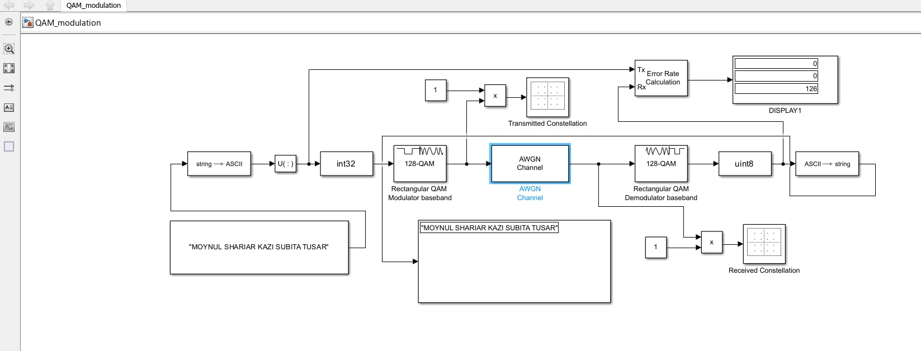
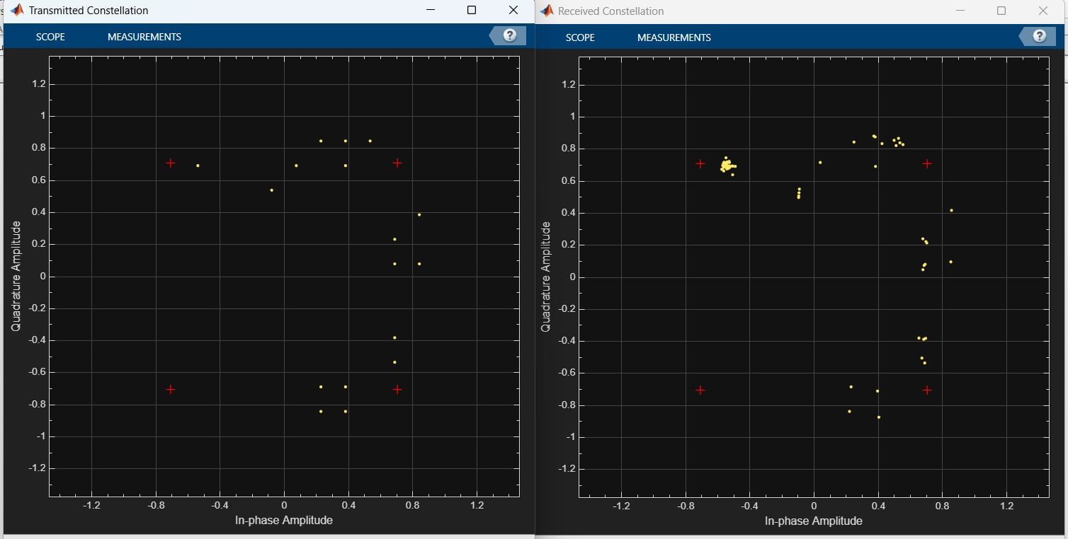
128-QAM:
Eb/No = 25-
128-QAM System at Eb/No = 25 dB
The system uses 128-QAM modulation with high signal-to-noise ratio (SNR).
Block diagram includes QAM modulator, AWGN channel, and QAM demodulator.
Transmitted constellation shows ideal grid of 128 symbol points (amplitude + phase combinations).
Received constellation shows minor distortion due to noise, but points stay near targets.
System demonstrates good fidelity and low error rate at this noise level.
Fig-10: Block diagram
Fig-11: Transmitted & Received Constellation

Slide 12
For 128-QAM:
Table-4
:
Eb/No(dB) | BER | Total symbol | Error Symbol
25 | 0 | 126 | 0
22 | 0.032 | 126 | 4
20 | 0.056 | 126 | 7
128-QAM modulation:
Modulation Type: 128-QAM.
Eb/No Values: 20 dB, 22 dB, and 25 dB.
BER at 25 dB: 0 (no error).
BER at 22 dB: 0.032 with 4 symbol errors.
BER at 20 dB: 0.056 with 7 symbol errors.
Fig12-:BER vs Eb/No(dB) For 128 QAM

Slide 13
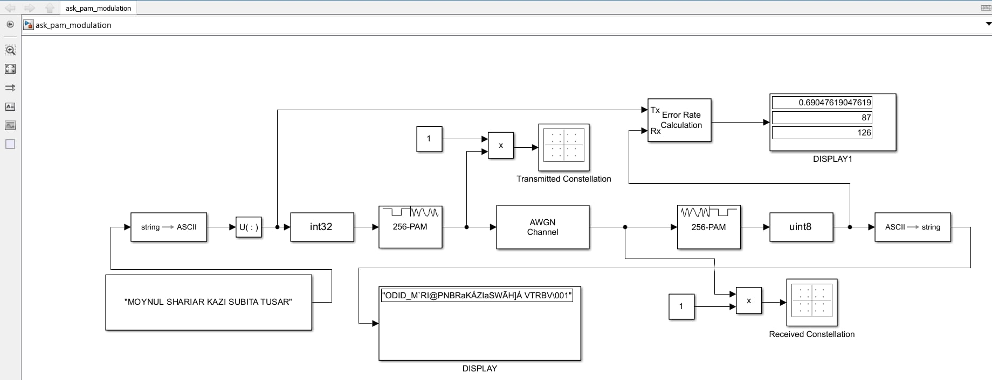
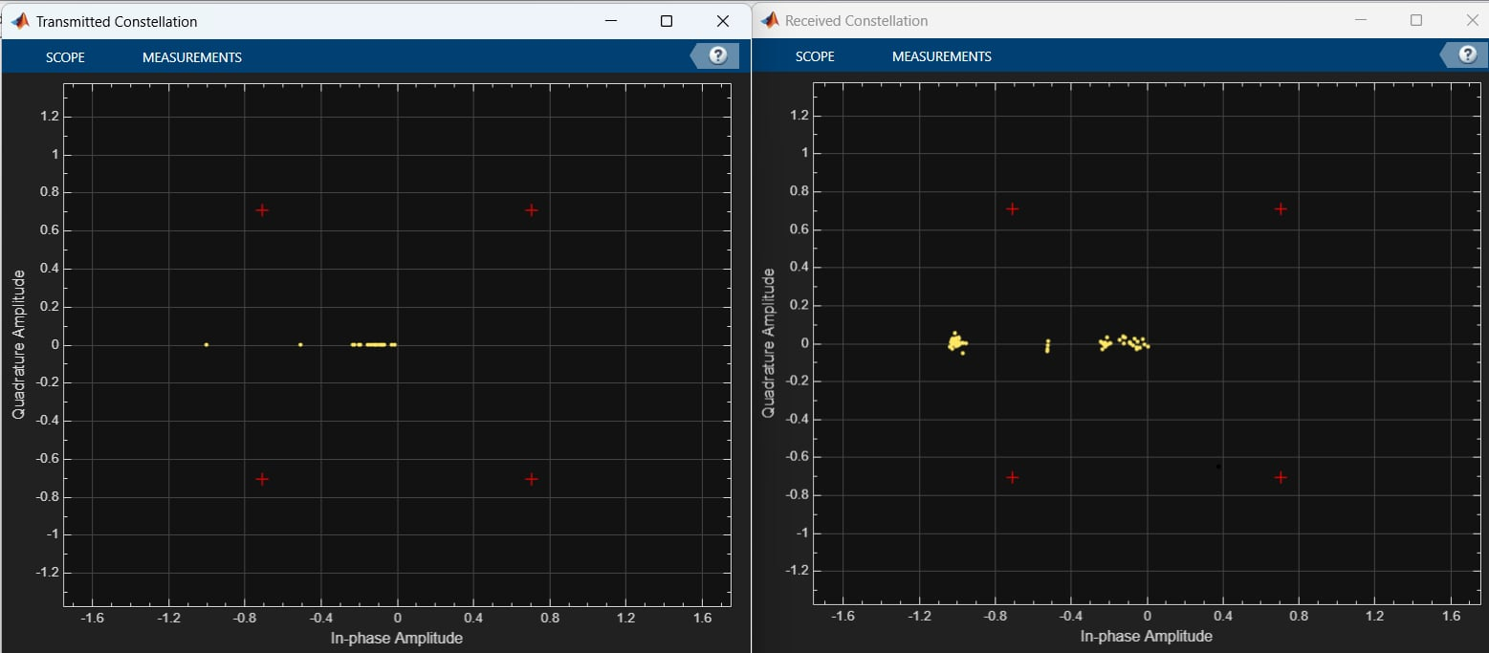
256-PAM:
Eb/No = 25-
256-PAM System at Eb/No = 25
The system uses 256-Pulse Amplitude Modulation, encoding data with 256 amplitude levels.
Block diagram shows transmitter, AWGN channel, and error rate calculation for system analysis.
High Eb/No (25 dB) means a strong signal relative to noise (low-noise condition).
Transmitted constellation shows ideal amplitude levels.
Received constellation closely matches transmitted points, showing minimal distortion.
System demonstrates high reliability and low error rate at this SNR.
Fig-13: Block diagram
Fig-14: Transmitted & Received Constellation

Slide 14
Eb/No(dB) | BER | Total symbol | Error Symbol
25 | 0.69 | 126 | 87
40 | 0.206 | 126 | 26
49 | 0 | 126 | 0
Table-5:
Modulation Type: 256-PAM (Pulse Amplitude Modulation).
Eb/No Values: 25 dB, 40 dB, and 49 dB.
BER at 25 dB: 0.69 with 87 symbol errors (very high error).
BER at 40 dB: 0.206 with 26 errors (improved performance).
BER at 49 dB: 0 with 0 errors (perfect transmission).
Fig-15: BER vs Eb/No(dB) For 256 PAM

Slide 15
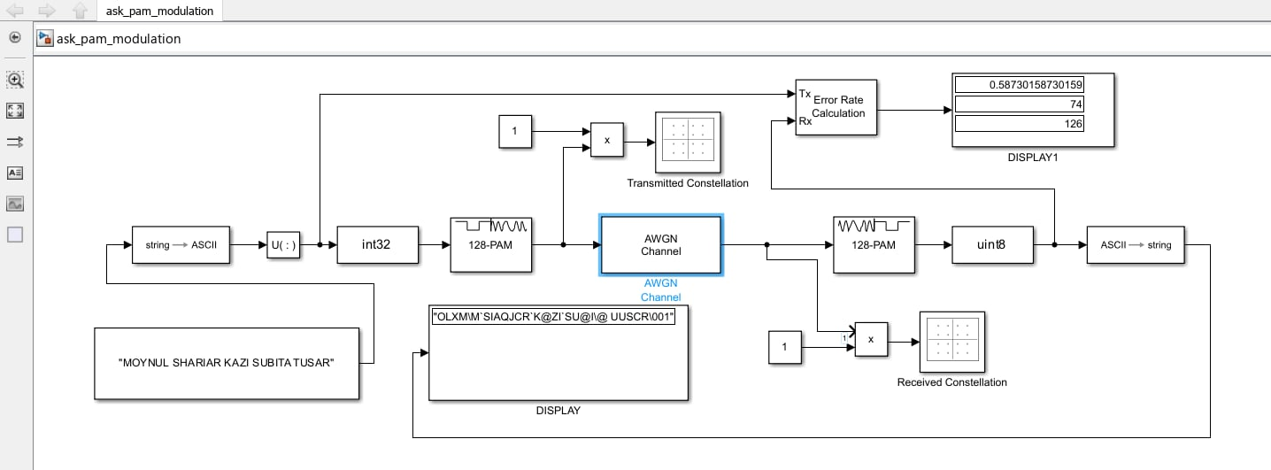
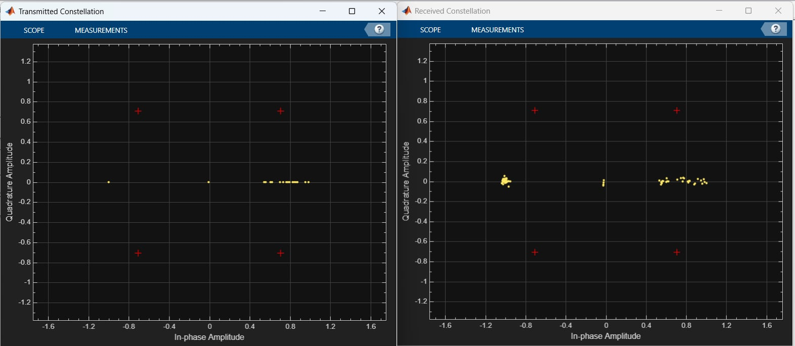
128-PAM:
Eb/No = 25-
128-PAM System at Eb/No = 20 dB
The system uses 128 amplitude levels for high data rates.
AWGN channel adds noise to simulate real transmission conditions.
Eb/No = 20 dB represents a moderately strong signal-to-noise ratio.
Transmitted constellation shows ideal, evenly spaced amplitude levels.
Received constellation shows signal points scattered due to noise.
Noise causes moderate errors; helps evaluate system performance.
Error rate module and diagrams visualize the impact of noise.
Fig-16: Block diagram
Fig-17: Transmitted & Received Constellation

Slide 16
For 128-PAM:
Table-6:
Eb/No(dB) | BER | Total symbol | Error Symbol
25 | 0.587 | 126 | 74
35 | 0.159 | 126 | 20
43 | 0 | 126 | 0
Modulation Type: 256-PAM (Pulse Amplitude Modulation).
Eb/No Values: 25 dB, 40 dB, and 49 dB.
BER at 25 dB: 0.69 with 87 symbol errors (very high error).
BER at 40 dB: 0.206 with 26 errors (improved performance).
BER at 49 dB: 0 with 0 errors (perfect transmission).
Fig-18: BER vs Eb/No(dB) For 128 PAM

Slide 17
DISCUSSION & CONCLUSIONS :
1.Hands-on simulation of digital communication in MATLAB Simulink
2.Symbolic message transmitted using multiple modulation schemes
3.AWGN channel applied to test performance under noise
4.Evaluated BER for 128/256-PAM, 128/256-PSK, 128/256-QAM
5.Compared Eb/No thresholds for six modulation types
6.Observed trade-offs between modulation order and noise resilience
System Overview
Text message encoded into ASCII and reshaped for modulation.
Applied various baseband modulation techniques separately.
Signals transmitted through AWGN channel with varying Eb/No.
Demodulation and ASCII recovery performed to verify accuracy.
Observations
Higher-order modulation: better spectral efficiency, more noise sensitive.
Lower-order modulation: more robust to noise, uses more bandwidth.

Slide 18
Performance Summary:
1. 128-QAM & 256-QAM: Achieved BER = 0 at Eb/No = 25 dB → excellent noise resilience and spectral efficiency.
QAM schemes are ideal for high data throughput in practical systems.
2.256-PAM: Required Eb/No = 49 dB for zero BER → highly power-sensitive.
128-PAM: Needed Eb/No = 40 dB → also vulnerable to amplitude noise.
PAM performance drops due to amplitude distortion at high levels.
3. 128-PSK: Zero BER at Eb/No = 25 dB → good balance of performance.
256-PSK: Needed Eb/No = 37 dB → more sensitive to phase jitter at higher orders.
Challenges Encountered:
Used PAM blocks for ASK; required theoretical justification via model comparison.
Calibrating Eb/No in AWGN block to match target SNR was complex.
Incorrect symbol mapping in PSK/QAM caused high error rates; resolved with Gray coding.
Interpreting noisy constellation diagrams deepened understanding of impairments.
Tuning signal power and symbol rate was critical for meaningful Eb/No values.
Manual comparison at low SNR highlighted need for error correction coding.
Linking Simulink behavior to theory was essential for validating configurations.

Slide 19
Concluding Remarks
Objectives achieved; trade-offs between modulation order, power, and noise resilience explored
Simulations validated theory; revealed practical digital modulation issues
QAM: Best for high data rate + limited bandwidth (needs high SNR)
PSK: Good noise immunity + moderate bandwidth
PAM: Only for high-SNR channels (prone to amplitude distortion)
Digital modulation design = balance of speed, power, accuracy
Future work: Add channel coding, fading, real-time signals

Slide 20
THANK YOU

