Slide 1


Slide 2

Value semantics
Author: Sioux Technologies

Slide 3
Semantics
Value semantics
Reference semantics
Notes:
In C++ we have two formas of semantics
- value semantics
- reference semantics

Slide 4
Reference semantics
Reference variables
May refer to any memory location that holds a type-compatible object
Many reference variables per object possible
Llifetimes of variable and referenced object are independent
Base b; Derived &d = b;
int &b = a; int &c = a;
Base b; { Derived &d = b; }
Notes:
Even though it’s called “reference semantics” it’s just terminology.
C++ references are a mix of reference and value semantics.
A pointer does adhere more to the value semantics

Slide 5
Reference semantics
Reference members
Refer to separately stored objects
Have independent lifetimes from referenced objects

Slide 6
Reference semantics
Shallow copying
Produces a new reference to the same object
Shallow assignment
Destination variable refers to the same object as the source variable
Identity-Based Comparison
Objects are identical, if their memory addresses are equal
Notes:
In c++ references are a mix of reference and value semantics
int &a;
int &b;
a == b; will compare the value not the reference
&a == &b will compare the reference

Slide 7
Value semantics
Value variables
Refer to objects itself, i.e., one specific memory location
Exactly one value variable per object
lifetimes of variable and associated object are identical.
A a; int b; double c;

Slide 8
Value semantics
Value Members
Are stored as part of the containing object
Refer to objects with the same lifetime as the containing object
struct A { int a; double b; B c; };

Slide 9
Value semantics
Deep copying
Produces a new, independent object; object (member) values are copied
Deep assignment
Makes value of target object equal to that of the source object
Done by (recursively) copy-assigning members
Equality-based comparison
Objects are equal, if their (member) values are equal

Slide 10
Value/Reference semantics in C++
Default: value semantics for fundamental types and user-defined types
Reference semantics for C-arrays and C-strings
Optional reference semantics (through references*/pointers) for all types
*References do not fully provide reference semantics. Comparison for example is based on value.
Notes:
References do not fully provide reference semantics. Comparison for example is based on value.

Slide 11
Value/Reference semantics in C++
std::any
std::variant
std::string*
std::string_view*
Notes:
A lot of operations on std::string adhere to value semantics (substr)
String_view itself adheres to value semantics, but it refers to an object somewhere else

Slide 12
What’s better/easier to use?
Value semantics
Reference semantics
int i = 0; int copy = i; std::vector<int> v;
do_i_keep_a_reference(A &a); do_i_take_ownership(A &a);
Base *i = new Derived(); Base *copy = i->clone(); std::vector<Base*> v;
do_i_keep_a_reference(A a); do_i_take_ownership(A a);
Notes:
What is wrong with the vector of base pointers?
How can we fix this? (unique_ptr)

Slide 13
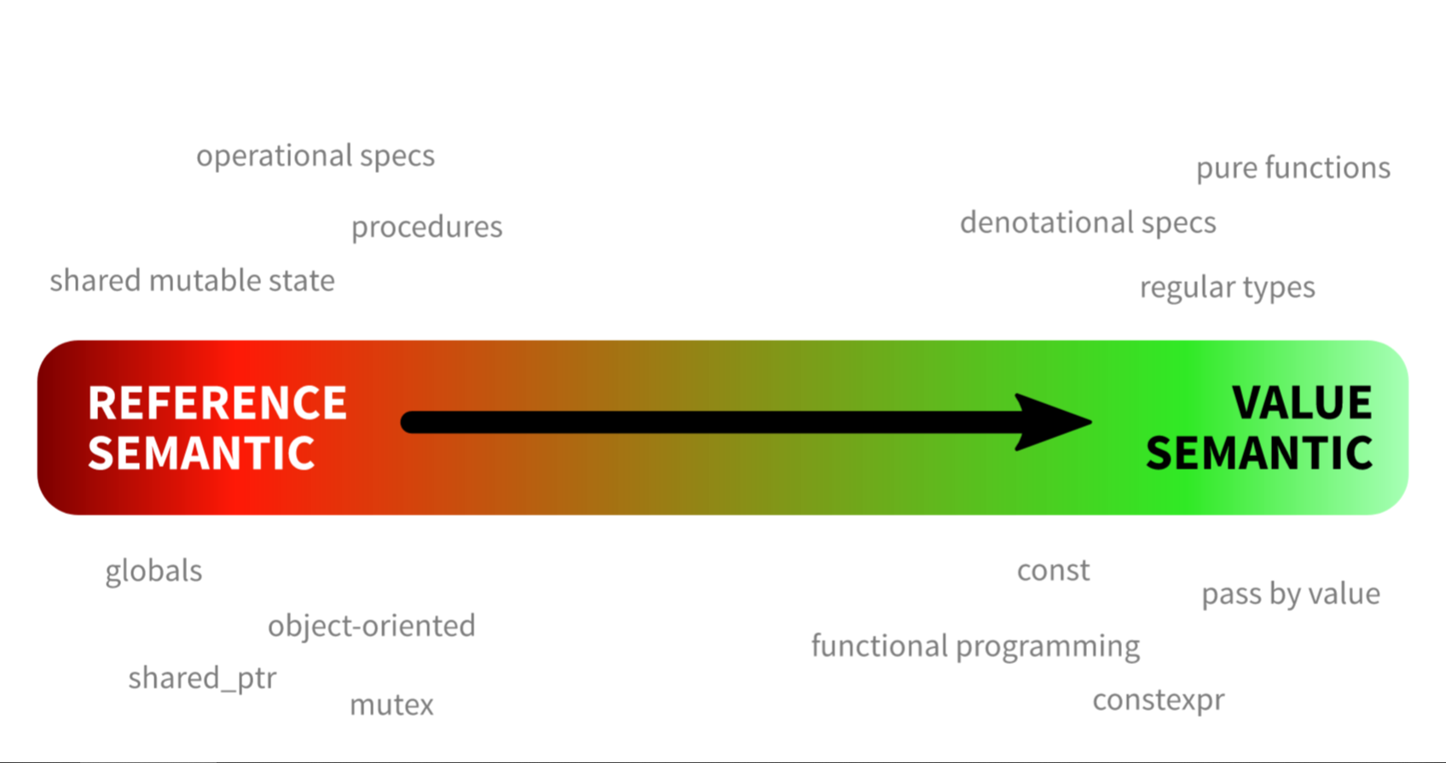
Notes:
So we want to move more to value semantics

Slide 14
Why don’t we always use value semantics?
Slicing
Performance
Derived d; Base b = d;
LargeObject a; LargeObject b = a;

Slide 15

Problem
Undo buffer
Saver thread
Render thread
DATA MODEL
App Logic
Notes:
All operations need access to the same model

Slide 16
Problem
Undo buffer
Saver thread
COPY
COPY
Render thread
COPY
DATA MODEL
App Logic
COPY
Notes:
We just saw how great value semantics are. So let’s apply them here.
All these copies can only work with small data structures.

Slide 17
Problem
Undo buffer
Saver thread
REFERENCE
REFERENCE
Render thread
REFERENCE
DATA MODEL
App Logic
REFERENCE
Notes:
So we immediatly fall back to our old ways

Slide 18

Problem
Undo buffer
Saver thread
REFERENCE
REFERENCE
Render thread
REFERENCE
DATA MODEL
App Logic
REFERENCE
Notes:
Now we need to add locks everywhere
And need to add notifiers to keep everything up to date

Slide 19
Mutability => pass by value => copying
Notes:
Since the data structure can change we want to pass it by value.
And thus create a copy of it.

Slide 20

Mutability => pass by value => copying
Notes:
But what if passing by value doesn’t need to result in a copy.

Slide 21
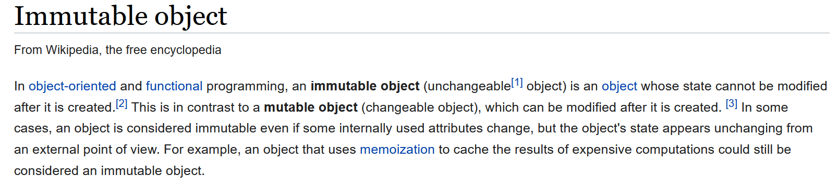
Immutable data structures

Slide 22
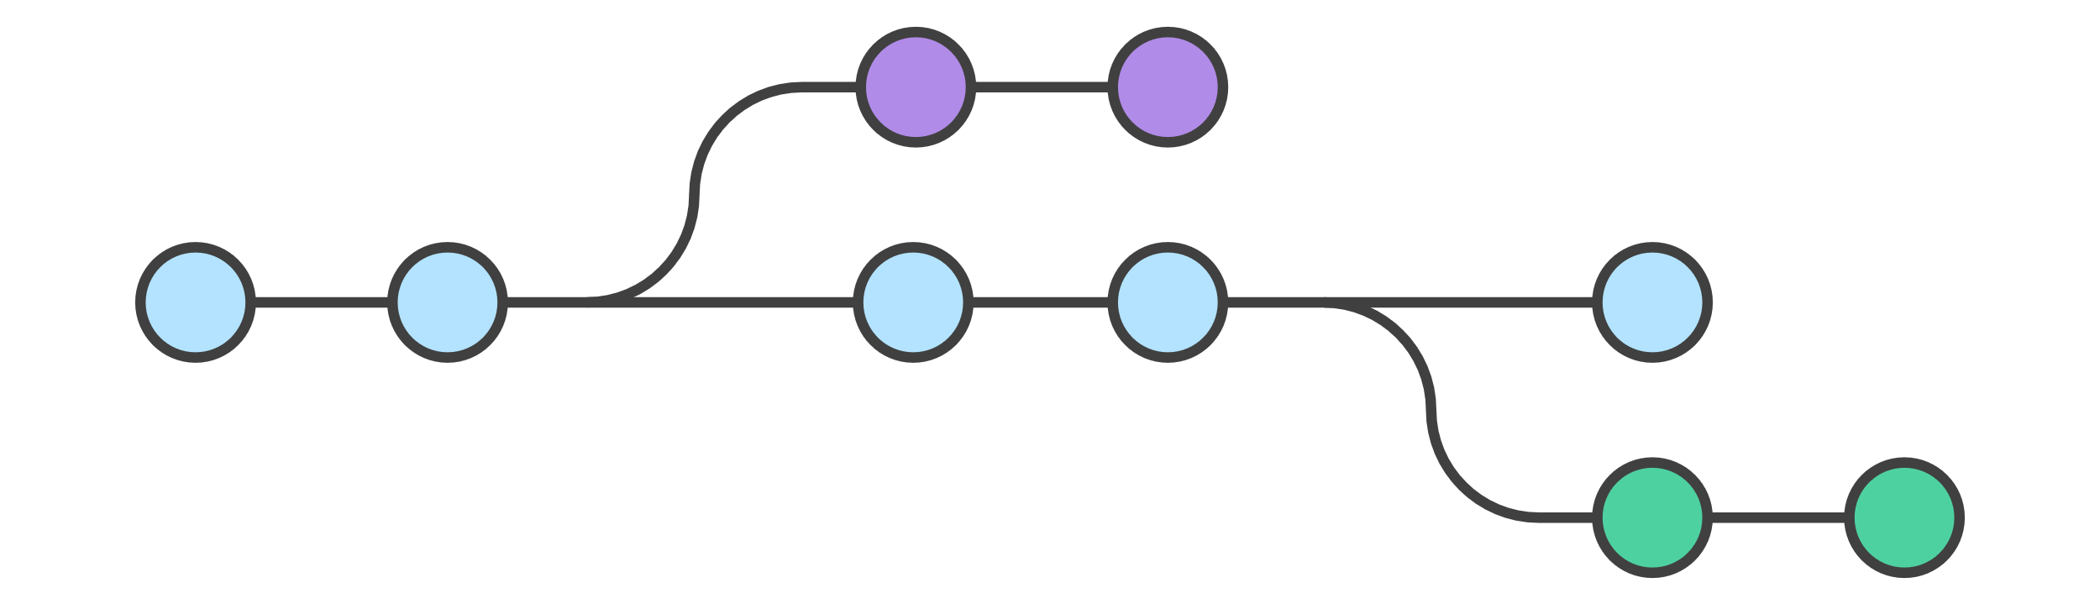
Immutable data structures
Notes:
You can compare it a bit with a source control system.

Slide 23
Immutable data structures
const auto v0 = std::vector<int>();
const auto v1 = v0.push_back(15);
const auto v2 = v1.push_back(16);
const auto v3 = v2.set(0, 42);
assert(v2.size() == 2);
assert(v3[0] == v1[0]);
One with all methods marked const
Persistent
Notes:
Persistent (old values are preserved)

Slide 24
Immutable data structures
Structural sharing
No copying
Fast comparison

Slide 25
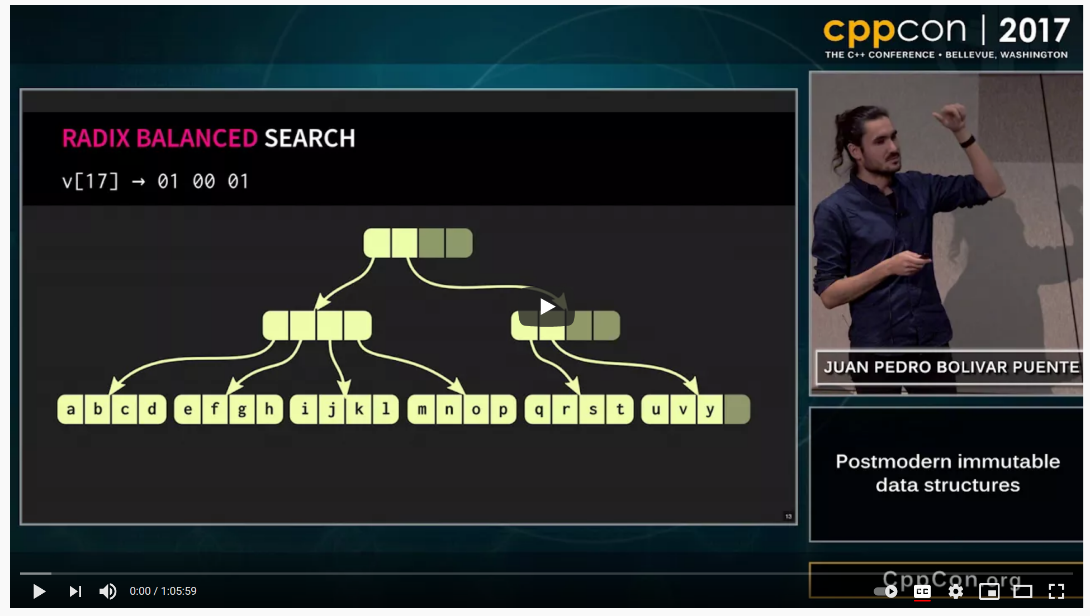
Notes:
https://youtu.be/sPhpelUfu8Q?t=594
Let’s watch at how structural sharing works

Slide 26
Advantages
Inherently thread safe
Easy to use
Performant

Slide 27
Immutable data structures
Immer https://github.com/arximboldi/immer
Lager https://github.com/arximboldi/lager
Immutable-cpp https://github.com/rsms/immutable-cpp

Slide 28
Real life use-case
Photoshop
Facebook
Ewig (editor) https://github.com/arximboldi/ewig/tree/master/src/ewig

Slide 29
Type erasure
Author: Sioux Technologies

Slide 30
Value semantics for class hierarchy
How do get value semantics for base classes?
Base &a; auto b = a;
Notes:
How do we get value semantics with base classes.
In this case we will get slicing

Slide 31
Value semantics for class hierarchy
What we want
Derived a; Base &b = a; auto c = b;
std::vector<Base> v; v.emplace_pack(Derived1()); v.emplace_pack(Derived2()); v.emplace_pack(Derived3());
Notes:
What we want is that in this example “c” is an instance of the derived class.
Or that we can add derived classes to a Base container (preserving the value semantics)

Slide 32
Type erasure
We want to generalize the concrete types to a common interface

Slide 33
Type erasure (Goal)
int main() { std::vector<Animal> v; v.emplace_back(Dog()); v.emplace_back(Cat()); for (auto &a : v) a.speak(); }
Notes:
The goal from the example we are going to make is to have two independent types that both support “speak” to live together in a container.

Slide 34
Type erasure
struct Vtable { void (*speak)(void *ptr); void (*destroy)(void *ptr); };
Notes:
We need to start out with our own vtable that contains all the behavior we require from our other types.

Slide 35
Type erasure
template <class Concrete> constexpr Vtable vtable_for { };
Notes:
Now we need to fill-in this vtable for the types we want to support.
We create a global variable for every type “Concrete” that will have the behaviour we want.

Slide 36
Type erasure
template <class Concrete> constexpr Vtable vtable_for { [](void *ptr){ static_cast<Concrete*>(ptr)->speak(); }, [](void *ptr){ delete static_cast<Concrete*>(ptr); }, };
Notes:
Lambdas without state decay to C-style function pointers

Slide 37
Type erasure
struct Animal { Animal(const T& t); ~Animal(); void speak(); void *m_concrete; const Vtable *m_vtable; };
Notes:
Now we need to define our ‘base’class
Constructor that takes in an arbitrary type.
A “speak”function
Two members:
a void pointer to the actual implementation
A pointer to the vtable

Slide 38
Type erasure
template<class T> Animal(const T& t) : m_concrete(new T(t)) , m_vtable(&vtable_for<T>)
{};
Notes:
Templated constructor.
You normally want to limit the type we get passed here.
We use out global variable as the vtable pointer
We now use ‘new’ but this can be changed with a small buffer implementation.

Slide 39
Type erasure
~Animal() { if (m_vtable) m_vtable->destroy(m_concrete); }
void speak() { if (m_vtable) m_vtable->speak(m_concrete); }
Notes:
Templated constructor.
You normally want to limit the type we get passed here.
We now use ‘new’but this can be changed with a small buffer implementation.

Slide 40
Type erasure
struct Dog { void speak() { std::cout << "Woof\n"; } };
struct Cat { void speak() { std::cout << "Meow\n"; } };
Notes:
We now create two independent types that both have the “speak” gift.

Slide 41
Type erasure
int main() { std::vector<Animal> v; v.emplace_back(Dog()); v.emplace_back(Cat()); for (auto &a : v) a.speak(); }
Notes:
Our example now works

Slide 42
Type erasure in the STL
std::any
std::variant
std::function
…

Slide 43
Other use case
You can’t extend a class with interfaces
Cleanup class hierarchy
Template cleanup
…

Slide 44
Future
C++23 reflection
Notes:
For c++23 there is a proposal for static reflection se we could automate this whole thing.

Slide 45
Source of your technology

