Slide 1


Slide 2

Couroutines
Author: Sioux Technologies

Slide 3
Coroutine
A generalization of a subroutine.
Retains the call/return operations.
Adds a suspend and a resume operation.

Slide 4
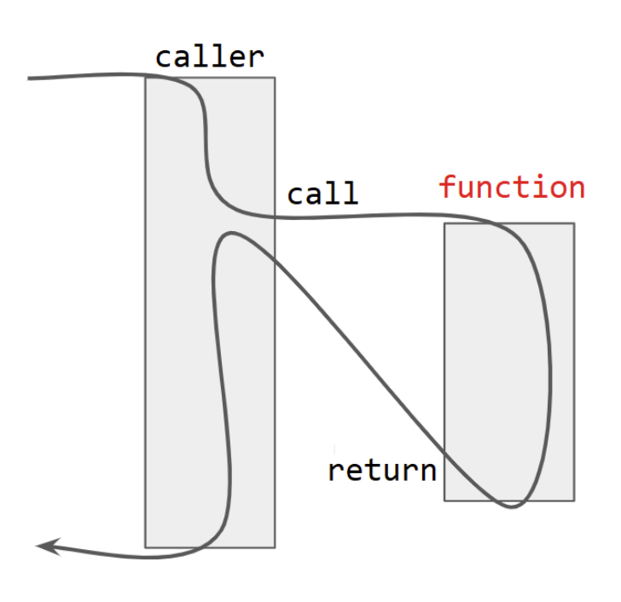
Functions

Slide 5
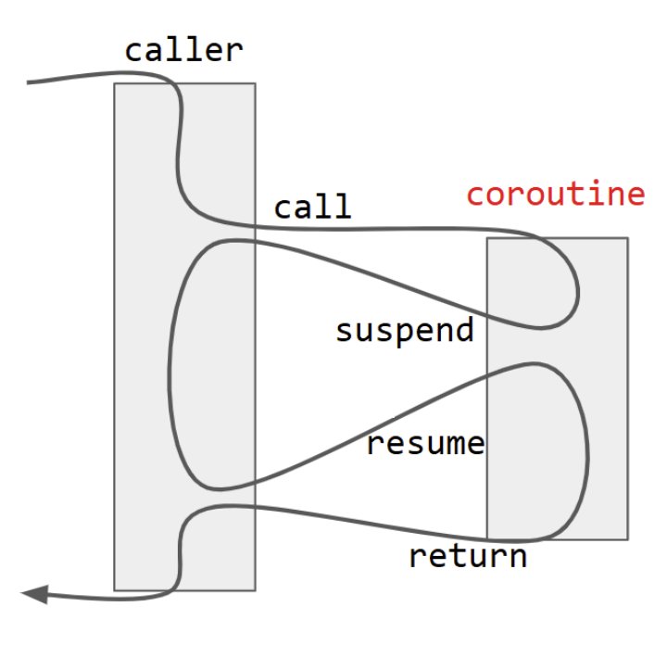
Coroutines

Slide 6
Coroutine
Allows developers to write code that looks linear and logical, however, the execution flow is a cooperative multitasking between the coroutines.
Natural use cases:
lazy generators
structured concurrency.
Reactive stream programming
Implementing state machines

Slide 7
Coroutines
Stackless
First-class
Offer asymmetric (or symmetric) transfer
“The most efficient, scalable, open ended, versatile coroutines.” – Gor Nishanov
Notes:
Even though it’s called “reference semantics” it’s just terminology.
C++ references are a mix of reference and value semantics.
A pointer does adhere more to the value semantics

Slide 8
Coroutines
Stackful
Save the whole stack on suspend. Can be suspended from within a nested stackframe. Execution resumes at exactly the same point in the code where it was suspended before.
Stackless
Only save the frame on suspend. Only the top-level routine may be suspended. Any routine called by that top-level routine may not itself suspend.
Notes:
Coroutines can be stackful or stackless.
Stackful: go, boost fibers, Rust, Python
Stackless: C++, Rust
Tldr: do we need a stack when being suspended, You can still call functions thus requiring a stack.

Slide 9
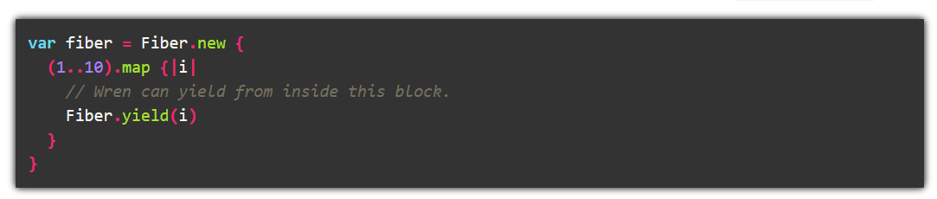
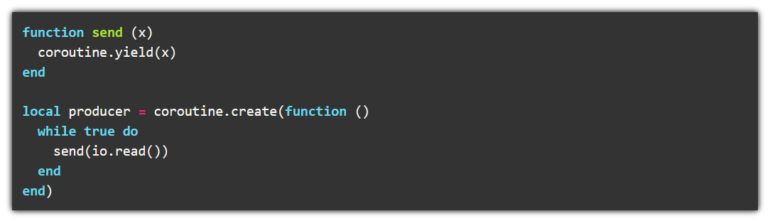
Stackful Coroutines
Notes:
Top example is written in Wren.
You can yield from within a lambda passed to a function.
Bottom example is Lua.
Same thing here, we yield from within a lambda
In both cases we need to preserve the whole stack if we suspend.

Slide 10
Coroutines
First-class
Can be stored in a data structure and passed around as a parameter
Constrained
Cannot be stored in a data structure and passed around as a parameter
Notes:
C++ coroutines are First-class citizens
The language provides a handle to the coroutine that can be saved

Slide 11
Coroutines
Asymetric
there is a stack-like caller–callee relationship between coroutines. A coroutine can either call another coroutine or suspend itself by yielding control to its caller
Symetric
A coroutine may yield control to any other coroutine without restriction.
Notes:
C++ uses symetric coroutines
Eventhough the two models actually have the same expressive power, symetric coroutines can do the same thing with less stack space.

Slide 12
Design goals
Scalable
The idea is that it should be able to support billions of coroutines
Efficient
resume and suspend operations comparable in cost to function call overhead
Open ended
Helps designers to develop coroutine libraries exposing high-level semantics, such as generators, green threads, tasks, and more.
Not based on exceptions

Slide 13
Coroutines
A coroutine is any function using any of the coroutine keywords:
co_return
Return a value and exit the coroutine (you can’t use a normal return statement)
co_yield
Return a value and suspend
co_await
causes the execution of the coroutine to be suspended or resumed
Notes:
C+20 introduces three new keywords.
Any function that uses one of these keywords is a coroutine

Slide 14
Coroutines
Cannot use:
variadic arguments
Plain return statements
Placeholder return types (auto)
Can’t be coroutines:
Constexpr functions
Constructors / Destructors
main

Slide 15
Goal
Acceptor acceptor{443}; while (true) { Socket socket= acceptor.accept(); // blocking auto request= socket.read(); // blocking auto response= handleRequest(request); socket.write(response); // blocking }
Acceptor acceptor{443}; while (true) { Socket socket= co_await acceptor.accept(); auto request= co_await socket.read(); auto response= handleRequest(request); co_await socket.write(response); }
Notes:
Just to remind you what our end goal is

Slide 16
Coroutines
int foo(){co_return 2;} // compilation error
int bar(){co_await 2;} // compilation error
int foo2(){return 2;} // ok
int bar2(){return 2} // ok
Notes:
Copy/paste into compiler explorer,
The compiler will give an error about the promise type

Slide 17
Cooncepts
Promise type
Defines the overall coroutine behaviour
Not to be confused with std::promise
Awaitable
Controls suspension and resumption bevaviour
Coroutine handle
Controls execution behaviour
Notes:
As the error from the previous slide indicates, we need some glue types to hold the coroutine together
Lewiss Baker has a few blog posts about coroutines and he introduced the concept of Awaiter and Awaitable.
These are not part of the standard, but used to differentiate between different responsibilities.
A coroutine can also be its own awaitable/awaiter

Slide 18
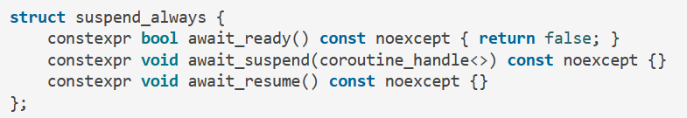
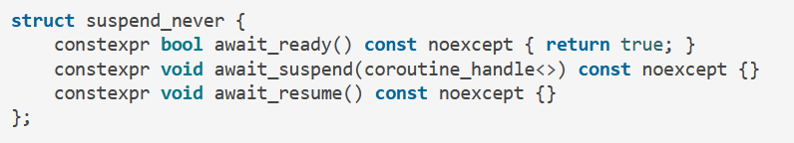
Awaitable
std::suspend_always
std::suspend_never
Notes:
C+20 introduces three new keywords.
Any function that uses one of these keywords is a coroutine

Slide 19
Coroutine handle
std::coroutine_handle<Promise>
Non owning
Can be created from the promise type
In a typical implementation holds a pointer to the coroutine state.
Can be used to check and resume the coroutine
https://en.cppreference.com/w/cpp/coroutine/coroutine_handle
Notes:
The promise type can be void. And all coroutine handles can be converted to std::coroutine_handle<void>
With type erasure (see previous chapters)

Slide 20
The return object
The return type of a coroutine requires a nested type “promise_type”.
Can be a “using” declaration or a real type
Requires a valid constructor (a default constr is enough)
A “get_return_object” method that returns the return type of the coroutine
An “initial_suspend” method returning an Awaitable
An “final_suspend” method returning an Awaitable

Slide 21
The return object
struct ReturnObject{ struct promise_type{ promise_type() = default; ReturnObject get_return_object() {return {}; } Awaitable initial_suspend() {return {};} Awaitable final_suspend() {return {};} void unhandled_exception(){} }; };
Notes:
This is the most basic form of a coroutine return object

Slide 22
The return object
ReturnObject foo() { co_await expr; }
Notes:
This is a coroutine that uses the just defined ReturnObject

Slide 23
The return object
struct ReturnObject { struct promise_type { ReturnObject get_return_object() { return {std::coroutine_handle<promise_type>::from_promise(*this)}; }
}; std::coroutine_handle<> h; ReturnObject(std::coroutine_handle<> handle):h{handle}{ } operator std::coroutine_handle<promise_type>() const { return h_; } };
Notes:
The return object from the previous slides canf’t actually be used to resume/pasue the coroutine.
We don’t have the handle to resume it. We need to change it to get the handle.

Slide 24
The return object
int main
{
std::coroutine_handle<> h = foo();
h.resume();
}
Notes:
This is how we can use the just created coroutine

Slide 25
The return object
Look at Ex1.cpp
Change the number of resumes, what happens?
Add your own co_awaits with suspend_always and suspend_never. What happens?
Remove a resume? What happens.
Can you write a while loop that runs the coroutine till the end?
Notes:
This is how we can use the just created coroutine

Slide 26
Lets dive deeper (coroutine start)
When a coroutine starts it:
Allocates the coroutine state object using the “operator new”
Copy all function params to the coroutine state
By value params are copied or moved
By reference params remain references (be careful here)
Calls the constructor of the promise object
Notes:
We saw a small and simple example of coroutines, let’s dive deeper to understand what’s actually happening

Slide 27
Lets dive deeper (coroutine start)
When a coroutine starts it:
Calls promise.get_return_object() and keeps the result in a local variable. This is returned to the caller when the coroutine suspends.
Call promise.initial_suspend() and co_await’s the result
When initial_suspend resumes, the body of the coroutine is executed

Slide 28
Lets dive deeper (coroutine suspension)
When a coroutine reaches a suspension point:
The return object is returned to the caller/resumer

Slide 29
Lets dive deeper (co_return)
When a coroutine reaches a co_return:
Calls promise.return_void() for
co_return;
co_return expr; where expr has type void
If the coroutine falls of the end of the body
Or calls promise.return_value(expr)

Slide 30
Lets dive deeper (co_return)
When a coroutine reaches a co_return:
Destroys all variables
Calls promise.final_suspend() and awaits the result

Slide 31
Lets dive deeper (destruction)
When a coroutine is destroyed:
Calls the destructor of the promise object
Calls the destructor of the function parameter copies
Calls operator delete for the coroutine state
Transfers execution back to the caller/resumer

Slide 32
Lets dive deeper
The awaitable interface specifies methods that control the semantics of a co_await expression. When a value is co_awaited, the code is translated into a series of calls to methods on the awaitable object that allow it to specify: whether to suspend the current coroutine, execute some logic after it has suspended to schedule the coroutine for later resumption, and execute some logic after the coroutine resumes to produce the result of the co_await expression.

Slide 33
Lets dive deeper
The awaitable interface:
co_await
The awaiter interface:
await_ready
await_suspend
await_resume

Slide 34
The awaitable
Obtaining the awaitable for “co_await expr”:
If promise.await_transform exists awaitable = promise.await_transform(expr)
Else
awaitable = expression
Notes:
If the promise type, P, has a member named await_transform then <expr> is first passed into a call to promise.await_transform(<expr>) to obtain the Awaitable value, awaitable. Otherwise, if the promise type does not have an await_transform member then we use the result of evaluating <expr> directly as the Awaitable object, awaitable.

Slide 35
The awaiter
Obtaining the awaiter from the awaitable:
If awaitable.operator co_await exists awaiter = awaitable.operator co_await()
Else
awaiter = awaitable
Notes:
Then, if the Awaitable object, awaitable, has an applicable operator co_await() overload then this is called to obtain the Awaiter object. Otherwise the object, awaitable, is used as the awaiter object.

Slide 36
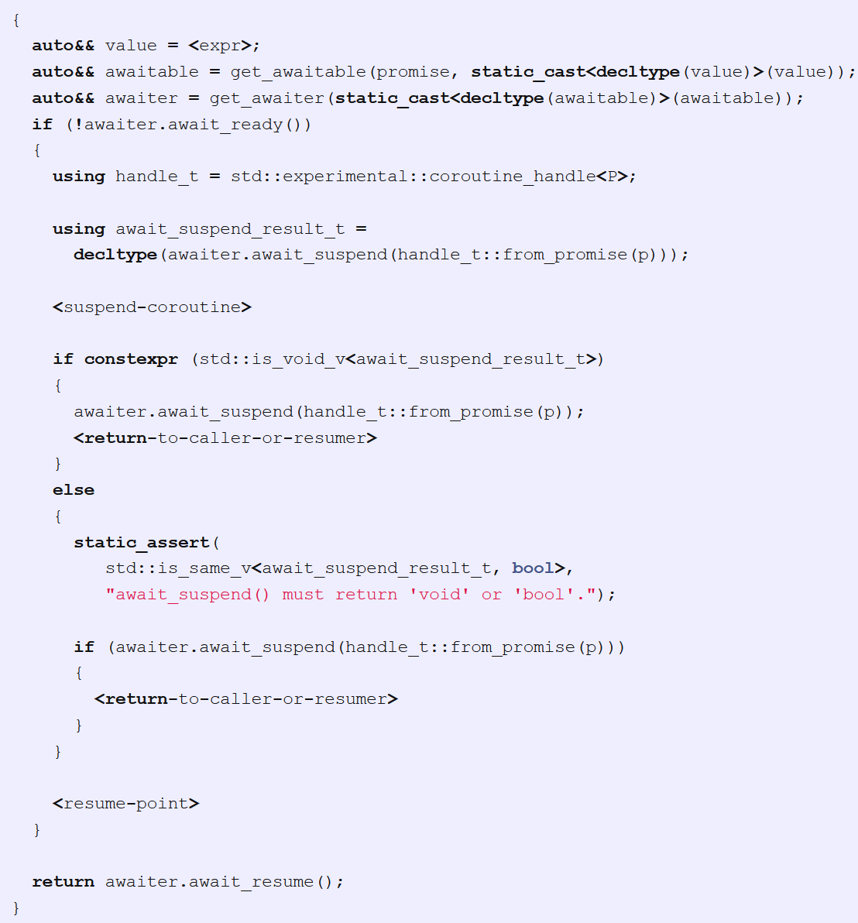
co_await
Notes:
This is pseudo code for a co_await call
The bool-returning version of await_suspend() can be useful in cases where the awaiter might start an async operation that can sometimes complete synchronously. In the cases where it completes synchronously, the await_suspend() method can return false to indicate that the coroutine should be immediately resumed and continue execution.

Slide 37
The awaiter
await_ready allow you to avoid the cost of the <suspend-coroutine> operation in cases where it is known that the operation will complete synchronously without needing to suspend.

Slide 38
The awaiter
await_suspend can be useful in cases where the awaiter might start an async operation that can sometimes complete synchronously. In the cases where it completes synchronously, the await_suspend() method can return false to indicate that the coroutine should be immediately resumed and continue execution. The first point at which you can observe the suspended coroutine. You need to schedule the coroutine for resumption (or destruction) here.

Slide 39
The awaiter
await_resume When coroutine is eventually resumed, execution resumes at the <resume-point>. ie. immediately before the await_resume(). The return-value of the await_resume() method call becomes the result of the co_await expression.

Slide 40
exercise
Ex2.cpp
Notes:
https://lewissbaker.github.io/2017/11/17/understanding-operator-co-await

Slide 41
exercise
Look at ex1.cpp Can you explain how the code works?

Slide 42
Lets dive deeper
The promise interface specifies methods for customising the behaviour of the coroutine itself. The library-writer is able to customise what happens when the coroutine is called, what happens when the coroutine returns (either by normal means or via an unhandled exception) and customise the behaviour of any co_await or co_yield expression within the coroutine.

Slide 43
The promise interface
An instance of the promise object is constructed within the coroutine frame
The coroutine frame is allocated by the “operator new”of the promise type. The size is automatically calculated by the compiler.
It is destructed together with the coroutine After handle.destroy() or “final_suspend” you can’t access it anymore
Not related to std::promise

Slide 44
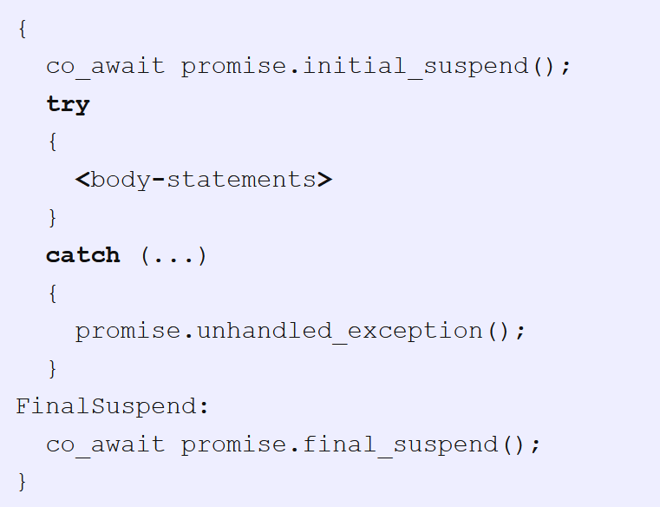
The promise interface
Notes:
The body of a coroutine is transformed into something like this

Slide 45
Initial_suspend
std::suspend_always
A lazy coroutine
std::suspend_never
An eager coroutine
The result of the co_await of the return value of initial_suspend is ignored.

Slide 46
co_return
Is translated to
promise.return_void()
promise.return_value(<expr>);

Slide 47
final_suspend
allows the coroutine to execute some logic, such as publishing a result, signalling completion or resuming a continuation.
Allows the coroutine to optionally suspend immediately before execution of the coroutine runs to completion and the coroutine frame is destroyed.
It is undefined behaviour to resume() a coroutine that is suspended at the final_suspend point. The only thing you can do with a coroutine suspended here is destroy() it.

Slide 48
final_suspend
allows the coroutine to execute some logic, such as publishing a result, signalling completion or resuming a continuation.
Allows the coroutine to optionally suspend immediately before execution of the coroutine runs to completion and the coroutine frame is destroyed.
It is undefined behaviour to resume() a coroutine that is suspended at the final_suspend point. The only thing you can do with a coroutine suspended here is destroy() it.

Slide 49
await_transform
The promise type can optionally customise the behaviour of every co_await expression that appears in the body of the coroutine.
By defining a method “await_transform()” on the promise type, the compiler will transform every co_await <expr> into co_await promise.await_transform(<expr>).

Slide 50
co_yield
co_yield <expr> gets translated to co_await promise.yield_value(<expr>)
Notes:
We didn’t talk about the co_yield operator yet.
It’s just syntactic sugar around co_await.

Slide 51
Libraries
https://github.com/lewissbaker/cppcoro
https://github.com/facebook/folly/tree/master/folly/experimental/coro
https://github.com/LoopPerfect/conduit
…

Slide 52
Coroutines in other languages
C
http://www.vishalchovatiya.com/coroutine-in-c-language/
Rust
https://blog.rust-lang.org/2019/11/07/Rust-1.39.0.html
Golang
https://tour.golang.org/concurrency/1
C#
https://docs.microsoft.com/en-us/archive/msdn-magazine/2003/september/implement-coroutines-for-net-by-wrapping-the-unmanaged-fiber-api

Slide 53
Source of your technology

