Slide 1


Slide 2

Advanced C++ training Move semantics
Author: Lode Mertens

Slide 3
Basics
struct A { A(…) { cout << "constructor\n"; … } A& operator=(const A &a) { cout << "assignment\n"; … } LargeResource *v = nullptr; … };
A a1{1,2,3,4,5};
a1
v
…
1
2
3
4
5

Slide 4
Basics
$> constructor constructor
assignment
struct A { A(…) { cout << "constructor\n"; … } A& operator=(const A &a) { cout << "assignment\n"; … } LargeResource *v = nullptr; … };
A a1{1,2,3,4,5}; A a2; a2 = a1;
a1
a2
v
…
v
…
1
2
3
4
5
1
2
3
4
5

Slide 5
Basics
A get_A();
A a1; a1 = get_A();
$> constructor constructor
assignment
_tmp_
a1
v
…
v
…
1
2
3
4
5
…
1
2
3
4
5
…

Slide 6
Basics
A get_A();
A a1; a1 = get_A();
_tmp_
a1
v
…
v
…
1
2
3
4
5
…

Slide 7
Basics
A get_A();
A a1; a1 = get_A();
This only works because no one has a reference to _tmp_!
_tmp_
a1
v
…
v
…
1
2
3
4
5
…

Slide 8
Basics
$> constructor constructor
assignment
struct A { A(…) { cout << "constructor\n"; … } A& operator=(const A &a) { cout << "assignment\n"; … } LargeResource *v = nullptr; … };
A a1{1,2,3,4,5}; A a2; a2 = a1;
a1
a2
v
…
v
…
1
2
3
4
5
1
2
3
4
5

Slide 9
Basics
struct A { A(…) { cout << "constructor\n"; … } A& operator=(const A &a) { cout << "assignment\n"; … } LargeResource *v = nullptr; … A& operator=(A &&a) { cout << “move\n"; … } };
A a1{1,2,3,4,5}; A a2; a2 = std::move(a1);
$> constructor constructor
move
a1
a2
v
…
v
…
1
2
3
4
5

Slide 10
L/R-values
Rvalue
A& operator=(const A &&a) { ... } ... a2 = std::move(a1);
Lvalue
Rvalue

Slide 11
L/R-values
Lvalue
l = r
Rvalue
std::string s{};
s + s = s;
Rvalue
Lvalue

Slide 12
Basics
struct A { … A& operator=(const A &a); A& operator=(A &&a); };
A a1; A a2;
a2 = a1;
a1 = get_A();
a2 = std::move(a1);

Slide 13
std::move
std::move unconditionally casts input to an rvalue reference
std::move does not actually do the move (only casts)
template<typename T> std::remove_reference_t<T>&& move(T &&t) noexcept { return static_cast<std::remove_reference_t<T>&&>(t); }
Notes:
Move does not actually move the object.
It just makes it possible that overload resolution select the move variant

Slide 14
Special member functions
Move constructor
Move assignment operator
A(A &&a) = default;
A& operator==(A &&a) = default;

Slide 15
Special member functions
struct A { A(); A(A &&a) noexcept; A& operator=(const A &&a); LargeResource *v; std::unique_ptr<B> w; };
A(A &&a) noexcept { v = a.v; w = std::move(a.w); a.v = nullptr; };

Slide 16
Special member functions
struct A { A(); A(A &&a) noexcept; A& operator=(const A &&a); LargeResource *v; std::unique_ptr<B> w; };
A& operator=(const A &&a) { delete v; v = a.v; w = std::move(a.w); a.v = nullptr; return *this; };

Slide 17
Special member functions
The default move operations are generated if no copy or destruction operator is user defined
The default copy operation are generated if no move operation is user defined
Note: =default and =delete count as user defined

Slide 18
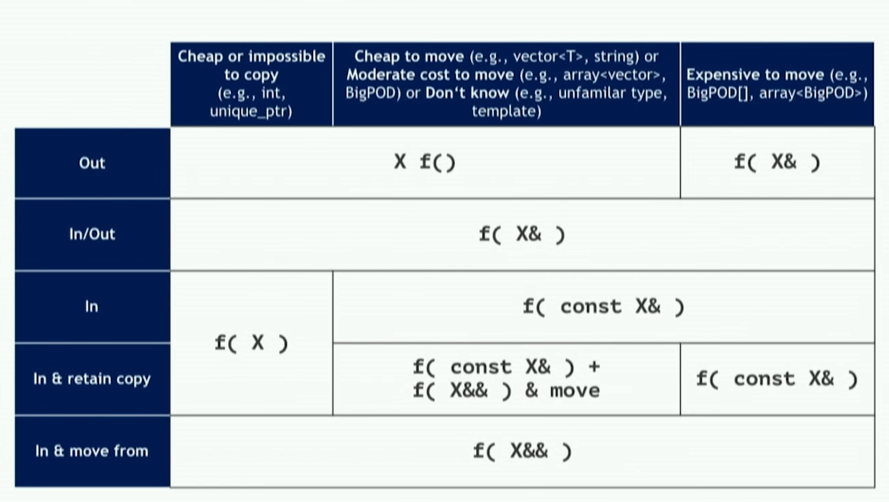
Parameter convention

Slide 19
Advanced C++ training Forwarding references
Author: Lode Mertens

Slide 20
Forwarding references
template <typename T> void foo(T &&) { cout << "foo(T &&)"; }
int main() { A a; foo(a); // Prints "foo(T &&)" }

Slide 21
Forwarding references
template <> void foo(A& &&) { cout << "foo(T &&)"; }
int main() { A a; foo(a); // Prints "foo(T &&)" }
lvalue

Slide 22
Forwarding references
template <> void foo(A& &&) { cout << "foo(T &&)"; }
int main() { A a; foo(a); // Prints "foo(T &&)" }
& & | => | &
&& & | => | &
& && | => | &
&& && | => | &&

Slide 23
Forwarding references
template <> void foo(A&) { cout << "foo(T &&)"; }
int main() { A a; foo(a); // Prints "foo(T &&)" }
& & | => | &
&& & | => | &
& && | => | &
&& && | => | &&

Slide 24
Forwarding references
template <> void foo(A&&) { cout << "foo(T &&)"; }
int main() { foo(A{}); }
& & | => | &
&& & | => | &
& && | => | &
&& && | => | &&

Slide 25
Perfect forwarding
template <typename T, ???> unique_ptr<T> make_unique(???) { return unique_ptr<T>(new T(???)); }
What should we replace the ??? with?

Slide 26
Perfect forwarding
template <typename T, typename Arg> unique_ptr<T> make_unique(Arg && arg) { return unique_ptr<T>(new T(arg)); }
One problem, this is an lvalue now

Slide 27
Perfect forwarding
template <typename T, typename Arg> unique_ptr<T> make_unique(Arg && arg) { return unique_ptr<T>(new T(std::forward<Arg>(arg))); }
Repeat the template type

Slide 28
Perfect forwarding: std::forward
template< class T > constexpr T&& forward( std::remove_reference_t<T>& t ) noexcept;
template< class T > constexpr T&& forward( std::remove_reference_t<T>&& t ) noexcept;

Slide 29
Perfect forwarding
class A; A a; auto a = make_unique<A>(a);
unique_ptr<A> make_unique(A& && arg) { return unique_ptr<A>(new A(std::forward<A&>(arg))); }
unique_ptr<A> make_unique(A& && arg) { return unique_ptr<A>(new A(static_cast<A& &&>(arg))); }

Slide 30
Perfect forwarding
class A; auto a = make_unique<A>(A());
unique_ptr<A> make_unique(A && arg) { return unique_ptr<A>(new A(std::forward<A>(arg))); }
unique_ptr<A> make_unique(A && arg) { return unique_ptr<A>(new A(static_cast<A&&>(arg))); }

Slide 31
Perfect forwarding
#include <iostream> class A {}; A get() { return A(); } template <typename T> void fun(T& ) { std::cout << "l-value\n"; } template <typename T> void fun(T&&) { std::cout << "r-value\n"; } int main() { A a; fun(a); fun(std::move(a)); fun(A()); fun(get()); }

Slide 32
When things go wrong
struct A { A(const std::string &a); template<typename T> A(T &&t); };
A a1("str");

Slide 33
When things go wrong
struct A { A(const std::string &a); // (1) template<typename T> A(T &&t); // (2) };
A a1("str"); // calls ctor (2) // argument type is char[4]

Slide 34
When things go wrong
struct A { A(const std::string &a); // (1) template<typename T> A(T &&t); // (2) };
std::string str("str"); A a2(str);

Slide 35
When things go wrong
struct A { A(const std::string &a); // (1) template<typename T> A(T &&t); // (2) };
std::string str("str"); A a2(str); // calls ctor (2) // because the argument is NOT const

Slide 36
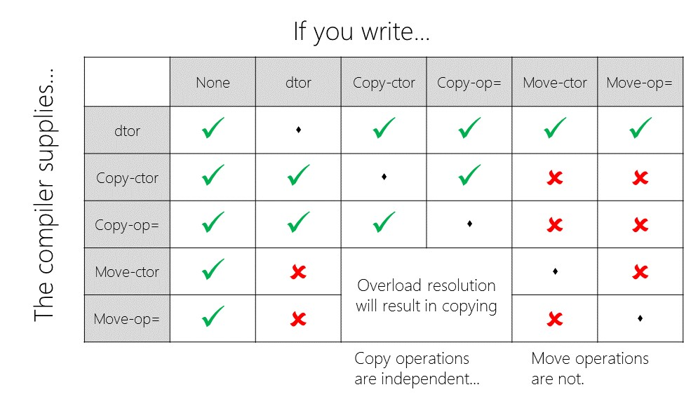
When things go wrong
struct A { A(const std::string &a); // (1) template<typename T> A(T &&t); // (2) };
A a3(a2);

Slide 37
When things go wrong
struct A { A(const std::string &a); // (1) template<typename T> A(T &&t); // (2) };
A a3(a2); // calls ctor (2) // because the argument is NOT const // and the default generated copy ctor accepts a “const A&”

Slide 38
Overloading
void fun( A& ) { std::cout << "fun (1)\n"; } void fun(const A& ) { std::cout << "fun (2)\n"; } void fun( A&&) { std::cout << "fun (3)\n"; } void fun(const A&&) { std::cout << "fun (4)\n"; } template<typename T> void fun(T &&) { std::cout << "fun (5)\n"; } template<typename T> void fun(const T &&) { std::cout << "fun (6)\n"; } int main() { A a{}; fun(a); }

Slide 39
Overloading
void fun( A& ) { std::cout << "fun (1)\n"; } (1) void fun(const A& ) { std::cout << "fun (2)\n"; } (3) void fun( A&&) { std::cout << "fun (3)\n"; } void fun(const A&&) { std::cout << "fun (4)\n"; } template<typename T> void fun(T &&) { std::cout << "fun (5)\n"; } (2) template<typename T> void fun(const T &&) { std::cout << "fun (6)\n"; } int main() { A a{}; fun(a); }

Slide 40
Overloading
void fun( A& ) { std::cout << "fun (1)\n"; } void fun(const A& ) { std::cout << "fun (2)\n"; } void fun( A&&) { std::cout << "fun (3)\n"; } void fun(const A&&) { std::cout << "fun (4)\n"; } template<typename T> void fun(T &&) { std::cout << "fun (5)\n"; } template<typename T> void fun(const T &&) { std::cout << "fun (6)\n"; } int main() { const A a{}; fun(a); }

Slide 41
Overloading
void fun( A& ) { std::cout << "fun (1)\n"; } void fun(const A& ) { std::cout << "fun (2)\n"; } (1) void fun( A&&) { std::cout << "fun (3)\n"; } void fun(const A&&) { std::cout << "fun (4)\n"; } template<typename T> void fun(T &&) { std::cout << "fun (5)\n"; } (2) template<typename T> void fun(const T &&) { std::cout << "fun (6)\n"; } int main() { const A a{}; fun(a); }

Slide 42
Overloading
void fun( A& ) { std::cout << "fun (1)\n"; } void fun(const A& ) { std::cout << "fun (2)\n"; } void fun( A&&) { std::cout << "fun (3)\n"; } void fun(const A&&) { std::cout << "fun (4)\n"; } template<typename T> void fun(T &&) { std::cout << "fun (5)\n"; } template<typename T> void fun(const T &&) { std::cout << "fun (6)\n"; } A get(); int main() { fun(get()); }

Slide 43
Overloading
void fun( A& ) { std::cout << "fun (1)\n"; } void fun(const A& ) { std::cout << "fun (2)\n"; } (5) void fun( A&&) { std::cout << "fun (3)\n"; } (1) void fun(const A&&) { std::cout << "fun (4)\n"; } (3) template<typename T> void fun(T &&) { std::cout << "fun (5)\n"; } (2) template<typename T> void fun(const T &&) { std::cout << "fun (6)\n"; } (4) A get(); int main() { fun(get()); }

Slide 44
Overloading
Effective Modern C++, Item26: Avoid overloading on universal references.

Slide 45
Exam (Q1)
struct A { template<typename T> A(T&& t) : m_b(std::move(t)) {} B m_b; };

Slide 46
Exam (Q1)
struct A { template<typename T> A(T&& t) : m_b(std::forward<T>(t)) {} B m_b; };

Slide 47
Exam (Q2)
template<typename T> struct A { A(T&& t) : m_b(std::forward<T>(t)) {} B m_b; };

Slide 48
Exam (Q2)
CLASS template
template<typename T> struct A { A(T&& t) : m_b(std::move(t)) {} B m_b; };
Rvalue reference not a forwarding reference
Notes:
The code itself compiles and will work, but will probably not do what you want, pass everything to construct a B.
You will only notice this mistake if you want to pass a lvalue to the constructor.

Slide 49
Exam (Q3)
struct A { template<typename T> A(T&& t) : m_b(std::forward<T>(t)) , m_c(std::forward<T>(t)) {} B m_b; C m_c; };

Slide 50
Exam (Q3)
struct A { template<typename T> A(T&& t) : m_b(t) , m_c(std::forward<T>(t)) {} B m_b; C m_c; };
Notes:
Possible duplicate move if t is passed as an rvalue.

Slide 51
Source of your technology

