Slide 1


Slide 2

Strong types
Author: Sioux Technologies

Slide 3
Problem
set_user_info(0, 0, 0, 1.0, "Dave", "Wilson", 1); set_user_info(0, 1, 0, 2.0, "X Æ A-12", "Musk", 1); set_user_info(0, 0, 1, 3.0, "Bezoss", "Jeff", 0);
What does this code do?
Notes:
If you see this code, do you know what it does?
What’s the intent of the developer here?

Slide 4
Problem
void setUserInfo(int x, int y, int z, string firstName, string lastName, int state);
You need the declaration/definition when reading code.
Notes:
The problem is that we can’t be expressif enough add call site.
The generic types don’t allow us to add intent.
Did anyone catch the mistake on the first slide?

Slide 5
Problem
Sometimes the definition/declararion is not enough
void setHandler(Interface *ifPtr);
Interface *ifPtr = new Interface(); setHandler(ifPtr);
Interface ifObj; setHandler(&ifObj);
Notes:
Given the declaration what is the correct use?
Both versions compile but the first might lead to a memory leak
and the other may lead to a segfault.
The problem is exactly the same, there is a lack of intent.

Slide 6
Problem
Sometimes the basic type is not enough,
struct Circle { explicit Circle(double radius); explicit Circle(double diameter); };
Notes:
Sometimes multiple semantic meanings can be represented by the same type.
A solution for this problem is tag dispatching as is done with std::piecewise_construct

Slide 7
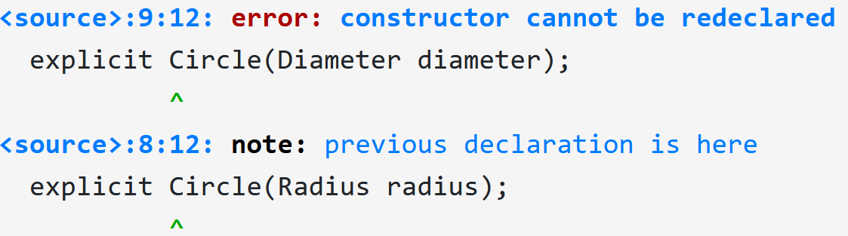
Typedef problem
A typedef or using statement is not a real type
struct Circle { typedef double Radius; typedef double Diameter; explicit Circle(Radius radius); explicit Circle(Diameter diameter); };
Notes:
If a type is complex, you can use a typedef to “hide” the actual type.
The problem is that you don’t actually create a new type, it’s just an alias.

Slide 8
Solution
A STRONG type is a type used in place of another type to carry specific meaning through its name.
Jonathan Boccara - Meeting C++ 2017 https://www.youtube.com/watch?v=WVleZqzTw2k

Slide 9
Solution
Libraries
BOOST_STRONG_TYPEDEF (Robert Ramley, 2002)
NamedType (Jonathan Boccara, 2017)
true_typedef (Matthew Wilson, 2003)
Strong typedef for integer/floating point types (Akira Takahashi, 2012)
DESLAT_NEWTYPE (Oyama Koichi, 2013)
Type_safe (Jonathan Muller, 2016)

Slide 10
Solution
Proposals
Towards Opaque Typedefs for C++1Y (N3741, N3515, P0109R0, Walter Brown)
newtype (P0027R0, Troy Korjusiommi)

Slide 11
Strong types in the stl
std::unique_ptr<>
std::chrono library
Notes:
We already have a number of strong types in the stl.
Types that are wrappers around ”basic” types that add intent.

Slide 12
unique_ptr<>
Adds ownership semantics to a pointer.
Solves the forgot to delete problem.
Forces the developer to think about ownership
Notes:
Everybody probably knows unique_ptr<>
It adds ownership intent to a pointer type.

Slide 13
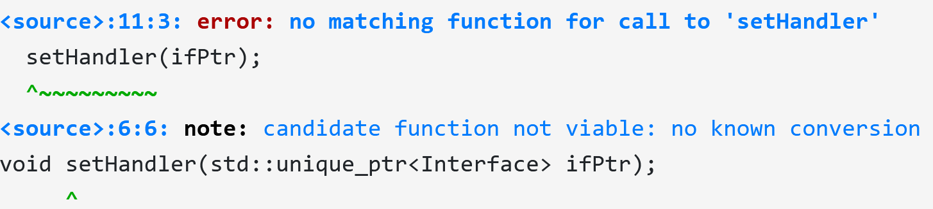
unique_ptr<>
void setHandler(std::unique_ptr<Interface> ifPtr); Interface *ifPtr = ...; setHandler(ifPtr);
Notes:
The compiler will force you to think about ownership.
No direct conversion from a pointer to a unique_ptr<>

Slide 14
unique_ptr<>
void setHandler(std::unique_ptr<Interface> ifPtr); auto ifPtr = std::make_unique<Interface>(); setHandler(ifPtr);
Notes:
The compiler will force you to think about ownership.
Ownership can’t be copied, only moved.

Slide 15
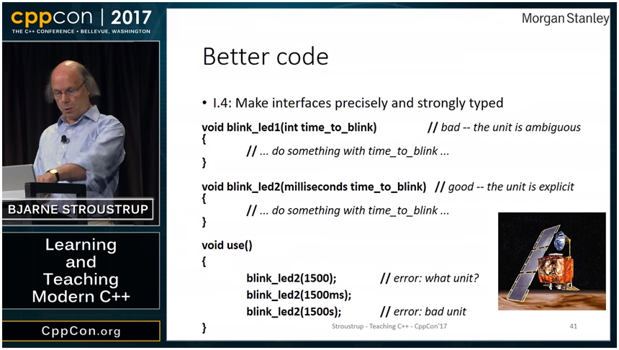
std::chrono

Slide 16
std::chrono clocks
Clocks are time providers
Starting point (epoch)
Tick rate
Ex:
system_clock
steady_clock
…

Slide 17
std::chrono duration
Duration:
Number of ticks
Unit (compile time)
Ex:
std::chrono::seconds
std::chrono::nanoseconds
…

Slide 18
std::chrono time_point
Time point:
Duration
Clock
time_point<system_clock> t = system_clock::now();

Slide 19
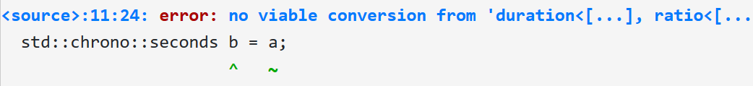
std::chrono
std::chrono::seconds a = 1s; std::chrono::milliseconds b = a; std::chrono::milliseconds a = 1000ms; std::chrono::seconds b = a;
auto c = std::chrono::duration_cast<std::chrono::seconds>(a);
Notes:
The compiler forces you here to think about what a type means. Is precision maintained or not.

Slide 20
Further info
Boost Units

Slide 21
Write code that is easy to use, hard to misuse.

Slide 22
Source of your technology

