Slide 1

Title: Application of Sparse Identification of Non-linear Dynamics (SINDy) and Artificial Neural Network (ANN) algorithm, for Magnetoelectric Sensor/Actuator Modelling Author
MD SAIDUL ISLAM
Supervisor
Dr. Mohammad Sadeghi Examiners Prof. Dr. rer. nat. Franz Faupel Prof. Dr. Stephan Wulfinghoff
Sep 2023
Master thesis report

Slide 2
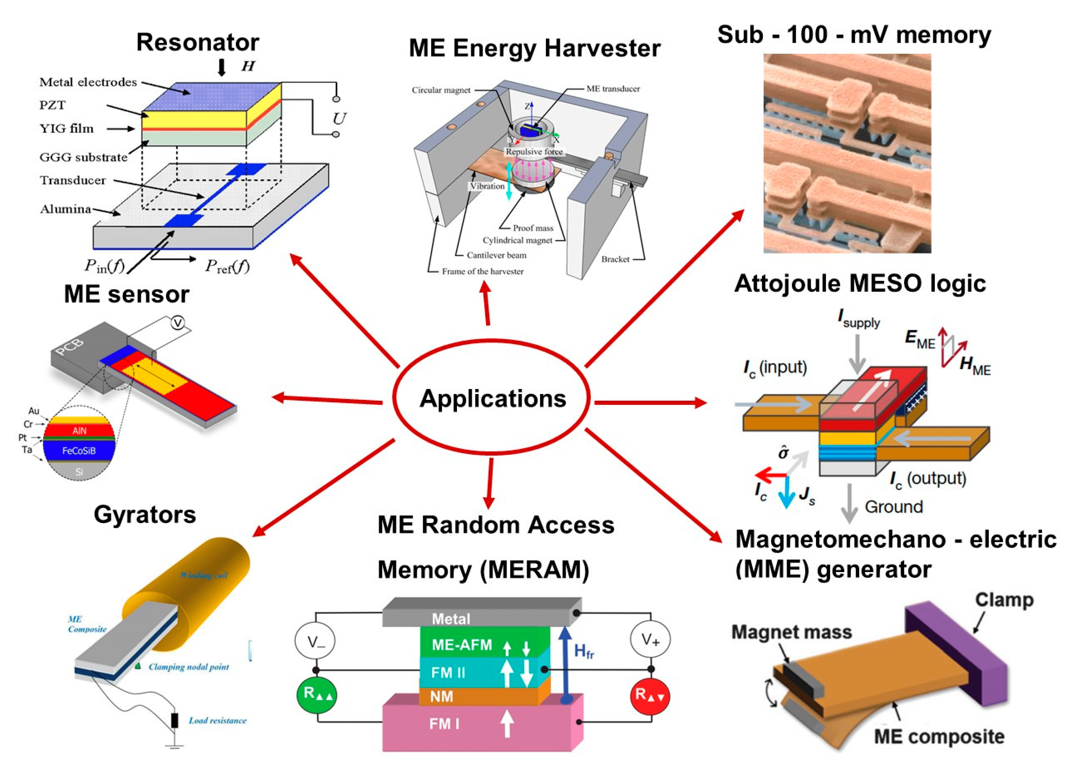
Motivation
Understanding the nonlinear dynamics
Prediction of the nonlinear response.--- Control/exploit the nonlinearity
https://doi.org/10.3390/nano10102072

Slide 3
Introduction: The ME effect (DME/CME)
Fig. Breakdown of Magnetoelectric (ME) effect.
Image source: LibreTexts/magnetostriction
Image source: Wikipedia/Piezoelectric sensor

Slide 4
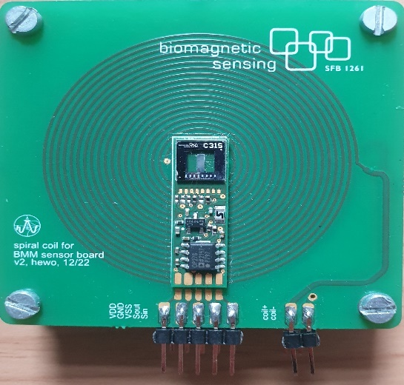
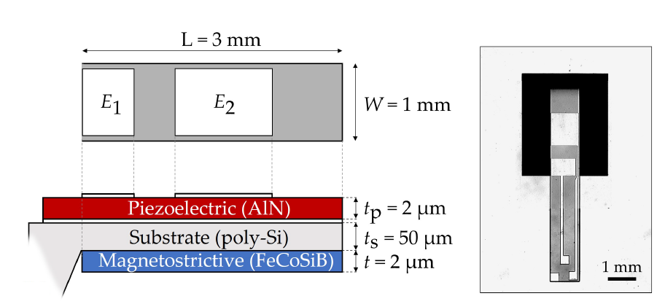
Introduction: The ME sensor
Fig. Utilized sensor-coil system
Fig. Magnetoelectric Sensor configuration.
Ref: DOI 10.1088/0953-8984/20/43/434220

Slide 5
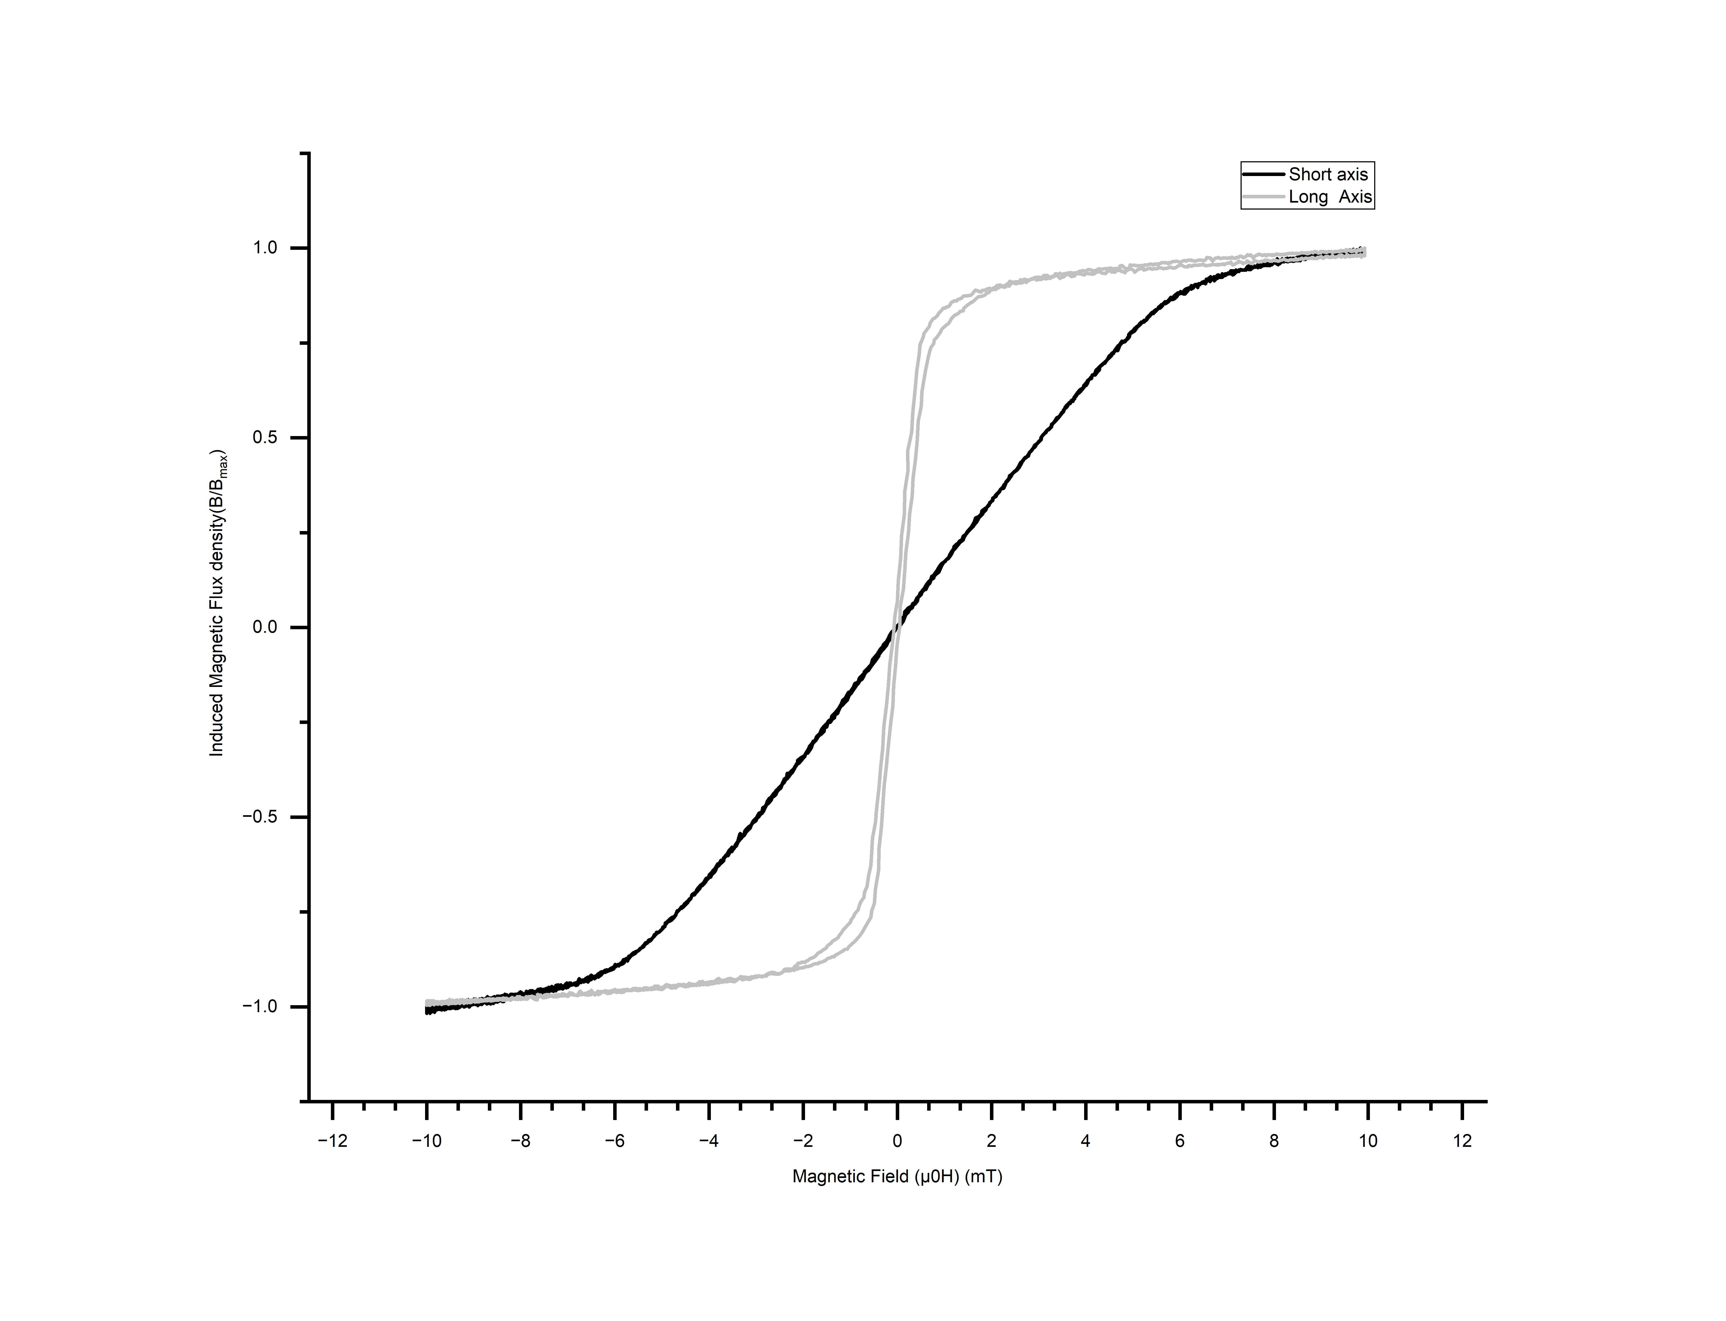
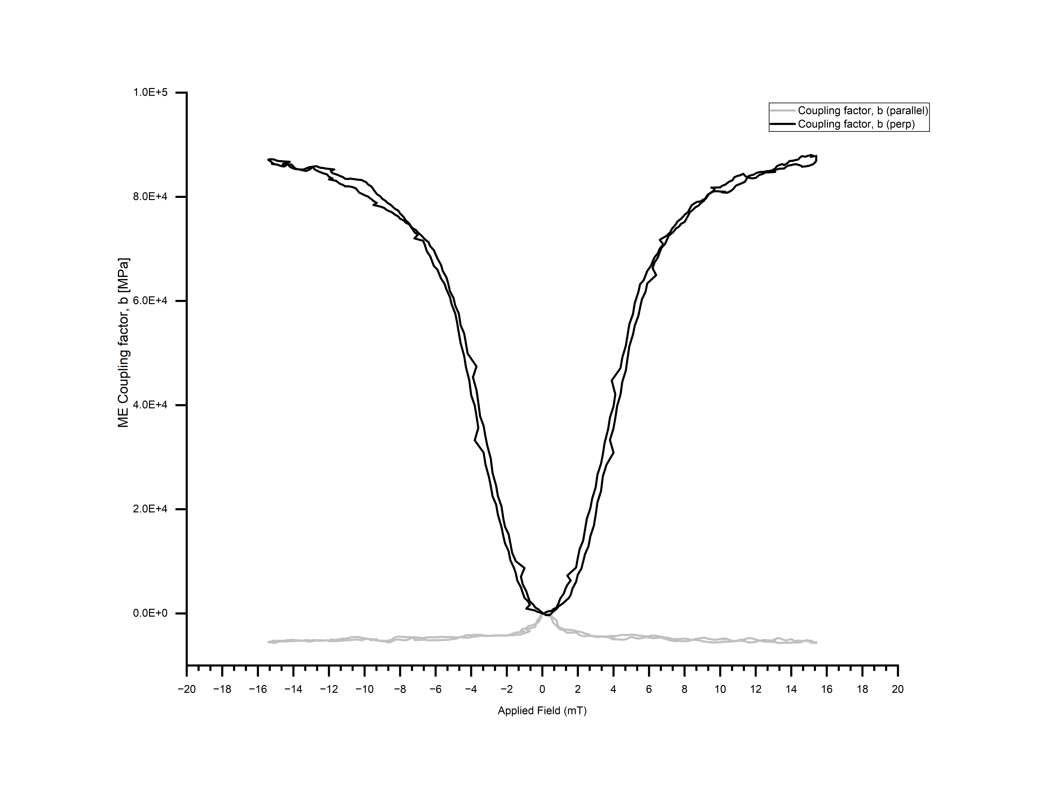
Introduction: Magnetic characterization
Fig. Left: B-H characterization; Right: ME coupling factor vs. Applied field

Slide 6
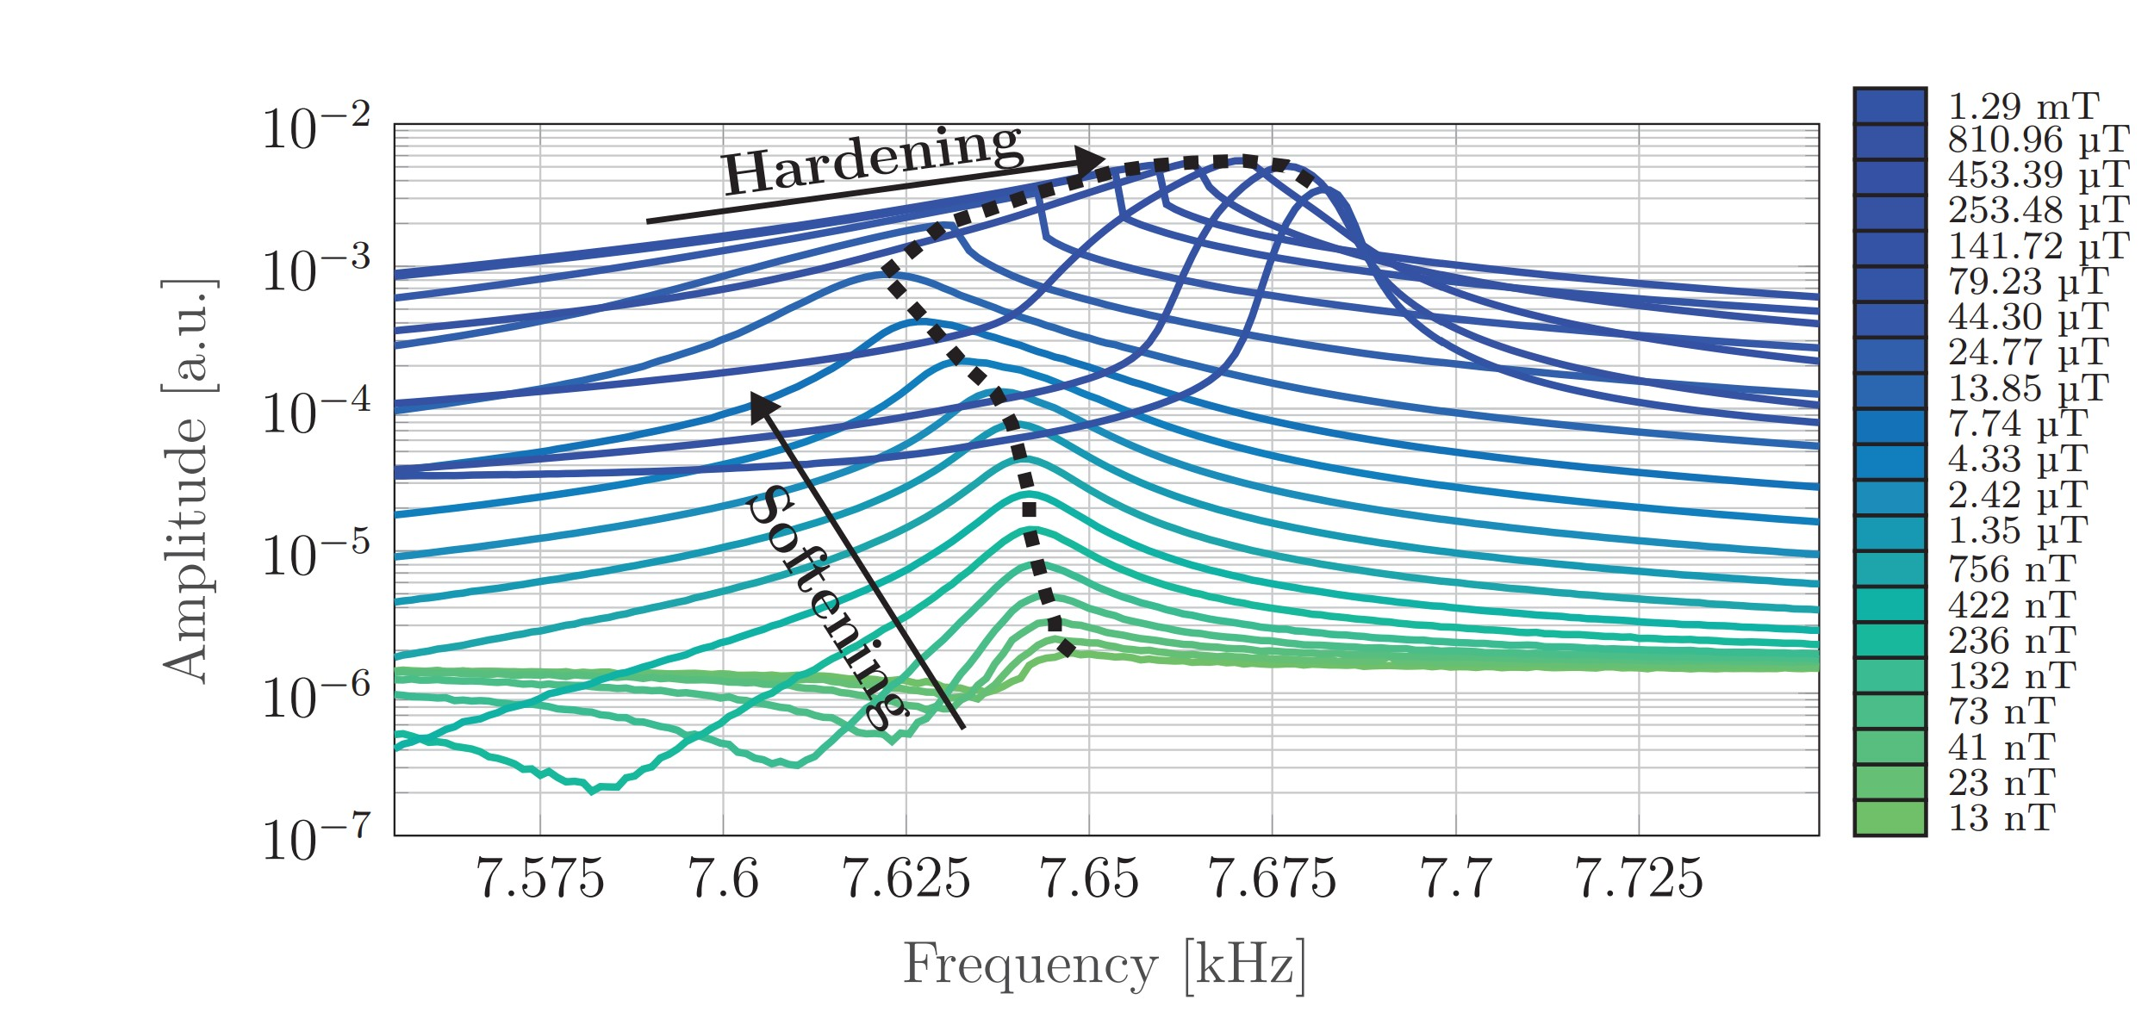
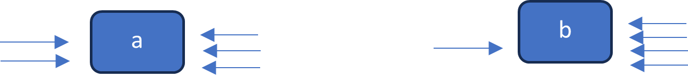
Introduction: Nonlinearity sources
Intended/Excited nonlinearity
Amplification induced/Source nonlinearity
Fig. ‘Mechanical force on a rigid body’ analogy to visualize the effect of higher harmonics
Fig. Exemplary frequency response of the displacement amplitude for a nonlinear system.
Ref: DOI 10.1103/PhysRevApplied.12.044001

Slide 7
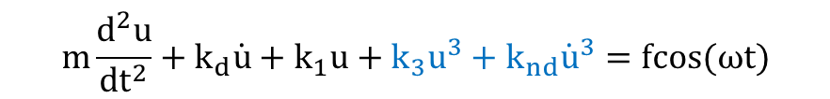

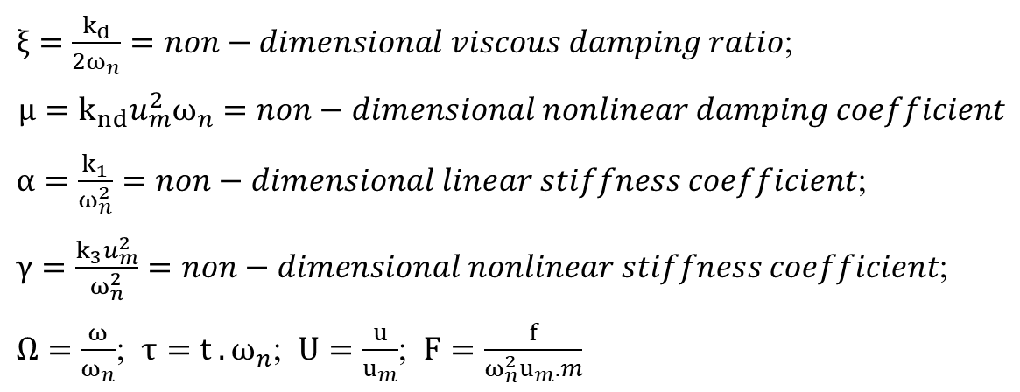
$$\ddot{U}+2ξ\dot{U}+αU+γU^{3}+μ{\dot{U}}^{3}=F cos ⁡(Ωτ)$$
Introduction: Nonlinearity expressed in a duffing equation
$$m\frac{d^{2}u}{{dt}^{2}}+k_{d}\dot{u}+k_{1}u+k_{3}u^{3}+k_{nd}{\dot{u}}^{3}=fcos⁡(ωt)$$
Nonlinear contributions
Linear contributions
$ξ=\frac{k_{d}}{{2ω}_{n}}=non−dimensional viscous damping ratio$;
$$μ=k_{nd}u_{m}^{2}ω_{n}=non−dimensional nonlinear damping coefficient$$
$α=\frac{k_{1}}{ω_{n}^{2}}=non−dimensional linear stiffness coefficient$;
$γ=\frac{k_{3}u_{m}^{2}}{ω_{n}^{2}}=non−dimensional nonlinear stiffness coefficient$;
$Ω=\frac{ω}{ω_{n}}$; $τ=t . ω_{n}$; $U=\frac{u}{u_{m}}$; $F=\frac{f}{{ω_{n}^{2}u}_{m}.m}$

Slide 8
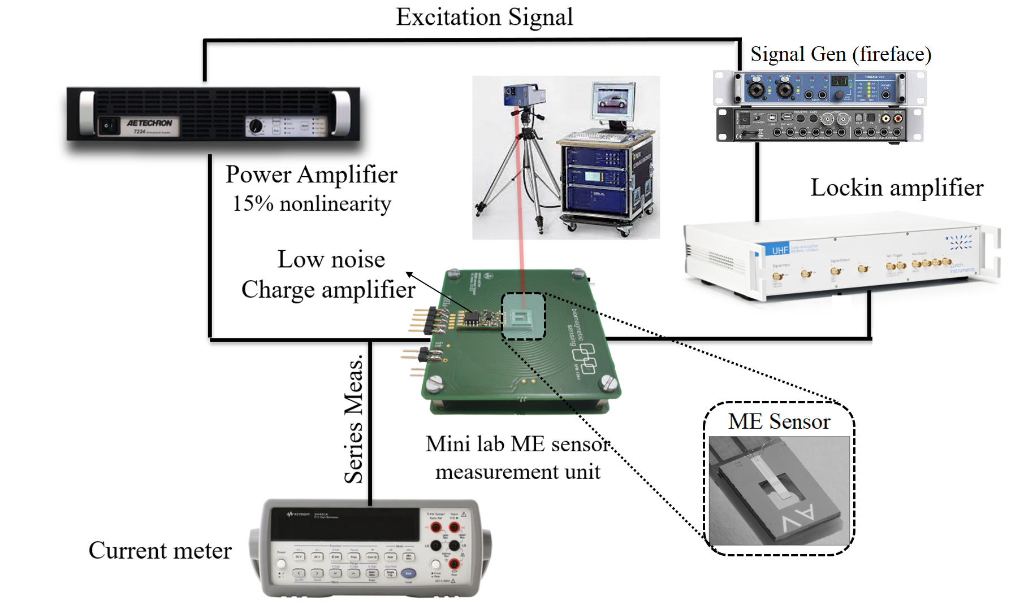
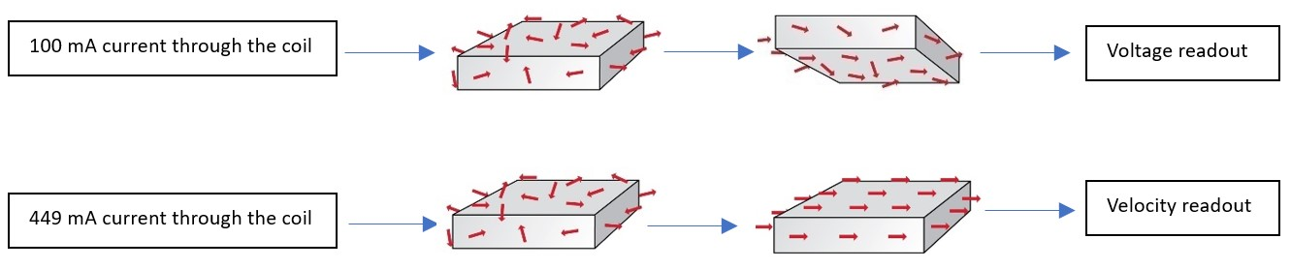
Measurement apparatus and dataset
Laser Doppler

Slide 9
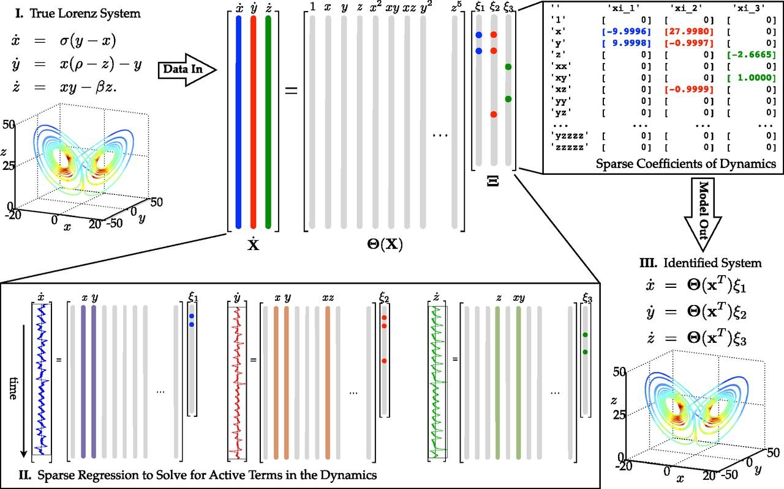
Modelling Tool 1: SINDy
Sparse Identification of Non-linear Dynamics (SINDy)
First introduced in 2016 by Steven L. Brunton
Ref: DOI 10.1073/pnas.151738411

Slide 10
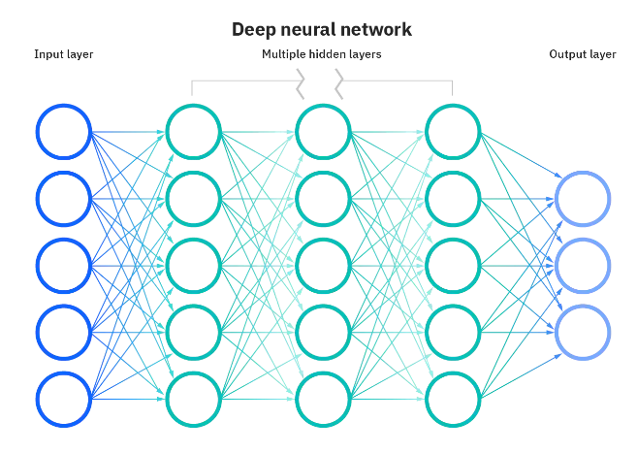
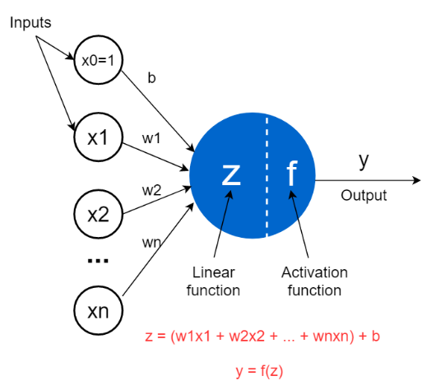
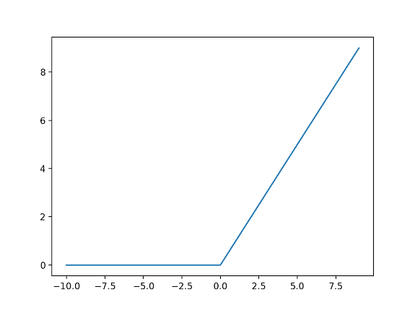
Modelling Tool 2: ANN
Artificial Neural Network: a. MultiLayer Perceptrop (MLP) b. Long-Short-Term-Memory
Fig. A feed-forward network
Fig. Schematic Artificial Neuron
Fig. ReLU activation function
Image source: Machine learning mastery by Jason Brownlee.

Slide 11
SINDy Algorithm for sensor response prediction
Load Libraries
Prepare & Load the dataset
Transform 2nd order ODE into two 1st order ODEs
Define and train the model
Try possible Variance/Bias fix
Model performance on training & validation dataset??
No for both/ one of them
satisfactory for both
Tune model hyperparameters and check Test set error.
Not satisfactory
Satisfactory
Check for dataset quality, model architecture & repeat the whole process.
Report the model with test set error.

Slide 12
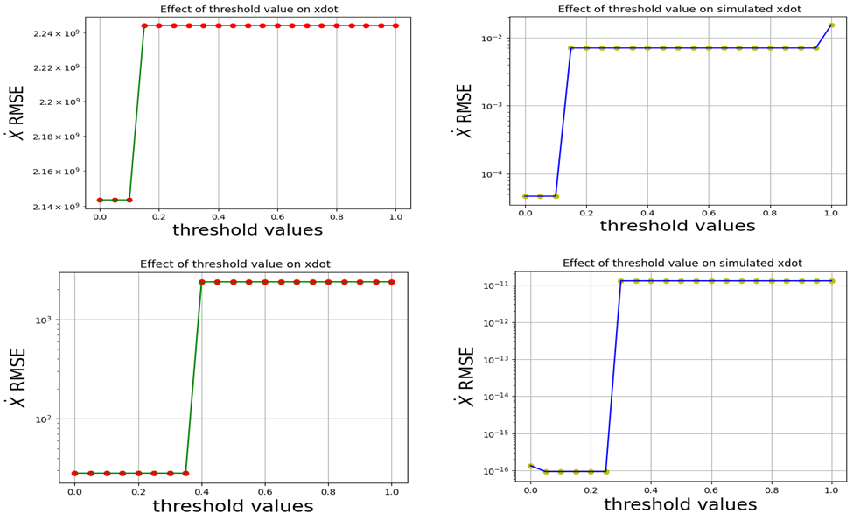
Hyperparameters of SINDy models: Threshold value
Theshold choosen = 0.1
Theshold choosen = 0.2
Fig. : Effect of threshold for voltage (Top) and Displacement dataset (below)

Slide 13
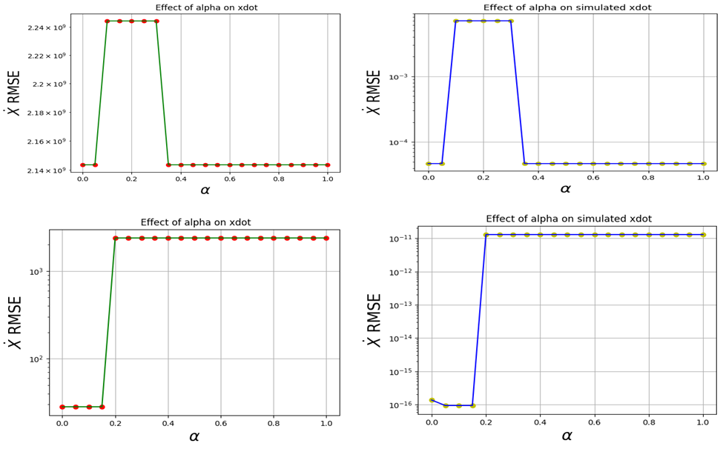
Hyperparameters of SINDy models: Regularization strength
Alpha choosen = 0.0
Alpha choosen = 0.05
Fig. : Effect of alpha for voltage (Top) and Displacement dataset (below)

Slide 14
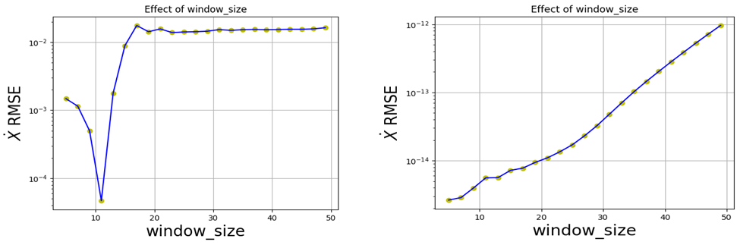
Hyperparameters of SINDy models: Window length
Fig. : Effect of window_length for voltage (left) and Displacement dataset (right)

Slide 15
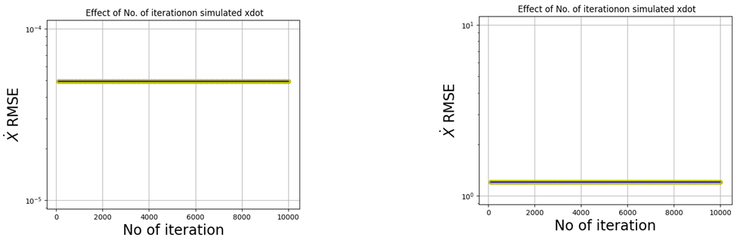
Hyperparameters of SINDy models: No. Of epochs
Fig. : Effect of training duration for voltage (Left) and Displacement dataset (Right)

Slide 16
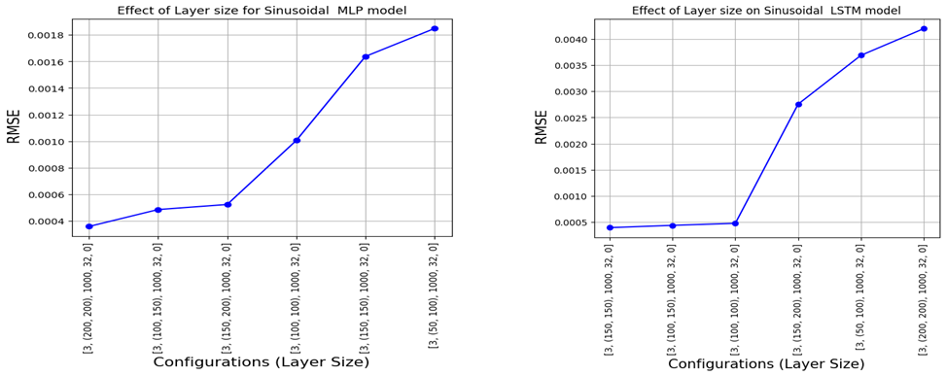
Hyperparameters of ANN models: Layer Size
Fig. : Effect of Layer Size for MLP (Left) and LSTM (Right) model

Slide 17
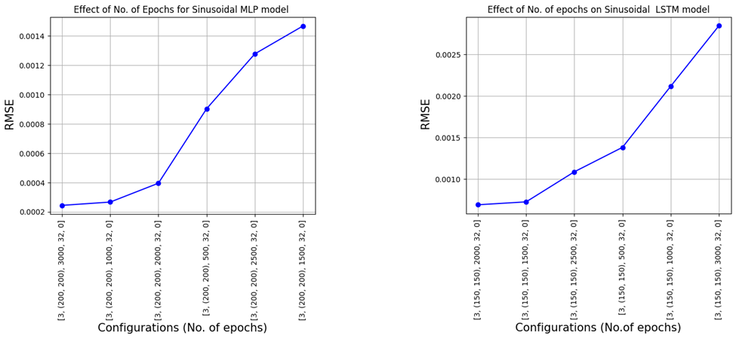
Hyperparameters of ANN models: No. Of epochs
Fig. : Effect of No. of epochs for MLP (Left) and LSTM (Right) model

Slide 18
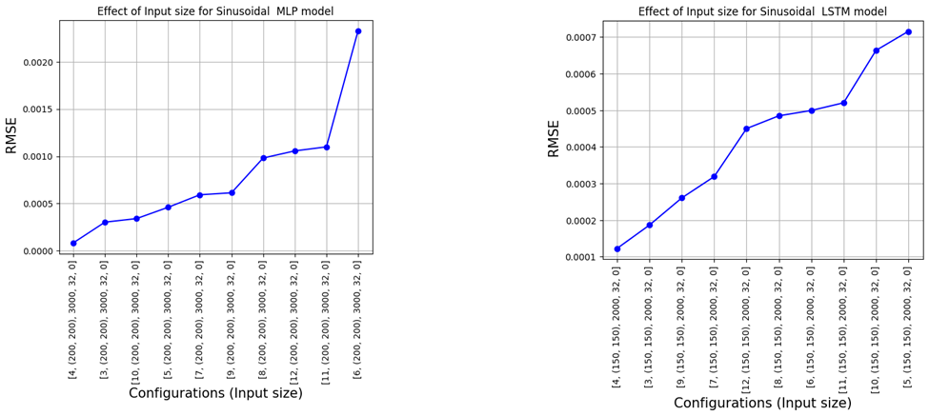
Hyperparameters of ANN models: Input Size
Fig. : Effect of Input Size for MLP (Left) and LSTM (Right) model

Slide 19
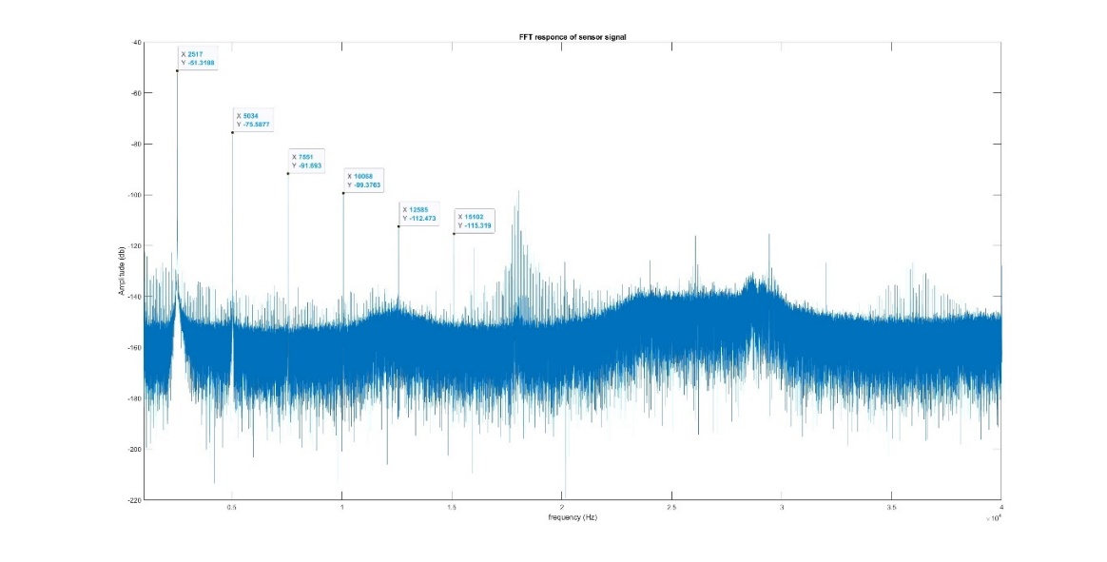
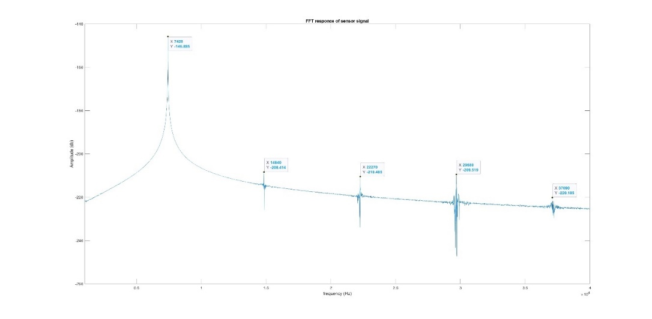
Dataset quality
FFT of voltage (top) and Displacement readouts

Slide 20
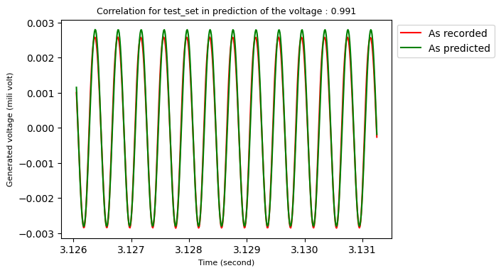
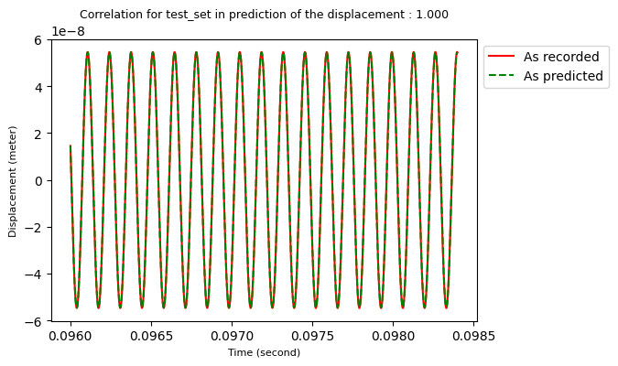
SINDy Model Performance: For the readouts
Fig. : Sindy prediction of the readouts with the developed equations

Slide 21
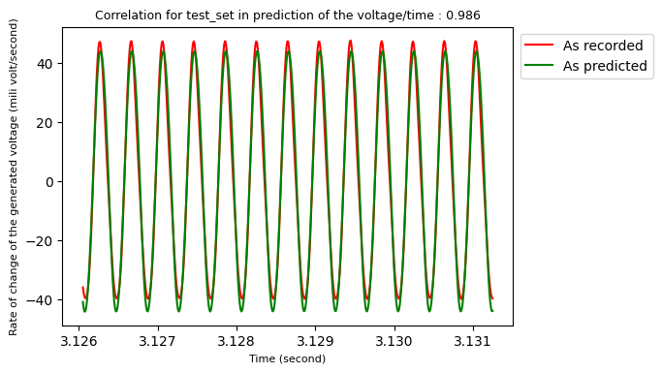
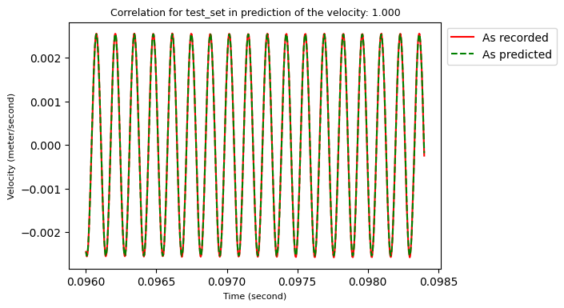
SINDy Model Performance: For the Derivatives of the readouts
Fig. : Sindy prediction of the derivatives of the readouts with the developed equations

Slide 22
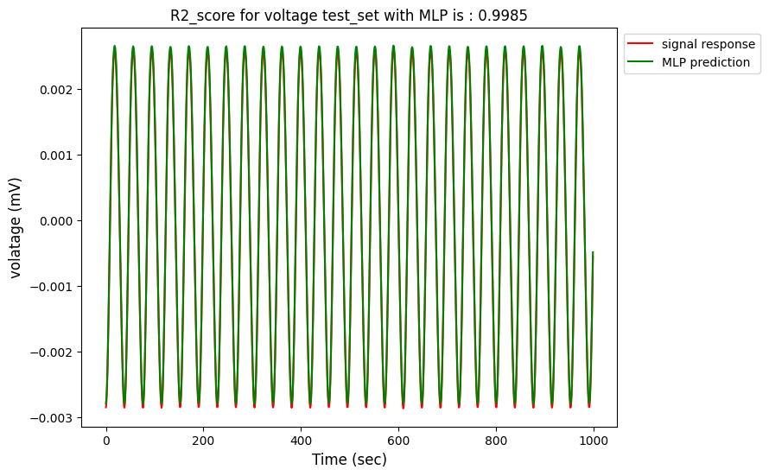
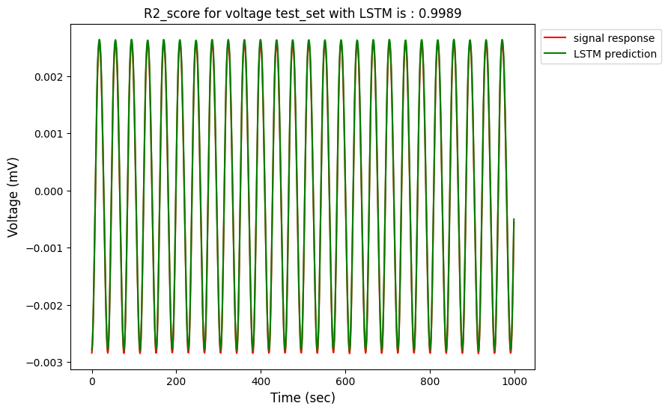
ANN Model(s) Performance: For the voltage readouts
Fig. : MLP (left) & LSTM (right) prediction of the voltage readouts

Slide 23
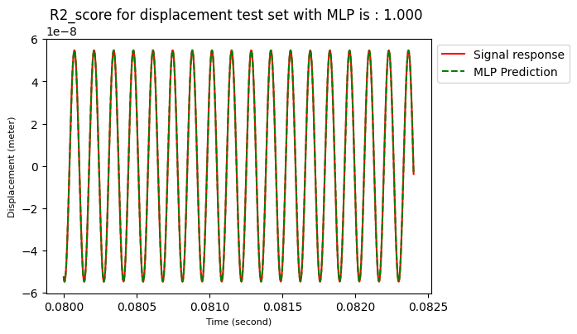
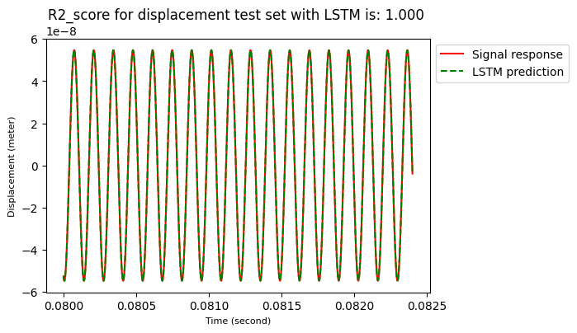
ANN Model(s) Performance: For the displacement readouts
Fig. : MLP (left) & LSTM (right) prediction of the displacement readouts

Slide 24

Developed Non-Dimensional SINDy Equations
Voltage readout
$$\ddot{U}=−38.33 U + \left(2 × 0.2992\right)\dot{U} – 1.428 U^{3}−0.019 {\dot{U}}^{3}−0.0222 Cos\left(τ\right)+0.0223 Cos\left(2τ\right)−0.0035 Cos\left(3τ\right)−0.0018 Cos\left(4τ\right)+0.0063 Cos\left(5τ\right)$$
$$\ddot{U}=−38.33 U + \left(2 × 0.2992\right)\dot{U} – 1.428 U^{3}−0.019 {\dot{U}}^{3}−0.0222 Cos\left(τ\right)+0.0223 Cos\left(2τ\right)−0.0035 Cos\left(3τ\right)−0.0018 Cos\left(4τ\right)+0.0063 Cos\left(5τ\right)$$
Displacement readout
$$\ddot{U}=−39.4905 U − \left(2×0.0002\right)\dot{U}+0.0040 Cos\left(τ\right)−0.0007 Cos\left(2τ\right)− 0.0046 Cos\left(3τ\right)−0.0060 Cos\left(4τ\right)$$
$$\ddot{U}=−39.4905 U − \left(2×0.0002\right)\dot{U}+0.0040 Cos\left(τ\right)−0.0007 Cos\left(2τ\right)− 0.0046 Cos\left(3τ\right)−0.0060 Cos\left(4τ\right) −0.0043 Cos\left(5τ\right)$$
Damping
Stiffness
Excitation frequency contribution
Higher Harmonics contribution

Slide 25
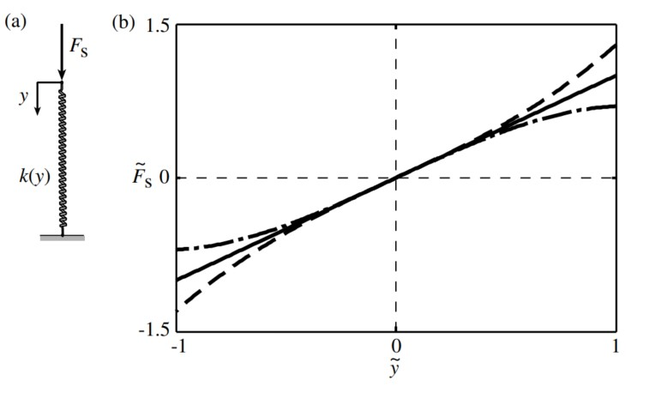
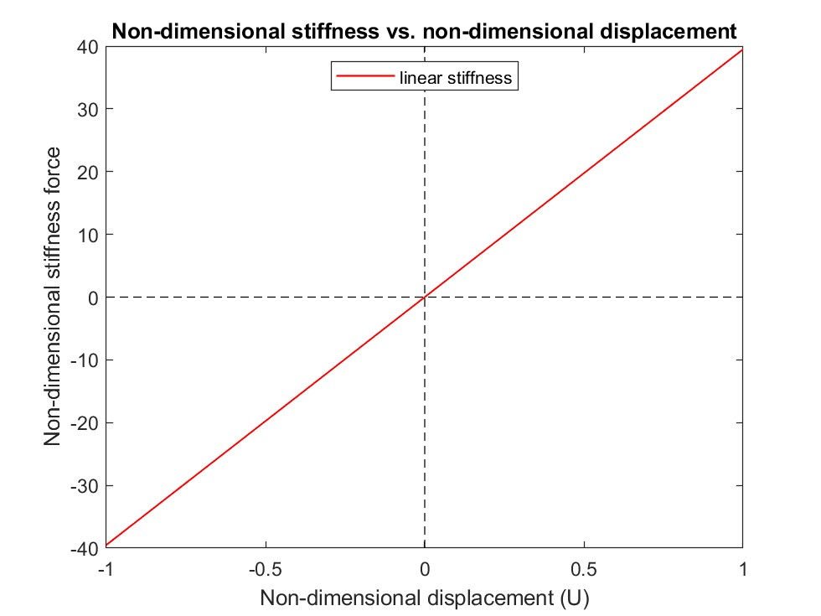
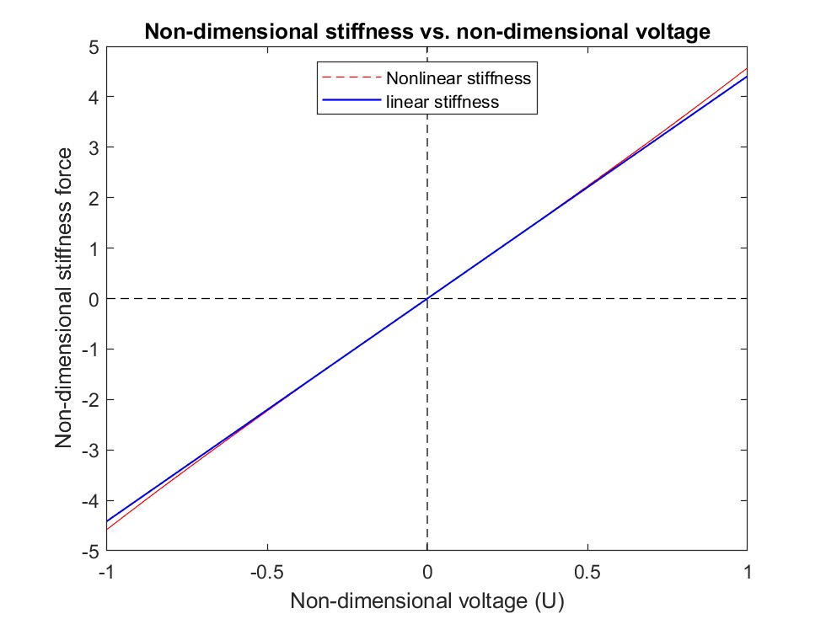
Analyzing governing equations: Stiffness force
Voltage readout ($−38.33 U– 1.428 U^{3}$)
D$isplacement readout(−39.4905 U)$
What to expect:
DOI: 10.1002/9780470977859.ch2
What is found:
Hardening Oscillator
Linear Oscillator
Fig. : Expected (top) and found (bottom) Stiffness fore vs. displacement characteristics

Slide 26
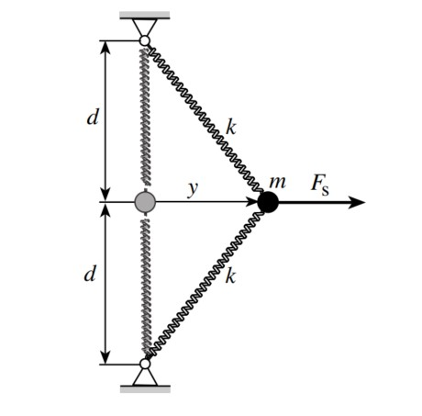
Analyzing governing equations: Analogous Two-spring system
The two-spring system:
The ME cantilever:
Rotation of domain wall : y
Adjacent domains: the springs
Accomodation provided by adjacent domains for a specific domain wall rotation: change of length of the springs
Displacement measurement: ‘Accomodation of the adjacent domains‘ information is lost
Voltage measurement: Specific domain wall rotation information is lost
Might be overcome by: Two LASER spots (tip and the middle) whose size is comparable to the size of a domain wall.
Readout of the sopts: domain wall rotation
Difference between the readouts: accomodation of adjacent domains
DOI: 10.1002/9780470977859.ch2

Slide 27
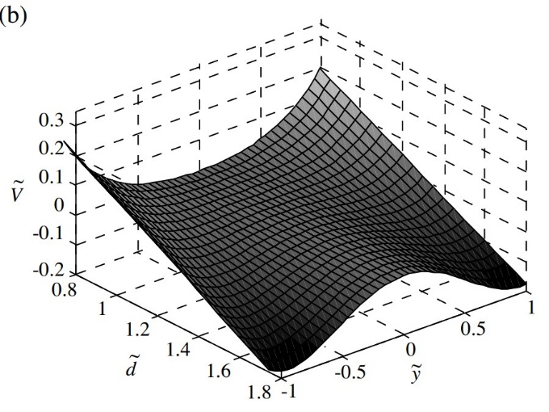
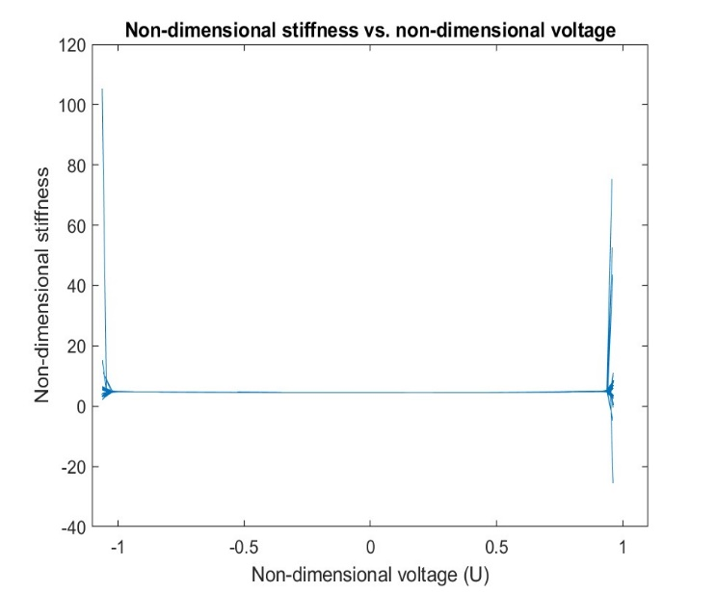
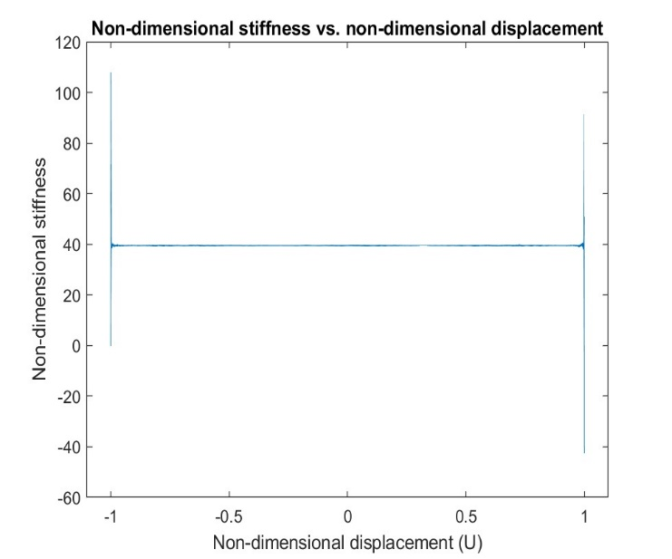
Analyzing governing equations: Stiffness/P.E
Voltage readout ($−38.33 U– 1.428 U^{3}$)
D$isplacement readout(−39.4905 U)$
What to expect:
DOI: 10.1002/9780470977859.ch2
What is found:
Single well potential energy
Linear potential energy
Fig. : Expected (top) and found (bottom) Potential energy (P.E) vs. displacement characteristics

Slide 28
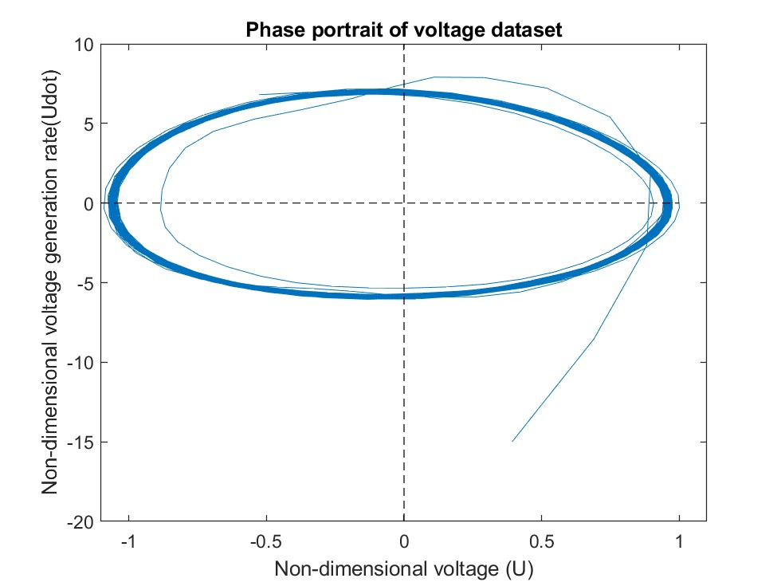
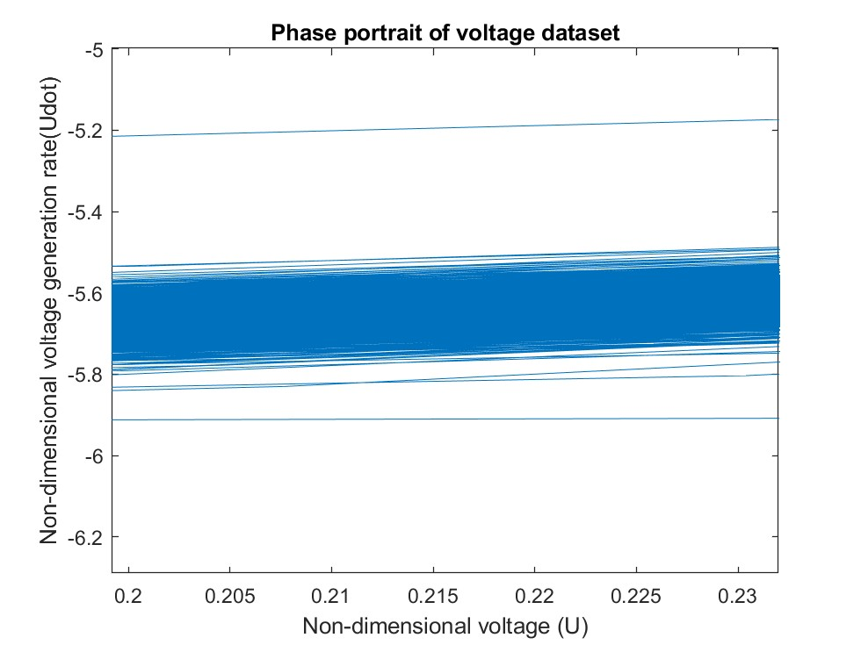
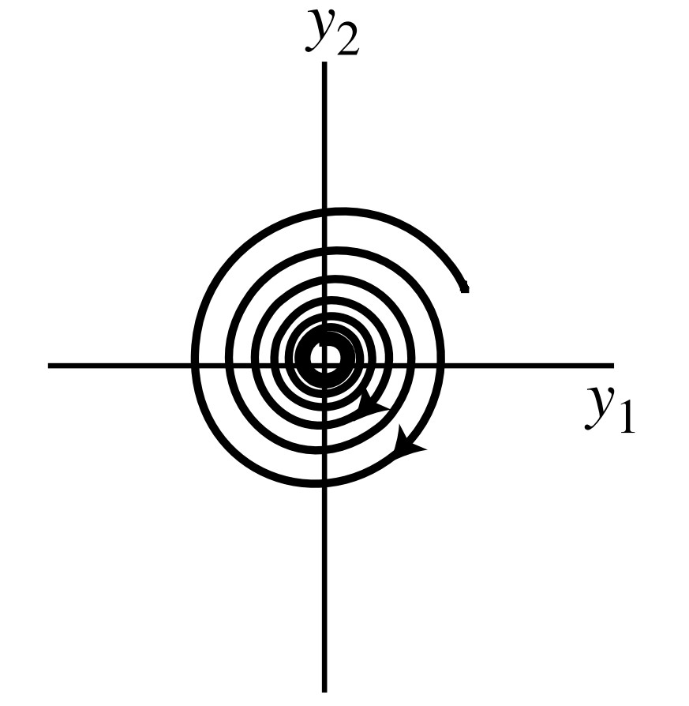
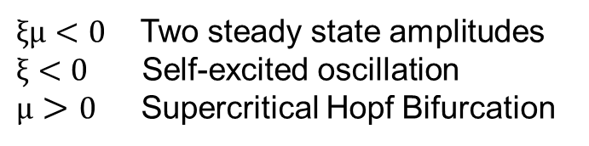
Analyzing governing equations: Damping force
Voltage readout $\left(2 × 0.2992\right)\dot{U} −0.019 {\dot{U}}^{3}$)
What is found:
$ξμ<0$ Two steady state amplitudes
$ξ<0$ Self-excited oscillation
$μ>0$ Supercritical Hopf Bifurcation
What to expect:
Fig. : The found and Expected Phase portraits for voltage readouts
DOI:https://doi.org/10.1002/9780470977859.ch3

Slide 29
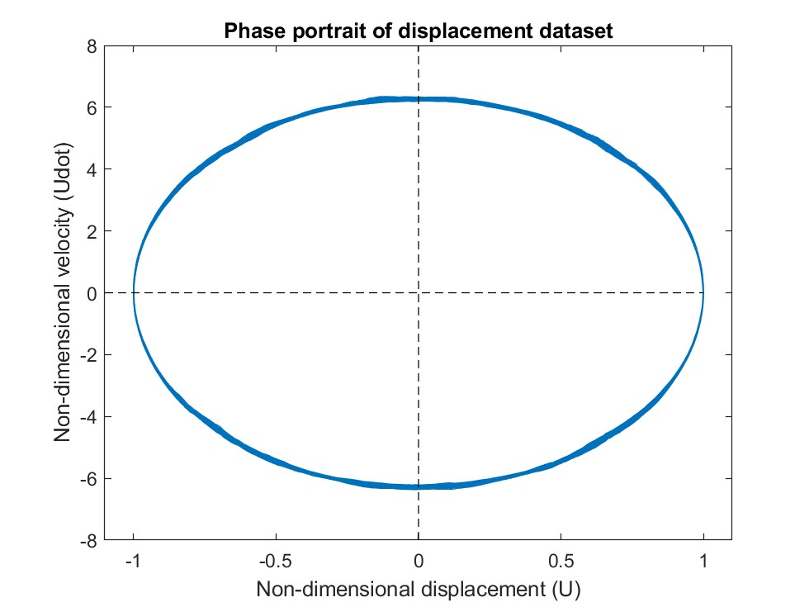
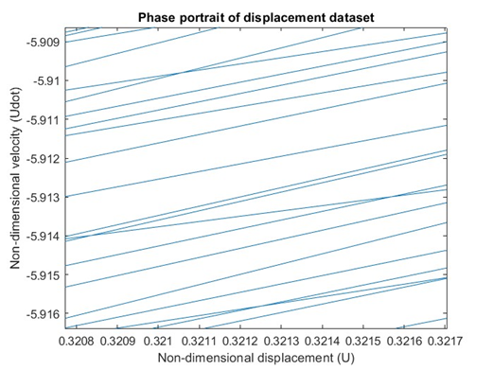
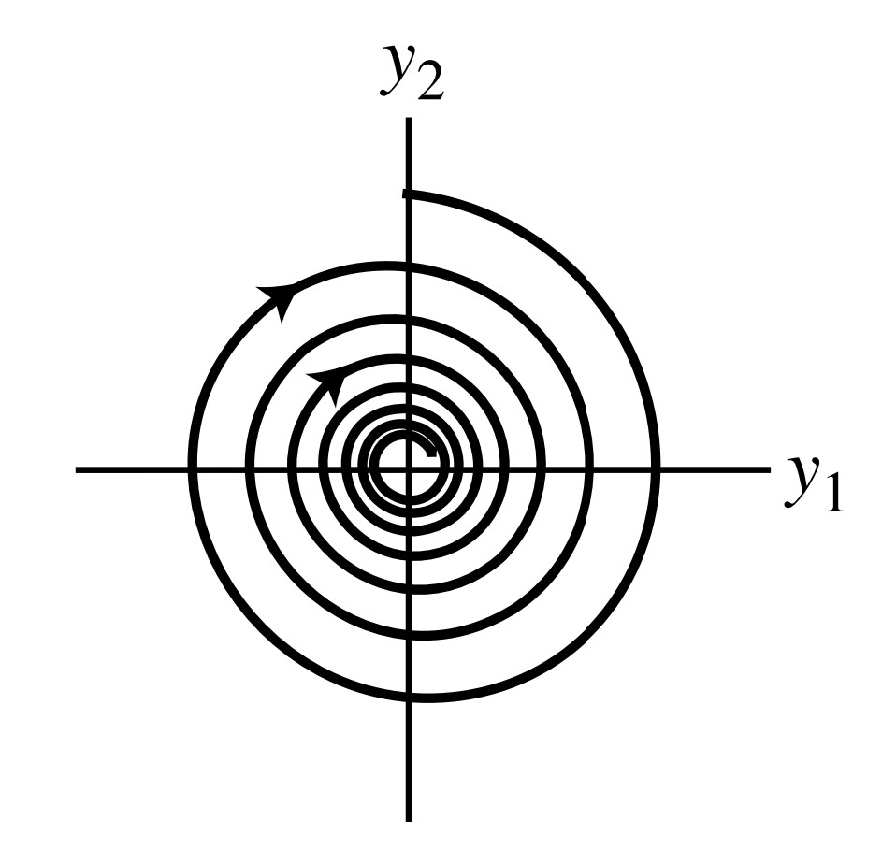
Analyzing governing equations: Damping force
D$isplacement readout\text{(}− \left(2×0.0002\right)\dot{U}\text{)}$
What is found:
What to expect:
Fig. : The found and Expected Phase portraits for displacement readouts.
DOI:https://doi.org/10.1002/9780470977859.ch3

Slide 30
SINDy vs. ANN

Slide 31
Summary of the model Gains: Voltage readout
Nonlinear stiffness and nonlinear damping.
Supercritical Hop bifurcation occurred via self-excited oscillation
Hardening oscillator detected
Trivial steady state amplitude is not stable
Characteristic single well potential energy behavior
The effect of higher harmonics dominate, and such an operating condition is not desired

Slide 32
Summary of the model Gains: Displacement readout
Linear stiffness and Linear viscous damping.
Linear damped oscillator detected
The trivial steady state amplitude is stable
The potential energy behavior is almost linear
The effect of higher harmonics is negligible and Such an operating condition is desired.
SINDy is a potentially good candidate to study the nonlinear dynamics of ME heterostructure!

Slide 33

Thanks for your attentions

