Slide 1
Early assessment of progression free survival in metastatic breast cancer: Preliminary multi-omic analysis from initial post treatment ct data
Subrata Mukherjee¹, Qian Cao¹ , Thibaud Coroller², Craig Wang², Ravi K. Samala¹,
Julie A. Schneider³, Laleh Amiri Kordestani⁴, Berkman Sahiner¹, Nicholas Petrick¹
¹Center for Devices and Radiological Health,
³Oncology Center of Excellence,
⁴Center for Drug Evaluation and Research
U.S. Food and Drug Administration
²Novartis Pharmaceutical Corporation
Dec. 5th, 2024
Notes:
Session: Data Driven Methods and Data Processing (13:00-14:20, Next Tuesday on 18th June), 4 talk per session, hence 20 mins per talk I believe

Slide 2
Disclaimer
The mention of commercial products, their sources, or their use in connection with material reported herein is not to be construed as either an actual or implied endorsement of such products by the Department of Health and Human Services
This is a contribution of the U.S. Food and Drug Administration and is not subject to copyright

Slide 3
Background
Background: Early prediction of cancer progression or treatment response can enable personalized cancer treatment.
Purpose: To evaluate and identify radio-genomics-based prognostic and predictive markers of predicting cancer progression.
  Retrospective analysis: Anonymized data from two Phase III (MONALEESA-3 and 7) trials investigating the role of drug Ribociclib: in prolonging progression-free survival (PFS) and overall survival (OS) in patients with metastatic breast cancer (mBC)
Notes:
Progression free survival (PFS): It is the measure of time that is taken from the start of a treatment or intervention until the disease progresses or worsens or until the patient experiences death from any cause which ever occurs first

Slide 4
Dataset
MONALEESA Clinical Trial Data
  Multimodal : Imaging, clinical and genomics data collected
  Time-to-Event : Primary endpoint is PFS (right censored) per the RECIST v1.1 criteria
Event
Baseline
Week 8
Week 16
Patient #1
Event: Lesion progression
Patient #2
No event: Lost to Follow-up
Patient #3
Event: Death
…
~55% of the patient data censored due to lost-to-follow-up or no event
Data Sample Size
Training cohort: 112 patients (patients in rows)
Test cohort: 101 patients
Notes:
Progression free survival (PFS): It is the measure of time that is taken from the start of a treatment or intervention until the disease progresses or worsens or until the patient experiences death from any cause which ever occurs first

Slide 5
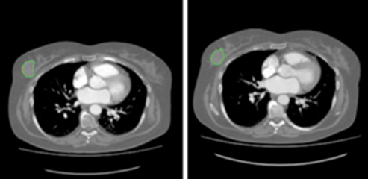
Modeling
Developed an interpretable model for early assessment of PFS in patients with metastatic breast cancer
  Based on clinical features, chest CT radiomic features.
Cox Proportional
Hazards Models
Chest CT with Radiologist Annotation
Original Features
Processed Features
B
Baseline Radiomics (B)
Radiomics (196)
B+D
*Delta Radiomics (D)
Clinical (9)
B+D+C
Clinical Features (C)
B+D+C+I
*Delta Radiomics are the ratio of Week 8 radiomics features to Baseline radiomics
Notes:
Annotation are 2D masks, followed RECIST criteria. Radiomic features aggregated patient wise.
Description of modelling pipeline:
I: II: Clinical features along with Radiomics features
III: Principal component-based Dimensionality Reduction applied separatelyto Baseline and Delta (first followup/baseline$)$
IV. Performance evaluation of different models based on Concordance index (C-index)

Slide 6
Dimensionality Reduction
Radiomics and Clinical features stacked across columns resulting in 205 columns (features) for each patient
First 3 Principal components used for Radiomic and Delta Radiomic features
  70% of the variability accounted for by first 3 principal components
Original Features
Baseline Radiomics Features (N=98)
Delta Radiomics Features (N=98)
Clinical Features (N=9)
15-dimensional
covariate vector
Principal Components Analysis
Processed Features
B (N=3)
D (N=3)
C (N=9)

Slide 7
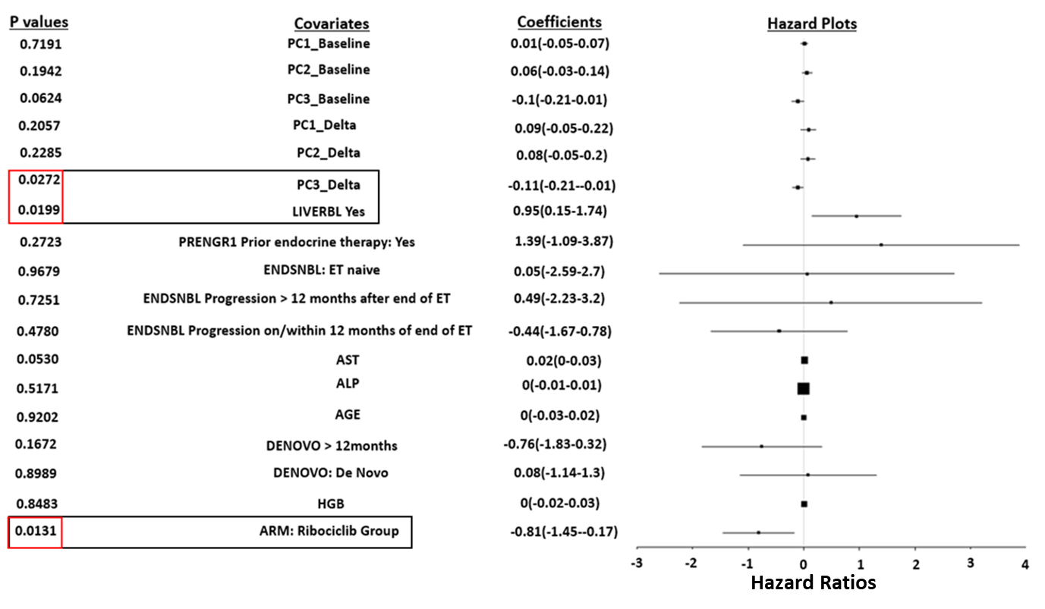
Interactions Selection
Variable Importance of Cox Proportional Hazards Model
Significant Features (p <0.05)
  Delta PC3
  LiverBL
  Ribociclib Arm
Pairwise interactions also modeled among these features
Notes:
Plots contains the coefficient estimates and their confidence intervals for each predictor variable
Point estimates of hazard ratios are shown as dots and the horizontal lines represent the corresponding confidence interval
Hazard ratio (HR) greater than 1 indicates an increased hazard risk while a HR less than 1 indicates a decreased hazard
Cox proportional hazard
model fitted on training data
using the reduced
15-dimensional covariate vector
Coefficients of the fitted model
show delta radiomics, treatment arm
and liver involvement to be significant
(shown in red as p value <0.05)
Ribociclib has significant negative
coefficient, illustrating efficiency in
reducing hazard
Interactions between delta-radiomics
and clinical features considered

Slide 8
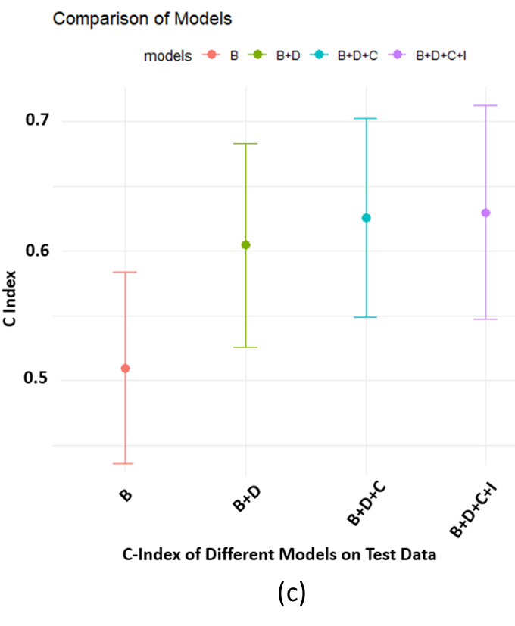
Results: Model Performance
Performance Metric: Concordance Index
B: 0.52 (95%CI:0.44-0.58) | B+D: 0.61 (95%CI:0.52-0.68) | B+D+C: 0.625 (95%CI:0.55-0.70)* | B+D+C+I: 0.63 (95% CI: 0.55-0.71)*
*Statistically significant improvement over baseline (B) model based
on Z-test using compareC
Significant improvement over Baseline model when incorporating Delta Radiomics and Clinical variables.
  Including interactions did not improve performance much more
B: Baseline Radiomics Only - 3 features
B+D: Baseline + Delta Radiomics - 6 features
B+D+C: Baseline + Delta + Clinical - 15 features
B+D+C+I: Baseline + Delta + Clinical + Interaction Terms - 18 features
Notes:
C index being a rank-based measure, is not always a true measure. ‘Good ness of fit’
Spearman rank correlation is a non-parametric measure of association between two variables. It does not require the variables to bear a linear relationship or to be normally distributed.
Additional Interaction terms in the Interaction model: Drug and significant PC from Delta radiomics, Drug and LiverBL, Significant PC and LiverBL

Slide 9
Summary & Conclusion
Multimodal models combining imaging and clinical data can potentially be used to help the assessment of personalized treatment in metastatic breast cancer.
  Including delta radiomics and clinical variables improved the C-index performance
    Statistically significant improvement over baseline (radiomics) model alone
Ongoing work:
  New machine learning models
  Integrating genomics and ctDNA features as well
Contact: Qian.Cao@fda.hhs.gov

