Slide 1

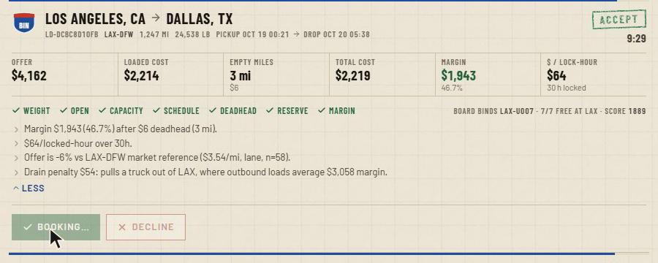
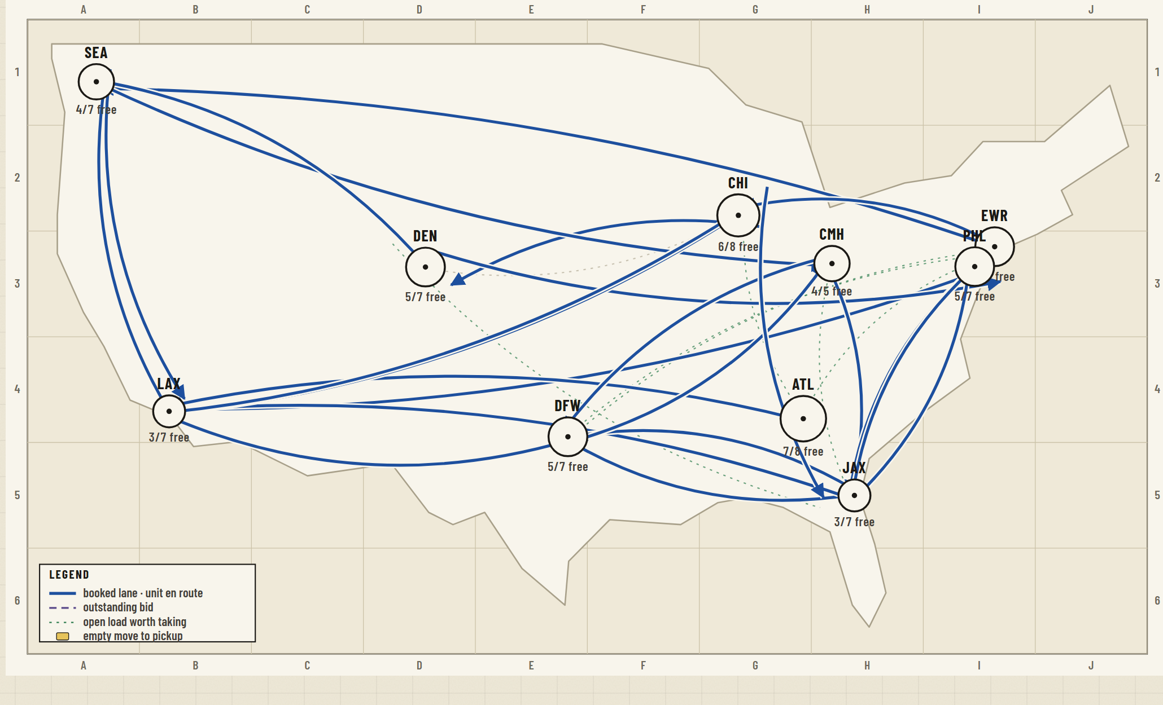
LODESTAR DISPATCH
TEAM REENGINEERS
An intelligent freight load board & autonomous dispatch engine
THE CHALLENGE
SFI International Fall 2026 Engineering Mini-Challenge: an intelligent freight load board and autonomous dispatch engine that books loads profitably under capacity, time-window and margin constraints.
OUR SOLUTION
Lodestar is the dispatch brain between a customer load board and a carrier’s fleet. It ingests the live board in real time, prices every load honestly (including the empty miles), and refuses bad business before the board is ever called. Each unit’s schedule is a set of temporal locks, so trucks are never double-booked and the next load is planned from where the last one drops. An auto-pilot books the clear winners through the same guardrails a human faces, and explains every decision in a ledger.
A load card: offer, loaded cost, empty miles, margin, seven guardrails and the engine’s reasons, before you click.
$20.5k
1.8%
0
margin on 11 loads (35 %)
empty-mile ratio
board rejections
Live demo lodestar-production-4820.up.railway.app
Code github.com/subodh-thallada/lodestar-dispatch
Network map: hubs by free units, booked lanes, outstanding bids.
Notes:
Display slide for H324. Team ReEngineers, Lodestar Dispatch, SFI International Fall 2026 Engineering Mini-Challenge.

