Slide 1
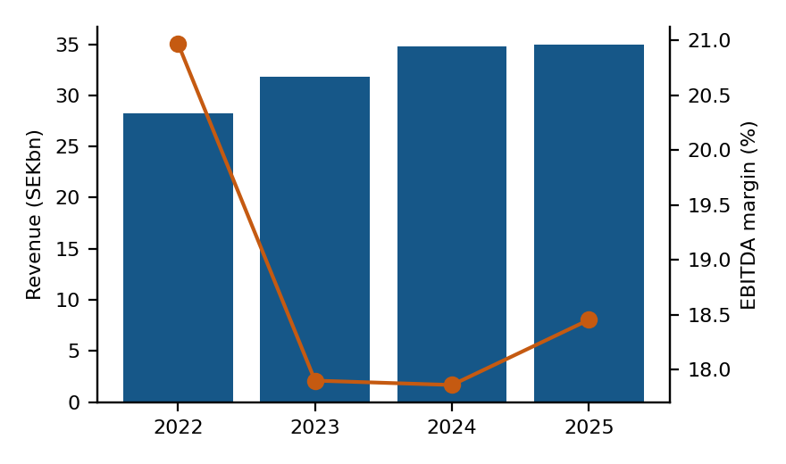
Getinge AB (publ) — company profile
Business overview
• Swedish medtech: acute care therapies, surgical workflows and life science equipment; HQ Gothenburg
• SEK 34.7bn FY25 revenue, ~10,000+ hospital customers globally, listed on Nasdaq Stockholm
• Recurring revenue (consumables, service) is roughly two-thirds of sales and rising
• Q1 2026: order intake +3.9%, organic sales +0.8% against a record comparison quarter
Why interesting
• Guides 3-5% organic growth for 2026; margin recovery underway (12.6% adj. EBITA ex tariffs/FX)
• CardioHelp II ECMO launch in Q2 2026 with US FDA submission planned in H2
• EBITDA margin of ~19% trails medtech peers, leaving self-help upside if execution holds
SEKmm | 2022 | 2023 | 2024 | 2025
Revenue | 28,291 | 31,827 | 34,759 | 34,968
growth % | – | +12.5% | +9.2% | +0.6%
EBITDA | 5,932 | 5,697 | 6,208 | 6,453
margin % | 21.0% | 17.9% | 17.9% | 18.5%
Risks / open questions
• Tariffs and currency cost SEK 226mm of adjusted EBITDA in Q1 2026 alone
• Screening DCF implies EV ~26% below market: the market is pricing recovery, not the trailing numbers
• Multi-year quality-remediation history (FDA consent decree legacy) still weighs on sentiment
Valuation snapshot
• Market cap SEK 54.8bn | EV SEK 63.1bn
• EV/EBITDA 11.6x | P/E 23.2x
• Quick DCF (8.5% WACC, 2.0% TGR, growth fading 7.3%→2.0%): implied EV SEK 46.6bn (-26% vs market)
Source: Yahoo Finance market data; agent-generated summary — verify before use. DCF is a screening heuristic, not investment advice.

