Slide 1
Weather as a Service on Windows Azure
Supplemental Windows Azure Portal Screenshots
Notes:
You may want to use these to supplement the demo script, since it is difficult to share the Windows Azure portal with everyone.

Slide 2
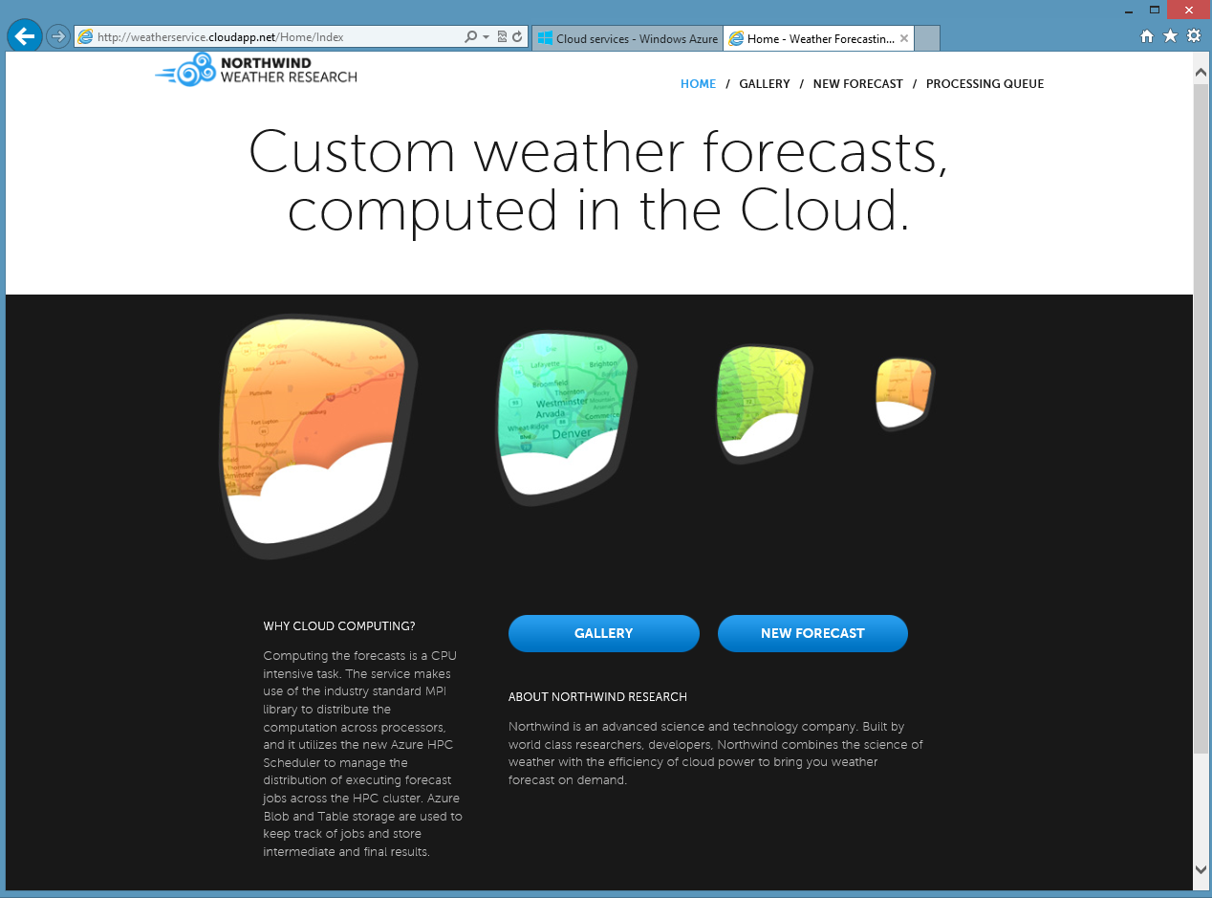
Notes:
Front page of the Live Demo Site.

Slide 3
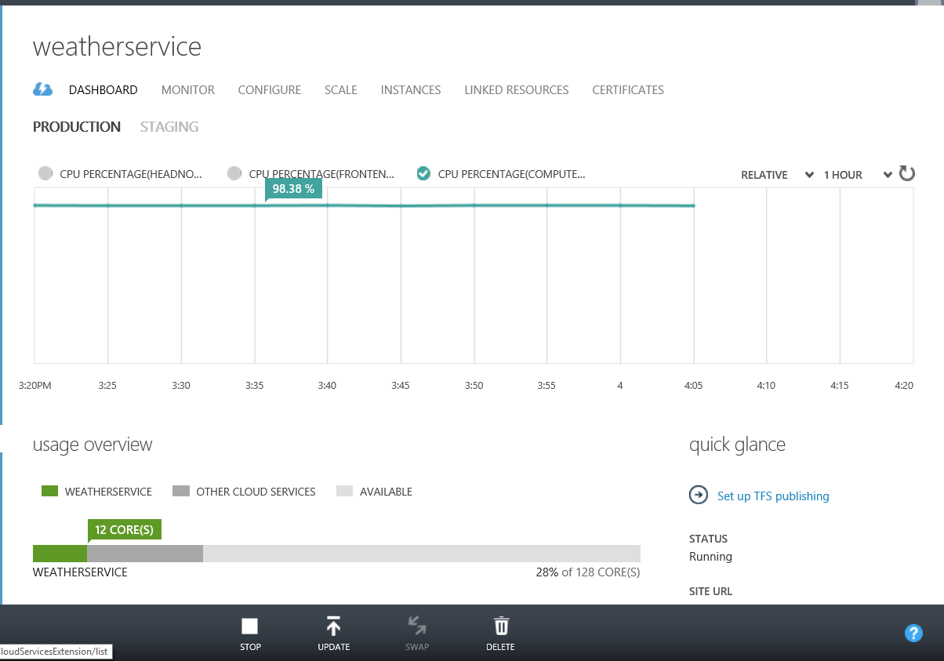
Notes:
Dash board shows that the Compute Node’s CPU has been running at close to 100%.

Slide 4
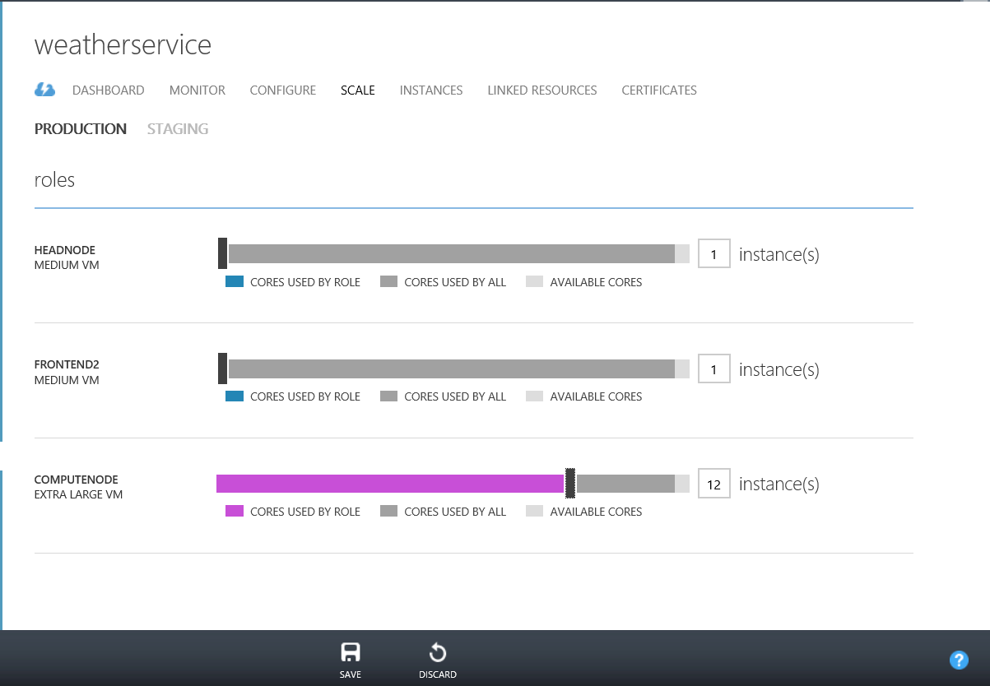
Notes:
You can scale the compute resources horizontally by adding the number of X-Large ComputeNode instances.

Slide 5
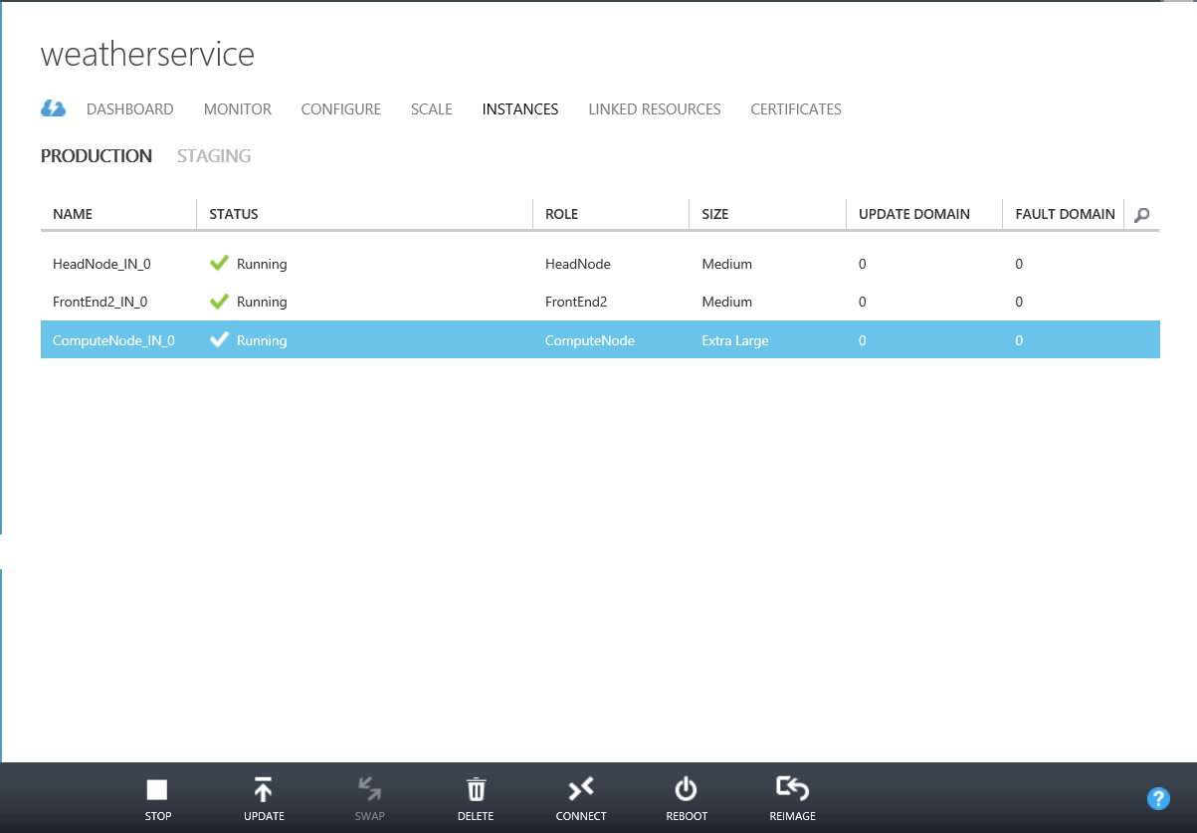
Notes:
Instance page shows that there are 3 types of instances in the Windows Azure HPC Scheduler.
HeadNode which controls the cluster.
A FrontEnd Web role which hosts the MVC website.
Extra Large Compute Nodes which can scale to meet computing needs.

Slide 6
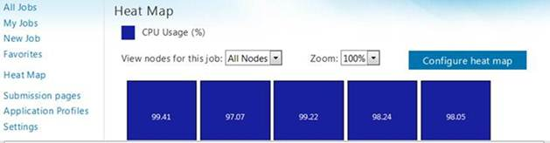
HeatMap: 5 Compute Nodes running at 100%
Notes:
Optional showing CPU running at 100% https://weatherservice.cloudapp.net/HeatMapPage.aspx

Slide 7
Resources
Weather as a Service live demo site http://weatherservice.cloudapp.net/
Technical Details Blog on the Service http://blogs.msdn.com/hpctrekker/
Twitter Contact: @wenmingye

