Slide 1
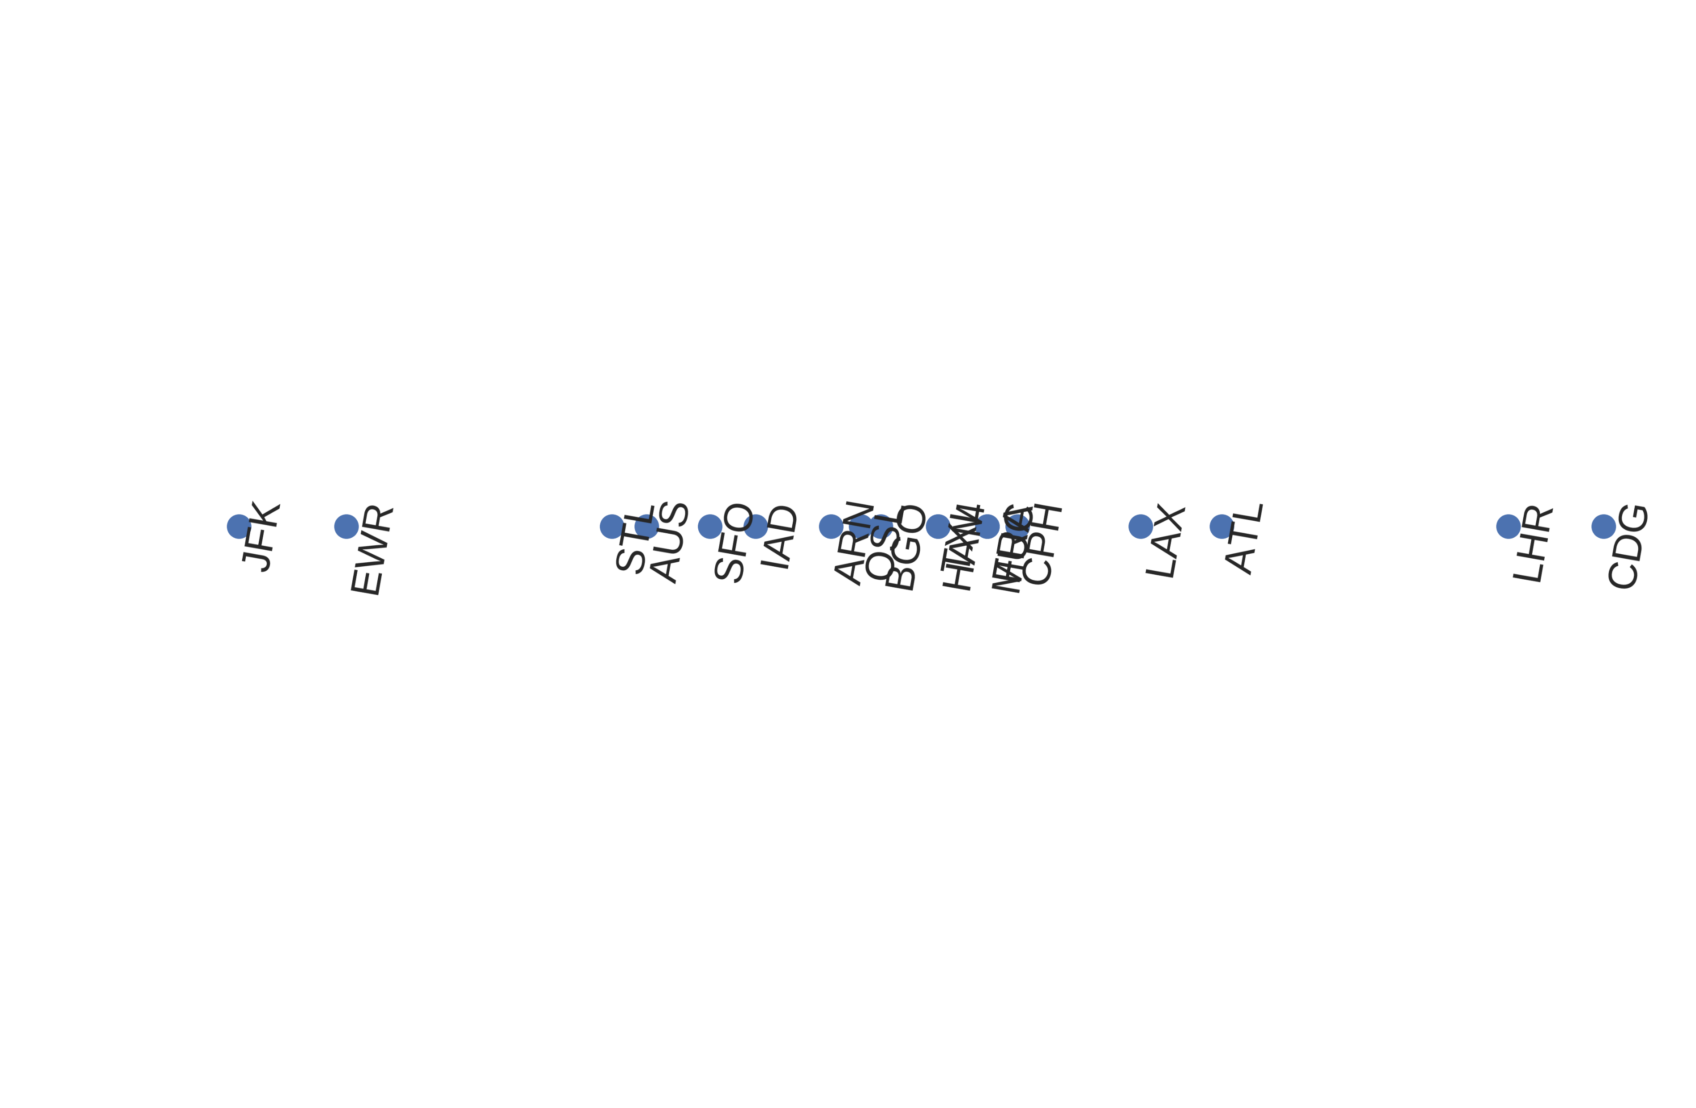
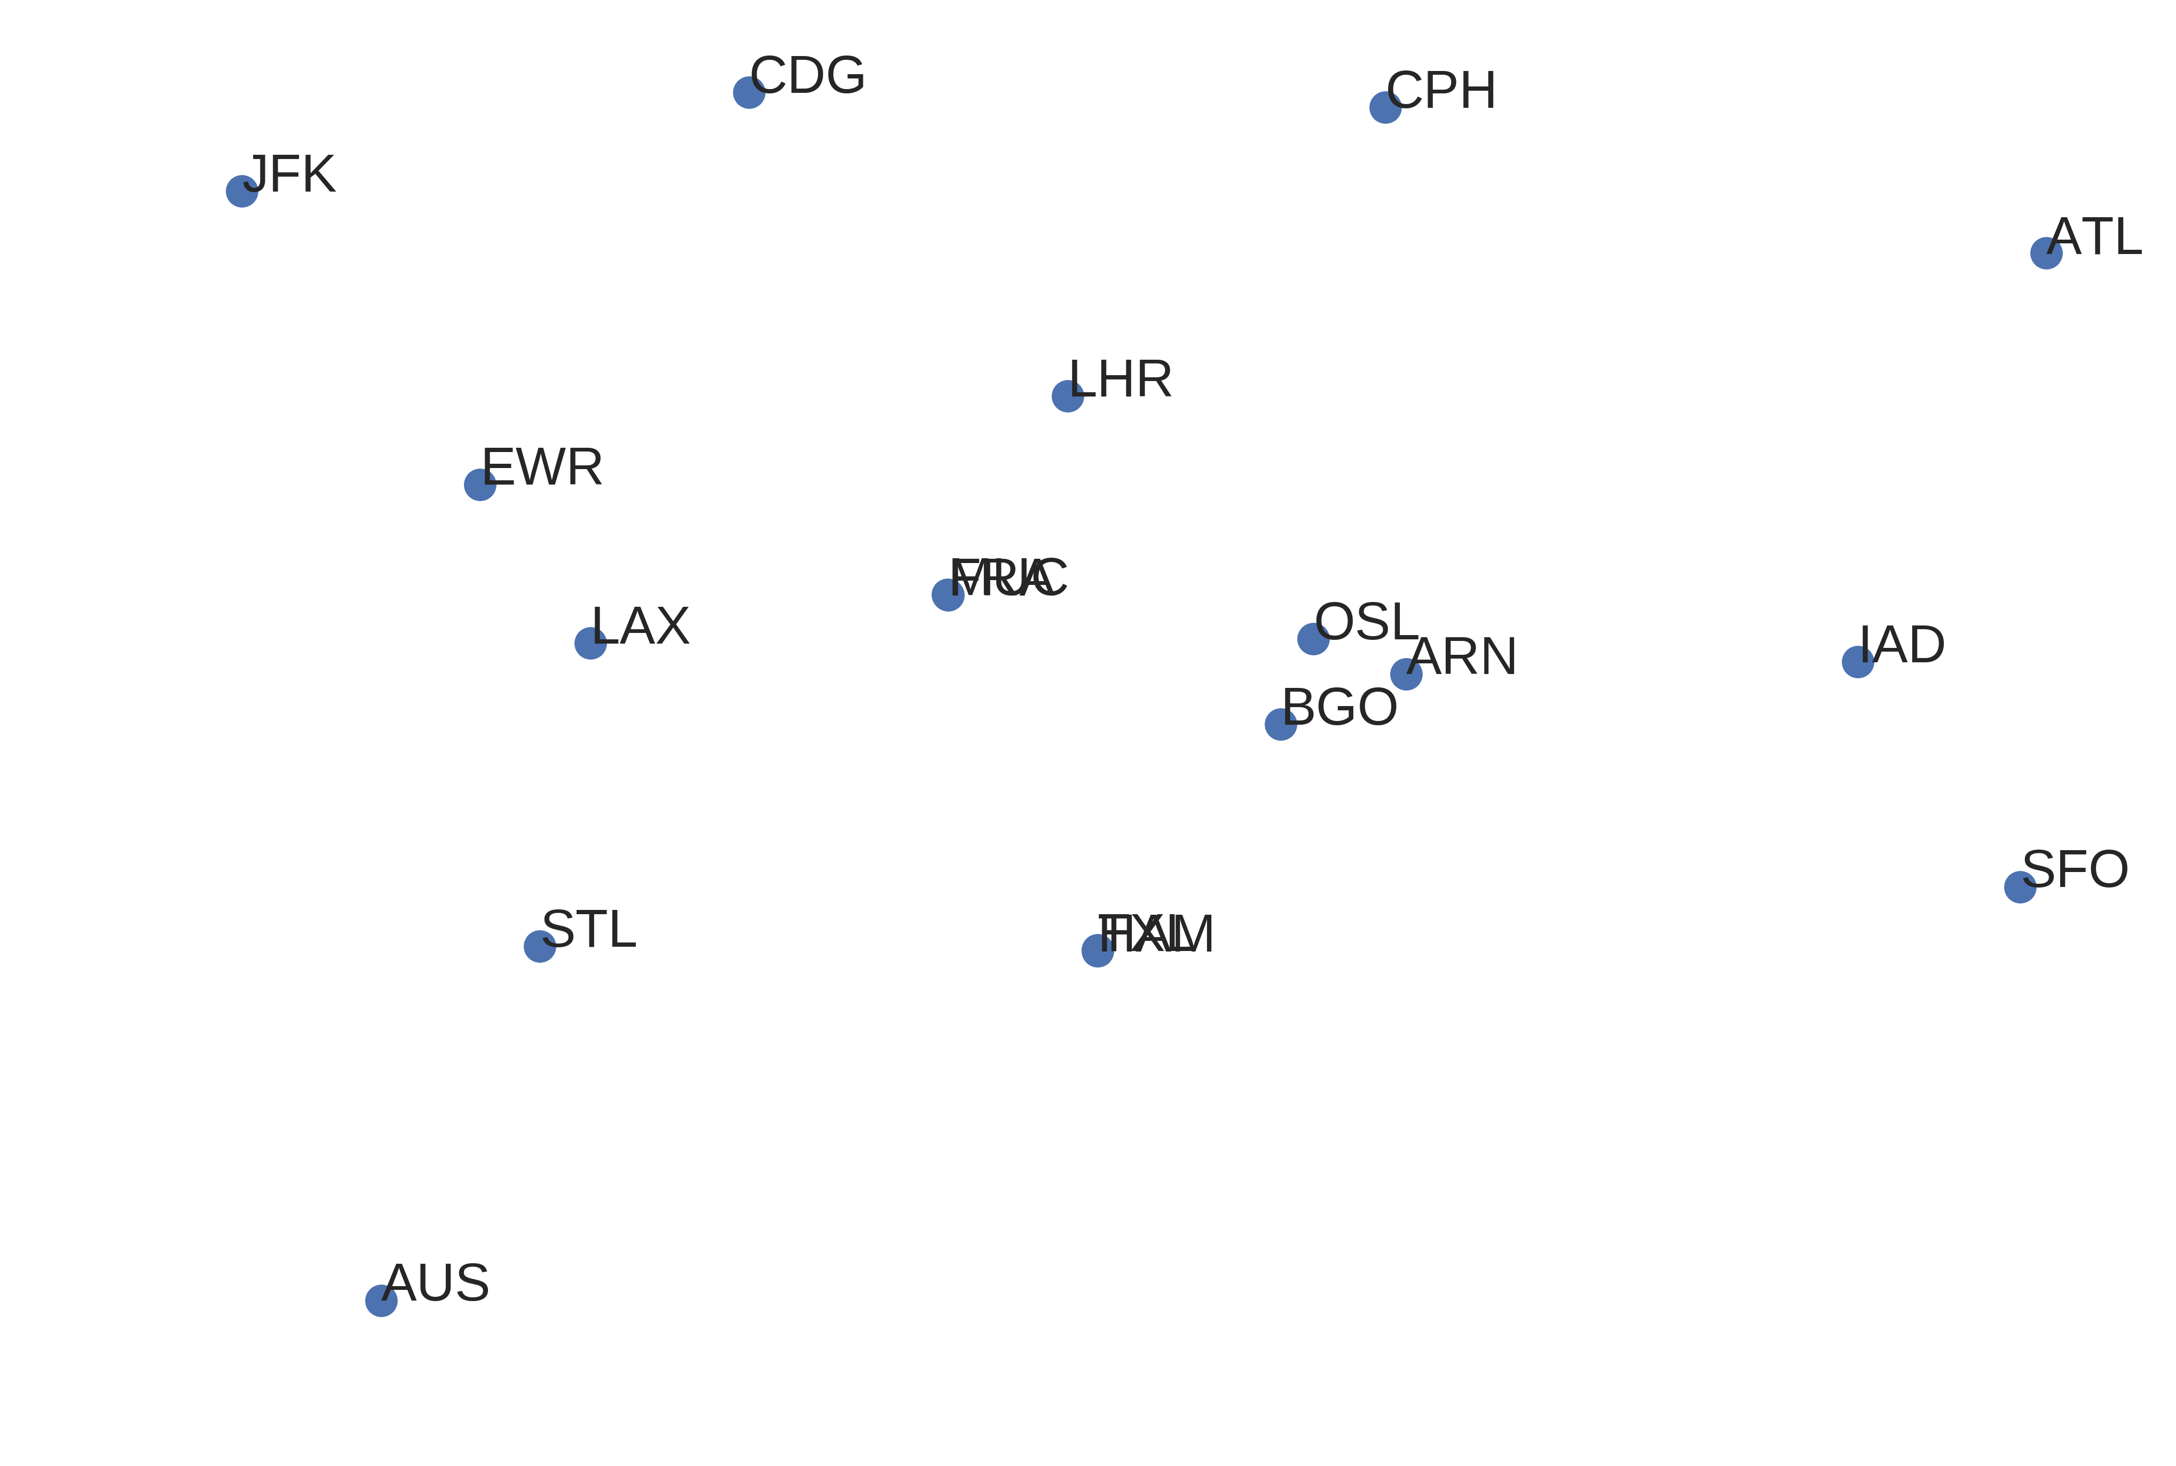



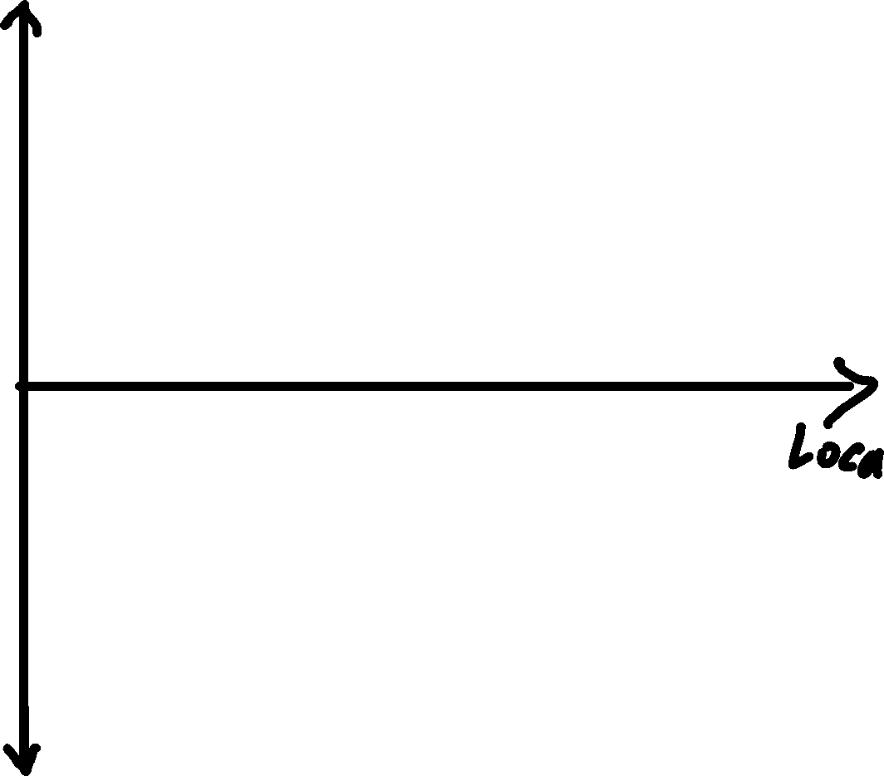

Understanding Latent Neural Spaces
Understanding Embeddings
Basic question: How to turn categories into numbers?
neural networks can not deal with symbols
only numerical values can be processed by neural networks
even words and texts can be seen as categories / symbols
Would it be possible to still make those numbers carry the semantics of the symbols?
Example airports:
Core and Basics
TODO: NN Setup Hand written sketch, what to keep
Advanced and Details
TODO:
Clustering über Embedding und Flugzahlen
1d durch PCA erzeugen
Link to notebook: TODO

