Slide 1
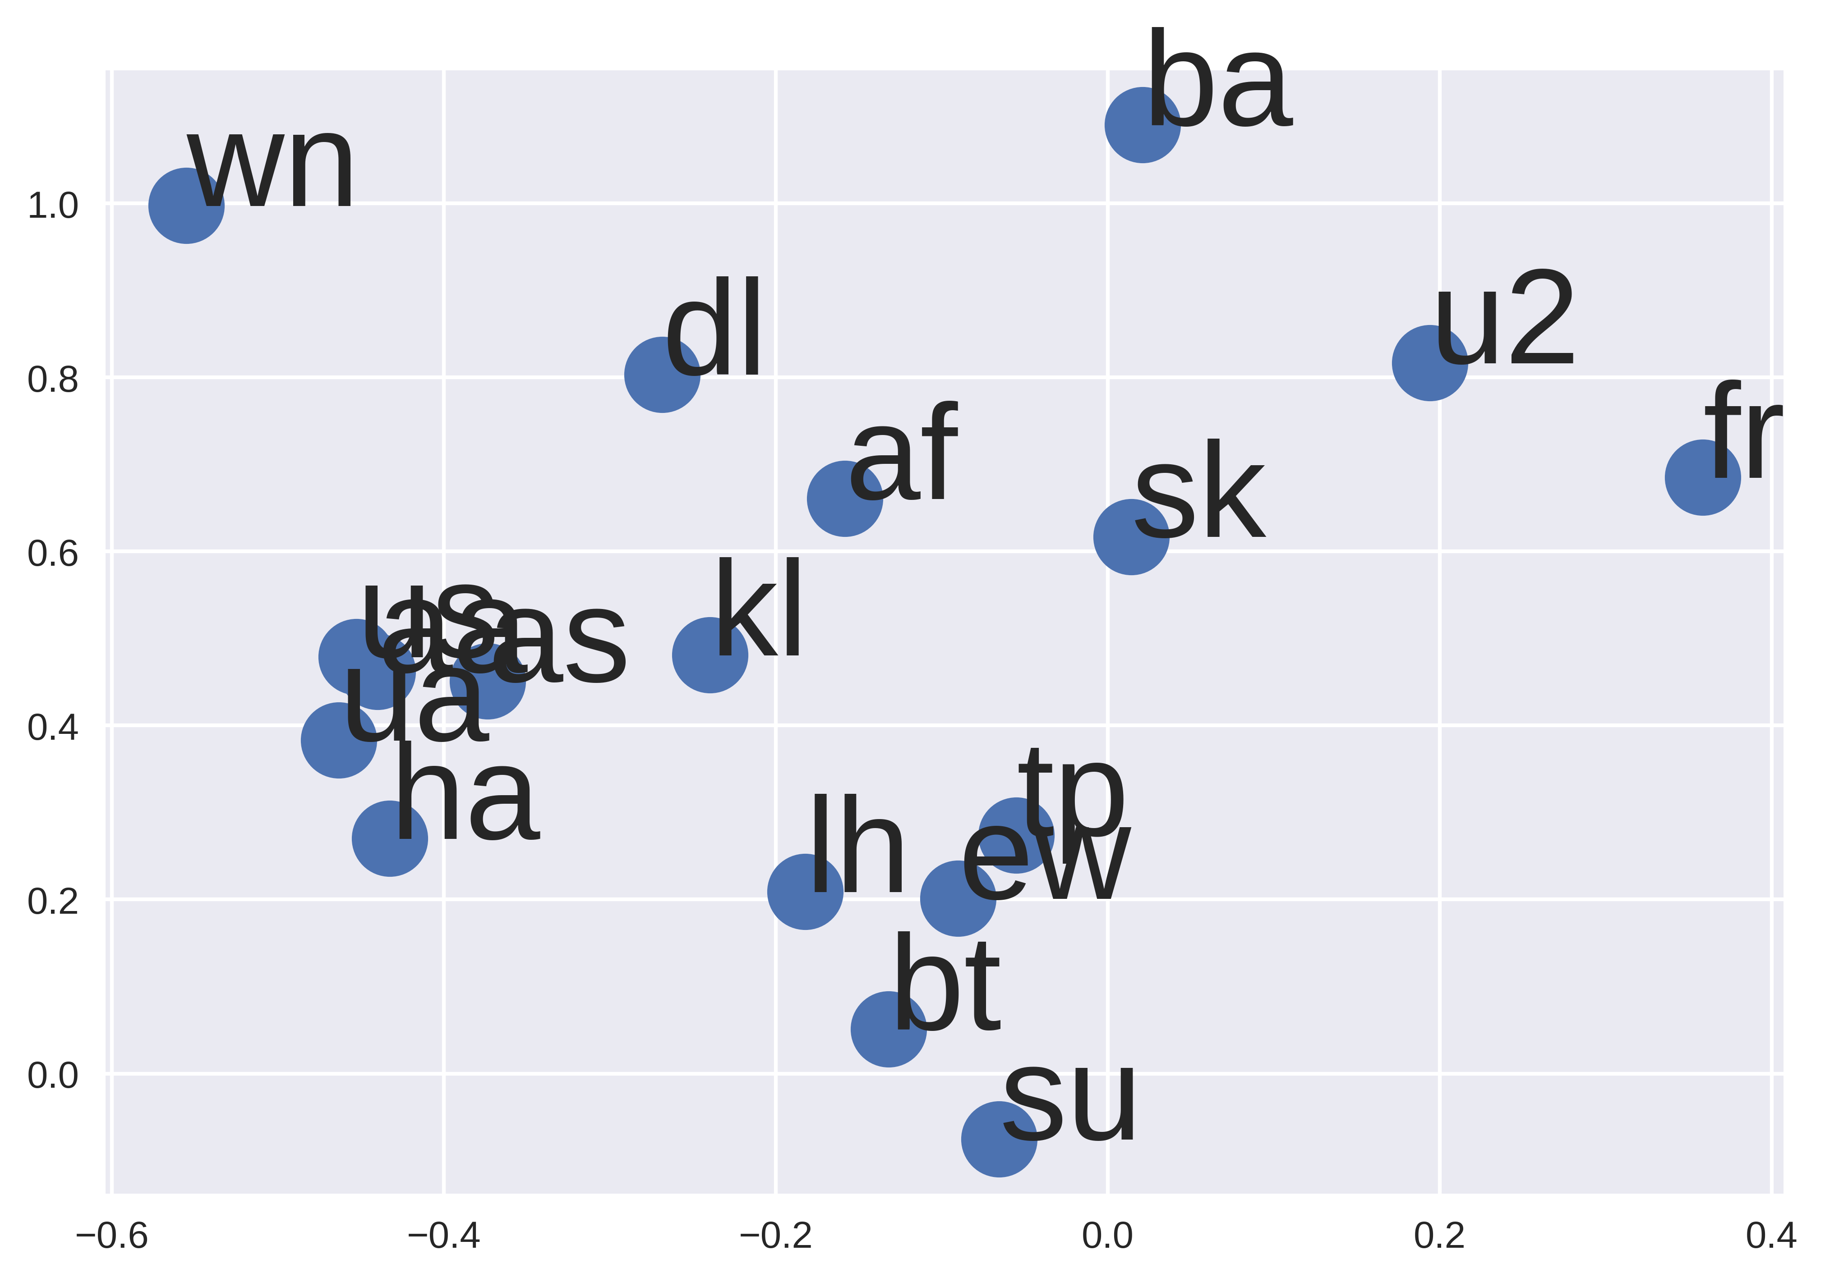
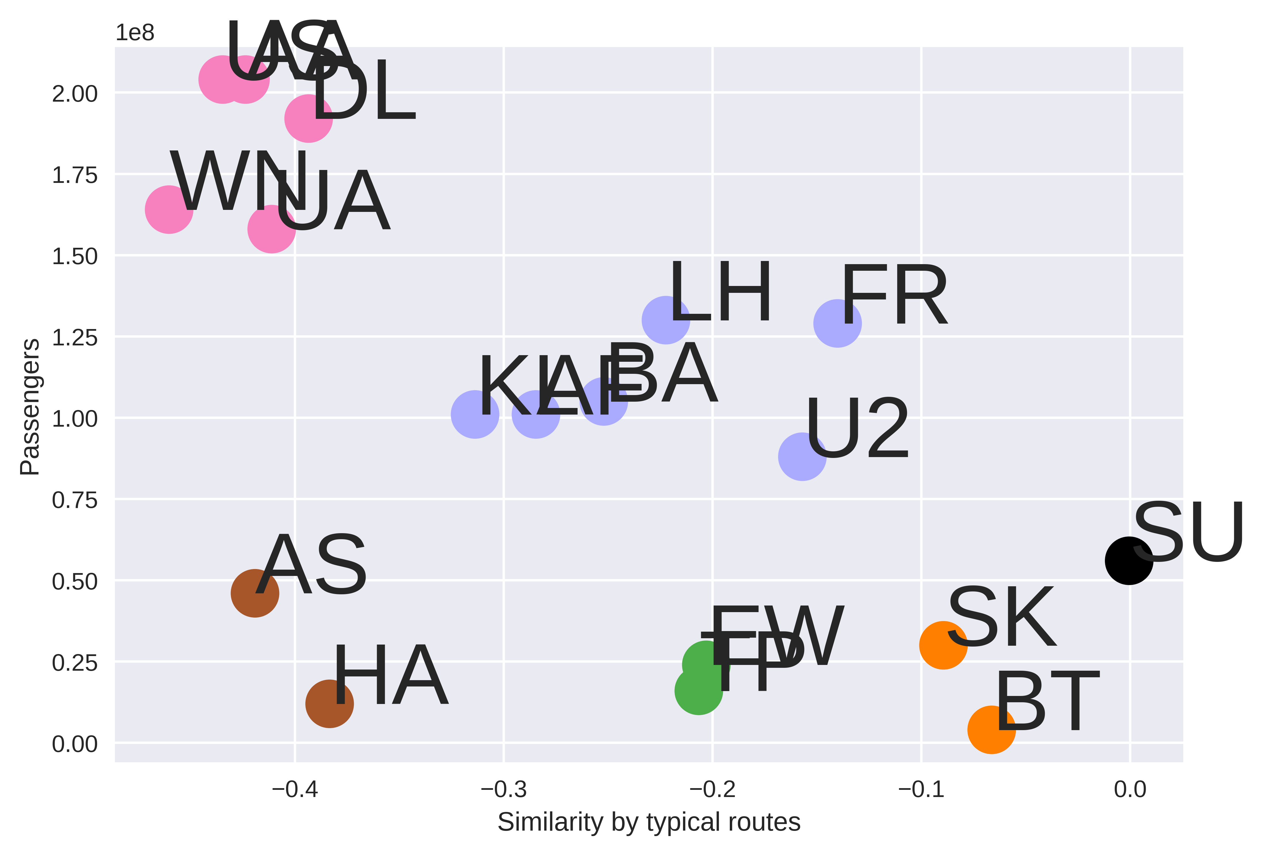



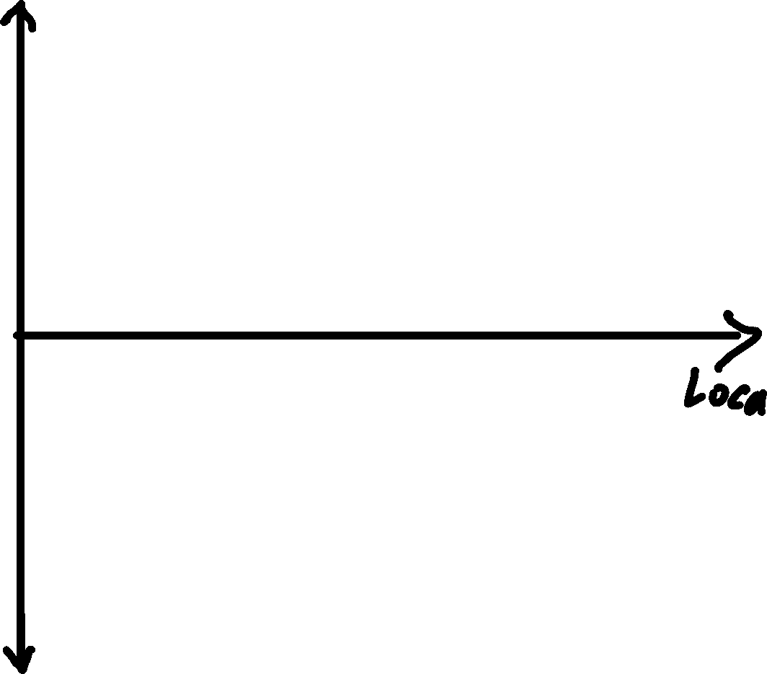

Understanding Neural Embeddings Oliver Zeigermann @DJCordhose
Understanding Semantic Embeddings
Basic question: How to turn categories into numbers?
neural networks can not deal with symbols
only numerical values can be processed
even words and texts can be seen as categories / symbols
Ideal Solution: make those numbers carry the semantics of the words or symbols
Humans are good at this: Locate your favorite airport below
Sample Application: Airlines
Use Case 1: n-dim Embedding as input layer for further processing
Use Case 2: 1-d Embedding as a plot / cluster for data visualization
How to Embed
Basic Idea: Train a model and squeeze input through a bottle-neck. Use that bottle-neck as the semantic representation.
What do you want to embed? Airlines
What data do you want to use to express similarity? Typical Routes flown by Airline
Prepare data accordingly
Set up network and choose loss function
TODO: Sketch NN setup
Train with small batch size and make sure loss goes down
Extract Embedding layer (the bottle-neck)
TODO: Sketch What to keep
Use layer to embed airlines of choice
Plot embedding, reduce dimension if more than 2 or 3 (PCA or T-SNE)
Link to notebook: http://bit.ly/embed-airlines

