Slide 1
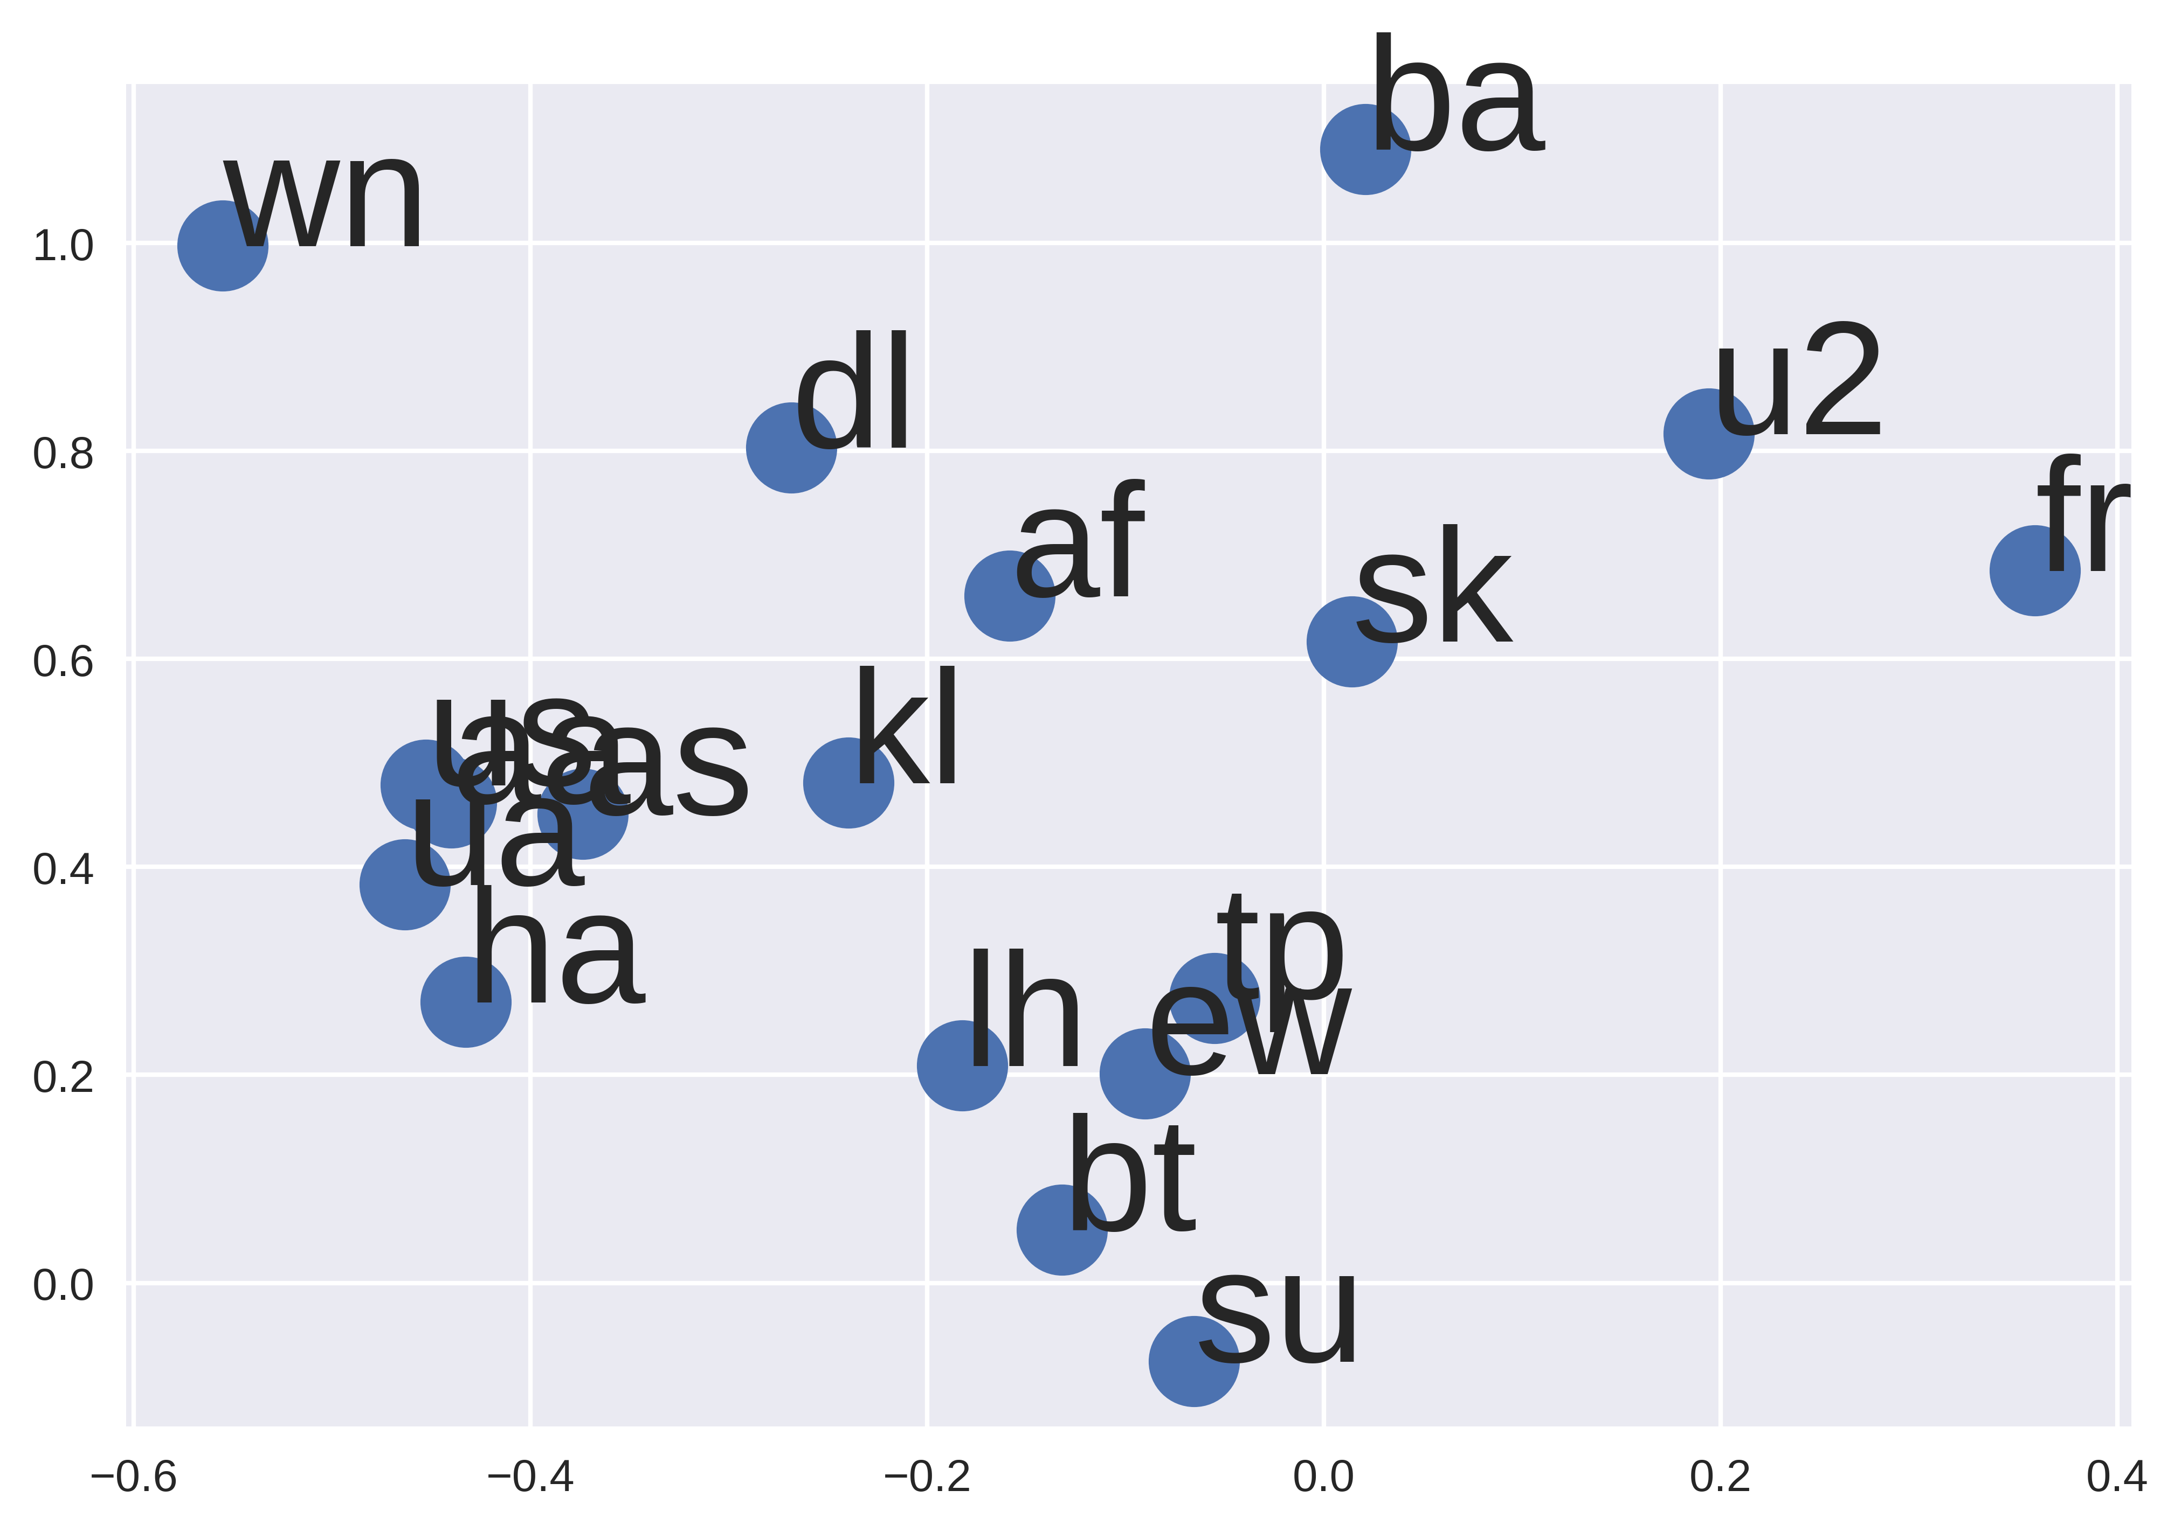
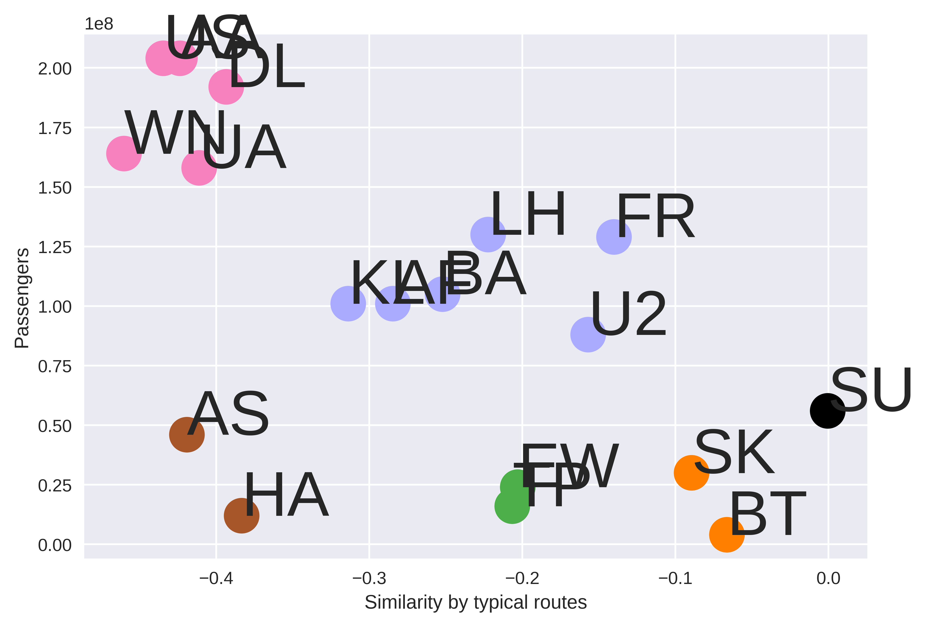



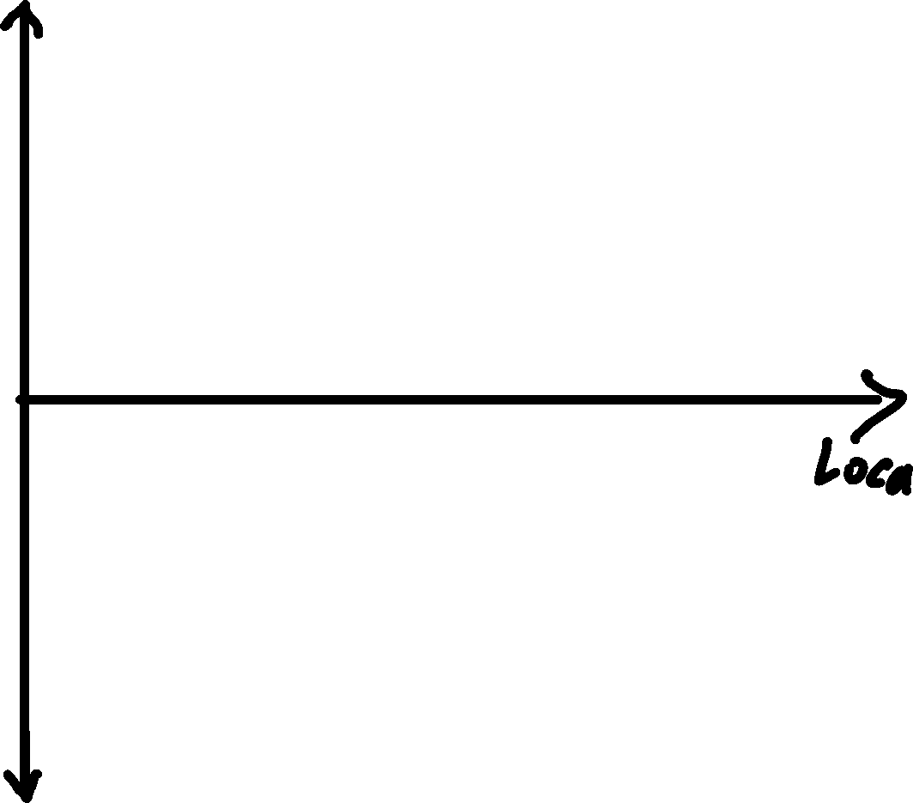

Understanding Latent Neural Spaces Oliver Zeigermann @DJCordhose
Understanding Semantic Embeddings
Basic question: How to turn categories into numbers?
neural networks can not deal with symbols
only numerical values can be processed
even words and texts can be seen as categories / symbols
Ideal Solution: make those numbers carry the semantics of the words or symbols
Humans are code at this: Locate your favorite airport below
Sample Application: Airlines
Use Case 1: n-dim Embedding as input layer for further processing
Use Case 2: 1-d Embedding as a plot / cluster for data visualization
How to Embed
Basic Idea: Train a model and squeeze input through a bottle-neck. Use that bottle-neck as the semantic representation.
Step 1: What do you want to embed? Airlines
Step 2: What data do you want to use to express similarity? Typical Routes flown by Airline
Step 3: Prepare data accordingly
Step 4: Set up network and choose loss function
TODO: Sketch NN setup
Step 5: Train with small batch size and make sure loss goes down
Step 6: Extract Embedding layer (the bottle-neck)
TODO: Sketch What to keep
Step 7: Use layer to embed airlines of choice
Step 8: Plot embedding, reduce dimension if more than 2 or 3 (PCA or T-SNE)
Link to notebook: http://bit.ly/embed-airlines

