Slide 1
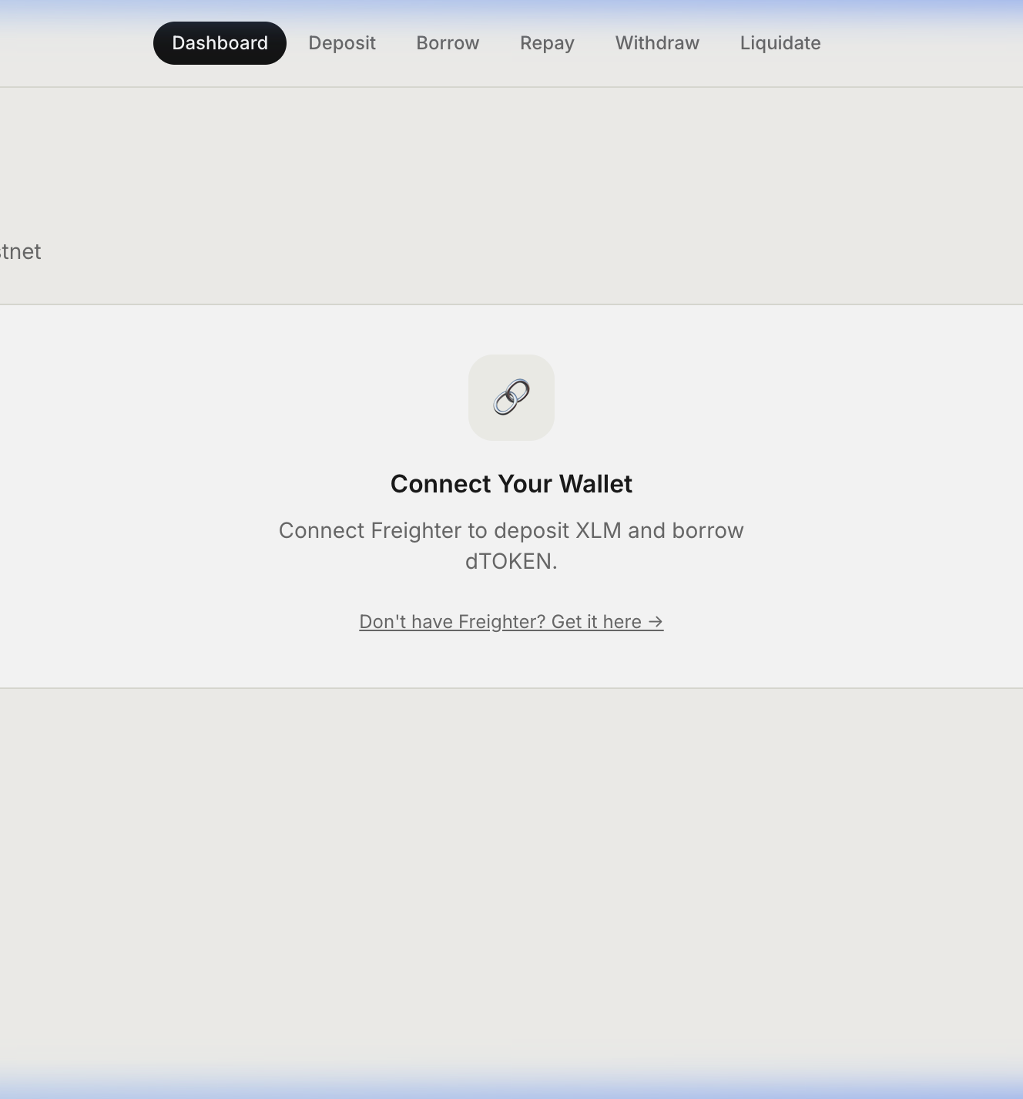
STELLAR TESTNET · LEVEL 5
Borrow against
your XLM.
A non-custodial Soroban lending flow with clearer onboarding, position safety, and verifiable Testnet activity.
THE LEVEL 5 STORY
Product iteration · user growth · proof
STELLAR LENDING · LEVEL 5
01
Notes:
[Sources]
Product screenshot: repository asset docs/screenshots/dashboard_page.png. All product statements are based on the repository README and deployed Testnet app.

Slide 2
THE PROBLEM
Liquidity should not require leaving XLM behind.
The first lending interaction is hard to trust when risk, steps, and proof are fragmented.
01
02
03
Opaque risk
Friction at first use
Weak evidence
Users need to see the collateral rule and liquidation threshold before they sign.
Wallet setup, Testnet funding, and the first action often happen in separate places.
A working dApp needs confirmed, public Testnet activity—not unverified claims.
STELLAR LENDING · LEVEL 5
02
Notes:
[Sources]
Problem framing is a project positioning statement; no external market-statistic claim is used.

Slide 3
THE SOLUTION
One transparent loop: deposit, borrow, manage, prove.
Stellar Lending makes native XLM collateral, dTOKEN borrowing, and position safety visible in one Testnet interface.
01
02
03
04
Deposit XLM
→
Borrow dTOKEN
→
Monitor health
→
Repay / withdraw
Designed for a Testnet-first experience: transparent parameters, public wallet proof, and no custody of user assets.
STELLAR LENDING · LEVEL 5
03
Notes:
[Sources]
Flow and feature statements are derived from repository README and frontend routes.

Slide 4
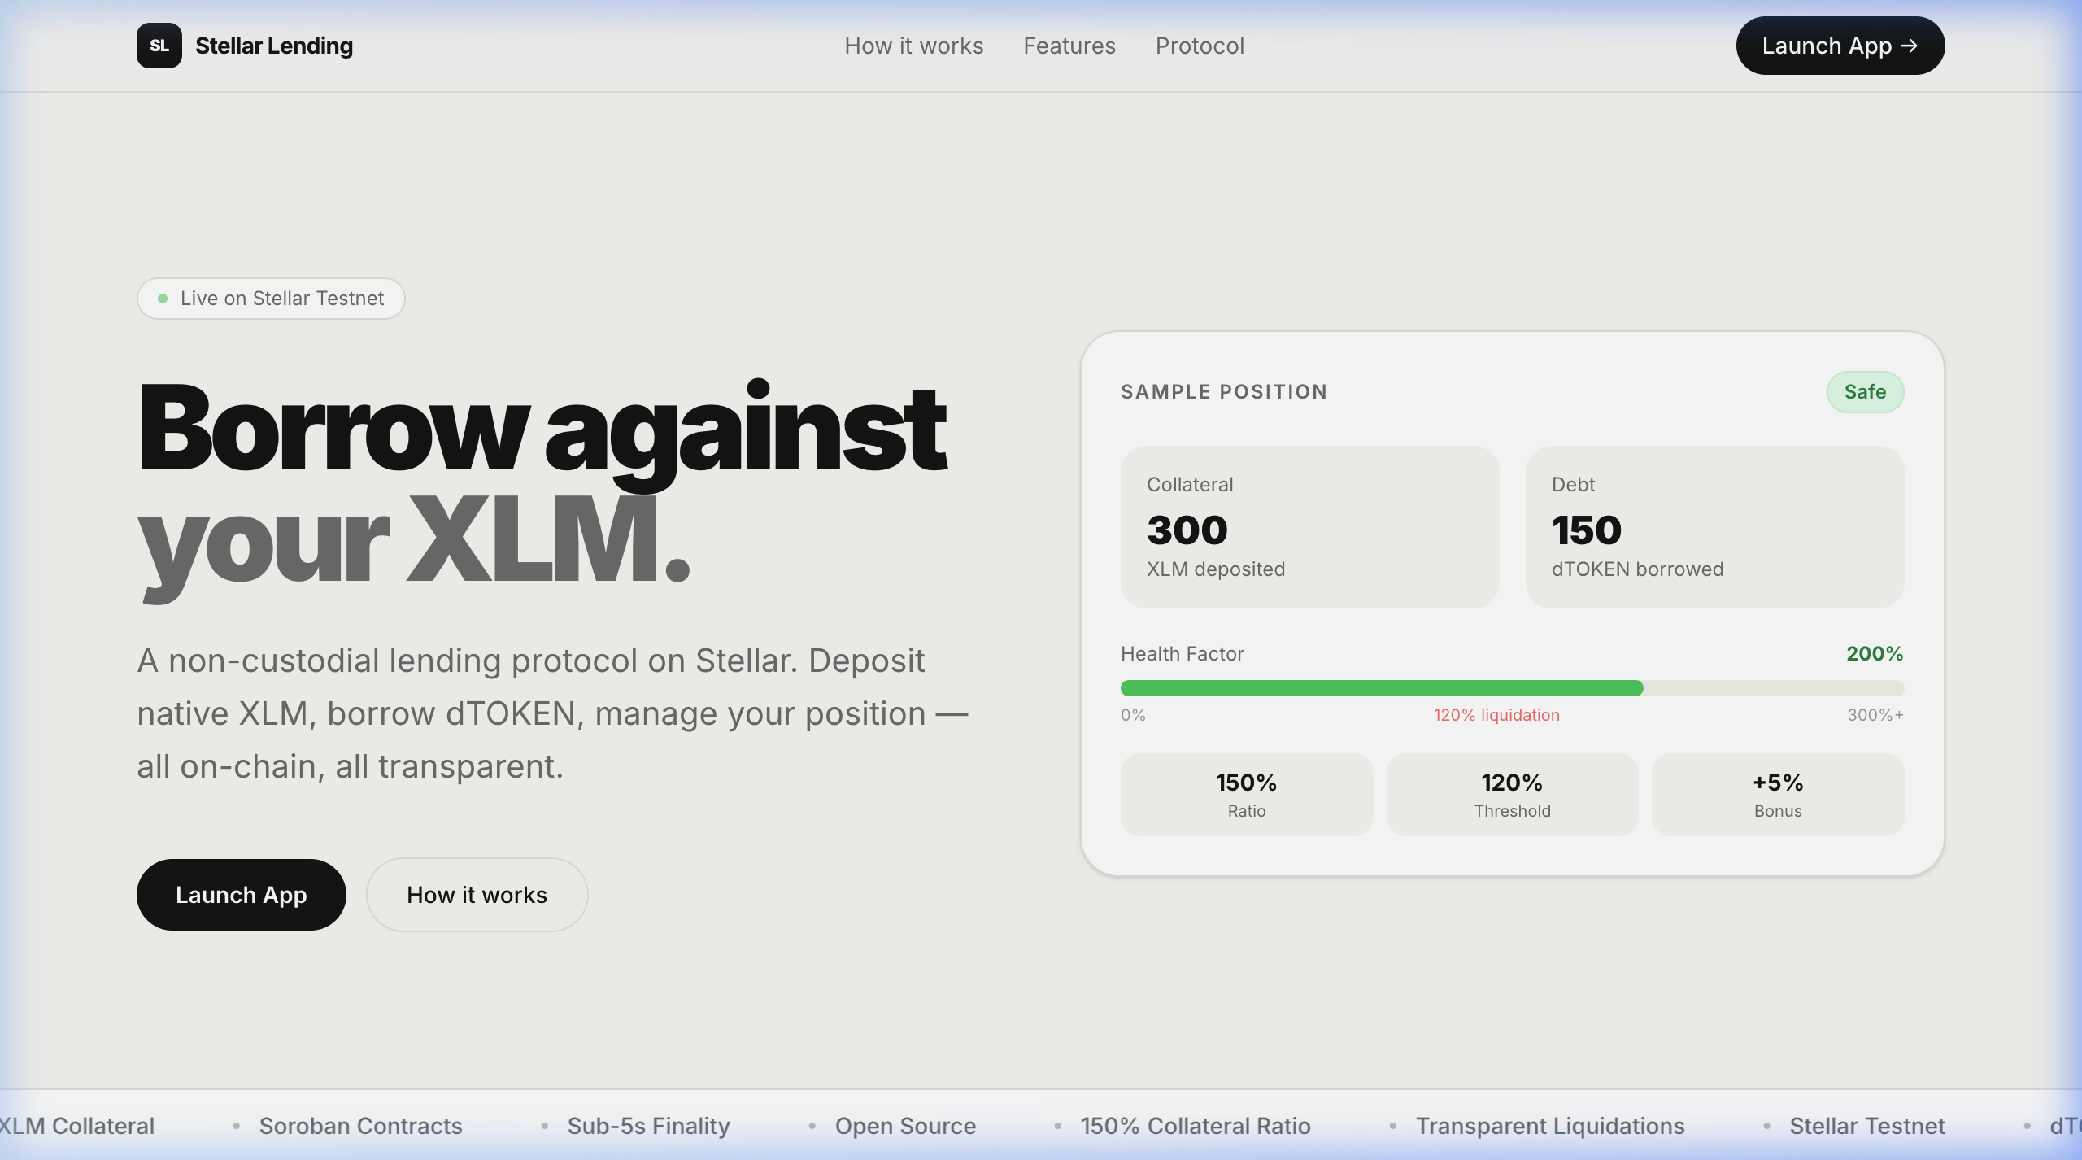
PRODUCT ITERATION
The first five minutes now have a path.
The new Start on Testnet page turns wallet setup and proof collection into a clear checklist.
1
Connect Freighter
Use Stellar Testnet only.
2
Fund with Friendbot
Get Testnet XLM, not mainnet funds.
3
Complete one action
Deposit, borrow, repay, withdraw, or liquidate.
4
Retain proof
Save only the public address and transaction hash.
STELLAR LENDING · LEVEL 5
04
Notes:
[Sources]
Product screenshot: repository asset docs/screenshots/desktop_landing.png. Onboarding flow: new frontend page /app/onboarding in this Level 5 update.

Slide 5
ARCHITECTURE
A thin wallet interface over Soroban contracts.
The app keeps signing in Freighter while React reads and invokes contracts through Stellar RPC.
Freighter wallet
React + Vite
Stellar RPC
Soroban contracts
Public address
Signs Testnet transactions
→
Dashboard and guided flows
Position previews
→
Simulation and transaction
confirmation polling
→
Pool · debt token
Flash liquidation
Native XLM collateral · USD-aware health factor · 150% collateral ratio · 120% liquidation threshold · 5% liquidation bonus
STELLAR LENDING · LEVEL 5
05
Notes:
[Sources]
Architecture is based on repository README architecture section and frontend/src/lib/ContractInteraction.ts.

Slide 6
FEEDBACK → FIXES
We turned specific usability issues into product changes.
The objective is less guesswork: clearer safety states, a richer desktop layout, and stable wallet data.
Health factor
Landing experience
Cap the visual display and make very-safe positions readable.
Add a position preview, protocol parameters, and a stronger first CTA.
Desktop layout
Wallet state
Replace the narrow mobile-style frame with purposeful two-column pages.
Prevent stale requests from an older connected wallet overwriting dashboard data.
STELLAR LENDING · LEVEL 5
06
Notes:
[Sources]
Feedback/fix details: repository README Feedback & Fixes table. Related commit: 60ea9161abdcf3719f97b4c9d26f5f2785eb693e.

Slide 7
MARKET OPPORTUNITY
Start where the learning
loop is real.
Builders
Open-source Soroban implementation
The immediate opportunity is a focused Testnet cohort: users who can validate wallet onboarding, lending safety cues, and the complete transaction loop.
Testers
Publicly verifiable Testnet flow
Ecosystem
A demoable native-XLM lending use case
No invented TAM. Growth claims come only after verified cohort evidence.
STELLAR LENDING · LEVEL 5
07
Notes:
[Sources]
Market opportunity is qualitative positioning; the deck intentionally makes no external market-size claim.

Slide 8
GROWTH STRATEGY
A measured path to 50 real wallet interactions.
Every row must be a separately confirmed public Testnet transaction—not a generated address or an unverified claim.
01
02
03
04
05
Invite
→
Onboard
→
Interact
→
Verify
→
Iterate
Share the Testnet guide
Fund wallet and connect
One meaningful action
Check Stellar Expert proof
Use rating and comments
Operating rule: schedule each real interaction 2–3 minutes apart; retain only public wallet address + confirmed hash + optional feedback.
STELLAR LENDING · LEVEL 5
08
Notes:
[Sources]
Growth protocol: docs/LEVEL_5.md and docs/evidence/wallet-interactions.csv in this update. 50-wallet count is a target, not an achieved metric.

Slide 9
READINESS SNAPSHOT
The product is ready to be tested; the real cohort is still pending.
These are engineering and operational signals, not user-growth claims.
40+
39
7
50
meaningful commits
in current history
contract tests
previously passing
frontend tests
previously passing
real wallets
cohort target
Internal Testnet smoke tests and prior test results are not substituted for independent user activity.
STELLAR LENDING · LEVEL 5
09
Notes:
[Sources]
Commit count is from local repository history at deck creation. Test counts are documented in project history; final test verification should accompany the submission. 50 is a target.

Slide 10
ROADMAP
Validate first. Then expand with evidence.
The next phase is deliberately tied to real observed friction rather than a speculative feature list.
Now
Next
Then
Later
Guided Testnet onboarding
50-user verified cohort
Prioritised product iteration
Ecosystem readiness
Clear first action, safety, and proof instructions.
Timed Testnet interactions plus ratings and feedback.
Fix the highest-impact onboarding and position-management friction.
Publish demo, analytics evidence, and a refined public narrative.
STELLAR LENDING · LEVEL 5
10
Notes:
[Sources]
Roadmap is a forward-looking project plan; no external sources used.

Slide 11
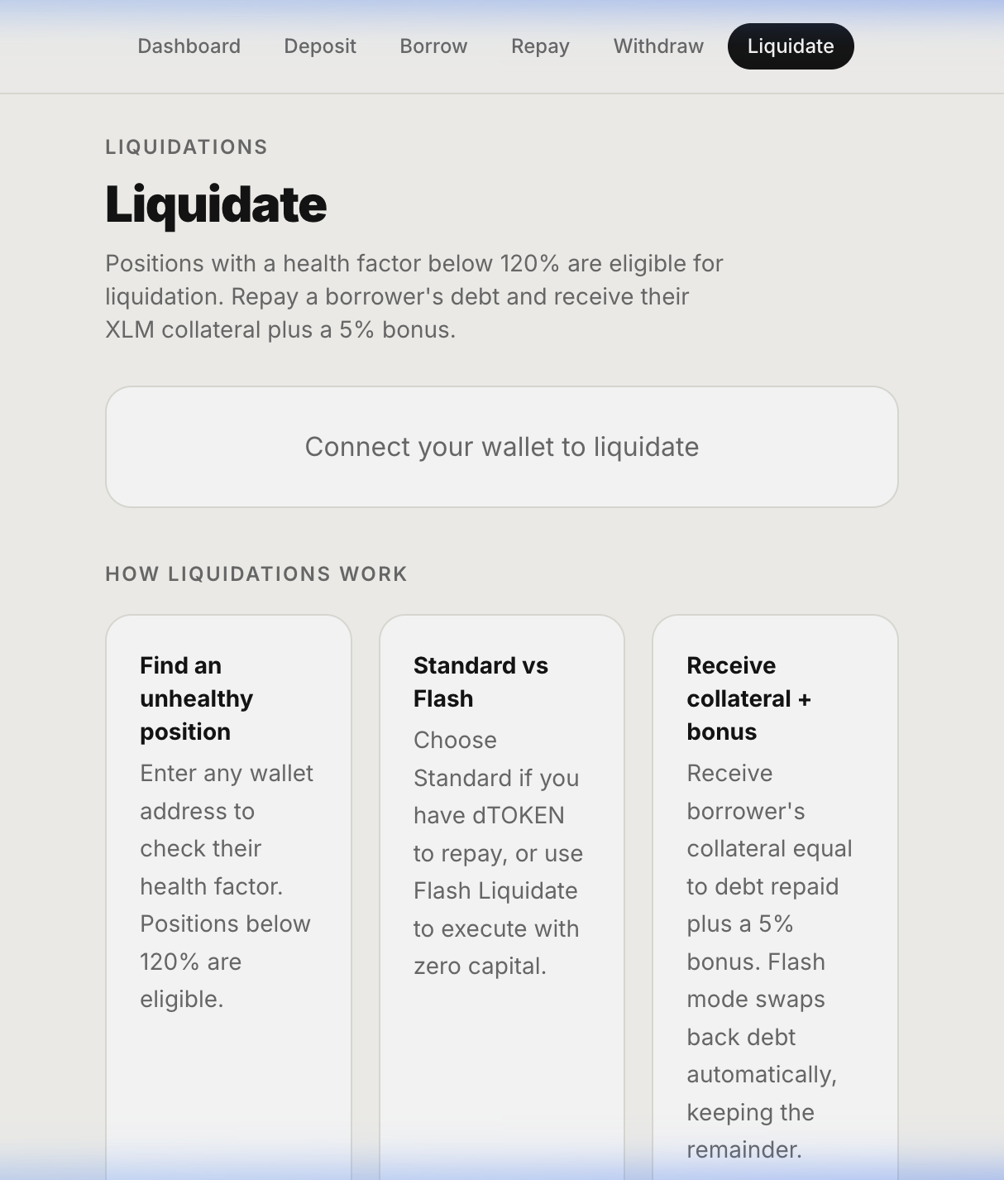
LIVE ON STELLAR TESTNET
Ready for the
next real interaction.
Open-source lending flow · guided Testnet onboarding · public transaction evidence
LIVE APP
stellar-lending-app.vercel.app
STELLAR LENDING · LEVEL 5
11
Notes:
[Sources]
Live app URL and screenshot source: repository README and docs/screenshots/liquidate_page.png. Demo workflow: docs/DEMO_SCRIPT.md.

