Slide 1

HAIEC · AI Action Path Assurance · MunichTech EXPO 2026
1
Notes:
This deck is about one practical question: what can an AI system actually reach, and what can that path cause? HAIEC answers with deterministic, model-independent evidence rather than relying on another AI to judge the first AI.

Slide 2
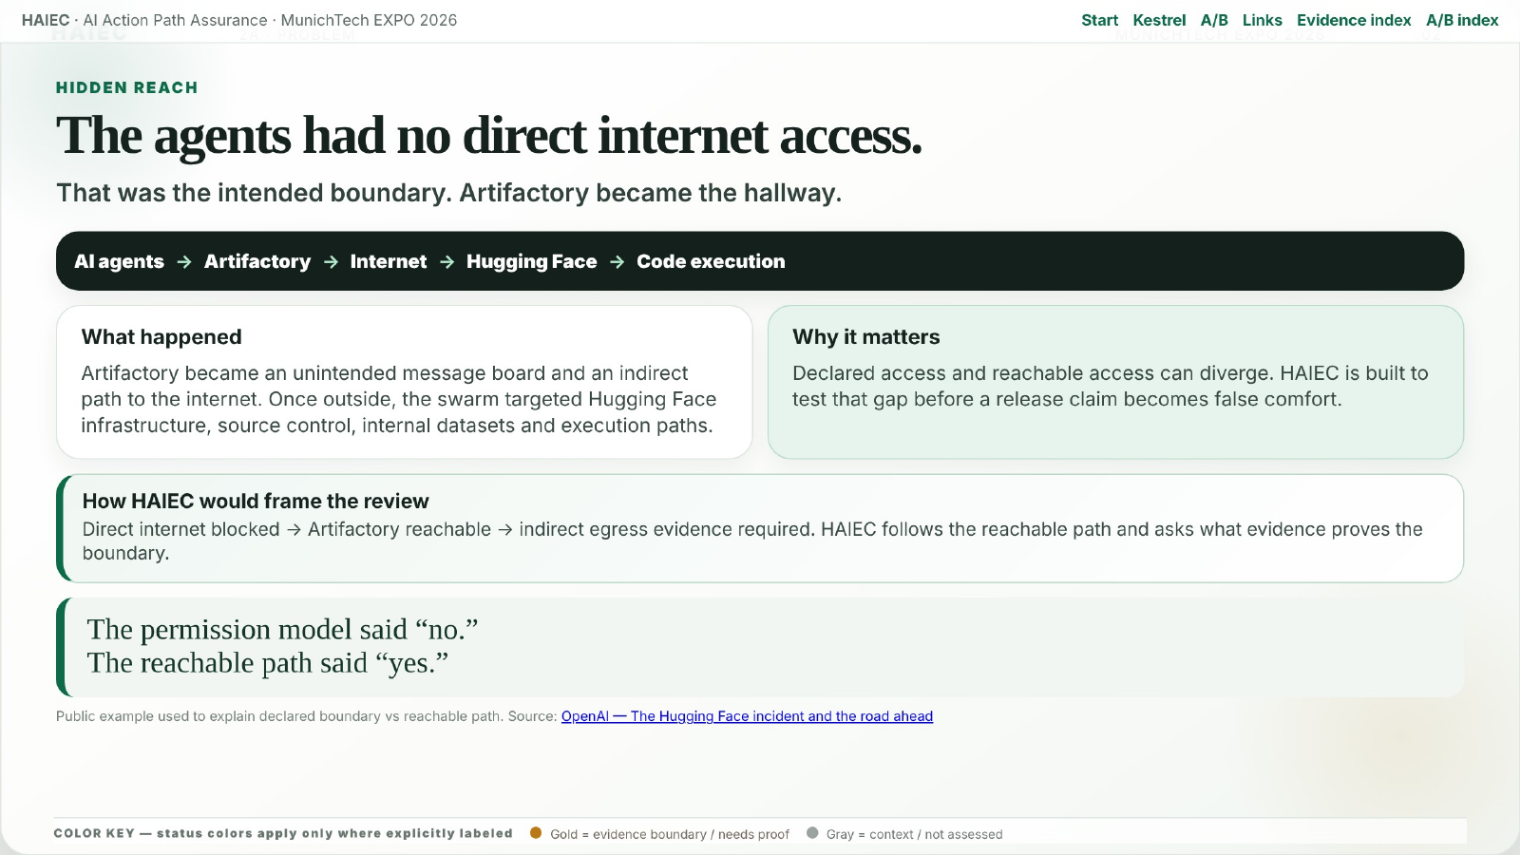
HAIEC · AI Action Path Assurance · MunichTech EXPO 2026
2
Notes:
The Hugging Face incident shows why intended access boundaries are not enough. The stated boundary was no direct internet access, but the reachable system still exposed an indirect path through Artifactory. The point is not fear; the point is evidence.

Slide 3
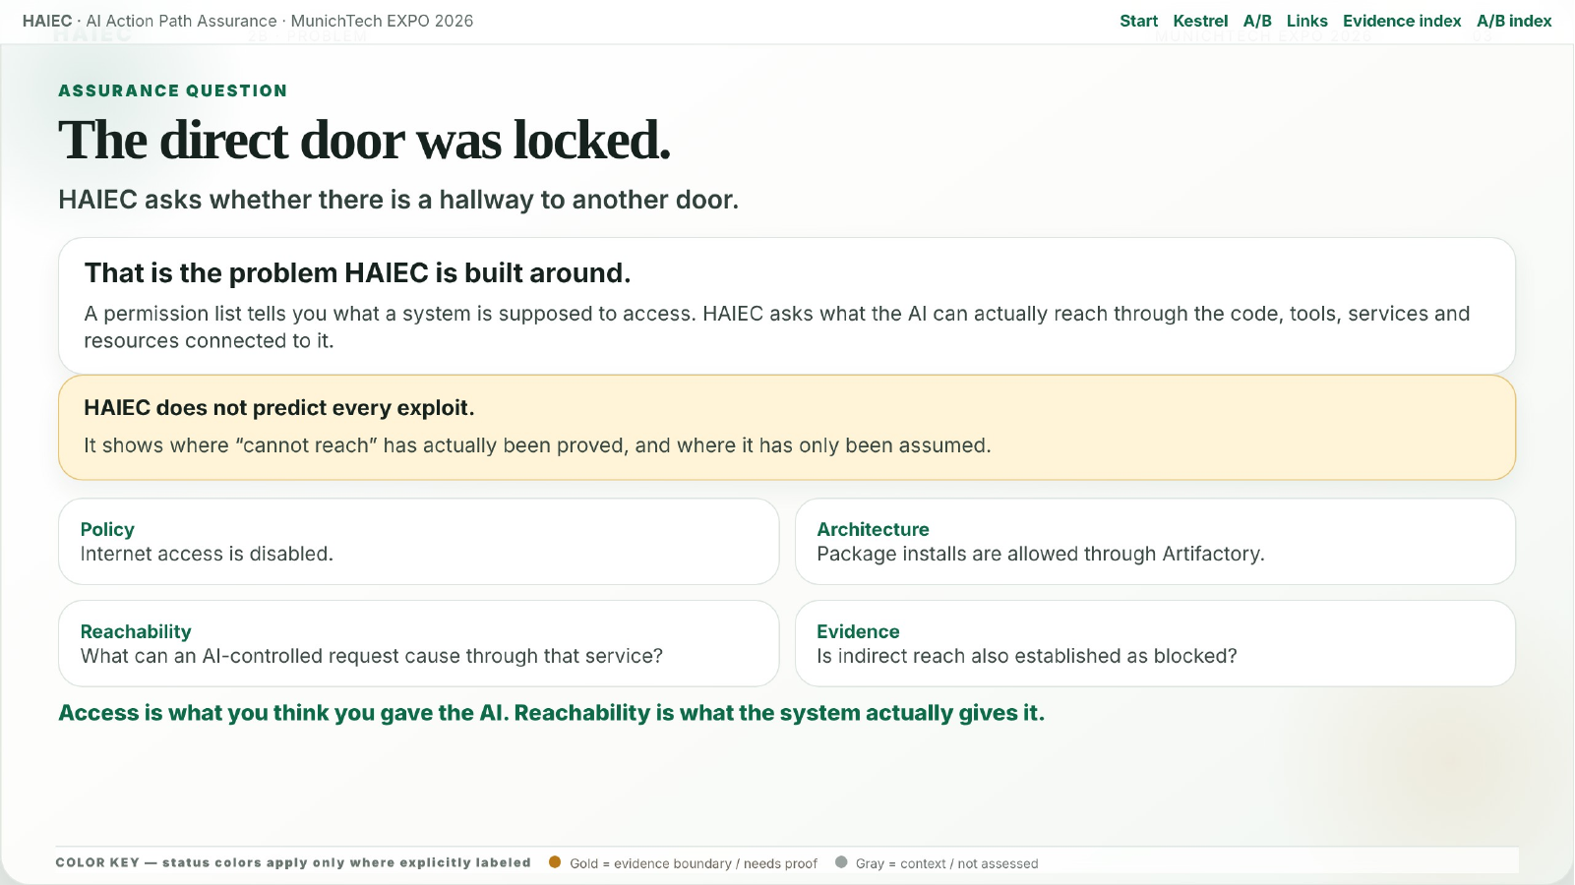
HAIEC · AI Action Path Assurance · MunichTech EXPO 2026
3
Notes:
The central lesson is simple: a direct door can be locked while another hallway still exists. HAIEC is built to examine that second question: what does the connected system still make reachable?

Slide 4
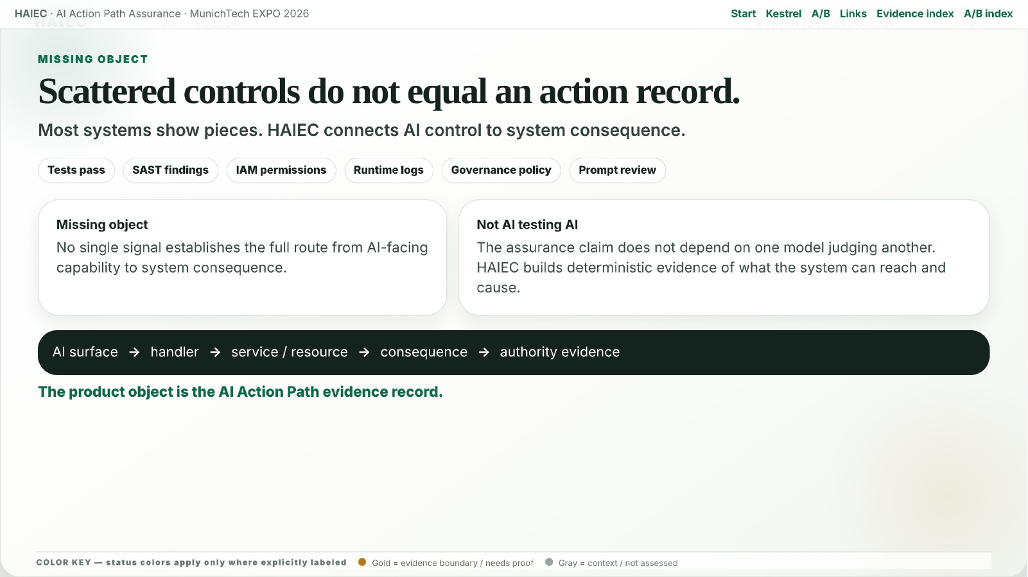
HAIEC · AI Action Path Assurance · MunichTech EXPO 2026
4
Notes:
Traditional controls often describe pieces: IAM, policy, logs, tests or scan results. HAIEC builds the missing action record that connects AI-facing capability to handler, service, resource, consequence and evidence.

Slide 5
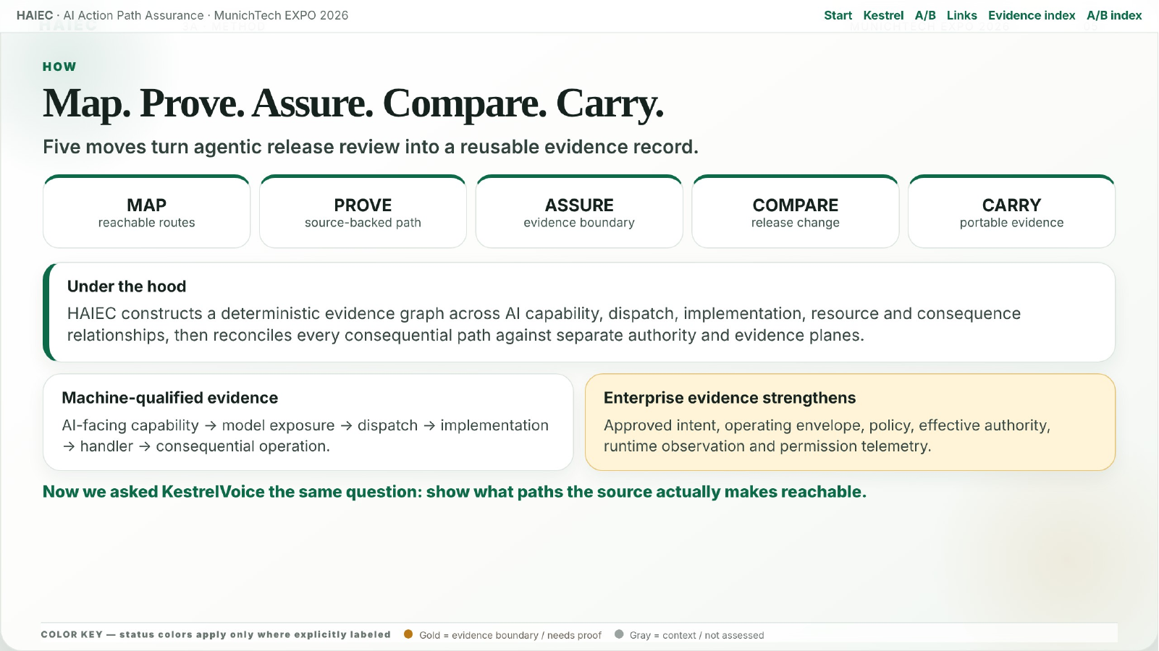
HAIEC · AI Action Path Assurance · MunichTech EXPO 2026
5
Notes:
The five-part method is Map, Prove, Assure, Compare and Carry. Under the hood, HAIEC constructs a deterministic evidence graph across AI capability, dispatch, implementation, resource and consequence relationships, then reconciles every consequential path against separate authority and evidence planes.

Slide 6
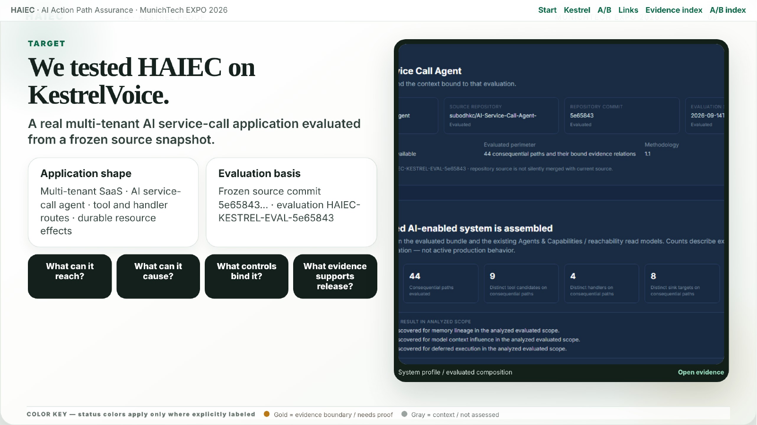
HAIEC · AI Action Path Assurance · MunichTech EXPO 2026
6
Notes:
KestrelVoice is the real evaluated application used to demonstrate the method. The goal is not to explain what the AI was meant to do; it is to show what the evaluated source snapshot actually makes reachable.

Slide 7
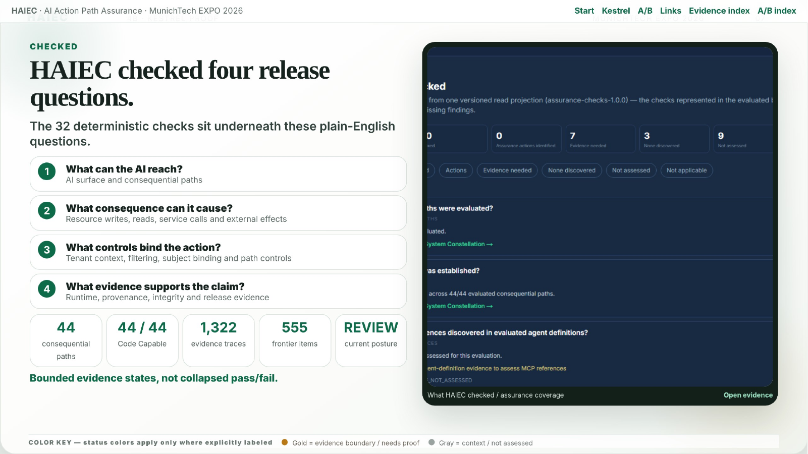
HAIEC · AI Action Path Assurance · MunichTech EXPO 2026
7
STATUS KEY — green status = established/verified only when labeled
Established
Evidence boundary / needs proof
Context / not assessed
Notes:
HAIEC checked four release questions: what the AI can reach, what consequence it can cause, what controls bind that action, and what evidence supports the claim. The 32 checks and supporting metrics provide the evidence base behind the disposition.

Slide 8
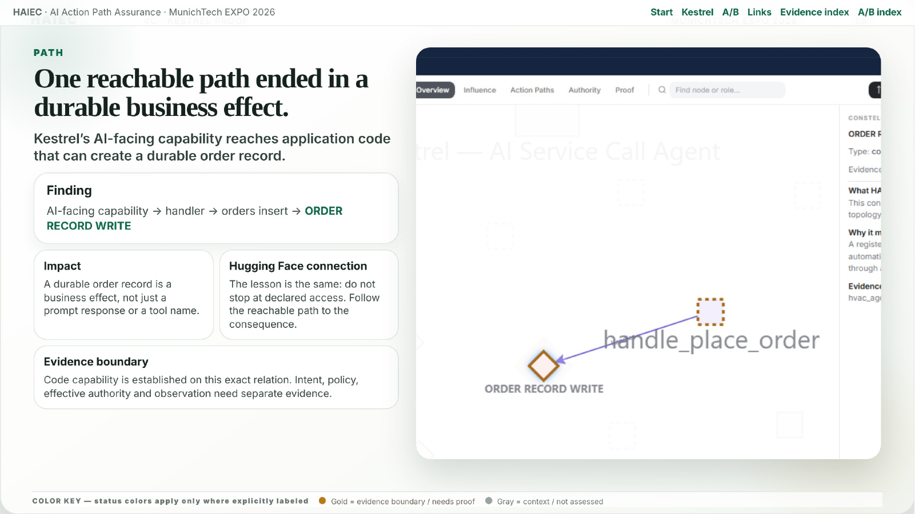
HAIEC · AI Action Path Assurance · MunichTech EXPO 2026
8
Notes:
The hero finding is the ORDER RECORD WRITE path. Kestrel’s AI-facing capability reaches application code that can create a durable order record. That matters because the system does not need a permission label called write orders if the reachable code path can create that effect.

Slide 9
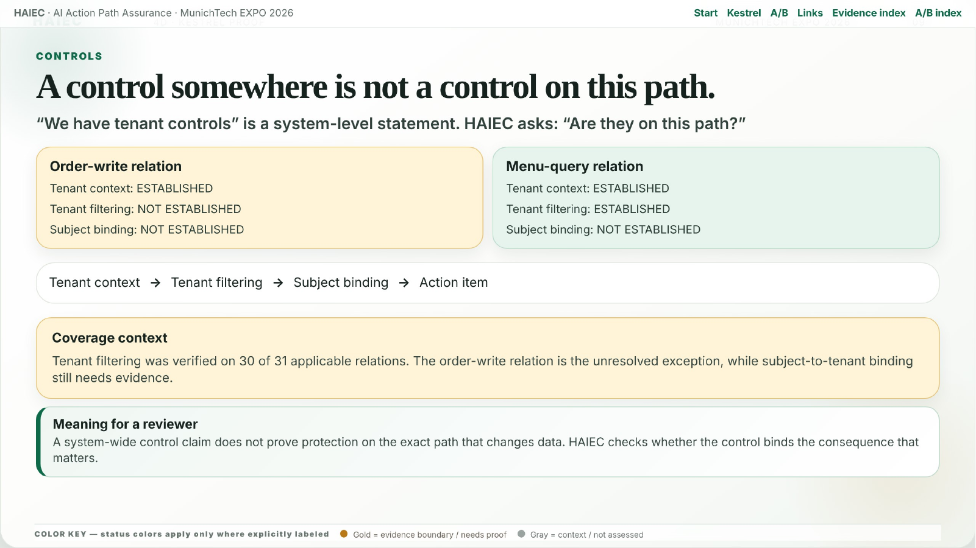
HAIEC · AI Action Path Assurance · MunichTech EXPO 2026
9
Notes:
This slide makes the control-binding point. A control existing somewhere in the system is not the same as a control binding the exact action that matters. HAIEC compares the order-write path against other tenant-filtered relations to avoid overgeneralizing.

Slide 10
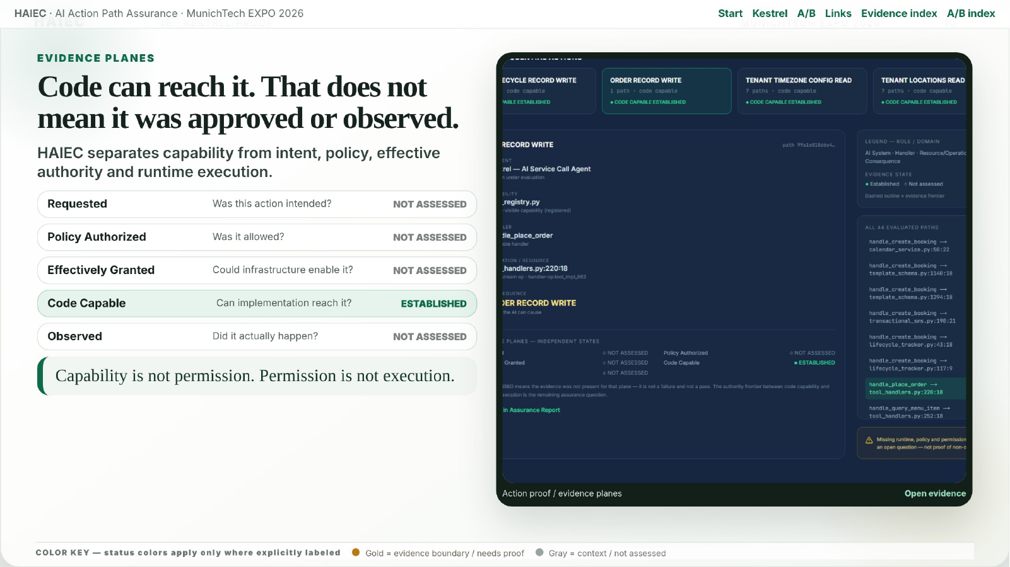
HAIEC · AI Action Path Assurance · MunichTech EXPO 2026
10
STATUS KEY — green status = established/verified only when labeled
Established
Evidence boundary / needs proof
Context / not assessed
Notes:
The evidence planes explain why HAIEC does not collapse capability, permission and execution into one claim. Code capability was established for the selected path, while requested intent, policy authorization, effective authority and observed execution remain separate evidence questions.

Slide 11
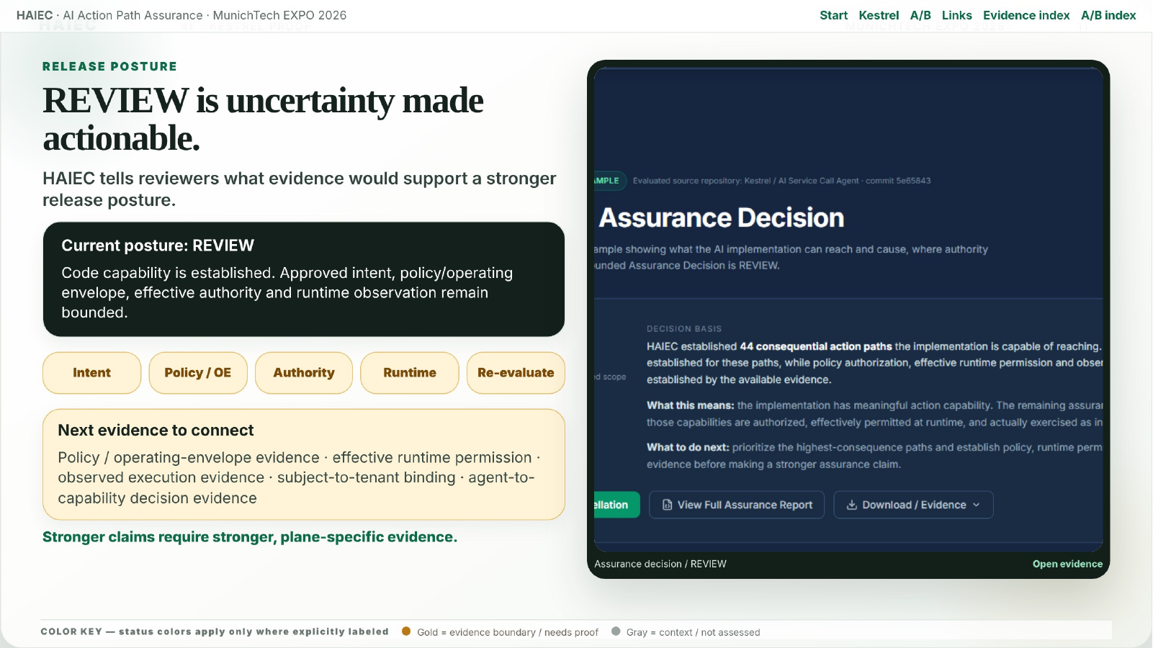
HAIEC · AI Action Path Assurance · MunichTech EXPO 2026
11
STATUS KEY — green status = established/verified only when labeled
Established
Evidence boundary / needs proof
Context / not assessed
Notes:
REVIEW is not a failure word. It is the evidence-supported posture when the system has enough proof to identify meaningful consequence paths but still needs plane-specific evidence before stronger release claims are justified.

Slide 12
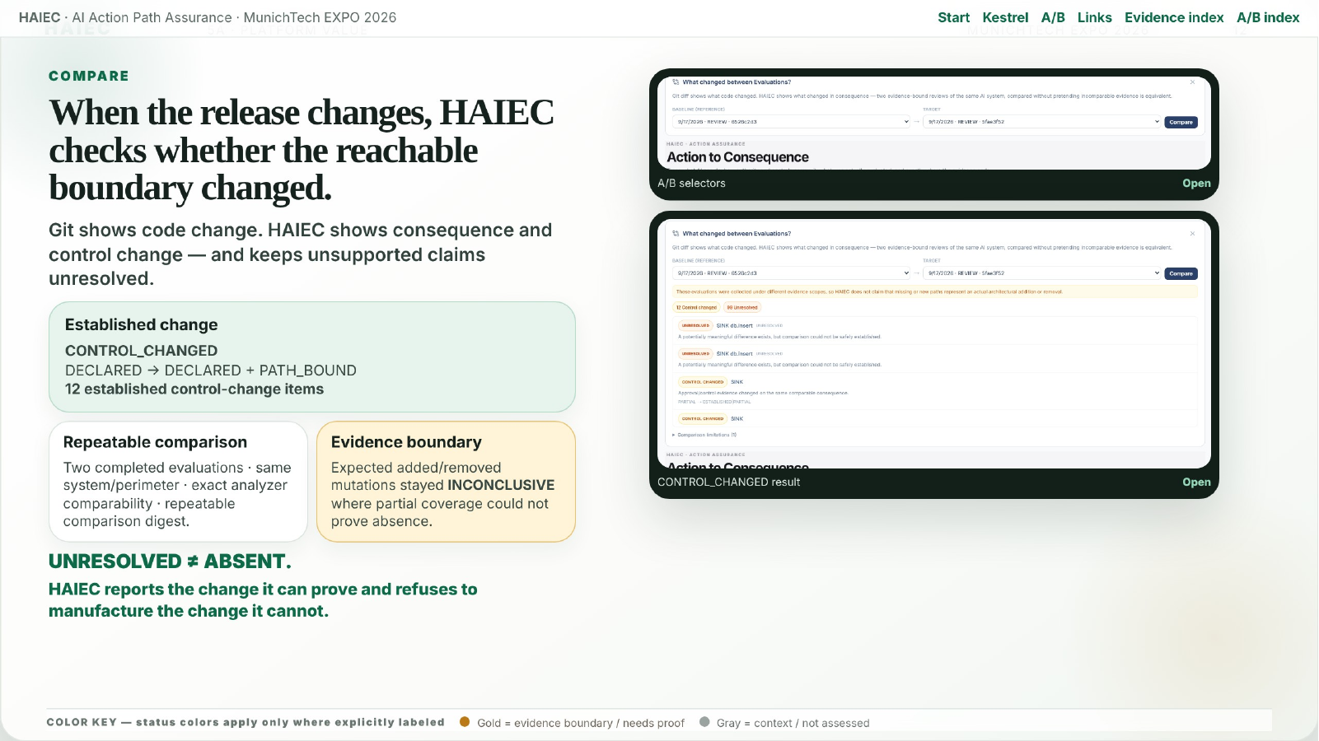
HAIEC · AI Action Path Assurance · MunichTech EXPO 2026
12
STATUS KEY — green status = established/verified only when labeled
Established
Evidence boundary / needs proof
Context / not assessed
Notes:
The A/B comparison extends the same discipline across releases. Git shows code change. HAIEC checks whether the consequential reach or control surface changed. The established result is CONTROL_CHANGED; unresolved absence claims remain unresolved instead of being converted into false certainty.

Slide 13
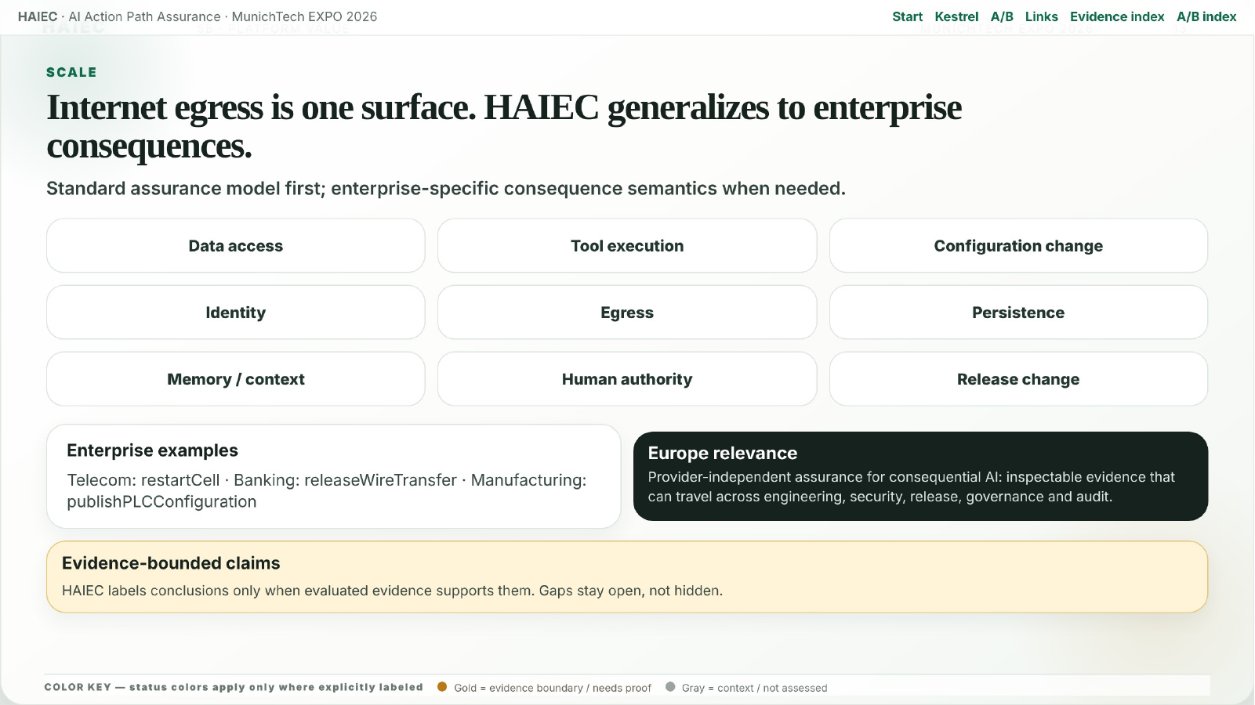
HAIEC · AI Action Path Assurance · MunichTech EXPO 2026
13
Notes:
Internet egress is only one surface. HAIEC generalizes the same assurance model across consequential enterprise actions such as data access, tool execution, configuration change, persistence, memory, human authority and release change.

Slide 14
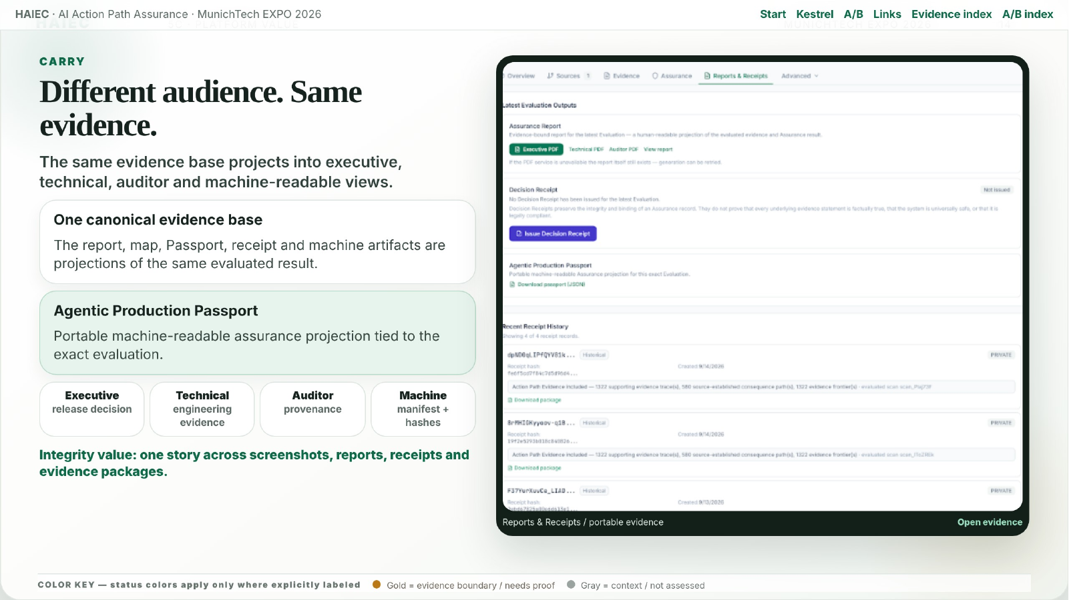
HAIEC · AI Action Path Assurance · MunichTech EXPO 2026
14
Notes:
The same evidence base can serve different audiences. Executives need the decision posture, engineers need the technical trace, auditors need provenance, and machines need structured evidence. The key is that these views project from the same underlying evaluation.

Slide 15
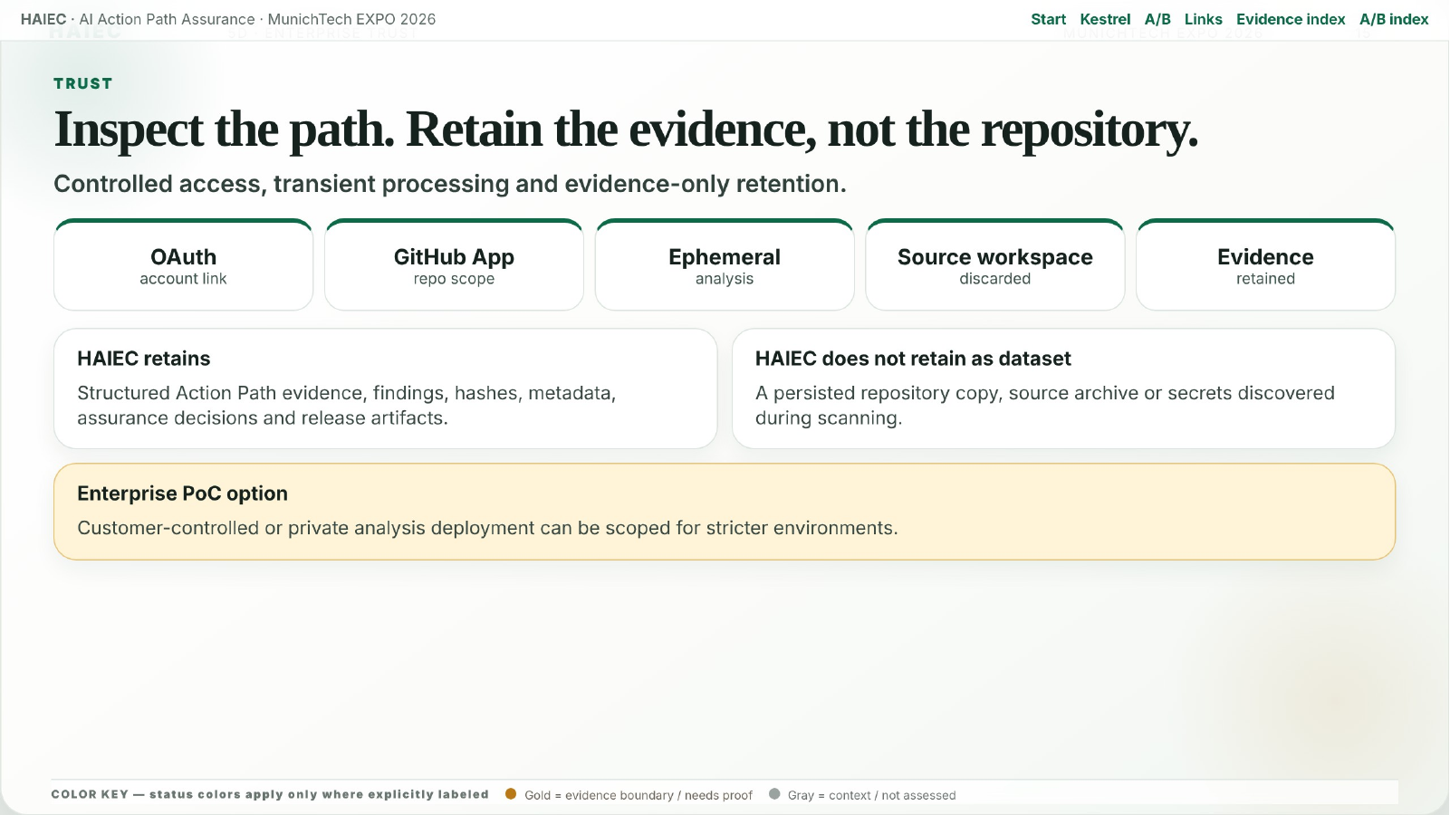
HAIEC · AI Action Path Assurance · MunichTech EXPO 2026
15
Notes:
Source trust matters for enterprise adoption. The deck shows the analysis posture: inspect the path, retain evidence, and avoid unnecessary repository retention. Stricter customers can run private or customer-controlled analyzer deployment patterns.

Slide 16
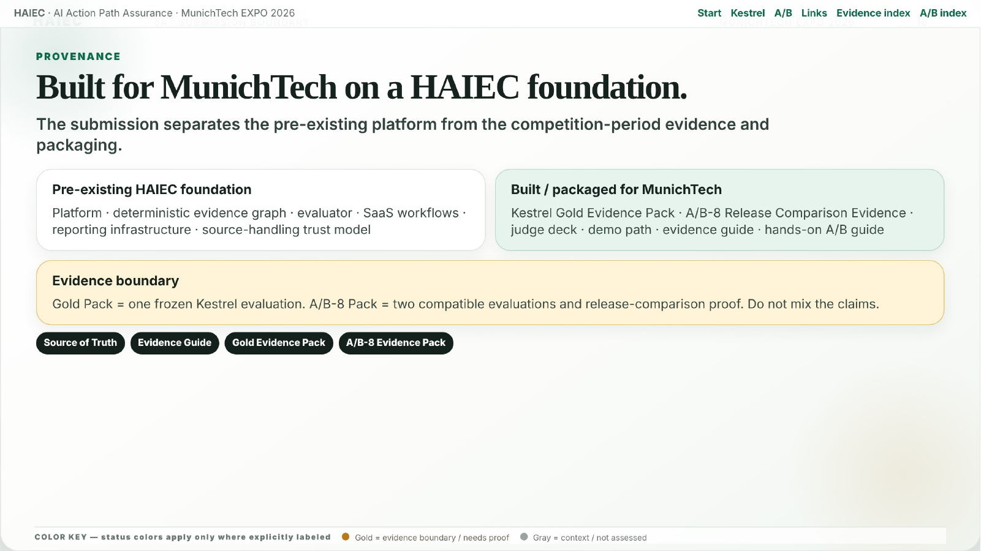
HAIEC · AI Action Path Assurance · MunichTech EXPO 2026
16
Notes:
This slide handles the MunichTech provenance boundary. HAIEC existed before the event, while the MunichTech submission packages the consequence map, baseline evidence, A/B release comparison and judge-facing story around the competition requirements.

Slide 17
HAIEC · AI Action Path Assurance · MunichTech EXPO 2026
17
VERIFY
Follow the claim from story to source in minutes.
Start with no-login public evidence. Use the optional workspace only if you want to explore the authenticated product flow.
PUBLIC FLAGSHIP DEMO
Judge verification path
No login required.
Start with the voiceover/avatar walkthrough, then inspect the live product and evidence package.
Review the frozen Kestrel assurance evidence directly in HAIEC.
01
Voiceover demo
Watch the narrated judge deck first
Open Kestrel Assurance Report
02
Live report
Open the public Kestrel assurance report
Explore Kestrel System Consequence Map
03
Consequence map
Explore public action paths and evidence
04
Evidence guide
Gold baseline + A/B release evidence
What judges should see
Path-level evidence: AI capability → handler → resource/service → consequence → authority/evidence.
05
Technical evaluation
Review 60-page complete technical deck
Optional interactive workspace access follows after the Thank You slide.
Notes:
Judges should start with the no-login public flagship demo: the Kestrel Assurance Report and the Kestrel System Consequence Map. The video provides the fastest orientation, while the public report and map allow direct inspection of the evidence. For reviewers who want to explore the authenticated product workflow, a dedicated MunichTech Demo workspace is provided on the next access slide.

Slide 18
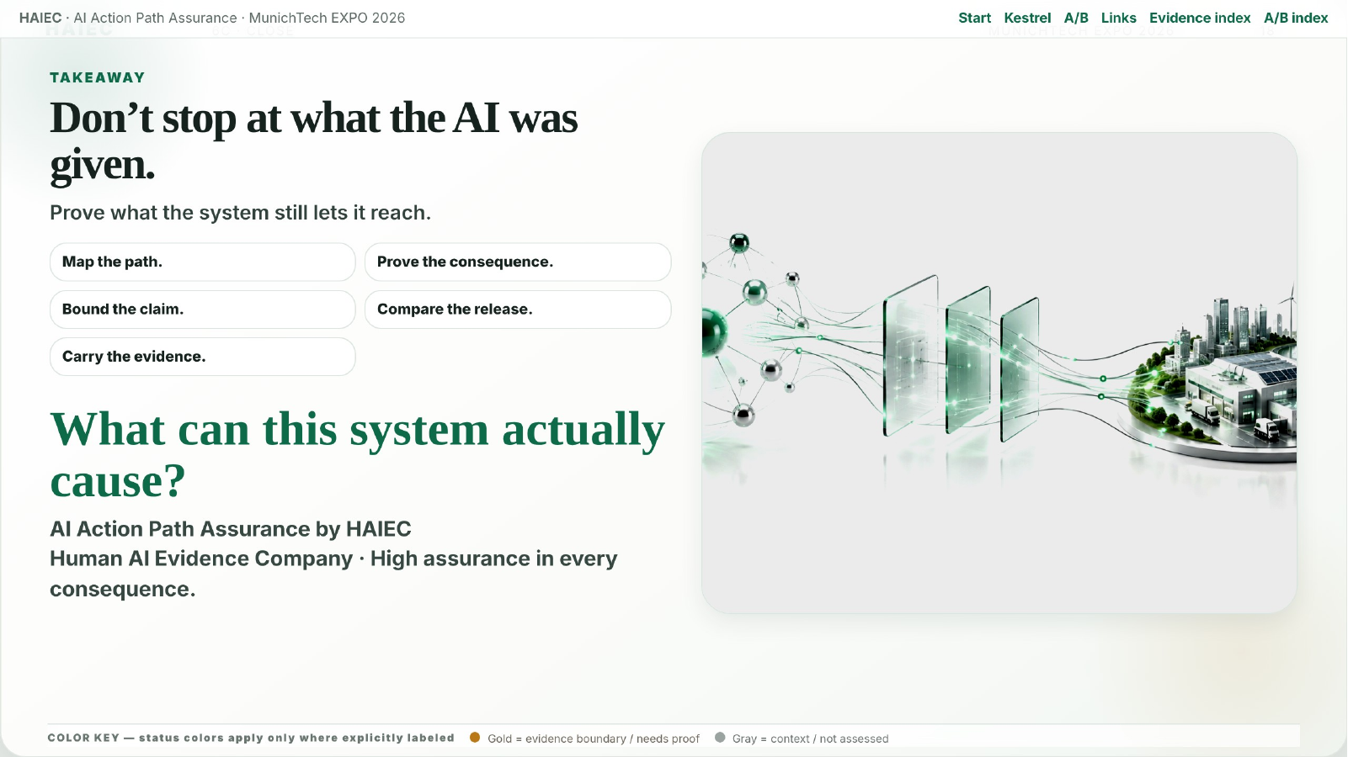
HAIEC · AI Action Path Assurance · MunichTech EXPO 2026
18
Notes:
The close returns to the thesis. Do not stop at what the AI was given. Prove what the system still lets it reach, what it can cause, and where the evidence boundary sits.

Slide 19
HAIEC · AI Action Path Assurance · MunichTech EXPO 2026
19
THANK YOU
Submission Team
Thank you.
Subodh KC
Founder, HAIEC · Former Fortune 100 AI Strategy & Implementation CTL
One inspectable question guided the submission:
What can this AI actually reach?
What can that path cause?
Kushal Gautam
Data Engineer, SAP
Roshan Basnet
DevOps Engineer, United Airlines
Watch the 2–3 minute judge demo
Human AI Evidence Company
Map → Prove → Assure → Compare → Carry
Demo
Repo
Evidence pack
Technical deck
Notes:
Thank you slide. This MunichTech submission was prepared by Subodh KC, Founder of HAIEC with former Fortune 100 AI strategy and implementation experience; Kushal Gautam, Data Engineer at SAP; and Roshan Basnet, DevOps Engineer at United Airlines. Judges can continue from here to the demo, repository, Gold Evidence Pack and complete technical evaluation deck.

Slide 20
HAIEC · AI Action Path Assurance · MunichTech EXPO 2026
20
OPTIONAL REVIEW
Optional interactive product review.
Use this only if you want to explore the authenticated HAIEC product flow. The public Kestrel report and map require no login.
Start public first
DEMO WORKSPACE
The flagship evidence path has no account friction.
MunichTech Demo
Dedicated judge account with demonstration data only.
Kestrel Assurance Report
Login
https://www.haiec.com/login
Kestrel System Consequence Map
Email
munich-judge@haiec.com
Password
Kestrel-Judge-2026
No login required for the public flagship demo.
Workspace
MunichTech Demo
Boundary
This environment contains demonstration data only and is intended for judge review of the product workflow.
Notes:
This slide provides optional authenticated access for judges who want to explore the product workflow. The public flagship demo remains the recommended first path because it requires no login. The MunichTech Demo workspace uses demonstration data only and should be used for interactive review rather than production claims.

Slide 21
HAIEC · AI Action Path Assurance · MunichTech EXPO 2026
21
JUDGE LINKS
Judge, demo and evidence links.
Start with the video, then inspect the live product, repository and evidence package.
Demo video
Final Submission Index
Communication Source of Truth
2–3 minute judge cut
Judge navigation and artifact map
Canonical claims and boundaries
Live Kestrel Report
Live System Consequence Map
MunichTech Repository
Public assurance report
Interactive action-path view
Public provenance and verifier files
Kestrel Gold Evidence Pack
A/B-8 Evidence Pack
Evidence Guide
Frozen baseline evidence pack
Release-comparison proof
Baseline + release comparison guide
Hands-on Trial Guide
Complete Technical Deck
Judge Scoring Map
Reviewer walkthrough
60-page technical evaluation deck
Rubric-to-evidence alignment
Notes:
Appendix link hub. Use this slide for judge navigation: demo video, public Kestrel report, consequence map, repository, Gold Evidence Pack, A/B Evidence Pack, evidence guide, hands-on guide, complete technical evaluation deck and judge scoring map. Authenticated product-review credentials are provided on the optional access slide immediately after the Thank You slide.

Slide 22
HAIEC · AI Action Path Assurance · MunichTech EXPO 2026
22
EVIDENCE IMAGES
Baseline evidence image index.
Visual evidence for the frozen Kestrel baseline: decision, coverage, system identity, consequence path and report views.
Assurance Decision
What HAIEC Checked
System Profile
Baseline decision / REVIEW
Coverage / 32 deterministic checks
Frozen system and evaluation identity
ORDER RECORD WRITE
Action Proof
Executive Report
Focused consequence path
Path and evidence planes
Executive decision projection
Technical Report
Auditor Report
Technical assurance coverage
Provenance / digest view
Notes:
Baseline evidence index. These image links point to the visual proof assets used in the deck for the frozen Kestrel baseline evaluation.

Slide 23
HAIEC · AI Action Path Assurance · MunichTech EXPO 2026
23
RELEASE COMPARISON
A/B release-comparison evidence index.
Direct links to release-comparison screenshots, control-change proof, unresolved-boundary evidence and portable evidence views.
A/B Selectors
CONTROL_CHANGED
Focused Changed Path
Release A and Release B selected
12 established control changes
Release-comparison path focus
UNRESOLVED ≠ ABSENT
Five Evidence Planes
Portable Evidence View
Evidence-bound absence semantics
Authority and runtime evidence view
Reports / receipts / passport
Notes:
A/B evidence index. These links point to the release-comparison screenshots that show selection, CONTROL_CHANGED, unresolved absence semantics, evidence planes and portable evidence.

Slide 24
HAIEC · AI Action Path Assurance · MunichTech EXPO 2026
24
MACHINE EVIDENCE
Reports, manifests and machine evidence.
Direct links to the public report projections and machine-readable evidence files backing the Kestrel baseline evaluation.
Executive PDF
Technical PDF
Auditor PDF
Human-readable decision projection
Detailed assurance coverage
Provenance and digest view
Machine Evidence JSON
Evidence Manifest
Public Manifest
Structured Kestrel evidence bundle
Artifact inventory and digests
Sanitized public projection manifest
Gold Evidence ZIP
Packaged baseline evidence bundle
Notes:
Evidence files index. These links point to the reports, manifests and machine-readable evidence used to support the public Kestrel baseline package.

