Slide 1

TECHNICAL COMPANION
AI Action Path Assurance
Technical Evaluation Companion for MunichTech reviewers
Judge deck tells the story.
This companion proves the story.
A compact technical deck for reviewers who want implementation logic, evidence semantics, Kestrel details, A/B release comparison, and verification paths.
Not AI testing AI
Deterministic evidence
Narrated judge presentation
Product demo video
AI Action Path Assurance · Technical Evaluation Companion · MunichTech EXPO 2026
01

Slide 2
TECHNICAL COMPANION
How to review this companion
A suggested path for technical evaluators
01 · Watch
Start with the narrated judge presentation or product demo.
02 · Inspect
Open the public Kestrel report and System Consequence Map.
03 · Verify
Use the evidence packs, manifests, and technical artifacts.
04 · Validate claims
Read the claim-boundary slides before interpreting REVIEW as pass/fail.
Report
Map
Gold evidence
A/B evidence
Hands-on guide
Final index
Color convention: green = HAIEC/product evidence; gold = evidence boundary or release action; gray = context or non-claim.
AI Action Path Assurance · Technical Evaluation Companion · MunichTech EXPO 2026
02

Slide 3
TECHNICAL THESIS
Not AI testing AI
The assurance claim does not depend on one model judging another model
Not AI testing AI.
LLMs can explain evidence.
They do not establish the evidence.
HAIEC does not ask another model whether an agent “looks safe.” It builds deterministic, source-backed evidence of what the system can reach and cause.
Capability
Dispatch
Implementation
Resource
Consequence
Evidence
Why this matters
• reviewable evidence, not opinion
• reproducible claims
• bounded uncertainty
• release-ready artifacts
Technical USP: deterministic action-path evidence from capability to consequence.
AI Action Path Assurance · Technical Evaluation Companion · MunichTech EXPO 2026
03

Slide 4
TECHNICAL THESIS
Deterministic evidence graph
The approved technical “how” line
Under the hood, HAIEC constructs a deterministic evidence graph across AI capability, dispatch, implementation, resource and consequence relationships, then reconciles every consequential path against separate authority and evidence planes.
AI capability
Dispatch
Implementation
Resource
Consequence
Authority / evidence
What is proprietary
The engine’s internal methods, coverage models and qualification logic.
What is judge-visible
Evidence graph outputs, source-backed path trails, reports, manifests and claim boundaries.
What is not claimed
Universal coverage, runtime execution, certification, or exploit prevention.
AI Action Path Assurance · Technical Evaluation Companion · MunichTech EXPO 2026
04

Slide 5
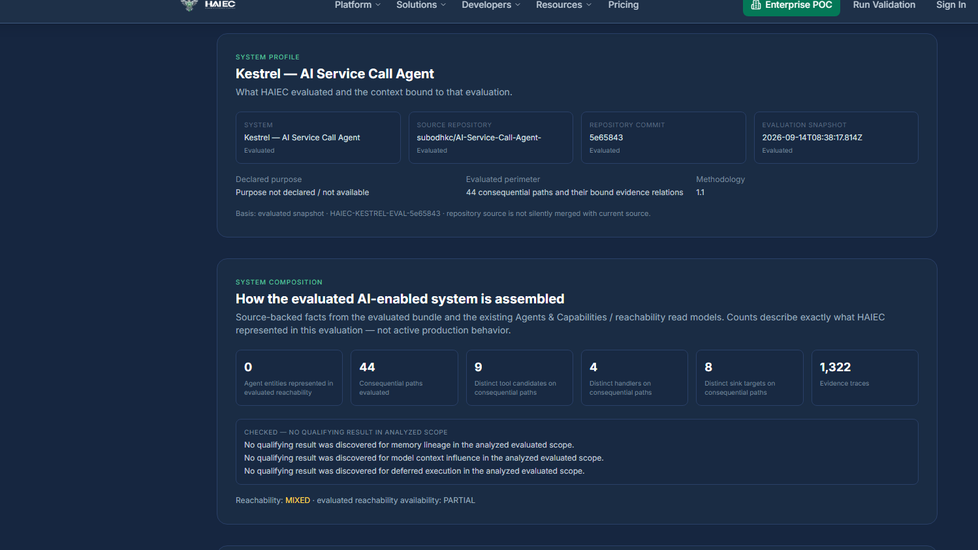
EVALUATION SCOPE
Kestrel frozen evaluation identity
The technical facts behind the public demo
Frozen evaluation
• Repository: subodhkc/AI-Service-Call-Agent
• Source commit: 5e65843fddfe5f907485b798e464ad37b3b3b2c7
• Public evaluation ref: HAIEC-KESTREL-EVAL-5e65843
• Snapshot: 2026-09-14T08:38:17.814Z
• Schema: assurance-evidence-bundle-1.1.0
Kestrel system profile and composition snapshot
Bundle digest: 3e21e47c0fdfa89d7dc0a7516d680b578b4051d923c47c731aee411c47e50901
AI Action Path Assurance · Technical Evaluation Companion · MunichTech EXPO 2026
05

Slide 6
EVALUATION SCOPE
Live access for reviewers
Public flagship demo first; optional interactive product review second
PUBLIC FLAGSHIP DEMO
Kestrel Assurance Report
https://www.haiec.com/sample-reports/kestrel
Kestrel System Consequence Map
https://www.haiec.com/sample-reports/kestrel/constellation
No login required.
OPTIONAL INTERACTIVE PRODUCT REVIEW
Demo workspace: https://www.haiec.com/login
Email: munich-judge@haiec.com
Password: Kestrel-Judge-2026
Workspace: MunichTech Demo
Demo data only.
Public report
System map
Login workspace
Narrated presentation
Primary path: public report and map. Credentials are for optional workflow review in a demonstration workspace.
AI Action Path Assurance · Technical Evaluation Companion · MunichTech EXPO 2026
06

Slide 7
KESTREL RESULT
Technical result summary
A frozen evaluation produced a concrete release-review result
44
AI action paths confirmed in code
44 / 44
evaluated paths met Code Capability evidence criteria
1,322
supporting Action Path traces
555
Verified Action Frontier review checkpoints
REVIEW
release posture
4
Release Action Flags
Interpretation: this is not a vulnerability count. It is a source-backed map of consequential AI action paths and the evidence needed before stronger release claims.
AI Action Path Assurance · Technical Evaluation Companion · MunichTech EXPO 2026
07

Slide 8
PROOF MODEL
Unit of assurance: AI Action Path
A connected route from AI-facing capability to consequence
The unit of assurance is not the prompt.
It is the path.
AI
surface
Capability
Handler
Resource
Conseq.
Evidence
AI Action Path includes
• AI-facing capability
• dispatch and implementation path
• resource or service operation
• consequential effect
• authority and evidence state
A tool list says what exists.
An action path says what can happen.
Same object powers the map, report, release flags, passport and A/B comparison.
AI Action Path Assurance · Technical Evaluation Companion · MunichTech EXPO 2026
08

Slide 9
PROOF MODEL
Action path chain
Capability → dispatch → handler → resource → consequence
Capability
Dispatch
Handler
Resource
Consequence
Capability
The AI-facing action or tool surface exists and is within evaluated scope.
Dispatch
The request can route toward implementation through code or framework relationships.
Handler
Application logic receives the action and controls argument/context handling.
Resource
The handler reaches data, service, API, storage or infrastructure operations.
Consequence
The path reaches a durable or external effect requiring release review.
Technical line: defined ≠ registered ≠ visible ≠ dispatched ≠ handler-bound ≠ consequence-bound ≠ observed.
AI Action Path Assurance · Technical Evaluation Companion · MunichTech EXPO 2026
09

Slide 10
PROOF MODEL
Qualified relationships
Every edge must carry evidence before it advances the claim
Accepted relationship evidence
• source location or artifact reference
• qualified relationship type
• known limitation state
• evidence strength
• weakest-state propagation
Rejected shortcuts
• name match alone
• comment-only inference
• tool exists somewhere
• policy without path binding
• runtime event without action identity
Reviewer value
• inspectable trail
• bounded claims
• repeatable evidence review
• release comparison
• portable artifact integrity
This is the difference between a diagram and evidence: every meaningful edge carries proof quality and boundary semantics.
AI Action Path Assurance · Technical Evaluation Companion · MunichTech EXPO 2026
10

Slide 11
PROOF MODEL
Source-qualified vs enterprise-supplied
The engine separates code capability from business authority
Machine-qualified from source
AI-facing capability → model exposure → dispatch → implementation → handler → consequential operation. Qualified relationships establish Code Capability.
Enterprise-supplied when applicable
Requested intent, policy rules, Operating Envelope, effective authority evidence, approval context and runtime observation evidence.
Kestrel interpretation
44 of 44 means every consequential path in the evaluated KestrelVoice result met the Code Capability evidence requirement. It does not claim perfect repository coverage, universal analyzer accuracy or runtime execution.
AI Action Path Assurance · Technical Evaluation Companion · MunichTech EXPO 2026
11

Slide 12
PROOF MODEL
Evidence states and claim boundaries
HAIEC advances only as far as the evidence supports
ESTABLISHED
Evidence supports the claim.
Unknown is not safe.
Unknown is also not guilty.
PARTIAL
Evidence supports part of the claim.
NOT ASSESSED
Plane was not evaluated in this run.
Technical discipline
Unknown is a boundary requiring evidence. This keeps the review useful without converting missing proof into false certainty.
UNRESOLVED
Available evidence cannot support stronger conclusion.
NOT CLAIMED
Out of scope or intentionally unasserted.
This is why REVIEW is an actionable posture, not a disguised failure state.
AI Action Path Assurance · Technical Evaluation Companion · MunichTech EXPO 2026
12

Slide 13
PROOF MODEL
Five authority and evidence planes
One plane cannot answer another
Requested
Was the action declared or requested?
Policy Authorized
Did policy approve capability and scope?
Effectively Granted
Did IAM/provider configuration grant authority?
Code Capable
Can implementation reach the consequence?
Observed
Do logs or witnesses support runtime execution?
Kestrel result
Code Capability is established for evaluated paths; Requested, Policy Authorized, Effectively Granted and Observed remain release-review planes unless enterprise evidence is attached.
AI Action Path Assurance · Technical Evaluation Companion · MunichTech EXPO 2026
13

Slide 14
PROOF MODEL
Code Capability boundary
Capability confirmed in code is not approval or execution
What Code Capability means
• the evaluated source contains a qualified route
• the route reaches a consequential operation
• source relations support the chain
• the claim is pre-release evidence
What it does not mean
• the action was requested
• policy approved the action
• the acting identity held authority
• runtime execution occurred
• the path is automatically a vulnerability
Capability is a review anchor, not an accusation.
AI Action Path Assurance · Technical Evaluation Companion · MunichTech EXPO 2026
14

Slide 15
PROOF MODEL
Verified Action Frontier
Where the current evidence stops and the next review action begins
Frontiers convert uncertainty into the next concrete evidence step.
What it is not
• README scan
• vulnerability count
• defect count
• proof of absence
• runtime proof by itself
What it is
• last verified step in an action route
• evidence checkpoint for stronger claims
• review action for release teams
• not a vague risk score
Kestrel scale
555 frontier checkpoints were generated across 44 evaluated action paths.
AI Action Path Assurance · Technical Evaluation Companion · MunichTech EXPO 2026
15

Slide 16
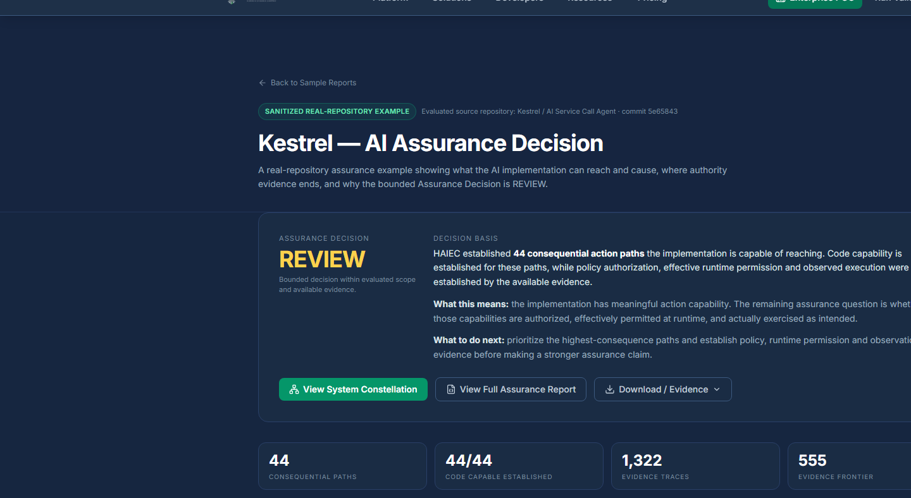
PROOF MODEL
REVIEW decision semantics
REVIEW is not failure; it is the defensible posture for current evidence
REVIEW means
• consequential capability is confirmed
• specific release flags remain open
• stronger approval needs plane-specific evidence
• decision is limited to what evidence supports
Kestrel assurance decision view
REVIEW is uncertainty made actionable.
AI Action Path Assurance · Technical Evaluation Companion · MunichTech EXPO 2026
16

Slide 17
PROOF MODEL
Release Action Flags
Flags become concrete reviewer work, not generic warnings
Intent
Attach the approved request, ticket or declared capability.
Policy
Show the policy or workflow permitting the action.
Authority
Bind IAM/provider evidence for the acting identity.
Runtime
Attach logs, traces or action-witness events.
Control
Show approval or containment on the action path.
Release value
The release team gets a concrete action list instead of a vague risk score.
AI Action Path Assurance · Technical Evaluation Companion · MunichTech EXPO 2026
17

Slide 18
KESTREL PROOF
Kestrel system profile
Working multi-tenant AI SaaS test subject
Application shape
• functional AI service-call application
• multi-tenant SaaS architecture
• agents use tools and application handlers
• evaluation based on frozen source snapshot
• authorized test application for submission
KestrelVoice system profile in HAIEC
Why it matters: the product is tested against a real application surface, not a synthetic diagram.
AI Action Path Assurance · Technical Evaluation Companion · MunichTech EXPO 2026
18

Slide 19
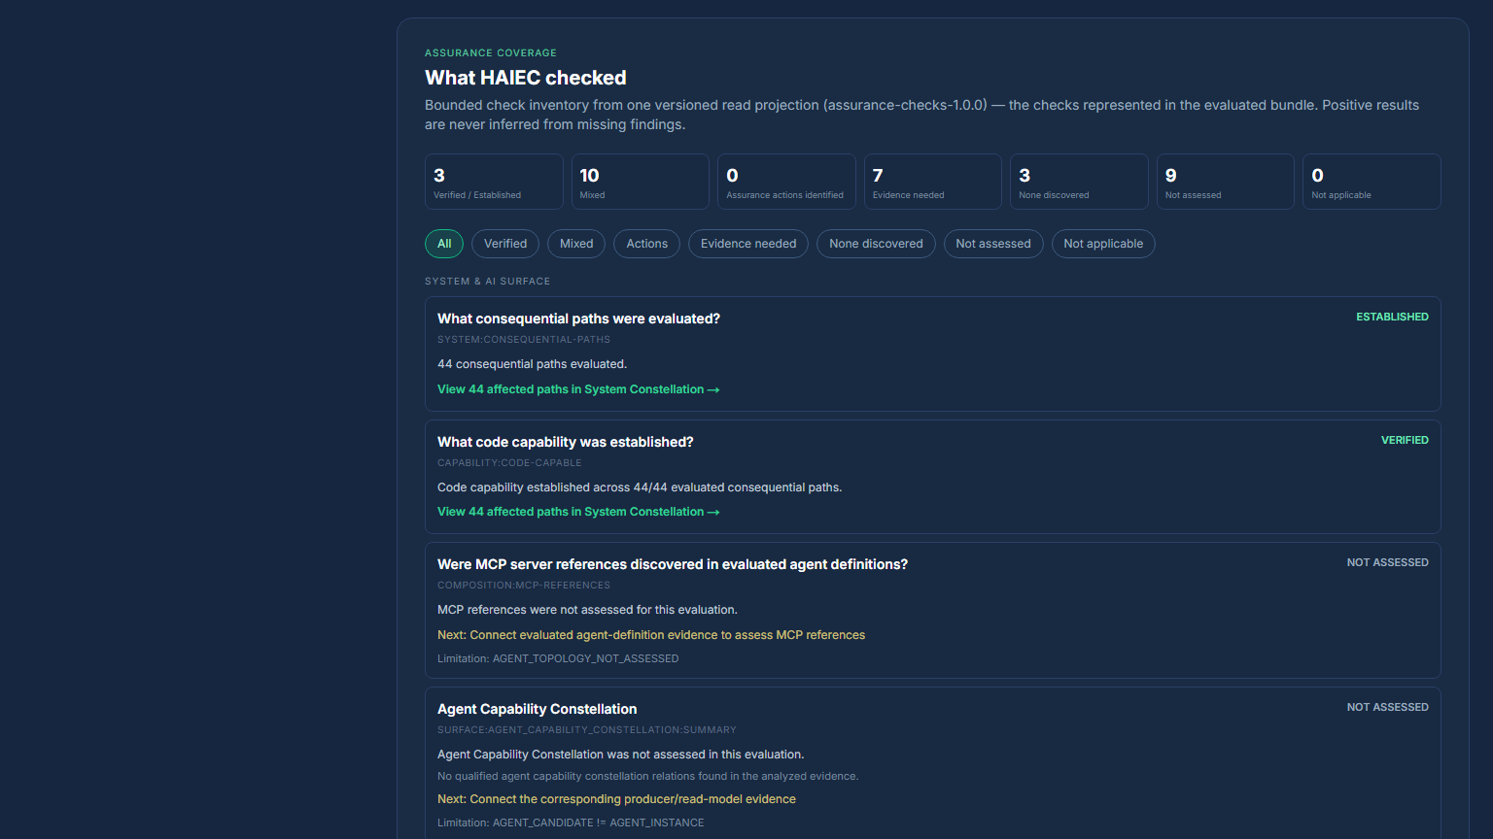
KESTREL PROOF
Assurance surface coverage
What HAIEC checked before making a release claim
Four technical questions
• What can the AI reach?
• What consequence can it cause?
• What controls bind that action?
• What evidence supports the claim?
Kestrel output
32 deterministic checks across the evaluated assurance surface. 44 paths confirmed in code. 555 frontier checkpoints produced.
Assurance surface coverage view
AI Action Path Assurance · Technical Evaluation Companion · MunichTech EXPO 2026
19

Slide 20
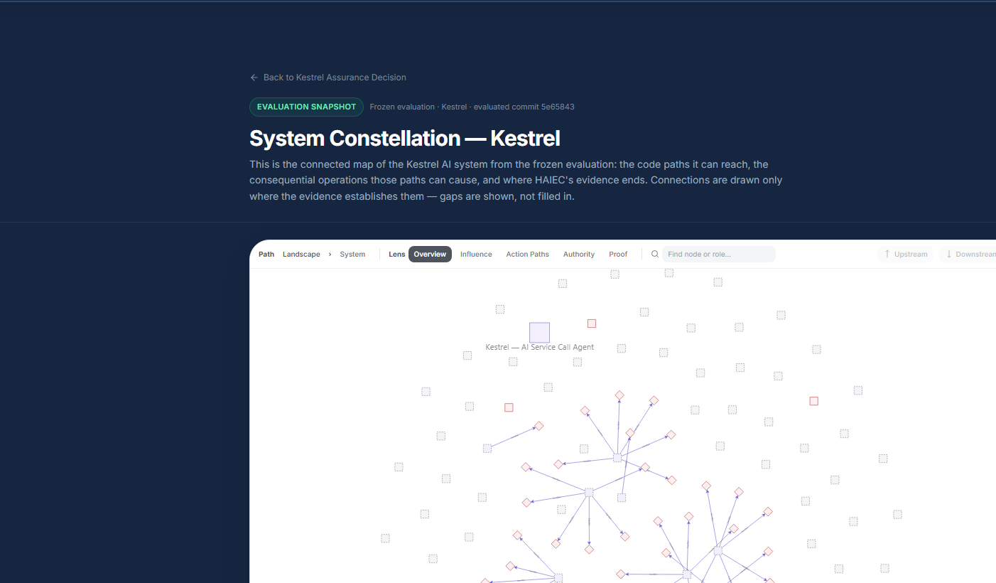
KESTREL PROOF
System Consequence Map
One visual entry point into the evaluated source
Technical interpretation
• nodes represent evaluated action-path elements
• edges are source-backed relationships
• map is a projection of evaluation evidence
• not separate diagram truth
Open live map
Review path: start wide, then inspect the AI action path that matters.
System Consequence Map overview
AI Action Path Assurance · Technical Evaluation Companion · MunichTech EXPO 2026
20

Slide 21
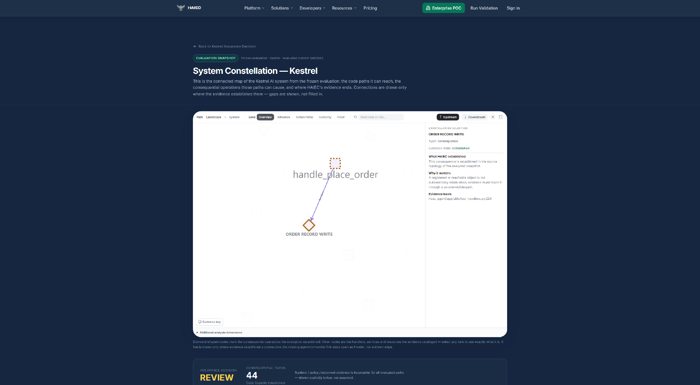
KESTREL PROOF
Hero path: ORDER RECORD WRITE
A concrete path reaches a durable business effect
Finding
Kestrel’s AI-facing capability reaches application code that can create a durable order record.
Impact
This is the same assurance question as hidden reach: do not tell us what the AI is meant to do; show what paths the source actually makes reachable.
Boundary
Confirmed in source. Runtime execution is not claimed from this evidence alone.
Focused ORDER RECORD WRITE path
AI Action Path Assurance · Technical Evaluation Companion · MunichTech EXPO 2026
21

Slide 22
KESTREL PROOF
Hero path evidence detail
Source-backed chain and exact claim boundary
AI Service Call Agent
AI-facing capability
handle_place_order
orders.insert(...)
ORDER RECORD WRITE
Source details
• source location: pydb_hvac_agent/app/utils/tool_handlers.py:220
• operation: orders table insert
• customer display label: ORDER RECORD WRITE
• evidence strength: capability confirmed in code
Claim boundary
• not runtime execution
• not policy approval
• not effective authority
• not a vulnerability label
• not proof that every adjacent path is covered
The path is valuable because it is inspectable, bounded and tied to a real consequence.
AI Action Path Assurance · Technical Evaluation Companion · MunichTech EXPO 2026
22

Slide 23
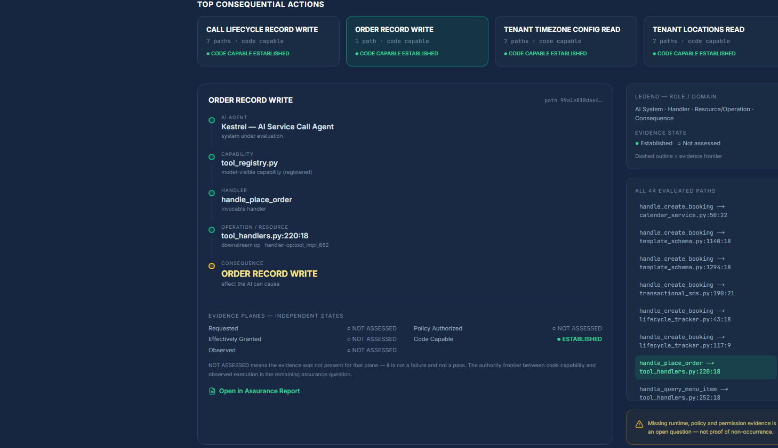
KESTREL PROOF
Action Proof view
The product exposes evidence, not just the conclusion
What reviewers can inspect
• qualified source relation
• action path trail
• evidence strength
• plane separation
• frontier and next evidence
Technical value
The result can be challenged at the path level rather than accepted as a black-box score.
Action proof evidence view
AI Action Path Assurance · Technical Evaluation Companion · MunichTech EXPO 2026
23

Slide 24
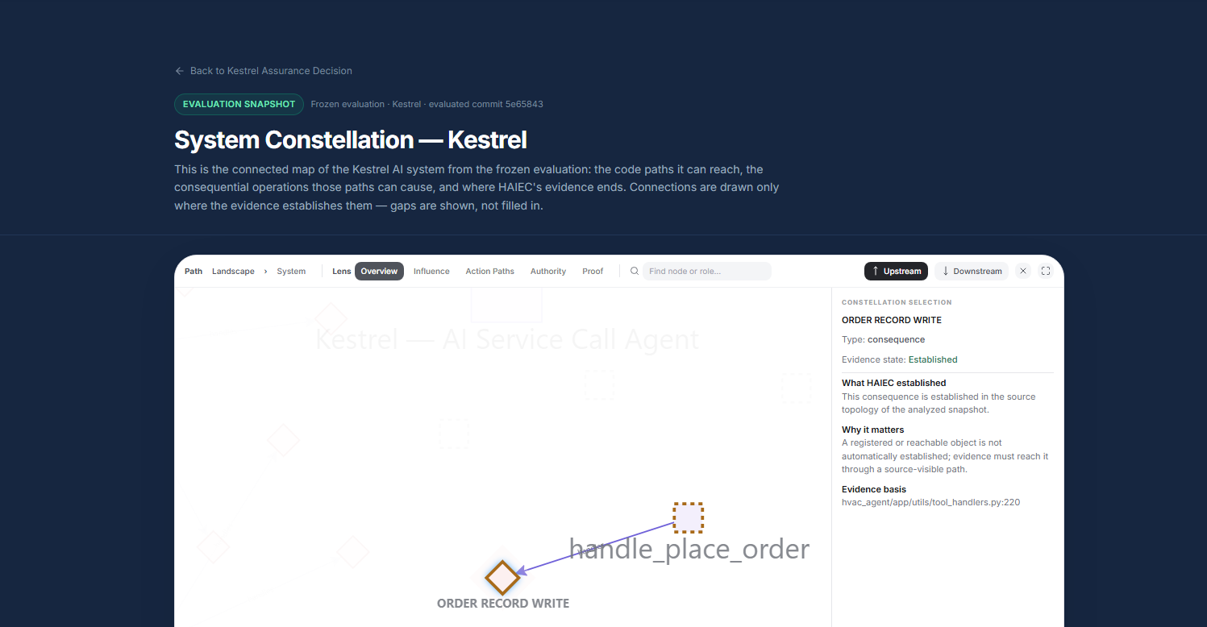
KESTREL PROOF
Path-specific control binding
A control somewhere is not a control on this path
“We have tenant controls” is a system-level statement.
HAIEC asks: are they on this path?
Kestrel path finding
Tenant context was present, but tenant filtering and authenticated-subject binding were not established on the exact ORDER RECORD WRITE relation.
Wider context
Across the evaluated scope, tenant filtering was verified on most applicable relations; this path remained the review-relevant exception.
Path context for ORDER RECORD WRITE
AI Action Path Assurance · Technical Evaluation Companion · MunichTech EXPO 2026
24

Slide 25
KESTREL PROOF
Resource and service reachability
Reachable does not automatically mean accessed
Resource access
• 590 relations evaluated
• partial coverage
• outcome: MIXED
• REACHABLE ≠ ACCESSED
Service calls
• service invocation is tracked separately
• SERVICE CALL ≠ RESOURCE ACCESS ESTABLISHED
• continuity requires exact relation support
Evidence boundary
• partial coverage is not hidden
• unsupported continuity remains unresolved
• reviewer sees what still needs proof
This is how HAIEC handles hidden-reach questions without converting every potential route into a claimed incident.
AI Action Path Assurance · Technical Evaluation Companion · MunichTech EXPO 2026
25

Slide 26
KESTREL PROOF
Persistence and shared-substrate boundaries
Not every reachable surface is a proven cross-agent channel
Persistence creation
66 relations evaluated. Candidate persistence-creation paths were present, but not established as observed runtime events.
Shared substrate
Shared substrate remained UNKNOWN in the evaluated evidence. SHARED SUBSTRATE ≠ CROSS-AGENT EXFILTRATION.
Review implication
• do not assume safe
• do not accuse without proof
• attach runtime / topology / platform evidence to advance the claim
Unknown is a review boundary, not a theatrical claim.
AI Action Path Assurance · Technical Evaluation Companion · MunichTech EXPO 2026
26

Slide 27
KESTREL PROOF
Security boundary questions
What remains as explicit release evidence work
Secret exposure prevention
• evidence needed
• do not infer prevention from absence of a path alone
• requires source, configuration or runtime proof
Untrusted input boundary
• evidence needed
• user/tool input crossing must be bounded
• path-specific validation matters
Positive framing
• these are not hidden failures
• they are explicit evidence tasks
• release review can act on them
The technical win is not pretending uncertainty disappeared. It is naming where the next proof must attach.
AI Action Path Assurance · Technical Evaluation Companion · MunichTech EXPO 2026
27

Slide 28
KESTREL PROOF
What HAIEC found vs did not claim
The result is stronger because it is bounded
Found
• 44 consequential AI action paths confirmed in code
• ORDER RECORD WRITE path
• path-level evidence boundaries
• Release Action Flags
• reviewable outputs and manifests
Did not claim
• runtime execution by Kestrel
• 44 vulnerabilities
• 555 defects
• universal analyzer coverage
• certification
• Hugging Face-style escape in Kestrel
Precision is the credibility layer.
AI Action Path Assurance · Technical Evaluation Companion · MunichTech EXPO 2026
28

Slide 29
PRODUCT EVIDENCE
One canonical evidence base
Multiple outputs should not create multiple truths
Frozen source snapshot
Evidence bundle
Report
Map
Receipt
Passport
Machine JSON
Consistency rule
Analyze one frozen snapshot, persist one canonical evidence bundle, and project the same result into audience-specific views.
Why judges should care
The report, map, Passport, receipt and machine artifacts should agree because they are projections of the same evidence base.
No separate diagram truth. No separate report truth.
AI Action Path Assurance · Technical Evaluation Companion · MunichTech EXPO 2026
29

Slide 30
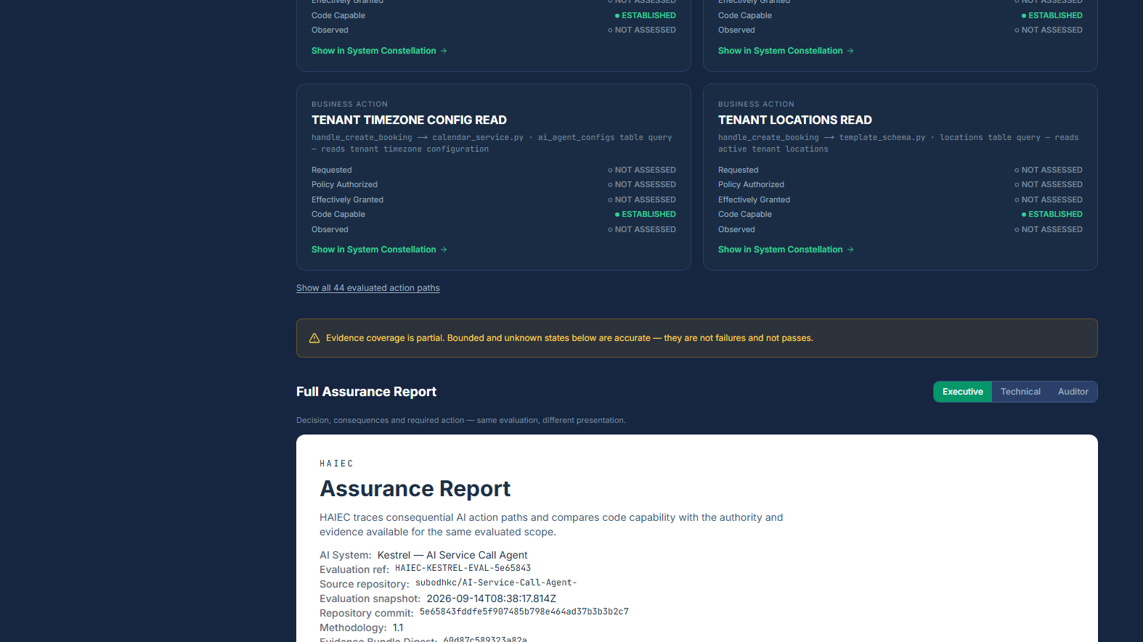

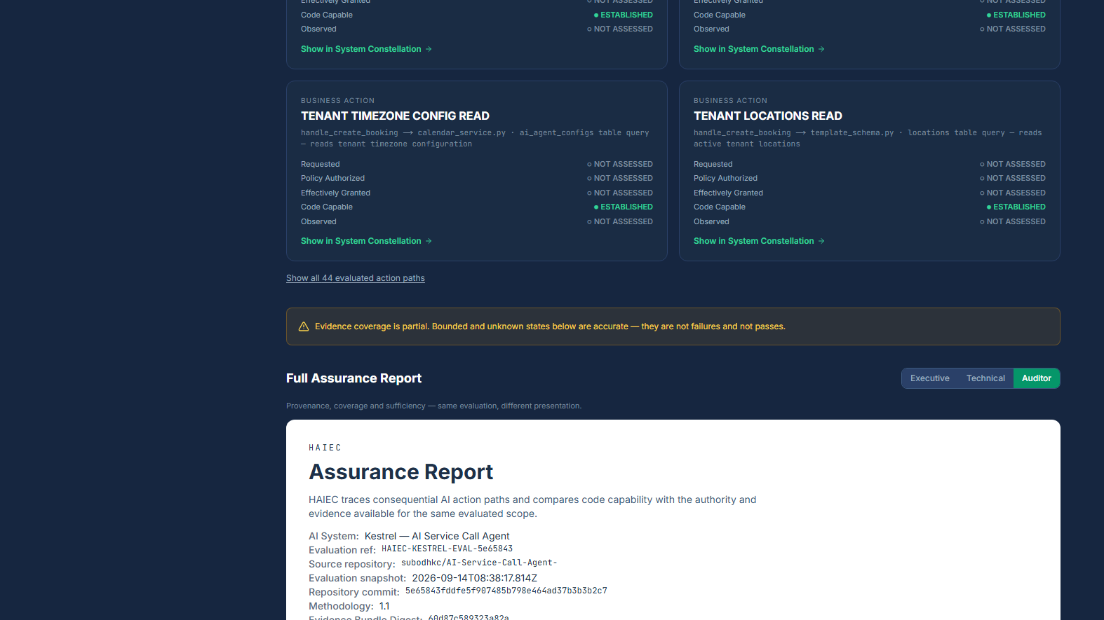
PRODUCT EVIDENCE
Report projections
Executive, technical and auditor views share the same evidence source
Executive report
Technical report
Auditor report
Projection principle
Different audience. Same evidence. The profile changes the view, not the canonical result.
AI Action Path Assurance · Technical Evaluation Companion · MunichTech EXPO 2026
30

Slide 31
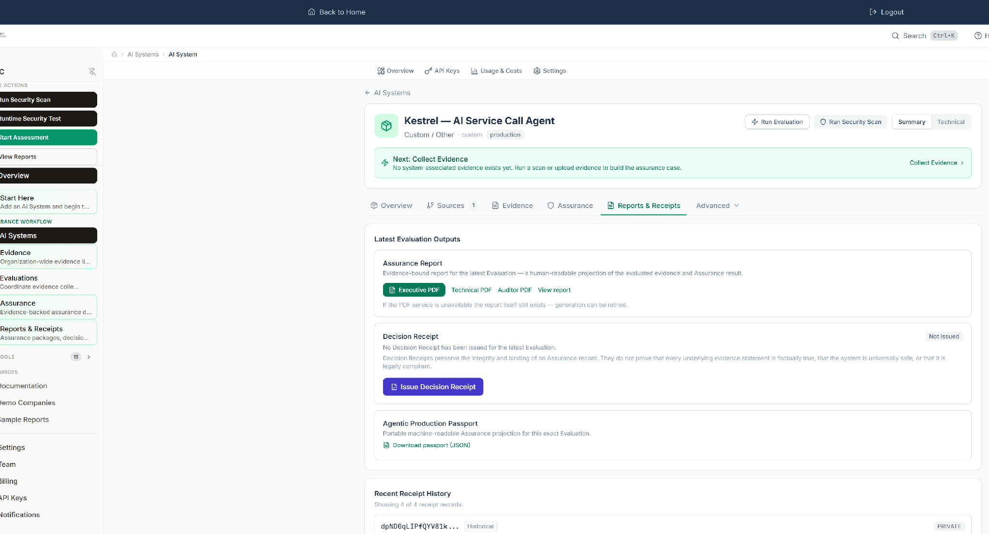
PRODUCT EVIDENCE
Decision Receipt and Passport
The action record travels with the release
Portable outputs
• Decision Receipt preserves bounded posture
• Passport carries machine-readable action context
• receipt history supports continuity
• reports can be retrieved after release
Important boundary
Portable action record. Not certification.
Reports, receipts and production passport view
AI Action Path Assurance · Technical Evaluation Companion · MunichTech EXPO 2026
31

Slide 32
PRODUCT EVIDENCE
Machine evidence and manifest
Artifacts are inspectable and hash-bound
Artifacts
• machine-readable assurance JSON
• public manifest
• evidence manifest
• Executive / Technical / Auditor PDFs
• README and evidence-pack contents
Integrity
• SHA-256 digests bind outputs
• manifest links file identity to evaluation
• package consistency can be checked
• integrity is separable from semantic re-analysis
Gold evidence folder
Evidence guide
Final submission index
AI Action Path Assurance · Technical Evaluation Companion · MunichTech EXPO 2026
32

Slide 33
PRODUCT EVIDENCE
Artifact hash anchors
Public artifacts are tied to the frozen evaluation
Public report JSON
6a1dcae3cc557ef251d1d8e505269cc852fbe707c846f9c771ed258e9e86b285
Machine JSON
b21057c803e21cdddf3087d2f3048ee1d85be62f96a66f7ef4cf9368191a5679
Executive PDF
06cf17662a799305e98564d38f08a891bdc6803fdcacad8648393a553f51bac3
Technical PDF
1f7a202c3271649db9fe9db2f5c2ebe3b136ccd5f4170a6f6cf1452a4f77ac26
Auditor PDF
7650952ce0831bce3a97ce96360c59466948bc05b425b0192728339de48aa548
Purpose: let reviewers tie report outputs back to a frozen evidence package instead of trusting screenshots alone.
AI Action Path Assurance · Technical Evaluation Companion · MunichTech EXPO 2026
33

Slide 34
PRODUCT EVIDENCE
Verifier scope
Integrity verification is not overclaimed as full semantic rediscovery
Verifier checks
• artifact hashes
• expected files
• manifest consistency
• decision/output consistency
• evidence package integrity
Verifier does not claim
• independent rediscovery of every semantic path
• proof of complete repository behavior coverage
• runtime execution proof
• certification
Positioning
Integrity is machine-verifiable; semantic paths are inspectable through their Action Path Trail.
AI Action Path Assurance · Technical Evaluation Companion · MunichTech EXPO 2026
34

Slide 35
SOURCE TRUST
Source-code trust model
Source is processed transiently; evidence is retained
OAuth account link
GitHub App scope
Ephemeral analysis
Discard source workspace
Retain evidence
Accurate source-handling claim
HAIEC processes authorized source temporarily to analyze it, then retains structured evidence, hashes, metadata, assurance decisions and release artifacts.
What is not retained as dataset
A persisted repository copy, source archive, or secrets discovered during scanning.
Enterprise PoC option: customer-controlled or private analysis deployment can be scoped for teams that cannot permit external source processing.
AI Action Path Assurance · Technical Evaluation Companion · MunichTech EXPO 2026
35

Slide 36
RELEASE COMPARISON
Why Git diff is insufficient
Files changed is not the same as consequences changed
Git tells you what changed in the code.
HAIEC asks what changed in what the AI can cause.
HAIEC Delta
Answers: what changed in consequential reach, control binding, and evidence boundaries?
Git diff
Answers: what files or lines changed? Useful, but insufficient when an AI path travels through tools, handlers, resources and controls.
A release can alter assurance even when the interesting change is not obvious from file names.
AI Action Path Assurance · Technical Evaluation Companion · MunichTech EXPO 2026
36

Slide 37
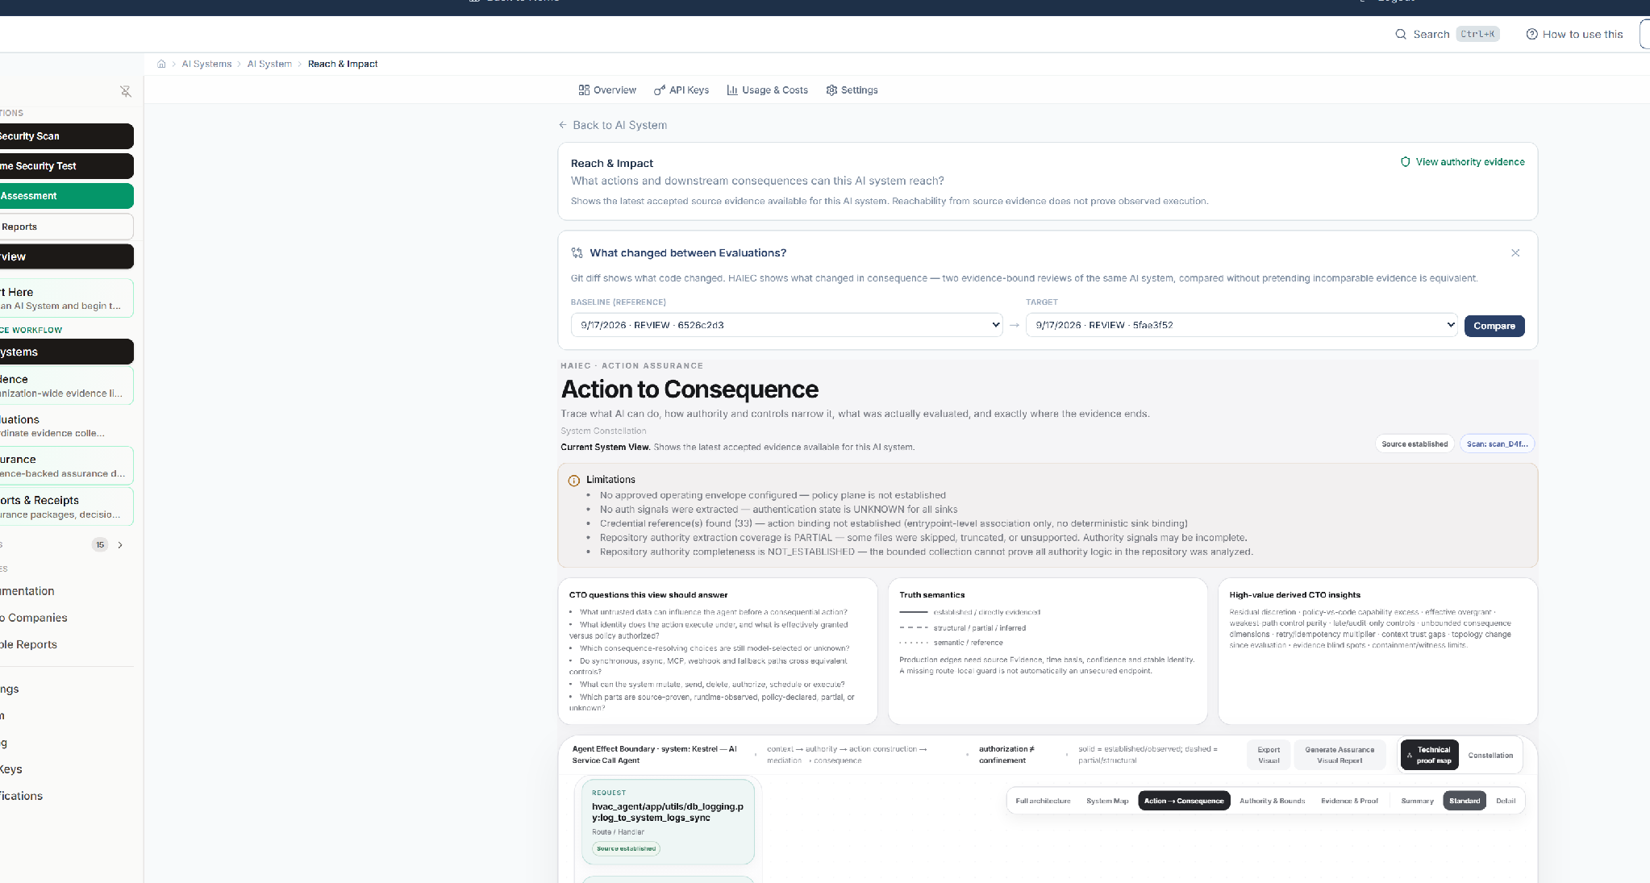
RELEASE COMPARISON
A/B-8 setup
Release A → Release B comparison uses completed evaluations
Comparability gates
• same organization and AI system
• completed evaluations selected
• release perimeter comparable
• analyzer/version evidence tracked
• repeatable comparison path
Result posture
A/B-8 produced a repeatable comparison while preserving bounded conclusions.
Release A and Release B selected for comparison
AI Action Path Assurance · Technical Evaluation Companion · MunichTech EXPO 2026
37

Slide 38
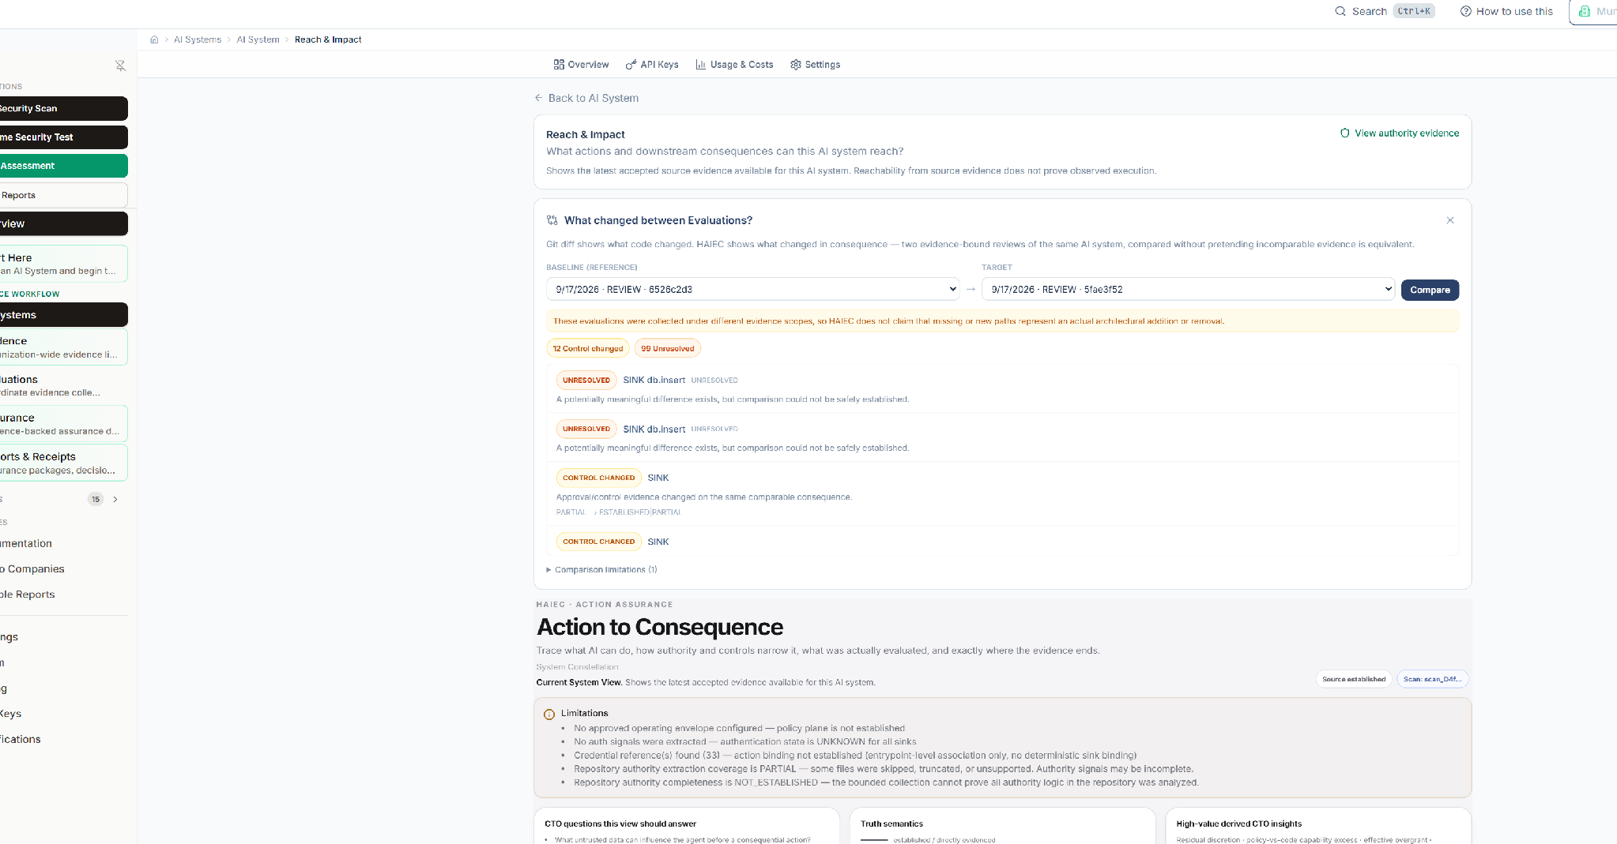
RELEASE COMPARISON
CONTROL_CHANGED established
The comparison found a control-evidence transition
Established result
• CONTROL_CHANGED established
• 12 established control-change items
• evidence moved from DECLARED to DECLARED + PATH_BOUND
• comparison repeatable
Claim boundary
• not a blanket “A/B passed” claim
• not proof that every expected mutation was established
• added/removed remained bounded by absence evidence
A/B result: CONTROL_CHANGED
AI Action Path Assurance · Technical Evaluation Companion · MunichTech EXPO 2026
38

Slide 39
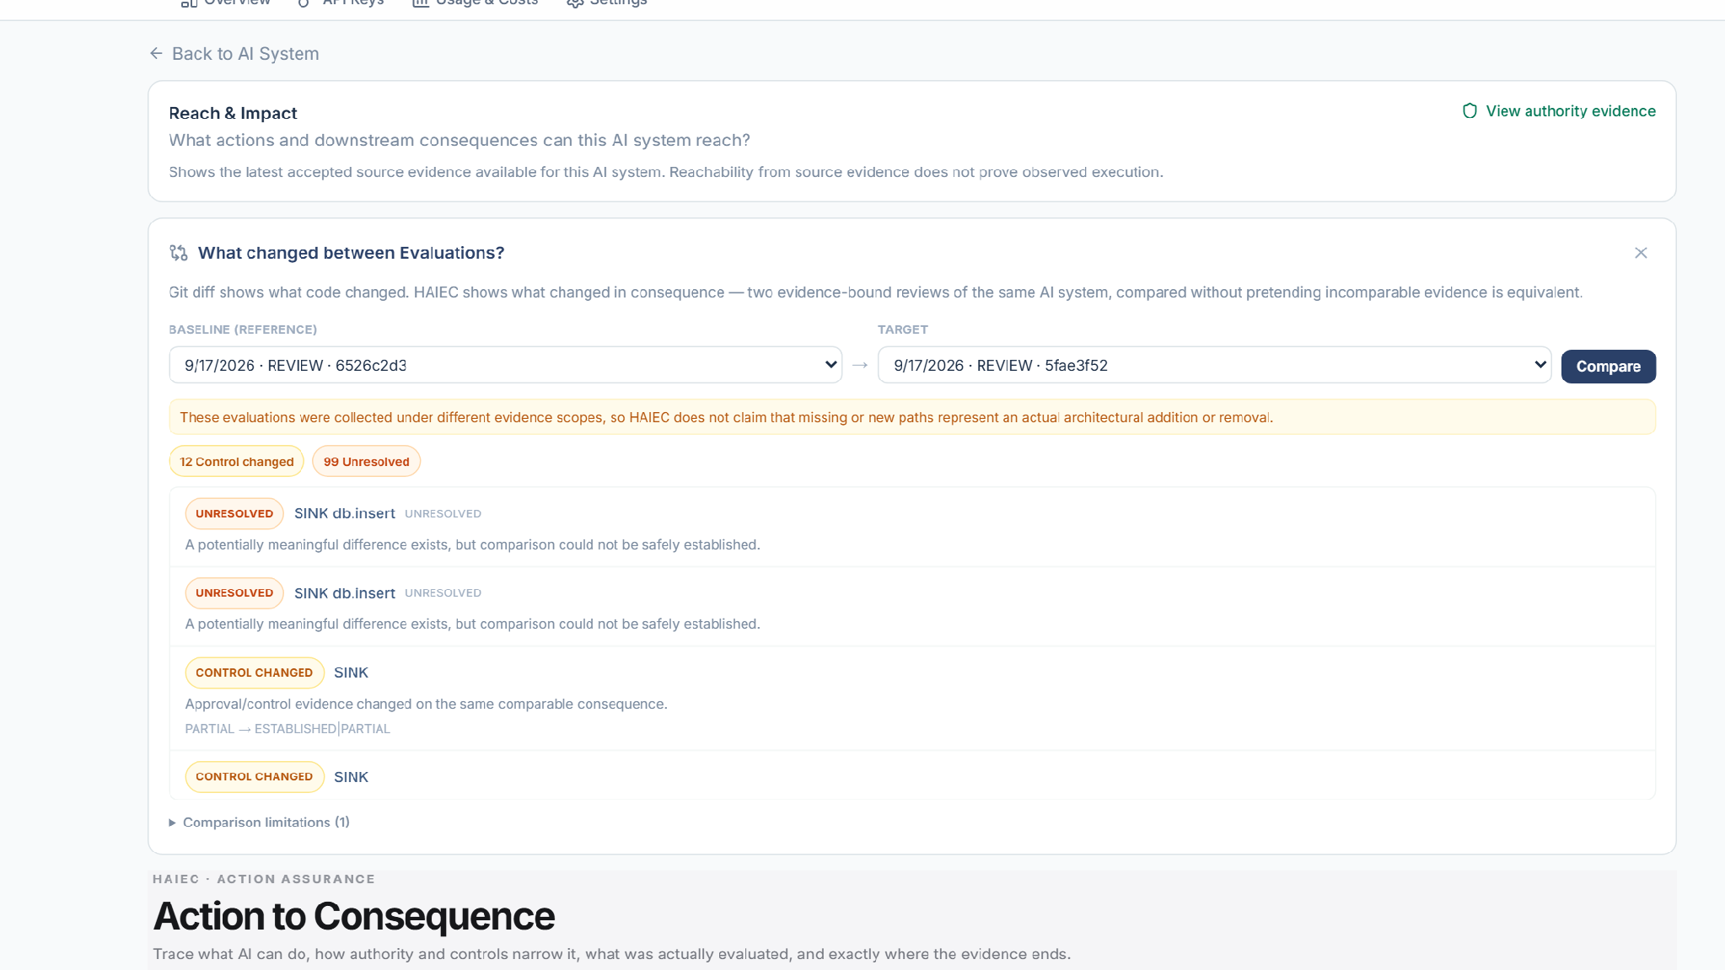
RELEASE COMPARISON
DECLARED → DECLARED + PATH_BOUND
Control evidence became bound to the path
DECLARED
→
DECLARED + PATH_BOUND
Technical meaning
A control that was previously only declared gained evidence that bound it to an action path. HAIEC distinguishes declared control from path-bound control.
Focused A/B control evidence region
AI Action Path Assurance · Technical Evaluation Companion · MunichTech EXPO 2026
39

Slide 40
RELEASE COMPARISON
UNRESOLVED ≠ ABSENT
Partial absence evidence remains unresolved
UNRESOLVED
≠ ABSENT
Why this matters
• expected added/removed path claims remained inconclusive where absence coverage was partial
• HAIEC did not manufacture a stronger conclusion
• missing proof became explicit review information
Same discipline before and between releases: do not turn missing evidence into reassuring certainty.
A/B unresolved result view
AI Action Path Assurance · Technical Evaluation Companion · MunichTech EXPO 2026
40

Slide 41
RELEASE COMPARISON
Delta dimensions
Consequence Delta compares more than path existence
Action consequence
Resource reachability
Service reachability
Agent reachability
Shared substrate
Approval control
Egress
Supply chain
Memory/context
Deferred execution
Evaluation integrity
Evidence coverage
Positioning
Delta compares the system’s consequential reach and assurance boundary, not just source-file differences.
AI Action Path Assurance · Technical Evaluation Companion · MunichTech EXPO 2026
41

Slide 42
ENTERPRISE DEPTH
Universal capability ontology
Standard coverage first; enterprise precision when needed
Identity & privilege
Data access
Resource scope
Tool/action execution
Configuration actuation
Model lifecycle
RAG/context memory
Inter-agent communication
External egress
Persistence
Supply chain
Human authority
Resilience
Observability
Privacy/residency
Change/release
Universal model first.
Qualified enterprise extensions when needed.
HAIEC does not force every enterprise into a generic action vocabulary; the standard model can be extended with qualified domain action definitions.
AI Action Path Assurance · Technical Evaluation Companion · MunichTech EXPO 2026
42

Slide 43
ENTERPRISE DEPTH
Requested Capability + Operating Envelope
Business intent becomes an evidence plane, not an assumption
Requested Capability Manifest
• declared action
• resource and scope
• business meaning
• required guards
• operational bounds
Operating Envelope
• allowed operations
• resource scopes
• data classes
• approved tools/models
• target count, magnitude and approvals
Example
AI may restart up to five cells after approved maintenance authorization. HAIEC compares that declared intent to what the system can actually reach.
AI Action Path Assurance · Technical Evaluation Companion · MunichTech EXPO 2026
43

Slide 44
ENTERPRISE DEPTH
Proprietary capability packs
Enterprise-specific action recognition while preserving proof quality
Recognition inputs
• imports
• call signatures
• SDK operations
• routes and annotations
• protocol operations
Semantics captured
• canonical action
• effect and resource
• scope and cardinality
• reversibility and timing
• authority requirements
Proof quality
• exact vs heuristic matching
• provenance
• qualification state
• known limitations
• residual unknowns
Enterprise packs sharpen recognition; they do not erase claim-boundary discipline.
AI Action Path Assurance · Technical Evaluation Companion · MunichTech EXPO 2026
44

Slide 45
MUNICHTECH ALIGNMENT
Originality boundary
Built during MunichTech on a HAIEC foundation
Pre-existing foundation
• HAIEC platform and SaaS infrastructure
• evaluation engine and evidence services
• reporting/output pipeline
• repository intelligence foundation
Built / packaged for MunichTech
• System Consequence Map projection
• Action assurance views
• Passport / Decision Receipt packaging
• A/B-8 release comparison evidence
• Kestrel evidence pack and public judge path
Disclosure principle
The submission separates the pre-existing platform from the competition-period build and provides public Git/evidence provenance where relevant.
AI Action Path Assurance · Technical Evaluation Companion · MunichTech EXPO 2026
45

Slide 46
MUNICHTECH ALIGNMENT
Europe and enterprise relevance
Provider-independent assurance for consequential AI
Provider-independent evidence that travels across engineering, security, release, governance and audit.
What HAIEC adds
• action-path accountability
• bounded claim semantics
• portable release records
• technical evidence, not certification overclaim
Why it matters
• agentic systems act through tools and services
• controls must bind exact paths
• evidence must be inspectable across teams
• release posture must be defensible
AI Action Path Assurance · Technical Evaluation Companion · MunichTech EXPO 2026
46

Slide 47
MUNICHTECH ALIGNMENT
Judge verification and access
Recommended technical review order
1 · Watch narrated presentation
Optional workspace credentials
Login: https://www.haiec.com/login
Email: munich-judge@haiec.com
Password: Kestrel-Judge-2026
Workspace: MunichTech Demo
Demo data only.
2 · Watch product demo video
3 · Open public Kestrel report
4 · Open System Consequence Map
5 · Review Gold Evidence Pack
6 · Review A/B-8 Evidence Pack
7 · Optional interactive workspace
Public flagship demo
Kestrel Assurance Report and System Consequence Map require no login.
8 · Final Submission Index
AI Action Path Assurance · Technical Evaluation Companion · MunichTech EXPO 2026
47

Slide 48
FINAL TAKEAWAY
Technical takeaway
Trace the AI action path to consequence and carry the evidence forward
Do not stop at prompts, policies or tool lists.
AI surface
Capability
Handler
Resource
Consequence
Authority evidence
What can this AI actually cause?
HAIEC turns that question into a deterministic evidence graph, a bounded release posture, a comparison record, and a portable action artifact.
AI Action Path Assurance · Technical Evaluation Companion · MunichTech EXPO 2026
48

