Slide 1

Online Medical Report
Drive
Varun raparla (11310104114)
Srihari reddy.T(11310104107)
Subodh krishna C.P.(11310104109)
PROJECT GUIDE:
N.INDIRA
(ASSISTANT PROFESSOR)

Slide 2
ABSTRACT
PHR is emerging patient-centric model of health information exchange
Often outsourced to be stored at a third party, such as cloud providers
wide privacy concerns as personal health information could be exposed to those third party servers and to unauthorized parties.
promising method is to encrypt the PHRs before outsourcing.
Yet, issues such as risks of privacy exposure, scalability in key management, flexible access and efficient user revocation, have remained the most important challenges toward achieving fine-grained, cryptographically enforced data access control.

Slide 3
In this paper, we propose a novel patient-centric framework and a suite of mechanisms for data access control to PHRs stored in semi-trusted servers. To achieve fine-grained and scalable data access control for PHRs.
we leverage attribute based encryption (ABE) techniques to encrypt each patient’s PHR file.
we focus on the multiple data owner scenario, and divide the users in the PHR system into multiple security domains that greatly reduces the key management complexity for owners and users.
A high degree of patient privacy is guaranteed simultaneously by exploiting multi-authority ABE.
Our scheme also enables dynamic modification of access policies or file attributes, supports efficient on-demand user/attribute revocation and break-glass access under emergency scenarios.

Slide 4
EXISTING SYSTEM
A PHR service allows a patient to create, manage, and control her personal health data in one place through the web.
Each patient is promised the full control of her medical records and can share her health data with a wide range of users, including healthcare providers, family members or friends.
Due to the high cost of building and maintaining specialized data centers, many PHR services are outsourced to or provided by third-party service providers.
The main concern is about whether the patients could actually control the sharing of their sensitive personal health information (PHI), especially when they are stored on a third-party server which people may not fully trust.

Slide 5
Due to the high value of the sensitive personal health information (PHI), the third-party storage servers are often the targets of various malicious behaviors.
Disadvantages:
Patients could actually control the sharing of their sensitive personal health information (PHI), especially when they are stored on a third-party server which people may not fully trust. Because a third-party server inside hackers can able to leak the patients information and security records to other peoples so this scheme is not fully trust.
In Existing attribute-based encryption important issues such as key management scalability, dynamic policy updates, and efficient on-demand revocation are non-trivial to solve, and remain largely open up-to-date.

Slide 6
PROPOSED SYSTEM:
We propose a novel ABE-based framework for patient-centric secure sharing of PHRs in cloud computing environments, under the multi-owner settings.
we conceptually divide the users in the system into two types of domains, namely public and personal domains.
Majority professional users are managed distributively by attribute authorities in the former, while each owner only needs to manage the keys of a small number of users in her personal domain.
Our framework can simultaneously handle different types of PHR sharing applications’ requirements, while incurring minimal key management overhead for both owners and users in the system.

Slide 7
In the public domain, we use multi-authority ABE (MA-ABE) to improve the security and avoid key escrow problem. Each attribute authority (AA) in it governs a disjoint subset of user role attributes ,while none of them alone is able to control the security of the whole system.
We propose mechanisms for key distribution and encryption so that PHR owners can specify personalized fine-grained role-based access policies during file encryption.
In the personal domain, owners directly assign access privileges for personal users and encrypt a PHR file under its data attributes.
we enhance MA-ABE by putting forward an efficient and on-demand user/attribute revocation scheme, and prove its security under standard security assumptions. In this way, patients have full privacy control over their PHRs.

Slide 8
Advantages:
Our proposed secure PHR sharing solution, in terms of multiple metrics in computation, communication, storage and key management.
We also compare our scheme to several previous ones in complexity, scalability and security.
Furthermore, we demonstrate the efficiency of our scheme by implementing it on a modern workstation and performing experiments or simulations.

Slide 9
MODULES
PHR Owner Module
Cloud Server Module
Attribute based Access Policy Module
Data confidentiality Module

Slide 10
PHR Owner Module:
The main goal of our framework is to provide secure patient-centric PHR access and efficient key management at the same time.
The key idea is to divide the system into multiple security domains (namely, public domains (PUDs) and personal domains (PSDs)) according to the different users’ data access requirements.
The PUDs consist of users who make access based on their professional roles, such as doctors, nurses and medical researchers.
For each PSD, its users are personally associated with a data owner (such as family members or close friends).
Each data owner (e.g., patient) is a trusted authority of her own PSD, who uses a KP-ABE system to manage the secret keys and access rights of users in her PSD.

Slide 11
Since the users are personally known by the PHR owner, to realize patient-centric access, the owner is at the best position to grant user access privileges on a case-by-case basis.
For PSD, data attributes are defined which refer to the intrinsic properties of the PHR data, such as the category of a PHR file.
For the purpose of PSD access, each PHR file is labeled with its data attributes, while the key size is only linear with the number of file categories a user can access. Since the number of users in a PSD is often small, it reduces the burden for the owner.
When encrypting the data for PSD, all that the owner needs to know is the intrinsic data properties.

Slide 12
Cloud Server Module:
In this project, we consider the server to be semi-trusted. That means the server will try to find out as much secret information in the stored PHR files as possible, but they will honestly follow the protocol in general.
some users will also try to access the files beyond their privileges.
For example, a pharmacy may want to obtain the prescriptions of patients for marketing and boosting its profits. To do so, they may collude with other users, or even with the server.
In addition, we assume each party in our system is preloaded with a public/private key pair, and entity authentication can be done by traditional challenge-response protocols

Slide 13
Attribute based Access Policy Module:
Framework :
Multiple SD’s
Multiple owners
Multiple AttributeAuthority’s
Multiple users.
In addition, two Attribute Based Encryption(ABE) systems are involved.
Users having read access - data readers.
Users having write access - contributors.

Slide 14
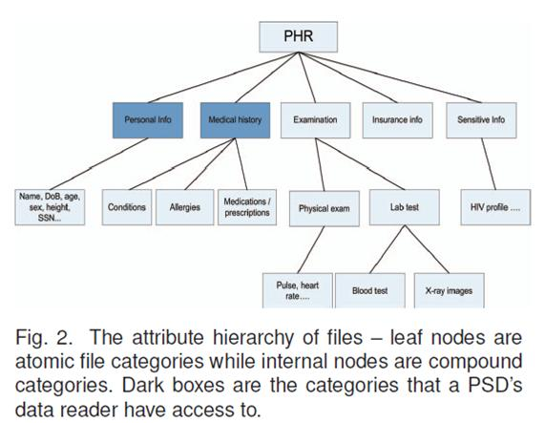

Slide 15
Data confidentiality Module:
Owners upload ABE-encrypted PHR files to the server.
Each owner’s PHR file is encrypted both under a certain fine grained and role-based access policy for users from the PUD to access.
Under a selected set of data attributes that allows access from users in the PSD.
Only authorized users can decrypt the PHR files, excluding the server.

Slide 16
SYSTEM CONFIGURATION:
HARDWARE REQUIREMENTS:
PROCESSOR - Pentium-III
SPEED - 1.1 Ghz
RAM - 256 MB(min)
HARD DISK - 20 GB
FLOPPY DRIVE - 1.44 MB

Slide 17
SOFTWARE REQUIREMENTS:
Operating System : Windows95/98/2000/XP
Application Server : Tomcat5.0/6.X
Front End : Java, JSP
Script : JavaScript.
Server side Script : Java Server Pages.
Database : MYSQL

Slide 18
REFERENCES:
Ming Li
Shucheng Yu
Yao Zheng
Kui Ren
Wenjing Lou

Slide 19
THANK YOU.

