Slide 1
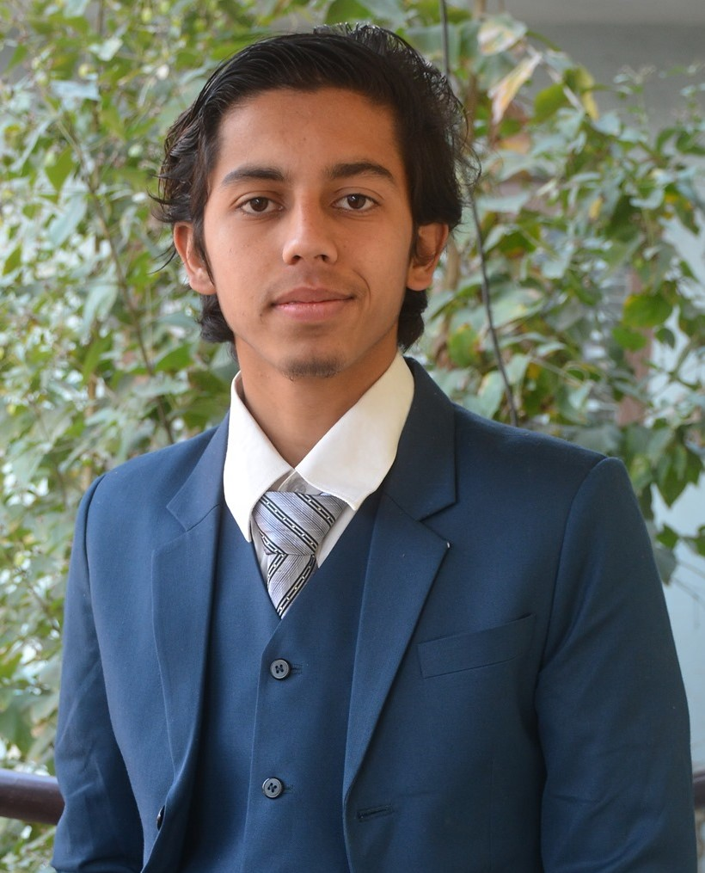


“Python for Automation”
We will begin shortly
PDSC Workshop Day-3
Raj Krishna Nepal
Electrical Engineering
Pulchowk Campus

Slide 2
Objectives:
A password manager program
Downloading images automatically
GUI Automation
Assignments

Slide 3
Password Manager Program
Command Prompt knowledge
Edit environment variables
Code the program
Run it from cmd

Slide 4
Required modules for the program:
pip install pyperclip (done in cmd)
import pyperclip
import sys

Slide 5
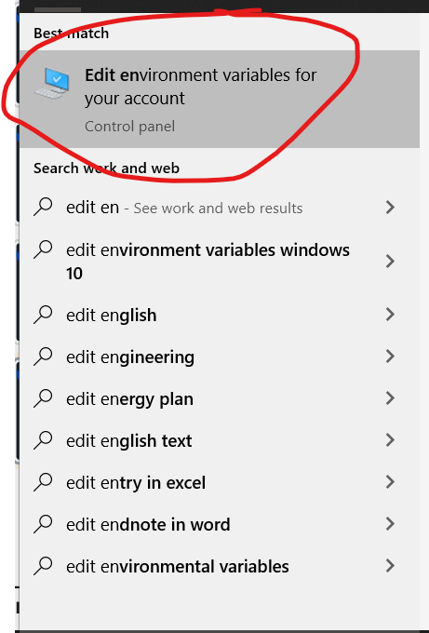
Engaging with Environment Variables:
In order to make stuffs easy in accordance to
previous slide we create environment variables:
To create and edit environment variable
search and click on the tab as in
picture:

Slide 6
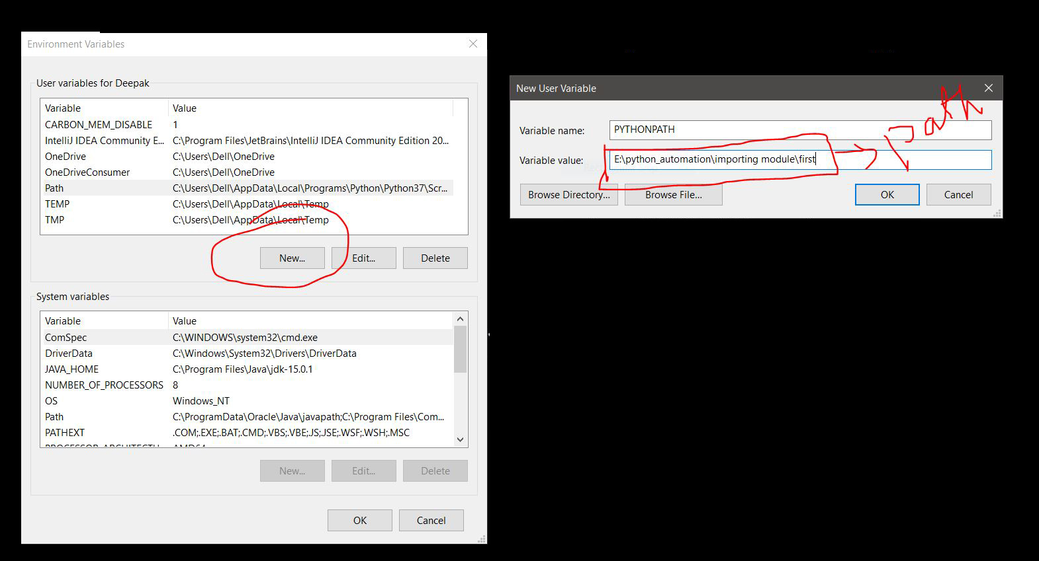

Slide 7
Downloading Images from google
Selenium module and its webdriver
Downloading and installing required modules
pip install selenium

Slide 8
Importing Modules
from selenium import webdriver
from selenium.webdriver.common.keys import Keys
import time

Slide 9
GUI Automation

Slide 10
Controlling the mouse
pip install pyautogui
pyautogui modules basics
Now the automation part

Slide 11
pyautogui.displayMousePosition()

Slide 12
Controlling the keyboard
pyautogui.click(100, 100); pyautogui.typewrite('Hello world!')

Slide 13

Any
Questions?

Slide 14
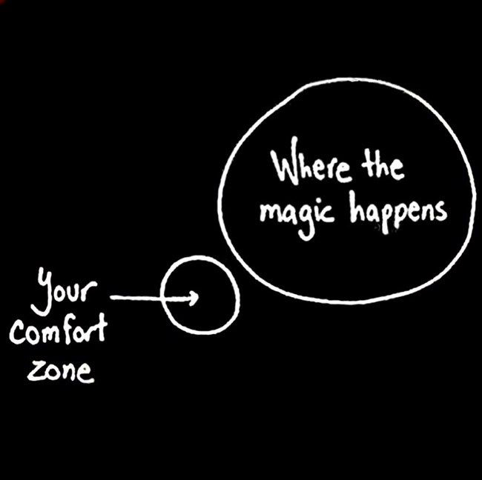
Thank You and All The Best.

