Slide 1

Welcome to Our Presentation

Slide 2
Project Name
File Management System

Slide 3
Supervisor
Team Members
Md. A. M. Reza Khan
Lecturer of CSE Department
Southeast University
Name : Amena Akter
ID : 2015100000027
Name : Mohammad Shohel
ID : 201500000045
Name : Tamanna Sikder Bristy
ID : 2015000000126

Slide 4
Project Outline
* Introduction
* Tools
* Objective
* Benefits
* Related Work
* Diagram
* Working Process
* Conclusion

Slide 5
Introduction
This project is based on a corporate company’s need. A leading company has many documental issue. If we use file management system, we can store our older or newer official data file on it. Sometimes we need to find old data file immediately. In this case we can find out that file and download the needy file from the uploaded folder. Thus there is no opportunity of files getting corrupted or lost.
A file management system is a type of software that manages data files in a computer system. It has limited capabilities and is designed to manage individual or group files, such as special office documents and records. It may display report details, like owner, creation date, state of completion and similar features useful in an office environment. A file management system is also known as a file manager.knowledge is safe, accurate, and accessible. Mainly use for private file sharing system

Slide 6
Motivation
Every day your company is creating and managing massive amounts of business documents, contracts, proposals, marketing material, HR guidelines, training manuals, onboarding material, etc. These files are often scattered all over the place on your digital devices- you may have stored in cloud apps like Dropbox, Google Drive etc.What happens when your manager immediately needs that important document, but he cannot remember where you stored it? So Every organization use private file management system according to their activities. Also A company has many branches. All branch can use this file management system together by uploading and downloading file through their ID and password.

Slide 7
Development Tools
* HTML & CSS
* Bootstrap
* Java script
* PHP
* MySQL

Slide 8
Objective
* Creating a software where the Current employs can easily enter with the help of ID and password which is given by their admin.
* Every role will have their own different home page.
Safely store and accessing les based in a
client/server architecture.
* Multiple department works can be safely stored and accessed based on officer management architecture.
* Current user can upload their selected files, and admins can checkout their profiles,see the uploaded documents and download them if they needed.
* Admins from each department can add their own employs by their own.

Slide 9
Benefits
. It will reduce the problems of keeping paper documents in corporate office .
It will reduce time complexity.
File can be uploaded from any country and any time.
For using LAN connection it will be helpful for them to keep their information safe and private from the other companies.

Slide 10
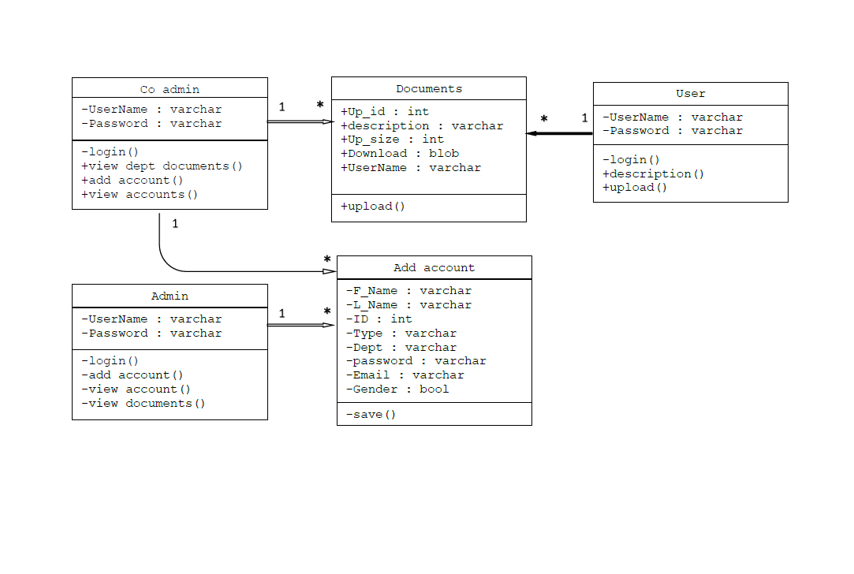
Class diagram

Slide 11
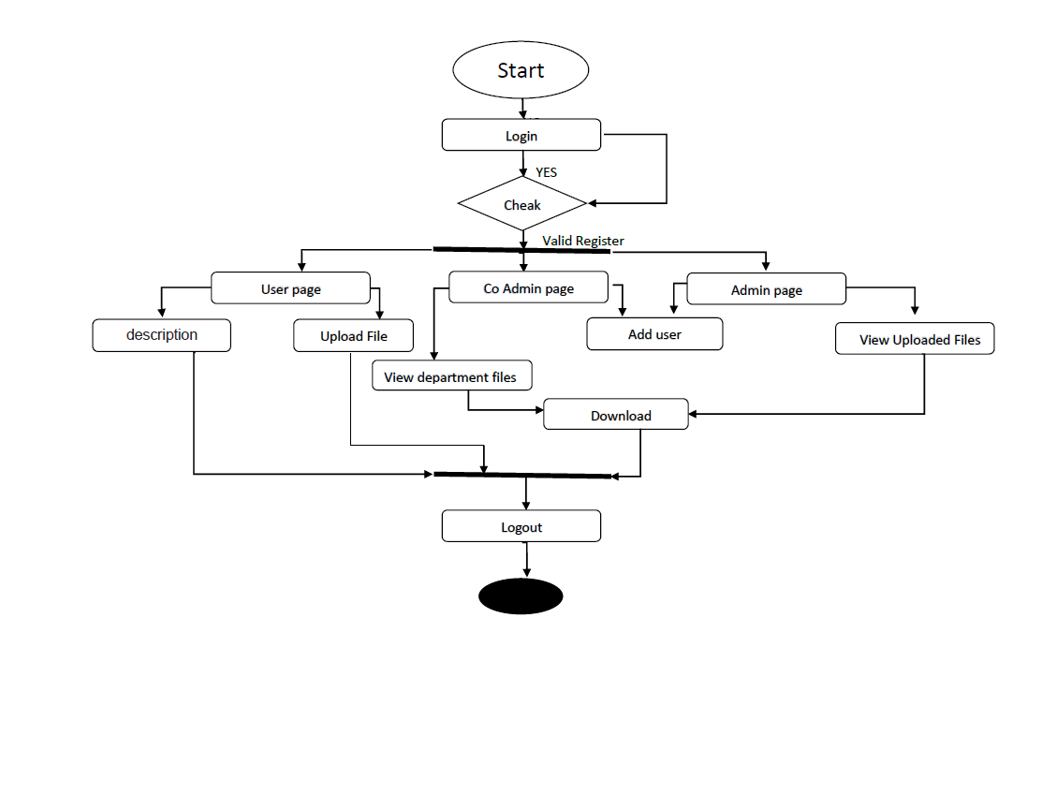
Activity diagram

Slide 12
Working Progress
Completed
Project view
Tool Idea
Completed
Completed
Diagram
Coding
Working
Submission & report writing
Working

Slide 13
Conclusion
Our development is now is an early stage. We’ll take it to a more advanced stage in the future.

Slide 14
Thank You ☺

Slide 15
Any Question? ☺

