Slide 1
FRST 232 Computer Applications in Forestry
Microsoft Word

Slide 2
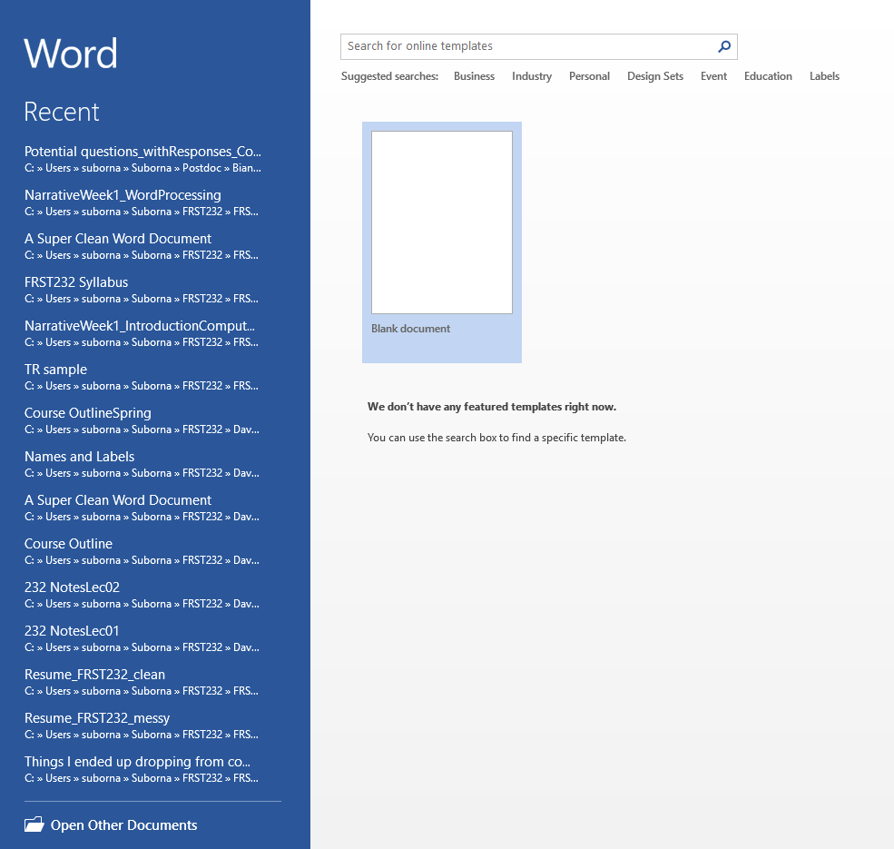
Getting started with MS Word
Basics
Open new document
Template
Recently opened
Notes:
Student repot: templtae

Slide 3
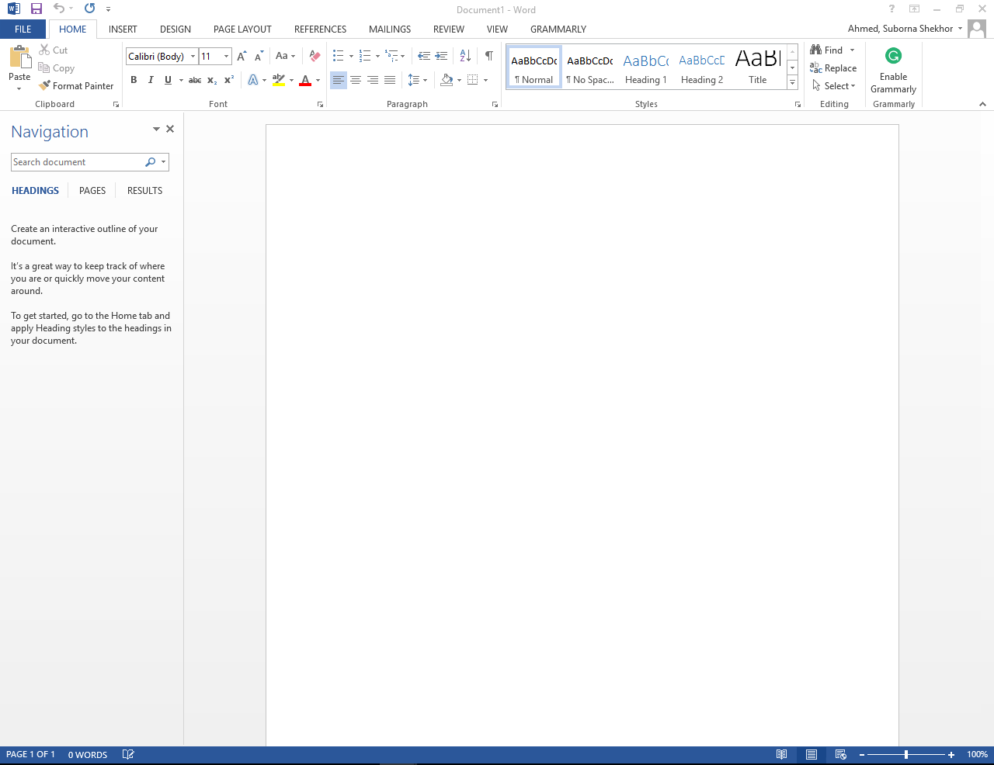
Microsoft Word
Basics
Toolbars
Home
Insert
Design
Page Layout
References
Mailings
Review
View

Slide 4
Microsoft Word
Home Toolbar
Font
Sets the font style for the selected text
Common professional fonts are: Arial, Calibri, Times New Roman
Common font size for text in body is 11 or 12.
Paragraph
Sets the font style for the selected text
Common professional fonts are: Arial, Calibri, Times New Roman
Common font size for text in body is 11 or 12.
Defines the style of each paragraph in the body
Bullet points, numbering, and indenting
Line space: single or double space
Notes:
There are two methods to format text in a word document. The one described above using ‘Styles’ or you can use commands from the ‘Font’ or ‘Paragraph’ groups in the HOME tab. The latter is referred to as manual formatting. Throughout FRST 232 we will try to avoid manual formatting unless it is to change or design a Style. “Styles save time and make you document look good^{C}”! The two basic advantages are consistent formatting and making changes easily in large documents. What if you don’t like the MS Word defaults? After all, they are pretty hideous. You can change any individual style, create your own style, or assemble your own style set. There are different ways to change styles. You can use the Styles pull down list to modify and add styles: Right click on Style in the Styles pull down list, click ‘Modify’ and make changes to your liking. Or you can use a default style and then manually format it to what you want it to look like. Manual formatting will create an ‘augmented style.’ To get rid of the augmentation, go to the Styles pull down list and update the non-augmented style to match the selection (e.g., “Update Normal to Match Selection”). The augmented style will disappear from the Styles list. Note: if markers find augmented styles in your assignments, you lose points!
Add indention on first line

Slide 5
Microsoft Word
Home Toolbar
Styles
Used to quickly style pieces of text in the document
Modifying styles for body, headings, and document level
Editing
Find
Replace
Throughout FRST 232 we will try to avoid manual formatting unless it is to change or design a Style. Styles save time and make you document look good.

Slide 6
Microsoft Word
Insert Toolbar
Page break
Used to Separates two sections from each other
Modifying previous pages won’t impact the following section when page break is used
Table
Used to insert word-native tables in word
You can also import tables from other MS applications such as Excel
Use consistent format for all tables in a document

Slide 7
Microsoft Word
Insert Toolbar
Pictures and graphs
Can be easily copied and pasted from clipboard (under “Format Painter”) or other applications such as Excel
Decide how they appear within the text.
Make sure they are properly aligned
Shapes and text box
Used to draw e.g. diagrams within the text
Pay attention to alignments
Don’t make too flashy or over use unfamiliar shapes
Keep look and feel consistent throughout your document
Grouping objects is a good way to avoid misalignment in different versions
Notes:
The Clipboard task pane holds many of the last images and text you copied or cut. To open the Clipboard task pane, click Home, then click the Clipboard dialog box launcher. Double-click the image or text you want to paste. To see things you can do to the task pane, click Options at the bottom of the task pane.
To use Office’s clipboard, first select the text or image you want to add to the clipboard and copy (Ctrl+C) or cut (Ctrl+X) it. The text or image is copied or cut to both the Windows clipboard and the Office clipboard.

Slide 8
Microsoft Word
Insert Toolbar
Equations and symbols
Can be Used to insert formulas
Can you use symbols, superscripts and subscripts instead of equations? Equations aren’t very easy to edit
Notes:
Save inserted equation
Ink equation

Slide 9
Microsoft Word
References Toolbar
Footnote
Used to add reference or additional explanation within text
Don’t overuse, usually only a few exist in the whole document
Captions
Figures and Tables are the two main categories of captioned items in the document
Used to label and describe charts, graphs, diagrams, pictures, and tables
Sequentially numbered either throughout the document or in each section
Cross-reference caption in the text in relevant places. Usually only label and number is cited in the text
Notes:
Add cross reference: refer table, figure: use full title or just the table number
Ctrl+text : to find the original table
To change any cross reference: select all text (ctrl+A) the unpdate doc.

Slide 10
Microsoft Word
Cover page
Layout:
Page orientation
Sometimes you may need to re-orient the page to landscape.
To achieve this, you can open dialogue box for the page setup, choose landscape and apply to “this point forward” only.
Headers and Footers
Set-up page numbers
Notes:
Other pages will follow or not

Slide 11
Microsoft Word
References Toolbar
Table of Contents
Choose the style
Custom style
Update after adding sections or at the end
Insert Table of Figures/Tables
Custom style
Update after adding Tables/Figures or at the end
Separate for Tables and Figures

Slide 12
Microsoft Word
References Toolbar
Citations
Citation to other documents are used when a piece of information or rephrased text is used from another document
Citation is usually done through a third-party software such as Mendeley
Citations are usually automatically imported into a reference management software (eg Mendeley)
Whenever you need to cite a document, the dialogue box will let you add your citation within the text.
The software will automatically create the reference list at the end for you, you just need to choose the reference style
Notes:
Adams, J.P., Matney, T.G., Land, S.B., Belli, K.L. and Duzan, H.W. 2006. Incorporating
genetic parameters into loblolly pine growth-and-yield model. Can. J. For. Res. 36:1959-1967.
“edit citation. ”Suppress “author” will remove author from view, only years will show up.
Adding multiple references: You need to add a reference first say:(Jones,2010) or [1]
After that you click left side of the closing parenthesis/ bracket.
Now add your second reference and it will show:
(Jones, 2010; Smith, 2009) or [1,2]

Slide 13
Microsoft Word
Review Articles
Facilitates collaboration on the same document and/or editing hierarchically
Comments: add comment box for the selected text
Tracking changes
Turn track changes on to add edits
While reviewing accept or reject edits
Comparing documents
Compares two documents for differences
Notes:
Use same document but one with a slight change: then locate & compare

Slide 14
Some Official instructions on how to create and change styles
Online training course for Word 2013
https://support.office.com/en-us/article/Word-2013-videos-and-tutorials-14807f76-d2b5-44d6-af11-9c880c44e551?ui=en-US&rs=en-US&ad=US
Spellcheck and proofing
https://blogs.office.com/en-us/2013/01/07/webinar-spell-check-and-proofing-your-word-doc/

Slide 15
Saving works in this course
If you have an external hard drive (USB flash drive) you can use that to save your work.
Find deleted files
When you delete a file, it typically goes into the ‘Recycle Bin’ of the computer. That means the file is still on the computer. This is just something to remember when you use public computers to work with personal files!

Slide 16
Word Templates
In Assignment, you will create styles that you like. It may be a good idea to create a template for FRST 232 assignments. That could potentially save you quite a bit of time when you submit the remaining assignments for this course.
What is a template? It is a document that is formatted in a certain way and you use it as starting point to create a new document. For example, a template for FRST 232 assignments could already include a Header with your name and course number as well as your favorite Title and Heading Styles. You can create your own template by saving your formatted file with the extension ‘.dotx’ (FILE/Save as/Browse/Word template (*.dotx)). More detailed instructions are here:
https://support.office.com/en-us/article/Save-a-Word-document-as-a-template-cb17846d-ecec-49d4-82ea-a6f5e3e8b9ae?ui=en-US&rs=en-001&ad=US
Think about creating your own template for a Resume. It may save you a lot of time in the future when you apply for internships and jobs! You can find some examples of Microsoft Office templates online:
https://templates.office.com/templates/?ui=en-US&rs=en-CA&ad=CA
Notes:
To open a saved template: go to file> new> personal>

Slide 17
A Messy Word Document
A 'messy' Word document uses typewriter formatting. Typewriter formatting was all that you could do in the days before computers. Typewriter formatting uses the space bar and or multiple tabs to generate horizontal spacing and multiple uses of the ‘carriage return’ to generate vertical spacing. Typewriter formatting is the hall mark of an individual that doesn’t know how to use a word processor. A messy Word document has lost control of its layout.
For example, we could enter a single blank line before each header. We might decide that we want 24 points in front of each heading rather than the current 12. In the messy version we would have to go to each heading and enter a second blank line. In a large document, with many headings, this would take time and be a potential source of error. I might miss a heading. After changing all the headings we may again change my mind and want to have only 8 points of space above each heading.

Slide 18
A Clean Word Document
A clean Word document is a document that has no ‘messy’ or ‘typewriter’ formatting. A clean word document uses format controls to provide both horizontal and vertical layout in a Word document. This means that the layout will not be generated using multiple space bar spaces, multiple tabs, multiple line feeds or other non-printing characters.
A Super Clean Word Document
A super clean word document is a clean word document that contains no manual formatting. Manual formatting can be recognized by noticing that you have to select the text to change the formatting. If you had many places that had used manual formatting and you wanted to change the format you would have to select each piece and change it. If you had a super clean word document, all you would do is change the style.

