Slide 1
FRST 232 Computer Applications in Forestry
Basic Graphs: R and RStudio

Slide 2
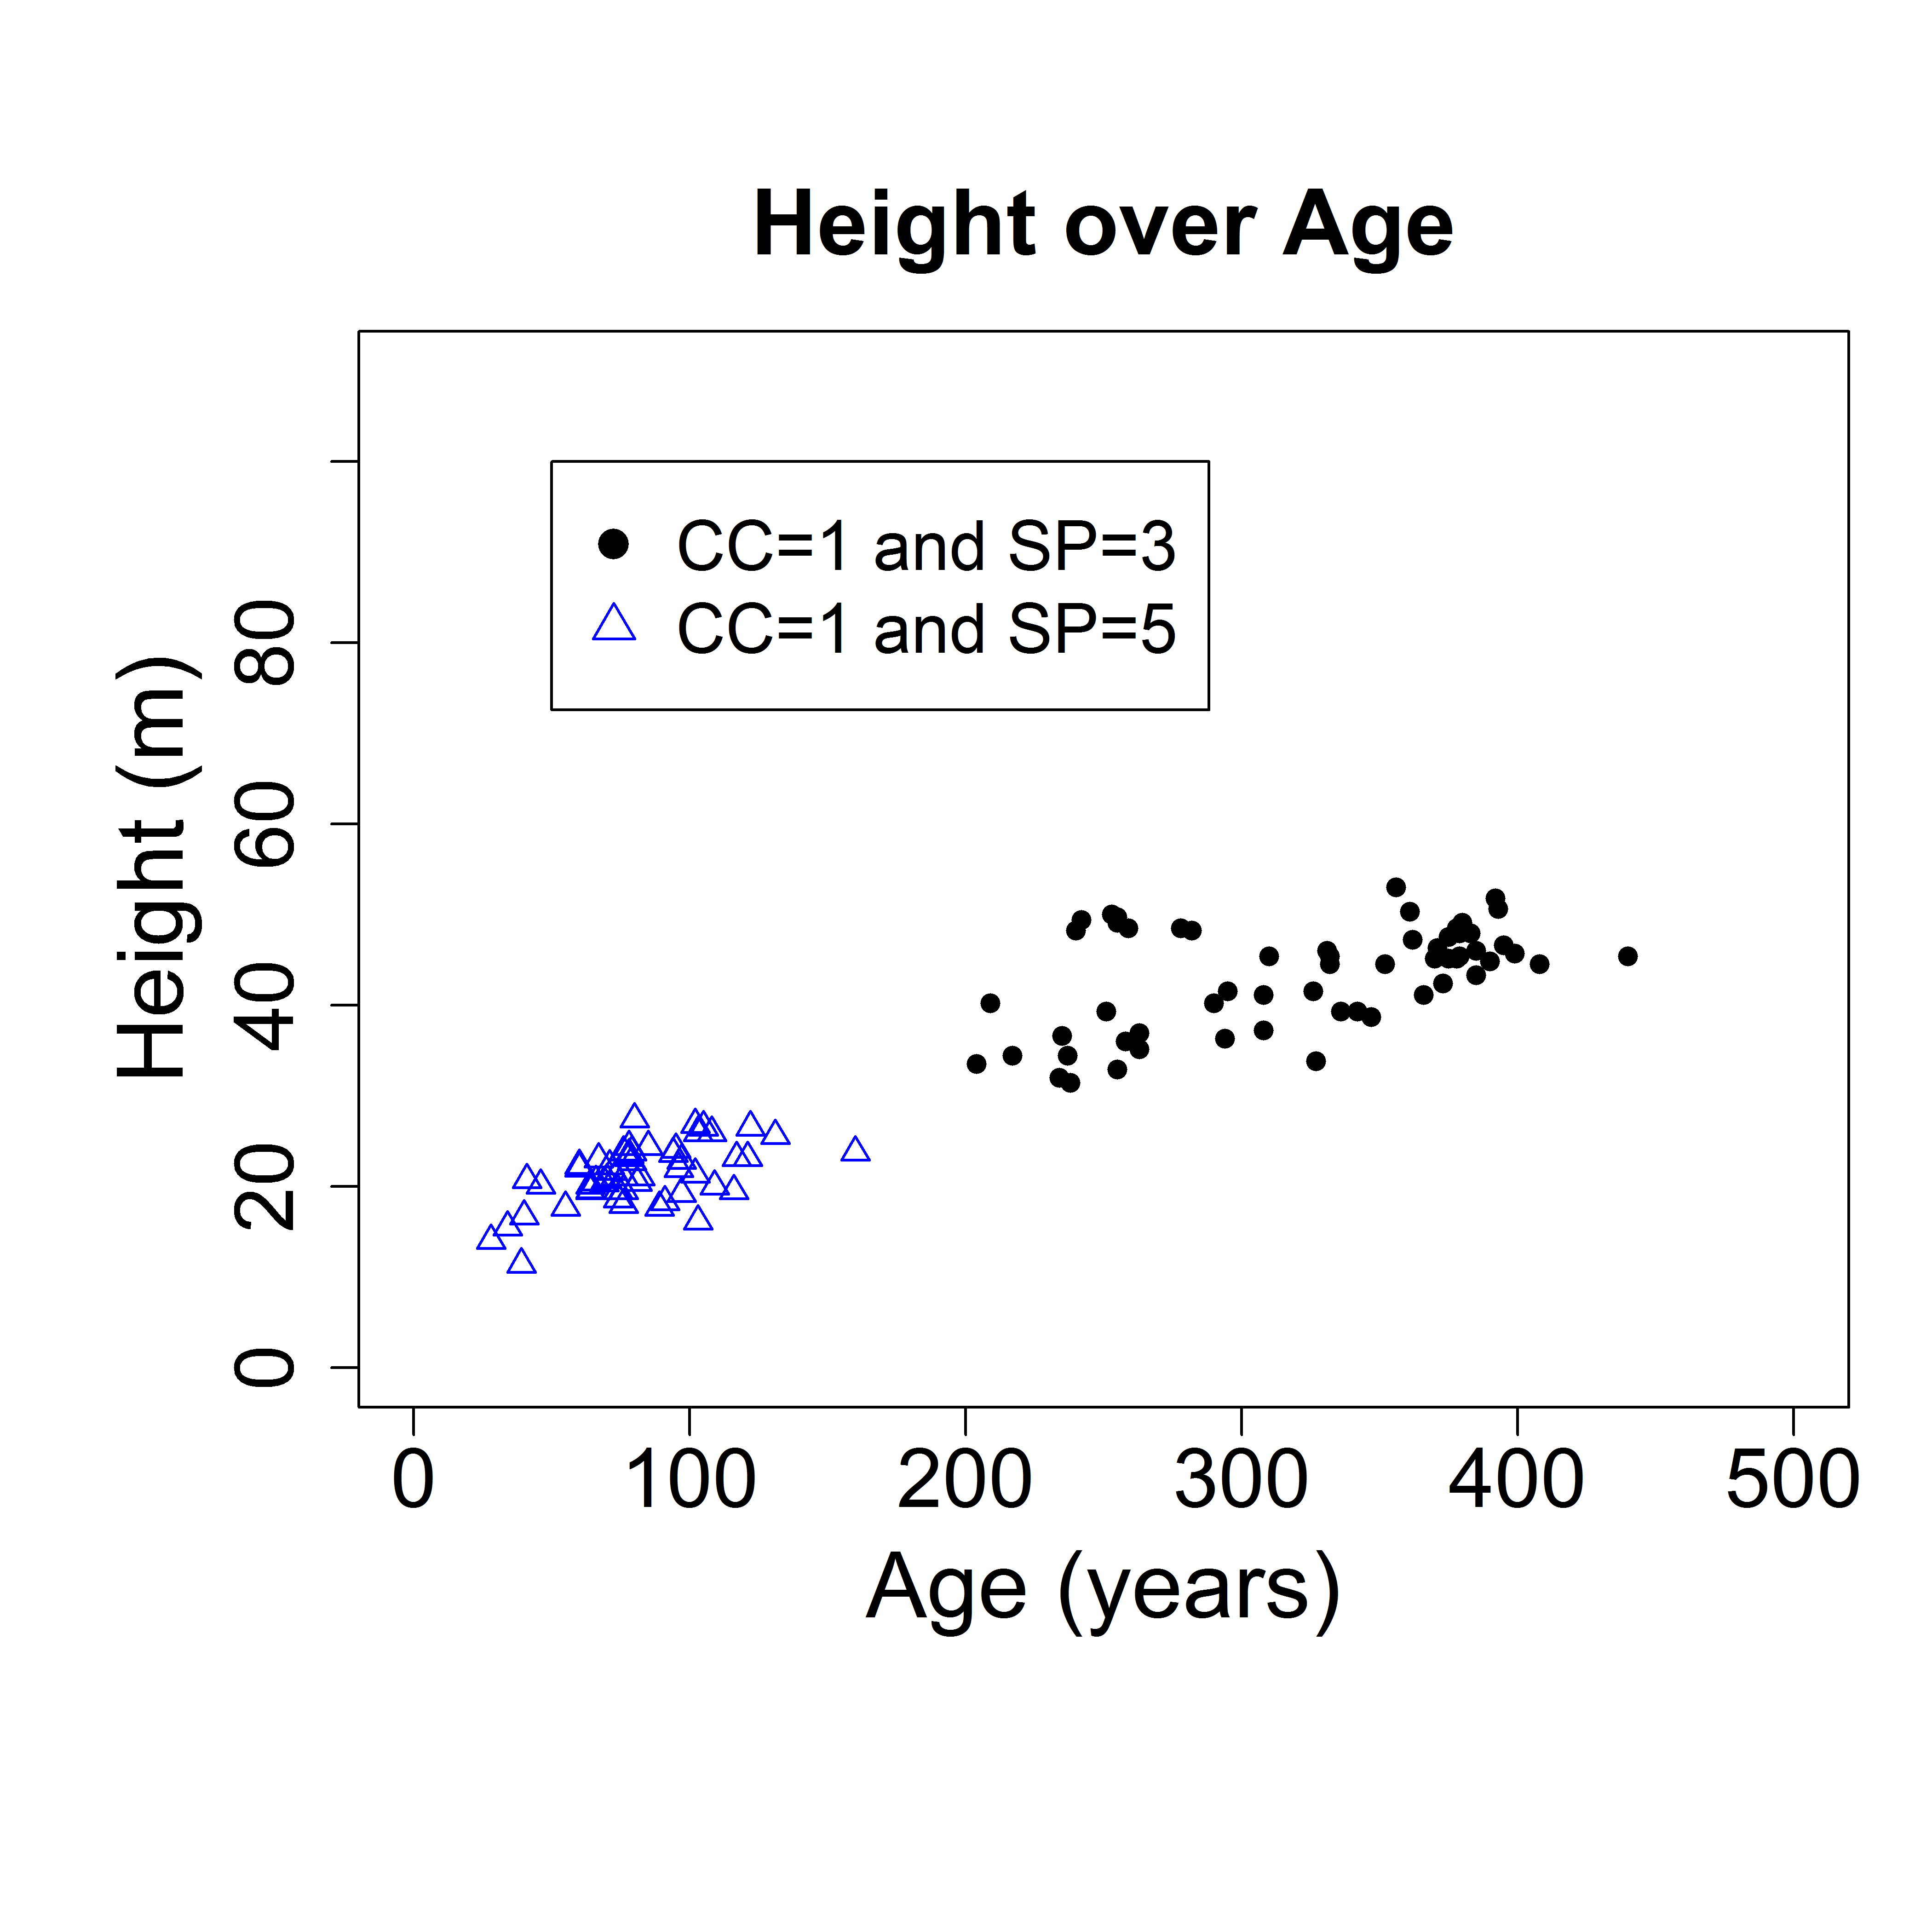
Graphs in R
Graphs in R are called plots and the commands used to create them are referred to as plotting commands.
we will focus on the functions plot() to create scatterplots, hist() to create histograms, barplot() to create bargraphs, and points() and lines() to add points and lines to an existing plot, respectively.
Some of the more common arguments we will be using are xlim and ylim to define the ranges of the X- and Y-axes, as well as xlab and ylab to add and modify axes labels.

Slide 3
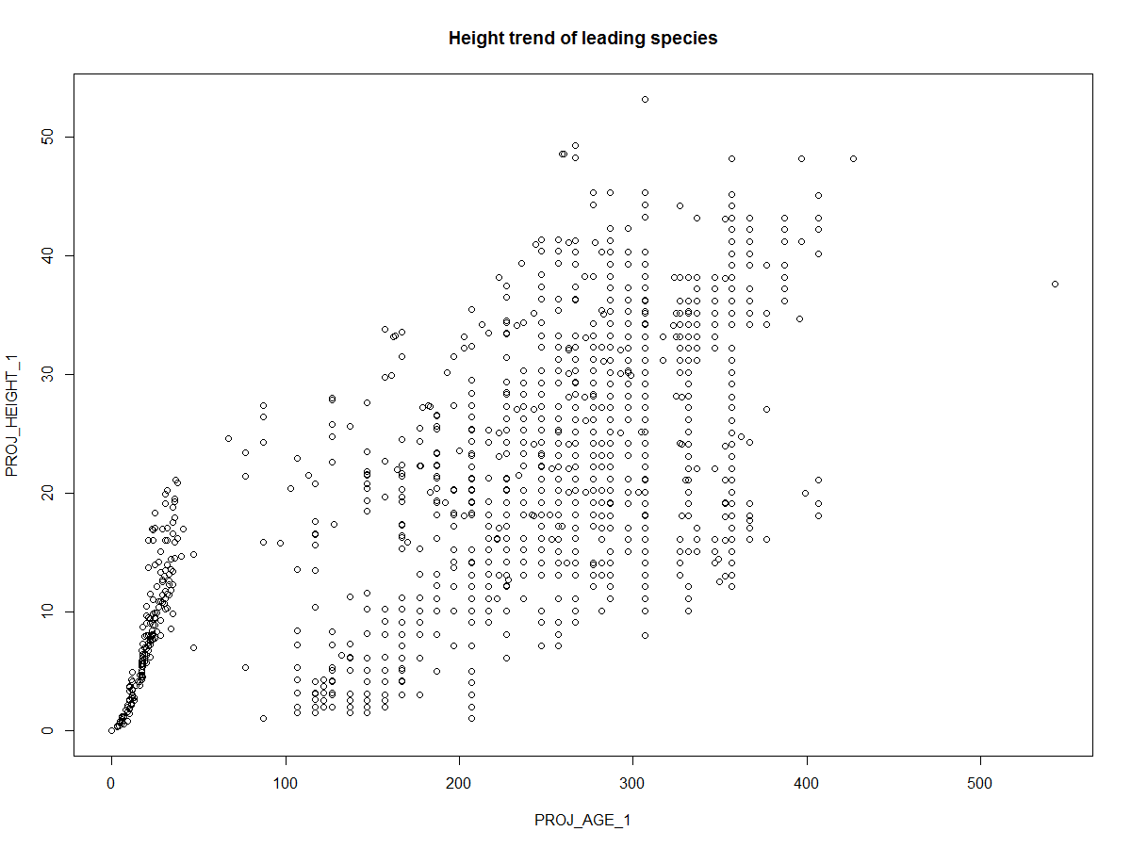
Graphs in R
Scatter plots:
Scatter plots are useful to visualize relationship between two numeric variables. Usually, we use scatter plots to visually discover trends between variables.
Scatter plots can be created using plot() command.
Example: a scatter plot showing relationship between “height” and “age” of the leading species:
plot(PROJ_AGE_1,PROJ_HEIGHT_1, main="Height trend of leading species")

Slide 4
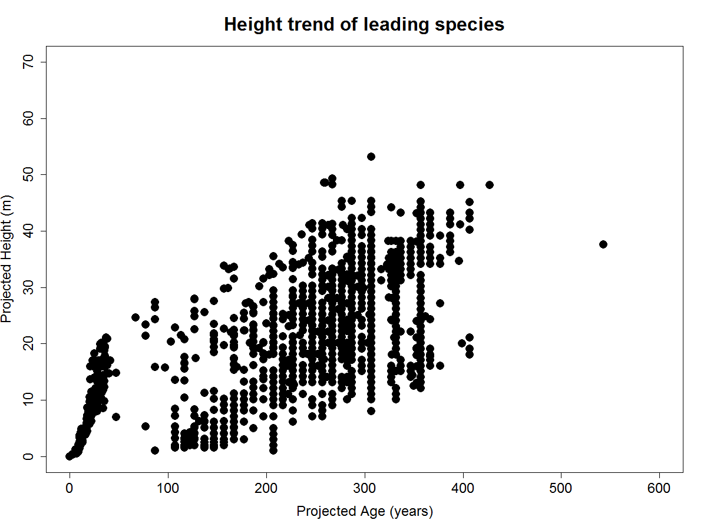
Graphs in R
Scatter plots:
ylabel="Projected Height (m)"
xlabel="Projected Age (years)"
ylm=c(0,70)
xlm=c(0,600)
cxlb=1.5 # axis level – font size of both axis
cxaxis=1.5 # axis font size-
maincx=2 # title font
row1=3 # age column number
row2=4 # ht column number
ldcex=2
plot(vri_data[,row1], vri_data[,row2], xlab=xlabel, ylab=ylabel, type = "p", pch = 16, col = "black", ylim=ylm, xlim=xlm, cex=ldcex, cex.lab=cxlb, cex.axis=cxaxis, main="Height trend of leading species", cex.main=maincx)

Slide 5

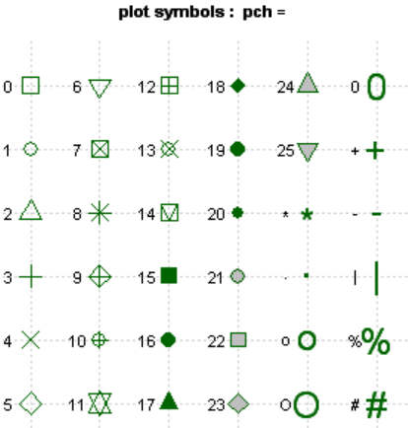
Graphs in R
Point Symbols
Plot (vri_data[,row1], vri_data[,row2], xlab=xlabel, ylab=ylabel, type = "p", pch = 10, col = "black", ylim=ylm, xlim=xlm, cex=ldcex, cex.lab=cxlb, cex.axis=cxaxis, main="Height trend of leading species", cex.main=maincx)
https://www.statmethods.net/advgraphs/parameters.html

Slide 6
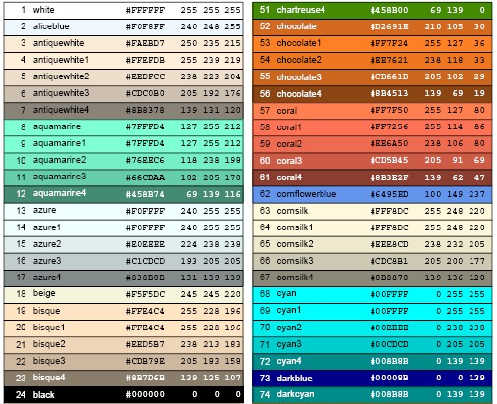
Graphs in R
Colour chart:
-First two column works for points
- First 3 columns works for lines
http://www.stat.columbia.edu/~tzheng/files/Rcolor.pdf

Slide 7
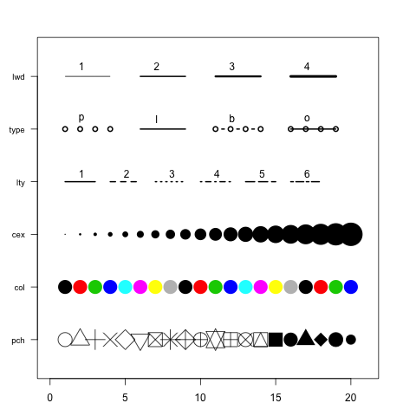
Graphs in R

Slide 8
Graphs in R
Scatter plots:
We could draw the scatter plot for selected categories
For instance let’s draw scatter plot showing relationship between “height” and “age” of the leading species Western Cedar
> plot(PROJ_AGE_1[SPECIES_CD_1 ==‘CW’],PROJ_HEIGHT_1[SPECIES_CD_1 ==‘CW’])
Let’s go ahead and add all modifications to this new graph:
> plot(PROJ_AGE_1[SPECIES_CD_1 =='CW'],PROJ_HEIGHT_1[SPECIES_CD_1 =='CW'], type = "p", pch = 1, col = "black", main="Height of leading species", ylim=ylm, xlim=xlm, cex=ldcex, cex.lab=cxlb, cex.axis=cxaxis, cex.main=maincx, xlab=xlabel, ylab=ylabel,)
We may wish to compare two or multiple categories of data on the same plot. In order to add more data categories to the plot, we could use the command points(). Let’s add data for Lodgepole pine (PLC) to this plot:
> points(PROJ_AGE_1[SPECIES_CD_1 =='PLC'], PROJ_HEIGHT_1[SPECIES_CD_1=='PLC'], type = "p", pch = 2, col = "green", lwd=2)
What did the graph show?

Slide 9
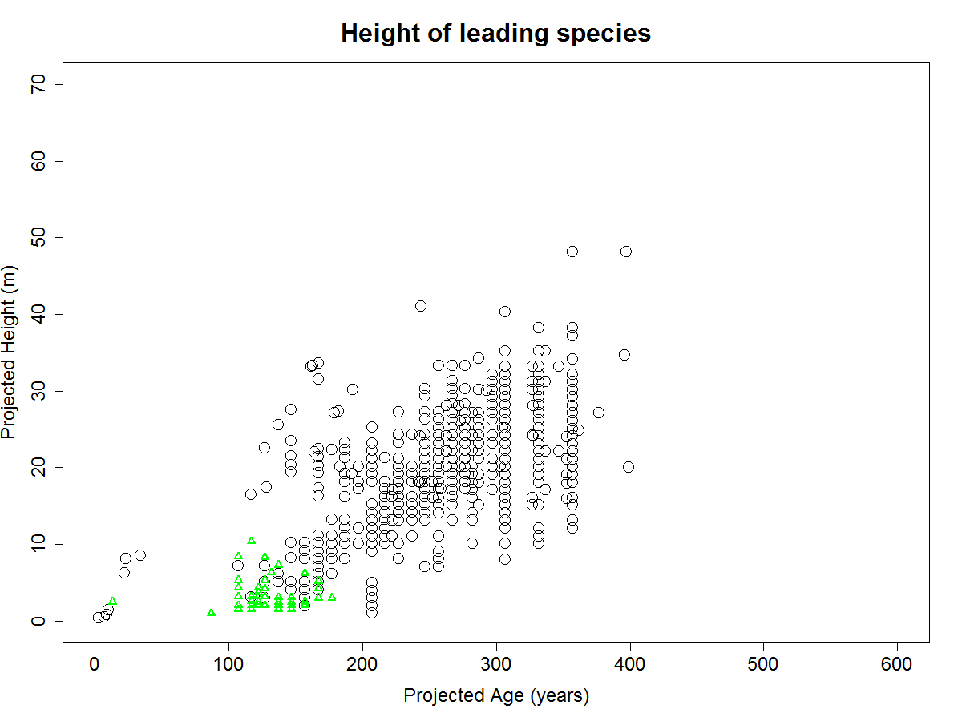
Graphs in R

Slide 10
Graphs in R
Scatter plots:
# plot subset: alternatevely
# separating data by species
d1<- subset(vri_data, (SPECIES_CD_1 =='CW'))
d2<- subset(vri_data, (SPECIES_CD_1 =='PLC'))
# define elements
plot(d1[,row1],d1[,row2], type = "p", pch = 1, col = "black", main="Height of leading species", ylim=ylm, xlim=xlm, cex=ldcex, cex.lab=cxlb, cex.axis=cxaxis, cex.main=maincx, xlab=xlabel, lab=ylabel)
points(d2[,row1],d2[,row2], type = "p", pch = 2, col = “blue", lwd=ld)

Slide 11
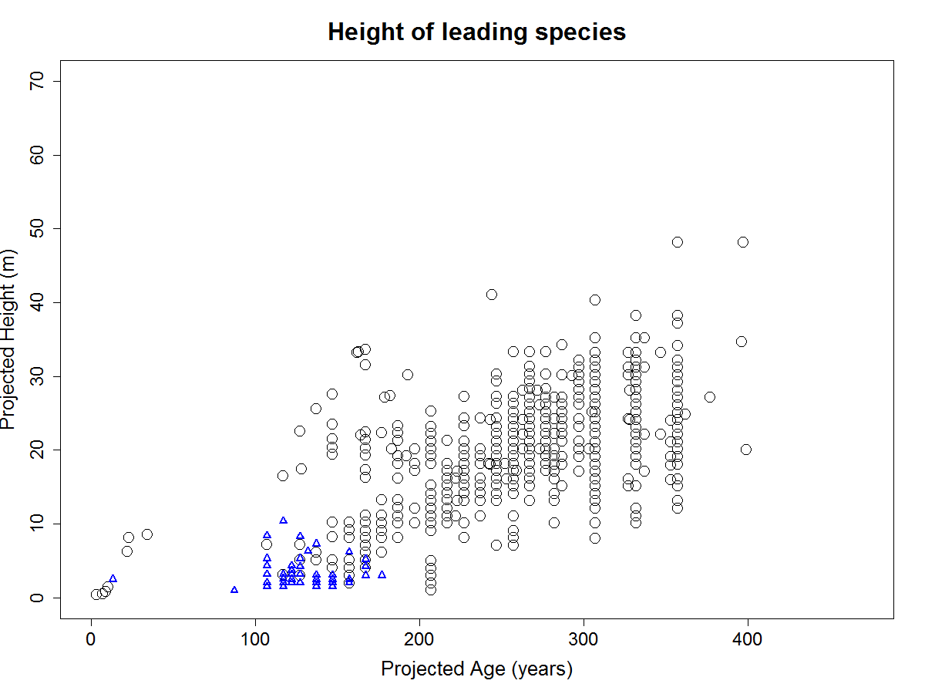
Graphs in R

Slide 12
Graphs in R
Scatter plots:
Points() command will act on the drawn plot and will not change limits to fit the data. You can reset the limits of x and y axes to fit all data points. For instance let’s reset ylim to 0 and 50 meters and xlim to 0 and 400 years and then add data points for lodgepole pine

Slide 13
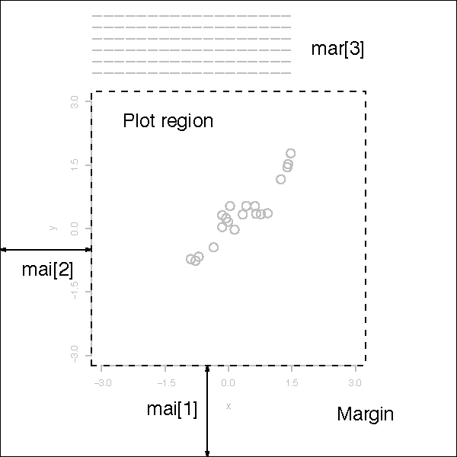
Graphs in R
Set margins

Slide 14
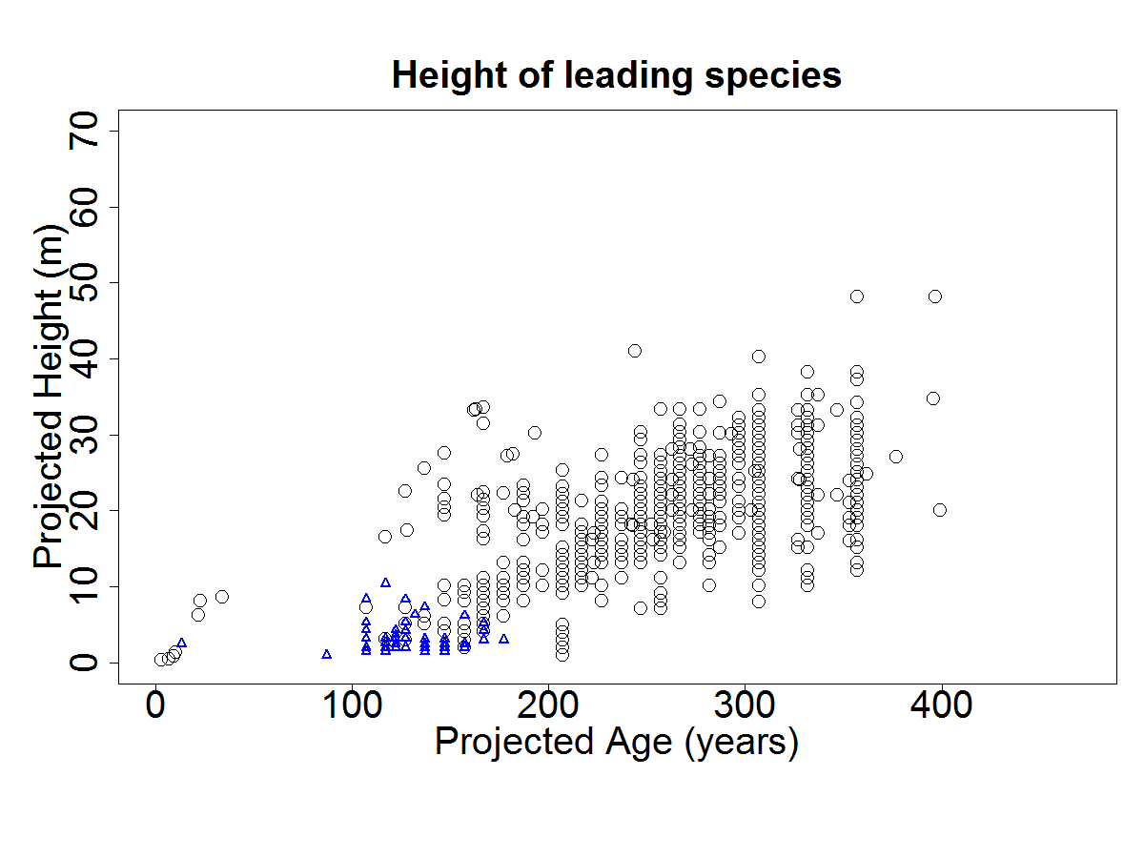
Graphs in R
Changed margins

Slide 15
Graphs in R
Set margins
par(mfrow=c(1,1),mai=c(0.9,0.9,0.8,0.3), cex=1.0 )
mai: a numerical vector of the form c(bottom, left, top, right) which gives the margin size specified in inches.

