Slide 1
FRST 232 Computer Applications in Forestry
Microsoft Excel Data Management and More Tools

Slide 2
Microsoft Excel: Overview
Become familiar with charts and graphs
Calculate: frequency and find random numbers
Eliminating duplicates
Perform debugging and tracing on formulas
Understand Excel limitations

Slide 3
Microsoft Excel
Excel Graphs
Frequency
Random number Generation

Slide 4
Microsoft Excel
Scatter Plots
Insert> Scatter Plot
Add/modify styles
Add elements

Slide 5
Microsoft Excel
Select The Right Chart
Excel has a number of different chart types available but these are not all equally effective in depicting the objective and data type.
A line chart - probably the best type for showing a trend.
Click on a chart you will see some new tabs.
Click on a bar graph and keep the curser on a bar to find the value.

Slide 6
Microsoft Excel
Eliminating Duplicates Data
Data ➔ Remove Duplicates
Write logical functions

Slide 7
Microsoft Excel
Eliminating Duplicates Data
Data ➔ Remove Duplicates
Write logical functions:
- Simply enter the formula
- write the formula then select the formula & Ctrl+Shift+Enter
Examples:
=IF(AND(E2=E3,F2=F3, G2=G3), "dup","unique")
=IF(AND(E3:G3=E6:G6), "dup","unique")+Ctrl+Shift+Enter
Notes:
Use formula cells and re-use

Slide 8
Microsoft Excel
Data Management
Import the data
Sort the data
Identify cleaning steps
Remove duplicates and identify variables to clean
Notes:
Cleaning steps: remove sheets, rows and columns.
Use climate data

Slide 9
Microsoft Excel
Data Management
Identify size/row numbers used in the data
→ Ctrl+End: no data below the identified row.
→ Go back to the first row: Ctrl+Home
Move around the data:
→ Ctrl+A: select All active cells
→ Ctrl+period (.): moves to all corners

Slide 10
Microsoft Excel
Data Management
Identify missing values
→ Filter
→ Sorting
→ Logical function

Slide 11
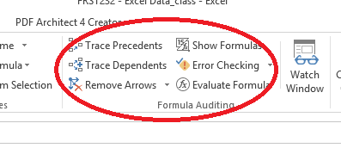
Microsoft Excel
Tracing formulas
Tracing means to work backwards to understand how the formulas are constructed.
You may need to trace certain formulas (especially complex ones) to understand or vet them especially if you have taken over someone else’s work.
Notes:
Use previous excel example file “Example_data_added_formulas”

Slide 12
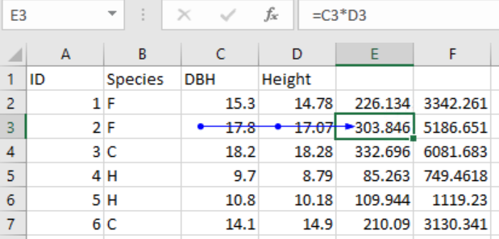
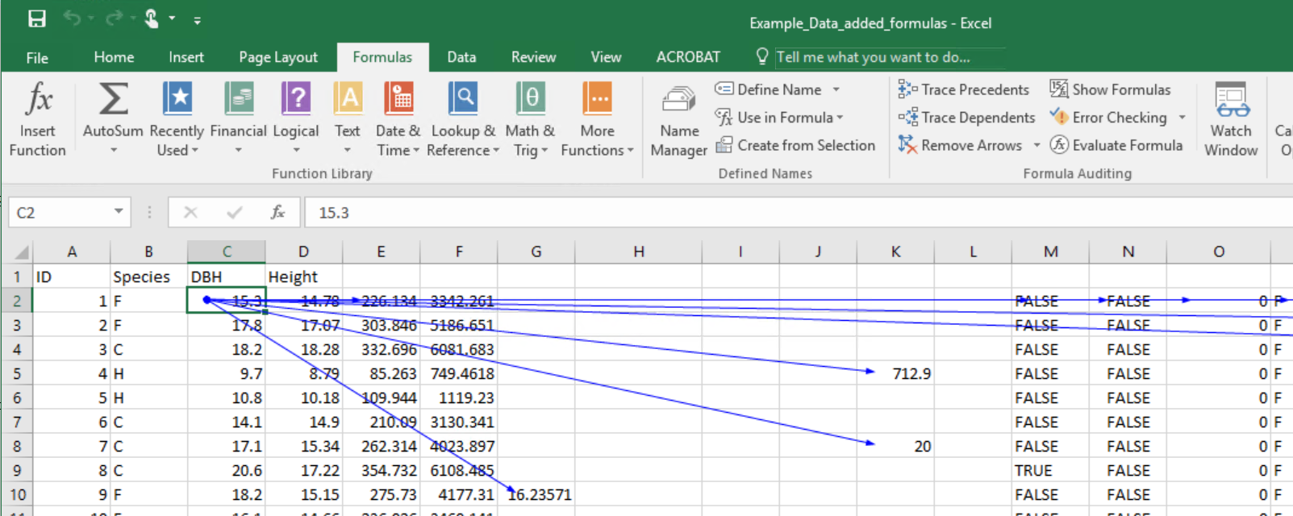
Microsoft Excel
Tracing formulas
Trace precedents:
To see what ranges/cells
have been used.
Trace dependents:
To see what ranges/cells
have used this cell

Slide 13
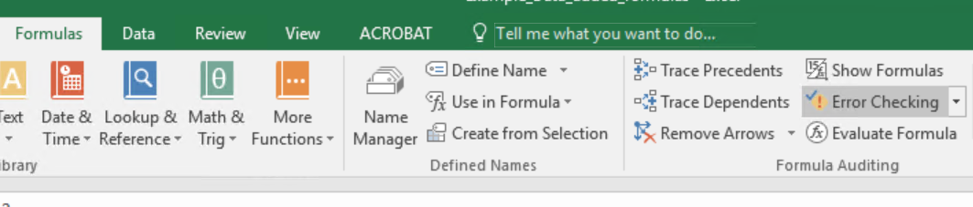
Microsoft Excel
Tracing formulas
Trace remove these arrows created by trace dependents and precedents

Slide 14
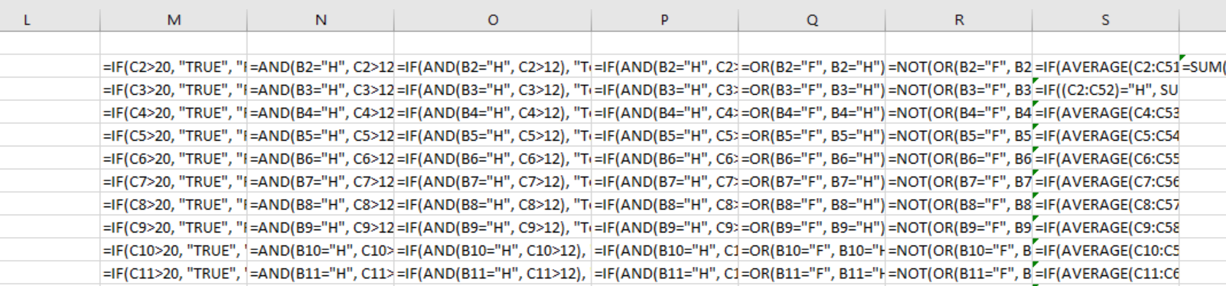
Microsoft Excel
Tracing formulas
Show formulas
Will replace the values with formulas in cells that have formulas.
Good way to visualize the spreadsheet structure and trace formulas.

Slide 15
Microsoft Excel
Tracing formulas
Evaluate Formula:
Evaluates formula arguments one by one. Useful especially for the nested formulas.
Be aware that it will replace the reference to ranges with an array representation of the range. So it can get messy pretty quickly.
The current calculation step will be underlined.
Step In will expand the current calculation for you.
Evaluate will do the calculations one step at a time

Slide 16
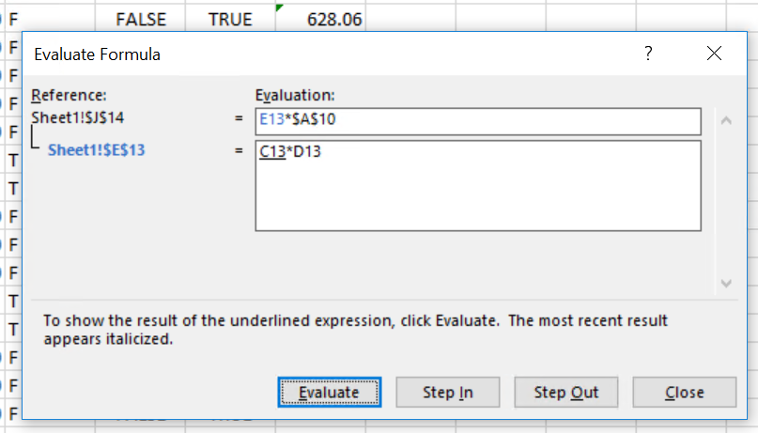
Microsoft Excel
Tracing formulas
Evaluate Formula:

Slide 17
Microsoft Excel
Excel Limitations
Working with very large datasets:
Each spreadsheet holds a finite number of rows and columns
Even before reaching the spreadsheet limits, large datasets become very large and slow to work with especially if you have used a lot of formulas and multiple sheets.
Excel is not the best tool for working with relational datasets. Especially lookup formulas are not very efficient. In other terms, Excel is not a good tool to use in place of database management systems.

Slide 18
Microsoft Excel
Excel Limitations
Working with very large datasets:
Excel by default re-calculates formulas of all cells in all worksheets. That means that if are working with a large workbook, every time you change a formula or value in a cell, Excel will try to recalculate the whole thing.

Slide 19
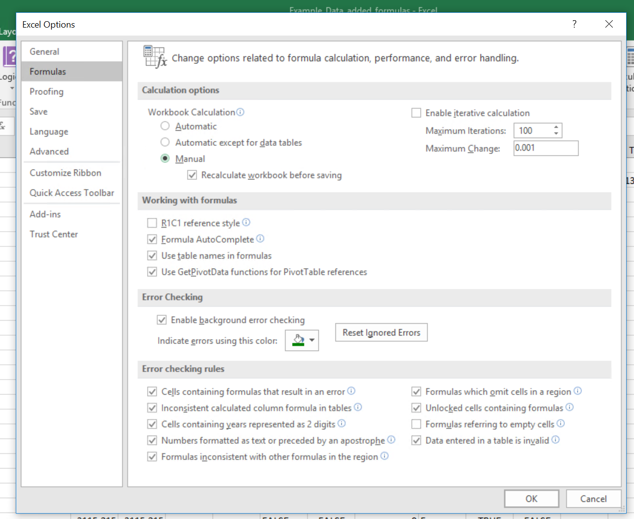
Microsoft Excel
Excel Limitations
Working with very large datasets:
Trick: Make formula re-calculation
manual and/or every time you save
the workbook. This will prevent
Excel from recalculating.
File ➔ Options ➔ Formulas ➔ Calculation Options ➔ Manual
Notes:
By selecting manual it will save while saving.
Usually it recalculate right away.

