Slide 1
FRST 232 Computer Applications in Forestry
Microsoft Excel

Slide 2
Microsoft Excel: Overview
Microsoft Excel Basics
Handling Data
Write formulas, syntax and structure data in Excel
Become familiar with basic math, logical, information, text, statistical formulas
Some advance formulas

Slide 3
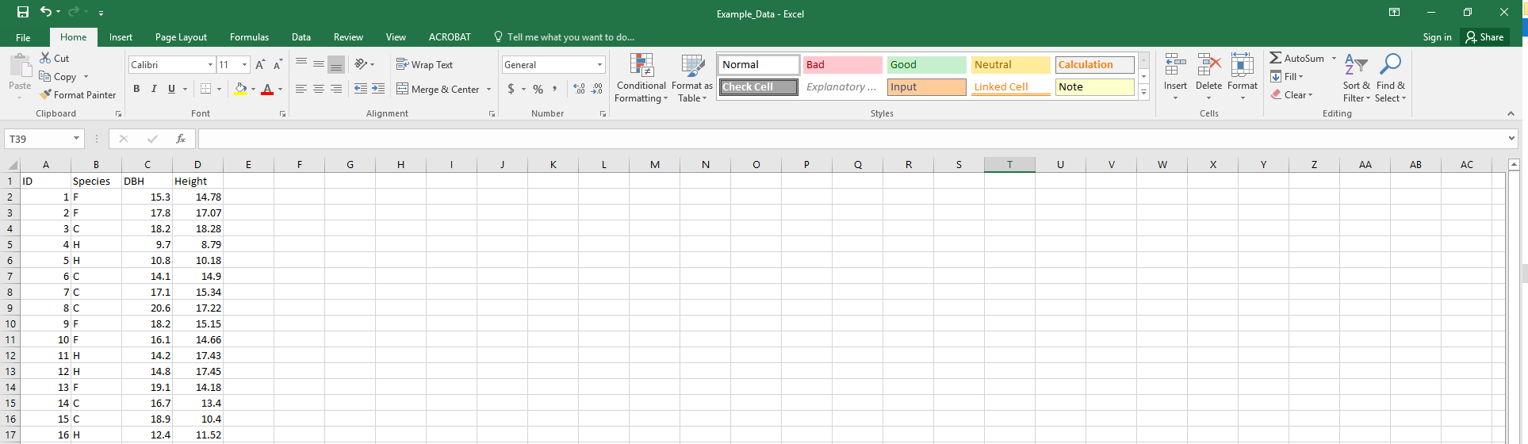
Microsoft Excel
A spreadsheet document displays and stores data in rows and columns.
Spreadsheets allow us to easily arrange and manipulate data (mostly numerical data).
Notes:
Cell, row, column,
Spreadsheet is a computerized ledger
Divided into rows and columns
Columns identified with alphabetic headings
Rows identified with numeric headings
Cell references
Constants--entries that do not change
Formulas--combination of constants and functions

Slide 4
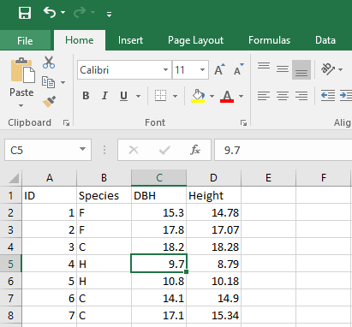
Microsoft Excel
Name Box
Selected Cell
Columns identified with alphabetic headings
Rows identified with numeric headings
Cell references
Notes:
The name of a cell is a combination of the Letter Of The Column that the cell is in followed by the Number Of The Row that the cell is in.
Example: the selected cell in the picture is named C5 (NOT 5C)
Excel automatically shows the the name of the currently selected cell in the “name box” (located above the worksheet).

Slide 5

Microsoft Excel: Excel Vs. Word
In Word, you can find the ribbon and the quick access toolbar. The Ribbon has tabs that are organized in groups.
Excel also has the Worksheet Area (rows and columns resulting in cells) and the Formula Bar that displays the address of the current cell along with the contents of that cell.

Slide 6
Useful Links
Spreadsheet: https://www.computerhope.com/jargon/s/spreadsheet.htm
Ribbon: https://support.office.com/en-us/article/Video-Introduction-to-the-ribbon-in-Excel-2010-751dfd81-afbe-4451-9594-45e726a0403a

Slide 7
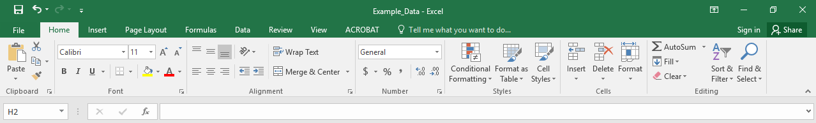
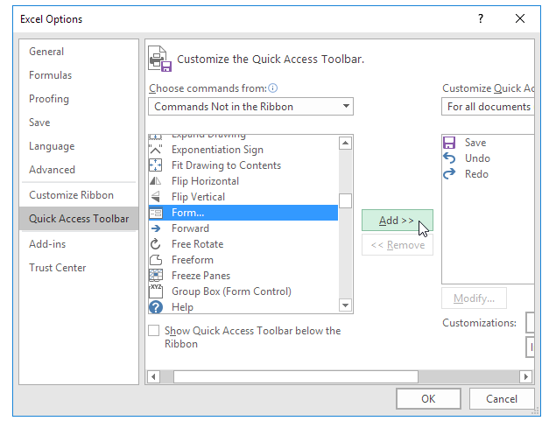
Microsoft Excel
Ribbon:
Quick access toolbar:
Right click on the ribbon
Add/remove commands

Slide 8
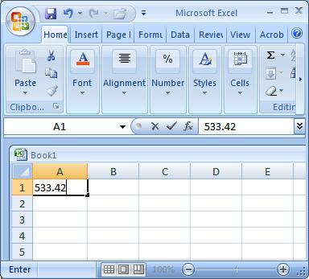
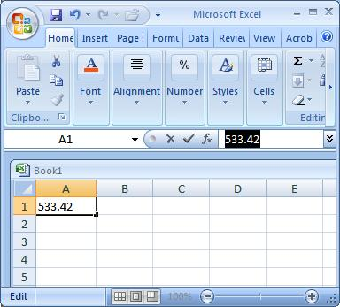
Data
Data is the plural of datum, and datum is a piece of information. Data is information that we collect on subjects or items.
Data Entry: manual→
in the formula or in a cell
Considered as text: Beginning with a letter of and are automatically
left-aligned in the cells.
Notes:
What is data and what do we do with data? Data is the plural of datum, and datum is a piece of information. Therefore, data is information that we collect. We typically collect data on subjects or items. Once data is collected, we can analyze and summarize it. Typically we enter data into spreadsheets and save it in data files. In forestry, we like to collect information on trees. Trees are our study elements or subjects. Imagine you own a small piece of land which has 50 trees on it. You collect the following information about each tree: 1) identification number, 2) species, 3) crown class, 4) number of neighbouring trees (within 5m radius), 5) diameter at breast height (cm), and 6) tree height (m). These 6 characteristics are referred to as variables, because they take on different values from tree to tree. The set of 6 variables collected for a tree is referred to as observation.
Variables can be qualitative or quantitative. Qualitative variables are also called categorical variables, because they place elements into distinct categories. In the example above, species and crown class are categorical variables. Quantitative variables are numeric. We distinguish between discrete and continuous variables. Discrete variables only take on whole values (e.g., identification number, number of neighbouring trees). Continuous variables can take on any possible values (e,g,, diameter at breast height or tree height).
What do we do with the data? We typically analyze the data that we collected. For example, we create graphical displays or we calculate statistics. The types of graphs we can create and analyses we can perform depends on the measurement scale of our measured variables. Four common scales are used: nominal, ordinal, interval, ratio. Nominal data can be both quantitative and qualitative, but we cannot perform any kind of calculations with it. We only use nominal scales to classify or identify items (e.g, identification number, species). The ordinal scale is similar to the nominal scale. It also classifies items, however, the order of the categories typically has a meaning (e.g., crown class, decay class, letter grades). The interval scale is always quantitative and differences between values are meaningful. A zero value on the interval scale is not equal to an absence of measurement. The standard example of a variable measured on the interval scale is temperature. 0 degrees Fahrenheit does not mean that there is no temperature. A difference between 10 and 20 degrees Celsius does not mean that it is twice as warm on the day with 20 degrees, however, the difference is meaningful. The ratio scale is similar to the interval scale in that it is always quantitative. However, a value of zero always means ‘none.’ Examples are tree height, tree diameter, weight, and distance. You can perform all arithmetic operations on variables that were measured on the interval scale. (This section mainly followed Chapter 1 in “Introductory Probability & Statistics. Applications for Forestry & Natural Sciences” by Kozak et al. (2013)).
Directly type data (both numbers and text) into the cells of the worksheet.
You must first select the cell where you want to enter data, then type in the data.
If the cell already contains data, you will replace the original entry with your new entry. The data entry in a cell must be completed by clicking the check mark in the Formula Bar, pressing the Enter key, or clicking on a new cell.
Excel Data Entry Shortcut Keys.
Data entries beginning with a letter of the alphabet or a punctuation mark, entries that mix letters and numbers are considered text and are automatically left-aligned in the cells.
Numbers are automatically right-aligned in their cells.
Numbers can be displayed as percentages, dates, currency by applying different number formats^{C}.
Numeric entries can be divided into three categories: 1) Numbers that you enter directly into a cell, 2) date and time numbers that are directly entered but automatically displayed by default Date & Time formats, and 3) Numbers calculated by formulas that you build yourself.
Another way to get data into Excel is to open data files in Excel. These could either come as Excel files (.xlsx) or other formats such as tab delimited text files (.txt) or comma separated value files (.csv). When you read data files that are not saved as Excel worksheets, Excel needs a bit of help from you and opens the Import Text Wizard^{C}. In this week’s assignment you will have the opportunity to practice this.

Slide 9
Data Entry
Numeric entries can be divided into three categories:
Numbers that you enter directly into a cell.
Date and time numbers that are directly entered but automatically displayed by default Date & Time formats.
Numbers calculated by formulas that you build yourself.

Slide 10
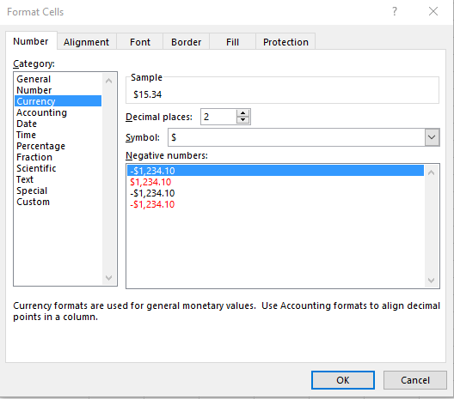
Data Entry: display
Numbers can be displayed as percentages, dates, currency by applying different number formats.
Use “Format Cells”

Slide 11
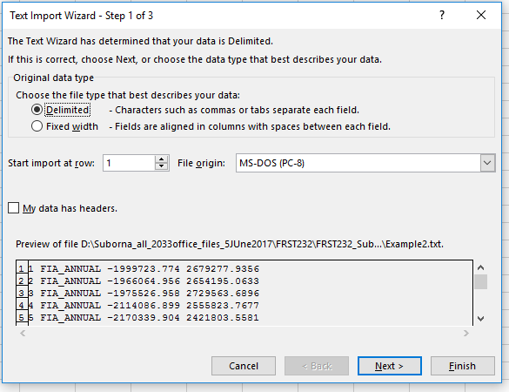
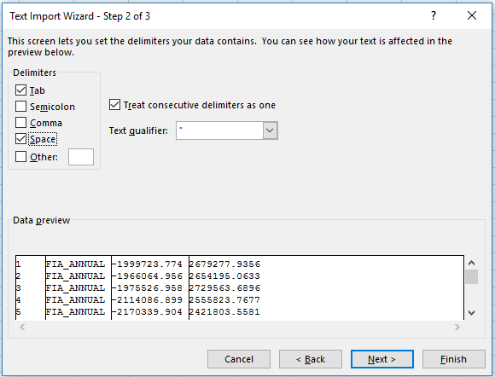
Data import in to Excel
Open Excel files: Excel files (.xlsx) or previous Excel versions, other formats such as tab delimited text files (.txt) or comma separated value files (.csv).
Data files that are not saved as Excel worksheets: Excel needs a bit of help from you and opens the Import Text Wizard by following your selected steps.

Slide 12
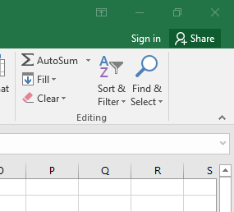
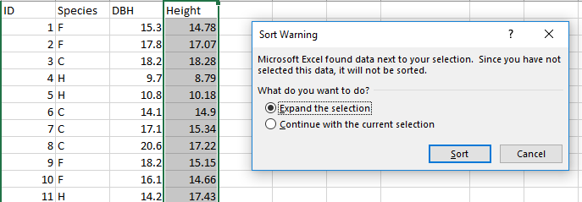
Sorting
Single:
One column only →

Slide 13
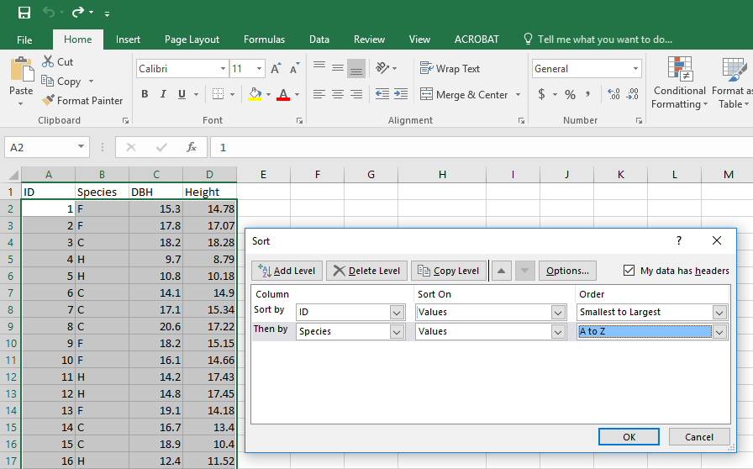
Sorting
Multiple: sort based on values of more than one column (nested/hierarchy): Data (row & column) ➔ Sort & Filter : In the dialogue box, select sort…

Slide 14
Useful Pieces: Organization
Column headings
Format header (color, bold, and width)
Pane first row/Column
Hide columns
Group columns
Hyperlink first row to data dictionary
Apply filter to first row
Notes:
Column headings: “Format as Table” or “Cell Style”
Format header (color, bold, and width): Home> Format>Column width
Pane first row/Column: search for “pane” or go to “View” > “Freeze Panes”
Hide columns : right click > hide
Group columns : group columns or rows and automatically create an outline. Go to “Data”> “Group”. Can ungroup
Create a table in another sheet for data dictionary.
Hyperlink first row to data dictionary: in the data dictionary link variable, column or table or file : go to : “Insert” > “Hyperlink”
Apply filter to first row

Slide 15
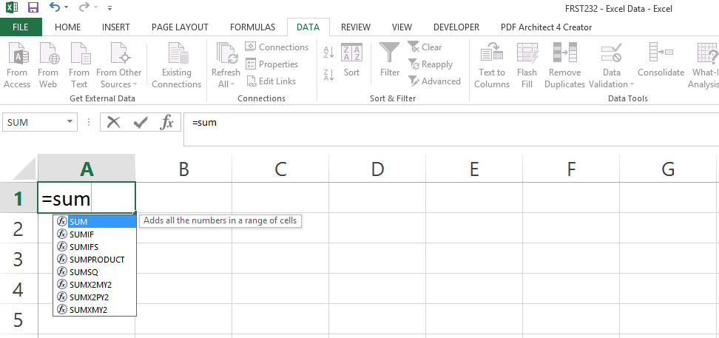
Creating formulas
Formulas are used to calculate the value of the cell based on values of other cells, ranges, etc.
Formulas start with “=“ and have specific Excel readable syntaxes.
Equality sign
Formula box
List of suggested formulas

Slide 16
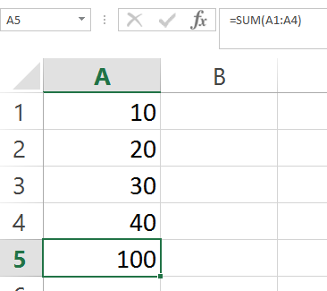
Creating formulas
Once formulas are entered, the cell will show the calculated value
Formula arguments are put in parenthesis
Reference to Cells:
E.g. summation formula
SUM(sum range)
“:” shows range
A1:A4 means all cells in
Column A from
Row 1 to Row 4
Formula box
A10
row
column
Arguments in parenthesis
Calculated value

Slide 17
Creating formulas
You build formulas by using simple arithmetical operators in conjunction with Excel’s built-in functions.
The simple arithmetical operators are pretty standard: Addition (+), Subtraction or Negation (-), Multiplication (*), Division (/), Exponentiation (^).
Math functions that we may use in some of the assignments are EXP(), POWER(), PI(), LN(), and SQRT().
Notes:
You can find more details about these functions hereC. Do not worry about any of the other functions listed. Over the past few years, I have found that students typically struggle with formula entry because they do not remember some of the basic math they learned in school. Unit conversions, area calculations, and volume calculations of basic geometric shapes (e.g., volume of a cylinder) will always come up. You may want to review some of these things.
PI()=3.14

Slide 18
Creating formulas: useful links
Order of operations:
https://www.mathsisfun.com/definitions/order-of-operations.html
Excel follows standard orders of mathematical operations (e.g., multiplication is performed before addition).
Excel math function list:
http://www.excelfunctions.net/Excel-Math-Functions.html
Notes:
You can find more details about these functions hereC. Do not worry about any of the other functions listed. Over the past few years, I have found that students typically struggle with formula entry because they do not remember some of the basic math they learned in school. Unit conversions, area calculations, and volume calculations of basic geometric shapes (e.g., volume of a cylinder) will always come up. You may want to review some of these things.

Slide 19
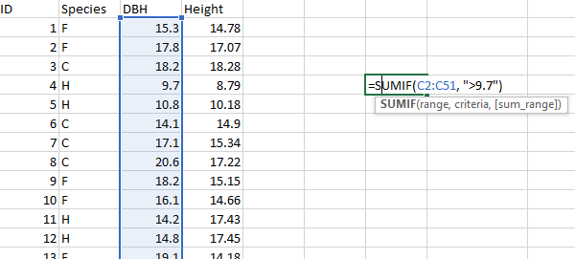
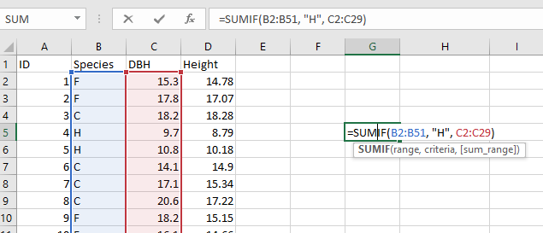
Creating formulas
SUMIF(S): Used to aggregate values in a column based on conditions on other column(s).
For instance add value of all DBH that are species “H”
Syntax:
=sumif(condition range, condition, sum range)
Notes:
SUMIF(range, criteria, [sum_range])
The SUMIF function syntax has the following arguments:
range Required. The range of cells that you want evaluated by criteria. Cells in each range must be numbers or names, arrays, or references that contain numbers. Blank and text values are ignored. The selected range may contain dates in standard Excel format (examples below).
criteria Required. The criteria in the form of a number, expression, a cell reference, text, or a function that defines which cells will be added. For example, criteria can be expressed as 32, ">32", B5, "32", "apples", or TODAY().
IMPORTANT: Any text criteria or any criteria that includes logical or mathematical symbols must be enclosed in double quotation marks ("). If the criteria is numeric, double quotation marks are not required.
sum_range Optional. The actual cells to add, if you want to add cells other than those specified in the range argument. If the sum_range argument is omitted, Excel adds the cells that are specified in the range argument (the same cells to which the criteria is applied).
You can use the wildcard characters—the question mark (?) and asterisk (*)—as the criteria argument. A question mark matches any single character; an asterisk matches any sequence of characters. If you want to find an actual question mark or asterisk, type a tilde (~) preceding the character.

Slide 20
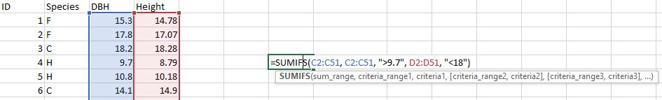
Creating formulas
SUMIFS function: one of the math and trig functions, adds all of its arguments that meet multiple criteria.
Examples:
=SUMIFS(sum_range, criteria_range1, criteria1, [criteria_range2, criteria2], ...)

Slide 21
Creating formulas
Common errors:
Mismatching ranges in sumifs: #VALUE!
- sum and condition range of two different sizes
Condition unreadable: Usually return a wrong value
Useful Link: https://support.office.com/en-us/article/SUMIFS-function-c9e748f5-7ea7-455d-9406-611cebce642b?ui=en-US&rs=en-US&ad=US

Slide 22
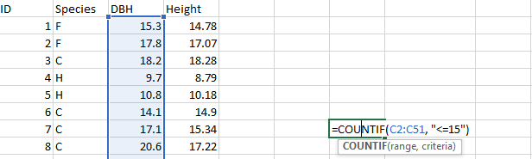
Creating formulas
COUNTIF(S)
Used to count the number of records in a selected range
How many trees have a DBH less than or equal to 15 cm?
Common errors are the same as SUMIF(S)

Slide 23
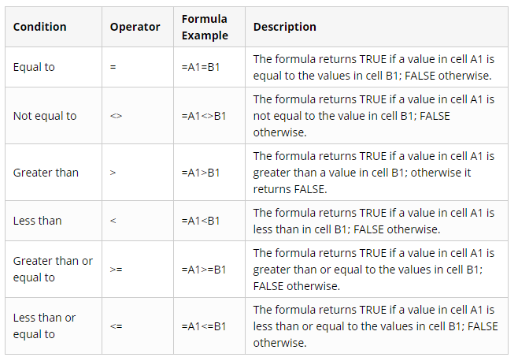
Creating formulas
Condition list:

Slide 24
Statistical Formulas
AVERAGE: Calculates the arithmetic mean (average) of values in a range
Calculates the arithmetic mean (average) of values in a range
What is the average height of all trees?
=AVERAGEIF(B2:B51, "H", C2:C51)
AVERAGEIF(S)
Similar to SUMIF(S) formulas, used when you’d need to average certain records based on other attributed (values in other columns)
What is the average height of trees for the species “H” only. =AVERAGEIF(B2:B51, "H", C2:C51)
Common errors are the same as SUMIF(S)

Slide 25
Statistical Formulas:
AVERAGEIFS | Mean of a set of numbers that meet one or more conditions
HARMEAN | Harmonic mean of a set of positive numbers
GEOMEAN | Geometric mean of a set of positive numbers
MODE.SNGL | Mode of a set of numbers
MEDIAN | Median of a set of numbers
VAR.P | Variance of a set of numbers considered to be a population
VAR.S | Variance of a set of numbers considered to be a sample
STDEV.P | Standard deviation of a set of numbers considered to be a population
STDEV.S | Standard deviation of a set of numbers considered to be a sample
STANDARDIZE | A standard score based on a given mean and standard deviation

Slide 26
Auto-adjusted Formulas:
The power of excel formulas is in auto-adjusting formula arguments when formulas are moved around or copied and pasted in different places.
Making references to cells (ranges) absolute
Adding $ before the column label or row number would make them absolute
This means that if you moved the formula around or copied it elsewhere, the reference to the column or row or both would not change
You can either type the in $ at the appropriate place or press F4 while cursor is on the reference multiple times to choose the desired absolute format
Examples: A10 (not a constant), $A10, A$10, $A$10
Notes:
$A10, A$10, $A$10
all same result . Constant that cell.
Where we add the $ - makes that place fix

Slide 27
Logical Formulas:
IF (Logical test, value if logical test is true, value if wrong)
The IF function can perform a logical test and return one value for a TRUE result, and another for a FALSE result.
Check all trees whether DBH of a tree is greater than 20?
=IF(C2>20, "TRUE", "FALSE")
Notes:
Nested IF statements
You may here the term "Nested IF" or "Nested IF statement". This refers to using more than one IF function so that you can test for more conditions and return more possible results. Each IF statement needs to be carefully "nested" inside another so that the logic is correct.
For example, the following formula can be used to assign an grade rather than a pass / fail result:
=IF(C6<70,"F",IF(C6<75,"D",IF(C6<85,"C",IF(C6<95,"B","A"))))

Slide 28
Logical Formulas
AND (Logical test1, Logical test2, …)
Similar AND formula will return true if all logical tests are true, and it will return false if at least one of the logical tests are false.
Check all trees whether DBH of a tree is greater than 12 and species is “H”?
=AND(B2="H", C2>12)

Slide 29
Logical Formulas
IF combined with AND:
Example: What’s the total height of the species “H” and “DBH>12”?
Step1: test to see whether species “H” and “DBH>12”?
=AND(B2="H", C2>12)
Step 2: if the above condition holds, total height of the true values.
=IF(AND(B2="H", C2>12),"T","F")
Step 3: take the total height where we have “T”

Slide 30
Logical Formulas
OR (Logical test1, Logical test2, …)
OR formula will return true if at least one of the logical tests is true, and it will return false only if all the logical tests are false
Check all trees whether species is ”F” or “H”?
=OR(B2="F", B2="H")
NOT (Logicaltest)
Returns false if logical test is true or true if logical test is false (changes true to false and vise versa)
Check all trees whether a tree is NOT ”F” or “H”?
= NOT(OR(B2="F", B2="H")) opposite of what we found above.

Slide 31
Nested Formulas
Excel allows you to nest up to 64 levels of functions. We create nested functions as part of a conditional formula.
Average of all trees is greater than 10 then find the total height
=IF(AVERAGE(C2:C51)>10, SUM(D2:D51),0)
AVERAGE and SUM functions are nested within the IF function

Slide 32
Lookup Formulas:
Lookup formulas are used to find values of a referenced cell within a larger range.
If the Lookup function can't find the lookup_value, the function matches the largest value in lookup_vector that is less than or equal to lookup_value
If lookup_value is smaller than the smallest value in lookup_vector, Lookup returns the #N/A error value.
At first sort by the lookup value in the column of interest and then write the formula:
=LOOKUP(9.9, C2:C51, D2:D51)
We would get 8.69 as a return value

Slide 33
Lookup Formulas:
VLOOKUP(Lookup value, lookup range, column index, exact or approximate match)
Returns the value found in the column identified by the column index for the record (row) whose first column contains the look up value.
The table must be sorted in an ascending order
when you need to find things in a table or a range by row.
=VLOOKUP(Value you want to look up, range where you want to lookup the value, the column number in the range containing the return value, Exact Match or Approximate Match – indicated as 0/FALSE or 1/TRUE).

Slide 34
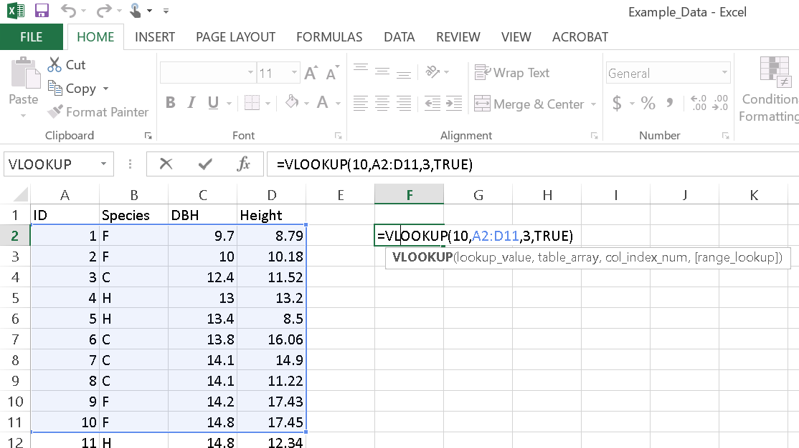
Lookup Formulas:
VLOOKUP(Lookup value, lookup range, column index, exact or approximate match)
=VLOOKUP(Value you want to look up, range where you want to lookup the value, the column number in the range containing the return value, Exact Match or Approximate Match
Notes:
Vlookup: need to list the table by ascending all columns and then delete duplicates.
=VLOOKUP(10,A2:D11,3,TRUE)
ID=10
Table range: A2:D11
3: result from which column
TRUE- approximate
False: exact

Slide 35
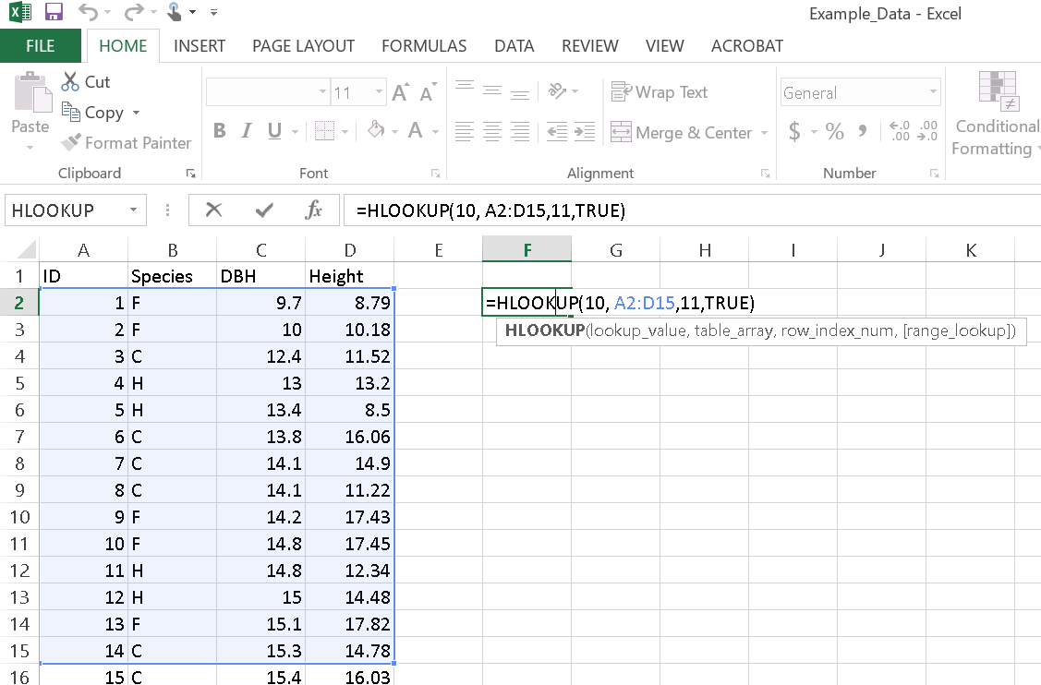
Lookup Formulas:
HLOOKUP(Lookup value, lookup range, row index, exact or approximate match)
Performs the same function as VLOOKUP, only applies it on a row basis
ie finds the value in column whose first row contains the lookup value
=HLOOKUP(10, A2:D15,11,TRUE)
Notes:
Hlookup: need to list the table by ascending all columns and then delete duplicates.
=HLOOKUP(10, A2:D15,11,TRUE
ID=10
Table range: A2:D115
11: result from which row no
TRUE- approximate
False: exact

Slide 36
Lookup Formulas:
Common errors
#REF: When the index value entered (for row or column index) is outside of the range boundary.
For example if you have 20 columns in your range but you enter 21 as your column index in the VLOOKUP formula
#N/A: When the lookup value doesn’t exist in the lookup array.

Slide 37
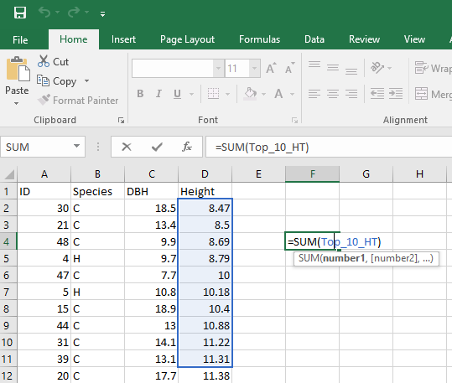
Names: Organizing Ranges
Ranges can be given names in Excel: selected column, rows or table
This helps to simplify referencing the range in formulas by replacing the range reference (e.g. Sheet1!A10:A100) with the name.
Example:
Sum of Top_10_HT = sum the range named “Top_10_HT”.
Give a name of the top height after sorting the column and provide name “Top_10_HT”. Then sum them.
Notes:
When you simply enter formulas by referencing cells, your formulas are extremely hard to understand. One way to avoid messy formulas, is to use names in formulas. Names in formulas not only increase our understanding of formulas, but they make maintaining formulas easier. Names can be defined for a constant, a function, a cell range, or a table. After names are defined, you can updated and manage these names in the Name Manager Dialog Box in the Defined Names group under the FORMULAS tab. Once you know how to use names, you may never want to use formulas without names again. In the Excel assignments in this course, I force you to use names in your formulas. Find out all the details about names in formulas here^{C}. Because I always mess up the first time around, I often have to change or delete already defined names. You may run into the same problem and will find these steps easy to follow: Change and delete defined a name^{C}.

Slide 38
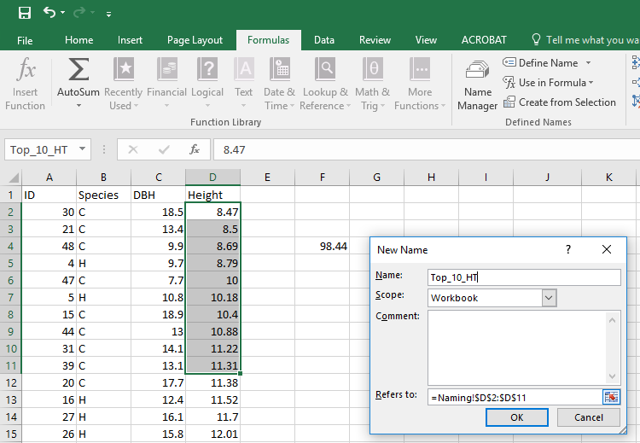
Names: Organizing Ranges
Method 1: Select the range you’d like to assign a name in the name box, type in the name. Shown on the previous slide.
Method 2: Use “Formulas” tab and
then “Define Name”.
Assign a name
Select the range
# Range could be selected earlier or later.

Slide 39
Excel Keyboard Shortcuts:
CTRL+ PgUp or CTRL+ PgDn – switches between worksheet tabs
CTRL+ Shift + ^ – applies scientific number format with two decimal places
CTRL+ A – selects entire worksheet
CTRL + C – copies selected cells
CTRL + D – uses Fill Down command to copy contents and format of the topmost cell of a selected range into the cells below
CTRL + S – saves active file with current file name, location, and file format
CTRL + V – inserts contents of the clipboard at insertion point

Slide 40
Excel Keyboard Shortcuts:
CTRL + X – cuts selected cells
CTRL + Z – uses the Undo command
CTRL + ARROW KEY – moves to the edge of the current data region in a worksheet
Shift + ARROW KEY – extends the selection of cells by one cell
CTRL + SHIFT + ARROW Key – extends the selection of cells to the last nonblank cell in the same column or row as the active cell
You can find some more here:
https://support.office.com/en-us/article/Excel-keyboard-shortcuts-and-function-keys-for-Windows-1798d9d5-842a-42b8-9c99-9b7213f0040f?ui=en-US&rs=en-001&ad=US

