Slide 1
FRST 232 Computer Applications in Forestry
Data Handling in R:
Input & Output

Slide 2
Data Import
Desktop version of R
Keep your data on a folder and keep this .RMD file on the same folder. If these are not kept on the same folder you have wrtie the location path in the code.
RStudio online
Upload the data file and then write the function to use the data file on your program

Slide 3
Data Import
If the data files are not on the folder then locate the data and add path.
Set the directory: setwd("D:\\Week10-12")
Import .CSV file:
alldat = read.csv("trees.csv", header = TRUE)
Import .xlsx file:
t11 <- read_excel("D:/Week10-12/trees.xlsx")
Import .txt file:
HDB<-read.table("D:/Week10-12/ht_dbh.txt", header = TRUE)

Slide 4
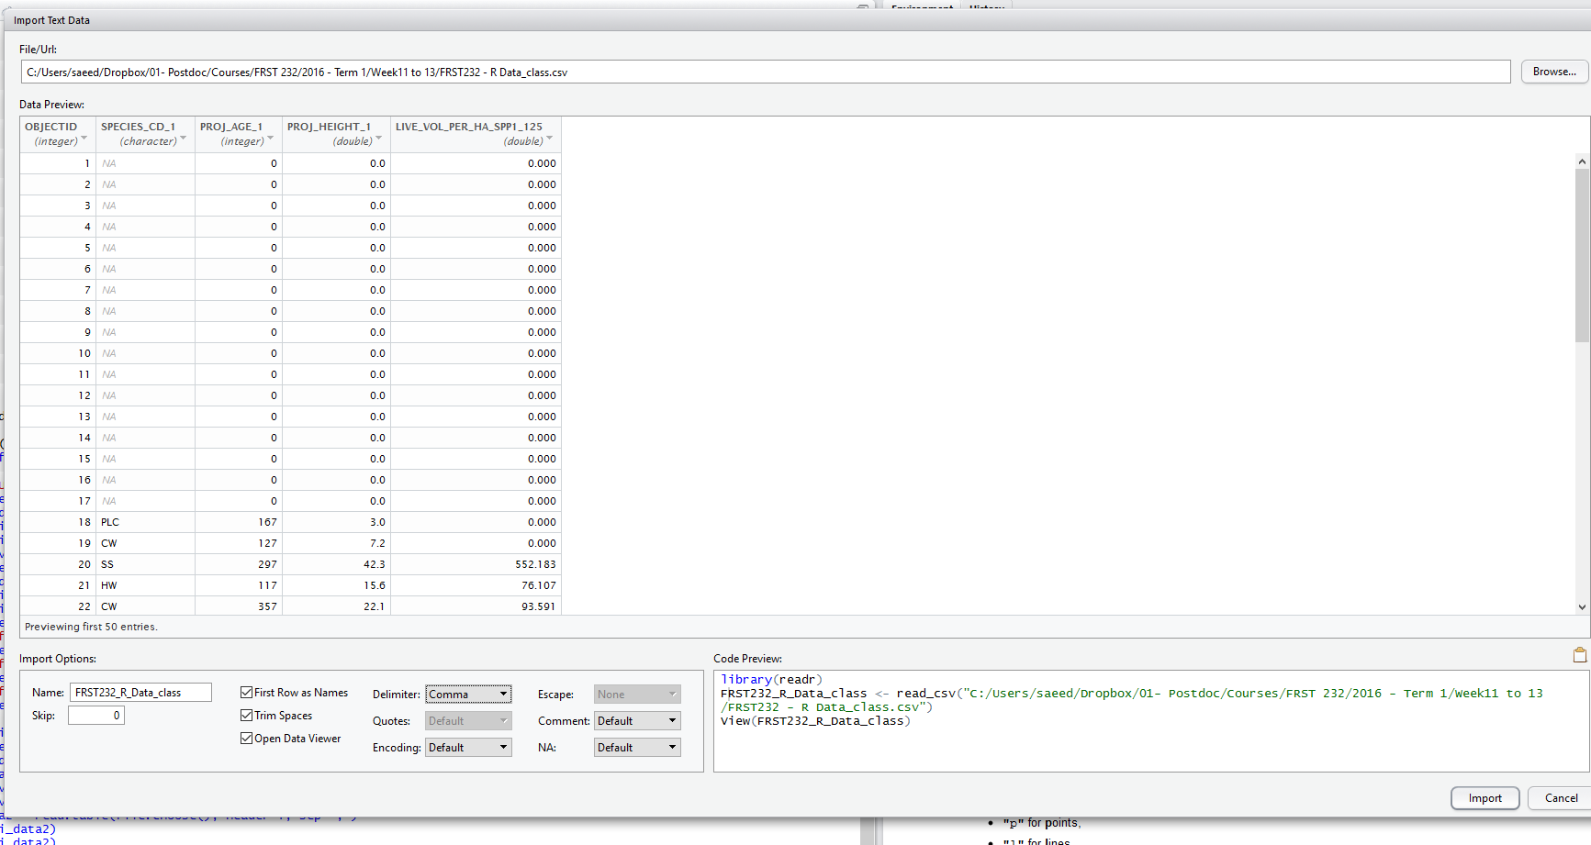
Data Import
You can import data in RStudio using the menu option: import Dataset
➔ File ➔ Import Dataset ➔ choose type of data
If you are developing a script, most likely you will need to import the using the read commands. The menu options also produce the code for you which you can use and copy into your script
code
Object name

Slide 5
Data Export
To A Tab Delimited Text File:
write.table(mydata, "c:/mydata.txt", sep="\t")
If you are keeping the data on the same folder then you do not need to rite the path.
To A .CSVFile:
write.table(HDB, file = "f1.csv", sep = ",", col.names = NA, qmethod = "double")

Slide 6
Data selection and variable information
You can view the dimension of the data you just imported by dim() command, or view it in the Environment window in RStudio.
> dim(vri_data)
> [1] 2700 6
Sometimes you may just view the very first, or last, few records to ensure your data is correct. You can achieve this by head() or tail() commands:
head(object): will show the first 6 records with heading (if available)
> head(vri_data)
OBJECTID SPECIES_CD_1 PROJ_AGE_1 PROJ_HEIGHT_1 LIVE_VOL_PER_HA_SPP1_125
1 1 0 0 0
2 2 0 0 0
3 3 0 0 0
4 4 0 0 0
5 5 0 0 0
6 6 0 0 0
tail(object): will show the last 6 records with heading (if available)
> tail(vri_data) what does this command show?

Slide 7
Data selection and variable information
Imported data into an object is essentially a matrix, therefore, we can ask for specific elements:
e.g.: Returning rows 10 to 13
> vri_data[10:13, ] #you remember that leaving column index blank would return all columns, right?
OBJECTID SPECIES_CD_1 PROJ_AGE_1 PROJ_HEIGHT_1 LIVE_VOL_PER_HA_SPP1_125
10 10 0 0 0
11 11 0 0 0
12 12 0 0 0
13 13 0 0 0
Or e.g.: Returning rows 10, 20, 23
> vri_data[c(10,20,23), ] #you remember c() command, right?
We can check the variable names in the imported data (column headers) using the names() command
> e.g. names(vri_data)
[1] "OBJECTID" "SPECIES_CD_1" "PROJ_AGE_1" "PROJ_HEIGHT_1"
[5] "LIVE_VOL_PER_HA_SPP1_125"

Slide 8
Working with data in R
We can call data columns by their names.
Here we’ll see how we can activate mean() function on data. We will learn more about data summary functions such as mean() later.
Mean() calculates arithmetic average of a vector.
eg: > x <-1:5
> mean(x)
> [1] 3
Let’s calculate mean of projected age of leading species in our data set:
> mean(PROJ_AGE_1)
Would this return result?

Slide 9
Working with data in R
In order to refer to a column in the dataset using column name, we have 2 methods:
$: including $ between name of dataset and column name
> e.g. mean(vri_data$PROJ_AGE_1)
[1] 230.6289
attach(): using the attach command we can store data vector-wise into R memory and refer to columns using their names.
> attach(data name) > e.g. attach(vri_data)
Now we can refer to columns in the imported data using just their names (without the $)

Slide 10
Working with data in R
We can ask the object type using class(object) function:
eg. > class(SPECIES_CD_1)
[1] “character”
> class(PROJ_AGE_1)
[1] “integer”
> class(PROJ_HEIGHT_1)
[1] “numeric”

Slide 11
Working with data in R
You can also ask R for a summary of data as R sees relevant for each class of objects using the summary(data) object:
eg > summary(vri_data)
… what does console show?
In some cases you may need to assign summary of data to an object for reuse. Summary data will be stored in a table object:
eg assigning summary to variable x: > x<- summary(vri_data)
Data and table objects are essentially like matrices in R. So we can refer to elements of data and table the same way we referred to matrix elements… Try a few examples from vri_data and summary object
eg > vri_data[10:15,]
eg > x[,1]

Slide 12
Working with data in R
In the VRI dataset, notice that SPECIES_CD_1 is a “character” class.
> class(SPECIES_CD_1) #note that this will only run if you have already attached vri_data
Usually in statistical analysis, we deal with fields of categorical data, which means that records can only be assigned one of the possible categories.
If R has not recognized a data as a categorical (called “factor” in R), we could manually set fields to factors in R using as.factor(field’s name) command.
eg setting SPECIES_CD_1 as a categorical data:
> as.factor(SPECIES_CD_1)

Slide 13
Working with data in R
On categorical fields (factor) data summary will return frequency of occurrence of each category. For instance, running summary of SPECIES_CD_1 will return frequency of each species type under:
> summary(SPECIES_CD_1)
CW DR HW PLC SS YC
59 1136 19 970 182 218 116
We could ask R for the levels of factor data using levels() command:
> levels (SPECIES_CD_1)
[1] "" "CW" "DR" "HW" "PLC" "SS" "YC"

Slide 14
Working with data in R
Logical Operators
Logical operators are very useful for subsetting vectors in a dataset.
• The usual arithemtic operators return logicals >, <, >=, <=, ==, and ! =
• Work element-wise on the two inputs.
Operator | Description
< | less than
<= | less than or equal to
> | greater than
>= | greater than or equal to
== | exactly equal to
!= | not equal to
!x | Not x
x | y | x OR y
x & y | x AND y
https://www.statmethods.net/management/operators.html

Slide 15
Working with data in R
Character Vectors
> y <- c("a", "bc", "def")
> length(y)
[1] 3
> nchar(y) # number of characters
[1] 1 2 3
> y == "a"
[1] TRUE FALSE FALSE
> y == "b"
[1] FALSE FALSE FALSE

Slide 16
Working with data in R
Logical Operators
x <- c(3, 7, 1, 2)
x > 2
[1] TRUE TRUE FALSE FALSE
x == 2
[1] FALSE FALSE FALSE TRUE
> !(x < 3) # x not equal to less than 3
[1] TRUE TRUE FALSE FALSE
> which(x > 2)
[1] 1 2

Slide 17
Working with data in R
Factor vs. Vector
Example - a family of two girls (1) and four boys (0),
> kids <- factor(c(1,0,1,0,0,0), levels = c(0, 1), labels = c("boy", "girl"))
>kids
[1] girl boy girl boy boy boy
Levels: boy girl
>class(kids)
[1] "factor"
> mode(kids) # Get or set the type or storage mode of an object
[1] "numeric"

Slide 18
Working with data in R
We could store a subset of the data in another object. Please note that we need to set character fields to factor since this command runs for factor data (or fields) and not character. For instance let’s store a subset of vri_data that only contains stands with lodgepole pine (plc)
> plc_stands <- subset(vri_data, SPECIES_CD_1=="PLC" )
== (double equality sign) is a condition checking expression (equal to) and is not an assignment.
We could subset our data with multiple simultaneous conditions, for instance, let’s store a subset of data with lodgepole pine (PLC) whose age is greater than 100 years:
> sub_vri = subset(vri_data, SPECIES_CD_1=="PLC" & PROJ_AGE_1 > 100)
> dim(sub_vri)
[1] 180 5

