Slide 1
FRST 232 Computer Applications in Forestry
R and RStudio Basics & Installation Process

Slide 2
R Studio Basics & R

Slide 3
Install R and Rstudio
Installation process is very similar for Mac, Windows, or Linux
You should install R before installing Rstudio
To run R, first you need to load the software. Generally, to load the software, you can go to R website directly. There are instructions for downloading software on the site for Windows as the operating system. The process is similar for other operating systems.

Slide 4
Install R and Rstudio
First, you will need to find a Cran near to your location, for faster service. A list of these can be found on the R website. This loads the standard package, with a number of libraries.
Here are the steps you would follow:
1. Go to the R website: http://www.r-project.org/
2. Select CRAN, which is under Download, on the left hand side of the screen
3. From the list (centre and right side of the screen), select the closest location [Canada, BC, Simon Fraser University]
4. Then, select the box at the top and centre of the screen labelled Download and Install R, and select Windows (or for Mac)

Slide 5
Install R and Rstudio
6. Under Subdirectories, select Base
7. Select Download 3.4.2 for windows [or whatever the latest version of R is] (or for Mac)
8. You will be asked if you want to run or to save this file. If you are ready to install the package, click on Run.
9. You will then be prompted for where you wish to save the file (pick a simple path on your computer e.g. C:/R ). Use the default settings.
When you are done, there should be the R icon on your desktop and R should be ready for your use.
Run installer and install R (accepting default selections should work for most cases)

Slide 6
Install R and Rstudio
Now that you have R, go ahead and install RStudio from www.rstudio.com
Click on download: download Rstudio Desktop. please note that personal use (license) is free➔ choose download link base on your operating system
Download and run installer
Note that RStudio will (should) automatically link with R you downloaded in the previous step.
Now let’s compare R and RStudio
Which one do you prefer to use?

Slide 7
Install R and Rstudio
You can now extend R’s functionality by adding new packages
Packages, as mentioned, are add-ons for new statistical methods, data structures, plots, etc
Packages are often created by individuals such as yourselves (well, if you are well versed in programming and statistics of course)
Currently more than 5,000 packages (and counting) are available.
In order to install packages you need to run install.packages() command:
> install.packages(“package name”)
Remember to put package name inside “”
Notes:
install.packages("ggplot2")

Slide 8
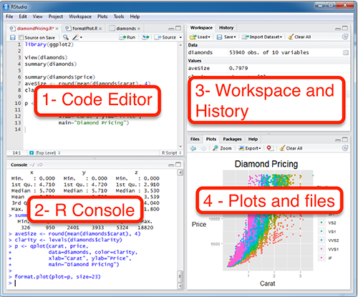
RStudio windows
RStudio provides 4 main windows:
Script viewer
Console
Environment and History
Files, Plots, Packages, and Help
http://www.sthda.com/english/wiki/running-rstudio-and-setting-up-your-working-directory-easy-r-programming

Slide 9
RStudio windows
Script viewer shows the scripts you create. Scripts are a series of R commands built into a single file. You can think of them as a R program.
Console is the gateway to interact with R. You can type commands on console to run, and R will also output results on console.

Slide 10
RStudio windows
Environment will show you the defined objects in R memory and their values.
History will show you the history of commands you have run in R (in the current session)
Files is the directory linkage to files and folders for your R files and projects
Plots window visualizes the plots you draw in R in an interactive way
Packages window provides a list of available (already installed) packages. You can select any package you would like to use within your script or while working with R.
Let’s activate ggplot2 which is an advanced plotting package:
Pay attention to the command that calls the package:
> library("ggplot2", lib.loc="~/R/win-library/3.3“)
Now you can use ggplot2 methods such as qplot
> qplot(x,y)
compare this plot with a simple R plot using the plot(x,y) command

Slide 11
How to get help on R?
Again, like VBA and any other programming language you could easily find lots of help, Q&A, etc. by just googling
You could use R’s help on functions by either using help(function/method name) method, or typing ? before the function/method name. For instance:
> help(install.packages)
> ?install.packages
Apparently using R’s help needs a little getting used to R terminology and structure

Slide 12
R Markdown
A simple formatting language to produce reports
Uses formatting cues instead of complex code
Can embed code chunks to provide code and output in one document
Can export the .Rmd file to Word, PDF, HTML, and more
Sources:
https://rmarkdown.rstudio.com/lesson-1.html
https://www.youtube.com/watch?v=DNS7i2m4sB0

Slide 13
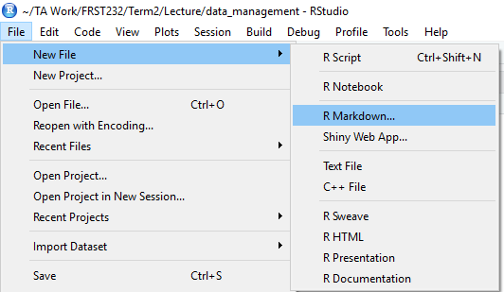
R Markdown
Step 1:
- open a new document

Slide 14
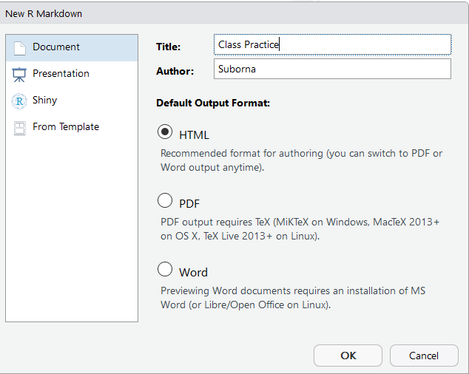
R Markdown
Step 2:
- select “html”
- in this step a bunch of packages will be installed.

Slide 15
R Markdown > PDF file
Need to install the latest version of R
Install package:
- install.packages("rmarkdown")
If the pdf file is showing some error while creating it then you may need to install more packages:
- miktex (https://miktex.org/2.9/setup)
install.packages(“stringi")
Other packages would be suggested.

