Slide 1
CSE 4101
Lecture 10
Topic: Probability and Uncertainty

Slide 2
Probability and Uncertainty
Bayesian networks
Markov decision processes (MDPs)
Hidden Markov models

Slide 3
Bayesian Networks
A Bayesian Network (BN) is a probabilistic graphical model that represents a set of random variables and their conditional dependencies via a Directed Acyclic Graph (DAG).

Slide 4
Structure of Bayesian Networks
Nodes = Random Variables
Each node in the network represents a random variable.
A random variable is something that can take different values, each with a certain probability.
Nodes can represent:
  Observable variables (things we can directly measure, like temperature, test results, or weather)
  Hidden/latent variables (things we can’t directly see, like someone's mood, disease status, or a hidden cause)

Slide 5
Structure of Bayesian Networks
Example:
In a medical diagnosis BN:
Node: “Flu” → Boolean variable (Yes/No)
Node: “Fever” → Boolean variable (Yes/No)
Node: “Cough” → Boolean variable (Yes/No)
Node: Weather → Possible values (Sunny, Rainy, Cloudy, Snowy)
Node: Blood Test Result →Possible values: {Positive, Negative, Inconclusive}

Slide 6
Structure of Bayesian Networks
Edges = Conditional Dependencies
An edge from node A → node B means that A has a direct influence on B.
These edges capture causal or probabilistic relationships.
If there’s no edge between two nodes, it implies conditional independence given their parents.
Example:
Flu → Fever
Flu → Cough
If you have the flu, it increases the probability of having a fever and cough. Fever and cough are conditionally independent given “Flu”.

Slide 7
Structure of Bayesian Networks
Conditional Probability Tables (CPTs)
Each node has a CPT that quantifies the effect of its parent nodes on it.
CPTspecifies:
  P(Node∣Parents)
  Example: If Fever has one parent “Flu”:
Flu | P(Fever=Yes)
Yes | 0.9
No | 0.1
This means:
If you have flu → 90% chance of fever
If you don’t have flu → 10% chance of fever
If a node has multiple parents, the CPT contains probabilities for every combination of parent values.

Slide 8
Structure of Bayesian Networks
If a node has multiple parents, the CPT contains probabilities for every combination of parent values.
Let’s take the classical Rain–Sprinkler–WetGrass Bayesian Network:
Rain (R): Can be {Yes, No}
Sprinkler (S): Can be {Yes, No}
WetGrass (W): Depends on both Rain and Sprinkler
Here, Wet Grass has two parents → Rain and Sprinkler.
So, its CPT must consider all combinations of Rain and Sprinkler:

Slide 9
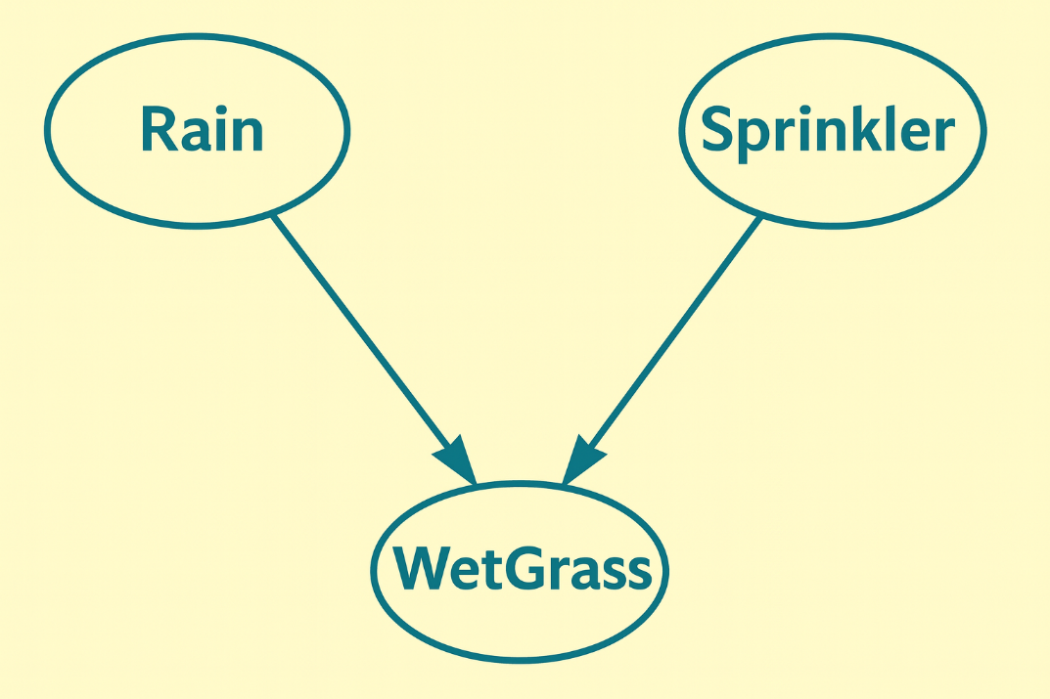
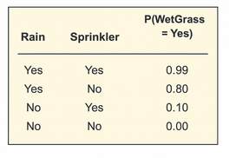
Structure of Bayesian Networks

Slide 10
Why the Graph is a DAG (Directed Acyclic Graph)
Directed: Arrows point from cause → effect (or dependency direction).
Acyclic: No cycles allowed (you can’t start from a node and follow arrows back to itself).

Slide 11

Law of total probability
The Law of Total Probability is a way to compute the probability of an event by partitioning the sample space into disjoint cases and summing over them.
Formally, suppose we have events B₁,B₂,...,B_{n} ​ that form a partition of the sample space (i.e., they are disjoint and cover all possibilities). Then, for any event A:
Let’s say: D=a person has a disease,
T= the test result is positive.
We want P(T), the probability that the test is positive.
Partition the space into D (disease present) and ¬D (disease absent):
P(T)=P(T∣D)P(D)+P(T∣¬D)P(¬D).
This is exactly the law of total probability in action.

Slide 12
Law of total probability-Example
A factory has two machines producing light bulbs:
Machine M1 produces 60% of the bulbs. Probability of a defective bulb from M1 = 2%.
Machine M2 produces 40% of the bulbs. Probability of a defective bulb from M2 = 5%.
What is the probability that a randomly chosen bulb is defective?
Let: A = bulb is defective
B1​ = bulb produced by M1
B2​ = bulb produced by M2
We apply the Law of Total
Probability: P(A)=P(A∣B1)P(B1)+P(A∣B2)P(B2)
Substitute values:
P(A)=(0.02)(0.60)+(0.05)(0.40)
P(Defective)=0.012+0.020=0.032

Slide 13

Mathematical Foundation of Bayesian Network
A Bayesian Network defines the joint probability distribution P(X₁,X₂,...,X_{n}) as:
This is the general factorization rule for Bayesian Networks (BNs).
Each variable X_{i}​ is expressed as conditional probability given its parents.
The whole joint probability distribution (JPD) is obtained by multiplying all those local conditional probabilities.

Slide 14
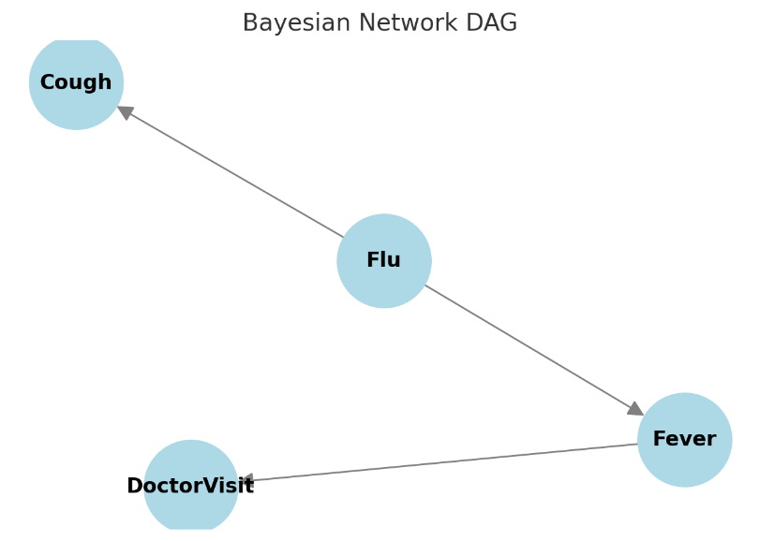
Mathematical Foundation of Bayesian Network
Here: Parents(X_{i}) are the direct parent nodes of X_{i}​ in the network. Each node is conditionally independent of its non-descendants given its parents.
Imagine this network:
Flu → Fever → DoctorVisit
Flu → Cough
Node = Fever
Parents = Flu
Descendants = DoctorVisit
Non-descendants = Cough
The rule says: P(Fever | Flu, Cough) = P(Fever | Flu)
once you know whether someone has Flu, knowing whether they are coughing gives you no additional information about Fever.

Slide 15

Mathematical Foundation
Example in Your Case
Nodes: R (Rain), S (Sprinkler), W (WetGrass).
Parents:
  R: no parents → P(R)
  S: no parents → P(S)
  W: parents are {R,S} → P(W∣R,S)
So: P(R,S,W)=P(R)⋅P(S)⋅P(W∣R,S).
Assumptions (from your BN)
P(R=1)=0.2, P(R=0)=0.8;
P(S=1)=0.1,P(S=0)=0.9 (independent of R)
CPT for W:
  P(W=1∣R=1,S=1)=0.99
  P(W=1∣R=1,S=0)=0.80
  P(W=1∣R=0,S=1)=0.90
  P(W=1∣R=0,S=0)=0.00

Slide 16
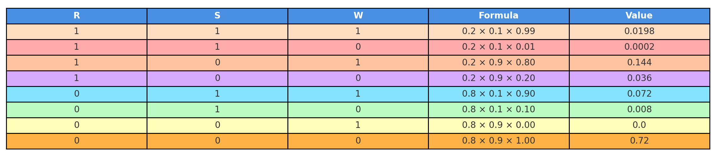
Mathematical Foundation-joint probability table

Slide 17
Mathematical Foundation
Using the joint probability table for the Rain–Sprinkler–WetGrass Bayesian Network:
What is the probability that the grass is wet (W=1), i.e., P(W=1)?
P(W=1)​=0.99(0.2)(0.1)+0.80(0.2)(0.9)+0.90(0.8)(0.1) +0.00(0.8)(0.9)=0.0198+0.1440+0.0720+0=0.2358​.
What is the probability that the grass is wet given that it rained, i.e., P(W=1∣R=1)? (Conditional Probability)
What is the probability that it rained given that the grass is wet, i.e., P(R=1, W=1)? (Joint Probability)

Slide 18

Mathematical Foundation-Conditional Probability
Conditional probability measures the probability of an event A happening, given that another event B has already happened
P(A∣B): Probability of A given B.
P(A∩B): Joint probability of both A and B happening.
P(B): Probability that B happens.

Slide 19
General rule for joint Probability
The chain rule of joint probability is essentially built from the definition of conditional probability.
From the definition:
This shows how a joint probability (both A and B) can be decomposed into:
A conditional probability P(A∣B)
Times the marginal probability P(B).

Slide 20

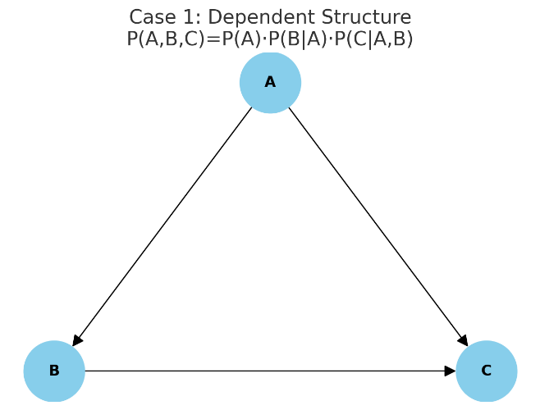
General rule for joint Probability
For n random variable X₁, X₂, …X_{n} the chain rule says:
For any three events A,B,C, the chain rule of probability says:
P(A,B,C)=P(A)⋅P(B∣A)⋅P(C∣A,B)
This is just repeatedly applying the definition of conditional probability.

Slide 21
General rule for joint Probability
For random variables A,B,C,D:
P(A,B,C,D)=P(A)⋅P(B∣A)⋅P(C∣A,B)⋅P(D∣A,B,C)
If only A and B are independent:
P(A,B,C)=P(A)⋅P(B)⋅P(C∣A,B)
If all three A, B, C are independent:
P(A,B,C)=P(A)⋅P(B)⋅P(C)

Slide 22
Probability and Uncertainty
Given the following simplified Bayesian Network: P(A)=0.3,P(B∣A)=0.8,P(B∣¬A)=0.4
Compute P(A,B), P(¬A,B) and P(B)
Using the definition of joint probability:
P(A,B)=P(A)⋅P(B∣A)
Substitute:
P(A,B)=0.3×0.8=0.24
P(¬A)=1−P(A)=1−0.3=0.7
Now apply the joint probability rule:
P(¬A,B)=P(¬A)⋅P(B∣¬A)
Substitute:
P(¬A,B)=0.7×0.4=0.28
P(B)=P(B∣A)P(A)+P(B∣¬A)P(¬A)
=(0.8×0.3)+(0.4×0.7)==0.24+0.28=0.52

Slide 23

Bayes’ Theorem
For two events A and B, with P(B)>0:
P(A): Prior Probability
This is our initial belief about event A before observing evidence B.
P(B∣A): Likelihood
The probability of seeing evidence B if A is true.
P(B): Marginal Probability (or Evidence)
The total probability of observing B, regardless of which event caused it.
It expresses how to compute the probability of A given B using the reverse conditional P(B∣A), the prior P(A), and the marginal probability P(B).

Slide 24

Bayes’ Theorem
Law of Total Probability:

Slide 25


Bayes’ Theorem-Example
Example (Medical Test)
Disease prevalence: P(D)=1%=0.01
Test sensitivity: P(Positive∣D)=0.99
False positive rate: P(Positive∣¬D)=0.05
What is the probability a person has the disease if they test positive?
Using Bayes’ Theorem:
Denominator P(Positive) is:
P(Positive)=P(Positive∣D)P(D)+P(Positive∣¬D)P(¬D)
=(0.99)(0.01)+(0.05)(0.99)=0.0099+0.0495=0.0594

Slide 26
Inference in Bayesian Networks
Inference in Bayesian Networks refers to the process of answering probabilistic queries using the structure and conditional probabilities encoded in the network. In simple terms, given some observed evidence (known values of certain variables), we calculate the probability distribution of other unobserved variables.
For example:
If we know it is raining, what is the probability that the grass is wet?
Or, given that the grass is wet, what is the probability that it rained?

Slide 27
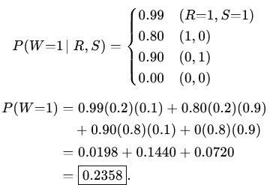
Types of Inference
A BN lets you answer probability queries about some variables given evidence about others.
Prediction (marginalization) (cause → effect)
Example: P(WetGrass=1) “Overall, how likely is the grass wet?”
Using the law of total probability over parents R (Rain) and S (Sprinkler) and your numbers
P(R=1)=0.2, P(S=1)=0.1 (independent) and

Slide 28


Inference in Bayesian Networks- Types of queries
Diagnosis (effect → cause)
Example: P(Rain=1∣WetGrass=1) “How likely did it rain, given we see wet grass?”
This uses Bayes’ theorem
Find the numerator P(W=1,R=1)
We need all rows where R=1 and W=1.
From the table:
Row 1: R=1,S=1,W=1⇒0.0198
Row 3: R=1,S=0,W=1⇒0.144
So:
P(W=1,R=1)=0.0198+0.144=0.1638

Slide 29

Inference in Bayesian Networks-Types of queries
Find the denominator P(R=1)
We need all rows where R=1.
From the table:
Row 1: 0.0198
Row 2: 0.0002
Row 3: 0.144
Row 4: 0.036
So:
P(R=1)=0.0198+0.0002+0.144+0.036=0.200
Apply Bayes formula

Slide 30

Inference in Bayesian Networks-Types of queries
Apply Bayes formula

Slide 31

Inference in Bayesian Networks-Types of queries
Inter-causal reasoning (“explaining away”)
Prior to any evidence on W: Rain R and Sprinkler S are modeled independent (by assumption).
After observing the common effect W (WetGrass): the causes R and S become dependent.
Show the independence (no conditioning on W)
So R and S are independent a priori.

Slide 32

Inference in Bayesian Networks-Types of queries
Conditioning on W=1 creates dependence
Case A: Sprinkler on (S=1) and grass wet (W=1)
Interpretation: Once we know the sprinkler was on, that already explains the wet grass well, so the posterior that it also rained drops from P(R=1∣W=1)≈0.695 to 0.216.

Slide 33
Inference in Bayesian Networks-Types of queries
Conditioning on W=1 creates dependence
Case B: Sprinkler off (S=0) and grass wet (W=1)
So, whenever the sprinkler is off (S=0) and the grass is wet, it must have rained with probability 1 (certainty).

Slide 34
Exercise
In a BN with variables Rain, Sprinkler, and WetGrass, suppose:
P(Rain)=0.2,P(Sprinkler)=0.1
P(WetGrass∣Rain,Sprinkler)=0.99
P(WetGrass∣Rain,¬Sprinkler)=0.80 P(WetGrass∣¬Rain,Sprinkler)=0.90
P(WetGrass∣¬Rain,¬Sprinkler)=0.0
Calculate P(WetGrass) assuming Rain and Sprinkler are independent.

Slide 35
Exercise
To get P(WetGrass), sum over all (Rain,Sprinkler) cases (law of total probability).
Since Rain and Sprinkler are independent:
P(W)=P(W∣R,S)P(R)P(S)+P(W∣R,¬S)P(R)P(¬S)+P(W∣¬R,S)P(¬R)P(S)+P(W∣¬R,¬S)P(¬R)P(¬S).
Plug in:
P(R)=0.2, P(¬R)=0.8
P(S)=0.1, P(¬S)=0.9
P(W∣R,S)=0.99, P(W∣R,¬S)=0.80, P(W∣¬R,S)=0.90, P(W∣¬R,¬S)=0
P(W)=0.99(0.2)(0.1)+0.80(0.2)(0.9)+0.90(0.8)(0.1)+0(0.8)(0.9)=0.0198+0.144+0.072+0=0.2358
So P(WetGrass)≈0.236 (about 23.6%).

Slide 36
Markov Decision Process (MDP)
A Markov Decision Process is a mathematical framework for modeling decision-making where outcomes are partly random and partly under the control of a decision maker.
Widely used in AI, robotics, operations research, and reinforcement learning.

Slide 37
Components of a Markov Decision Process (MDP)
S: States
  The set of all possible situations (states) the agent can be in.
  In a grid world, each cell represents a state.
  Provides a complete description of the environment at a given time.
A – Actions
  The set of all actions available to the agent in each state.
  In a grid-world, actions might be {up, down, left, right}.
  Represents the choices the agent can make.

Slide 38
Components of a Markov Decision Process (MDP)
P – Transition Probabilities
  P(s′∣s,a)– the probability of reaching state s′ after taking action a in state s.
  Example: In a stochastic (random) environment, moving "up" might take the agent up with probability 0.8, left with 0.1, right with 0.1.
  Captures uncertainty in outcomes and models the environment’s dynamics.
  R – Reward Function
      R(s,a) or R(s,a,s′) – the immediate reward received after taking action a in state s (or transitioning to s′).
      In a navigation task, reaching the goal state may give a reward of +10, while bumping into a wall may give −1.
      Encodes the agent’s objective by assigning desirability to states or actions.

Slide 39
Components of a Markov Decision Process (MDP)
γ: Discount Factor
  A number between 0 and 1 that determines how much future rewards are worth compared to immediate rewards.
    γ=0: Agent only cares about immediate rewards.
    γ≈1: Agent values future rewards almost as much as immediate ones.

Slide 40
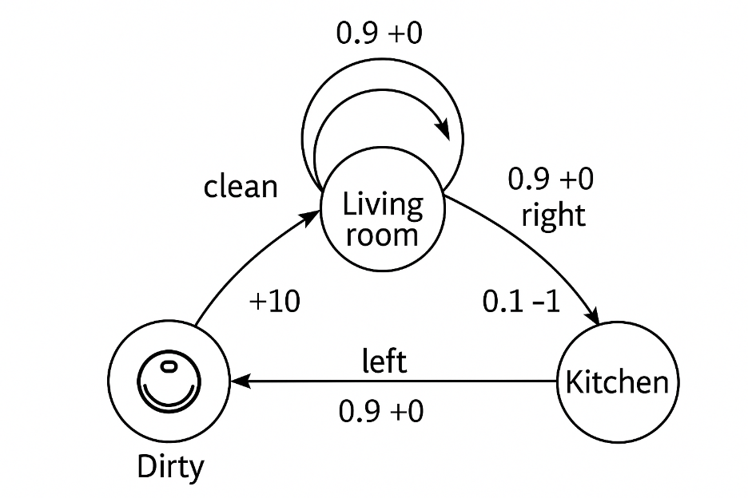
Components of a Markov Decision Process (MDP)
This figure is a Markov Decision Process (MDP) diagram illustrating how an agent (like a robot) can move between states, take actions, and receive rewards.
States
  Dirty
  Living Room
  Kitchen
These circles represent the possible states the agent can be in.

Slide 41

Components of a Markov Decision Process (MDP)
From Living Room, the agent (robot) can:
  right → move to "Kitchen" with probability 0.9 and get reward 0.
  There’s a 0.1 probability that something goes wrong (slip/error), giving reward −1.
  stay in “Living Room” with probability 0.9 and reward 0.
From Kitchen, the agent can:
  left → return to "Dirty" with 0.9 probability and reward 0.
  From Dirty, the agent can:
        clean → move to “Living Room" state and receive reward +10.

Slide 42
Components of a Markov Decision Process (MDP)
If you don’t see a probability on a transition, it’s usually because the action is deterministic.
Probabilities are explicitly written only when stochastic outcomes are involved.

Slide 43


Probabilities in MDP Transitions
In an MDP, each action from a state is associated with a transition probability function
which tells you the probability of landing in next state s′ given that you were in state s and took action a.
If an action always leads to a certain state (no randomness), then:
for that next state s′, and
P(any other state∣s,a)=0

Slide 44




Probabilities in MDP Transitions

Slide 45
Markov Decision Process (MDP)
An MDP (Markov Decision Process) satisfies the Markov property if:
“The probability of transitioning to the next state depends only on the current state and action, and not on any past states or actions.”
Mathematically:
probability of reaching the next state S_{t+1} ​given the entire history of past states and actions (from time 0 to t)= probability of reaching S_{t+1} depends on the current state S_{t}​ and current action A_{t} ​.

Slide 46

Markov Decision Process (MDP)
This means the future is independent of the past given the present — the system is memoryless except for the current state.
If you know S_{t}​ (current state) and A_{t} (chosen action), you have all the information you need to predict what happens next — no need to remember S_{t−1},S_{t−2},...

Slide 47
Markov Decision Process (MDP)
Example: Robot Navigation
Imagine a robot navigating a grid:
  Current state (S_{t}): robot at cell (2,3)
  Current action (A_{t}): "move right“
  Future state (S_{{t+1}}): cell (2,4)
The probability of landing in (2,4) depends only on the current cell (2,3) and the action chosen (move right), not on how the robot arrived at (2,3).

Slide 48




Difference between deterministic and stochastic policies?
A deterministic policy always chooses the same action in a given state.
where π is the policy, s is the state, and a is the selected action.
If the agent is in state s, it always takes action a. There is no randomness involved in action selection.
For example, if “clean” from Dirty state always goes to Living Room with reward +10, that would be deterministic. There is no randomness in which action the agent selects.

Slide 49


Difference between deterministic and stochastic policies?
But there is an important distinction: a deterministic policy does not mean the environment must be deterministic.
For example, the policy can say:
π(Living room)=right
so the agent always chooses right in the Living room. But your transition figure says the result of taking right can still be stochastic.
A stochastic policy specifies a probability distribution over actions for each state.

Slide 50


Difference between deterministic and stochastic policies?
In state s, the agent chooses among available actions with certain probabilities. This allows for exploration and uncertainty in behavior.
P(Kitchen∣Living room,right)=0.9 P(Living room∣Living room,right)=0.1
So:
Does not necessary mean:

Slide 51

Difference between deterministic and stochastic policies?
Stochastic Policies Example
  Living Room → Kitchen (Right):
  0.9 → Kitchen (reward 0)
  0.1 → Kitchen (reward −1)
  Stochastic: Multiple possible outcomes.
Living Room → Living Room (Stay):
  0.9 → Stay (reward 0)
  0.1 → Other outcome (not shown)
  Stochastic: Next state not guaranteed.
Kitchen → Dirty (Left):
  0.9 → Dirty (reward 0)
  0.1 → Other outcome (not shown)
  Stochastic: Action success is probabilistic.

Slide 52

Bellman Equations of State Value Function
Fundamental recursive relationships:
V^{π}(s) = the value of state s under policy π.
π(a∣s) = the probability that the agent chooses action a when in state s.
P(s′∣s,a) = the probability of landing in state s′ given that the agent takes action a in state s.
R(s,a,s′)=immediate reward for transitioning from s to s′ by taking action a.
γ∈[0,1] = the discount factor.
V^{π}(s′) = the value of the next state.

Slide 53
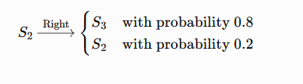
Bellman Equations -Problem
In a 1D world with 3 states (S₁, S₂, S₃), the agent can choose Left or Right.
Moving Right from S₂ to S₃ succeeds with probability 0.8, but with 0.2 it stays in S₂.
Reward: +5 for reaching S₃, 0 otherwise
Define P(s′∣s,a) for all s,a.
Compute expected return V^{π}(S₂) for a policy that always goes Right, with γ=0.9.
Transition model P(s′∣s,a) S₁ <--> S₂ <--> S₃
Transitions: From S₂​:
From S2​:

Slide 54





Bellman Equations -Problem
What happens if the agent chooses Left?
The slide assumes that Left is deterministic:

Slide 55
Bellman Equations -Problem
In the problem, we are specifically analyzing what happens when the agent takes the "Right" action from state S₂.
P(S₂ | S₂, Right) means:
"What is the probability of ending up back in S₂ after starting in S₂ and taking the action Right?“
The problem explicitly says: Moving Right from S₂ to S₃ succeeds with probability 0.8,and with probability 0.2 the agent stays in S₂.
So, P(S₂ | S₂, Right) = 0.2 — because this is the probability of staying in S2 when choosing Right.

Slide 56
Bellman Equations -Problem
Why not P(S₂ | S₂, Left)?
If the agent takes Left from S₂, it always goes to S₁ (probability = 1).
So P(S₂ | S₂, Left) = 0, because after choosing Left, you never remain in S₂ — you definitely end up in S₁.

Slide 57
Bellman Equations -Problem
From S1​:
Right: P(S₂∣S₁,Right)=1
P(S₁∣S₁,Left)=1
P(S₁ | S₁, Left) = 1, means If the agent is in state S₁ and takes the action Left, it will remain in S₁ with probability 1 (100%).
State S₁ is at the "left end" of the world.
  In a 1D world with states S₁ → S₂ → S₃, there is no state to the left of S₁.
  If the agent tries to go Left from S₁, it cannot move further left, so it just stays in S₁.
  Because this outcome is guaranteed (no randomness here), the probability is 1.0.
So, this is a deterministic transition:

Slide 58

Bellman Equations of State Value Function
S1 <--> S2 <--> S3
0.8: probability of moving from S₂ → S₃ (success)
+5: reward for reaching S3
γV^{π}(S₃): future discounted value of S₃ (but 0 since terminal)
0.2: probability of failing and staying in S₂
γV^{π}(S₂): discounted value of being in S₂ again (since you stay there)

Slide 59
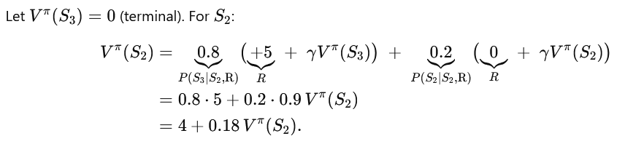
Bellman Equations of State Value Function
From S₃ ​ (terminal/absorbing):
Right: P(S₃∣S₃,Right)=1
Left: P(S₃∣S₃,Left)=1
S₁ <--> S₂ <--> S₃
Value under policy π that always chooses Right, with γ=0.9 ,:

Slide 60
Bellman Equations of State Value Function
the value of π is not explicitly written, because π usually represents the policy π(a∣s) — the probability of taking action a in state s.
The problem says the policy always chooses "Right" (deterministic policy). So, π(Right∣S₂)=1 and π(Left∣S₂)=0. Multiplying by 1 does not change the equation, so it’s omitted.
If the policy were stochastic (e.g., 70% chance Right, 30% Left), then μ (or π) would explicitly appear as a multiplier:

Slide 61
Bellman Equations of State Value Function
Why is γV^{π}(S₃)=0?
In the problem, S₃ is a terminal state:
A terminal state means there are no future rewards once you reach it — the episode ends.So even though we normally add γV^{π}(S₃) (the discounted value of future rewards), here it is simply 0 because there are no future rewards beyond S₃.

Slide 62
Bellman Equations of State Value Function
A 1-D world has 3 states S₁,S₂,S₃ (with S₃​ terminal). Actions: Left, Right. Discount γ=0.9.
Transitions & rewards S₁ <--> S₂ <--> S₃
From S₂​:
  Right: to S₃ ​ with prob 0.8 (reward +5), or stay in S₂ with prob 0.2 (reward 0).
  Left: deterministically to S₁​ (reward 0)
  From S₁​: Right deterministically to S₂​ (reward 0).
  (Left keeps you in S₁ ​, reward 0; we won’t use it.)
  S₃​ is terminal: V^{π}(S₃)=0
  Policy π
    At S₂​: π(Right∣S₂)=0.7, π(Left∣S₂)=0.3.
    At S₁​: π(Right∣S₁)=1.
  Find V^{π}(S₁) and V^{π}(S₂).

Slide 63



Bellman Equations of State Value Function
Solution:
Since S₃​ is terminal: V^{π}(S₃)=0.
Value at S₁ ​
Only action with nonzero prob is Right → S₂ ​:
…1
Value at S₂​
Right branch:

Slide 64





Bellman Equations of State Value Function
Value at S₂​
Left branch:
Combine:
…2
Solve:
So, under this stochastic policy and dynamics,

Slide 65

Bellman Equations for Q-values
The Bellman equation for Q-values expresses the action-value function Q^{π}(s,a) under a policy π.
s: current state
a: action taken in state ss
s′: next possible state
P(s′∣s,a): probability of ending in state s′ if we take action a in state s
R(s,a,s′): reward received when moving from s→s′ with action a
γ: discount factor (how much we value future rewards)
V^{π}(s′): value of next state (expected return following policy π from s′)

Slide 66
Bellman Equations of State Value Function
Given the following value function estimates:
State | V(s)
s1 | 4
s2 | 6
s3 | 0 (terminal)
And transition probabilities:
From s1:
  a₁ → s₂ (p=1.0, reward=+2)
  a₂ → s₃ (p=1.0, reward=+5)
From s2:
  a₁ → s₃ (p=1.0, reward=+1)
  Compute Q(s₁,a₁) and Q(s₁,a₂).

Slide 67




Bellman Equations of State Value Function
s₃​ is terminal ⇒V(s₃)=0
Discount factor γ.
From your transitions:
From s₁​:
  a₁→s₂​ with p=1, reward +2
  a₂→s₃ ​ with p=1, reward +5
From s₂:
  a₁→s₃​ with p=1, reward +1

Slide 68
Hidden Markov models
A Hidden Markov Model (HMM) is a statistical model that represents systems with:
Hidden states (not directly observable).
Observable outputs (emissions) that depend probabilistically on the hidden states.
HMMs are widely used in:
Speech recognition
Part-of-speech tagging
Bioinformatics (gene prediction)
Time-series modeling

Slide 69
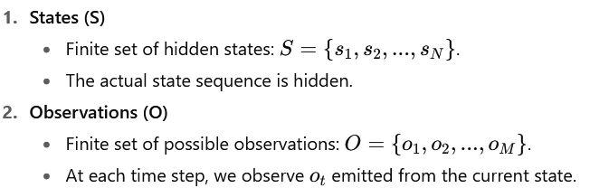
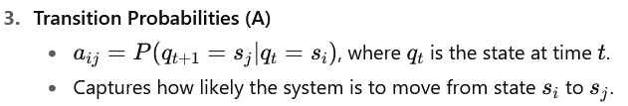
Components of an HMM
An HMM is defined by five elements:

Slide 70
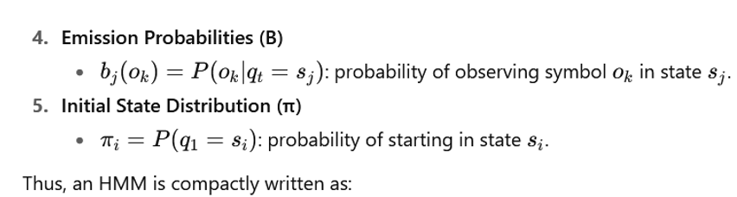

Components of an HMM
An HMM is defined by five elements:

Slide 71
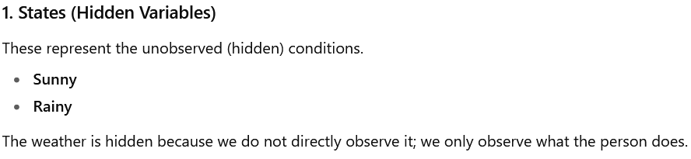
Components of an HMM-Example
Example: Weather and Activities
Let’s say we are modeling a person’s activity choices based on the weather, which we cannot directly observe.

Slide 72
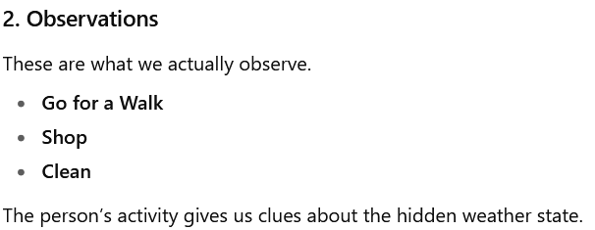
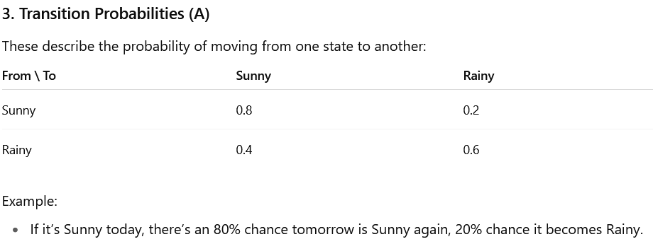
Components of an HMM-Example

Slide 73
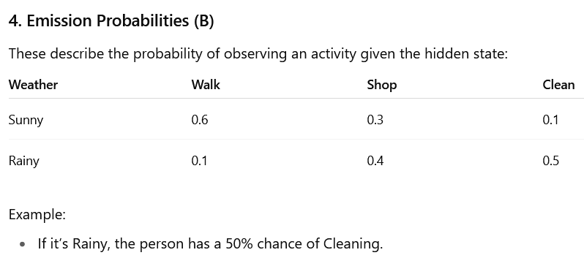
Components of an HMM-Example

Slide 74
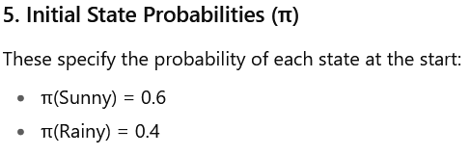
Components of an HMM-Example
Using this HMM, if we observe that the person Cleaned today, we can use algorithms (like Forward-Backward or Viterbi) to infer the most likely weather sequence or compute probabilities like P(Sunny | Clean).
P(Sunny∣Clean) means "Probability of Sunny given Clean.“
In this HMM there are two different things:
  Hidden state: Weather → Sunny or Rain
  Observation: Person's activity → Clean, Shop, Walk, etc.
  We cannot directly see the weather, but we can see what the person is doing.

Slide 75
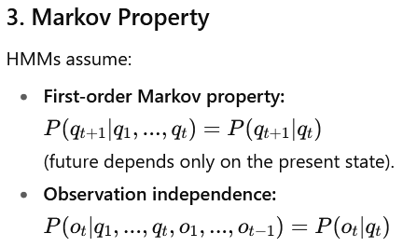
Markov Property

Slide 76
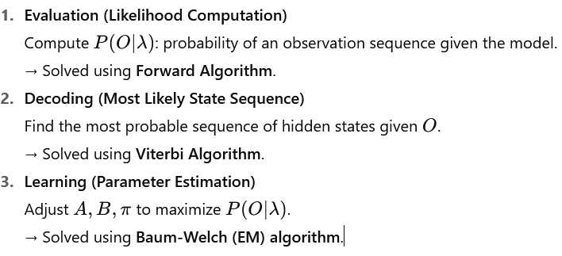
Three Key Problems in HMMs

Slide 77

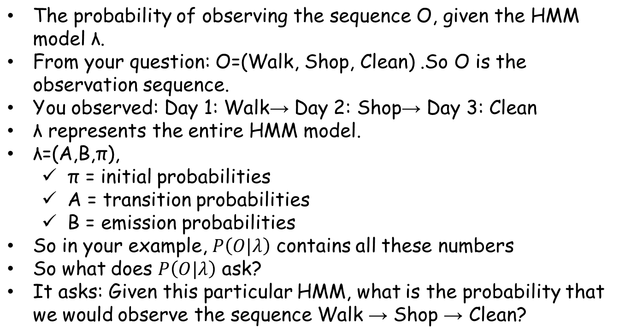
Three Key Problems in HMMs

Slide 78
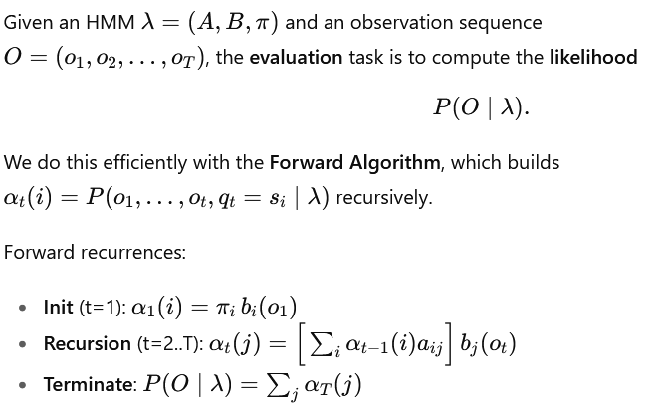
Evaluation (Likehood Computation)

Slide 79
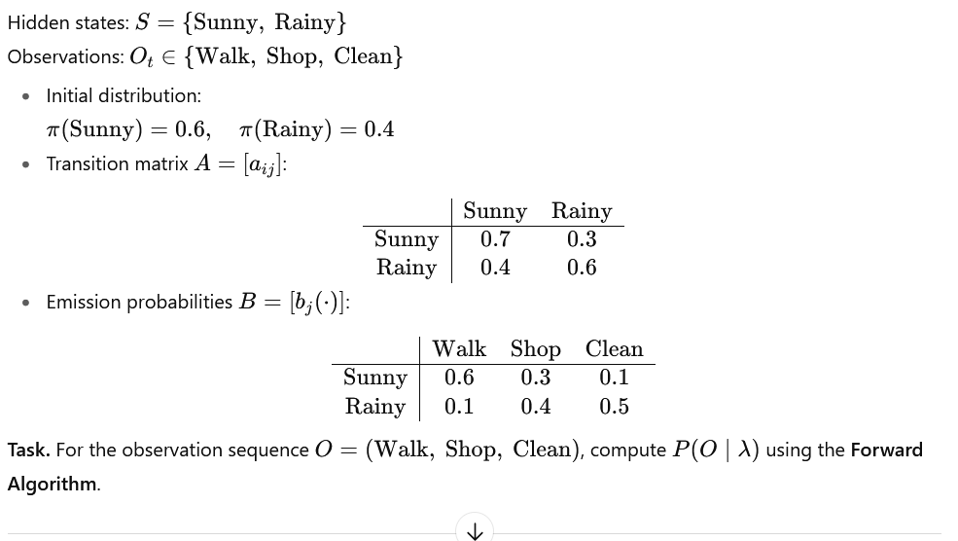
Evaluation (Likehood Computation)

Slide 80


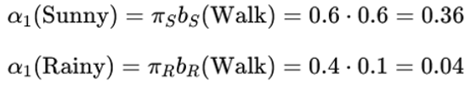
Evaluation (Likehood Computation)

Slide 81









Evaluation (Likehood Computation)

Slide 82





Evaluation (Likehood Computation)

Slide 83




Decoding (Most Likely State Sequence-Viberti Algorithm)

Slide 84
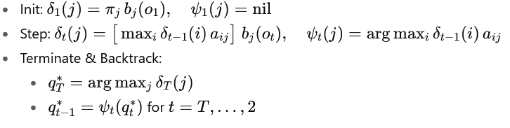
Decoding (Most Likely State Sequence-Viberti Algorithm)

Slide 85





Decoding (Most Likely State Sequence-Viberti Algorithm)

Slide 86

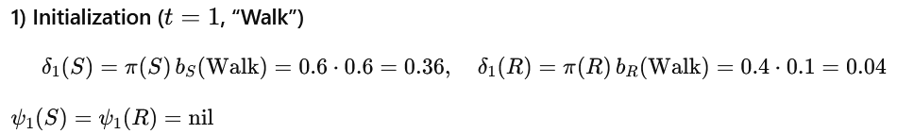



Decoding (Most Likely State Sequence-Viberti Algorithm)

Slide 87


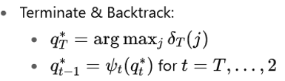



Decoding (Most Likely State Sequence-Viberti Algorithm)

Slide 88
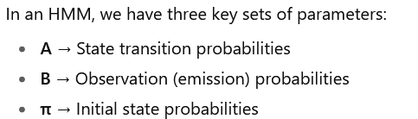
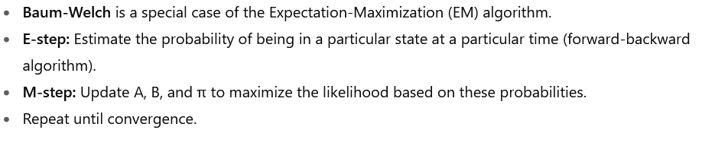
Learning (Parameter Estimation) Baum-Welch Algorithm

Slide 89
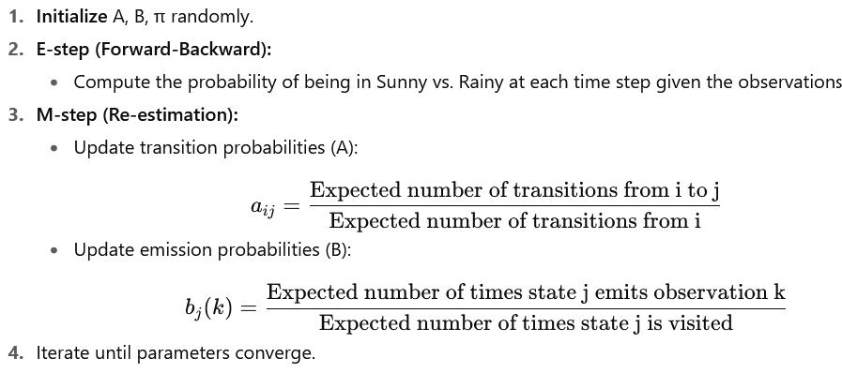
Learning (Parameter Estimation)

Slide 90



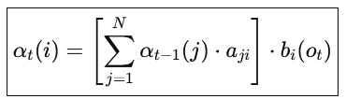
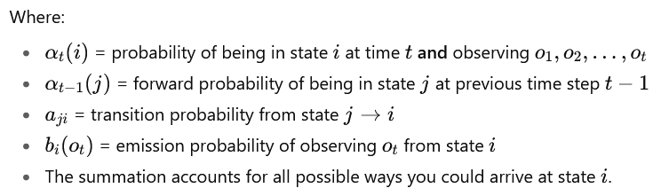
Learning (Parameter Estimation)

Slide 91



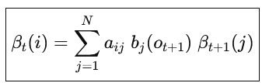
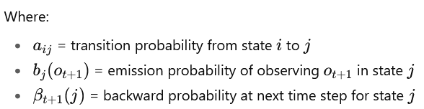
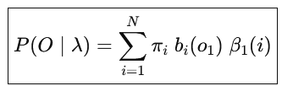
Learning (Parameter Estimation)

Slide 92










Learning (Parameter Estimation)

Slide 93



Learning (Parameter Estimation)

Slide 94
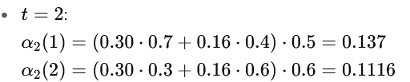
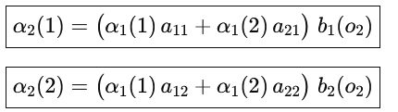
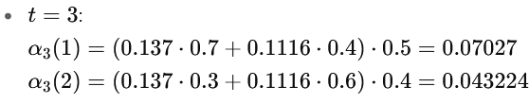
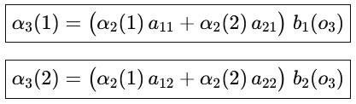

Learning (Parameter Estimation)

Slide 95





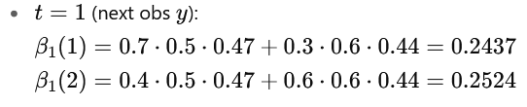

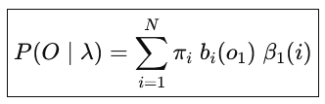
Learning (Parameter Estimation)

Slide 96



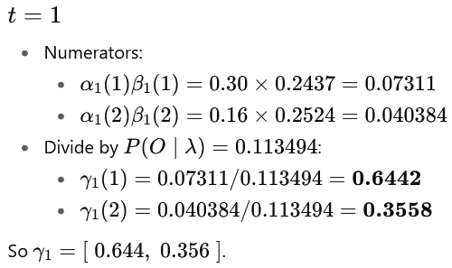
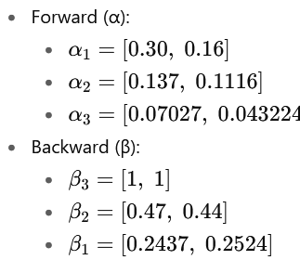
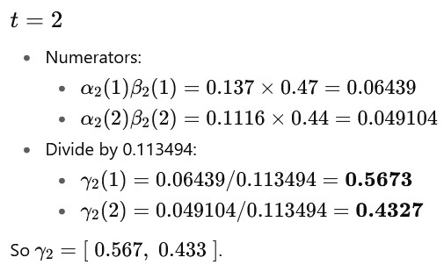


Learning (Parameter Estimation)

Slide 97
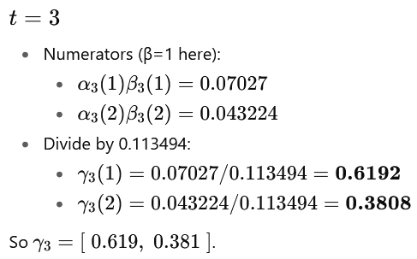
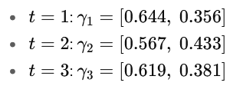
Learning (Parameter Estimation)

Slide 98

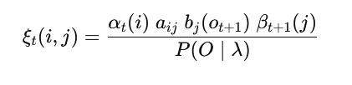
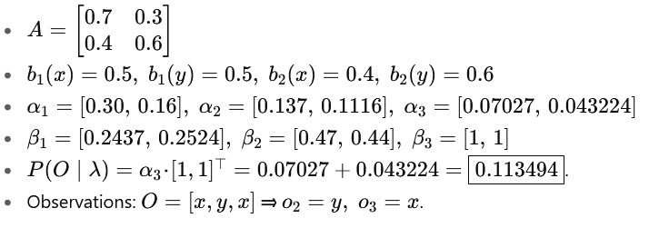

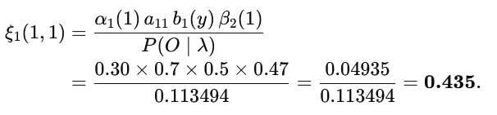
Learning (Parameter Estimation)

Slide 99
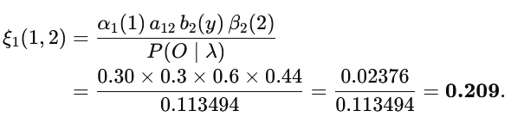
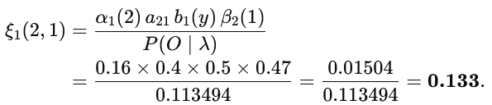




Learning (Parameter Estimation)

Slide 100




Learning (Parameter Estimation)

Slide 101


Learning (Parameter Estimation)

Slide 102



Learning (Parameter Estimation)

Slide 103




Learning (Parameter Estimation)

Slide 104





Learning (Parameter Estimation)

Slide 105
End

