Slide 1
CSE 4101
Lecture 11
Topic: Game Theory
1

Slide 2
Game theory-Introduction
Game theory is the study of mathematical models of strategic interaction among rational agents.
Games
  Players: Decision-making agents.
  Strategies: Complete plan of actions a player may take.
  Payoffs (Utilities): Rewards each player receives depending on strategy profile.
2

Slide 3
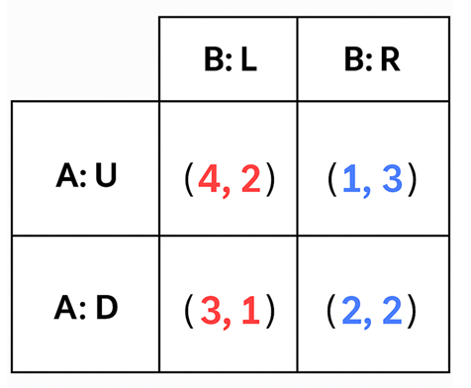
Game theory-Introduction
Two players: A (row player) and B (column player). Each has two strategies:
A: Up (U) or Down (D)
B: Left (L) or Right (R)
Payoff matrix:
Players
Player A → chooses U or D
Player B → chooses L or R
Strategies
A’s strategy set = {U, D}
B’s strategy set = {L, R}
3

Slide 4
Game theory-Introduction
Payoffs (Utilities)
If A chooses U and B chooses L → (4, 2) → A gets 4, B gets 2
If A chooses U and B chooses R → (1, 3) → A gets 1, B gets 3
If A chooses D and B chooses L → (3, 1) → A gets 3, B gets 1
If A chooses D and B chooses R → (2, 2) → A gets 2, B gets 2
4

Slide 5
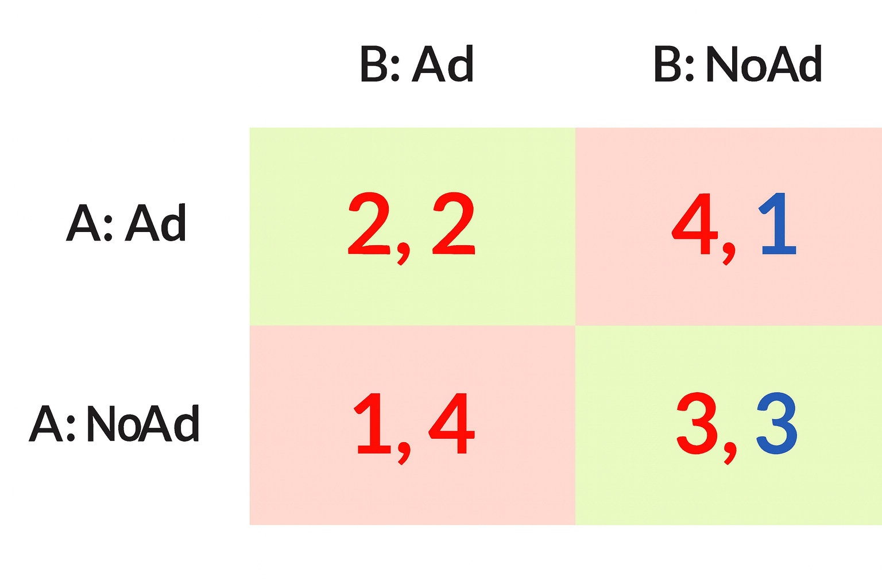
Dominant Strategy Equilibrium (DSE)
A dominant strategy is one that is best for a player no matter what the others do.
If every player has a dominant strategy and they all play them → that outcome is called a Dominant Strategy Equilibrium.
Stronger condition than Nash Equilibrium, because it does not depend on what others do.
Example: Advertising Game
Two competing firms (Firm A and Firm B) must decide whether to Advertise (Ad) or Not Advertise (NoAd).
5

Slide 6
Dominant Strategy Equilibrium (DSE)
Step 1: Check A’s strategies
If B plays Ad:
  A: Ad → 2, NoAd → 1 → Ad better
If B plays NoAd:
  A: Ad → 4, NoAd → 3 → Ad better
  Ad is dominant for A.
Step 2: Check B’s strategies
If A plays Ad:
  B: Ad → 2, NoAd → 1 → Ad better
If A plays NoAd:
  B: Ad → 4, NoAd → 3 → Ad better
  Ad is dominant for B.
6

Slide 7
Dominant Strategy Equilibrium (DSE)
Step 3: Outcome
Both firms have dominant strategy = Advertise.
So the Dominant Strategy Equilibrium is (Ad, Ad) with payoffs (2, 2).
7

Slide 8
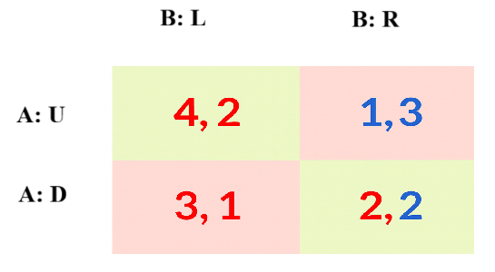
Nash Equilibrium (NE)
A Nash Equilibrium is a set of strategies where no player can improve by unilaterally deviating.
Weaker condition than DSE: you don’t need a strategy that’s always best, only one that’s best given what others are doing.
Every DSE is also an NE, but not every NE is a DSE.
Example Game
Two players (A and B) each have two strategies:
A can play Up (U) or Down (D).
B can play Left (L) or Right (R).
(First number = payoff for A, second number = payoff for B)
8

Slide 9
Nash Equilibrium (NE)
(First number = payoff for A, second number = payoff for B)
Step 1: Find A’s Dominant Strategy
Step 1: Find A’s Dominant Strategy
Look at A’s payoffs (first numbers):
  If B plays L:
    A: U → 4
    A: D → 3 → U is better
  If B plays R:
    A: U → 1
    A: D → 2 → D is better
A has no dominant strategy, because the best choice depends on what B does.
9

Slide 10
Nash Equilibrium (NE)
Step 2: Find B’s Dominant Strategy
Look at B’s payoffs (second numbers):
  If A plays U:
    B: L → 2
    B: R → 3 → R is better
  If A plays D:
    B: L → 1
    B: R → 2 → R is better
B has a dominant strategy: R, because it’s always better regardless of A’s move.
10

Slide 11
Nash Equilibrium (NE)
Step 3: Nash Equilibrium
Since B will always play R, A looks at the R column:
  A: U → 1
  A: D → 2 → A chooses D
So the Nash Equilibrium is (A: D, B: R) with payoffs (2, 2).
A dominant strategy is found by comparing payoffs row by row (for A) or column by column (for B).
In this example, B has a dominant strategy (R), but A does not.
This is the unique pure-strategy NE for this game.
11

Slide 12
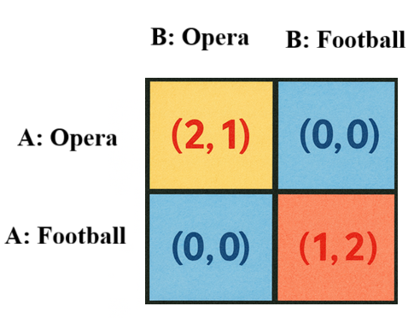
Nash Equilibrium (NE) - Battle of the Sexes
Story
Two players: A (say, husband) and B (say, wife).
They want to spend time together, but they disagree on the preferred activity:
  A prefers Opera (O).
  B prefers Football (F).
Being together is more important than the individual preference.
Payoff Matrix
12

Slide 13
Nash Equilibrium (NE) - Battle of the Sexes
Numbers = payoffs (A,B).
If they coordinate on Opera → A gets 2 (happy), B gets 1 (less happy but still together).
If they coordinate on Football → A gets 1, B gets 2.
If they choose different → payoff = (0,0) (they’re apart).
If B chooses O → A’s best is O.
If B chooses F → A’s best is F.
If A chooses O → B’s best is O.
If A chooses F → B’s best is F.
Two Nash equilibria: (O,O) and (F,F).
But no dominant strategy equilibrium.
13

Slide 14
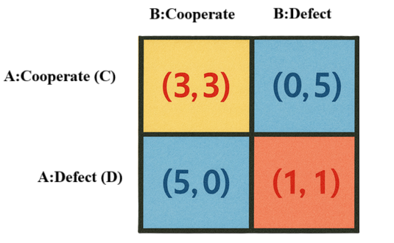
Prisoner’s Dilemma (PD)
Story Setup
Two suspects (Prisoner A and Prisoner B) are arrested for a crime.
They are interrogated separately, so they cannot communicate.
Each has two options:
  Cooperate (C) → Stay silent.
  Defect (D) → Betray the other (confess and blame).
Payoff Matrix
Let’s assign numbers to outcomes (bigger = better payoff, e.g. shorter prison sentence).
(First number = A’s payoff, second = B’s payoff)
14

Slide 15
Prisoner’s Dilemma (PD)
Interpreting Outcomes
(C,C) = (3,3) → Both stay silent → moderate sentence for both (better for society).
(C,D) = (0,5) → A cooperates, B defects → A gets worst outcome, B goes free.
(D,C) = (5,0) → A defects, B cooperates → A goes free, B gets worst outcome.
(D,D) = (1,1) → Both betray → both get bad (but not worst) outcome.
15

Slide 16
Prisoner’s Dilemma (PD)
Dominant Strategy Analysis
For A:
  If B plays C → A: C=3, D=5 → D better.
  If B plays D → A: C=0, D=1 → D better.
  D is dominant for A.
For B:
  If A plays C → B: C=3, D=5 → D better.
  If A plays D → B: C=0, D=1 → D better.
  D is dominant for B.
16

Slide 17
Prisoner’s Dilemma (PD)
Nash Equilibrium
Both players defect → (D,D) with payoffs (1,1).
This is the Nash Equilibrium (mutual best response).
The Dilemma
Paradox: (C,C) gives (3,3), which is better for both than (1,1).
But rational self-interest pushes players to defect → (D,D).
In Prisoner’s Dilemma, the dominant strategy outcome (D,D) is also the unique Nash equilibrium.
It is not Pareto optimal, because (C,C) = (3,3) would be better for both.
17

Slide 18

Types of Dominance- Strictly dominant
A strategy is strictly dominant for a player if it gives that player a strictly higher payoff than any other strategy, no matter what the other players do.
Strictly better means always greater, not equal.
If all players have strictly dominant strategies, the game has a strictly dominant strategy equilibrium.
For Player A:
Strategy S₁ is strictly dominant over S₂ if:
for every possible strategy profile of the other players s_{−A}​.
Where:
u_{A} = payoff function of Player A
S₁​,S₂​ = two strategies available to Player A
s_{−A}​ = strategies of all other players.
18

Slide 19
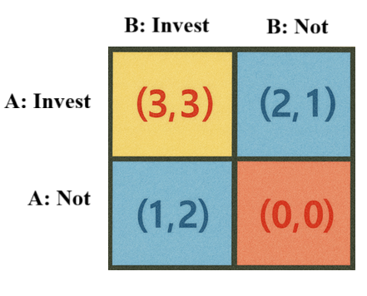
Types of Dominance- Strictly dominant-security-investment
Two firms decide whether to Invest in cybersecurity or Not.
A’s check:
  If B invests: 3 (Invest) > 1 (Not)
  If B doesn’t: 2 (Invest) > 0 (Not)
  ⇒ Invest strictly dominates for A.
B’s check: symmetric ⇒ Invest strictly dominates for B.
Dominant-Strategy Equilibrium (and NE): (Invest, Invest) with payoffs (3,3).
Intuition: At
19

Slide 20
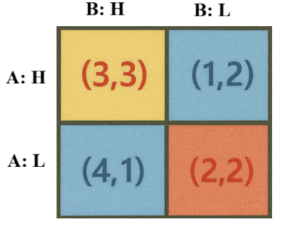
Types of Dominance- Strictly dominant-Pricing Game
Two firms (Firm A and Firm B) can choose between High Price (H) or Low Price (L).
Payoff Matrix
(First number = A’s payoff, second = B’s payoff)
Step 1: Check A’s strategies
If B plays H:
  A: H → 3
  A: L → 4 → L better
If B plays L:
  A: H → 1
  A: L → 2 → L better
L strictly dominates H for A.
20

Slide 21
Types of Dominance- Strictly dominant-Pricing Game
Step 2: Check B’s strategies
If A plays H:
  B: H → 3
  B: L → 2 → H better
If A plays L:
  B: H → 1
  B: L → 2 → L better
Neither H nor L strictly dominates overall (because B’s best move depends on A’s choice).
Step 3: Equilibrium
A will always play L (strictly dominant).
Given A plays L → B compares payoffs in the bottom row:
  H = 1, L = 2 → B plays L.
Equilibrium = (L,L) with payoffs (2,2).
21

Slide 22


Types of Dominance-Weakly dominant
A strategy is weakly dominant if it is never worse than any other strategy, no matter what the other players do, and is strictly better in at least one case.
Difference from strictly dominant:
Strictly dominant = always strictly better (>).
Weakly dominant = sometimes equal (≥), sometimes strictly better.
For Player A:Strategy S₁ weakly dominates S₂ if
and
22

Slide 23
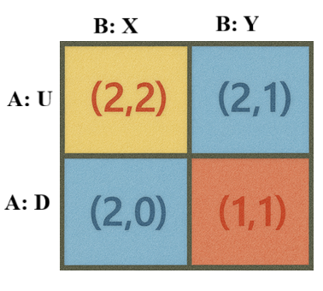
Types of Dominance-Weakly dominant-Coordination Game
Let’s illustrate with a small 2-player game.
For A:
If B plays X → A: U=2, D=2 → same.
If B plays Y → A: U=2, D=1 → U better.
U is a weakly dominant strategy.
For B:
If A plays U → B: X=2, Y=1 → X better.
If A plays D → B: X=0, Y=1 → Y better.
No dominant strategy.
23

Slide 24
Types of Dominance-Weakly dominant-Coordination Game
Nash Equilibrium
(U, X) gives (2,2).
A is playing a weakly dominant strategy (U).
B is best-responding with X.
NE = (U, X), involving A’s weakly dominant strategy.
Strict vs. Weak Dominance
Strict dominance: one strategy is always better (>) than the other.
Weak dominance: one strategy is never worse (≥) and sometimes better.
24

Slide 25
Types of Dominance-Weakly dominant
U weakly dominates D because:
It’s never worse (≥ everywhere).
It’s strictly better in at least one case (when B=R).
25

Slide 26
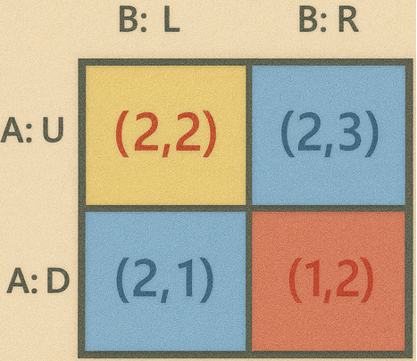
Types of Dominance-Weakly dominant
One weakly dominant strategy and one strictly dominant strategy
Payoff matrix (payoffs = (A, B))
Check dominance
For A (row player):
  If B plays L: A gets U=2, D=2 → equal
  If B plays R: A gets U=2, D=1 → U is better
→ U weakly dominates D (never worse, strictly better in one case). It’s not strictly dominant because at (B:L) the payoffs tie.
26

Slide 27
Types of Dominance-Weakly dominant
For B (column player):
If A plays U: B gets L=2, R=3 → R better
If A plays D: B gets L=1, R=2 → R better
→ R strictly dominates L for B.
Nash equilibrium
Since B will choose R (strictly dominant), A best-responds with U (2 > 1).
NE = (U, R) with payoffs (2, 3).
27

Slide 28
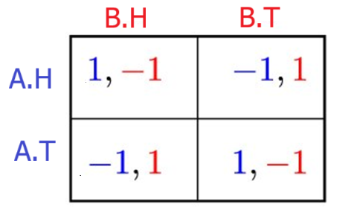
Types of Dominance-No dominance-Matching Pennies.
A player has no dominant strategy if none of their strategies is always better (or never worse) than the others across all opponent choices.
Step 1: Check Player A (row player)
If B plays H:
  A: H → 1
  A: T → -1
  Best = H
  If B plays T:
    A: H → -1
    A: T → 1
    Best = T
A’s best choice switches depending on what B does → so no dominant strategy.
28

Slide 29
Types of Dominance-No dominance-Matching Pennies.
Step 2: Check Player B (column player)
If A plays H:
  B: H → -1
  B: T → 1
  Best = T
If A plays T:
  B: H → 1
  B: T → -1
  Best = H
B’s best choice also switches depending on what A does → so no dominant strategy
A dominant strategy must be better (strictly or weakly) no matter what the other does.Here, each player’s “best” depends on the opponent’s move.That’s why neither A nor B has a dominant strategy.
29

Slide 30
Zero-sum game
A zero-sum game is a game where the total payoff of all players always sums to zero (or a constant).
In other words, one player’s gain is exactly the other player’s loss.
If Player A wins +3, then Player B must get -3.
Perfectly competitive: no possibility of mutual gain.
For a 2-player zero-sum game:
Classic Examples-Matching Pennies
If both choose the same → A wins (+1), B loses (-1).
If different → B wins (+1), A loses (-1).
Sum of payoffs = 0 in every cell.
This is the purest zero-sum game.
30

Slide 31
Mixed Strategy Nash Equilibrium (MSNE)
A mixed strategy = when a player randomizes over their available pure strategies with certain probabilities.
Instead of always playing H or T, a player may choose:
  H with probability p
  T with probability 1−p
A mixed strategy Nash equilibrium is a set of probabilities such that no player can improve their expected payoff by changing their probability mix, given the other player’s mix.
Some games (like Prisoner’s Dilemma) have pure NE.
But others (like Matching Pennies) have no pure NE — if one player’s move is predictable, the other exploits it.
The solution is randomization: make your actions unpredictable so the opponent can’t exploit you.
31

Slide 32
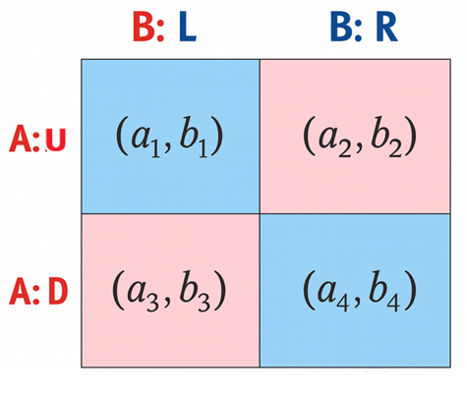
Mixed Strategy Nash Equilibrium (MSNE)
General 2×2 Game Setup
Suppose we have this payoff matrix (payoffs = (A,B)):
A = row player (chooses U or D).
B = column player (chooses L or R).
a_{i}​ = payoff to A,
b_{i}​ = payoff to B.
Step 1: Let players mix strategies
A plays U with probability p, D with probability 1−p.
B plays L with probability q, R with probability 1−q.
32

Slide 33
Mixed Strategy Nash Equilibrium (MSNE)
Step 2: Expected payoff to A from pure strategies
If A plays U:
U_{A}(U)=q⋅a₁+(1−q)⋅a₂
If A plays D:
U_{A}(D)=q⋅a₃+(1−q)⋅a₄
Step 3: Indifference condition for A
In equilibrium, A is willing to mix only if he is indifferent between U and D:
q⋅a₁+(1−q)⋅a₂=q⋅a₃+(1−q)⋅a₄
​Solve for q
This gives B’s mixing probability that makes A indifferent.
33

Slide 34
Mixed Strategy Nash Equilibrium (MSNE)
Step 4: Expected payoff to B from pure strategies
If B plays L:
U_{B}(L)=p⋅b₁+(1−p)⋅b₃
​ If B plays R:
U_{B}(R)=p⋅b₂+(1−p)⋅b₄
Step 5: Indifference condition for B
In equilibrium, B is willing to mix only if he is indifferent between L and R:
p⋅b₁+(1−p)⋅b₃=p⋅b₂+(1−p)⋅b₄
Solve for p.
This gives A’s mixing probability that makes B indifferent.
34

Slide 35
Mixed Strategy Nash Equilibrium (MSNE)
Step 6: Mixed Strategy Nash Equilibrium
The solution (p∗,q∗) from Steps 3 and 5 is the MSNE.
35

Slide 36
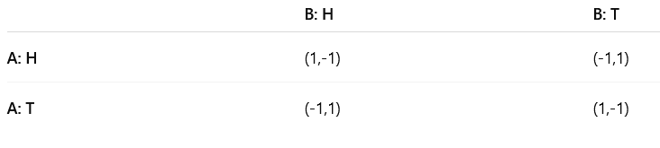
Mixed Strategy Nash Equilibrium (MSNE)- Matching Pennies
Payoff Matrix (A,B)
Zero-sum game.
Calculation of Mixed Strategy NE
Step 1: Let strategies be
A plays H with probability p, T with 1−p.
B plays H with probability q, T with 1−q.
Step 2: Expected payoff for A if B plays mixed
If A plays H:
U_{A}(H)=q(1)+(1−q)(−1)=2q−1
If A plays T:
U_{A}(T)=q(−1)+(1−q)(1)=1−2q
36

Slide 37
Mixed Strategy Nash Equilibrium (MSNE)- Matching Pennies
Payoff Matrix (A,B)
Step 3: A’s indifference condition
For A to be indifferent (so willing to mix), payoffs must be equal:
2q−1=1−2q
4q=2⇒q=1/2
So B must randomize: q = 0.5 (H half, T half).
Step 4: Symmetric reasoning for B
If B plays H:
U_{B}(H)=p(−1)+(1−p)(1)=1−2p
If B plays T:
U_{B}(T)=p(1)+(1−p)(−1)=2p−1
37

Slide 38
Mixed Strategy Nash Equilibrium (MSNE)- Matching Pennies
Set equal:
  1−2p=2p−1
  4p=2⇒p=12
So A must randomize: p = 0.5 (H half, T half).
Mixed Strategy NE Result
A plays H with 0.5, T with 0.5.
B plays H with 0.5, T with 0.5.
This is the mixed strategy Nash equilibrium.
If either player leans too much toward one action, the opponent can exploit.
At 50/50, each player makes the opponent indifferent → no one can gain by deviating.
That’s what defines an equilibrium.
38

Slide 39
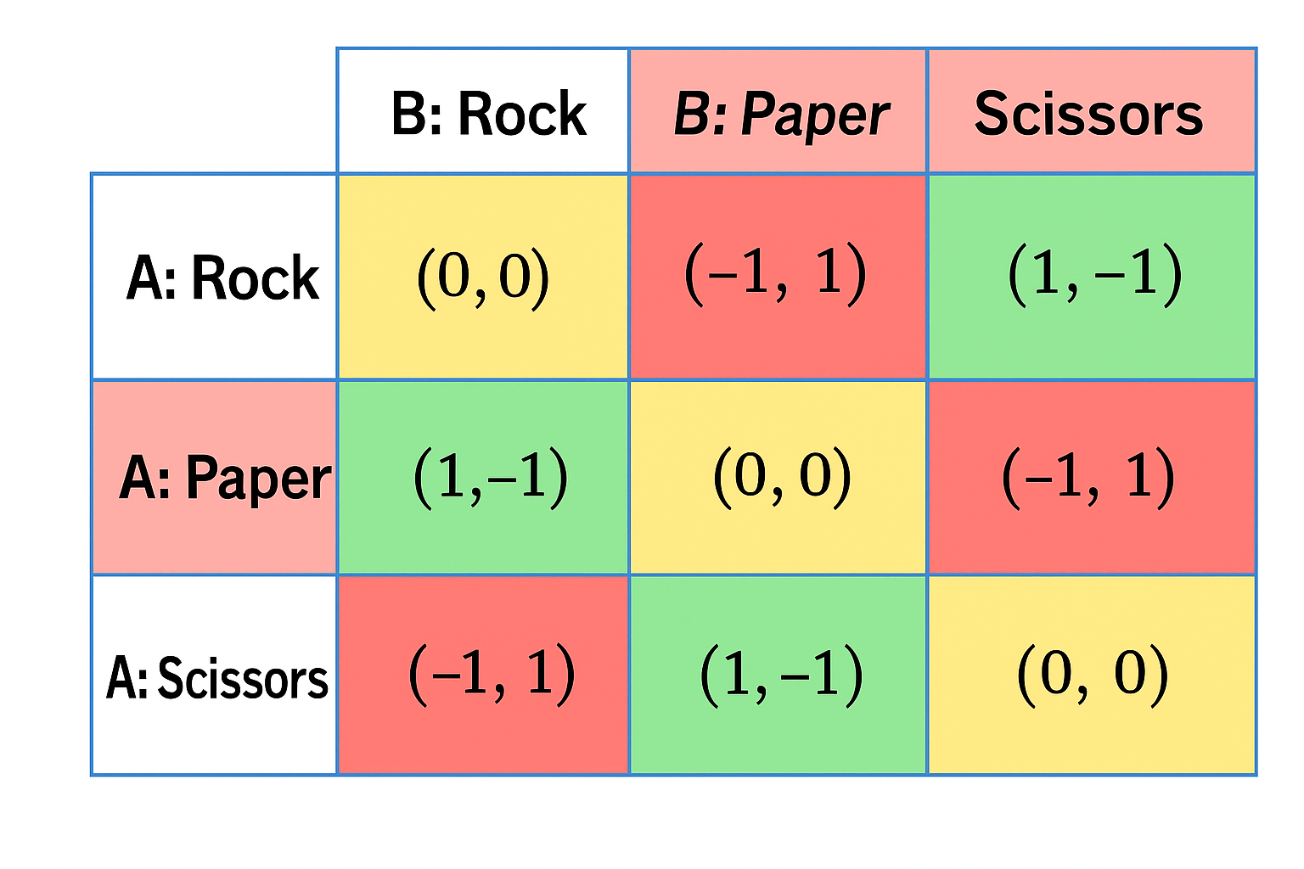
Mixed Strategy Nash Equilibrium (MSNE)- Rock–Paper–Scissors (RPS)
Payoff matrix for Player A (row player). Player B’s payoffs are just the negative (because RPS is a zero-sum game).
Step 1: Let Players Mix
A plays Rock (R) with probabilitp p_{R}​, Paper (P) with p_{P}​, Scissors (S) with p_{S}​.
  p_{R}+p_{P}+p_{S}=1.
B plays R with q_{R}, P with q_{P}, S with q_{S}​.
  q_{R}+q_{P}+q_{S}=1.
39

Slide 40
Mixed Strategy Nash Equilibrium (MSNE)- Rock–Paper–Scissors (RPS)
Step 2: Expected Payoff for A from Each Pure Strategy
Given B’s mix (q_{R},q_{P},q_{S})):
If A plays Rock:
    U_{A}(R)=0⋅q_{R}+(−1)⋅q_{P}+(1)⋅q_{S}=q_{S}−q_{P}
If A plays Paper:
    U_{A}(P)=(1)⋅q_{R}+0⋅q_{P}+(−1)⋅q_{S}=q_{R}−q_{S}
If A plays Scissors:
  U_{A}(S)=(−1)⋅q_{R}+(1)⋅q_{P}+0⋅q_{S}=q_{P}−q_{R}
40

Slide 41
Mixed Strategy Nash Equilibrium (MSNE)- Rock–Paper–Scissors (RPS)
Step 3: Indifference Condition for A
For A to be willing to mix, all three pure strategies must give the same expected payoff:
q_{S}−q_{P}=q_{R}−q_{S}=q_{P}−q_{R}
Solve this system (plus q_{R}+q_{P}+q_{S}=1):
Solution:
q_{R}=q_{P}=q_{S}=1/3​
So B must randomize uniformly to keep A indifferent.
41

Slide 42
Mixed Strategy Nash Equilibrium (MSNE)- Rock–Paper–Scissors (RPS)
Step 4: Expected Payoffs for B
If B plays Rock (R):
U_{B}(R)=p_{R}(0)+p_{P}(−1)+p_{S}(+1)=−p_{P}+p_{S}
If B plays Paper (P):
U_{B}(P)=p_{R}(+1)+p_{P}(0)+p_{S}(−1)=p_{R}−p_{S}
​If B plays Scissors (S):
U_{B}(S)=p_{R}(−1)+p_{P}(+1)+p_{S}(0)=−p_{R}+p_{P} ​
42

Slide 43
Mixed Strategy Nash Equilibrium (MSNE)- Rock–Paper–Scissors (RPS)
4. Indifference ConditionsFor B to be willing to mix, payoffs must be equal:
U_{B}(R)=U_{B}(P)=U_{B}(S)
Equate R and P:
−p_{P}+p_{S}=p_{R}−p_{S}
​p_{R}+p_{P}=2p_{S}(Equation 1)
p_{R}​+p_{P}​=2p_{S} ​(Equation 1)
Equate P and S:
p_{R}−p_{S}=−p_{R}+p_{P}
​ 2p_{R}=p_{P}+p_{S}(Equation 2)
43

Slide 44
Mixed Strategy Nash Equilibrium (MSNE)- Rock–Paper–Scissors (RPS)
Add Normalization:
p_{R}+p_{P}+p_{S}=1
Solve the system → Solution:
p_{R}=p_{P}=p_{S}=1/3
44

Slide 45
Mixed Strategy Nash Equilibrium (MSNE)- Rock–Paper–Scissors (RPS)
Mixed Strategy Nash Equilibrium
p_{R}=p_{P}=p_{S}=q_{R}=q_{P}=q_{S}=1/3
Interpretation:
Both players randomize equally among Rock, Paper, and Scissors.
This is the unique MSNE.
45

Slide 46
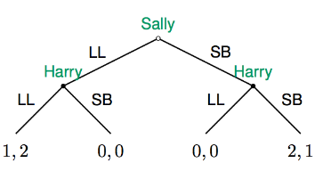
Sequential Games
Games in matrix (normal) form can only represent situations where people move simultaneously
→ sequential nature of decision making is suppressed
→ concept of ‘time’ plays no role
but many situations involve player choosing actions sequentially (over time),
rather than simultaneously
⇒ need games in extensive form = sequential games
Battle of the Sexes Reconsidered
suppose Sally moves first (and leaves Harry a text-message where he can find her)
Harry moves second (after reading Sally’s message)
⇒ extensive form game (game tree):
46

Slide 47
Game tree in extensive form
A game tree in extensive form — a way to model sequential games in game theory.
Here’s a breakdown of the key elements:
1. Nodes (Decision Points)
Circles or dots represent decision nodes where a player must choose an action.
The root node (at the top) is where the game begins.
Terminal nodes (at the bottom) represent the end of the game, where payoffs are realized.
2. Players and Turns
Each node is labeled with the player who makes the decision at that node (e.g., Player 1, Player 2).
The order of moves is explicit — one player moves first, then the other responds.
47

Slide 48
Game tree in extensive form
3. Branches (Actions)
Each branch represents a possible action available at a node.
Following a branch leads to a new node or to a terminal outcome.
4. Payoffs
At each terminal node, you see a pair of numbers (or general outcomes) indicating the payoffs for each player.
For example, (3,2) means Player 1 gets 3 and Player 2 gets 2 if that path is chosen.
5. Backward Induction
The main solution concept for sequential games is backward induction:
  Start from the last decision nodes and determine the optimal action for the player moving there.
  Then work backward step by step to find the equilibrium path.
  This gives the subgame perfect Nash equilibrium (SPNE).
48

Slide 49
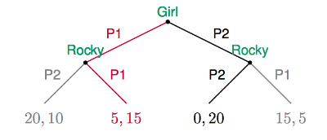
Game tree in extensive form
The extensive form of a game is a complete description of:
The set of players
Who moves when and what their choices are
What players know when they move
The players’ payoffs as a function of the choices that are made.
Avoiding Rocky
The "Avoiding Rocky" game is a game theory scenario where two players, a "Girl" who wants to avoid Rocky and Rocky who wants to find the Girl, each choose between two locations, "Party 1" and "Party 2".
49

Slide 50
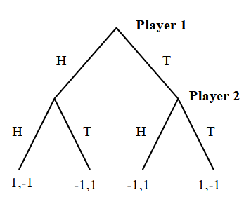
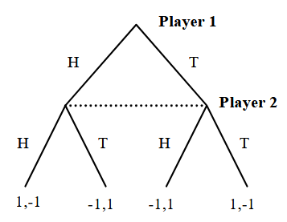
Game tree in extensive form
Matching Pennies
Consider two variants of the matching pennies game.
In the first variant, player one moves first, and then player two moves second after having observed player one’s action.
In the second, player two does not observe player one’s action
50

Slide 51
Subgame
A subgame is a part of an extensive-form game that:
Starts at a single decision node (a node where some player has to choose an action).
Includes all successors of that node (all future moves and outcomes that follow from there).
Contains no broken information sets – a subgame can only start at a singleton information set.
When it’s a player’s turn and the relevant information set is singleton, the player knows exactly where they are in the game tree (what has happened so far).
The player can condition their action on that precise history. Also, a proper subgame may start at that node (because starting there doesn’t “break” any information set).
Non-singleton information set = a set with multiple nodes; the player can’t distinguish which node they’re at.
If Player 2 observes Player 1’s move, the two Player-2 nodes (after H and after T) are separate → two singleton info sets.
If Player 2 doesn’t observe Player 1’s move, those two nodes are linked by a dotted line (same info set) → non-singleton.
51

Slide 52
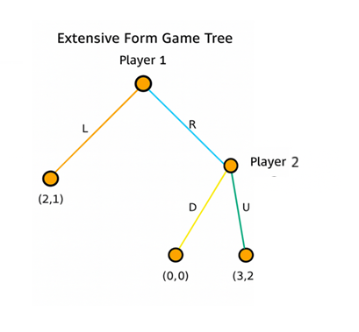
Subgame
The game has two subgames:
The entire game starting at the root (Player 1’s node).
The proper subgame that begins at Player 2’s node (reached after Player 1 plays R), where Player 2 chooses D → (0,0) or U → (3,2).
There is no subgame on the left branch after L, since that node is terminal (no decision to be made).
52

Slide 53
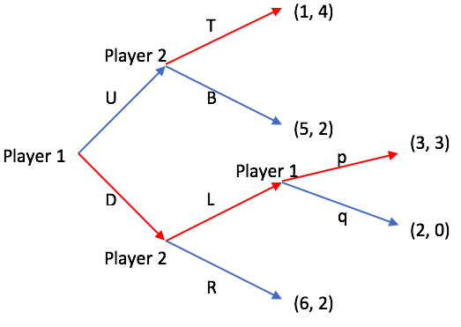
Subgame
Thus there are 4 subgames:
Whole game starting at the root (Player 1’s first move).
After U: subgame at the upper Player 2 node where Player 2 chooses T or B.
After D: subgame at the lower Player 2 node where Player 2 chooses L or R (and if L, the game continues).
After L: subgame at Player 1’s node where Player 1 chooses p or q.
53

Slide 54
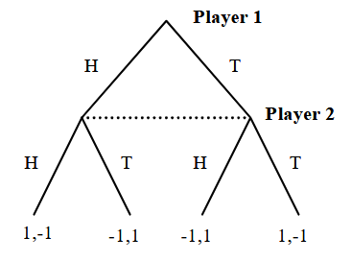
Subgame
Only one subgame: the entire game (starting at the root).
Player-2 nodes are in the same information set (dotted line).
If two nodes are in the same information set (often drawn with a dotted line):
  The player doesn’t know which of those nodes they are actually at (i.e., they don’t know exactly what happened earlier in the game).
  Player 2’s two nodes are in the same information set, meaning Player 2 doesn’t know whether Player 1 played H or T when it’s their turn.
  This is why no proper subgame can start at those nodes.
54

Slide 55
Subgame perfect equilibria
A Subgame Perfect Equilibrium (SPE) is a refinement of Nash equilibrium for extensive-form (sequential) games.
It is a strategy profile (a complete plan of action for every player) such that:
  The strategies form a Nash equilibrium in the entire game.
  And the strategies also form a Nash equilibrium in every subgame of the game.
A common technique for identifying subgame perfect equilibria is to start at the end of the game and work back to the front.
This process is called backward induction.
55

Slide 56
Subgame perfect equilibria
How We Find SPE
We usually use backward induction:
Solve the last subgame first – figure out what players will do there.
Replace that subgame with its resulting payoffs.
Move one step earlier and solve again.
Continue until you reach the root of the game tree.
The resulting strategy profile is the SPE.
56

Slide 57
Game tree in extensive form-Example-1
Consider the following sequential game between Player 1 and Player 2.
Player 1 moves first and chooses Left (L) or Right (R).
If Left (L) is chosen, the game ends with payoffs (2, 1) — Player 1 gets 2, Player 2 gets 1.
If Right (R) is chosen, Player 2 then chooses Up (U) or Down (D):
  If Up (U) is chosen, payoffs are (3, 2).
  If Down (D) is chosen, payoffs are (0, 0).
Represent this game in extensive form (draw the game tree).
Use backward induction to determine the subgame perfect equilibrium (SPE).
57

Slide 58
Game tree in extensive form-Example-1
Solution (Backward Induction → SPE)
Step 1: Solve the last mover’s decision (Player 2).
If Player 1 chooses Right (R), Player 2 chooses between:
Up (U) → payoff to P2 = 2
Down (D) → payoff to P2 = 0
Player 2 prefers U (since 2 > 0).
Optimal action at P2: U.
58

Slide 59
Game tree in extensive form-Example-1
Step 2: Roll back to Player 1’s decision.
Anticipating P2’s best reply (U), Player 1 compares:
Left (L) → payoffs (2,1) → P1 gets 2
Right (R) then U → payoffs (3,2) → P1 gets 3
Player 1 prefers R (since 3 > 2).
Optimal action at P1: R.
59

Slide 60
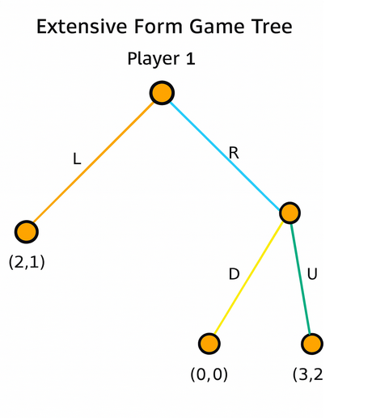
Game tree in extensive form-Example-1
Subgame Perfect Equilibrium (SPE):
Strategy profile:
  Player 1: R
  Player 2: U (after R)
Equilibrium path: R → U
Equilibrium payoffs: (3, 2)
60

Slide 61
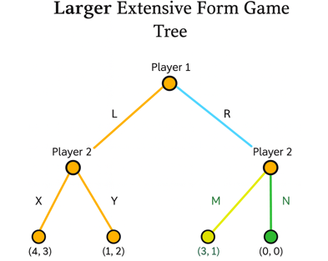
Game tree in extensive form-Example-2
Step 1: Solve Player 2’s subgames
After L: Player 2 chooses between
  X → (4, 3) (P2 gets 3)
  Y → (1, 2) (P2 gets 2)
  ⇒ Best for P2: X.
After R: Player 2 chooses between
  M → (3, 1) (P2 gets 1)
  N → (0, 0) (P2 gets 0)
  ⇒ Best for P2: M.
61

Slide 62
Game tree in extensive form-Example-2
Step 2: Roll back to Player 1
Anticipating P2’s optimal replies:
If L, outcome becomes (4, 3).
If R, outcome becomes (3, 1).
Player 1 compares own payoffs: 4 (via L) vs 3 (via R) ⇒ chooses L.
62

Slide 63
Game tree in extensive form-Example-2
Subgame Perfect Equilibrium (SPE)
Strategies
  Player 1: L.
  Player 2: X after L; M after R.
Equilibrium path: L → X.
Equilibrium payoffs: (4, 3).
63

Slide 64
Game tree in extensive form-Example-3
64

Slide 65
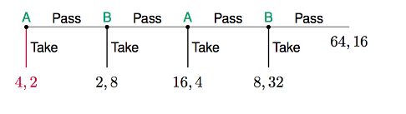
Game tree in extensive form-Example-4-the centipede game
SPE (by backward induction):
At the 4th node (Player B): compare Take → (8,32) vs Pass → (64,16).
B prefers 32>16 ⇒ B takes.
At the 3rd node (Player A): compare Take → (16,4) vs Pass → (8,32).
A prefers 16>8 ⇒ A takes.
At the 2nd node (Player B): compare Take → (2,8) vs Pass → (16,4).
B prefers 8>4 ⇒ B takes.
At the 1st node (Player A): compare Take → (4,2) vs Pass → (2,8).
A prefers 4>2 ⇒ A takes.
Equilibrium path and payoff:
A takes immediately → (4,2).
65

Slide 66

The Normal Form and Nash Equilibrium
Any extensive form game can also be represented in the normal form.
If we adopt a normal form representation, we can solve for the Nash equilibrium.
Player two does observes player one’s action:.
The columns (HH, HT, TH, TT) are Player 2’s contingent strategies—what Player 2 will do after each possible move of Player 1:
First letter = P2’s action if P1 played H
Second letter = P2’s action if P1 played T
66

Slide 67
The Normal Form and Nash Equilibrium
Row H (P1 plays H: use first letter of P2’s plan)
(H, HH): P2’s first letter = H → same (H vs H) → (1, −1)
(H, HT): P2’s first letter = H → same (H vs H) → (1, −1)
(H, TH): P2’s first letter = T → different (H vs T) → (−1, 1)
(H, TT): P2’s first letter = T → different (H vs T) → (−1, 1)
Row T (P1 plays T: use second letter of P2’s plan)
(T, HH): P2’s second letter = H → different (T vs H) → (−1, 1)
(T, HT): P2’s second letter = T → same (T vs T) → (1, −1)
(T, TH): P2’s second letter = H → different (T vs H) → (−1, 1)
(T, TT): P2’s second letter = T → same (T vs T) → (1, −1)
67

Slide 68
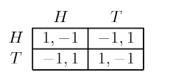
The Normal Form and Nash Equilibrium
Player two does not observe player one’s action.
Because of the dotted line, Player 2’s two decision nodes belong to the same information set
⇒ P2 cannot see whether P1 played H or T.
Therefore P2 must choose one action for both nodes.
So P2’s pure strategies are only H or T (not HH, HT, …).
P1’s pure strategies are H or T.
68

Slide 69
The Normal Form and Nash Equilibrium
Player two does not observe player one’s action.
How each entry is computed
(H, H): P1 plays H; P2 must also play H at her information set ⇒ coins match ⇒ P1 wins: (1, −1).
(H, T): P1 plays H; P2 plays T ⇒ coins differ ⇒ P2 wins: (−1, 1).
(T, H): P1 plays T; P2 plays H ⇒ coins differ ⇒ (−1, 1).
(T, T): Both play T ⇒ coins match ⇒ (1, −1).
So, with imperfect information (P2 doesn’t observe P1), the normal form reduces to the standard 2×2 matching-pennies payoff matrix.
69

Slide 70
Subgame perfect equilibrium
Backward induction
If Player 1 plays H, Player 2 compares
H → (1, −1) and • T → (−1, 1).
Best for P2 is T.
If Player 1 plays T, Player 2 compares
H → (−1, 1) and • T → (1, −1).
Best for P2 is H.
Player 1’s payoff is −1 whether she plays H or T, so she is indifferent.
Route(s) of the SPE:
Player 2 always plays the opposite of Player 1’s move. So:
If Player 1 plays H, Player 2 plays T → path H → T, payoff (−1, 1).
If Player 1 plays T, Player 2 plays H → path T → H, payoff (−1, 1).
(Player 1 is indifferent at the root since either way they get −1, so both routes are consistent with the subgame-perfect strategies.)
70

Slide 71
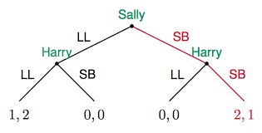
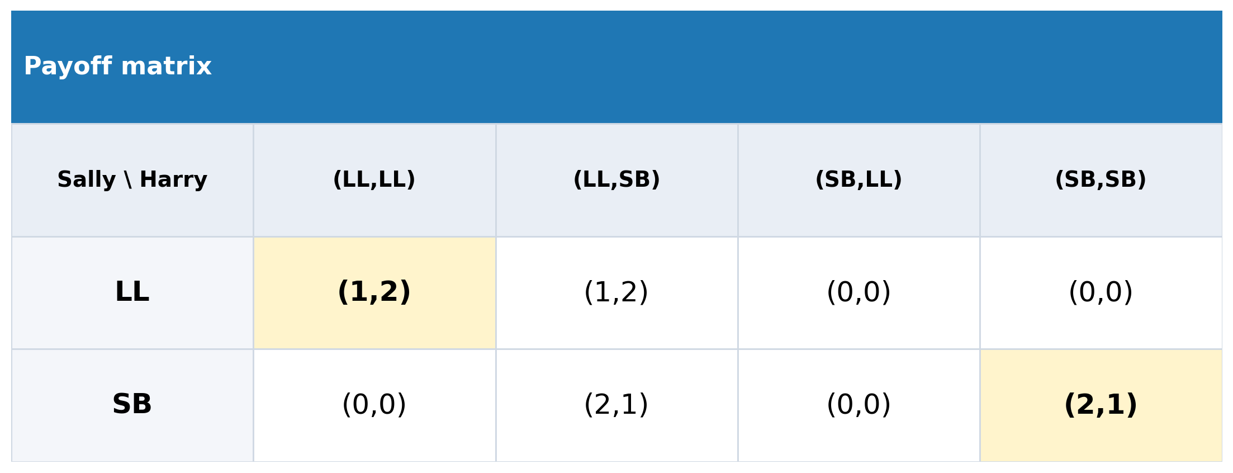
Battle of the Sexes Reconsidered
Harry knows Sally’s move:
Row LL (Sally plays LL: use first letter of Harry’s plan)
LL, (LL,LL): Harry’s first letter =LL → same (LL vs LL) → (1, 2)
LL, (LL, SB): Harry’s first letter =LL → same (LL vs LL) → (1, 2)
LL, (SB, LL): Harry’s first letter =SB → different (LL vs SB) → (0, 0)
LL, (SB, SB): Harry’s first letter =SB → different (LL vs SB) → (0, 0)
Row SB (Sally plays SB: use second letter of Harry’s plan)
SB, (LL,LL): Harry’s second letter =LL → same (SB vs LL) → (0,0)
SB, (LL, SB): Harry’s second letter=SB → same (SB vs SB) → (2,1)
SB, (SB, LL): Harry’s second letter =LL → different (SB vs LL) → (0, 0)
SB, (SB, SB):Harry’s second letter =SB → different (SB vs SB) → (2, 1)
71

Slide 72
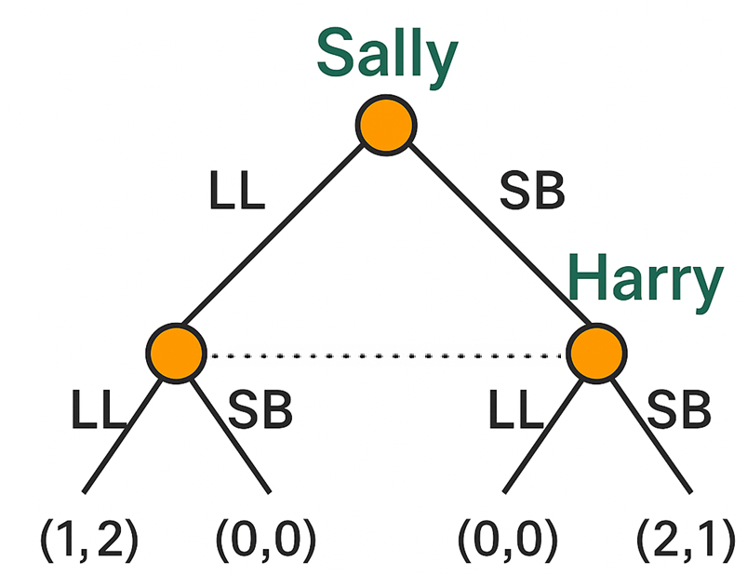
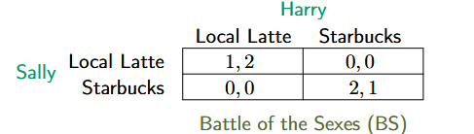
Battle of the Sexes Reconsidered
Harry doesn’t know Sally’s move :
Harry must choose one action to use no matter what Sally did.
Strategies
Sally: { LL, SB }
Harry: { LL, SB }
(Entries come directly from the leaves of the tree:
LL–LL → (1,2);
LL–SB → (0,0);
SB–LL → (0,0);
SB–SB → (2,1).)
72

Slide 73
Battle of the Sexes-subgame perfect equilibrium
Solve Harry’s subgames
  If Sally played LL (left node):
  Harry compares
  LL → (1,2) (Harry gets 2)
  SB → (0,0) (Harry gets 0)
  ⇒ Best reply: LL.
  If Sally played SB (right node):
  Harry compares
  LL → (0,0) (Harry gets 0)
  SB → (2,1) (Harry gets 1)
  ⇒ Best reply: SB.
Roll back to Sally’s initial move
  If Sally chooses LL, induced outcome is (1,2).
  If Sally chooses SB, induced outcome is (2,1).
  Sally prefers 2 to 1 ⇒ choose SB.
Equilibrium path & payoff:
SB → SB with payoff (2,1) (Sally, Harry).
73

Slide 74
Battle of the Sexes-subgame perfect equilibrium
You can’t use backward induction here.
Because Harry’s two decision nodes are linked by a single information set (dotted line), there is no proper subgame starting at Harry.
Backward induction needs proper subgames, so it doesn’t apply.
74

Slide 75
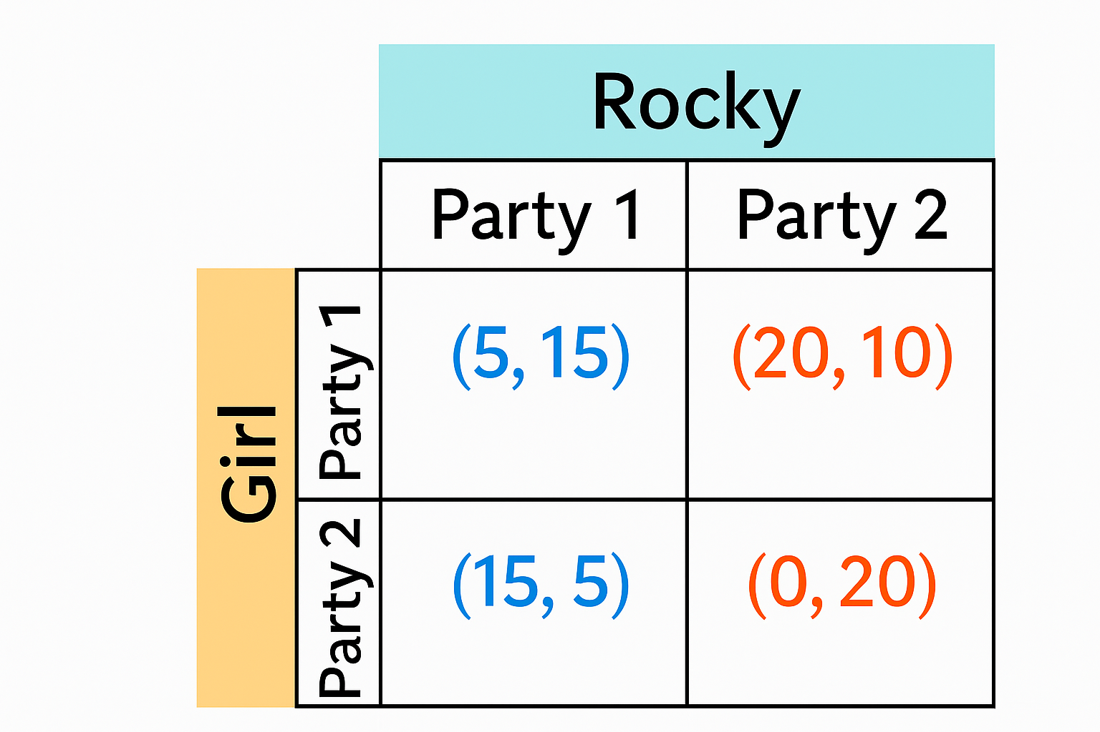
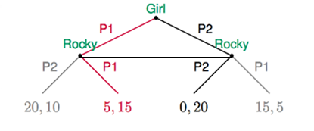
Avoiding Rocky
Construct the normal form (payoff matrix) for this game when Rocky doesn’t know the girl’s moves.
Game has no pure strategy Nash equilibria
Game has one mixed strategy Nash equilibrium in which Rocky and Girl meet with probability 7/12
75

Slide 76
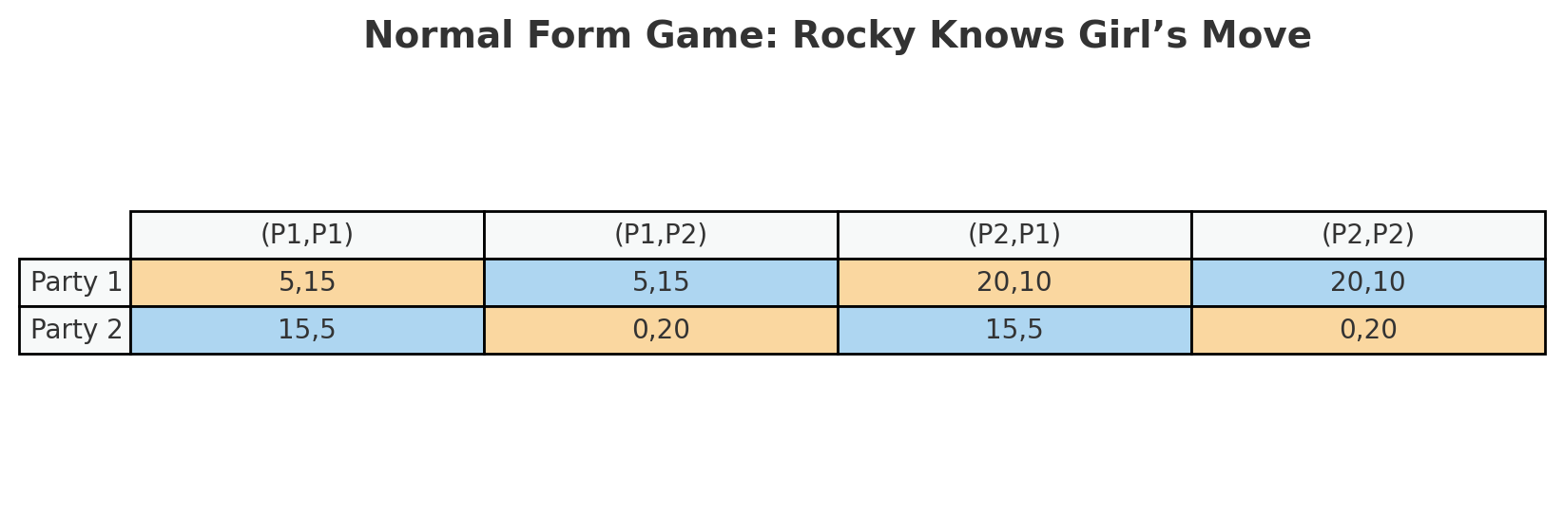
Avoiding Rocky
Construct the normal form (payoff matrix) for this game when Rocky knows the girl’s moves.
76

Slide 77
Avoiding Rocky
Subgame perfect equilibrium:
Evaluate Rocky’s payoff (second number in each pair) at each node.
Left subgame (Girl chose P1):
  Rocky plays P1 → payoff = 15 (outcome (5, 15))
  Rocky plays P2 → payoff = 10 (outcome (20, 10))
  ⇒ Best response: P1 (since 15 > 10).
  Subgame value to Girl if she plays P1: 5.
Right subgame (Girl chose P2):
  Rocky plays P2 → payoff = 20 (outcome (0, 20))
  Rocky plays P1 → payoff = 5 (outcome (15, 5))
  ⇒ Best response: P2 (since 20 > 5).
  Subgame value to Girl if she plays P2: 0.
77

Slide 78
Avoiding Rocky
Subgame perfect equilibrium:
Roll back to Girl’s initial choice
Girl compares her induced payoffs from Step 2:
If P1, she gets 5 (because Rocky will respond P1).
If P2, she gets 0 (because Rocky will respond P2).
⇒ Girl’s optimal move: P1 (since 5 > 0).
Outcome on the equilibrium path
Play: P1 → P1
Payoffs: (5, 15) (Girl, Rocky).
78

