Slide 1
CSE 4101
Topic 12: Fuzzy Logic
1

Slide 2
Introduction
Fuzzy set and crisp set are the part of the distinct set theories, where the fuzzy set implements infinite-valued logic while crisp set employs bi-valued logic.
Crisp sets are the sets that we have used most of our life.
Crips set represents the binary membership value of element in the set. In a crisp set, an element is either a member of the set or not.
For example, a jelly bean belongs in the class of food known as candy.
2

Slide 3
Introduction
The 'Fuzzy' word means the things that are not clear or are vague.
Fuzzy logic is not logic that is fuzzy, but logic that is used to describe fuzziness.
Fuzzy logic is the theory of fuzzy sets, sets that calibrate vagueness.
Fuzzy logic is based on the idea that all things admit od degrees. Temperature, height, speed, distance, beauty- all come on a sliding scale. For example: “The motor is running really hot”. “Tom is a very tall guy”.
3

Slide 4
Introduction
Boolean logic uses sharp distinction, It forces us to draw lines between members of a class and non-members. For instance, we may say, Tom is tall because his height is 181 cm. If we draw a line at 180 cm, we would find that David, who is 179 cm, is small.
Fuzzy logic reflects how people think. It attempts to model our sense of words, our decision making and our common senses. As a result, it is leading to new, more human, intelligent system.
In 1965, Lotfi Zadeh, published his famous paper “Fuzzy sets”. Zadeh extended the work on possibility theory into a formal system of mathematical logic, and introduced a new concept for applying natural language terms. This new logic for representing and manipulating fuzzy terms was called fuzzy logic, and Zadeh became the Master of Fuzzy logic.
4

Slide 5
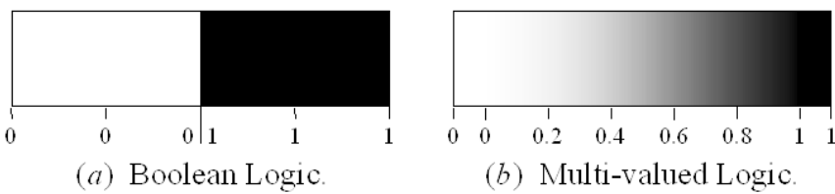
Fuzzy Logic
Fuzzy logic is a set of mathematical principles for knowledge representation-based degree of membership.
Unlike two-valued Boolean logic, fuzzy logic is multi valued.
Fuzzy logic uses the continuum (Range) of logical values between 0 (completely false) and 1 (Completely true).
For example, instead of black and white, it employs the spectrum of colors, accepting that things that things that can be partly true and partly false at the same time.
To practically compare between fuzzy logic and Boolean logic let us answer to the question “Is it cold?” The answer can be simple yes or no or it can vary significantly between yes and no like not so cold, cold enough, moderate cold, cold, very cold etc.
5

Slide 6
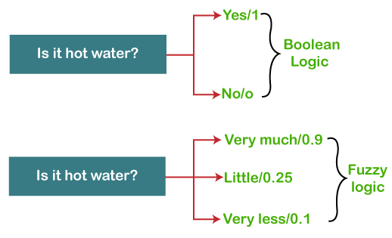
Comparison Between Fuzzy Logic and Boolean Logic
Boolean logic only works with two values 0 and 1. But using fuzzy logic helps us to represent the values between 0 and 1 like degree of something. In the above example, the answer to the question “Is it hot ?” can be simple yes or no or it can varies significantly between yes and no like not so hot, hot enough, moderate hot, hot, very etc.. For the first case, Boolean logic suffice. But for the latter case, Boolean logic will fail. That’s where Fuzzy logic comes into play.
6

Slide 7
Comparison Between Fuzzy Logic and Boolean Logic
Fuzzy logic will tell us how much the hotness or another way, the degree of coldness. Referring to the figure if the weather is “very much” hot, then fuzzy logic will say “The weather is hot up to degree 0.9”. For the “little” hot case, the degree of coldness is 0.25 and for the “very less” case, the degree of hotess is 0.1
Caution: Fuzzy logic value must be in the range [0-1]. The value can’t go outside this closed interval.
7

Slide 8
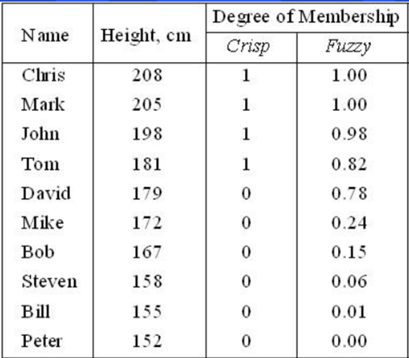
Fuzzy Set
The basic idea of the fuzzy set theory is that an element belongs to a fuzzy set with a certain degree of membership. The membership degree quantifies the grade of membership of the element. to the fuzzy set. The value 0 means that is not a member of the fuzzy set; the value 1 means that. is fully a member of the fuzzy set. The values between 0 and 1 characterize fuzzy members, which belong to the fuzzy set only partially.
One classical example in fuzzy sets is tall men. The elements of the fuzzy set “tall men” are all men, but their degree of membership depend on their height.
8

Slide 9
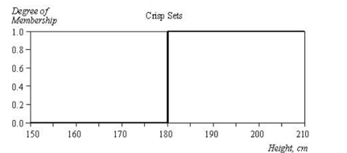
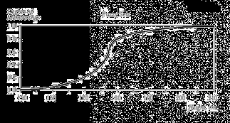
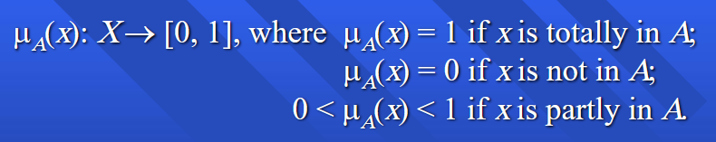
Fuzzy Set
The x-axis represents the universe of discourse- the range of all possible values applicable to a chosen variable. In this case, the variable is the man height. The y-axis represents the membership value of the fuzzy set.
Let X be the universe of is discourse and its element be denoted as X. In the fuzzy theory, fuzzy set A of universe X is defined by a function μ_{A} (X) called the membership function of set A.
9

Slide 10
Membership Function
The membership function is used to estimate or compute the degree of membership of a certain input element in a specific fuzzy set.
The Universe is on the x-axis, while the degrees of membership are on the y-axis.
The value 0 means that element is not a member of the fuzzy set.
The value 1 means that the element is fully a member of the fuzzy set. The values between 0 and 1 characterize fuzzy members, which belong to the fuzzy set only partially.
10

Slide 11
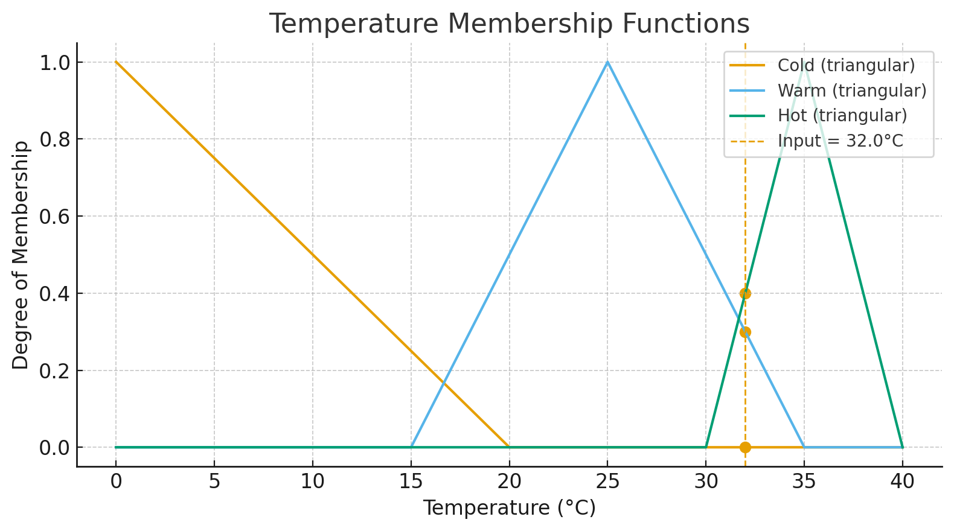
Membership Function
A membership function (MF) maps each crisp value ( refers to a precise, exact, and well-defined number) x in a variable’s domain (the universe of discourse) to a degree in [0,1] describing how strongly x belongs to a fuzzy set.
Membership Degree at 32⁰C
Crisp input (⁰C) | μ_{Cold} | μ_{Warm} | μ_{Hot}
32.0 | 0.0 | 0.3 | 0.4
11

Slide 12

Membership Function
The membership function μ_{A} forms the basis of fuzzy set and is denoted as,
Examples for a “Temperature” variable: Cold, Warm, Hot are fuzzy sets.
Their MFs might be triangular/trapezoidal curves on 0–40 °C.
Overlap lets the same input partially belong to several sets at once.
Three common MFs (triangular) for Cold, Warm, and Hot on 0–40 °C and marked a sample input of 32 °C.
The vertical dashed line shows the crisp input; the dots are the computed degrees.
12

Slide 13
Membership Function
Example (degrees at 32 °C)From the plotted functions (triangular definitions):
μ_{Cold}(32)=0.00
μ_{Warm}(32)=0.30
μ_{Hot}(32)=0.40
Interpretation: at 32 °C the air is “somewhat warm” (0.3) and “fairly hot” (0.4) at the same time; it isn’t cold.
13

Slide 14



Fuzzy Operation
Union: The membership function of the union of two fuzzy sets A and B is defined as the maximum of the two individual membership function, It is equivalent to the Boolean OR operation.
Intersection: The membership function of the intersection of two fuzzy sets A and B is defined as the minimum of the two individual membership functions and is equivalent to the Boolean AND operatio,
Complement: The membership function of the complement of a fuzzy set A is defined as the negation of the specified membership function. This is equivalent to Boolean NOT operation.
14

Slide 15
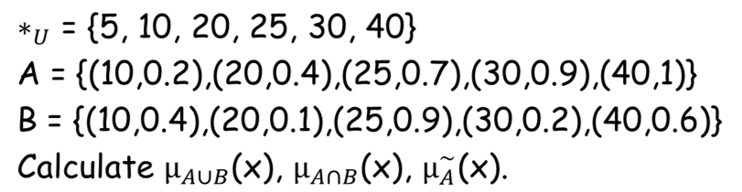
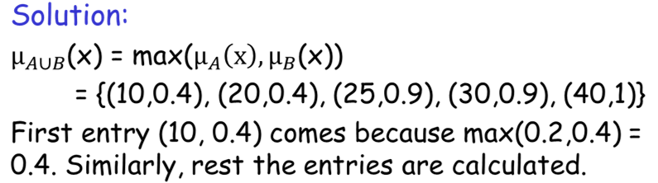
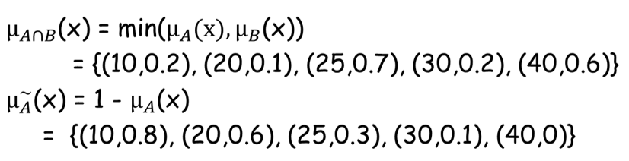
Fuzzy Operation
15

Slide 16
Linguistic Variable
A linguistic variable is a variable whose values are words or sentences in natural language, rather than numerical values.
Example: Temperature
Linguistic Values
The linguistic values of a linguistic variable are the qualitative categories it can take.
Example for Temperature:
  Cold
  Warm
  Hot
16

Slide 17
Linguistic Variable
In fuzzy expert systems, linguistic variable are used in fuzzy rules. For example:
IF wind is strong
THEN sailing is good
IF project_duration is long
THEN completion_risk is high
IF speed is slow
THEN stopping_distance is short
17

Slide 18
Linguistic Variable and Hedges
In fuzzy logic, hedges are operations applied to linguistic values (like "hot", "tall") to modify their meaning — usually intensifying or weakening them.
Common hedges:
  Very → narrows the membership (makes it “sharper”)
  More or less → broadens the membership (makes it “softer”)
  Extremely, slightly, etc. work similarly
  Example: If Tall is a fuzzy set, then:
    Very Tall → gives higher degree of membership only to the tallest people
    Slightly Tall → allows people with average height to have partial membership
18

Slide 19
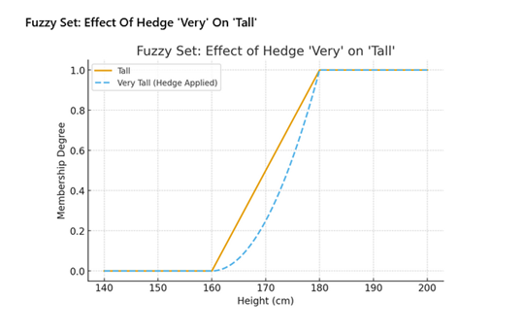
Linguistic Variable and Hedges
  Tall (solid line) shows the original fuzzy set — membership gradually increases from 160 cm to 180 cm.
  Very Tall (dashed line) shows the hedge applied — membership values are “sharpened,” meaning only taller people have high membership now.
19

Slide 20
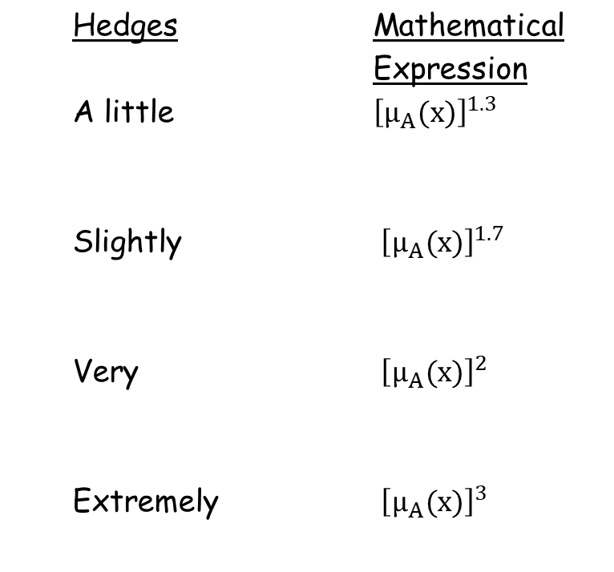
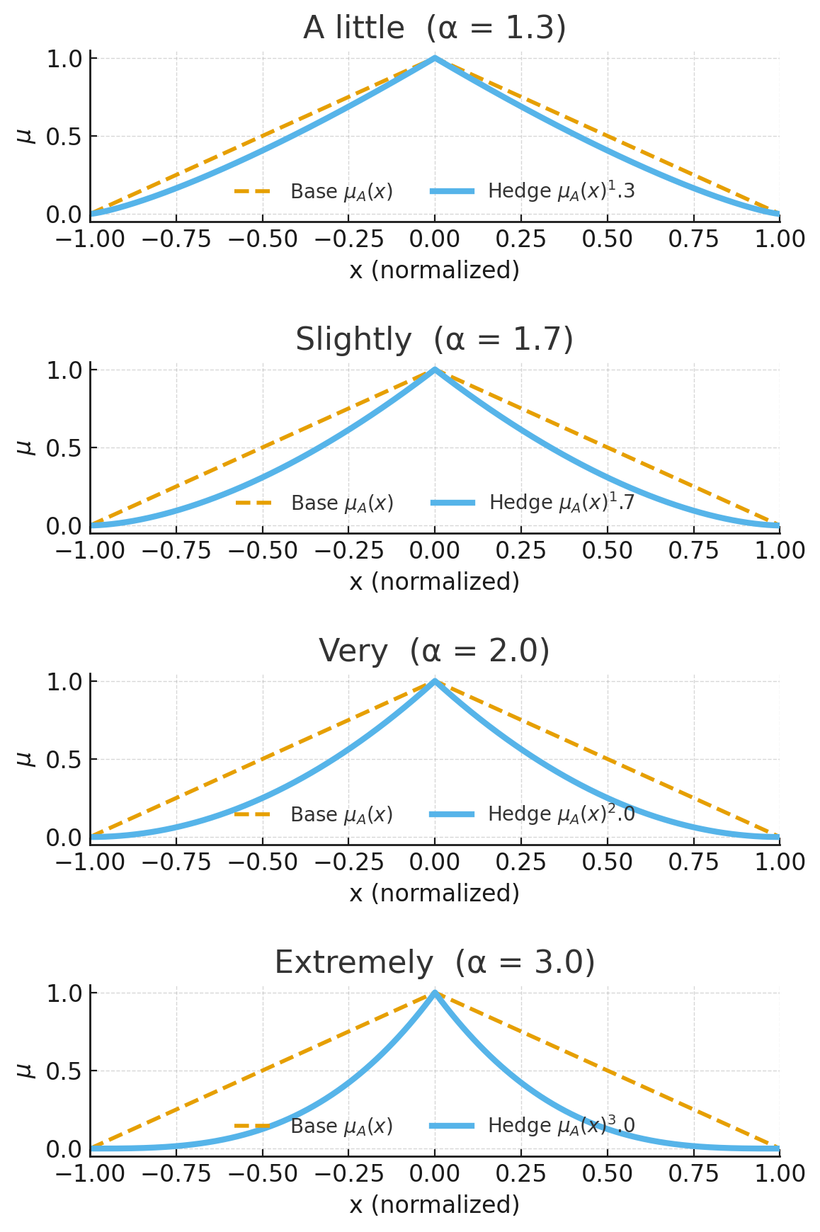
Linguistic Variable and Hedges
20

Slide 21
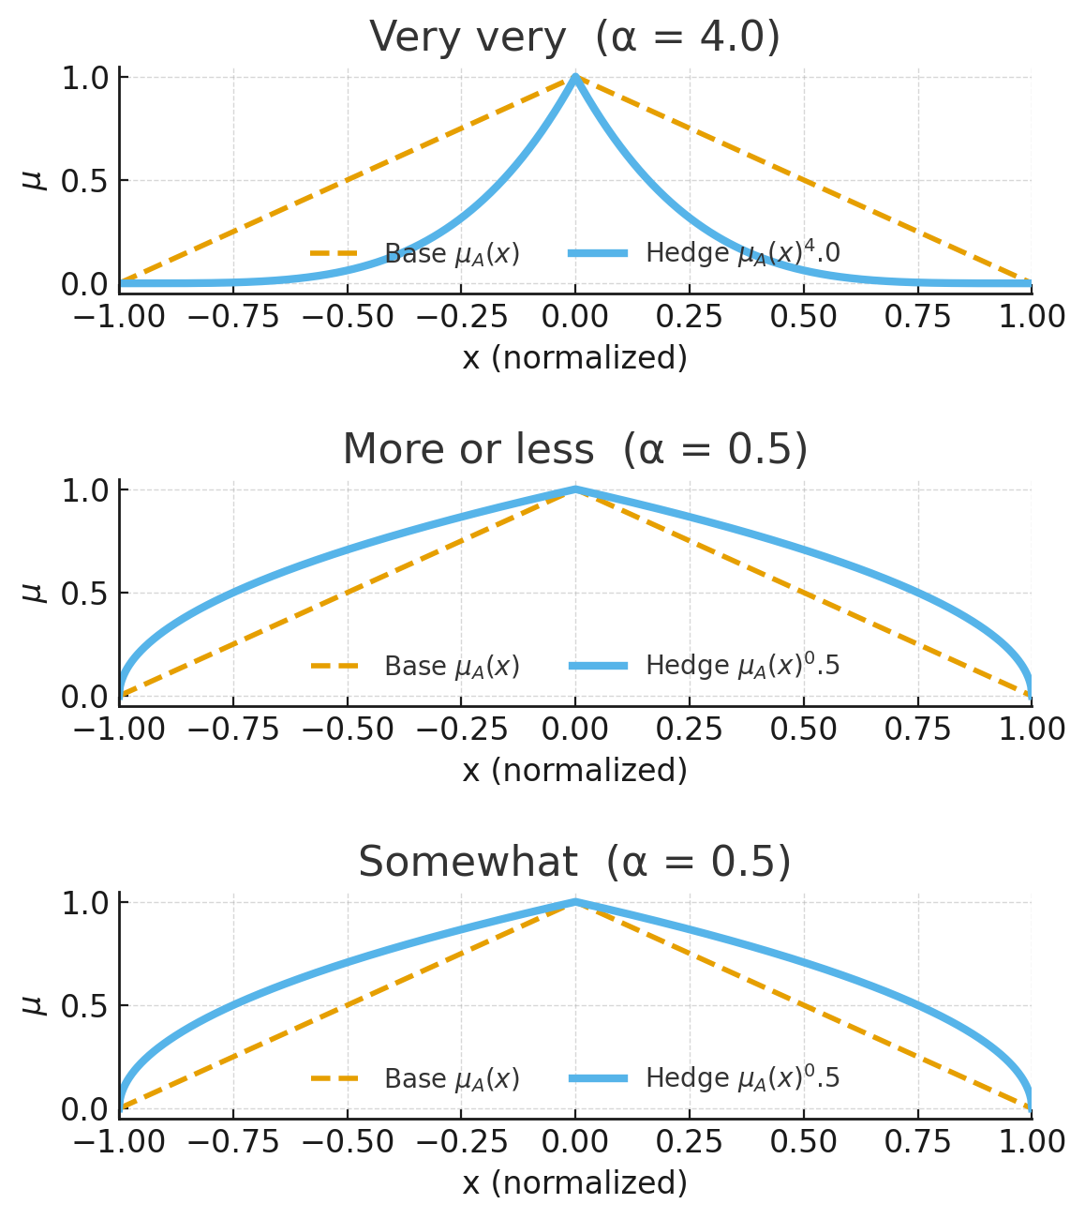
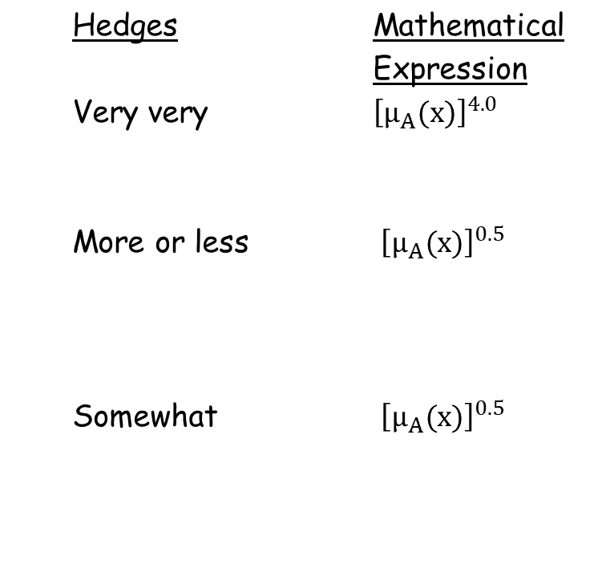
Linguistic Variable and Hedges
21

Slide 22
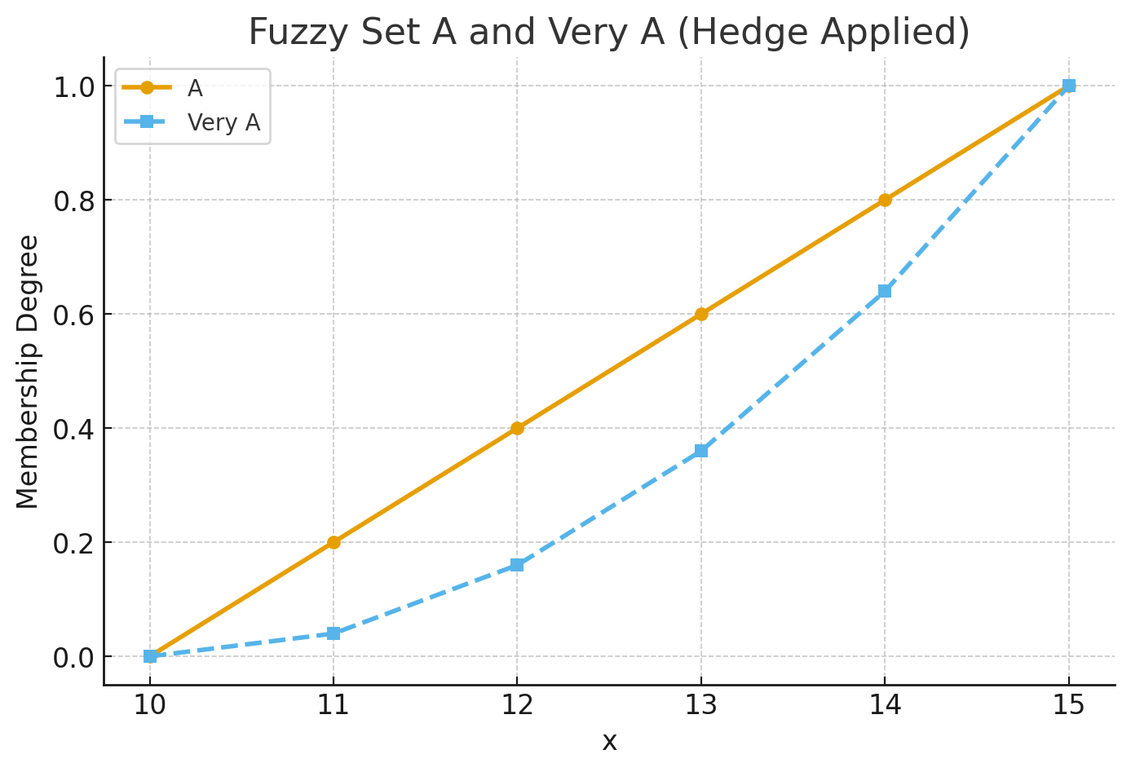
Linguistic Variable and Hedges
Example:
A={(0.0,10.0),(0.2,11.0),(0.4,12.0),(0.6,13.0),(0.8,14.0),(1.0,15.0)}
Here, the first number in each pair is the membership value, and the second number is the element of the universe of discourse.
In fuzzy logic, applying the hedge "very" means squaring each membership value:
Very A={(0.0,10.0),(0.04,11.0),(0.16,12.0),(0.36,13.0),(0.64,14.0),(1.0,15.0)}
22

Slide 23
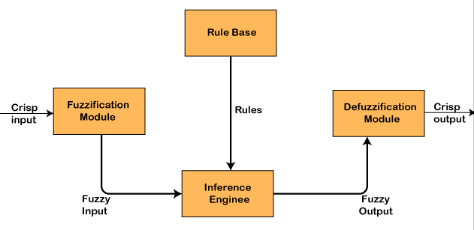
Architecture of Fuzzy Logic System
23

Slide 24
Architecture of Fuzzy Logic System
1) Fuzzifier (Fuzzification)
Converts crisp sensor inputs into degrees of membership in linguistic sets using membership functions (e.g., temperature is cold, warm, hot with values in [0,1]).
  2) Rule base
  Expert “IF–THEN” rules using linguistic terms, e.g.,IF temperature is hot AND humidity is humid THEN fan speed is high.
  3) Inference engine
  Matches fuzzified inputs to rules, computes each rule’s “firing strength” (e.g., using min/product), aggregates all rule outputs .
  4) Defuzzifier (Defuzzification)
  Converts the aggregated fuzzy output back to a single crisp control value (e.g., centroid, weighted average).
24

Slide 25
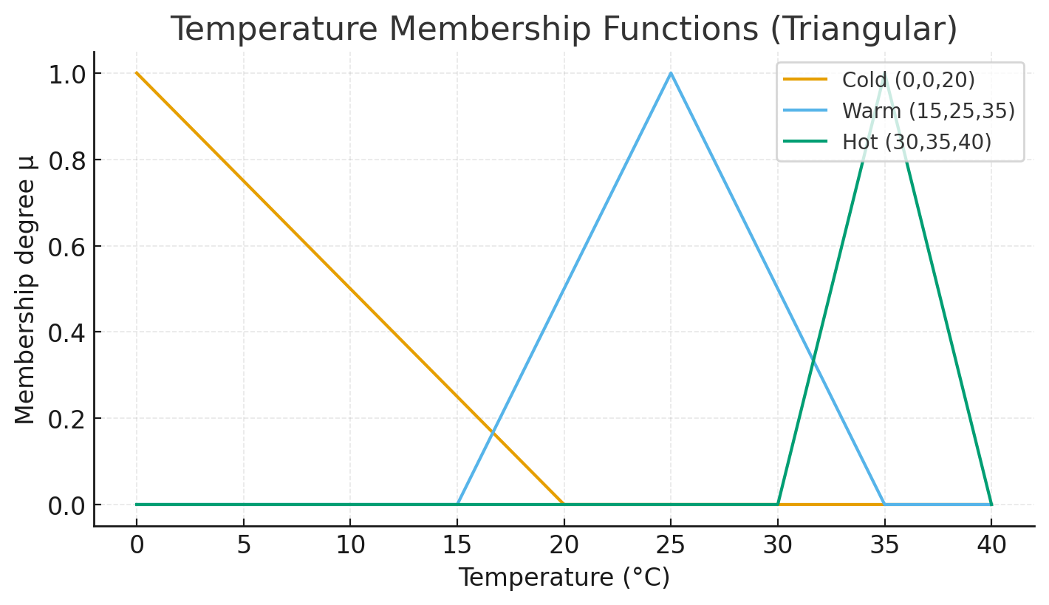
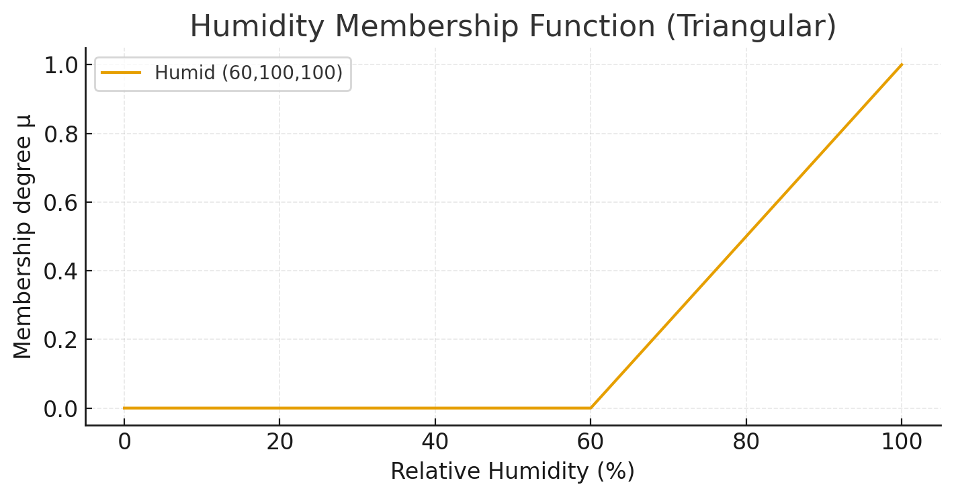
Architecture of Fuzzy Logic System
Fuzzifier (Fuzzification)
What it does: turns crisp inputs (precise numbers) into degrees of membership in linguistic sets (Cold/Warm/Hot, Humid, …).
Each linguistic set has a membership function μ(⋅)∈[0,1].
Why it’s needed: Fuzzy rules talk in words (“hot”, “humid”). The fuzzifier lets numbers talk that language.
Example (inputs):
  Temperature T=32∘C
  Humidity H=70%
  Membership functions (triangular):
  Temp: Cold=(0,0,20),
  Warm=(15,25,35),
  Hot=(30,35,40)
  Humidity: Humid=(60,100,100)
25

Slide 26
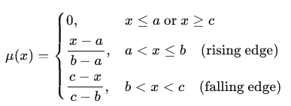



Architecture of Fuzzy Logic System
For a triangle (a, b, c):
Warm at 32
32 lies on Warm’s falling edge (25,35), so use (c−x)/(c−b):
Hot at 32
32 lies on Hot’s rising edge (30,35), so use (x−a)/(b−a):
Humid at 70
70 lies on the ramp from 60 to 100, so:
26

Slide 27

Architecture of Fuzzy Logic System
Degrees at the inputs:
So “32 °C” is 0.30 Warm and 0.40 Hot; “70%” is 0.25 Humid.
These degrees feed the fuzzy rules (e.g., IF Hot AND Humid THEN Fan High)
2) Rule base
What it does: stores expert IF–THEN rules using linguistic terms.
Why it’s needed: Encodes human know-how in a form the engine can evaluate.
Example rules (two rules fire for our inputs):
R1: IF Hot AND Humid THEN Fan is High
R2: IF Warm AND Humid THEN Fan is Medium
(You could have more rules, e.g., “IF Cold AND Dry THEN Fan Low”, but it won’t fire here.)
27

Slide 28
Architecture of Fuzzy Logic System
3) Inference engine
What it does: determines how strongly each rule applies (firing strength) and combines rule outputs.
Key choices:
AND operator (t-norm): commonly min or product
Aggregation of multiple rule outputs: commonly max (Mamdani) or weighted sum (Sugeno)
3A) Compute firing strengths (use min for AND)
α₁=min⁡(μ_{Hot},μ_{Humid})=min⁡(0.40,0.25)=0.25 (R1: Hot & Humid), ​
α₂=min⁡(μ_{Warm},μ_{Humid})=min⁡(0.30,0.25)=0.25 (R2: Warm & Humid)
28

Slide 29
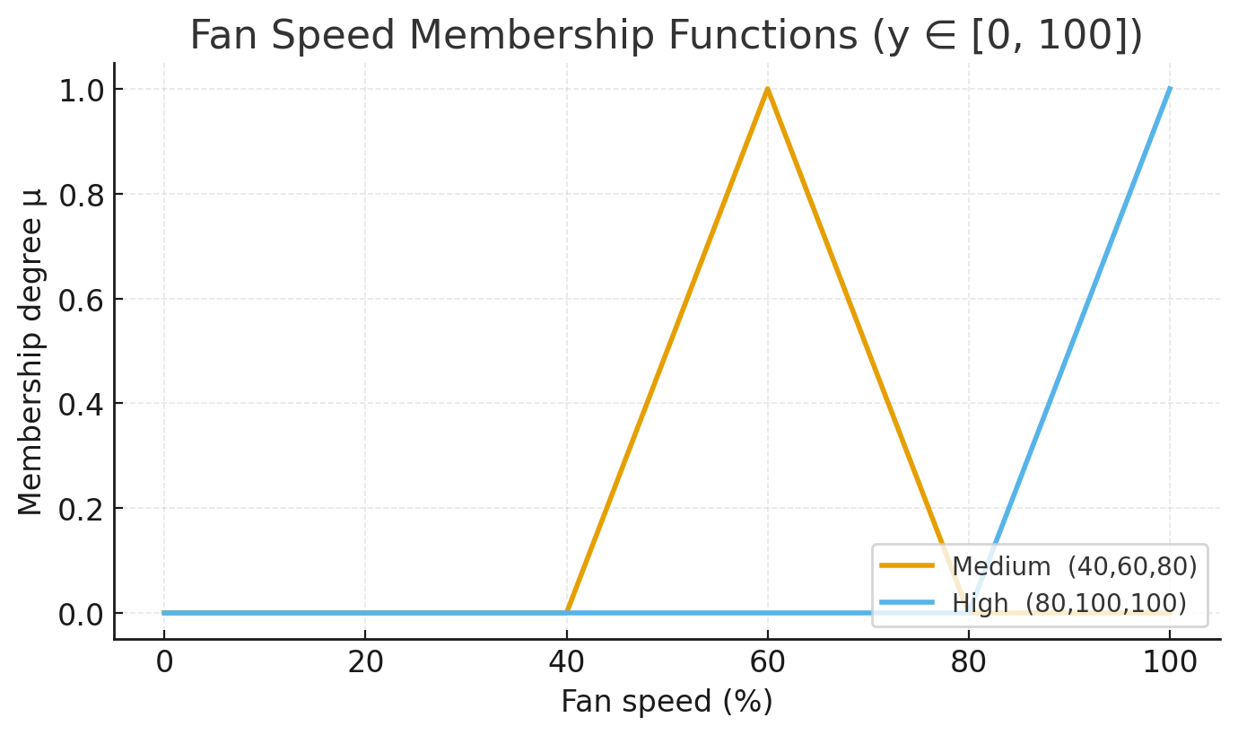
Architecture of Fuzzy Logic System
We also need an output variable “Fan speed” on y∈[0,100].
R1 and R2 are the two fuzzy rules in our controller:
R1 (Rule 1):
IF Temperature is Hot AND Humidity is Humid THEN Fan speed is High
R2 (Rule 2):
IF Temperature is Warm AND Humidity is Humid THEN Fan speed is Medium
Fuzzy set Medium has MF μ_{Med}(y) (e.g., a triangle centered near 60).
Fuzzy set High has MF μ_{High}(y) (e.g., a right-shoulder/triangle peaking near 100).
29

Slide 30

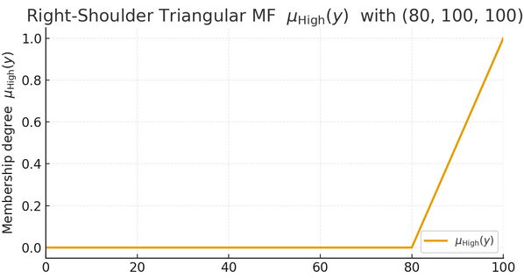
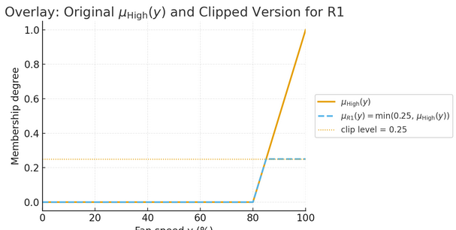
Architecture of Fuzzy Logic System
3B) What each rule outputs (implication):
Mamdani inference (fuzzy consequents)
Using min-implication, the rule’s output fuzzy set is clipped at the rule’s firing strength:
R1: IF Hot AND Humid THEN High
μ_{R1}(y)=min⁡(0.25, μ_{High}(y)) → High clipped at 0.25.
30

Slide 31
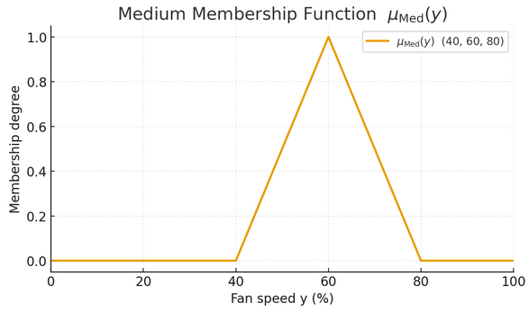
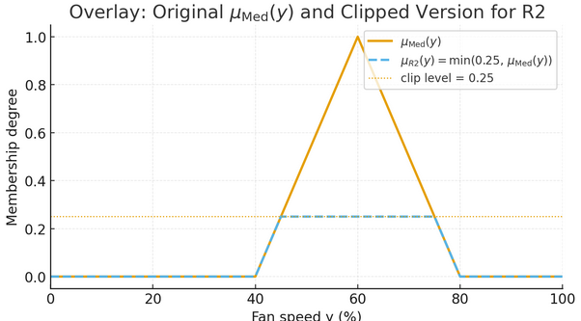
Architecture of Fuzzy Logic System
R2: IF Warm AND Humid THEN Medium
μ_{R2}(y)=min⁡(0.25, μ_{Med}(y)) → Medium clipped at 0.25.
31

Slide 32

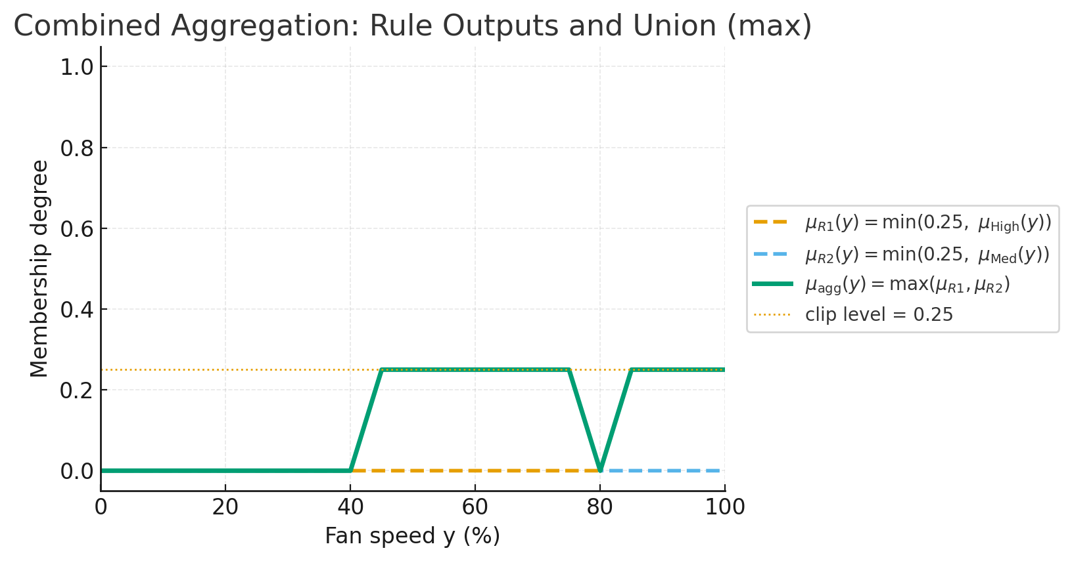
Architecture of Fuzzy Logic System
Aggregation across rules (union):
Combine rule outputs with max:
The orange/blue dashed horizontal line → It’s just a reference level, not a membership function.
32

Slide 33

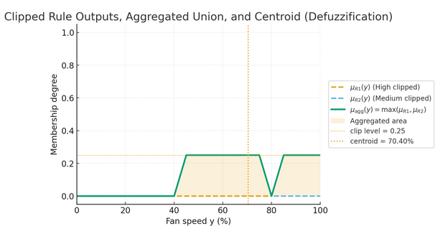
Architecture of Fuzzy Logic System
Defuzzification (to get a single fan setting):
If you choose centroid,
Geometrically this is two rectangles and three right triangles:
R1​: height 0.25, width 30 (from 45 to 75)
R2​: height 0.25, width 15 (from 85 to 100)
T1​: base 5 on [40,45], height 0.25 (rising)
T2​: base 5 on [75,80], height 0.25 (falling)
T3​: base 5 on [80,85], height 0.25 (rising)
33

Slide 34
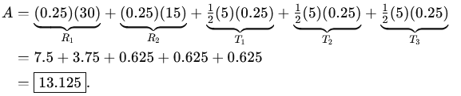
Architecture of Fuzzy Logic System
R1​: height 0.25, width 30 (from 45 to 75)
R2​: height 0.25, width 15 (from 85 to 100)
T1​: base 5 on [40,45], height 0.25 (rising)
T2​: base 5 on [75,80], height 0.25 (falling)
T3​: base 5 on [80,85], height 0.25 (rising)
Total area A=∫μ_{agg}(y) dy
34

Slide 35
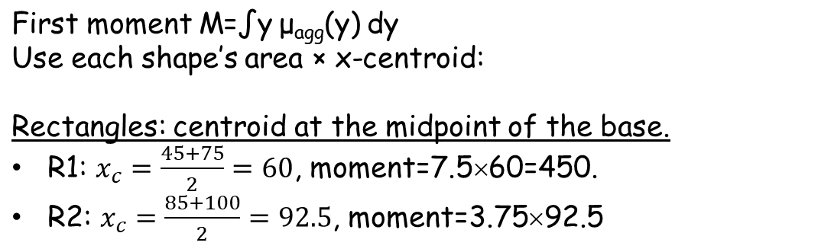
Architecture of Fuzzy Logic System
35

Slide 36

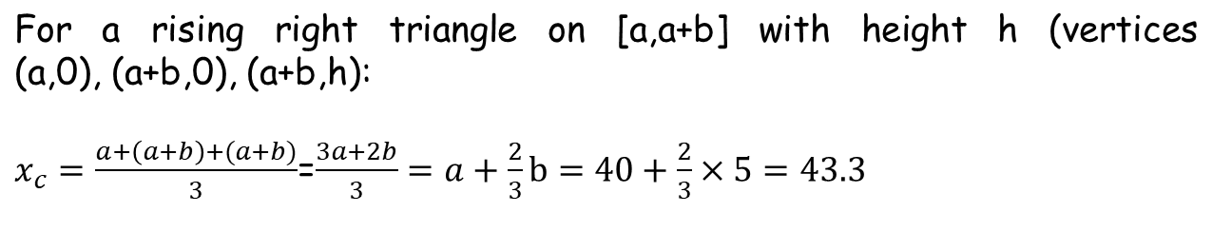
Architecture of Fuzzy Logic System
Right triangles (base on x-axis, height in μ):
For any triangle, the centroid is the average of the vertices:
36

Slide 37
Architecture of Fuzzy Logic System
Right triangles (base on x-axis, height in μ):
For any triangle, the centroid is the average of the vertices:
For a falling triangle on [a,a+b] (vertices (a,0),(a,h),(a+b,0)):
37

Slide 38

Architecture of Fuzzy Logic System
M​=450+346.875+27.0833+47.9167+52.0833=923.9583​.​
Centroid (defuzzified output)
38

Slide 39

Architecture of Fuzzy Logic System
3B) What each rule outputs (implication):
Sugeno inference (crisp consequents)
Each rule returns a crisp number.
R1 → High = 100
R2 → Medium = 60
  Aggregation (weighted average):
  Use the firing strengths as weights:
So Sugeno gives a crisp 80% fan speed directly—no fuzzy union or centroid needed.
39

Slide 40
End
40

