Slide 1

SafetyNet: Image-based Risk Assessment API USING JAVA Swing Library

Slide 2

Abstract
Purpose: The primary purpose of this Java application is to analyze images provided by users, focusing specifically on identifying potential weapons within those images
User Interface: The application utilizes Swing, a Java GUI toolkit, to create a user-friendly interface
Swing provides a set of GUI components like buttons, text fields, and panels that allow for the creation of interactive graphical applications
Image Analysis: The core functionality of the application involves analyzing the user-provided images
This analysis is aimed at detecting potential weapons within the images

Slide 3

Introduction
In today's digital world, image processing plays a pivotal role in various domains, such as computer vision, medical imaging, and multimedia applications.
It encompasses a multitude of techniques designed to extract valuable information from images. Weapon identification is a crucial aspect of security applications.
This project aims to develop a user-friendly tool that assists in identifying weapons within images. The application caters to users who require a basic weapon identification system.

Slide 4
Project Description

Slide 5

1. User Interface
The application utilizes Swing, a Java GUI framework, to create a user-friendly interface
Users can seamlessly input images through a file selection mechanism

Slide 6

2. Image Processing
The application employs image processing techniques to extract relevant features from the user-provided image
This may involve operations like colour space conversion, or filtering, depending on the chosen approach

Slide 7

3. Report Generation
Violent percentage: A numerical value reflecting the algorithm's certainty in the extracted information
Time Taken: The elapsed time during image processing, providing performance insights
Image Description: Precise dimensions of the image
Weapon Category: the recognized Weapon category
Weapon ID: A unique identifier associated with the assigned Weapon, facilitating further analysis

Slide 8

4. Output and Visualization
The generated report is presented to the user in a clear and concise format, potentially using Swing elements like text boxes or tables
The application may also choose to visually highlight potential weapons within the analysed image for enhanced user comprehension

Slide 9
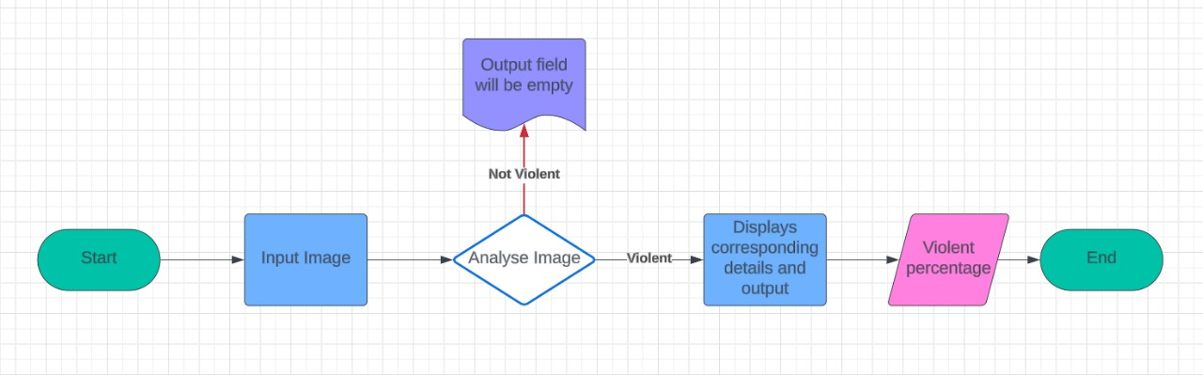
Schematic Diagram:

Slide 10
Output screenshots

Slide 11
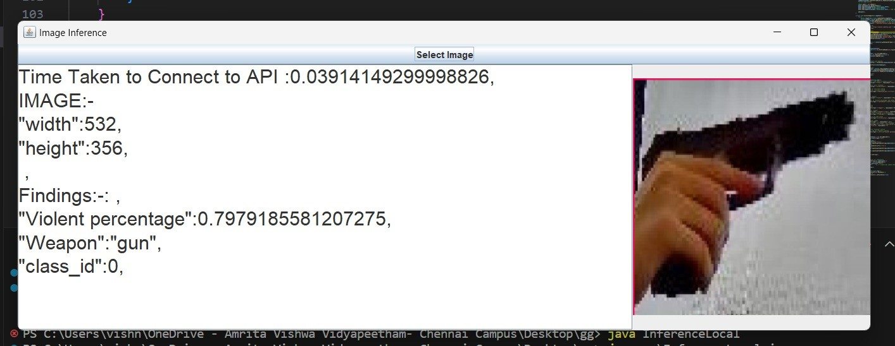
Output-1

Slide 12
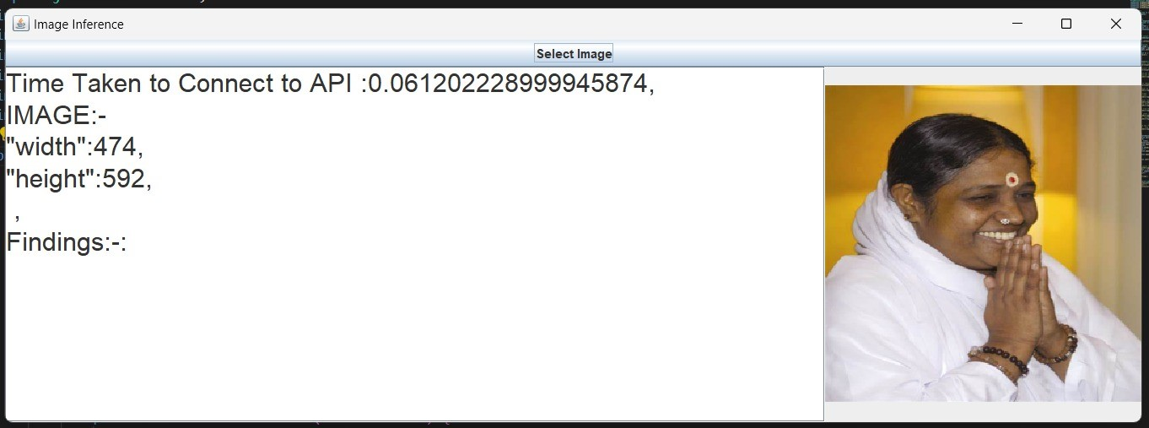
Output-2

