Slide 1
Supply Chain Automation Project
Automating Daily Operational Workflows Using Python and Pandas

Slide 2
Introduction
Objective: Streamline repetitive operational tasks in Excel using Python.
Key Highlights:
- Eliminated manual efforts, saving ~1 hour daily.
- Focused on merging, cleaning, and analyzing sales and customer data.

Slide 3
Dataset Overview
Two datasets were used:
1. Sales Data: Order details, product categories, regions, sales, and dates.
2. Customer Data: Customer IDs, names, cities, and states linked to orders.
Each dataset contains 5000+ records.

Slide 4
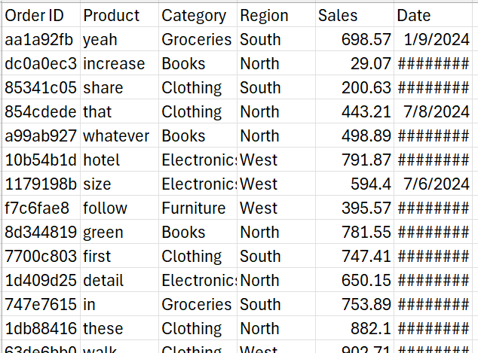
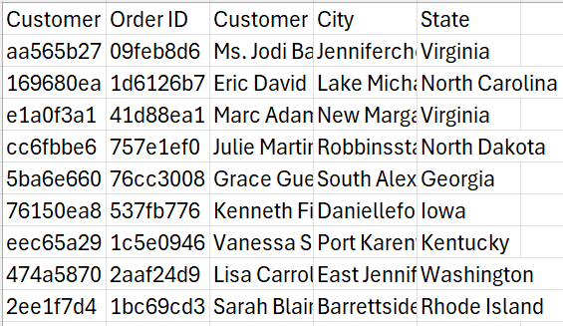
Sales Data
Customers Data

Slide 5
Project Objectives
1. Merge and clean datasets.
2. Remove duplicates and handle missing values.
3. Analyze sales and orders by category and region.
4. Identify top-performing products and customers.
5. Create pivot tables for detailed analysis.
6. Analyze monthly sales trends.
7. Save outputs to multi-sheet Excel files.

Slide 6
Process Automation Steps
1. Loaded and merged sales and customer datasets.
2. Cleaned data: Removed duplicates and handled missing values.
3. Performed data filtering and aggregation by category and region.
4. Created pivot tables and conducted trend analysis.
5. Exported final results to a consolidated Excel report.

Slide 7
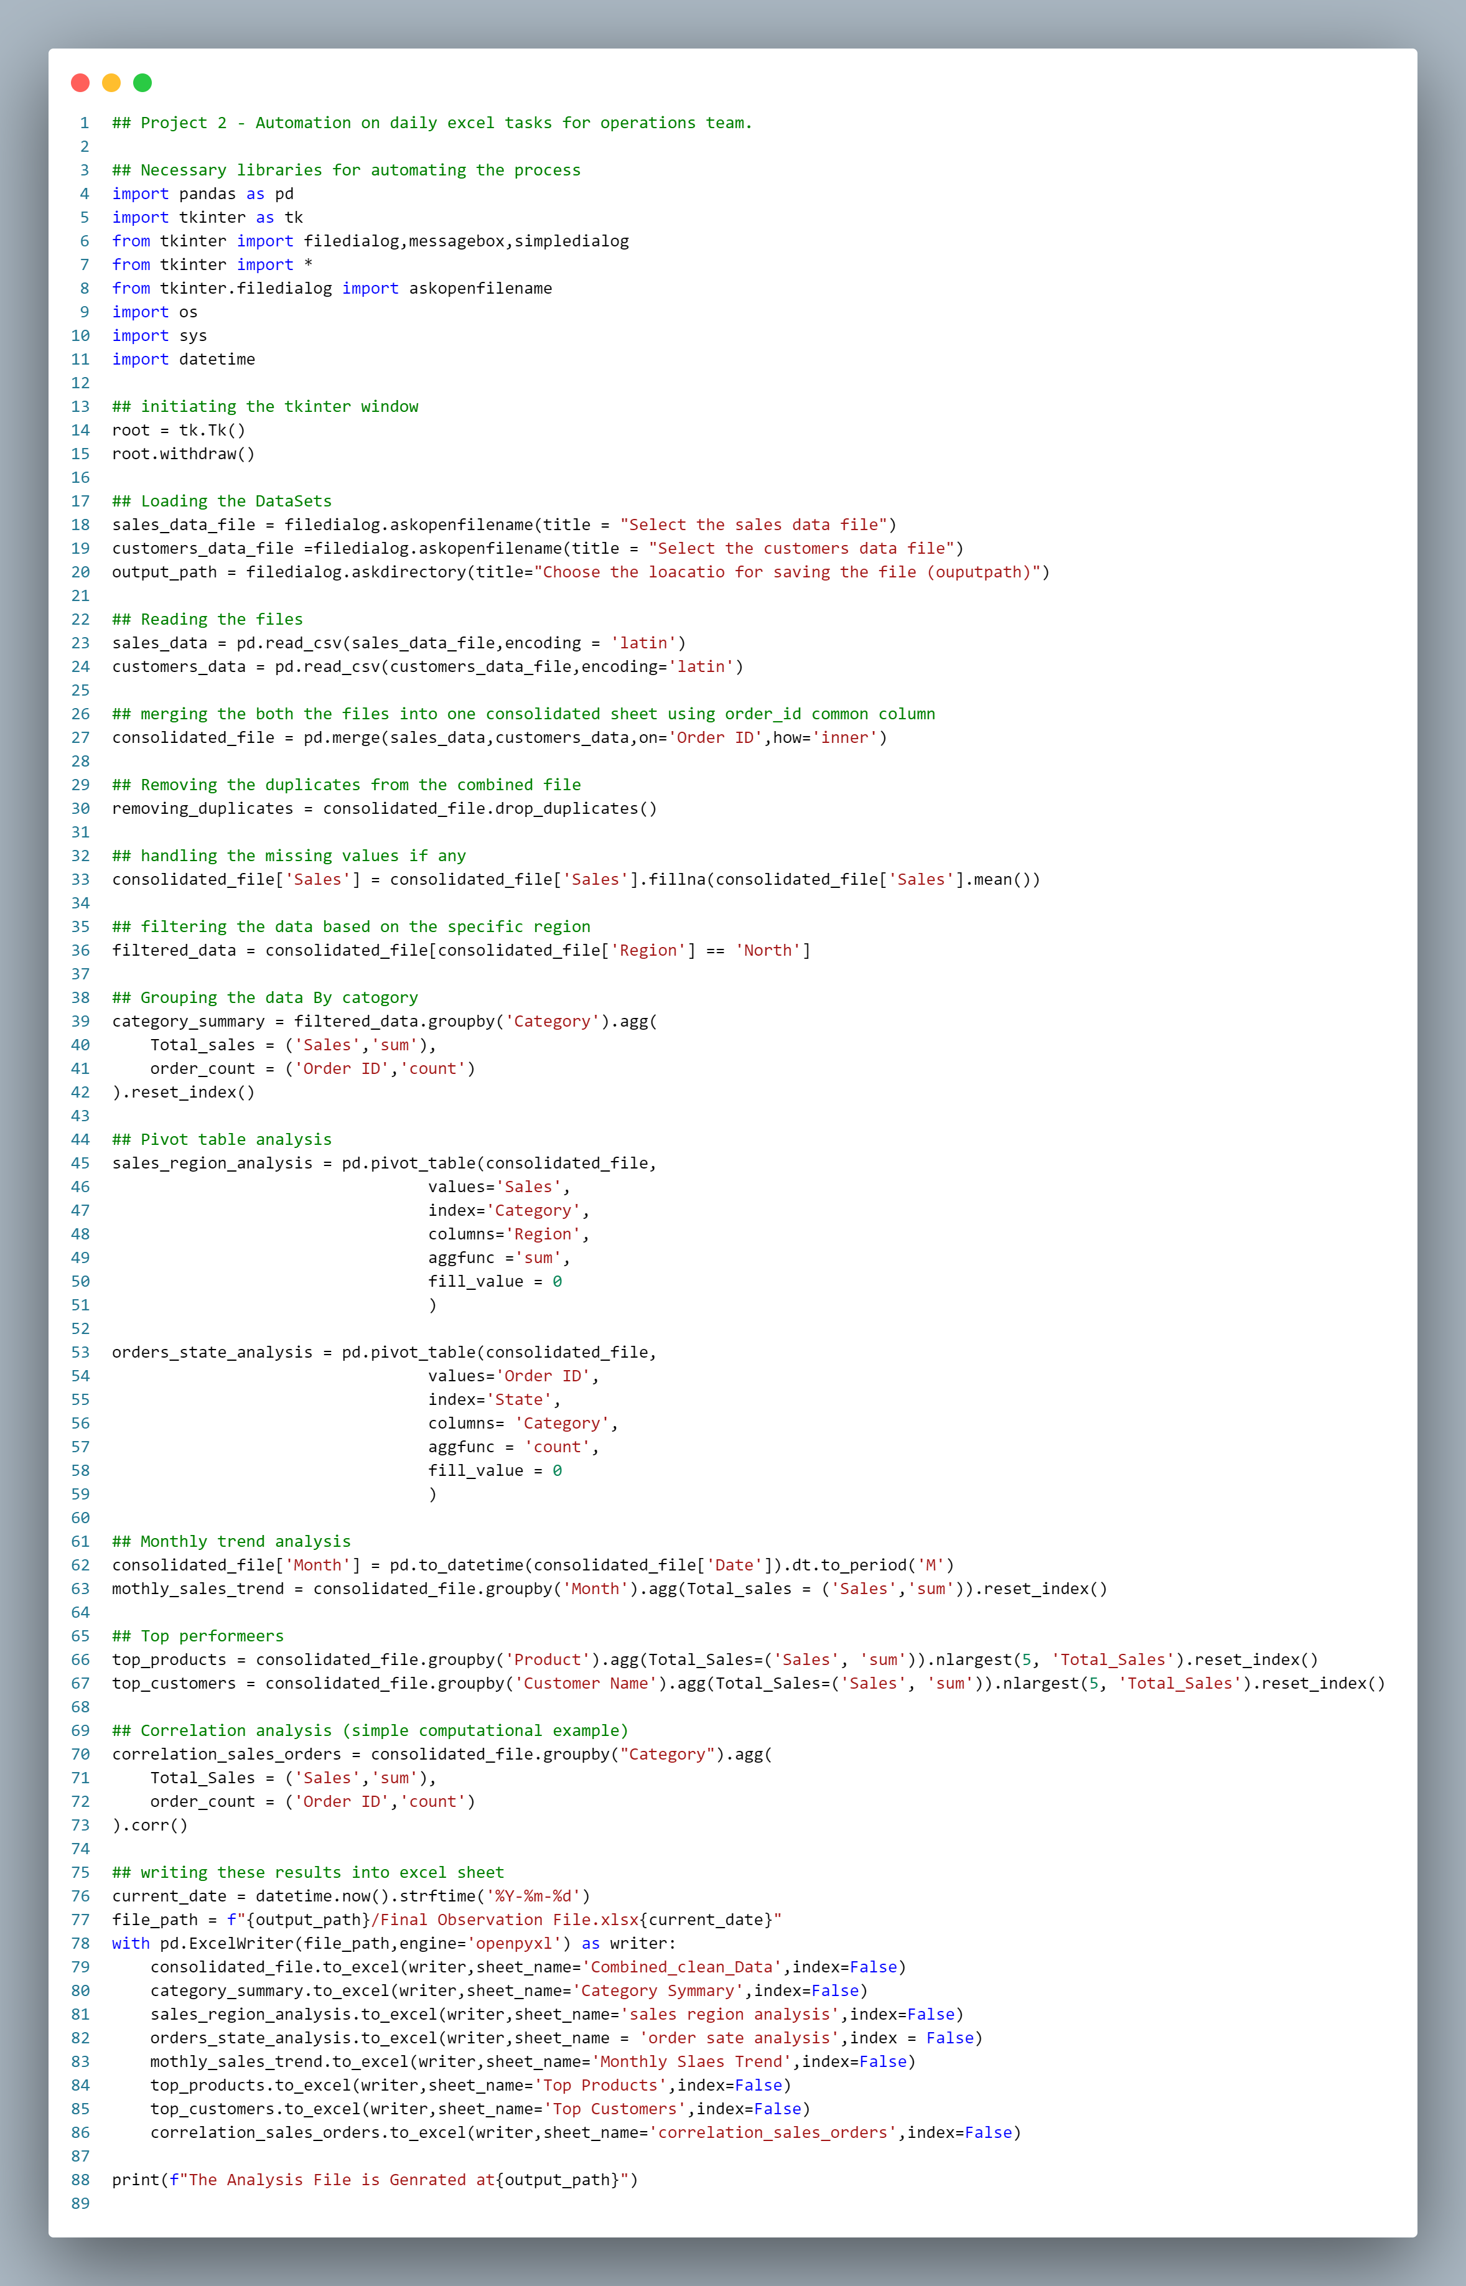

Slide 8
Key Findings
- Top-performing products and customers were identified.
- Monthly sales trends revealed seasonal patterns.
- The North region outperformed others in total sales.
- Significant correlations between sales and order counts.

Slide 9
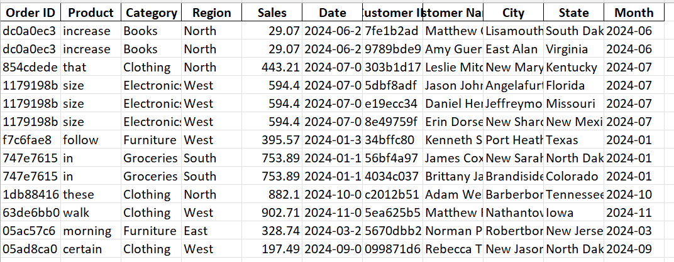
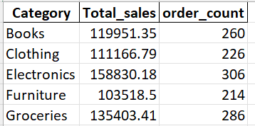
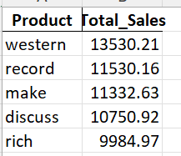
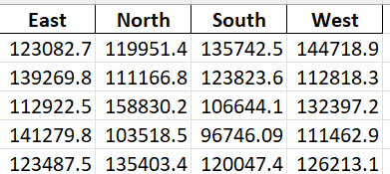
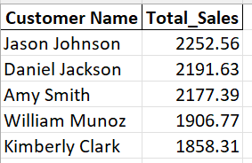
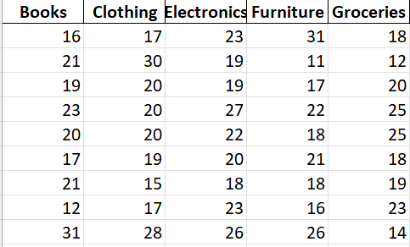
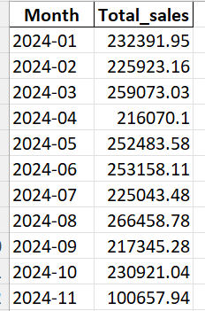

Final Result In One sheet
Combined Cleaned Data
Category Summary
Top Products
Sales Region Analysis
Top Customers
Order sate Analysis
Monthly sales Trend
Correlation Sales Orders

Slide 10
Challenges
1. Ensuring data accuracy while handling missing and duplicate values.
1
2. Designing efficient scripts to process large datasets.
2
3. Generating meaningful insights for stakeholders.
3

Slide 11
Conclusion
- Automated a repetitive, manual workflow, saving time and effort.
- Provided actionable insights to improve decision-making.
- Demonstrated advanced data analysis using Python and Pandas.

Slide 12
Future Scope
1. Incorporate predictive modeling for sales forecasting.
2. Automate additional operational processes.
3. Scale the project for larger datasets and more complex workflows.

Slide 13

Thank You!
Connect with me on LinkedIn to explore more projects.

